Slide 1
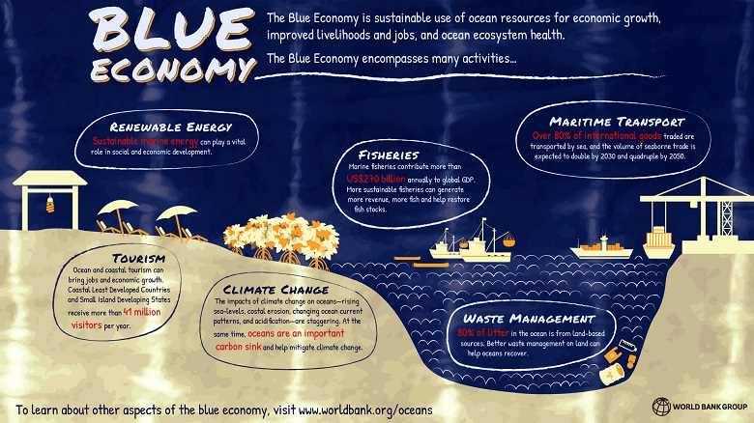

Slide 2
New Blue Economy PWG Deliberation
New Blue Economy
Ideas, themes, and subtopics identified by the Committee:
Technology Advancement
Data Management
Data Buys
Offshore Wind
Education and Workforce

Slide 3
New Blue Economy PWG Deliberation
New Blue Economy
References:
IOOS Advisory Committee - New Blue Economy(NBE) PWG
NOAA FY22-26 Strategic Plan
Recommendations to NOAA and the IOOC – June 2021
The Ocean Enterprise Study 2015-2020

Slide 4
New Blue Economy PWG Deliberation
Technology Advancement
A new funding model e.g DARPA/ARPA-E
Expanding readiness levels for data science-focused OTT projects
Proposed bill S.3866 - Ocean Regional Opportunity and Innovation Act of 2022
Evaluate the Regional Association business model

Slide 5
New Blue Economy PWG Deliberation
Data Management
Federated -> Centralization
Benefits - Cloud ready - Reaching for the Cloud initiative
Ocean Observing Catalog (BOOC)

Slide 6
New Blue Economy PWG Deliberation
Data Buys
NOAA has entered into agreements to purchase data, especially in the weather enterprise, and current technologies are expanding beyond the air-sea interface. Future opportunities for the data-purchase model in the ocean domain should be evaluated further.
Review and evaluate the data buys currently in place for the ocean domain
Identify critical data gaps
“best practices for data buys”

Slide 7
New Blue Economy PWG Deliberation
Offshore Wind
IOOS should be the leader in the coordination of data exchange between the energy developers and the federal agencies
Regional Wildlife Science Collaborative (https://rwsc.org/)
IOOS and RA’s as advisors
UK’s marine data exchange program https://www.marinedataexchange.co.uk/

Slide 8
New Blue Economy PWG Deliberation
Education, Citizen Science, and Workforce Development
IOOS is uniquely positioned to be the leader in providing data and content for our next generation of STEM students
IOOS tools and data should be promoted and used in high school and college courses
Continue to develop simple tools (e.g XLS, Python notebooks)
Promote the IOOS brand as the education and citizen science engagement platform for the U.S

