Slide 1
IOOS Operations Division Updates
Derrick Snowden, Operations Division Chief

Slide 2
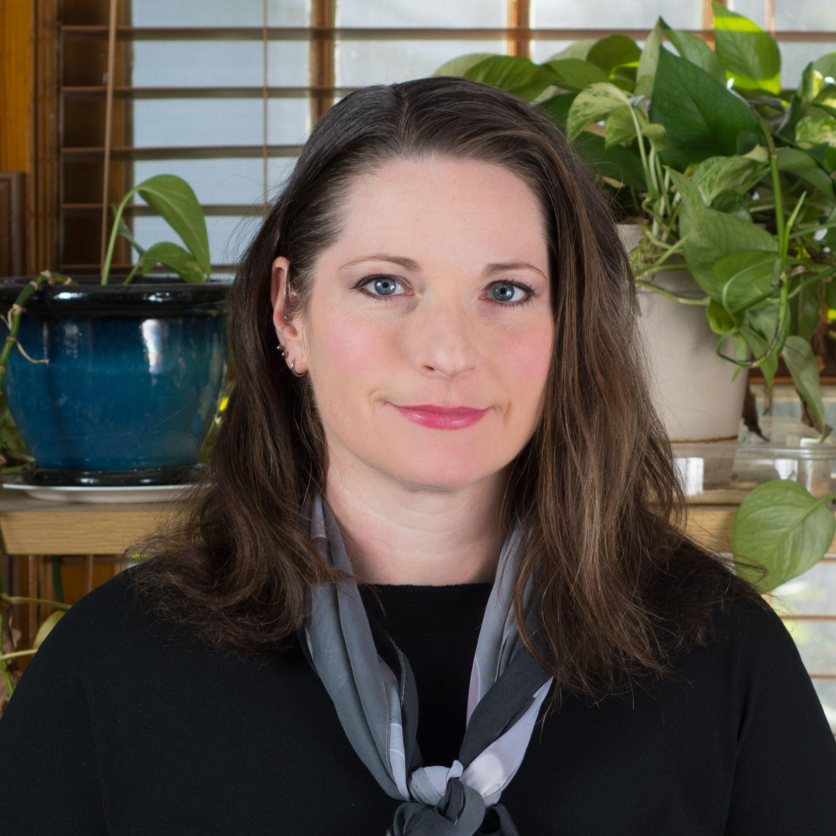
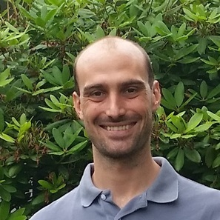
Welcome to IOOS! New members
Melissa Zweng
DMAC Program Coordinator
Program management
Strategic Planning
New Blue Economy
Matt Biddle
DMAC Data Management Analyst
Code sprints and Code Lab
Biological Data Standards
Marine Life Data Portal

Slide 3
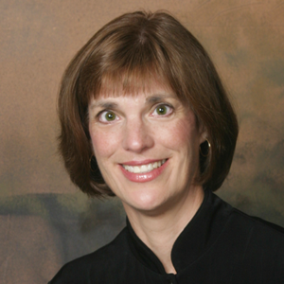
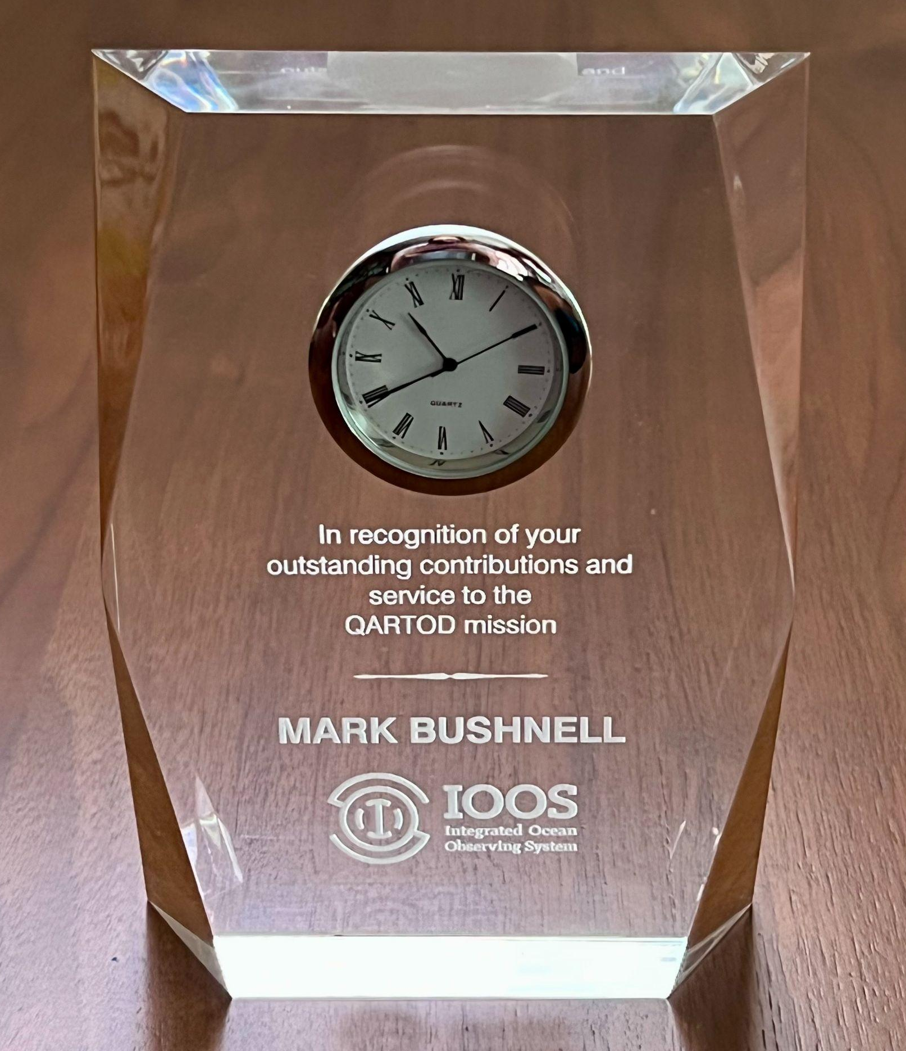
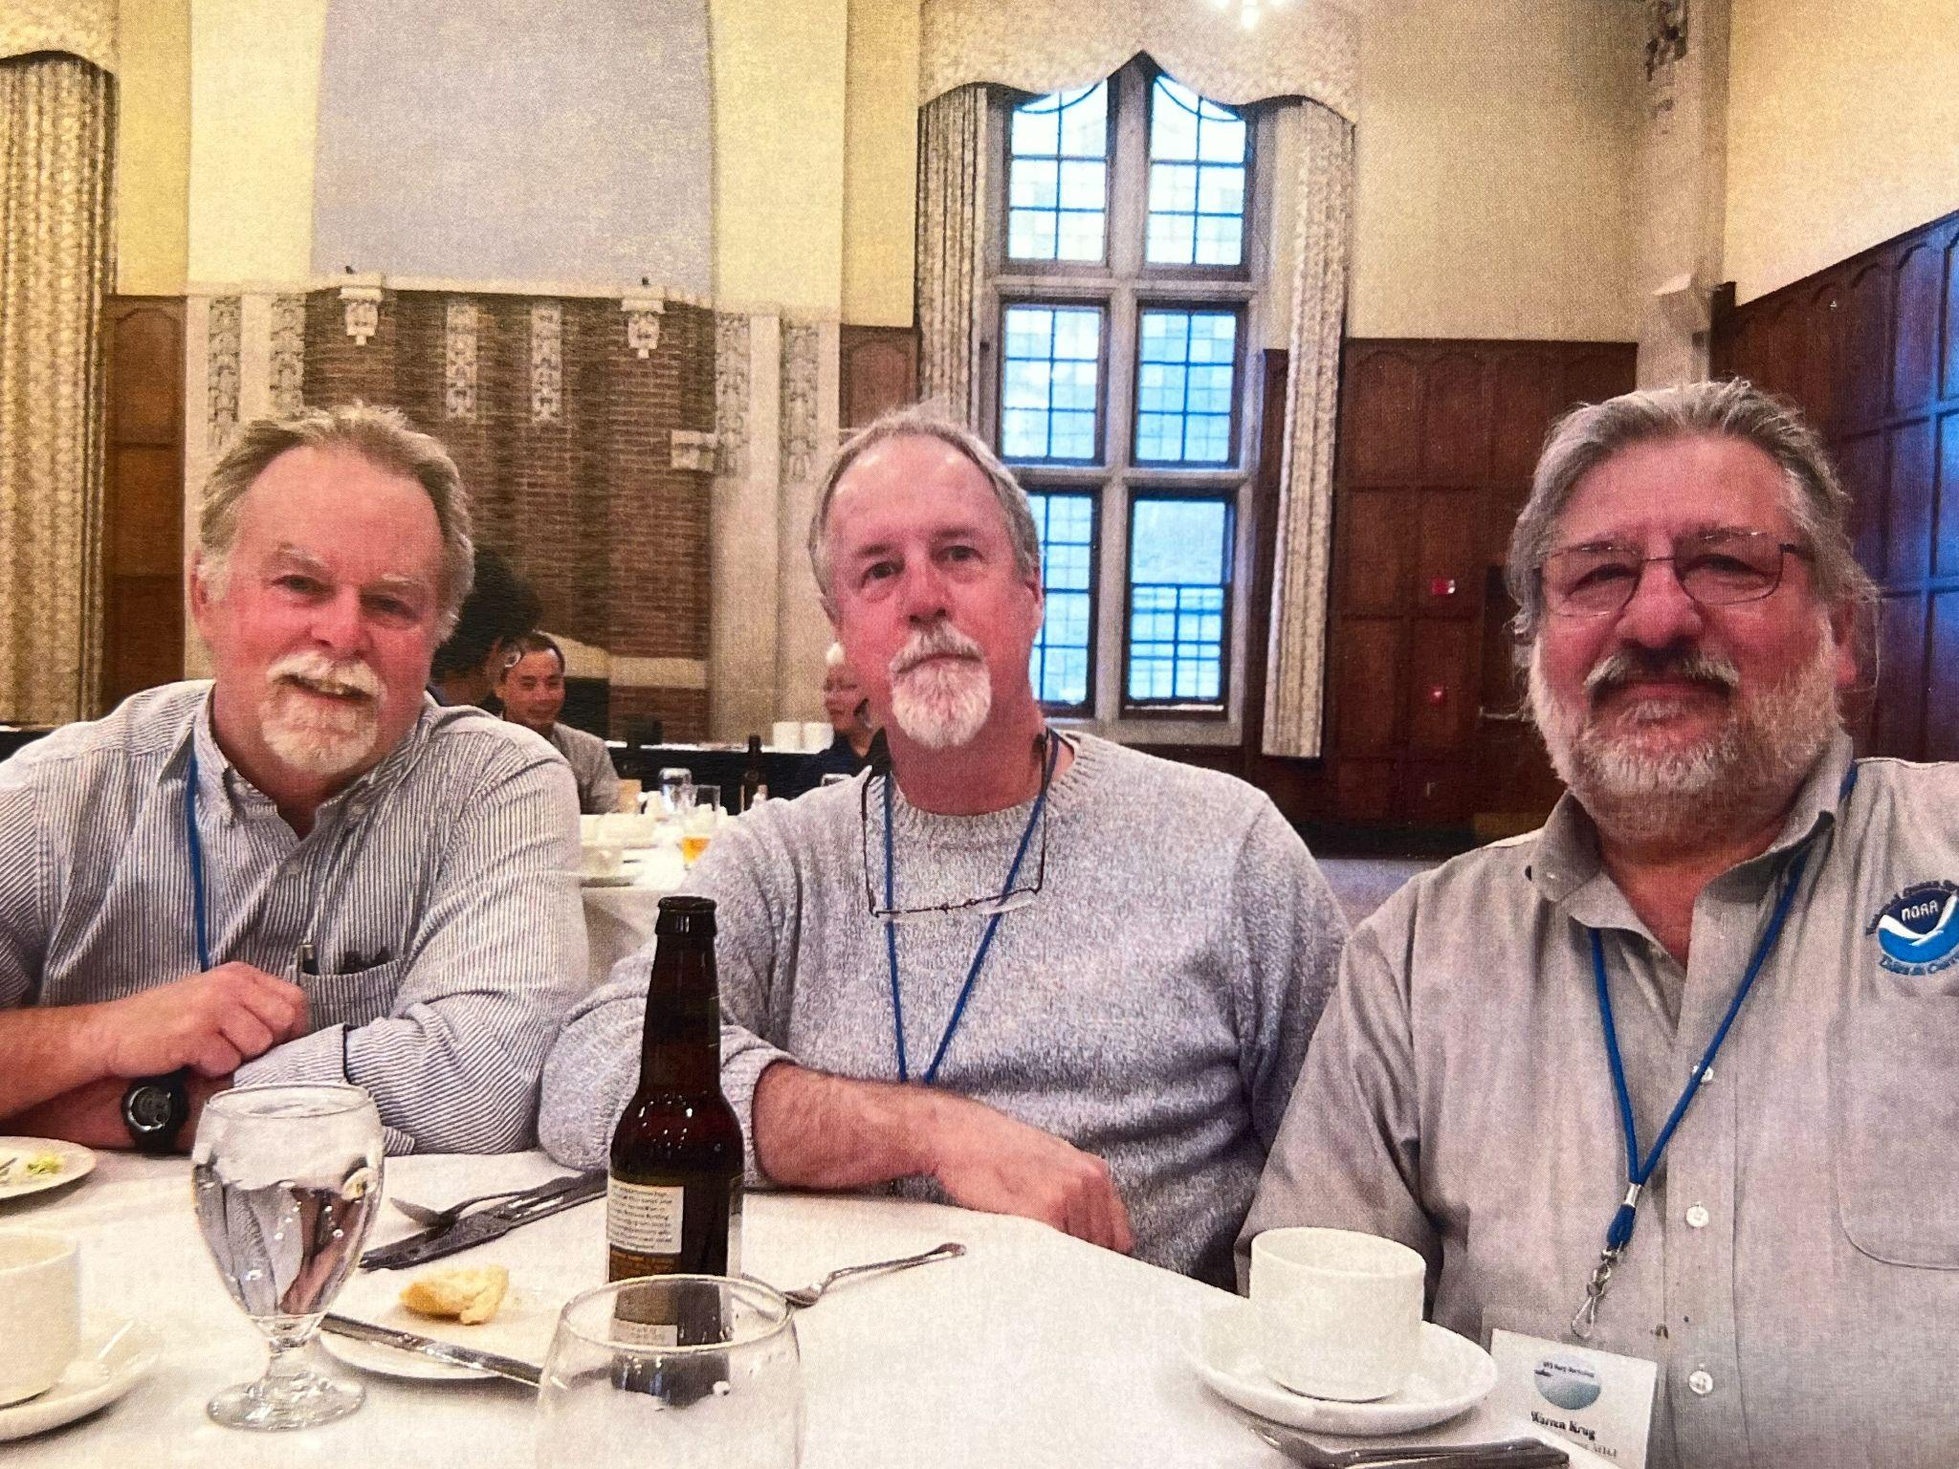
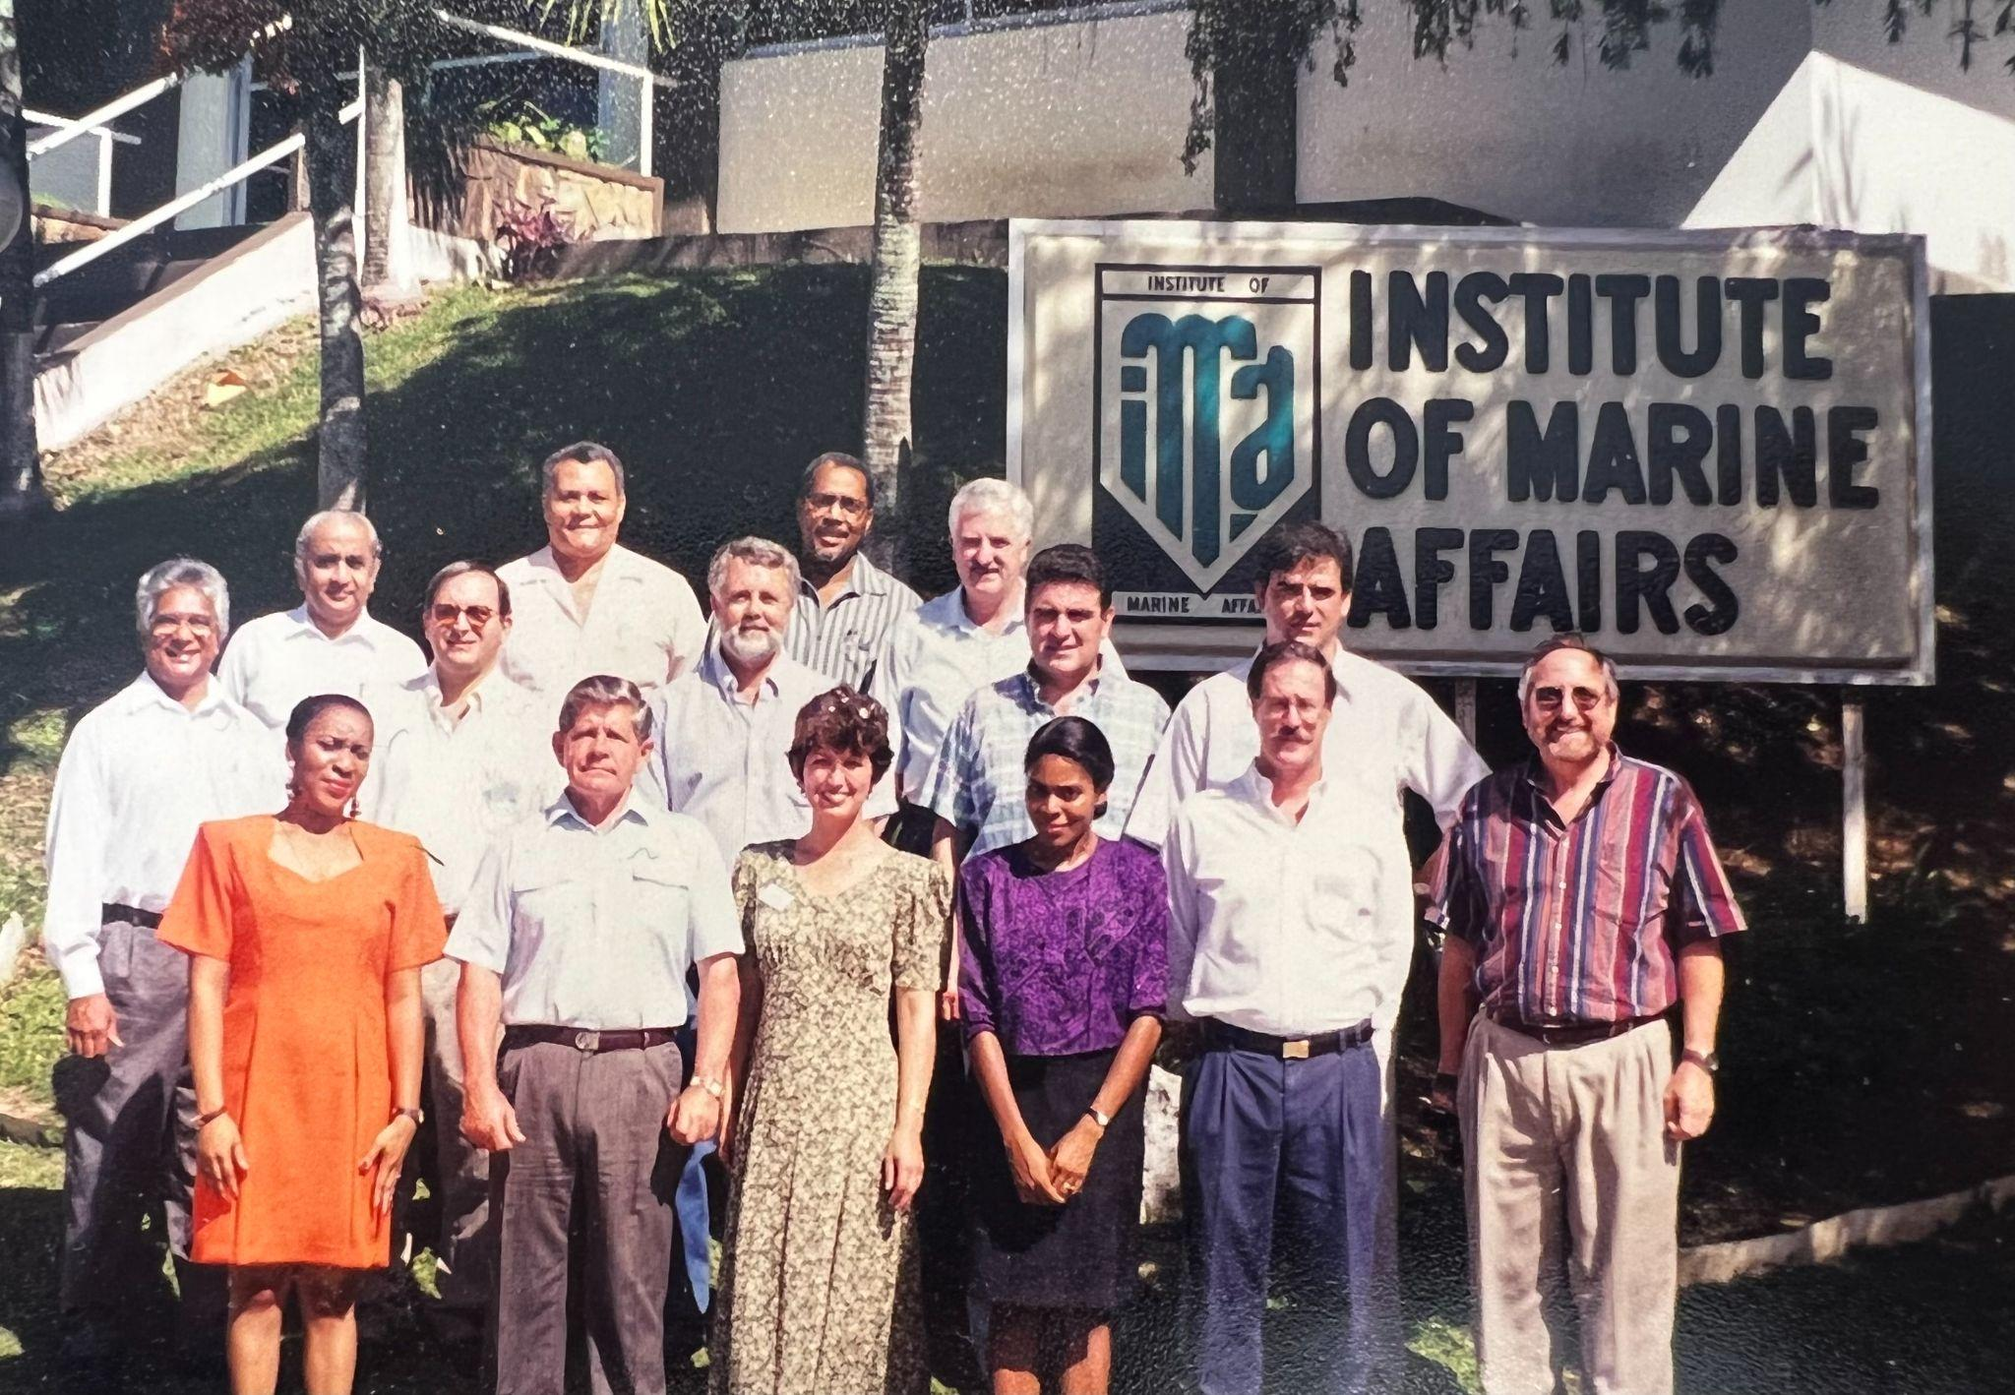
Recognition Ceremony
Mark Bushnell (National Coordinator) and Helen Worthington (Technical Writer)
QARTOD V, 2009, Atlanta

Slide 4
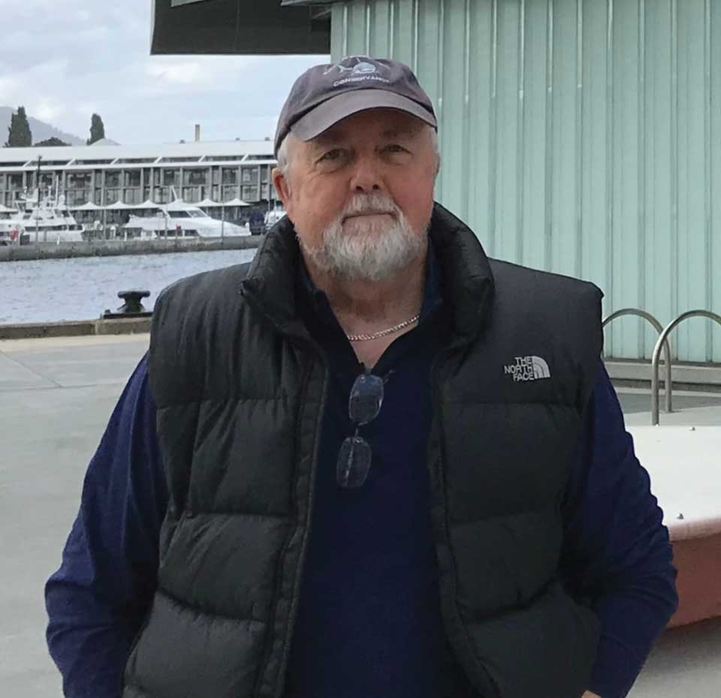
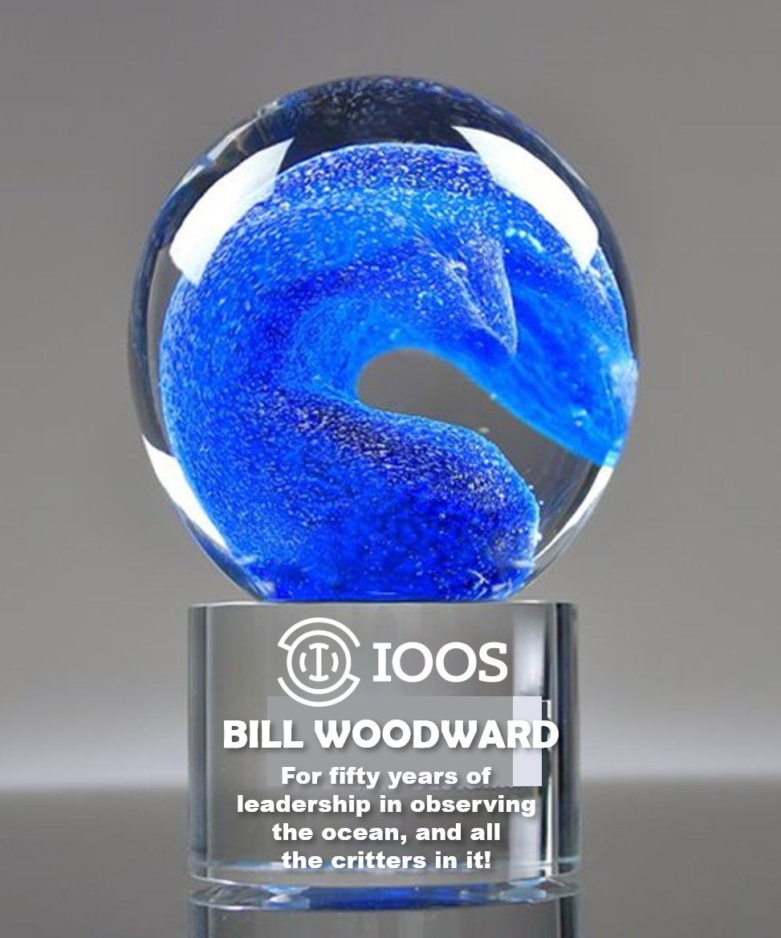
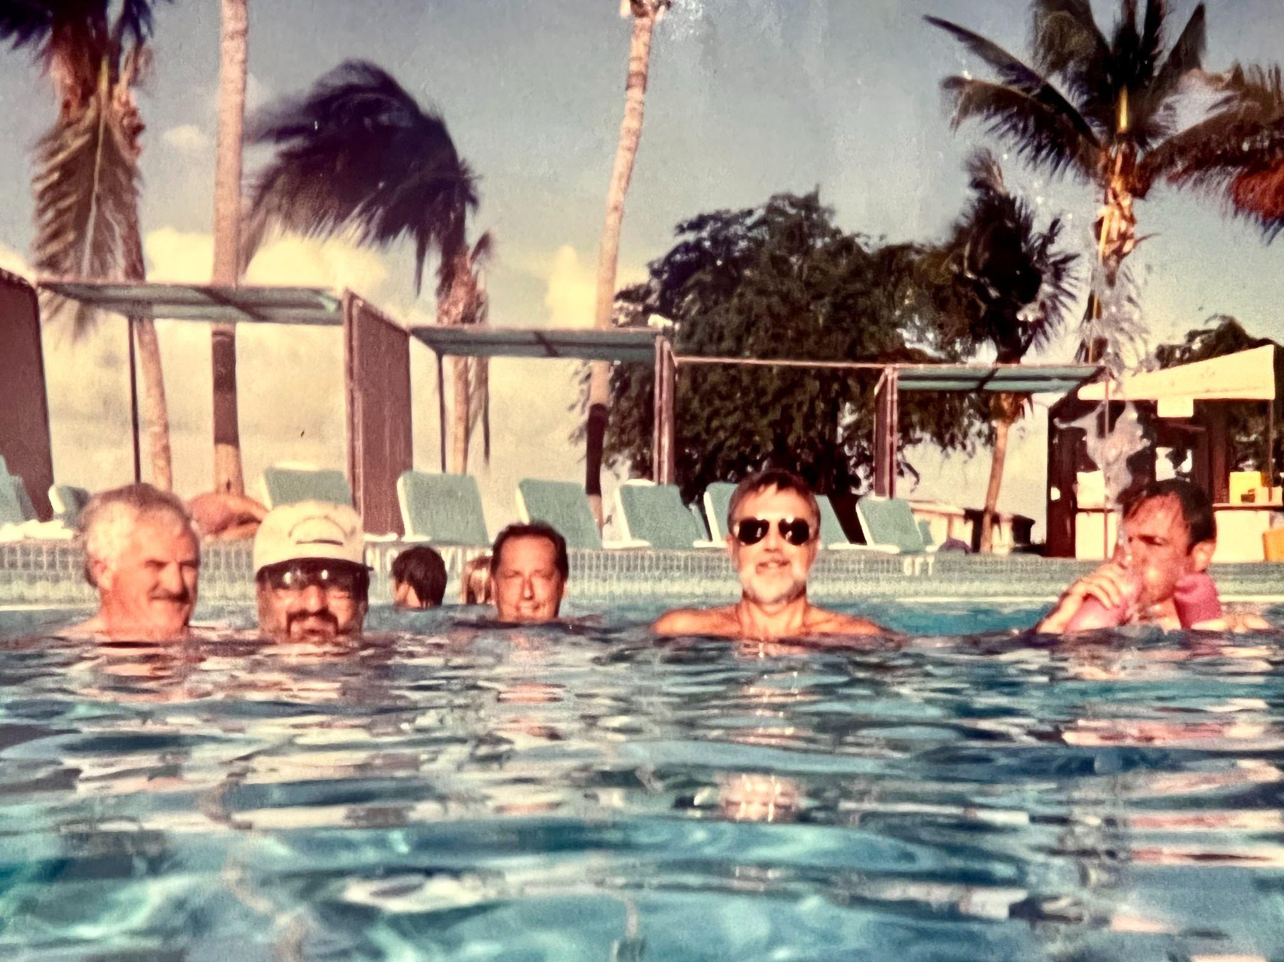
Recognition Ceremony
Bill Woodward (Animal Telemetry Network Coordinator)
https://oceanservice.noaa.gov/profiles/2022/bill-woodward.html

Slide 5
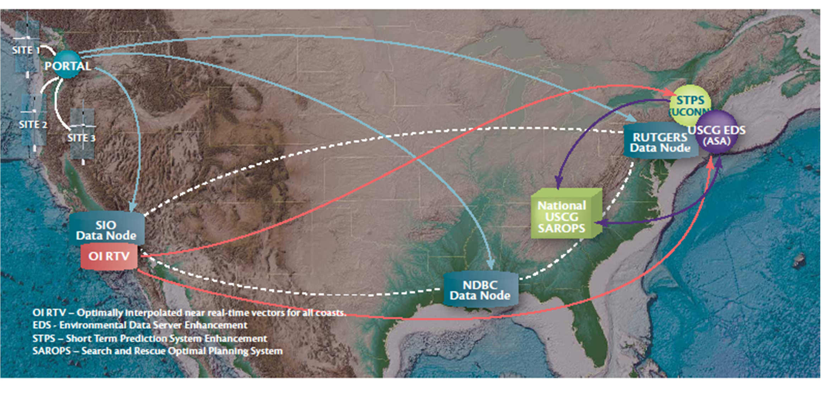
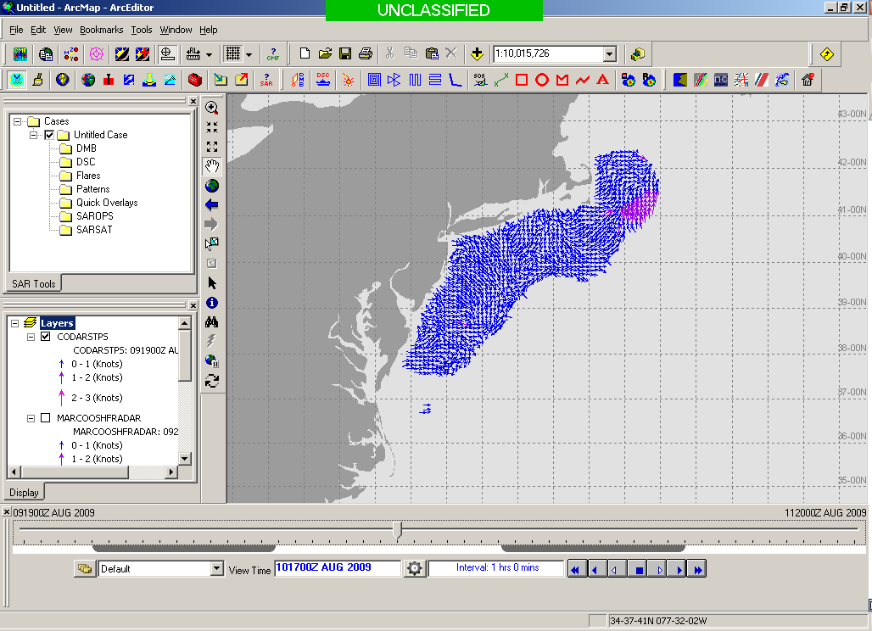
HFR Data Flow and Augmentation of STPS
NDBC Server
Thredds
6 Km vectors
UConn STPS
Scripps Server
Short Term Predictive System (STPS):
HFR Total Vector Files are retrieved hourly from NDBC/SCRIPPS.
https://hfrnet-tds.ucsd.edu/thredds/catalog.html
Hourly 24 hr. predictions from present time are made using STPS.
STPS results saved as NetCDF for accessibility through THREDDS server http://nopp.dms.uconn.edu:8080/thredds/catalog.html.
Domains have been expanded to deliver HFR-derived predictions nationwide to SAROPS.
Thredds
USCG Operational Server
EDS
Developmental Server
On a separate note… HFR Radials ERDDAP server at MARACOOS/RPS:
In the process of operationalizing.
Will rename URL http://3.219.116.209/erddap/info/index.html and post to IOOS website.
Assimilating radials into models, instead of totals, has the potential to significantly improve HFR data utilization, spatial coverage, and forecast accuracy.
HFR Range Series server at AOOS/Axiom:
Server under development to archive “raw” HFR data for QA/QC enhanced surface current reprocessing and extraction of additional products beyond surface velocities (e.g., waves, winds) from HFR data.
http://ioos-hfradar.axds.co/
SAROPS Operator

