Slide 1
Marine Data Cluster
Calls every
2nd Thursday
at 11 am PT / 2 pm ET
Explore critical topic areas in informatics such as
Data Management
Interoperability
Data Analytics
Data Quality
Best Practices
but specifically related to the marine environment
(anywhere in or over water)
http://wiki.esipfed.org/index.php/MarineData
#MarineDataCluster
Chair: Carolina Berys-Gonzalez, cberysgonzalez@ucsd.edu
Co-Chair: Chris Olson, cjolson@ucsd.edu
Co-Chair: Mathew Biddle, mathew.biddle@noaa.gov

Slide 2
Earth Science Information Partnership (ESIP)
“
”
To support the networking and data dissemination needs of our members and the global Earth science data community by linking the functional sectors of observation, research, application, education and use of Earth science.
https://www.esipfed.org/about

Slide 3
Earth Science Information Partnership (ESIP)
“
”
The goal of the Marine Data Cluster is to bring together ESIP members working with data in the marine geosciences to discuss advancements and challenges in their field, and to build relationships to foster future collaborations.
http://wiki.esipfed.org/index.php/MarineData

Slide 4
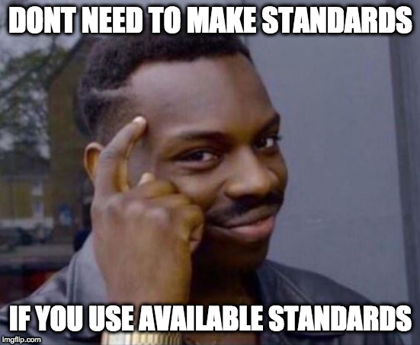
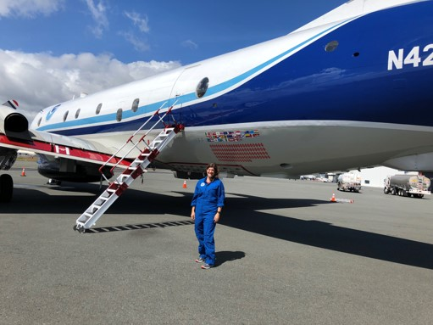
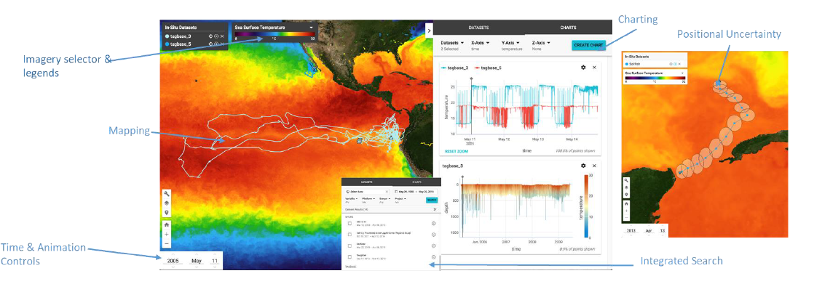
Marine Data Cluster Calls
Git Overview - C. Olson
Outreach & OceanHackWeek
S. Diggs, J. Gum
CCHDO CF compliant NetCDF
S. Diggs, C. Berys-Gonzalez, J. Gum
Satellite Winds
M. Bourassa, J. Elya
http://wiki.esipfed.org
/index.php/MarineData
Hurricane Hunter Data
H. Holbach
OIIP & THREDDS
V. Stontos, S. Arms

Slide 5
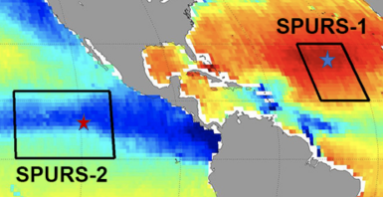
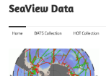
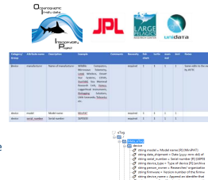
Marine Data Cluster Sessions
Controlled Vocabularies Decision Tree Development - Working Session
ESIP Summer 2021
Marine Data Cluster Introduction and Development of Focus Area
ESIP Winter 2019
Controlled Vocabularies
Special Session
February 11, 2021
Data Interoperability for In Situ Data Sets
ESIP Summer 2020
Vocabularies in the Marine World Special Session
March 08, 2021
Recent Advancements in Marine Data Management
ESIP Winter 2022

Slide 6
Upcoming Calls and Sessions
ESIP Summer Meeting 2022 DOOS Session
The Marine Data Cluster is collaborating with DOOS on their session at the ESIP Summer Meeting
Tuesday July 19th 11:00am - 12:30pm ET
Creating a “10 things” list about Data Management for (Deep) Ocean Scientists
Session info: https://bit.ly/doos-10-things-summer-2022
The summer meeting will be in person in Pittsburgh, PA with remote participation available
Upcoming Marine Data Cluster call:
August 2022-08-11
xarray for Marine Data (tentative)
Keep in touch about future calls:
Check out the calendar on the Wiki
Join the email list
If you would like to present or request a topic, feel free to reach out!

