Slide 1
IOOS Contributions to LIS and Connecticut Communities
James O’Donnell
Department of Marine Sciences and
Connecticut Institute for Resilience and Climate Adaptation
University of Connecticut
Supported by NERACOOS, MARACOOS and EPA LISS

Slide 2
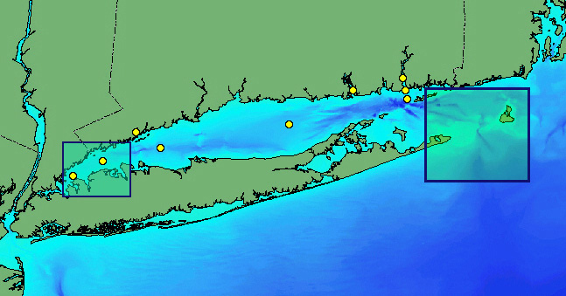
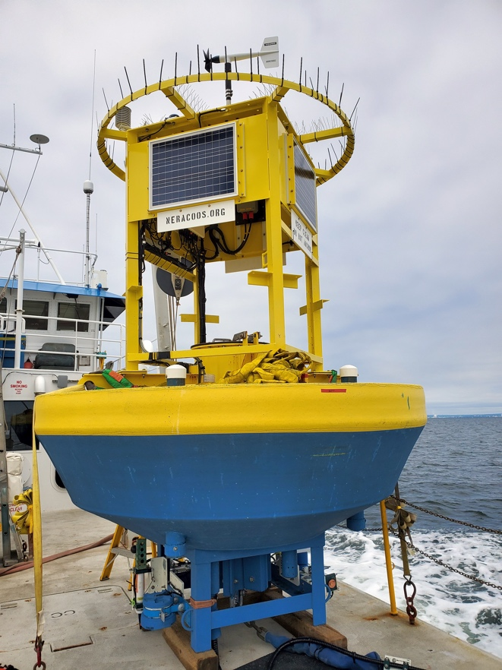
Long Island Sound Integrated Coastal Observing System 2002-2008
NOAA IOOS continued support for multi-use observations (Waves, Weather, SAR and WQ) and models in Long Island Sound since 2002
Notes:
Federal agencies (National Weather Service, Marine Fisheries, Coast Guard, EPA, USGS, Army Corp of Engineers, DOD) all make measurement in the ocean.
The don’t share data efficiently with states or each other.
The idea of IOOS was to coordinate with agencies to provide observations and analyses more efficiently, and to deliver products to states and towns.
Rep DeLauro supported the development of this program in 2004-2008

Slide 3
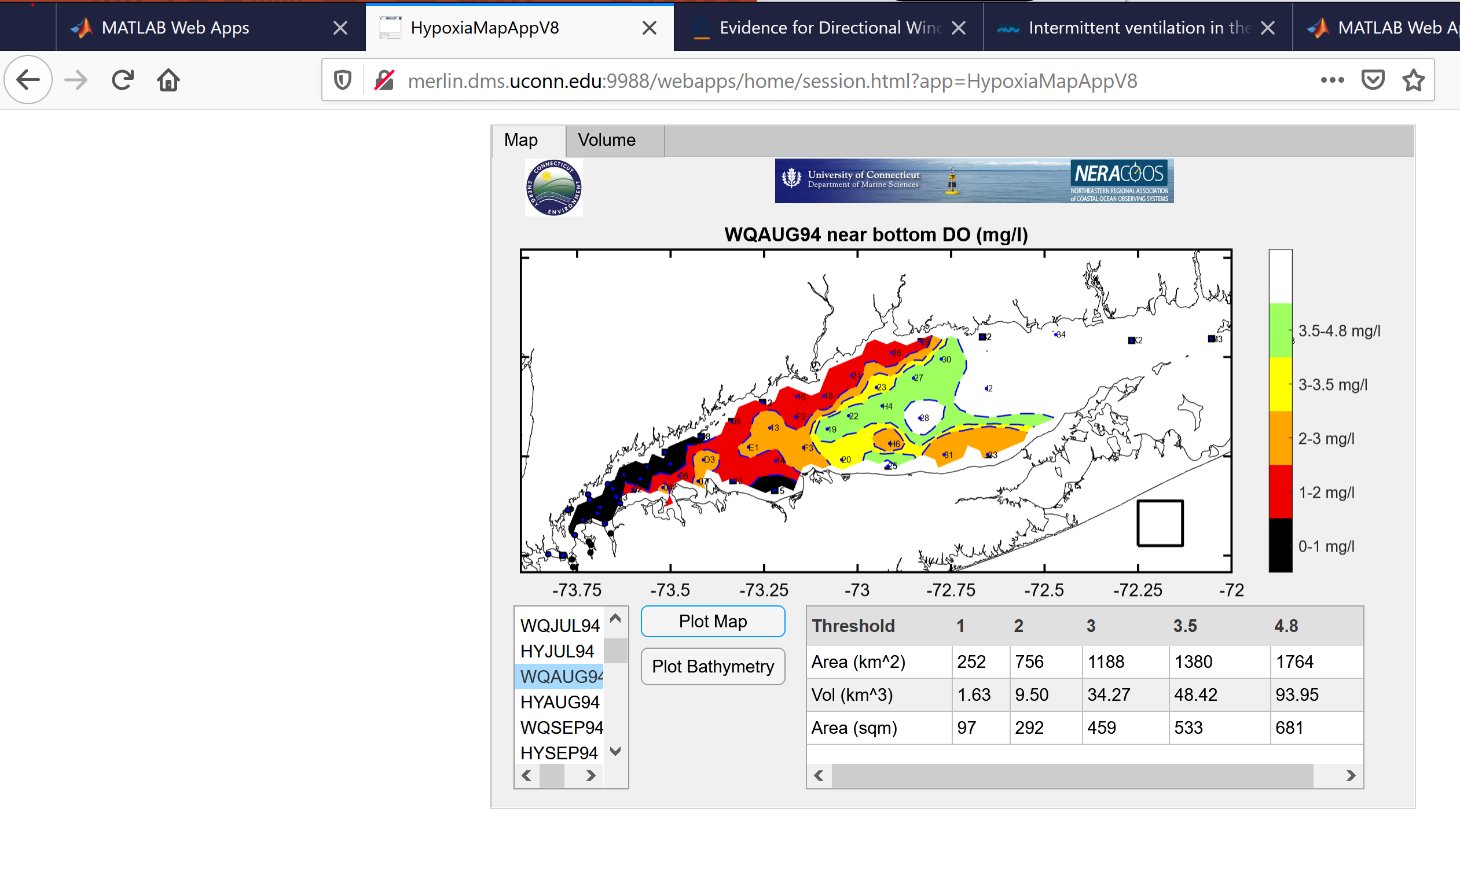
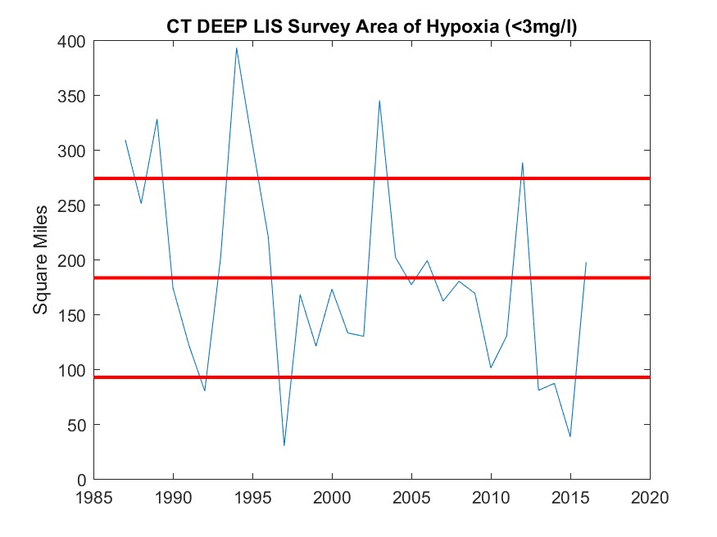

Slide 4
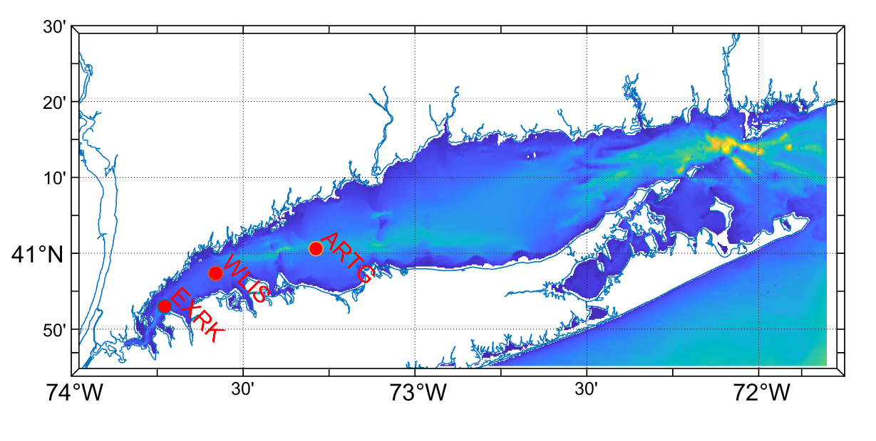
Figure15. (a) Map of the bathymetry of Long Island Sound and the location of three of the LISICOS buoys. (b) WLIS near-bottom DO concentration (mg/l) time series at the WLIS buoy in 2005 and (c) 2009. The * symbols show the measurements of CTDEEP at station C1 at the level of the level of the sensor and the error bar illustrates the range of values that would be obtained at the station and depth had the measurement occurred at other time in the two-week interval surrounding the survey dates.

Slide 5
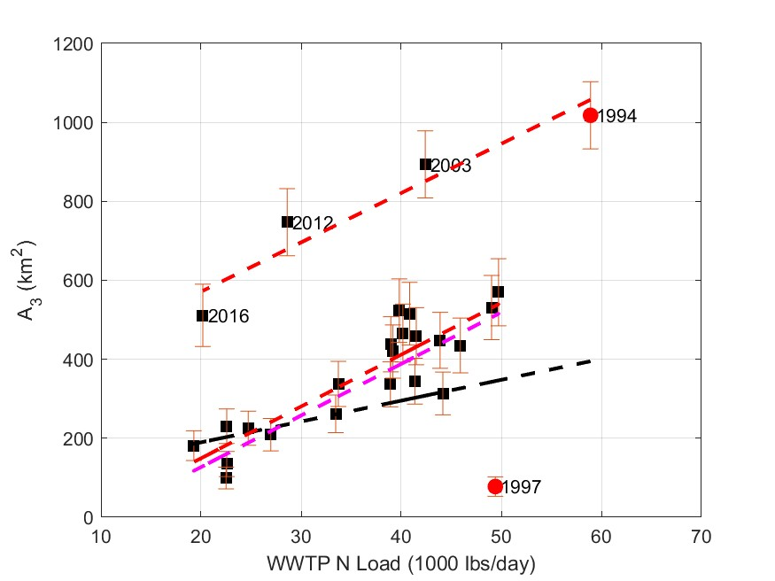
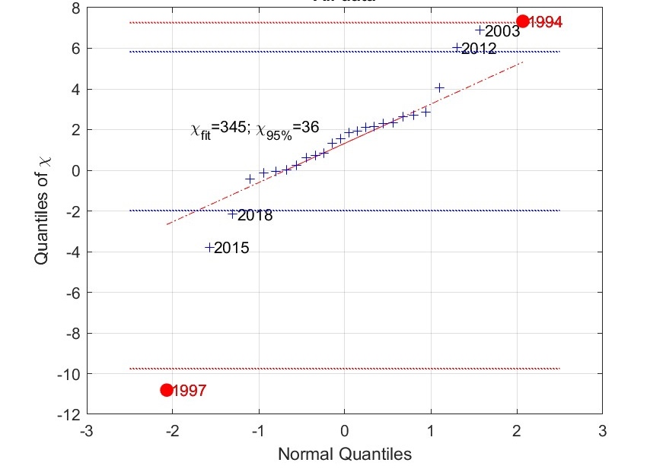
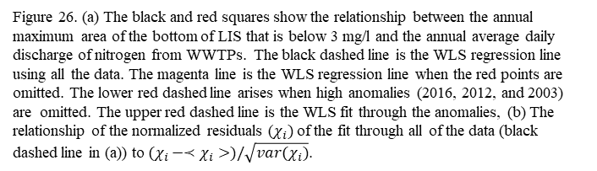
Figure 26. (a) The black and red squares show the relationship between the annual maximum area of the bottom of LIS that is below 3 mg/l and the annual average daily discharge of nitrogen from WWTPs. The black dashed line is the WLS regression line using all the data. The magenta line is the WLS regression line when the red points are omitted. The lower red dashed line arises when high anomalies (2016, 2012, and 2003) are omitted. The upper red dashed line is the WLS fit through the anomalies, (b) The relationship of the normalized residuals ($χ_{i})$of the fit through all of the data (black dashed line in (a)) to $(χ_{i}−≺χ_{i}>)/\sqrt{var(χ_{i})}$.

Slide 6
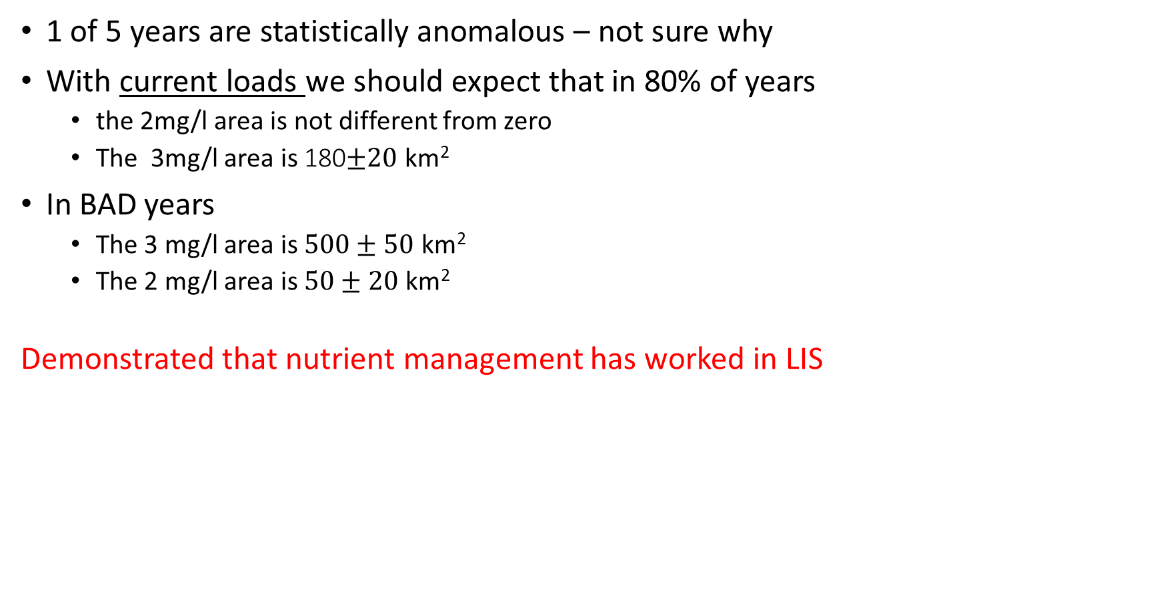
Integrated 30 years of EPA ship surveys, and 20 years of IOOS buoy data
1 of 5 years are statistically anomalous – not sure why
With current loads we should expect that in 80% of years
  the 2mg/l area is not different from zero
  The 3mg/l area is 180$±20$ km²
In BAD years
  The 3 mg/l area is $500±50$ km²
  The 2 mg/l area is $50±20$ km²
Demonstrated that nutrient management has worked in LIS

Slide 7
Connecticut Institute for Resilience and Climate Adaptation
February, 2012: Formation of Shoreline Preservation Task Force
June, 2013: Special Act 13-9 (U)
January, 2014: Gov. Malloy at Avery Point to Create CIRCA with $3,000,000 from a an environmental settlement fund
June 2018: Depth of Housing NDRC funds Bridgeport Project and Resilient Connecticut (regional risk assessment & planning in New Haven and Fairfield Counties)
June 2021: Connecticut Legislature Authorized Resilience Bonds from CT Green Bank, created authority for towns to raise revenue to fund projects, and provided $20,000,000 to CT DEEP for resilience projects
June 2021: Connecticut Legislature appropriates $5,000,000 for 2021-23 to expand- continue Resilient Connecticut to other counties

Slide 8
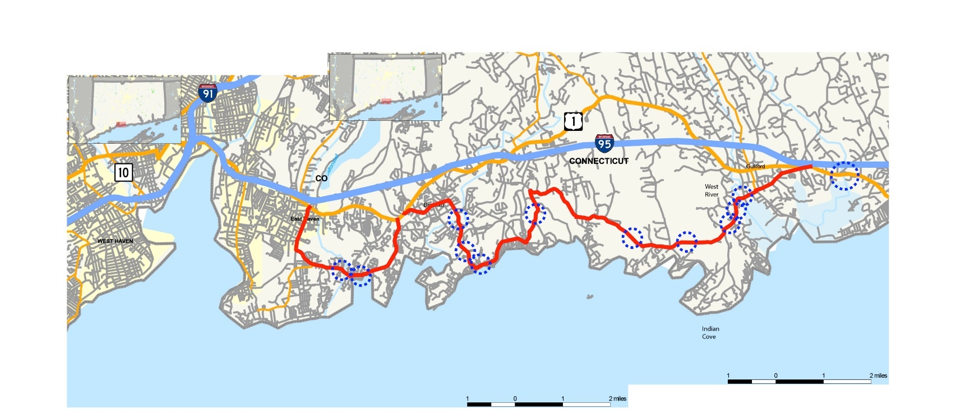
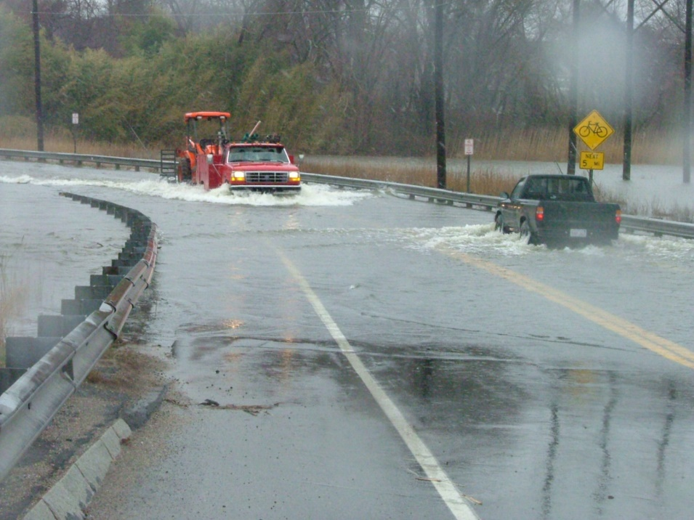
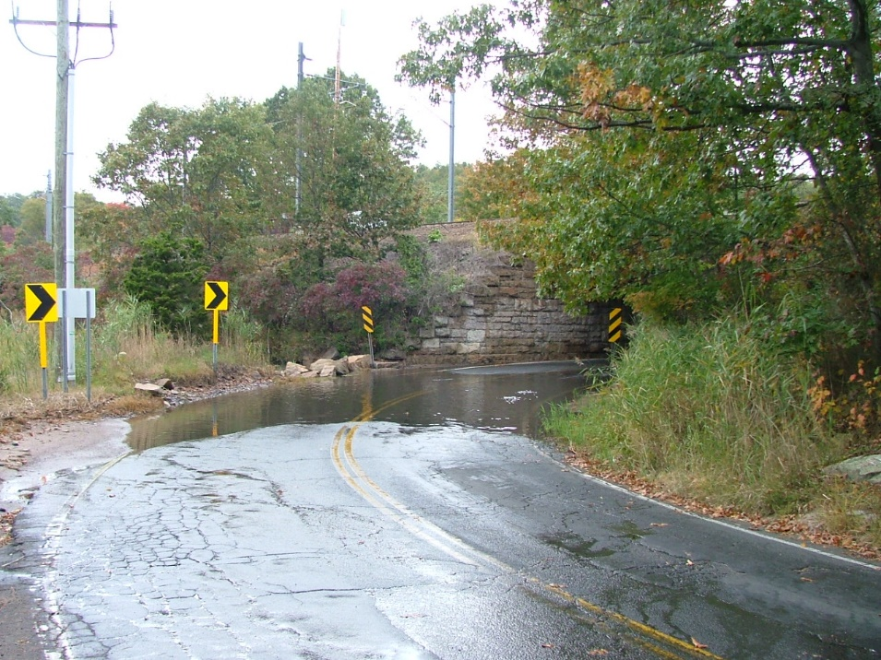
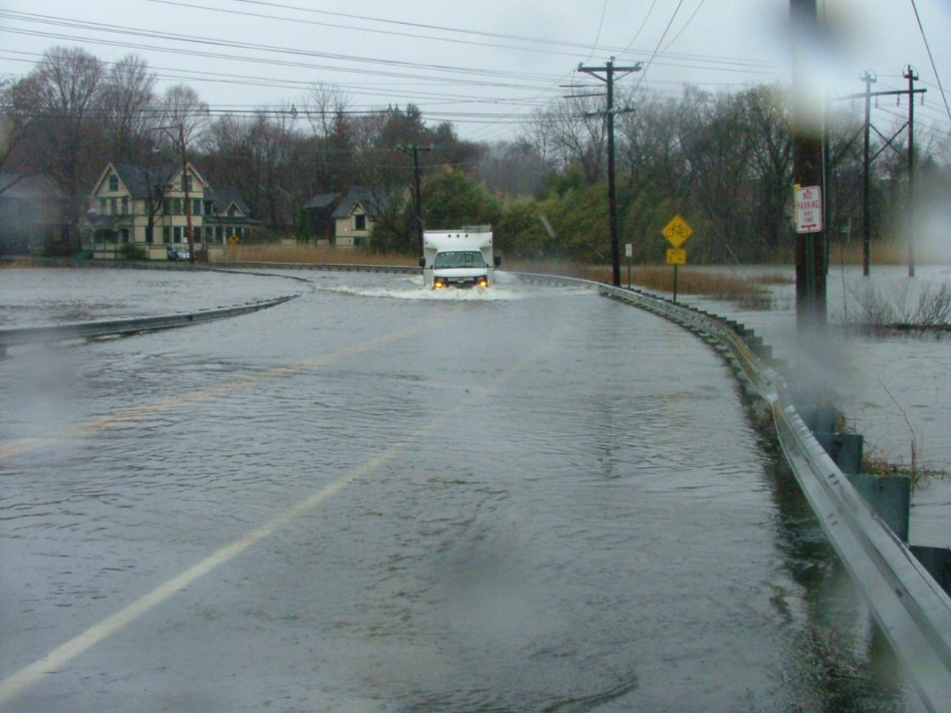
More frequent road flooding, disrupts business, e.g. RT 146
Notes:
Chronic/nuisance/tidal Flooding will also increase
Town and State roads are already experiencing this
Sea level rise will increase the cost of living on the shoreline.
The State’s strategy has been to reduce exposure by protecting critical infrastructure
Ensuring evacuation routes and Disaster Recovery Planning
Discouraging intensification of development in the (FEMA) flood plain
Public Act 18-82 requires sea level rise to be included in planning by towns and agencies with the sea level projection updated at least every 10 years.
FEMA estimate reducing risk exposure has a high (4 to 1) return on investment

Slide 9
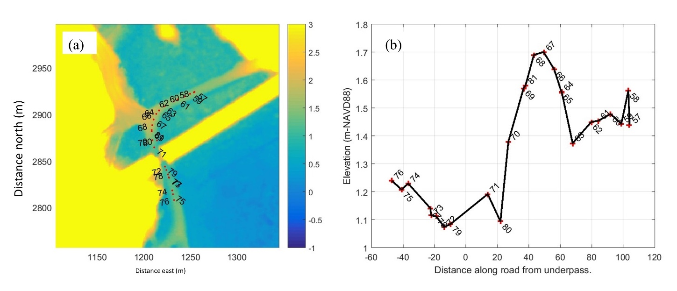
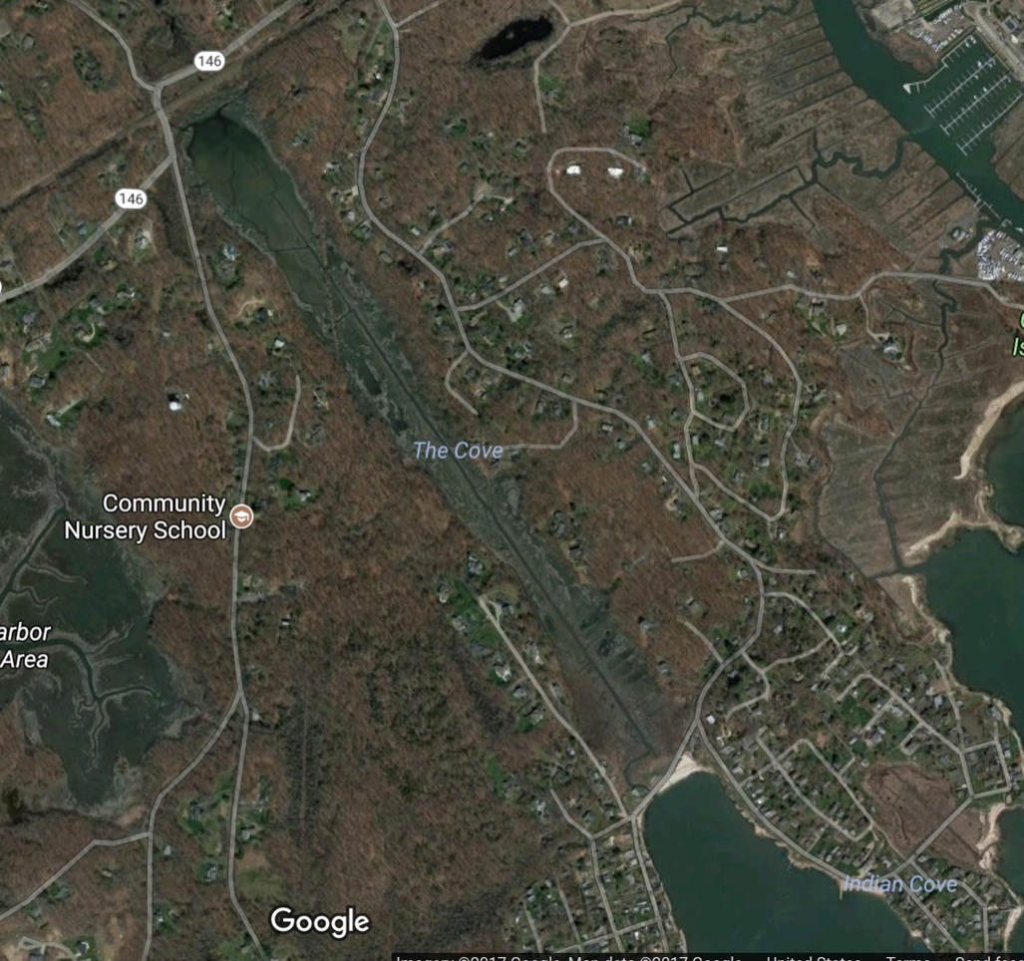
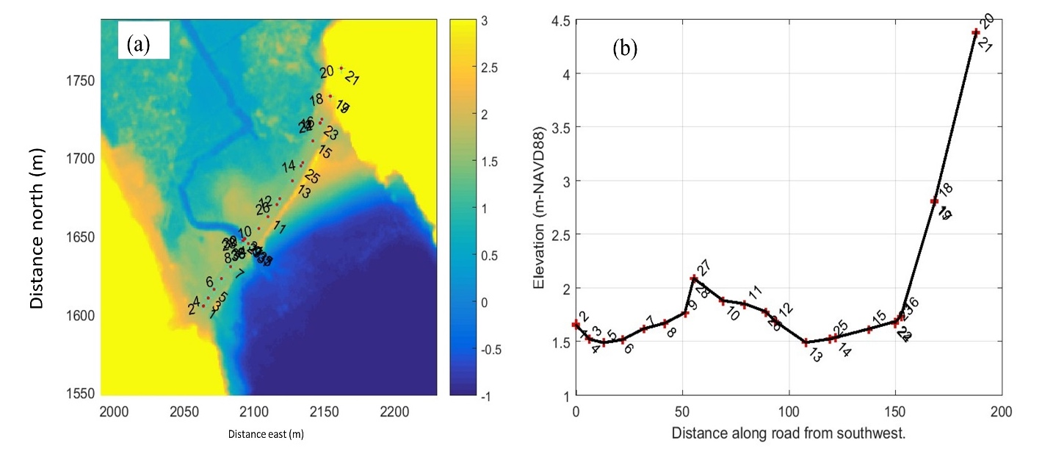
Sachems Head Road (RT 146)
Sachems Head Road (RT 146), Guilford
Sachems Head Road (RT 146)
Daniels Avenue
Daniels Avenue

Slide 10
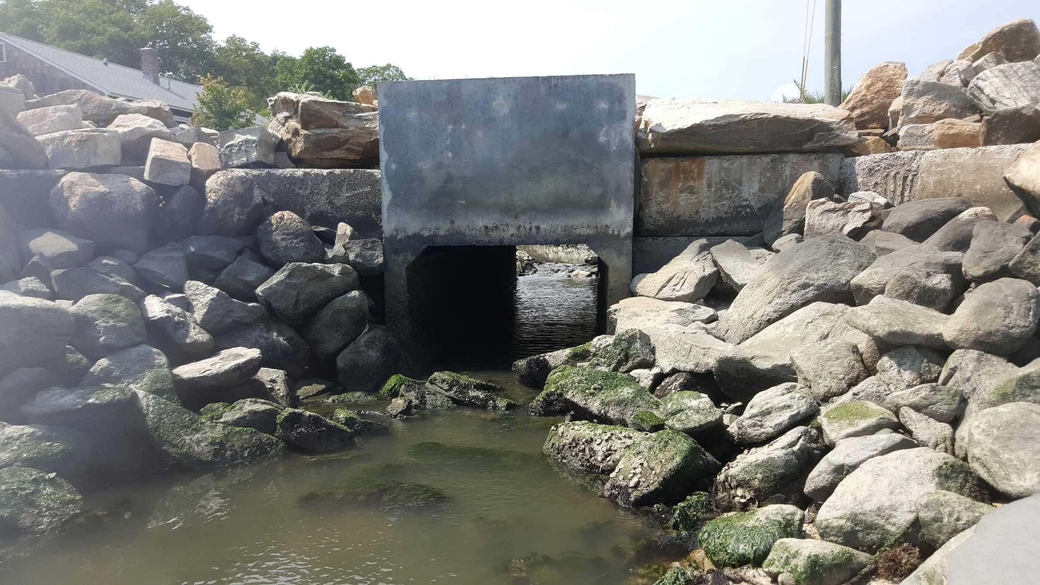
South side – Daniel Avenue Beach culvert
182.8 (6’)
121.9 (4’)

Slide 11
