Slide 1
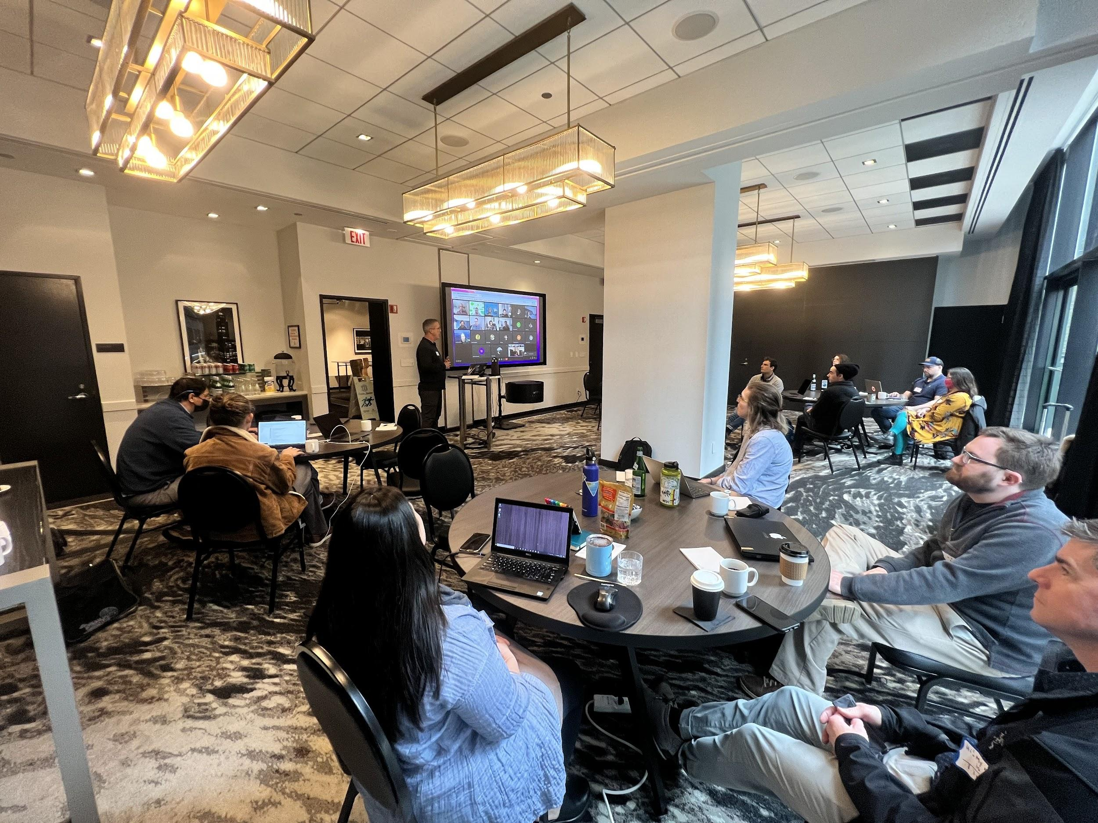
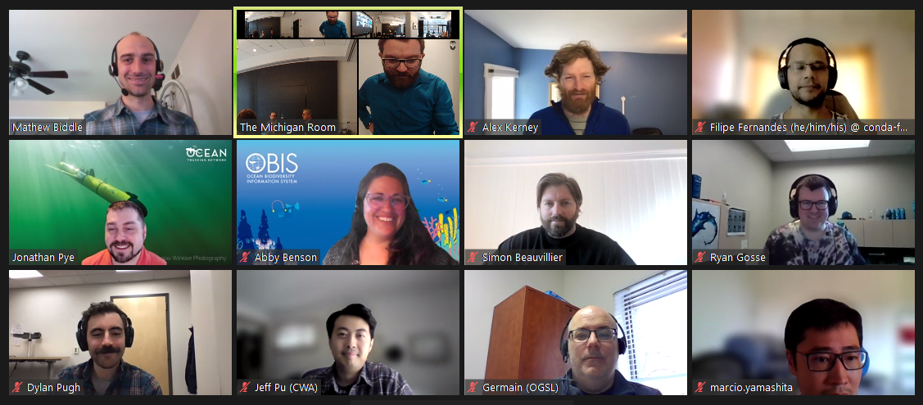
2022 IOOS Code Sprint
https://ioos.github.io/ioos-code-sprint/
Hybrid event hosted by
17 in-person
23 virtual

Slide 2
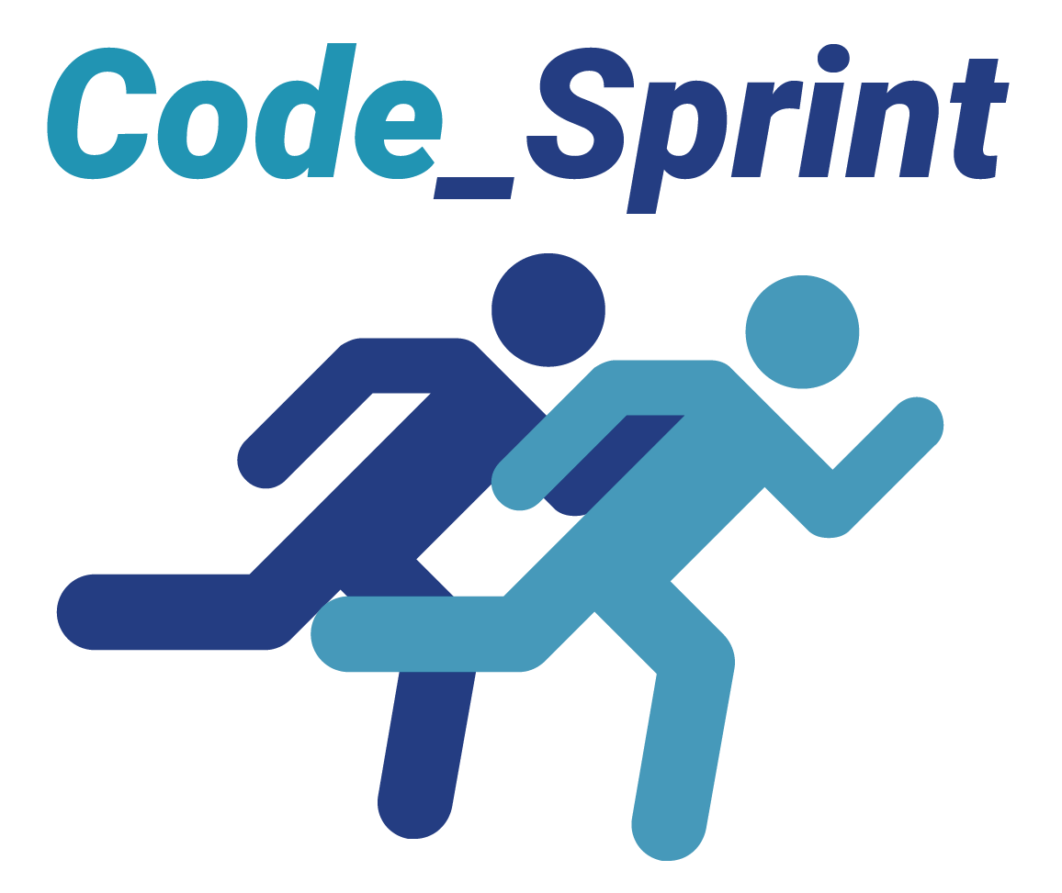
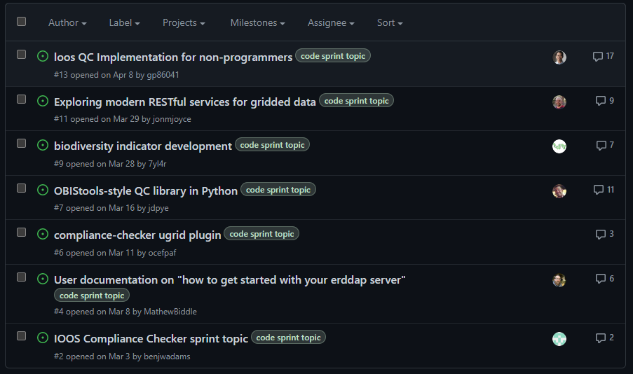
Event structure
Daily Agenda:
9:00am daily kickoff
1 hour 45 mins of breakout groups
1 hour lunch
4 hours of breakout groups (breaks when needed)
Short daily recap and lightning talks to round off each day
https://github.com/ioos/ioos-code-sprint/issues

Slide 3
Tools and Products
An open source tool to develop biodiversity indicators from open data: https://marinebon.org/obisindicators/articles/obisindicators.html
Exploring modern RESTful services for gridded data: https://asascience.github.io/restful-grids/README.html#
pyobistools: Python tools for working with OBIS data: https://cioos-siooc.github.io/pyobistools/
A quick start guide for standing up an ERDDAP server: https://ioos.github.io/erddap-gold-standard/index.html
An interactive web application for non-programmers to upload and QC their data using QARTOD tests: https://github.com/Dylan-Pugh/ioos-qc-front-end

Slide 4
Google Summer of Code 2022
SafeFromHome
Tuesday, June 14th
Melissa Zweng
Micah Wengren
Matt Biddle
Filipe Fernandes

Slide 5
Google Summer of Code (GSoC) is an
online, international program designed to
encourage new contributors to participate
in open source software development
under the guidance of mentors from the
open source community.
Selected candidates will work on medium (175 hours) or large size (350 hours) OSS projects.

Slide 6
The goals of GSoC are
Introduce new contributors to OSS
Help projects bring in new developers who stay involved in their communities after the program ends
Give contributors exposure to real-world software development (testing, version control, software licensing, distributed development, etc.).

Slide 7
GSoC Stats
● Since 2005, over 18,000+ participants from 112
countries have been accepted into GSoC
● Over 17,000 mentors from 124 countries
● 746 open source organizations have participated
● Over 40 million lines of code have been produced

Slide 8
GSoC and Met/Ocean and related Sciences:
Clear Climate Code
52North
OPeNDAP
ESIP
Probably more…

Slide 10
Dears Dingrui Lei
Computer science undergraduate from Tongji University. Going to Houston to study as a computer science graduate at Rice University in this summer.
Will develop the main APIs of echoshader based on the HoloViz suite of tools, test configuration for using echoshader widgets in Panel dashboards.

Slide 11
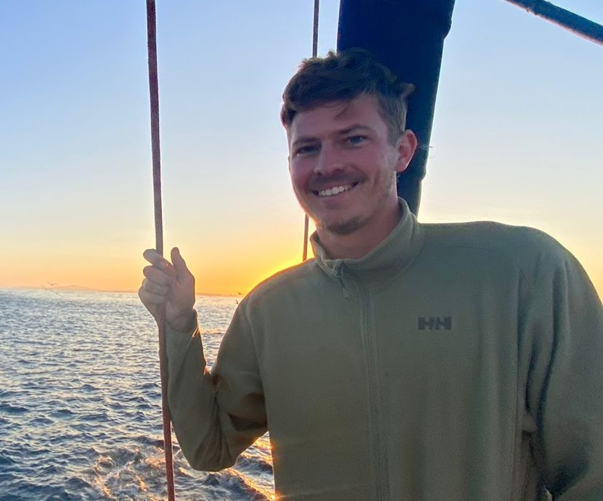
Peter Marsh
Recent Atmospheric Science Master’s graduate from the University of Cape Town.
My work will look to demonstrate the functionality of Kerchunk on new datasets such as GRIB2 operational forecast data.

Slide 12
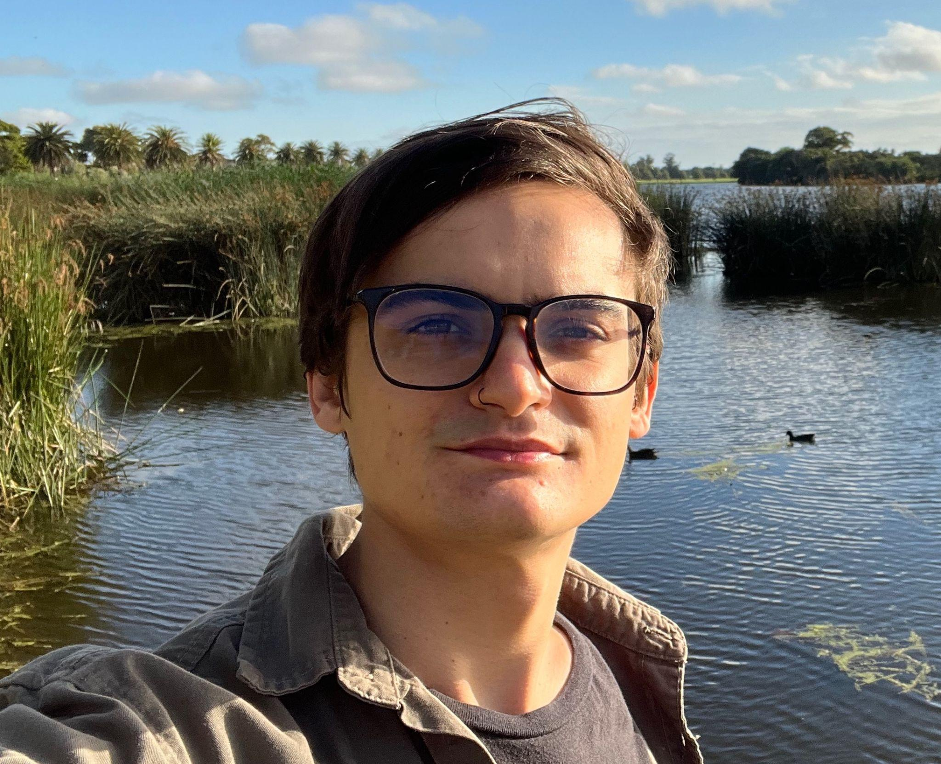
Vini Salazar
PhD student at the University of Melbourne. Vini is also the Maintainer Community lead at The Carpentries, a global organisation teaching coding and data skills to scientists.
Will work on refactoring erddapy.

Slide 13
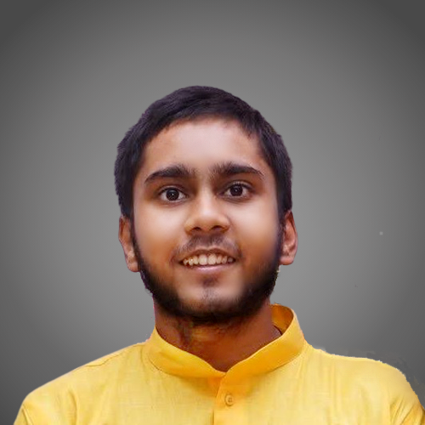
Ayush Anand
First-year CS undergraduate from the National Institute of Technology Durgapur. I love playing with data to address social challenges.
This summer, I will contribute to pyobis - python client for OBIS, to upgrade it to the new API and improve usability and test coverage.

Slide 15
Thank you!
Google for granting 4 slots
Micah Wengren, Mathew Biddle, and Melissa Zweng for the support with the application
All the project mentors

Slide 16
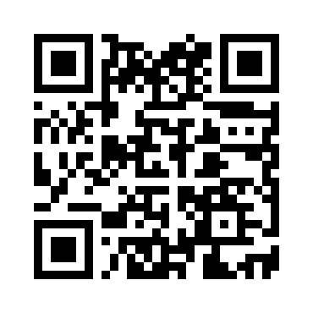
Extra Slides
Can we do more than GSoC?
IOOS Code Sprint
Outreachy
Hacktoberfest
OceanHackWeek ¹
1 https://oceanhackweek.github.io/

