Slide 1
Diversity, Equity, Inclusion and Accessibility in IOOS:
Fellowship Progress and Planning
Ashley Peiffer, IOOS Association
Diversity, Equity, Inclusion, and Accessibility Fellow
IOOS Advisory Committee Meeting, May 2022

Slide 2
Outline
Context and Relevance
Regional Efforts and Needs
Fellowship Approach and Focus Areas
Considerations for the Advisory Committee

Slide 3
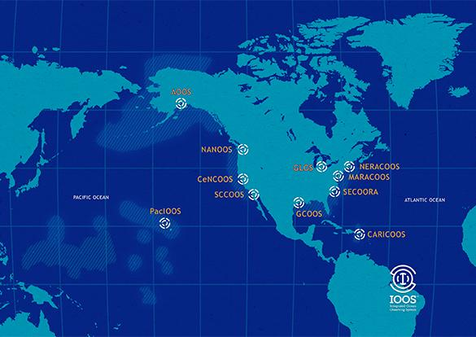
Context
IOOS Office, Federal Agencies, Regional Associations, IOOS Association
Observations
Data Management
Product Development

Slide 4
Relevance to IOOS
Internal policies & procedures
Hiring practices
Trainings and workshops
Informal discussion spaces
Board policies and practices
Strategic plans, core values, mission statements
External practices
Education and outreach
Workforce development
Access to information
Accountability and assessments
Co-design and co-development

Slide 5
IOOS Initiative
Diversity, Equity, Inclusion, and Accessibility Fellowship
Work with IOOS Office, 11 Regional Associations, and IOOC agencies to:
Amplify existing and planned efforts to improve DEIA and service equity,
Research and recommend best practices for improving service equity, training opportunities for staff, workforce development and support, co-development and other activities,
Facilitate information sharing, seek partnerships,
Identify next steps including possible funding opportunities
Timeline
January - December 2022

Slide 6
Fellowship Progress to Date
Initial Tasks
Outlined existing DEIA efforts, qualitatively assessed needs to identify areas for improvement
Compiled an up-to-date list of regional and national activities related to DEIA
Collated preliminary research on best practices in co-design, STEM outreach, etc.
Ongoing Tasks
Facilitating DEIA Dialogues - discussion spaces for key topics
Seeking out best practices and approaches
Connecting with IOOS partners to learn more about their DEIA initiatives
Advocating for IOOS with partners
Identifying funding opportunities for regional efforts

Slide 7
Ongoing Regional Efforts
Regional Examples
Bringing Spotter Buoys to Indigenous Communities
Internal conversations, workshops, and staff and Board trainings
Indigenous-led Smart Great Lakes effort
Building partnerships with HBCUs to connect with underserved communities
Translating websites and outreach materials
Supporting mentorship efforts

Slide 8
Expressed Needs
Structure
Shared DEIA goals, objectives, terminology
Information
Expand regional DEIA toolkit - “exploratory assessment”
Best practices - hiring practices, data accessibility, reaching underserved communities
IOOS Program Office and Regional Association exchanges
Capacity
Funding and capacity building for RAs

Slide 9
Approach
Collaboration and trusted partnerships are key
Accountability, open conversations, and reflection
Capacity (more than just checking the box)
Interagency dialogue and collaboration efforts

Slide 10
Fellowship Focus Areas
(1) Communicate DEIA activities internally and externally
Collate internal resources and updates
Prepare external communications (newsletters, webpage)
Facilitate Board discussions and next steps

Slide 11
Fellowship Focus Areas
(2) Facilitate information and knowledge-sharing opportunities between the IOOS Office and RAs and among regional associations
Plan and facilitate monthly meetings, quarterly discussions (DEIA Dialogues), and informational webinars
Meet regions where they are - exploratory “assessments”

Slide 12
Fellowship Focus Areas
(3) Identify funding resources to support RA diversity efforts including Federal programs, foundation, and others
Outline federal and foundation opportunities for capacity building and support for DEIA expansion
Capacity of Regional Associations, Program Office to invest in relationships

Slide 13
Fellowship Focus Areas
(4) Provide recommendations to improve service equity, develop long-term activities at both the national and regional level, and create new, and strengthen existing, long-term partnerships.
IOOS DEIA Strategy

Slide 14
Summary
Short-term objectives
Gathering lessons learned and outlining opportunities
Facilitating community dialogues at the national and regional level to develop common understanding
Long-term objectives
IOOS DEIA Strategy
Ultimately, these efforts become normalized with shared understanding and support across IOOS

Slide 15
Considerations for the Advisory Committee
Thanks to the Diversity, Inclusion, and Service Equity PWG!
Community of practice and support…
Please share resources or contacts…
Thank you!

