Slide 1
Quality Assurance / Quality Control of Real-Time Oceanographic Data Five-year plan update, 2022 - 2026
Mark Bushnell
National Coordinator, US IOOS/QARTOD
DMAC Annual Meeting, June 16, 2022
Notes:
Five-year plan development
Results of QARTOD Board of Advisors survey
Expanded project scope

Slide 2
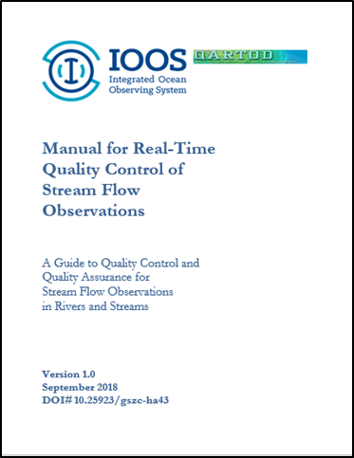
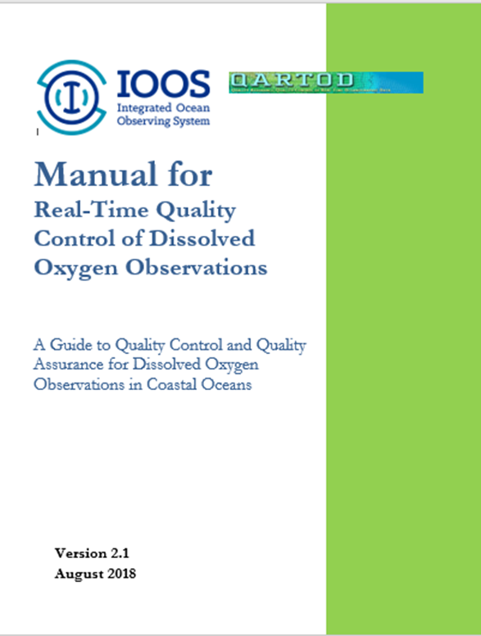
https://ioos.noaa.gov/project/qartod
Notes:
12 QC manuals plus supporting documents. Documents outlined in red:
QARTOD Project Plan Update 2022–2026
Update to the Manual for Real-Time Quality Control of High Frequency Radar Surface Current Data

Slide 3
QARTOD, So Far
Focus on real-time QC manuals, useful to those creating automated QC software
Requires:
Inter-operable data stream
Data used in real-time
Engaged user community
No obvious additional core variables ready for a traditional QARTOD manual.
What to do?

Slide 4
Seven Laws of QARTOD, 2003
Every real-time observation distributed to the ocean community must be accompanied by a quality descriptor.
All observations should be subject to some level of automated real-time quality test.
Quality flags and quality test descriptions must be sufficiently described in the accompanying metadata.
Observers should independently verify or calibrate a sensor before deployment.
Observers should describe their method / calibration in the real-time metadata.
Observers should quantify the level of calibration accuracy and the associated expected error bounds.
Manual checks on the automated procedures, the real-time data collected, and the status of the observing system must be provided by the observer on a time-scale appropriate to ensure the integrity of the observing system.

Slide 5
Board of Advisors
Eugene Burger
Kathy Bailey
Regina Easley
Julie Bosch
Matt Biddle
Karen Grissom
Mario Tamburri
Bob Jensen
Jim Behrens
Bob Heitsenrether
Jennifer Dorton
Christoph Waldmann
Mark Bushnell
Notes:
Good mix of skills, fortunate to have international representative.
Julie Thomas has stepped down, replaced by Jim Behrens
Eugene Burger elected to Chair
Matt Biddle joined – important link to DMAC

Slide 6
BOA Questionnaire 1
Developed with BOA input
Sixteen multiple choice questions
Most questions included provision for comments
Results discussed during a BOA quarterly meeting
Detailed summary of questionnaire appended to the Five-Year Plan update

Slide 7
BOA Questionnaire 2
1) QARTOD has evolved from its grassroots origin, to a U.S. IOOS project with a focus on QC manuals, and more recently shifting to include best practices, uncertainty, and development of additional QC manuals by the appropriate communities. Thinking about the resources and level of effort presently in place, which direction should the scope of the QARTOD project take? (select one):
Expand the scope to address additional activities with additional resources.
Scope is properly sized and should maintain focus on the 34 IOOS core variables as described in our recent paper (QARTOD - Prospects for Real-Time Quality Control Manuals, How to Create Them, and a Vision for Advanced Implementation, DOI: 10.25923/ysj8-5n28).
QARTOD has completed its mission and should be scaled down or closed.

Slide 8
BOA Questionnaire 3
Several questions had a nearly unanimous response:
A working group should be convened to assist with the development of the 5-year plan
The present quarterly BOA meetings suffice
Updating QC manuals was ranked as most important, but the frequency and method to determine which manual(s) to update was less clear
Also ranking fairly high – a) promote QARTOD to communities / variables not yet engaged, b) undertake documentation of best practices, and c) work towards embedding RT QC in field-deployed instruments
While QARTOD’s focus on real-time QC isn’t as unique as it was when formed, it’s still valuable
Interaction with relevant international programs is very important
Implementation of data flagging should still be left up to data providers
The present community interaction and end-product dissemination efforts are fine

Slide 9
BOA Questionnaire 4
Some spread in responses to other topics
BOA membership term limits were evenly split, about half for and half against
Most thought QARTOD was right-sized, but one third of the BOA suggests expansion of scope & resources
Most thought the present flexibility for the method(s) of dissemination of data quality metadata are adequate and desirable for data providers, but one-third of us called for QARTOD to be more prescriptive in setting standards
Most preferred to leave establishment & record-keeping of test thresholds to data providers, but one-third thought QARTOD should be more engaged
About evenly divided on the question of developing advanced testing, half for more effort and half for leaving it to others
Most agreed that QARTOD should flex to accommodate the biological communities’ need for QC (e.g., “timely data”) and best practice documentation. But there were concerns about diluting the QARTOD mission
Most thought implementation and adherence to QARTOD QC tests should be left to the operators, but one-third thought we should be more proactive
Only one-third ranked adding an early career ocean professional to the BOA highly
Notes:
BOA term limits have been implemented and membership will now turn over more frequently – fresh thoughts and broader awareness.

Slide 10
Five Year Plan Update - Process
QARTOD Plan Update Development
BOA Questionnaire
Working group plan development
BOA input
Input from RAs and broader community
Findings to IOOS
Plan issued

Slide 11
Ongoing Core Activities
Six core activities
Foster implementation of existing manuals
Update manuals
Work with communities to develop new manuals as appropriate
Interact with international entities as appropriate
Promote outreach
Work with manufacturers to embed QC tests in instruments

Slide 12
Expanded QARTOD Scope 1
QARTOD goes from “QC of RT data”
to “QA/QC of timely data”
Timely data - Include near-real time, but not post-processed
QA that impacts timely data quality – e.g., HF radar antenna pattern measurement

Slide 13
Expand QARTOD Scope 2
Uncertainty quantification
Satellite and acoustic telemetry data for animal movement
Seascape climatologies
High frequency radar surface current observations antenna pattern measurements
Vessel AIS data QC

Slide 14
Communities Generate Manuals
Shifts the focus from an IOOS-led effort to a community-driven development of QARTOD manuals
Designed to help communities whose variables of interest are not yet ready for a traditional QARTOD QC manual but are likely to benefit from the development of a QA/QC standardized process in the near future
Plan update and other documents provide a framework for those communities moving forward

Slide 15
Discussion questions
Will communities step up and produce their own manuals?
Will another technical writer be available to support those communities? We’ll miss Helen Worthington!
Will IOOS be able to manage the expanded project scope without additional resources?
Thank you DMAC members, for all you’ve done to support and implement QARTOD QC!!

