Slide 1
U.S. IOOS National Glider Data Assembly Center Updates
John Kerfoot¹, Ben Adams², Andy Nguyen², Don Moretti², Kathy Bailey³
¹ Rutgers University
² RPS/ASA
³ IOOS

Slide 2
Topics
Brief Background
Data Set Status
Raw Data Uploads
Application of Standardized Quality Control

Slide 3
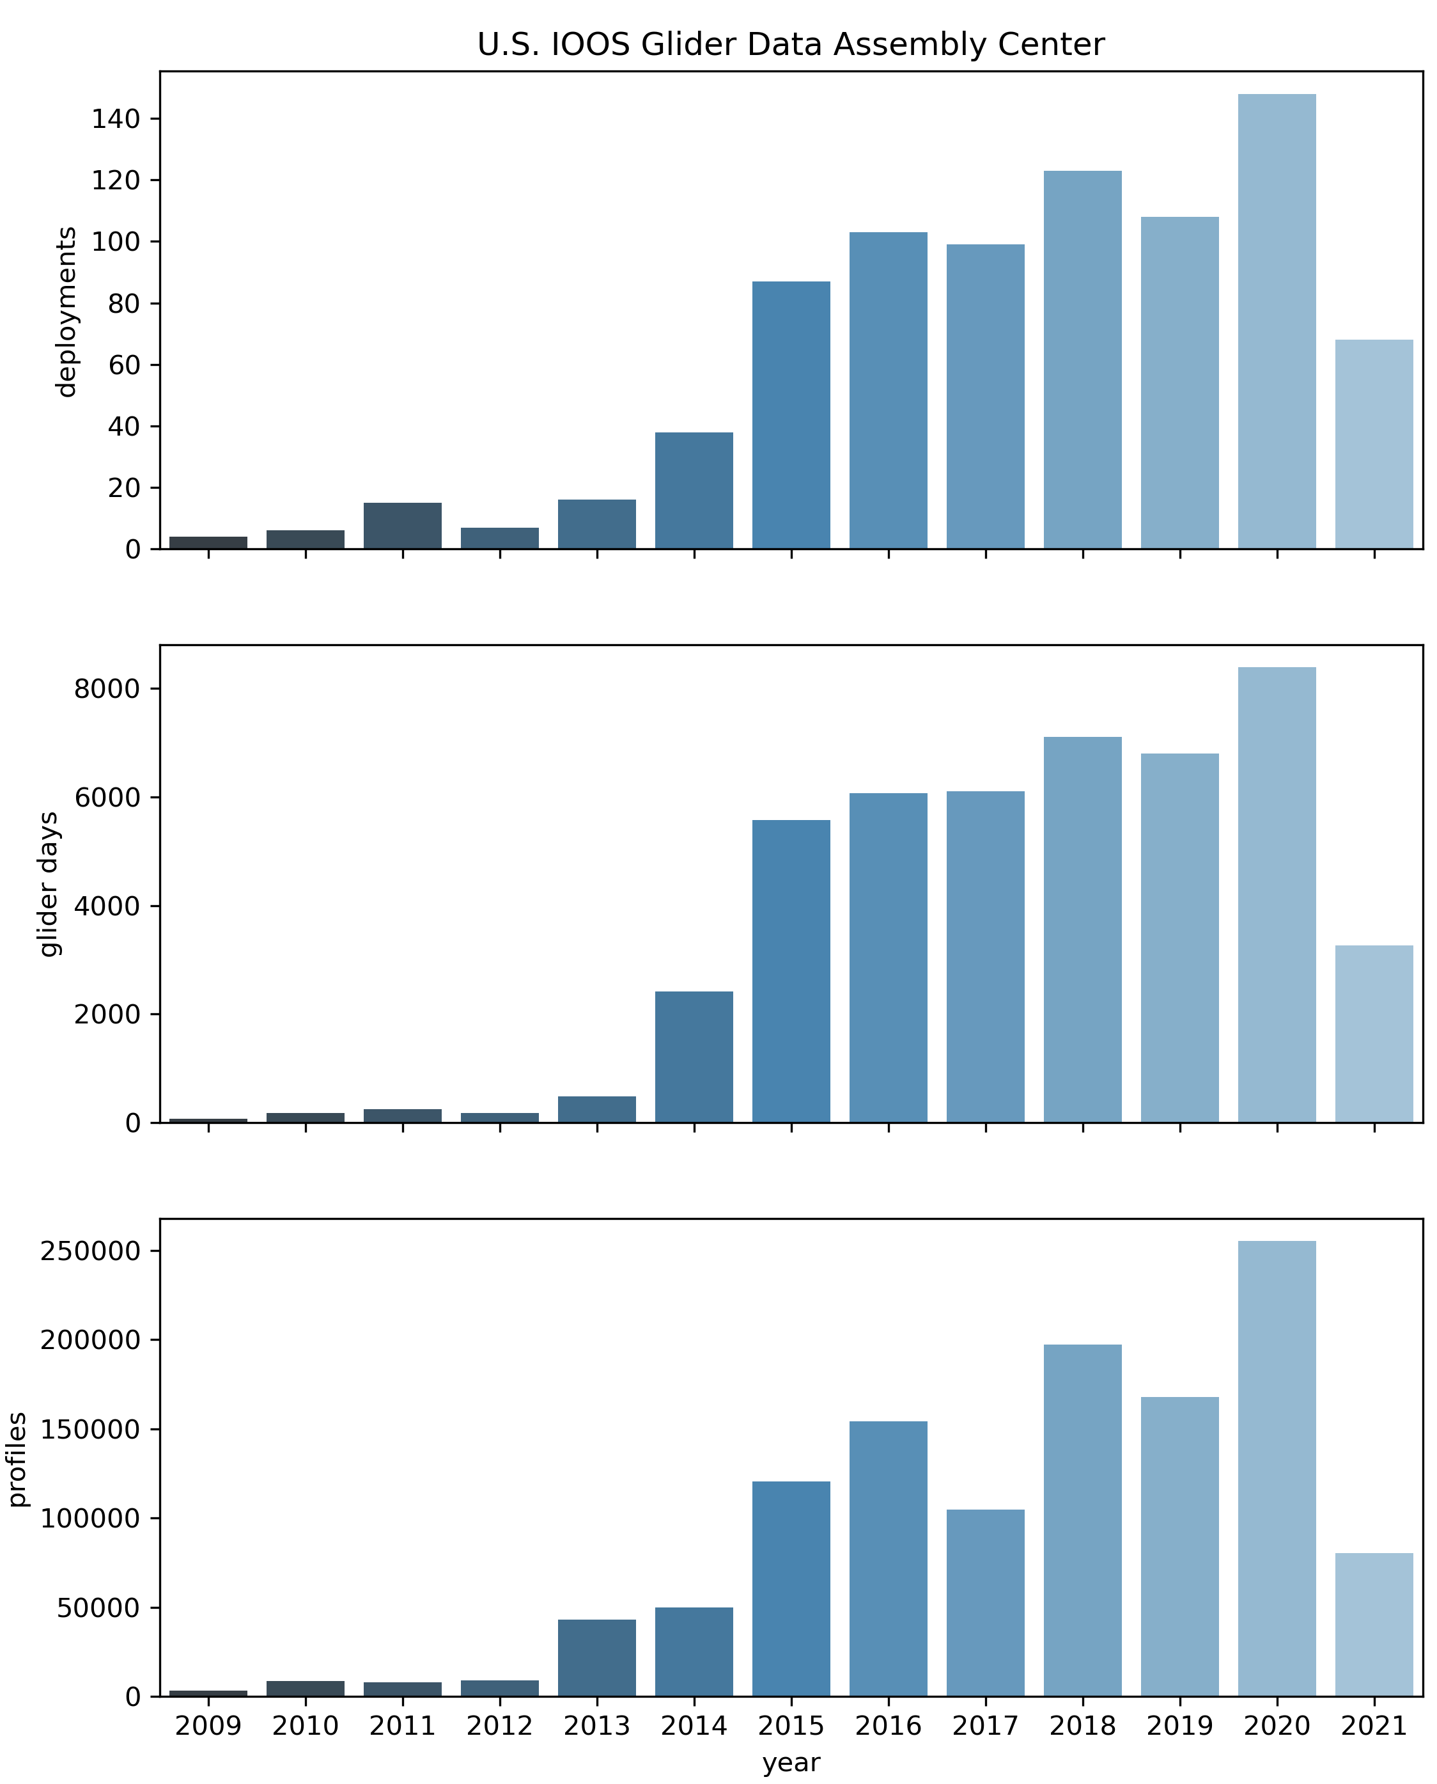
Brief Background
Construction began in 2013
Primary Goals
Glider agnostic standardization of data sets
Single distribution point
ERDDAP
THREDDS
Standard level of QC – QARTOD
Distribution to GTS
Permanent archive at NCEI
Real-Time and Delayed-Mode Accepted
724 Real-Time Data Sets
209 Delayed-Mode Data Sets

Slide 4
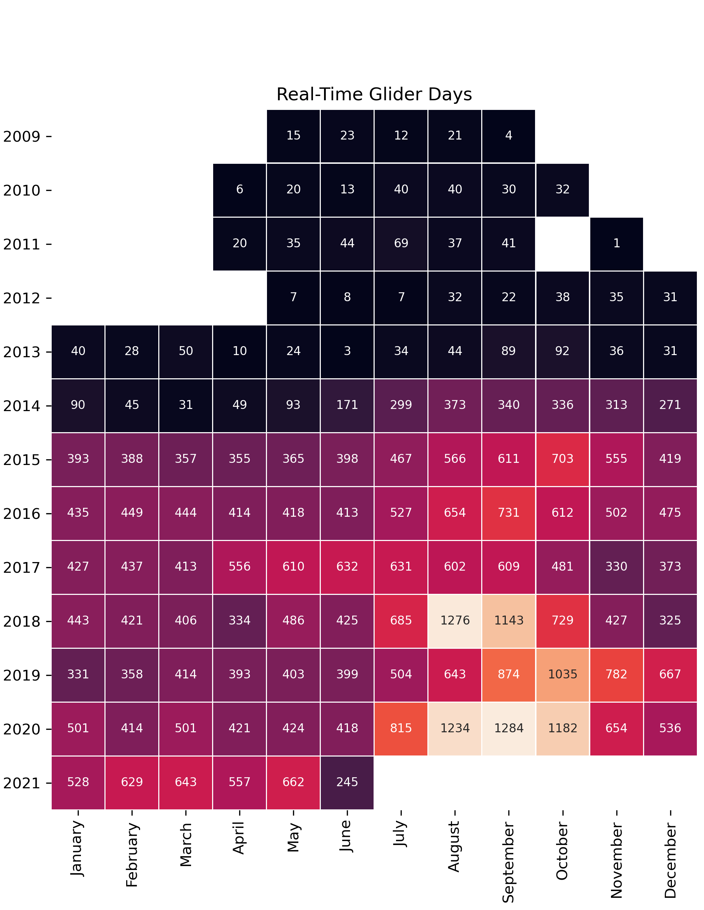
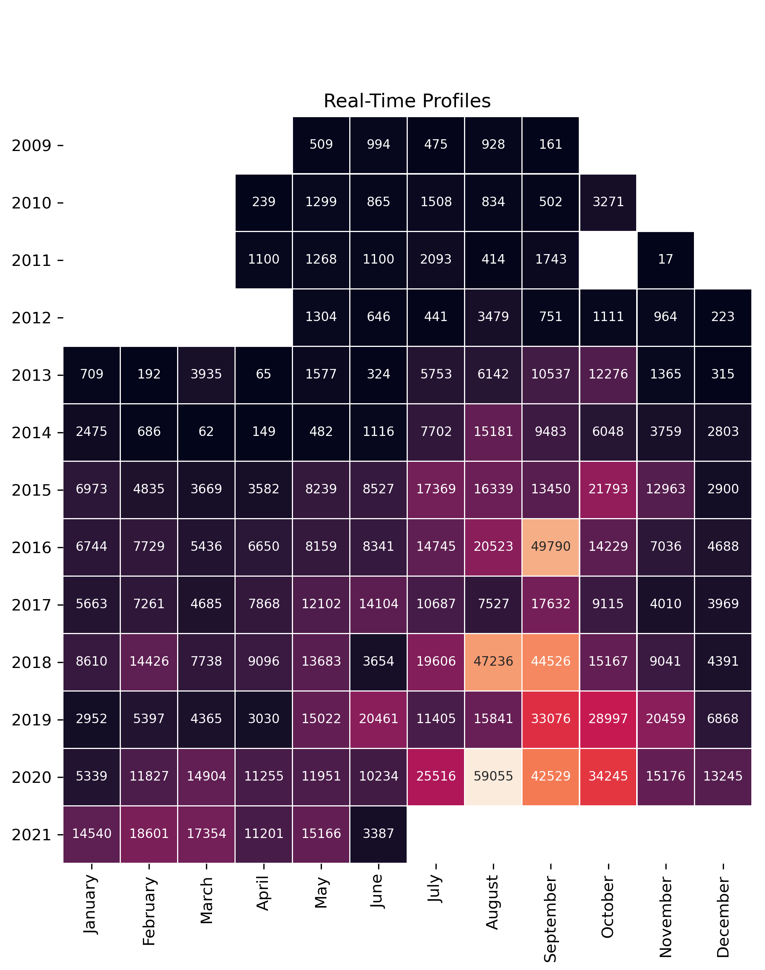
Current Data Set Inventory (2009 – Present)

Slide 5
Generalized Data Flow
OPeNDAP, .nc, .ncSOS, .ncISO, etc.
Native Glider Data Files
THREDDS
End users (NDBC, GTS, NCEI, Public
DAC Compliant NetCDF Files (Single Profiles)
Glider Data Assembly Center
ERDDAP Aggregations
FTP
OPeNDAP sequence or downloaded .geoJSON, .json, .nc, .ncCF, .ncCFMA, etc.
Provider Responsibility
DAC Responsibility

Slide 6
Individual Data Set Status
Data Provider: What is the status of my data set?
Monitoring data set status
Profile/Time-Series plots
How many observations have been released to GTS?

Slide 7
Fleet Track Map

Slide 8
Data Set Vizualization

Slide 9
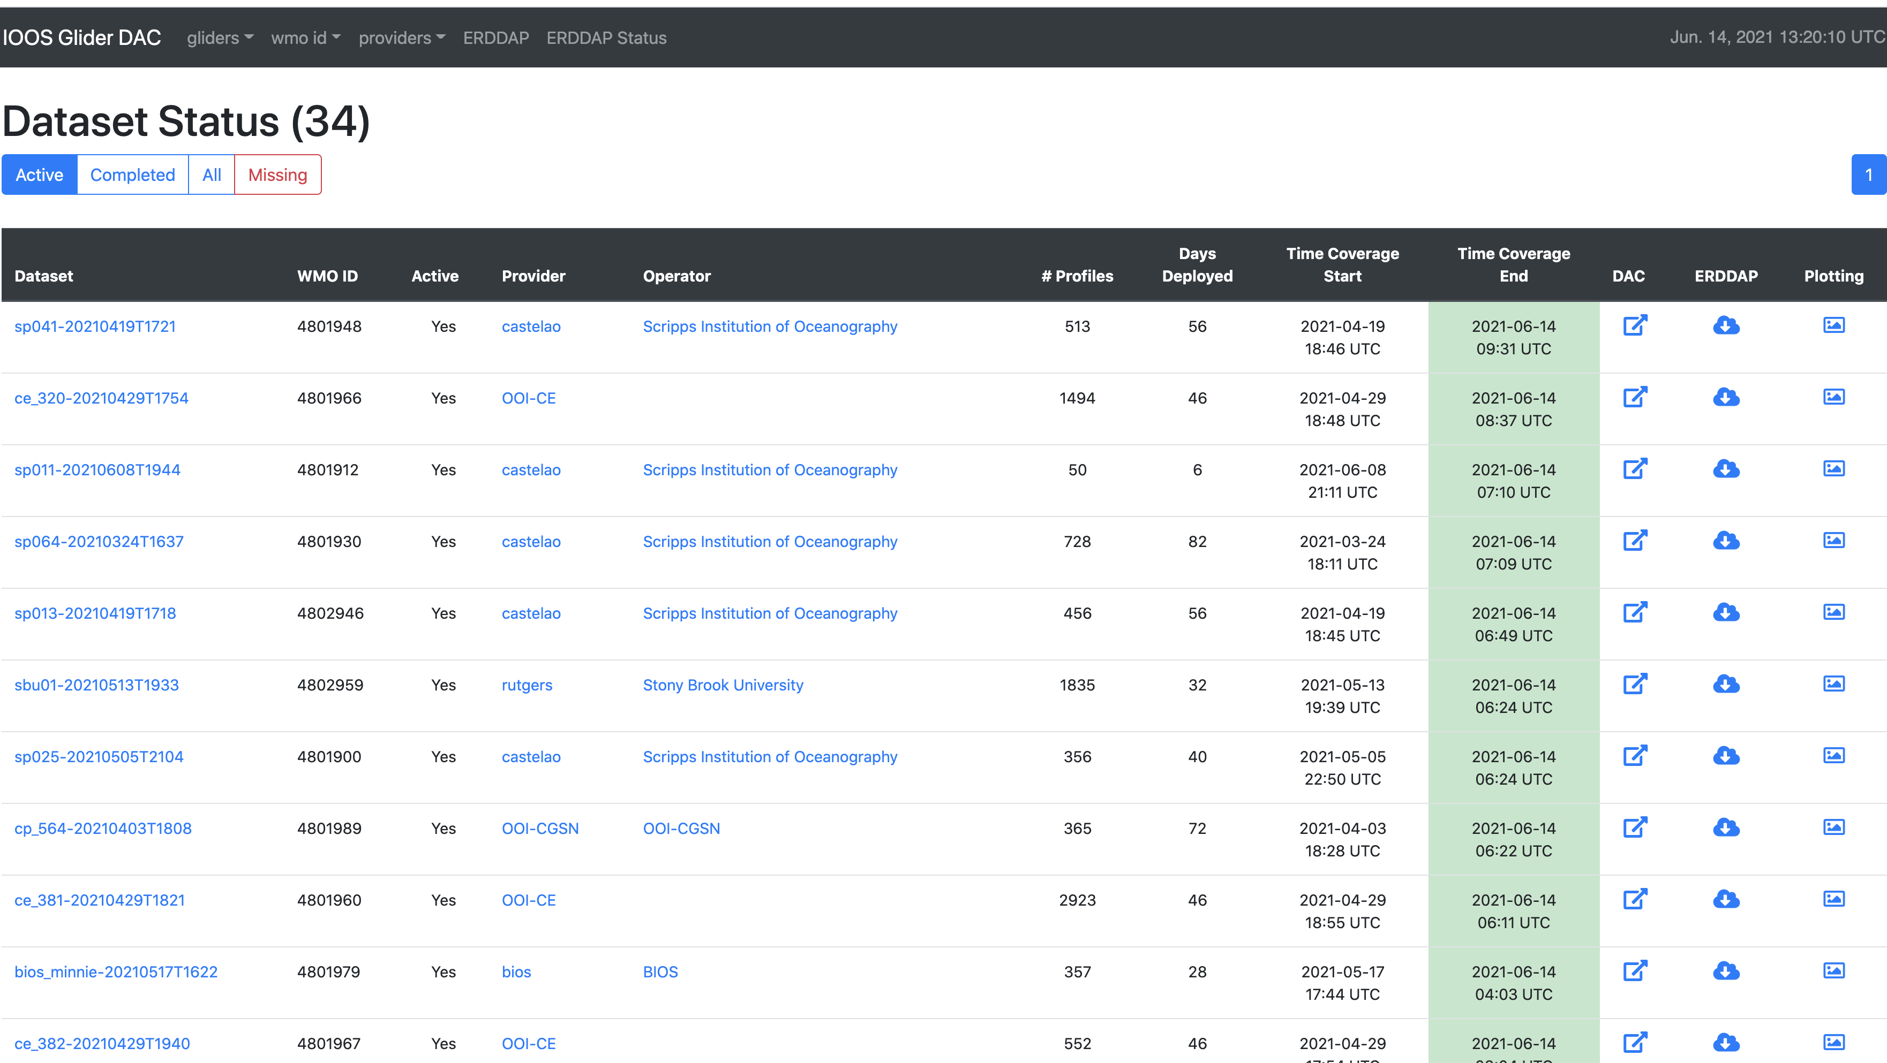
Real-Time Fleet Status

Slide 10
Individual Data Set Status

Slide 11
GTS Observations

Slide 12
Glider Raw Data Upload Tools
Barriers to Participation
Familiarity with NetCDF
NetCDF standards
CF
ACDD
IOOS Metadata Profile
Varying levels of programming experience
Prototype development based on Slocum Gliders
Seagliders
Spray
Others potentially (SEAEXPLORER, etc.)…

Slide 13
Raw Data Set Configuration & Upload
Currently under development with anticipated prototype release summer 2021
Register deployment and global attributes
Science payload
Serial Number
Type
Calibration Dates
Upload raw data files
Delayed mode
Real-time
Raw files are processed to DAC compliant NetCDFs with QARTOD QC and served via ERDDAP

Slide 14
Consistent Quality Control
Local knowledge QC
Probably better
Inconsistent across data sets
Standardized set of QC tests
increase confidence in the data sets
Provides a mechanism for automated flagging and masking of data prior to GTS release
QARTOD
Sources of regional/seasonal values for QC checks?

Slide 15
QARTOD Glider Tests
Timing/Gap Test (required)
Syntax Test (required)
Location Test (required)
Gross Range Test (required)
Pressure Test (required)
Climatology (Strongly Recommended)
Spikes (Strongly Recommended)
Rate of Change (Strongly Recommended)
Flat line (Strongly Recommended)
Multi-Variate (Suggested)
Attenuated Signal (Suggested)
Previous Profile (Suggested)
TS Curve/Space (Suggested)
Density Inversion (Suggested)

Slide 16
QC Test Application Challenges
20 or more real-time data sets at any given time
1000’s of files per data set
>5 variables that need to be QC’d
6 tests per variable (required and strongly recommended)
Where do the values come from?
Regional
Seasonal
…
Currently working on efficient implementation approaches for implementation Summer 2021

Slide 17
Thanks!

