Slide 1
The Distribution Mapping and Analysis Portal (DisMAP)
Melissa Karp
ECS tech, in support of, NMFS Office of Science & Technology
melissa.karp@noaa.gov

Slide 2
The Motivation For DisMAP
Notes:
The changes being observed in the oceans are familiar to us all, from increasing temperatures, to higher frequency of extreme events (such as marine heatwaves), to ocean acidification…..

Slide 3
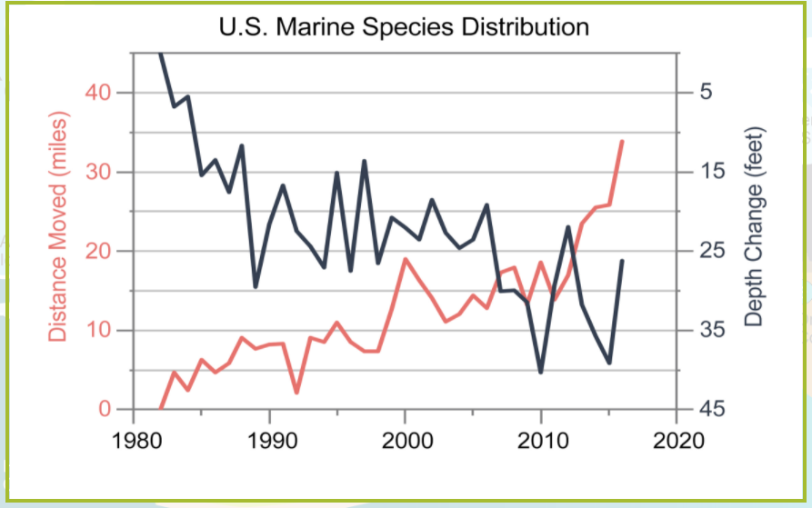
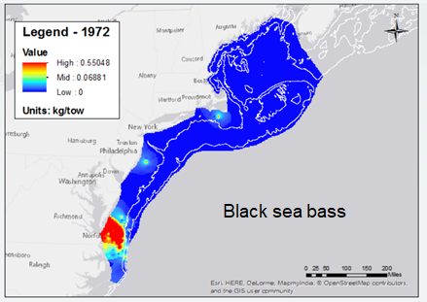
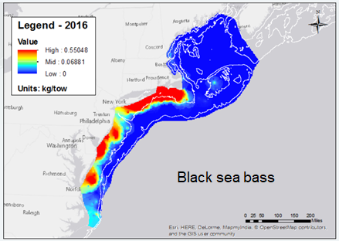
The Motivation For DisMAP
Increasing interest in and need to understand species responses, in terms of their distributions and abundance, to changing environmental conditions
Understanding the factors which govern a species distribution and abundance is one of the main goal of the study of ecology
Species distribution information is also important for government agencies and industry seeking to make decisions about ocean management (e.g. marine spatial planning), natural resource management, and biodiversity conservation
Source: US NCA4
Source: OceanAdapt (https://oceanadapt.rutgers.edu/)
Notes:
Increasing concerns regarding how those changes are and will impact fisheries -- As the oceans become warmer, species may adapt by shifting away from areas that have become too hot, into areas that were previously colder, in order to remain in their preferred env conditions (this often involves moving northward or deeper). And, we are already seeing these changes in species distributions in response to changing ocean conditions…. We can see this in the graph shown here taken from the 4th National Climate Assessment, showing on average US species moving north and deeper; Additionally, this can be seen in distribution maps as shown here, for the distribution of Black sea bass in 1972 vs. 2016. I will note, that ocean temperature is not the only factor that can cause a species to shift its distribution out of or into new areas; other factors such as hypoxia or ocean acidification among other factors, can make an area unsuitable for a species, and cause a shift to more suitable habitats as well.
Understanding factors that govern changes in species distributions is important to the study of ecology, but these changes also have implications for management and industry seeking to make decisions about ocean management (e.g. marine spatial planning), natural resource management, and biodiversity conservation. There is a high and growing demand for species distribution information for use in fishery science and management and other ocean use decision-making

Slide 4
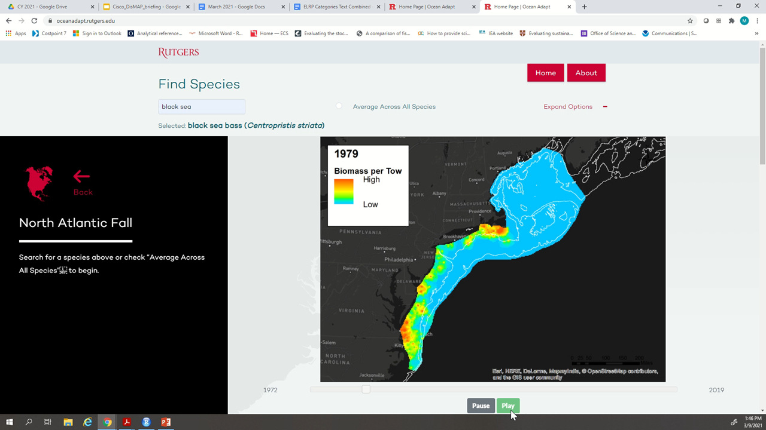
Successful Pilot: Ocean Adapt
Successful collaboration between NMFS and Rutgers since 2015.
Provides 50 years of biomass distributions for 700+ species in US and Canadian waters.
Provides projections of future distributions under climate change for @ 300 species.
Updated annually from NMFS and DFO trawl surveys.
NMFS Assessment:
Limited platform
Growing demands
Recommendation to develop next generation portal
Notes:
DisMAP will be building off of a previous effort called Ocean Adapt which was launched back in 2015 as an initial effort to begin to meet these needs through development of a webportal in partnership with Rutgers University.
Ocean Adapt successfully provided the first easy access to information on changes in the distributions of 700+ US and Canadian marine species over the past 50 years based on NMFS and DFO trawl survey data. However, by 2018 it was clear that the initial OceanAdapt website was not sufficient to meet the high and growing demand for information and the types of information and analysis/interactivity people were looking for.

Slide 5
The NMFS Distribution Mapping and Analysis Portal (DisMAP)
DisMAP is: A national online portal providing visualization and analysis tools to allow users to view, download, and dynamically interact with data to track and understand past and projected future distributions of marine species
DisMAP will:
Provide access to marine species distribution data and models across biogeographic and jurisdictional boundaries.
Provide consistent nationwide tracking and analysis of species distributions.
Support research and development to advance the field of species distribution modeling.
Leverage and amplify investments and efforts.

Slide 6
The NMFS Distribution Mapping and Analysis Portal (DisMAP)
DisMAP will have four modules where users can interact with and explore the distribution data in different ways:
Single Species Distributions
Explore visual and numerical representation of several key metrics that define a species range and distribution and how they have or are projected to change over time.
Multispecies Overlap & Interactions
Explore species interactions, such as area or range overlap, within an area of interest and evaluate how those interactions have or may change over time.
Species Shifts & Human Interactions
Examine how availability of different fish species has or is projected to change under future conditions for different ports
Regional Summary
Explore how communities have changed at the regional level (e.g. species richness and diversity), and quickly view changes in key distribution metrics across all species in a region at one time.

Slide 7
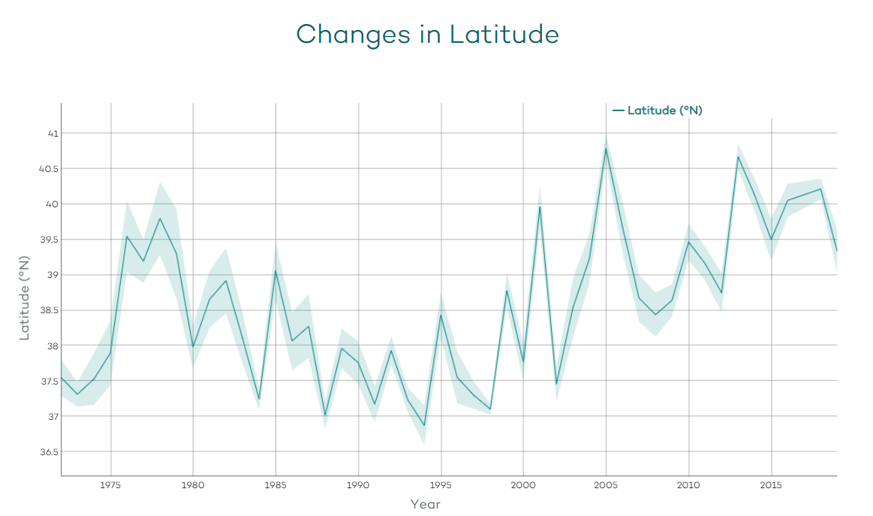
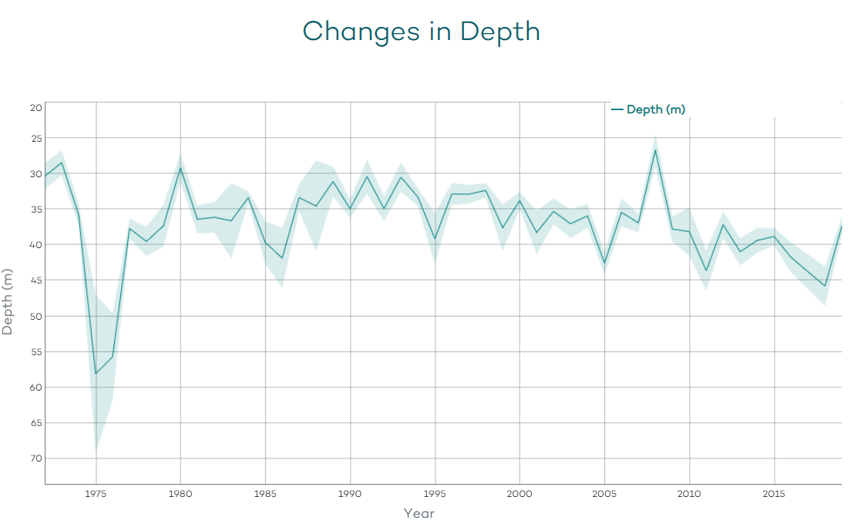
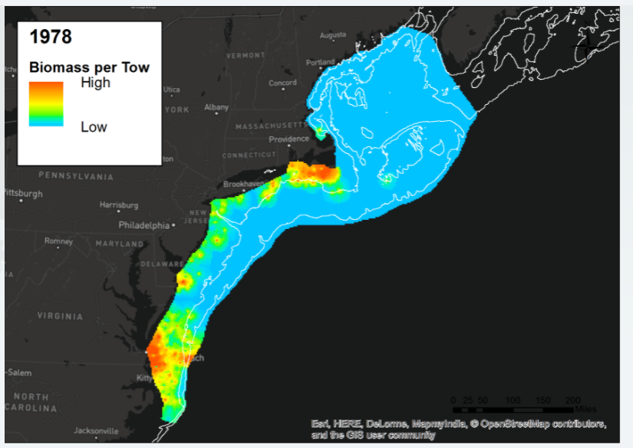
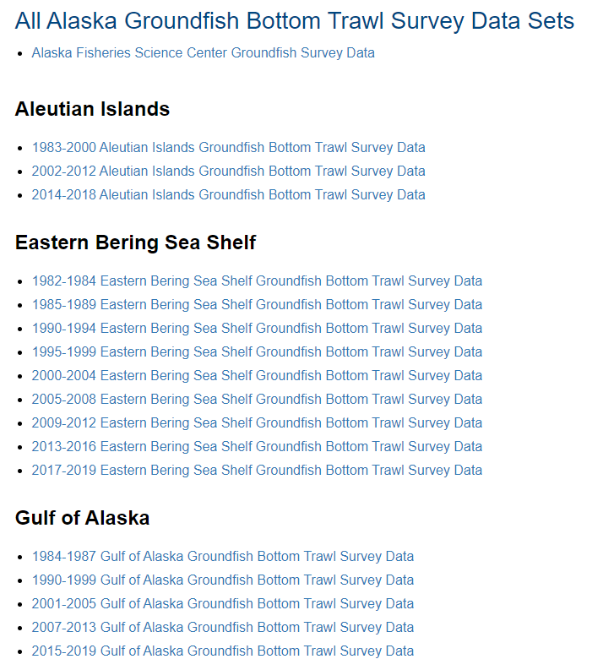
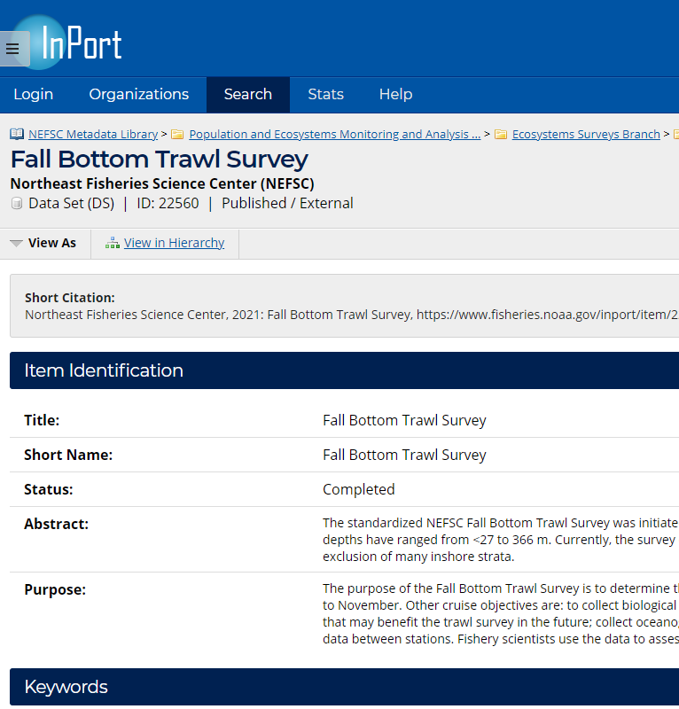
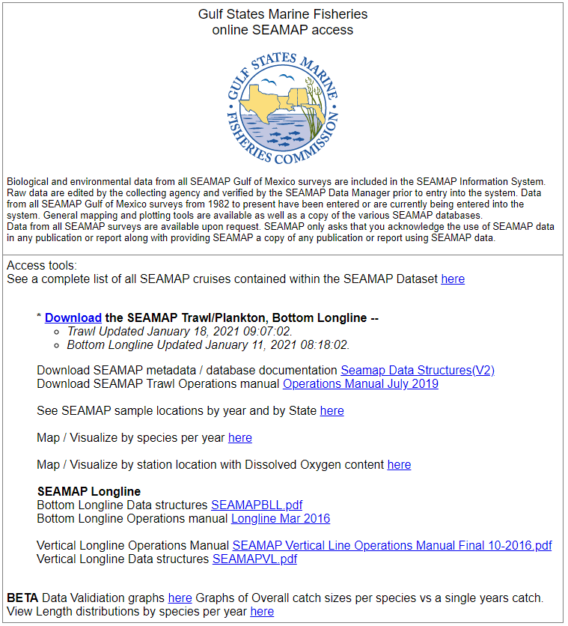
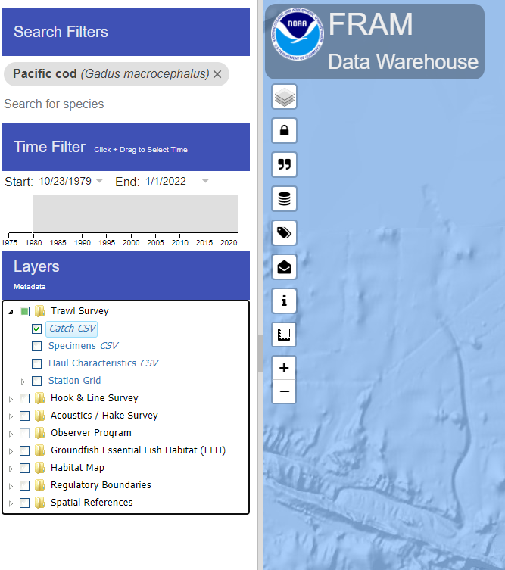
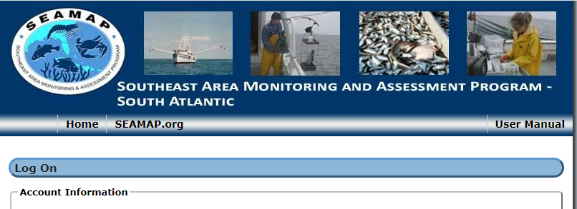
Back-end: Data Compilation & Processing
Step 1: Download Raw bottom trawl survey data from regional databases
Step 2: clean, standardize, and compile data using R script
Step 3: Run the standardized processed data through a python script to generate Interpolated biomass raster layers and calculate distribution metrics from that distribution surface
Notes:
Some backend data management is needed to run routines that standardize regional survey data and generate imagery data sets that will be uploaded to the NOAA GeoPlatform. R and Python will be the primary languages used for this backend processing.
Interpolation Procedure
inverse-distance weighting
interpolation only within survey domains
5 year window of data used, with data from mapped year having greatest weight
All distribution and area metrics calculated from these interpolated biomass layers

Slide 8
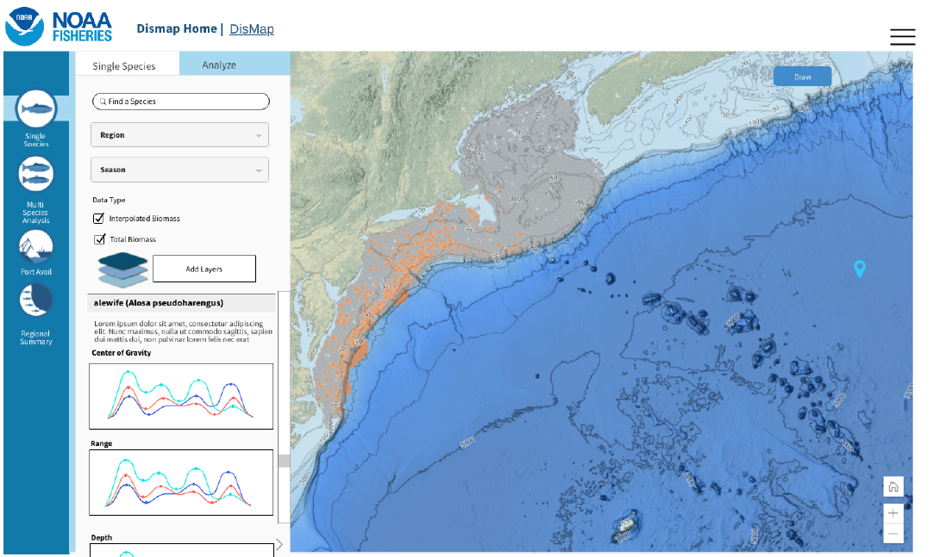
Key Features of DisMAP beta
Single Species Distribution Shifts
Species distribution information:
Distribution surface
Raw survey wtcpue (bubble plot)
Time-series graphs of:
latitudinal center of biomass & range limits
depth center of biomass
effective area occupied
core habitat area
Area overlap Analysis
time-series graphs of
proportion of species distribution covered by an area of interest
proportion of area of interest covered by species
Data Source: NMFS Fishery-independent Bottom Trawl Surveys
Notes:
“center of biomass” - biomass weighted center of a species distribution ;;; if a species moves north, or deeper, then its center of biomass will also move northwards or deeper…. good indicator of a shift in a species distribution …. However, it doesn’t tell the whole story, and therefore we will also provide time series information of a species ‘area occupied’. Combined with COB this will help determine if a species is shifting, expanding, or contracting its distribution.

Slide 9
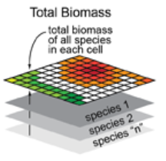
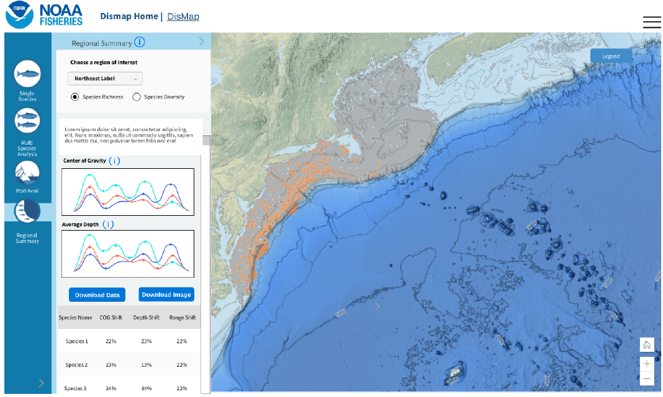
Key Features of DisMAP beta
Regional Summary Module
Species Richness
total # of species found (interpolated wtcpue >0) in each cell
Species richness & diversity as layers on map
Time-series graphs of latitudinal COB and depth COB averaged across all species in region
Table showing change in COG, depth, and area occupied for species in region
image modified from Northeast Ocean Data Portal

Slide 10
Front-end: Data Management
The NOAA GeoPlatform (ArcGIS Online) will be used to store and access processed DisMAP data, including:
Imagery layers to provide access to gridded data: interpolated species biomass, species richness, and species diversity
Hosted feature layers to provide access to survey observation points, with one service per data series.
Area layers, to be used for general orientation and focused analysis (e.g. area overlap analysis)
Jurisdictional Authority & Allocation Areas
Fishery Management Areas
Ecological Production Units (EPUs)
Marine Protected Areas
Oceanographic & Habitat Conditions layers
Sea Surface Temperature
Ocean Acidification layers??
Tabular data that supports the application:
Indicators - year-based indicators calculated for each species within a data series. The indicator tables will provide data for graphs in the application.
Center of Gravity (COG)
Area Occupied
Depth

Slide 11
Planned for Future Releases
Multispecies Overlap & Interactions and Species Shifts & Human Interactions
Pulling in statistical SDM output developed by Science Center Staff and Partners
Other survey data sources
Additional layers to include on map (e.g. environmental conditions (sst, salinity, Ocean acidification?), protected areas, Others? )

Slide 12
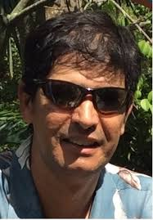
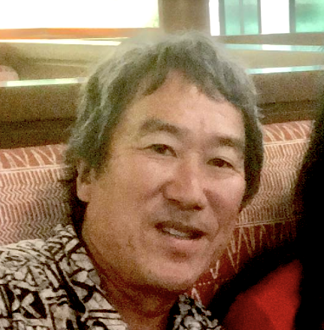
Steering Committee
Melissa Karp
NMFS OST - ST4
Project Manager
Roger Griffis
NMFS OST - ST7
Jay Peterson
NMFS OST - ST7
Patrick Lynch
NMFS OST - ST4
Corrine Bassin
NMFS OST - ST4
Mike Lewis
NMFS OST - ST1
Wendy Morrison
NMFS OSF
Hassan Moustahfid
IOOS
Jim Thorson
AFSC
Kevin Craig
SEFSC
Scott Large
NEFSC
Elliott Hazen
SWFSC
Isaac Kaplan
NWFSC
Don Kobayashi
PIFSC
Phoebe Woodworth-Jeffcoats
PIFSC
Notes:
We stood a national working group m is comprised of representatives from each of the FSC, OSF, OST, and IOOS. Over the last 2 years the group has worked to ID key needs and develop a proposal for a ‘next generation tool’ to provide access to species distribution information nationally, and also improve community of practice wrt SDM modelling nationally. Now we are in early stages of development to implement and build the portal outlined in our proposal.

Slide 13
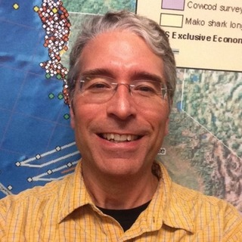
Development Team
Melissa Karp
NMFS OST - ST4
Project Manager
Kristan Blackhart
NMFS OST - ST4
Scott Sauri
NMFS OST - ST6
Tim Haverland
NMFS OST - ST6
John Kennedy
NMFS OST - ST6
Roger Griffis
NMFS OST - ST7
Patrick Lynch
NMFS OST - ST4
Elizabeth Chilton
NMFS OST - ST4
Dan Forrest
Rutgers – Ocean Adapt

Slide 14
QUESTIONS
Notes:
The NMFS Emblem is the key to a stronger brand.

