Slide 1
IOOS ERDDAP Implementation:
GTS and Sensor Map
DMAC Annual Meeting 2021
Presented By: Micah Wengren, Shane St Savage
Project Team:
Kathy Bailey, Tiffany Vance (IOOS)
Dawn Petraitis, Bill C. Smith, Kevin Kern (NDBC)
Stacey Buckelew, Shane St Savage, Jessica Austin* (Axiom)
Kevin O’Brien (OAR/PMEL)
The IOOS RA Data Managers

Slide 2
IOOS ERDDAP Implementation Project
Goals:
RA ERDDAP servers become the primary data dissemination services for IOOS’ regional in situ ocean observations (replacing SOS)
RAs real-time ERDDAP datasets are ingested by NDBC to publish to GTS and by Axiom to publish to IOOS Sensor Map
IOOS Metadata Profile 1.2 published to ensure dataset consistency
Compliance Checker updated to test for IOOS 1.2 compliance
RAs become a critical link in publishing PI/partner data to national/international data stores as NOAA certified regional data aggregators
Timeline:
Full ERDDAP GTS transition for all IOOS RAs by Q4 FY21
IOOS Sensor Map ingesting ERDDAP data from 8 IOOS RAs by Q4 FY21
The finish line is near, but we need your help!

Slide 3
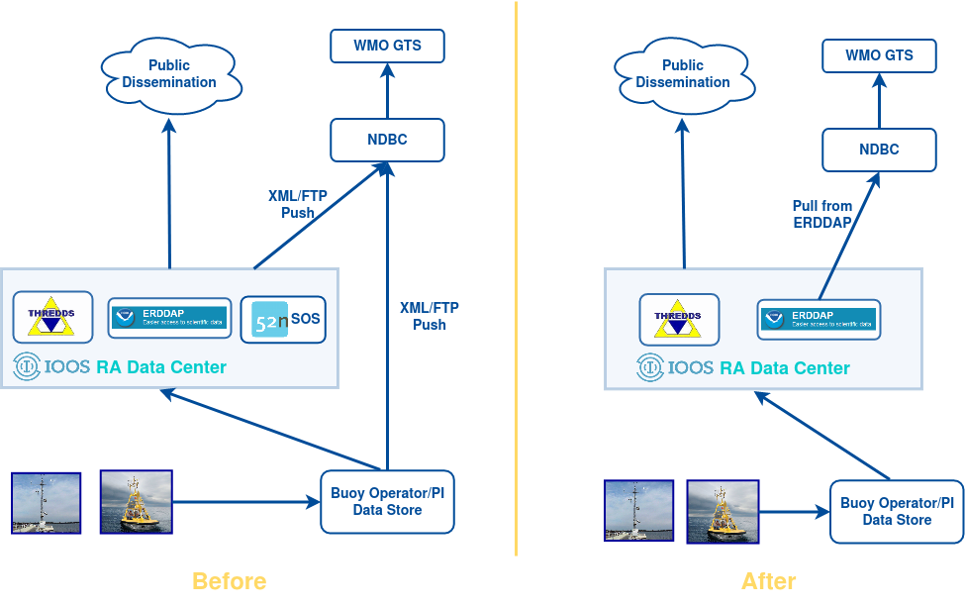
ERDDAP and NDBC/GTS Architecture Evolution

Slide 4
NDBC GTS Transition Status
Overall Transition Status:
Transition Timeline:*
Completed | In Transition | Remaining
PacIOOS | SECOORA | GLOS
CeNCOOS | NANOOS | NERACOOS
GCOOS |  | CARICOOS
N/A
AOOS (CDIP)
SCCOOS (CDIP)
MARACOOS
NANOOS | July/August
SECOORA | TBD
GLOS | TBD
NERACOOS | TDB
CARICOOS | TDB
* GTS transition goal of Q4 FY21 will likely extend to early FY22
Plan remains to transition from legacy XML/FTP for all IOOS RAs ASAP
Remaining RAs, please update your ERDDAP datasets to IOOS 1.2 to be ready to test ingest!
N/A: RAs that either submit data to NDBC exclusively via CDIP or do not submit any real-time data to NDBC/GTS

Slide 5
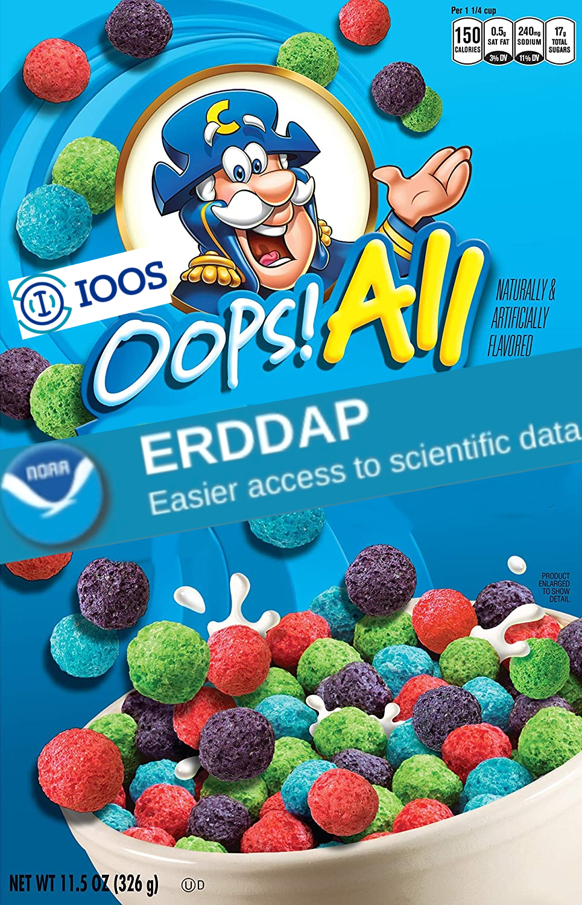
Sensor Map ERDDAP Implementation
Plans/Goals:
Sensor Map will discover RA real-time in situ ERDDAP datasets from IOOS Catalog inventory and harvest directly from RA ERDDAPs
IOOS Metadata Profile 1.2 compliant
Harvesting of RA SOS services and other sources will be replaced by ERDDAP
Harvest information and station metadata will be available in a dashboard
Data flow from RAs to Sensor Map will be simplified and more easily controlled

Slide 6
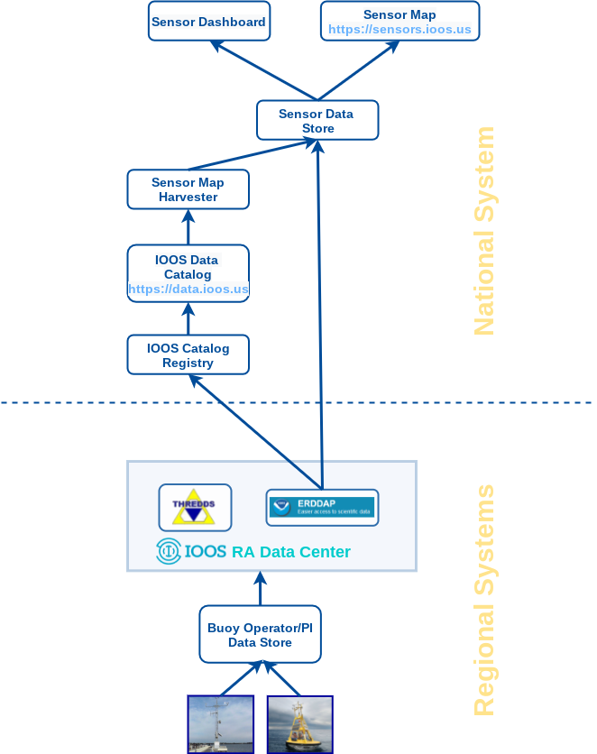
Sensor Map/Catalog/ERDDAP Architecture

Slide 7
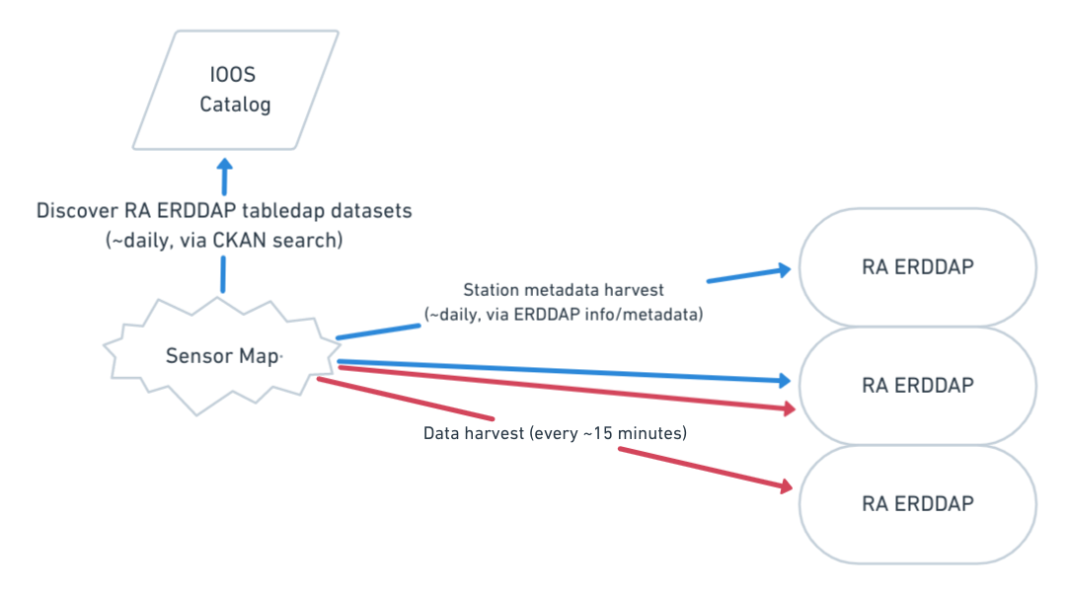
Sensor Map/Catalog/ERDDAP Architecture

Slide 8
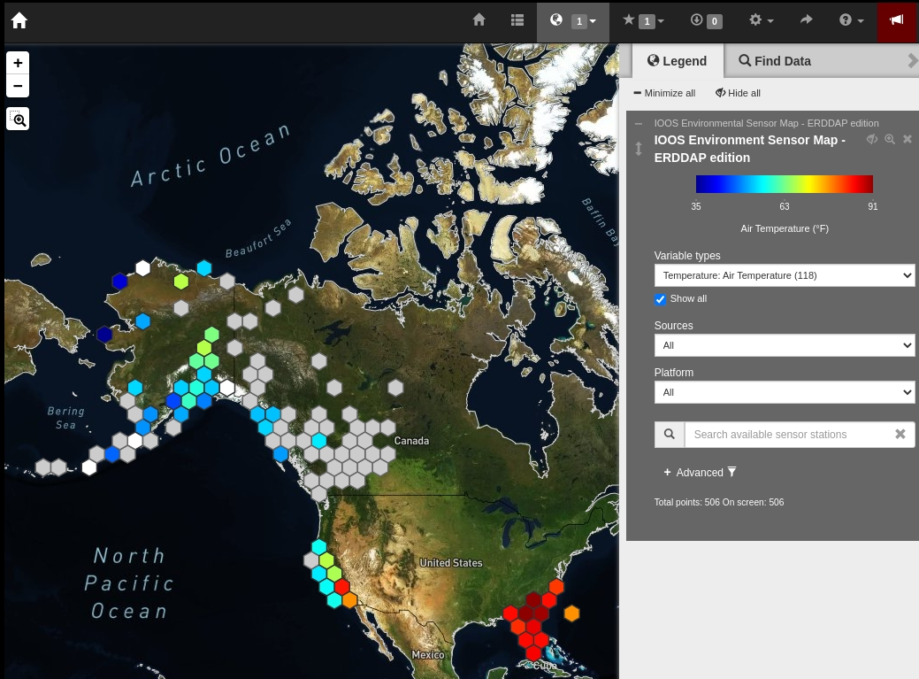
its_happening.gif

Slide 9
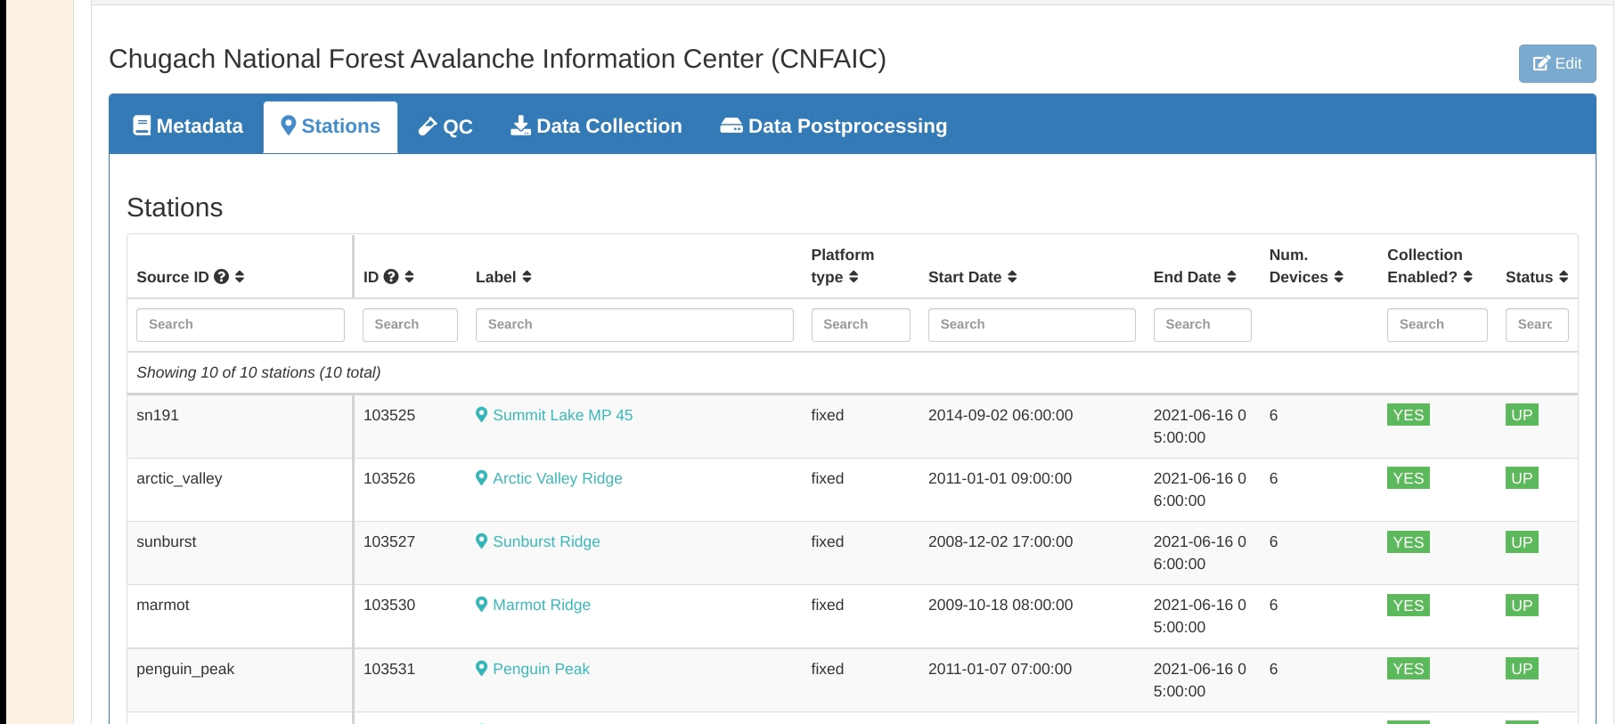
Dashboard - Stations

Slide 10
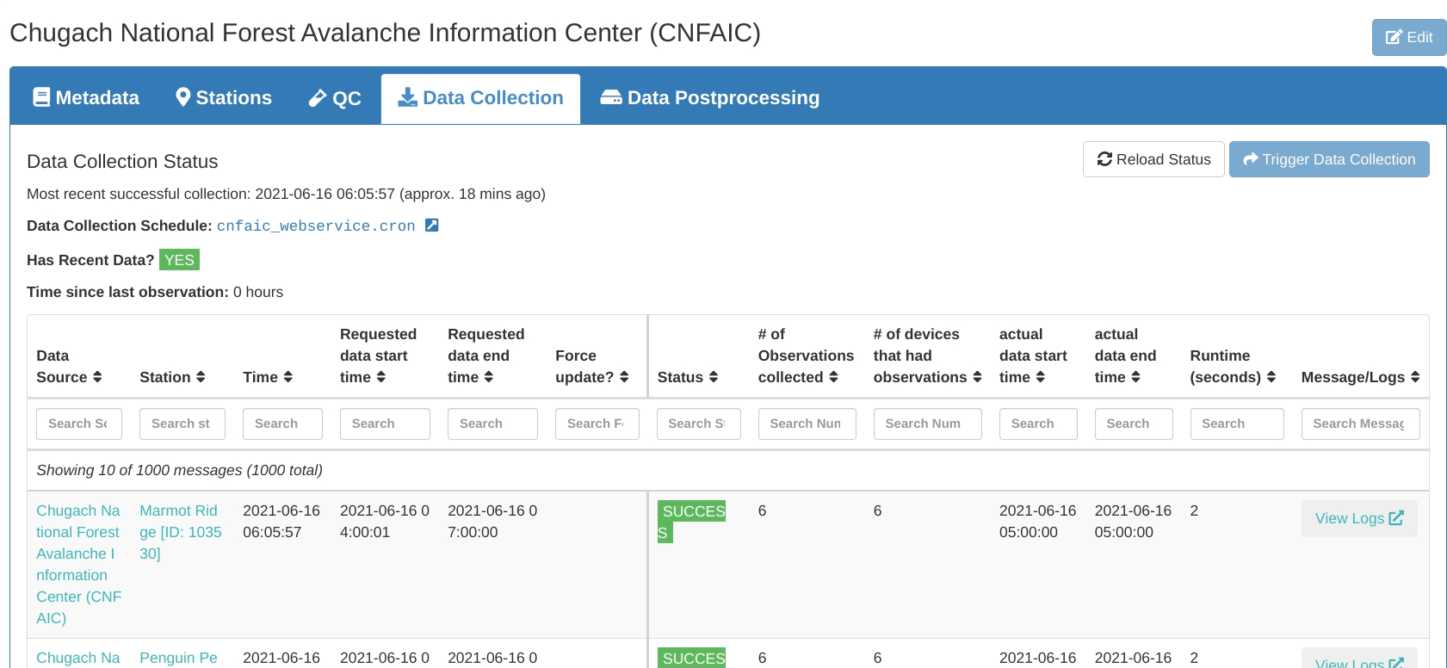
Dashboard - Data Collection

Slide 11
Implementation Notes
TODO
Import QC data variables as QC flags
Review/UAT
Add RA ERDDAPs
Add ingest logs to dashboard
Compliance Checker
CC is a very useful tool for evaluating dataset metadata robustness, but it does not provide a pass/fail result for compliance
CC is not run against datasets during Sensor Map ingestion, but would be useful in evaluating why a dataset might be failing to be ingested

Slide 12
Rollout Plans
Goal: Sensor Map harvests data from 8 RAs’ ERDDAPS by Q4 FY21
Four managed by Axiom
AOOS, CeNCOOS, SECOORA online
SCCOOS in progress
Two on deck
PacIOOS
GCOOS
Rumored to have ready datasets
NANOOS
MARACOOS
Others
GLOS? (Seagull)

Slide 13
SEE YOU SOON!

Slide 14
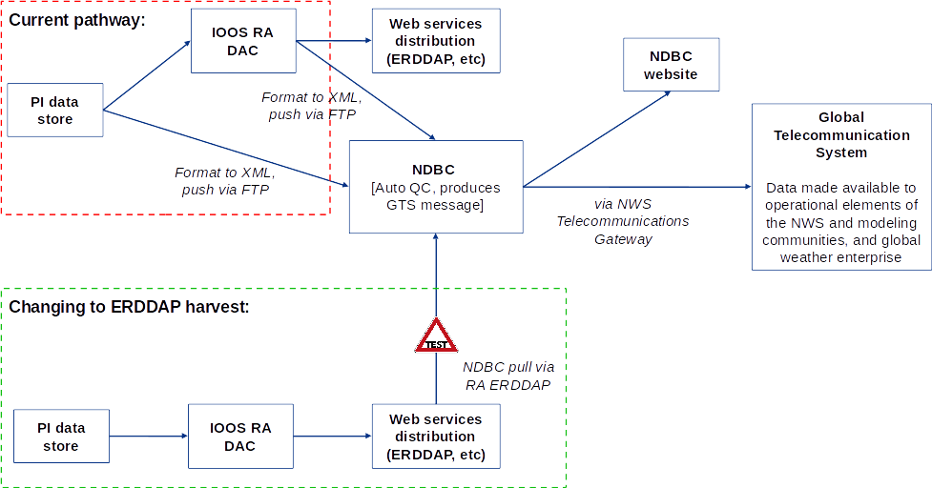
ERDDAP Transition - NDBC GTS Data Flow

