Slide 1
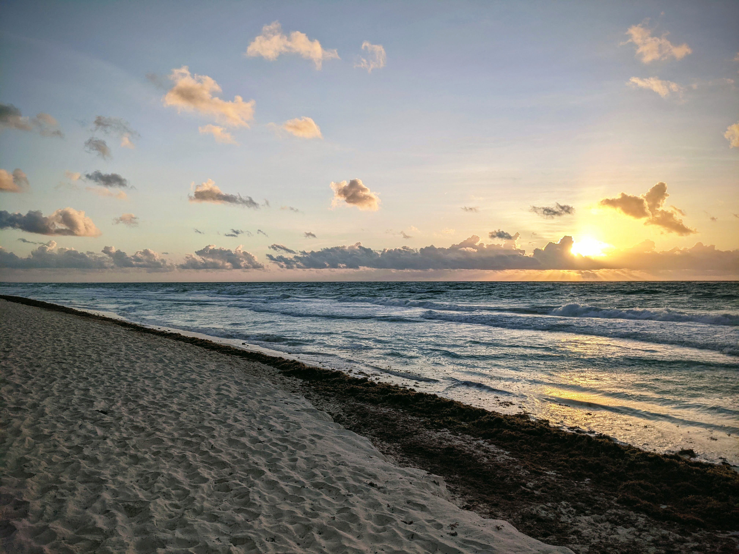
ESIP Biological Data Standards Cluster
Lead: Abby Benson (USGS)
Co-leads:
Diana LaScala-Gruenewald (MBARI, CeNCOOS)
Robert McGuinn (NOAA Affiliate) Erin Satterthwaite (UCSD, CA Sea Grant)

Slide 2
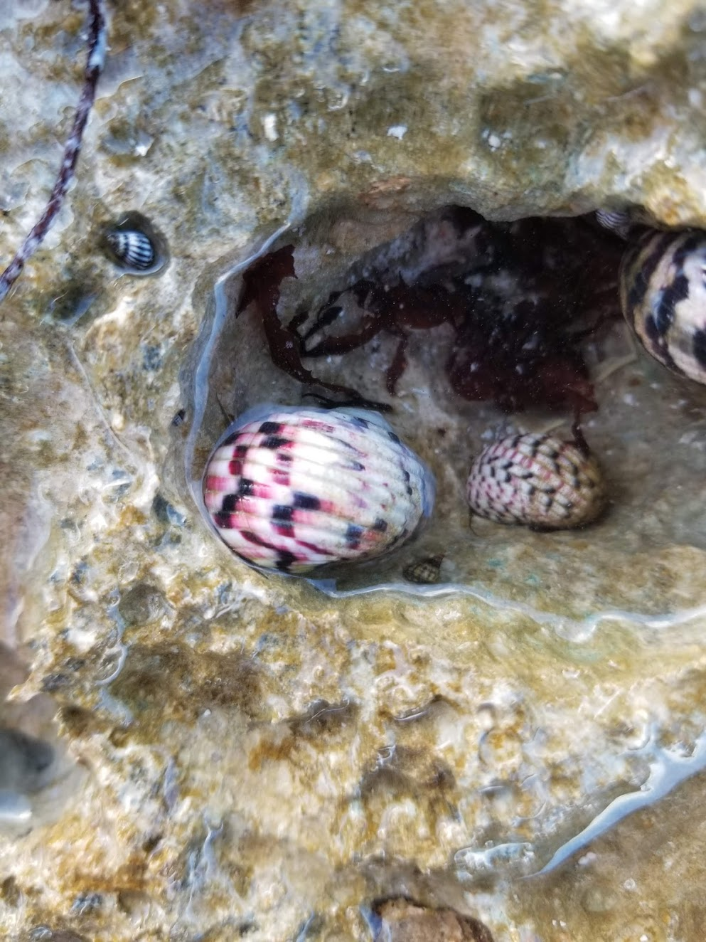
Integrated Ocean Observing System (IOOS) - Earth Science Information Partners (ESIP) Biological Data Standards Workshop
We brought together over 90 participants to discuss biological data standards, mostly as they relate to marine biological data, and discussed challenges, connections, and opportunities. Our primary goal was to build a community of practice around advancing standards and recommended practices within the biological data management community. Over the course of the workshop some themes began to emerge:
Themes
Vocabularies / Ontologies
Taxonomy (as related to standardized names and persistent identifiers)
Biological Data Lifecycle (Protocols, Provenance, Metadata, Discovery and Access)
Integrating Biological Data with Environmental Data
Social / Institutional Issues
Measurements
Crosswalks between standards
Building a Community of Practice

Slide 3
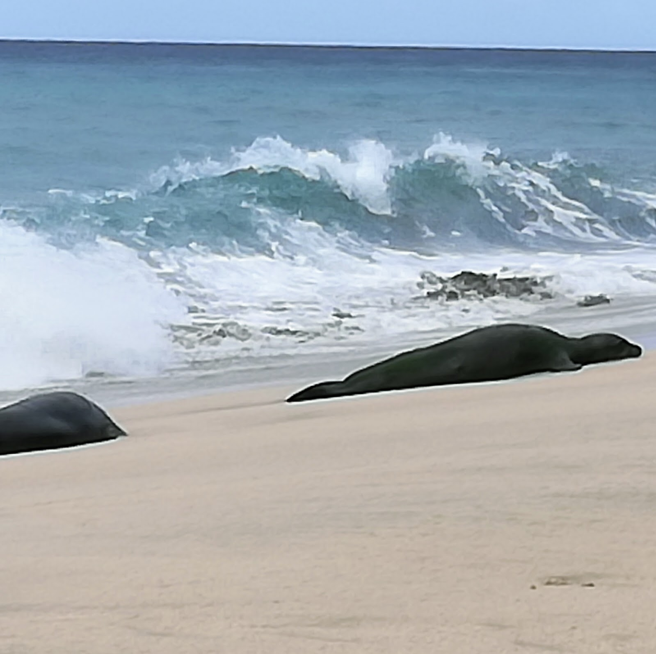
The Problem
“The diversity of biological data, and (seeming) lack of overarching community standards makes working with biological data challenging.” Several standards do exist for biological data, however these different data, metadata, and taxonomic standards are confusing for data managers and data users to navigate. The biological data community in the US could benefit from guidance, best practice documentation, training, and community building.

Slide 4
ESIP Biological Data Standards Cluster Goal
Goal is to maximize data relevance and utility for understanding changes in biodiversity over time

Slide 5
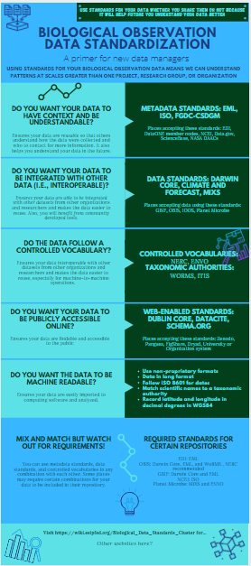
Current work to develop biological data standards primer for data managers
Aim: Assist data managers who are unfamiliar with biological data standards with understanding what’s out there
Audience: data managers tasked with managing biological data
Join our ESIP session Tuesday July 20 at 1100 ET! We would appreciate your feedback.
Join our ESIP cluster- next meeting June 24 at 1300 ET

Slide 6
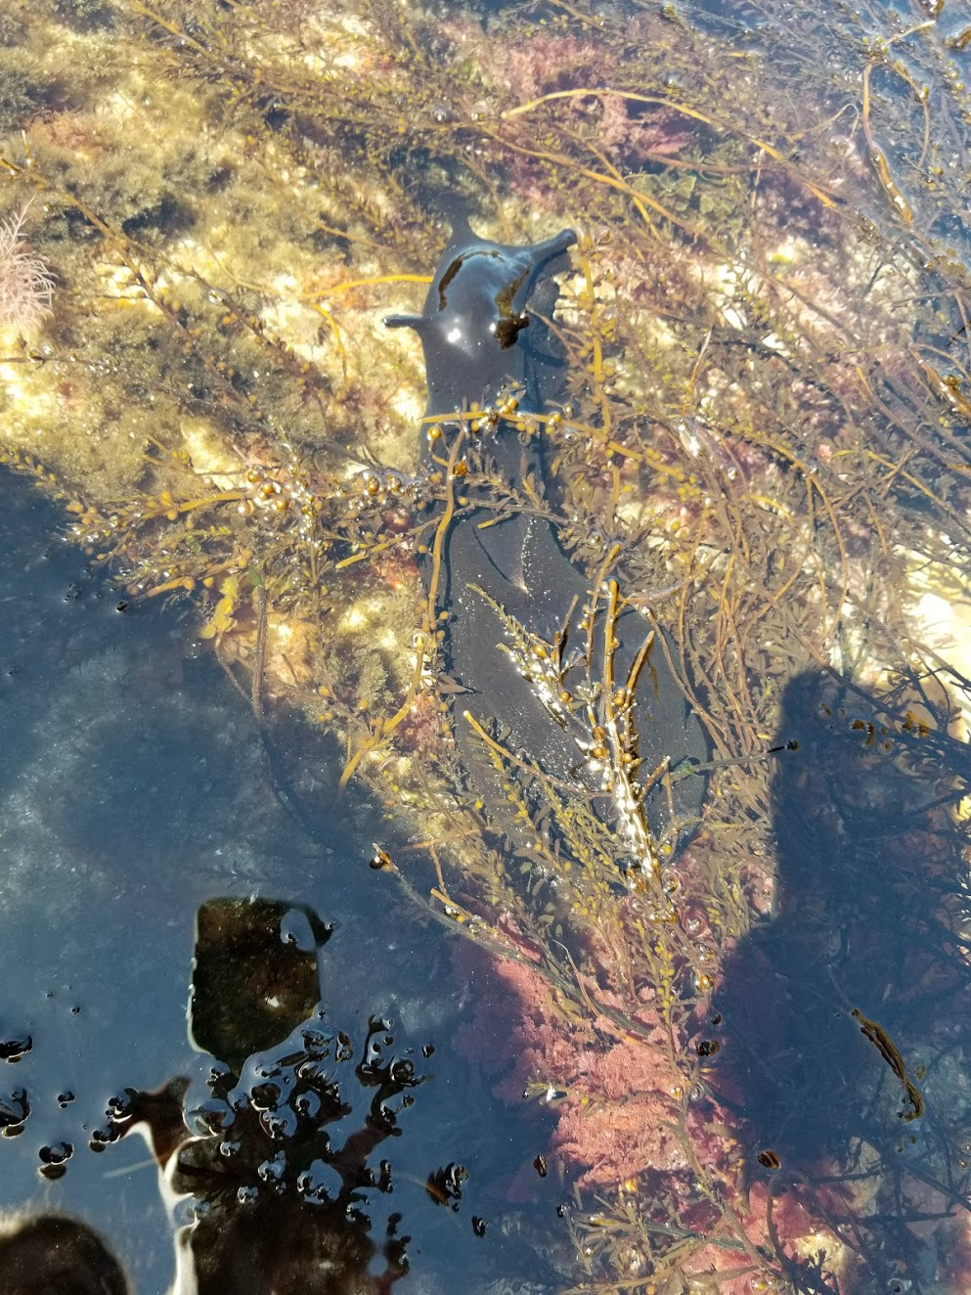
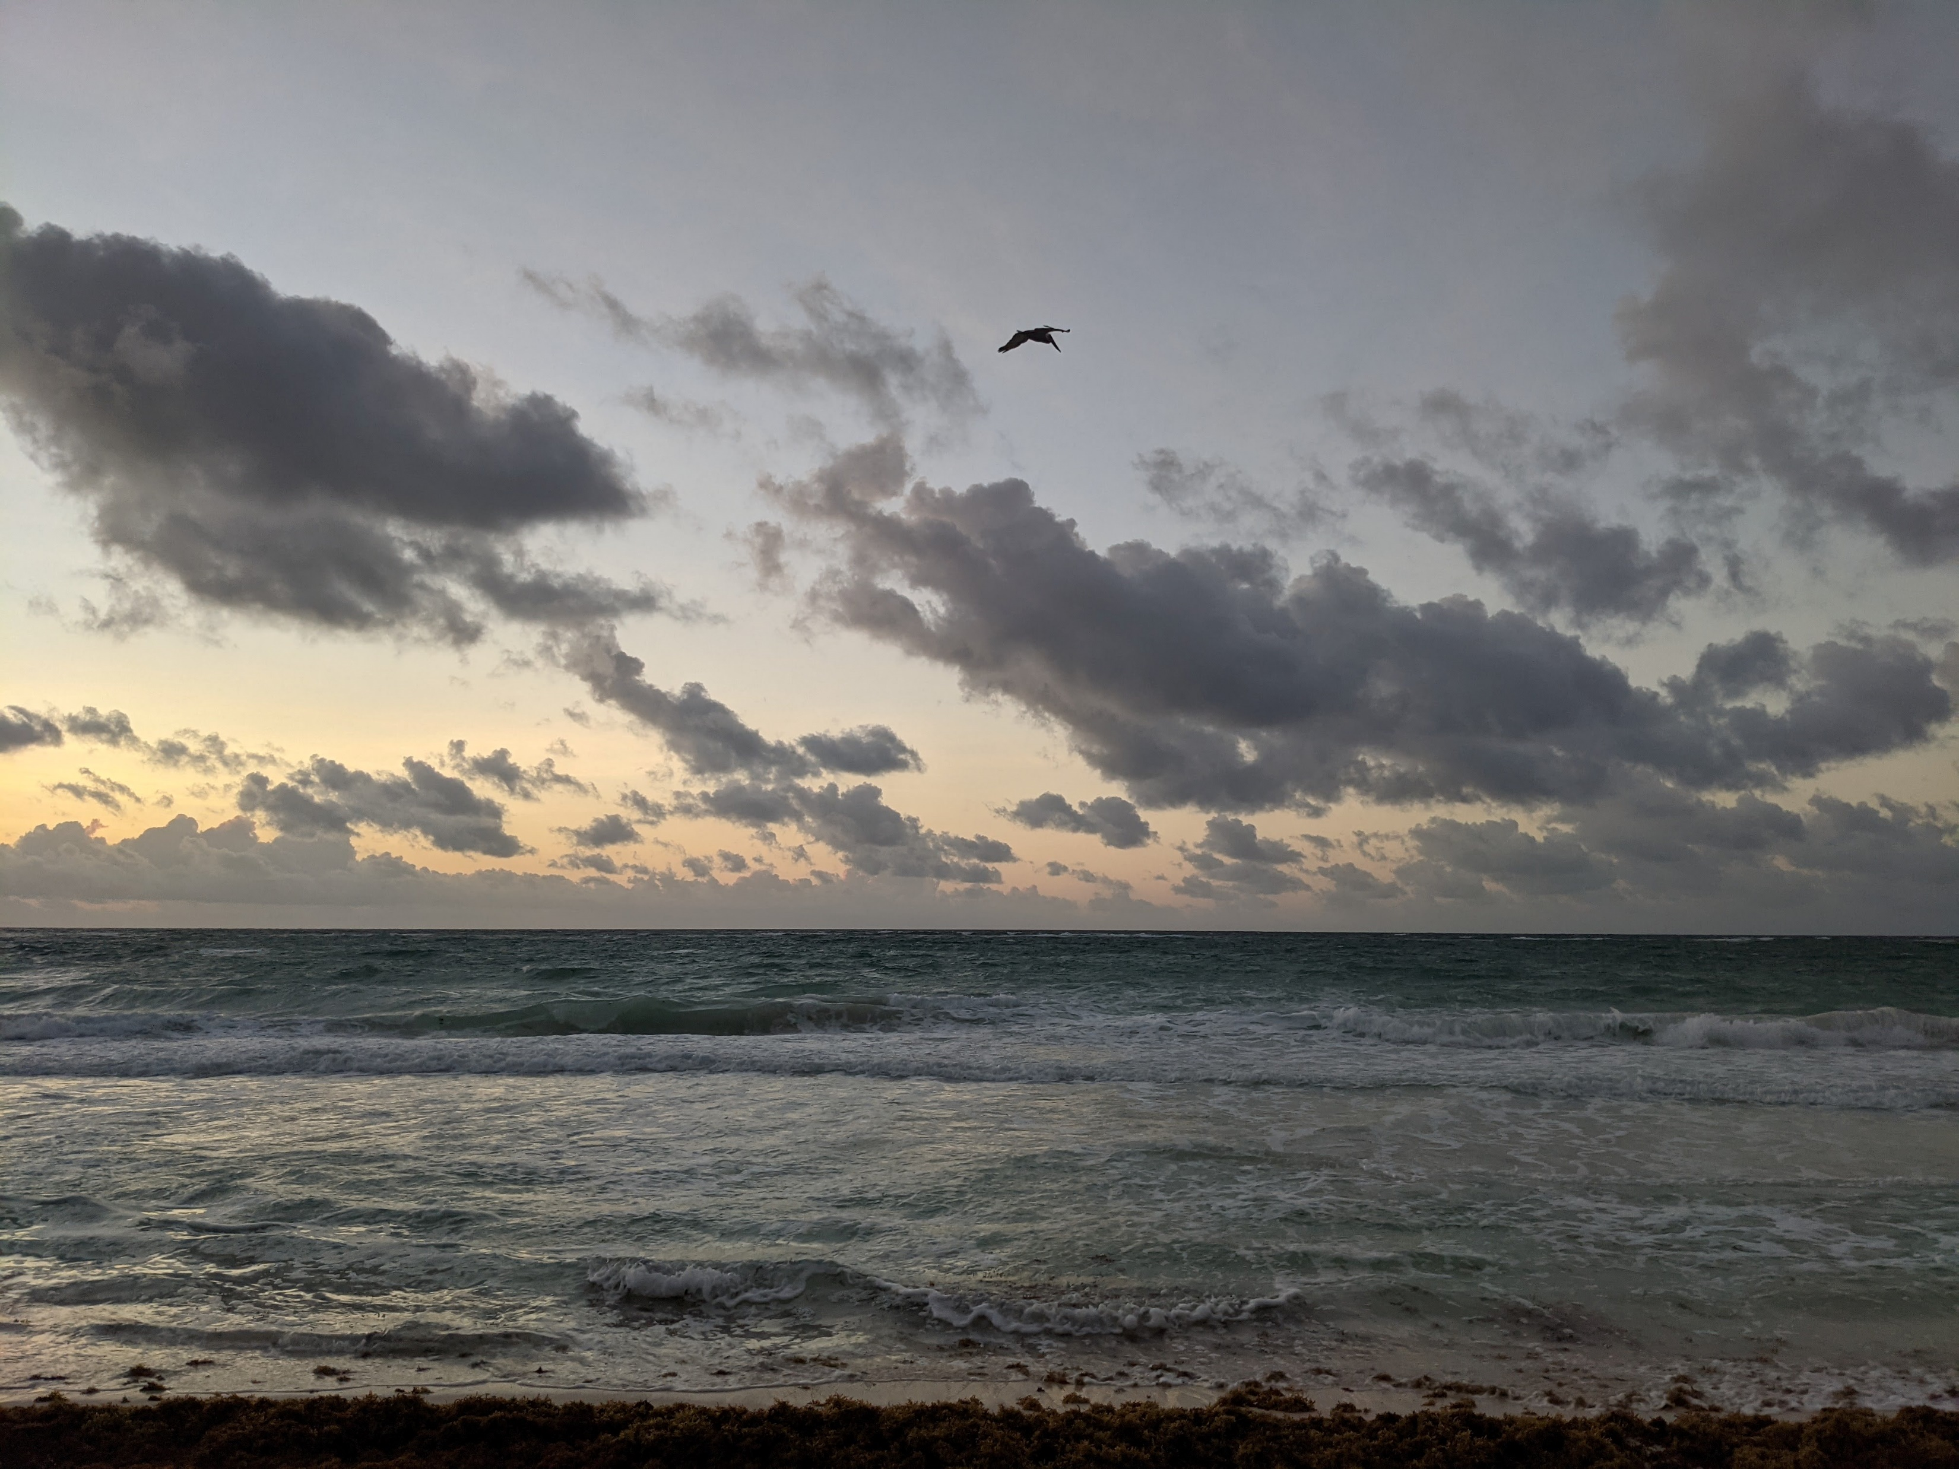
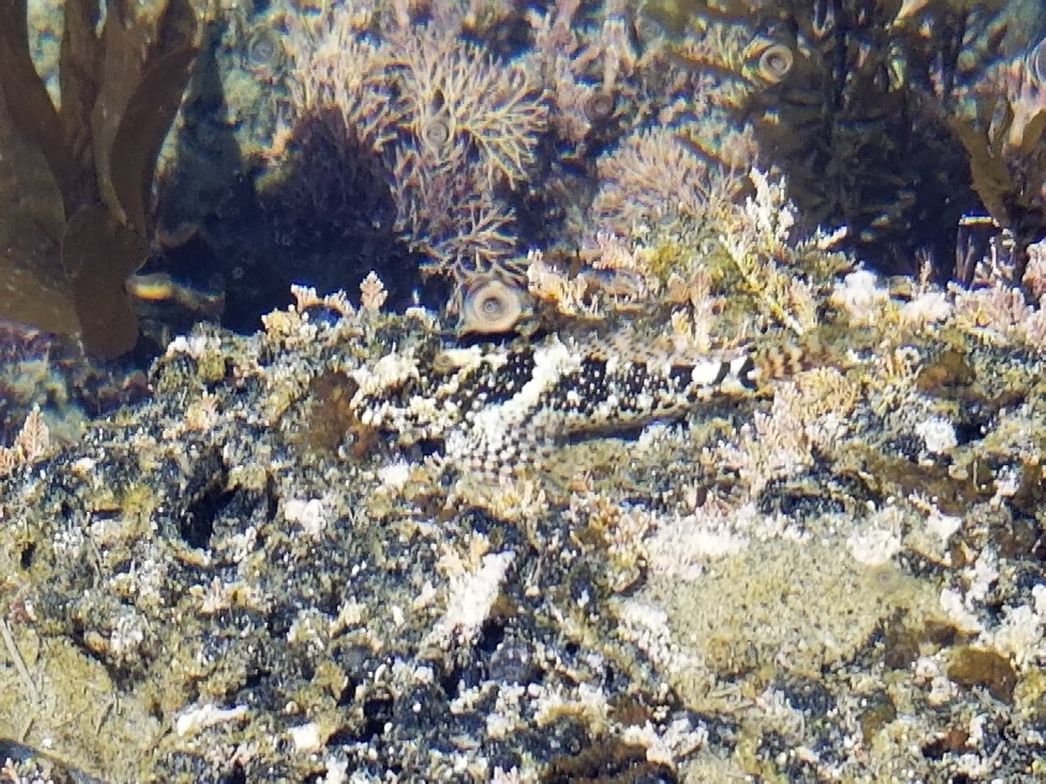
Communication
Monthly meetings
Wiki
Channel in the ESIP Slack
Mailing List

Slide 7
How do all the working groups fit together?
ESIP Biological Data Standards Cluster
Standardizing Marine Biological Data
MBON DMAC

