Slide 1
IOOS 2021 DMAC MEETING
Data Products and Applications
to Meet User Needs
Sylvia Rodríguez-Abudo
and the CARICOOS team
June 15, 2021
CARICOOS
PA’ LA PLAYA
BEACH APP

Slide 2
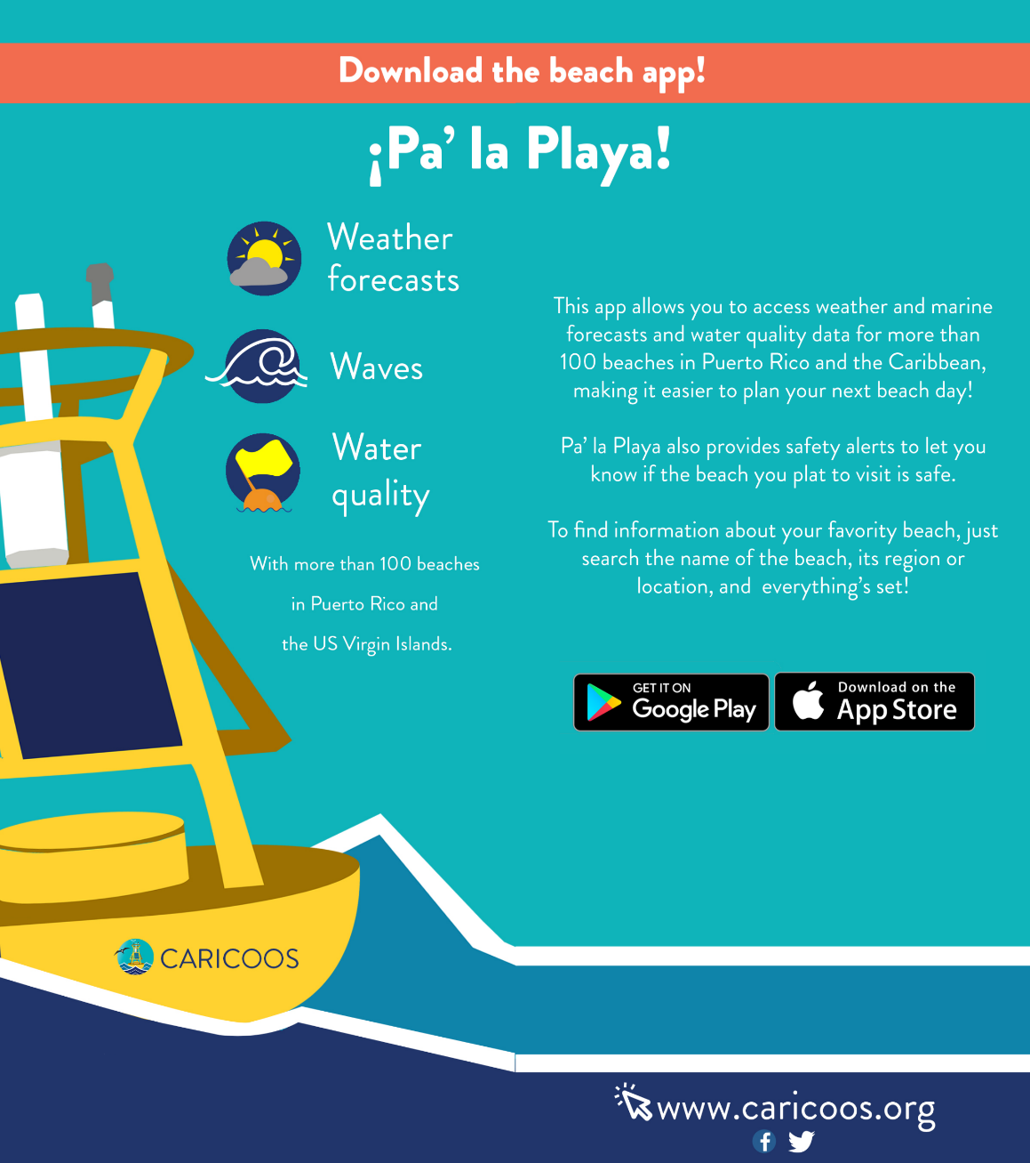
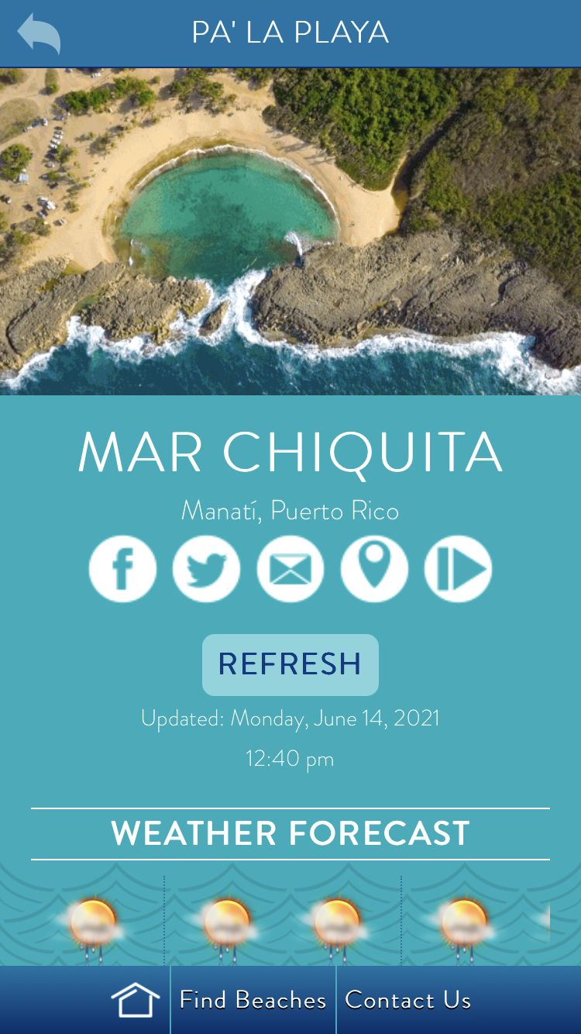
CARICOOS PA’ LA PLAYA
BEACH APP
with NWS ALERTS

Slide 3
THE NEED:
A user-friendly way of delivering data relevant to beachgoers in the Caribbean.
CARICOOS
PA’ LA PLAYA
BEACH APP
THE PROCESS:
Customer discovery
Design (stakeholder involvement)
RFP
Construction
Beta testing
Release

Slide 4
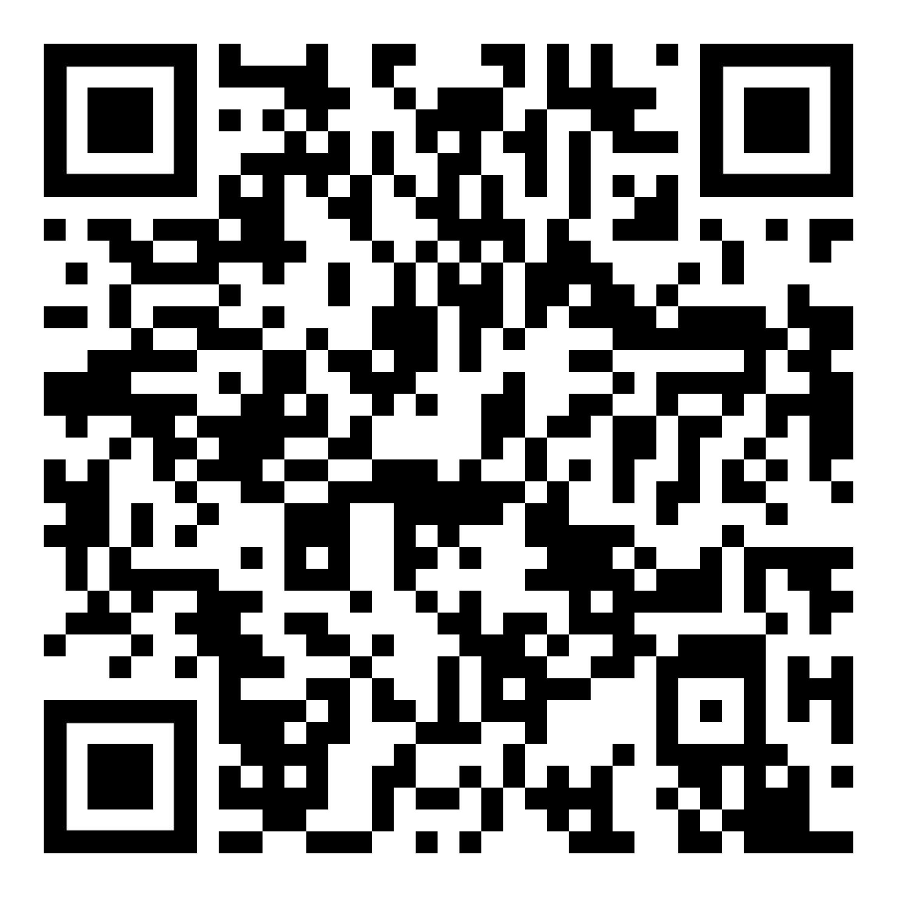
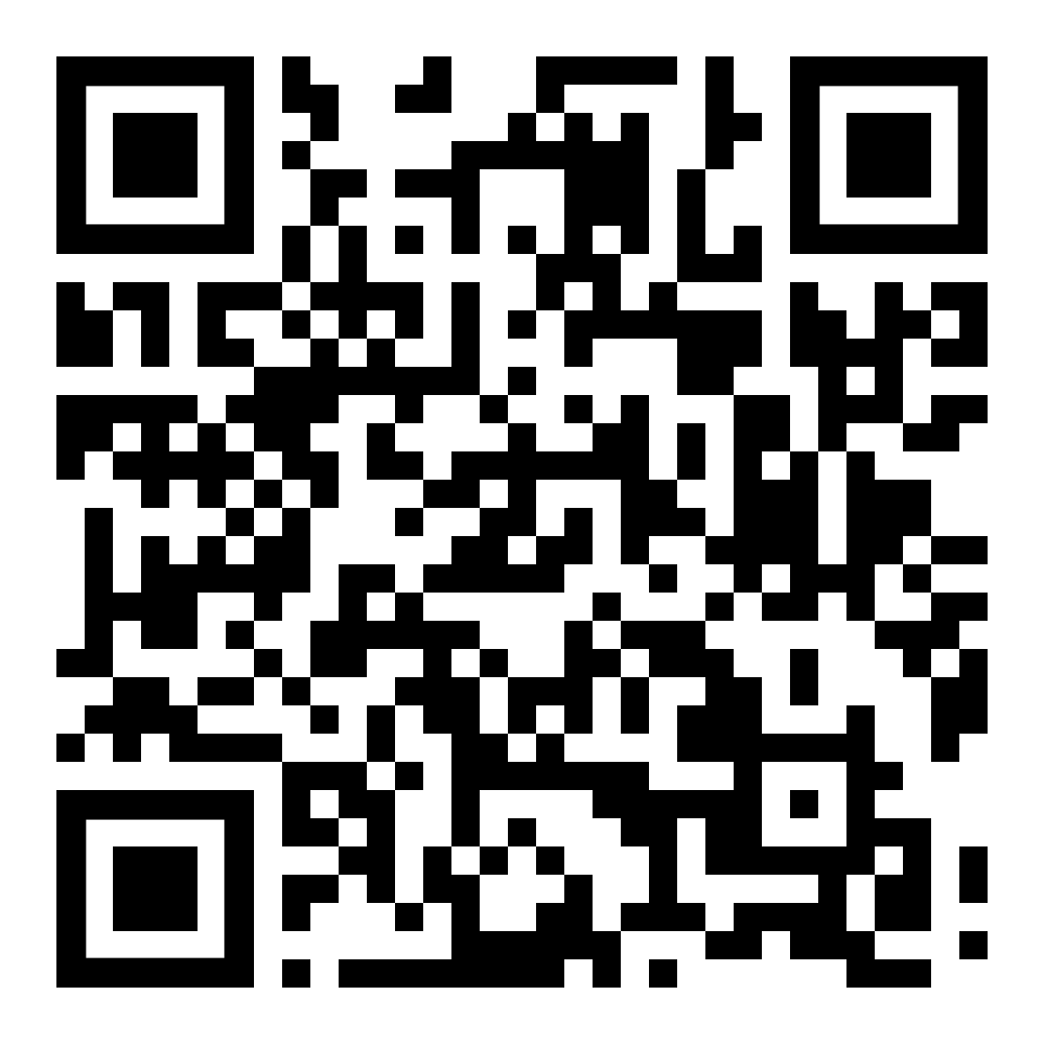
CARICOOS PA’ LA PLAYA
BEACH APP

Slide 5
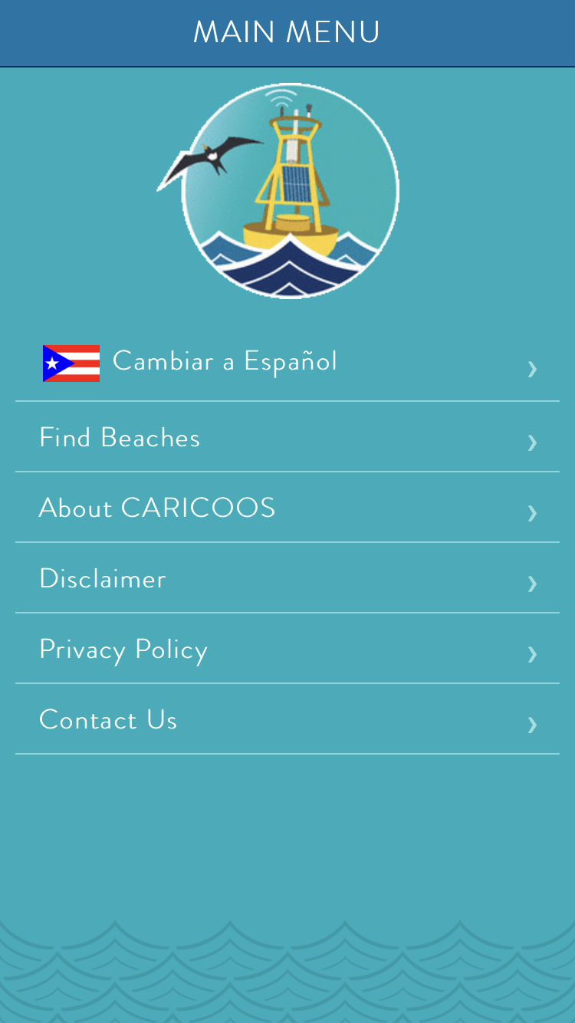
CARICOOS PA’ LA PLAYA
BEACH APP

Slide 6
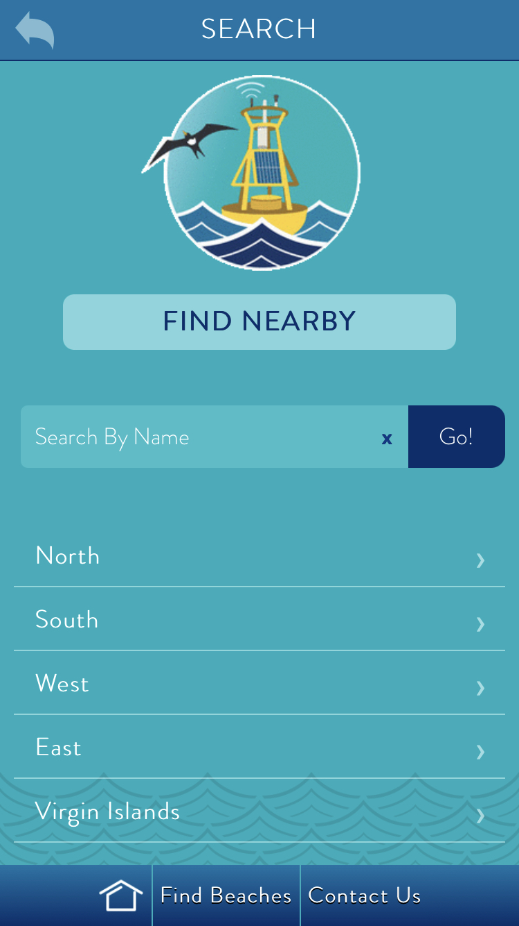
CARICOOS
PA’ LA PLAYA
BEACH APP

Slide 7
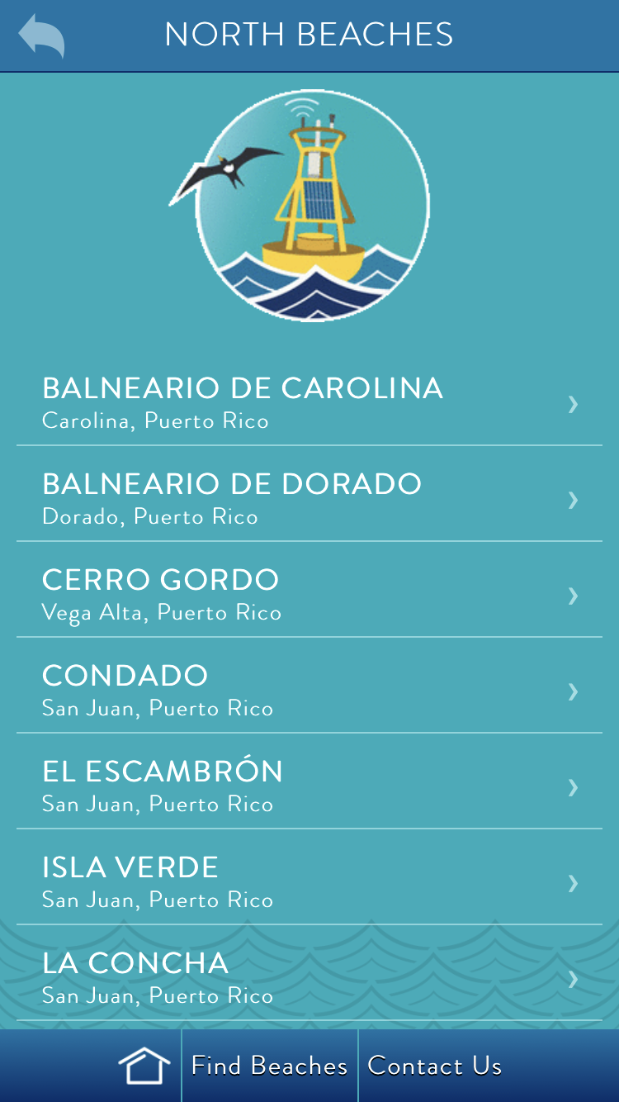
CARICOOS
PA’ LA PLAYA
BEACH APP

Slide 8
CARICOOS
PA’ LA PLAYA
BEACH APP

Slide 9
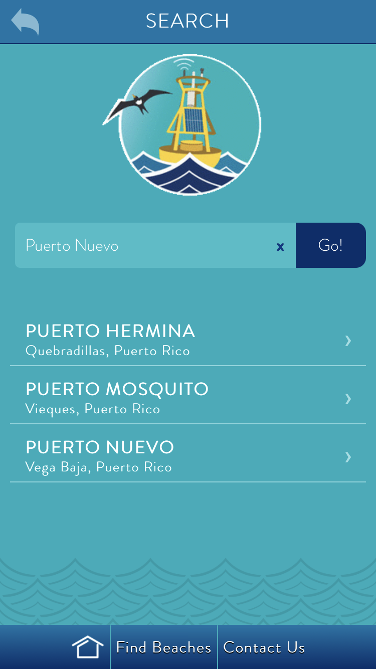
CARICOOS
PA’ LA PLAYA
BEACH APP

Slide 10
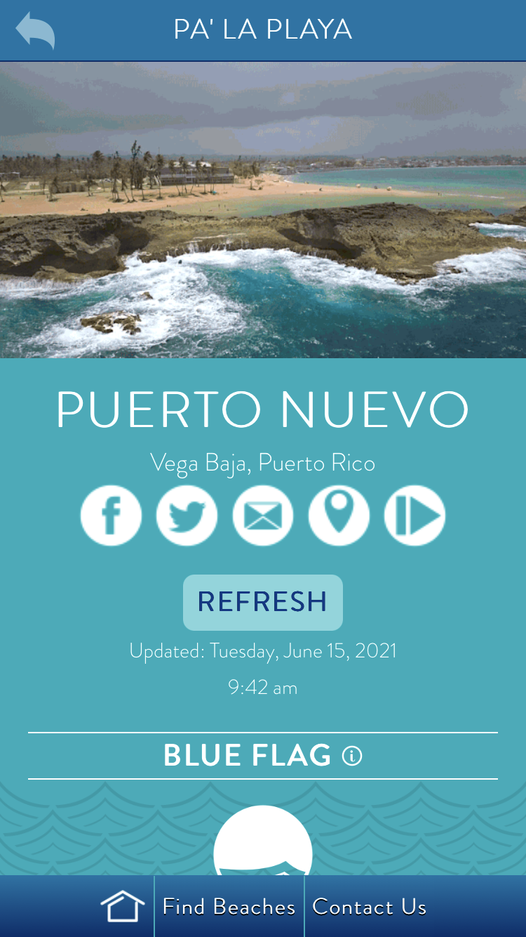
CARICOOS
PA’ LA PLAYA
BEACH APP

Slide 11
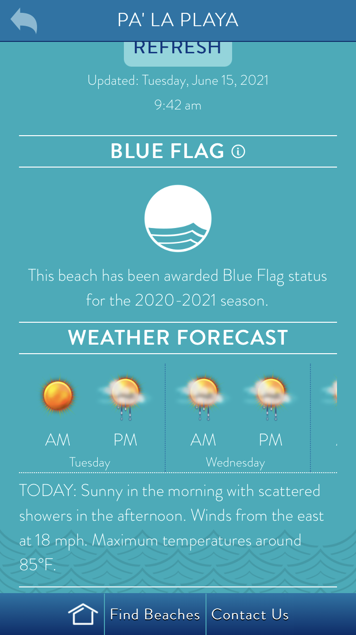
CARICOOS
PA’ LA PLAYA
BEACH APP

Slide 12
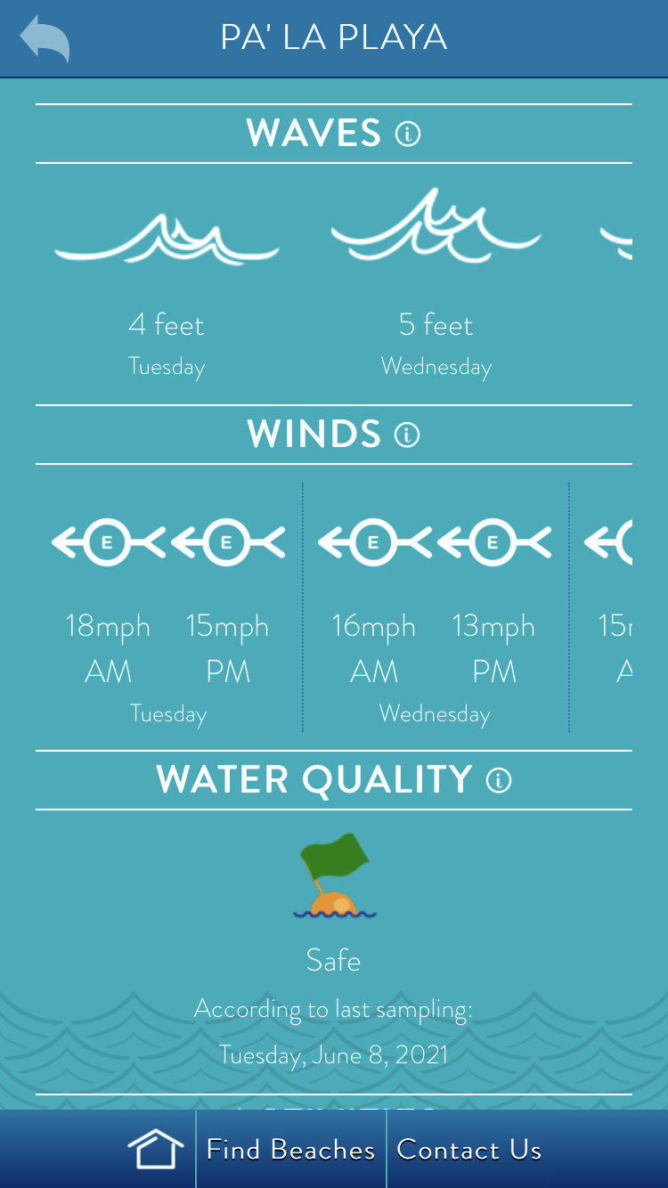
CARICOOS
PA’ LA PLAYA
BEACH APP

Slide 13
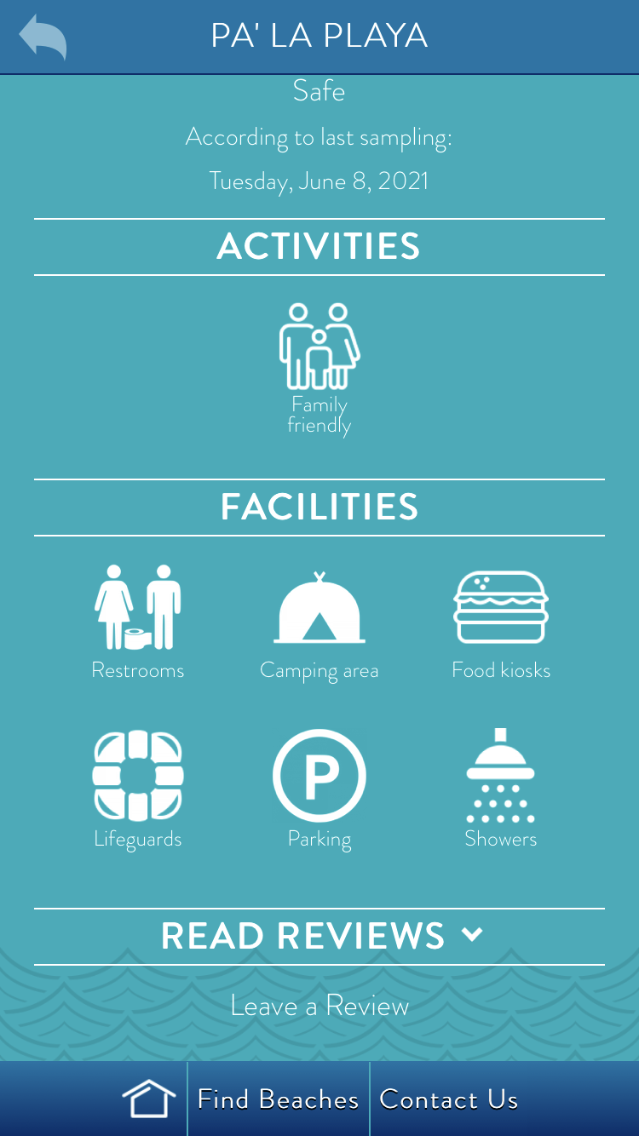
CARICOOS
PA’ LA PLAYA
BEACH APP

Slide 14
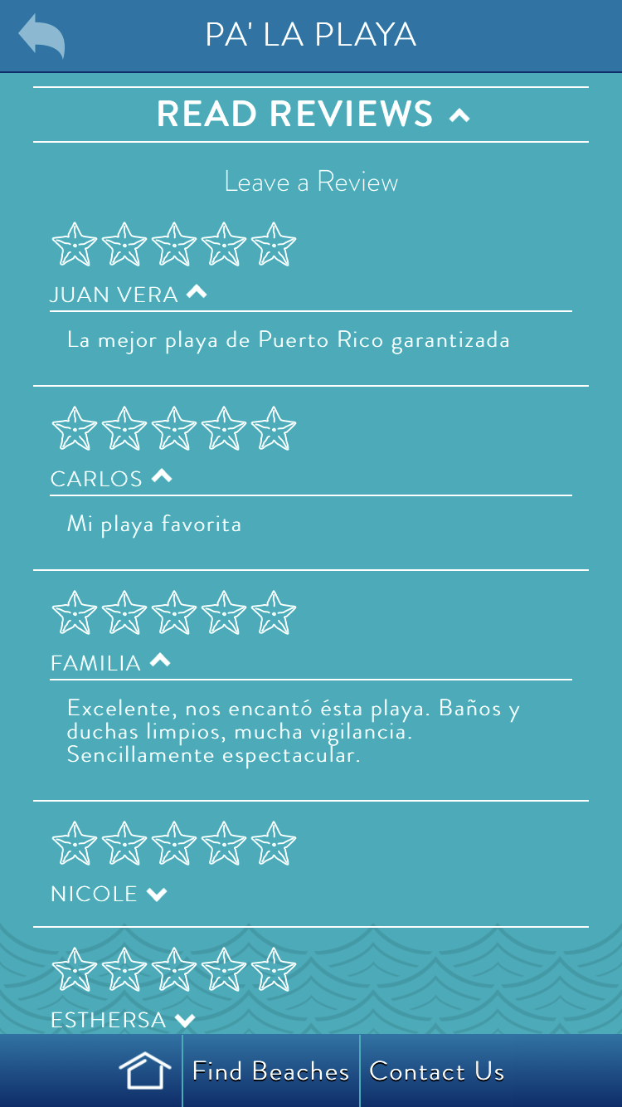
CARICOOS
PA’ LA PLAYA
BEACH APP

Slide 15
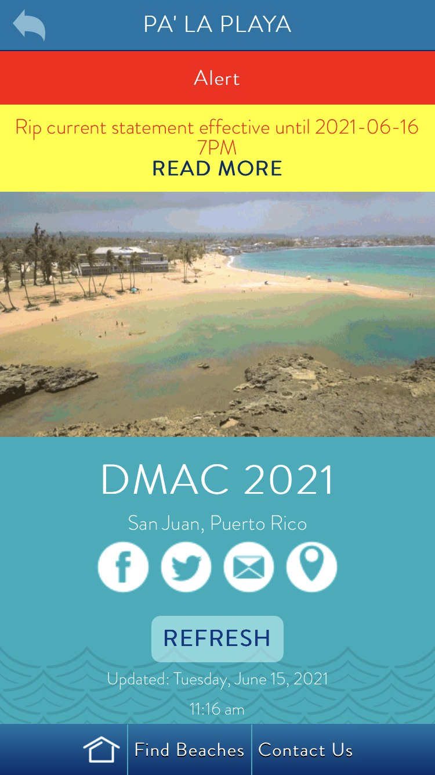
CARICOOS
PA’ LA PLAYA
BEACH APP

Slide 16
CHALLENGES:
Everything.
CARICOOS
PA’ LA PLAYA
BEACH APP
LESSONS LEARNED:
Customer discovery
Stakeholder-driven design
Hybrid nature of the development
CMS
THANKS!
rodriguez.abudo@upr.edu

