Slide 1
IOOS Office Update - DMAC 2021
Krisa Arzayus
Derrick Snowden
June 15, 2021

Slide 2
US IOOS Office Update
Krisa Arzayus, Deputy Director

Slide 3
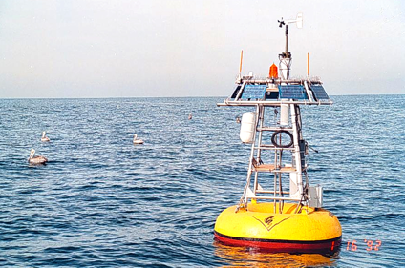
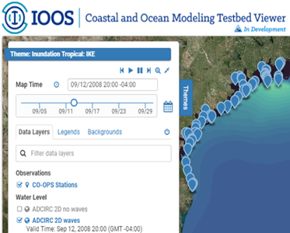
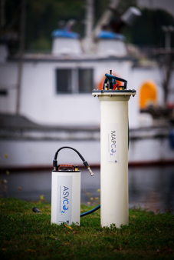
2021 U.S. IOOS Drivers
Implementing IOOS
ICOOS Act reauthorization—Coordinated Ocean Observing Research Act of 2020 - THANK YOU!
New Administration priorities - Executive orders, budgets, and legislation
Weather Research and Forecasting Innovation Act 2017 & 2019 - & NOAA Water Initiative - Title III of COORA
Supporting the Blue Economy - Ocean Enterprise Study & Benefits of Ocean Observing Catalog
CENOTE Act 2018 (Commercial Engagement Through Ocean Technology Act)
Research and Development
Coastal and Ocean Modeling Testbed (COMT) - Water Modeling, Forecasting, and Prediction - NEW starts in FY21
Ocean Technology Transition (OTT) - 2 new projects just selected for FY 2021 Awards
Notes:
Shout out to Josie and all that rallied and worked to get the reauthorization signed. It was a very pleasant surprise to finish 2020!
We continue to operate under these existing other authorities

Slide 4
New Administration Priorities - Executive Orders
Executive Orders on Climate Change
January 20, 2021
January 27
Executive Order on Racial Equity
Memorandum on Scientific Integrity
Executive Order on Protecting the Federal Workforce
All E.O.s here: https://www.federalregister.gov/presidential-documents/executive-orders/joe-biden/2021
Notes:
With the change in Administration there has been a flurry of new Executive Orders that speak to this Administration’s highest priorities, including
beating back the COVID pandemic,
economic recovery,
combating climate change, at home and abroad and
advancing racial equity and support for underserved communities.
It has been a very busy time for the IOOS Office as we began and continue this transition.
It’s becoming more and more clear that we are well poised to assist in some of the new Administration’s emerging priorities
These are several of the many executive orders signed by the President upon taking Office listed on the slide and which are guiding our next steps.
Background:
Executive Orders on Climate Change: Issued on January 20 and January 27, these Executive Orders require Federal agencies to review and rescind all actions taken in the last four years that are inconsistent with protecting the environment, reducing greenhouse gas emissions, bolstering resilience to the impacts of climate change, restoring and expanding national monuments, and prioritizing environmental justice.
We are currently conducting this review.
In addition, the Orders establish a National Climate Task Force to implement a Government-wide approach to combat the climate crisis, and the Department of Commerce and NOAA will play an important role in this effort.
Executive Order on Protecting the Federal Workforce: Issued on January 20, this Executive Order focuses on protecting the Federal workforce from COVID-19, and mandates mask-wearing in Federal buildings and on Federal lands.
NOAA has been substantially in compliance with this Order for several months, but we have been coordinating closely with the White House and the Department of Commerce to ensure that we are consistently applying this mandate to the wide range of work conditions and Federal areas that NOAA oversees.
Executive Order on Racial Equity: Issued on January 20, this Executive Order mandates that all Federal agencies pursue a comprehensive approach to advancing equity for all, including those who have been historically underserved.
Under the Executive Order, agencies must conduct an equity assessment by reviewing their programs and policies to determine whether underserved communities face systematic barriers to accessing benefits and services.
NOAA is actively pursuing this assessment, and has created a working group led by Senior Advisor Letise LaFeir to ensure we are in compliance with the Executive Order.
Memorandum on Scientific Integrity: Issued on January 27, this Presidential Memorandum requires scientific agencies to coordinate with a new Scientific Integrity Task Force to ensure, among other things, that their scientific integrity policies are consistent with scientific principles.
The Memorandum further requires agencies to allow public access to scientific data, publish an agency data plan, and review their scientific Federal advisory committees to ensure membership and policies are appropriate.
NOAA is substantially in compliance with this Memorandum, but we are conducting reviews to determine if NOAA must take additional steps.

Slide 5
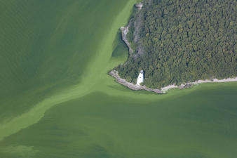
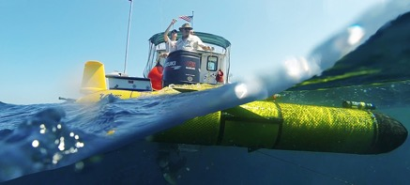
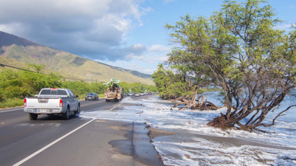
FY 2021 IOOS Office Priorities
Priorities
Continue sustained delivery of IOOS services everyday to meet customer needs
Capturing the Climate Signal at the coast and understanding its manifestations
Enhance ecological forecasting supported by regional observing, science, and service delivery
Thriving on the coastline - healthy blue economy and services in the face of coastal hazards
Align, inform, and contribute to coastal resilience and climate services as plans take shape
ICOOS Act Reauthorization “enrolled bill” - https://www.congress.gov/bill/116th-congress/senate-bill/914/text/enr?q=%7B%22search%22%3A%5B%22S+914%22%5D%7D&r=2
Notes:
[Speak to the priorities in the slide and note the following below specific to the reauthorization.]
Here are our IOOS priorities, and we continue to work on how to better position ourselves to accomplish these.
Overall we have been busy, trying to fit in our priorities with the new administration and leveraging these.
With the next cycle of regional observing system cooperative agreements, with this new administration, with the new legislation, and with a number of new opportunities, it seems we need to take some time and really consider how to advance things in a coordinated and complimentary way.
Background:
In regards to the Reauthorization Act
A priority within the new legislation is that it tells us to work together, [and this is one way to do this.]
The reauthorization also puts extra emphasis on modeling and prediction, where we have a lot of internal coordination within NOS happening, in particular through the water initiative.
We are looking to the regions to be a part of this. We need to work towards being better organized and trying to lay down a vision.
At the same time work with other parts of NOAA which in a way we are such as through the Coastal Ocean Modelling Testbed Program (COMT) and best practices in coupling and modelling.
[Example] The West Coast Ocean Forecasting System (WCOFS) offers us a good example, of a domain of what we think our observations and modeling should include.
Our office is getting asked to integrate across things, which is great.
We should be thinking about who could be owning it on the east coast?
The reauthorization speaks to a product development system to transform observations into products in a format that may be readily used and understood. Let me reiterate that we, IOOS/the regions are positioned and delivering services and support.
This is important because not all understand the legislation and don't understand the intricacies of IOOS. This provides that clarification that we sometimes need to justify our needs and/or issues.
It’s also good as justification to the private sector. Although this hasn’t happened, other Offices within NOAA have experienced this. Again, our belief is that the regions are positioned and delivering services and support.
Framework EPIC (coastal team with Derrick’s leadership that we are participating in). Expert with Scott
Through the weather act we have seat up ICAMs. Large, real and supposed to include earth systems (including oceans). Oceans being at the table is great - what that means and how we organize is unknown. Carl is on the committee for Obs, Mark Ossler is on the committee for
Background: From the CJS FY21 Appropriations Report:
Sea Level Rise.—The Committee is concerned by the increasing threat posed to coastal communities and assets of the Nation by sea level rise and the resultant increase in coastal flood risk. The recommendation includes no less than an increase of $600,000 above fiscal year 2020, within Coastal Science, Assessment, Response, Restoration, to initiate and accelerate efforts to create a National Coastal Data Information System which includes (1) combining existing observations, modeling, predictions, products and services into an integrated framework for producing and maintaining authoritative and timely data, maps and information services which quantify and communicate coastal flood risk to the US States and territories; (2) developing and strengthening partnerships with organizations that represent end users within coastal communities, including other Federalagencies, to better assess information gaps and needs; and (3) producing new information products and services, targeted to end-user needs, that allow coastal communities across the U.S. to plan for coastal flood risk today, next year, and for decades to come. NOAA shall, not less than 180 days after the enactment of this Act, provide the Committee with a holistic analysis of the need to expand observations, modeling, predictions, products and services to (1) improve the understanding of changing coastal flood risk, including impacts of sea level rise, (2) maintain and update this information on a regular cadence and (3) track and report how observed rates of sea level rise compare to the sea level rise predictions published within the National Climate Assessments.

Slide 6
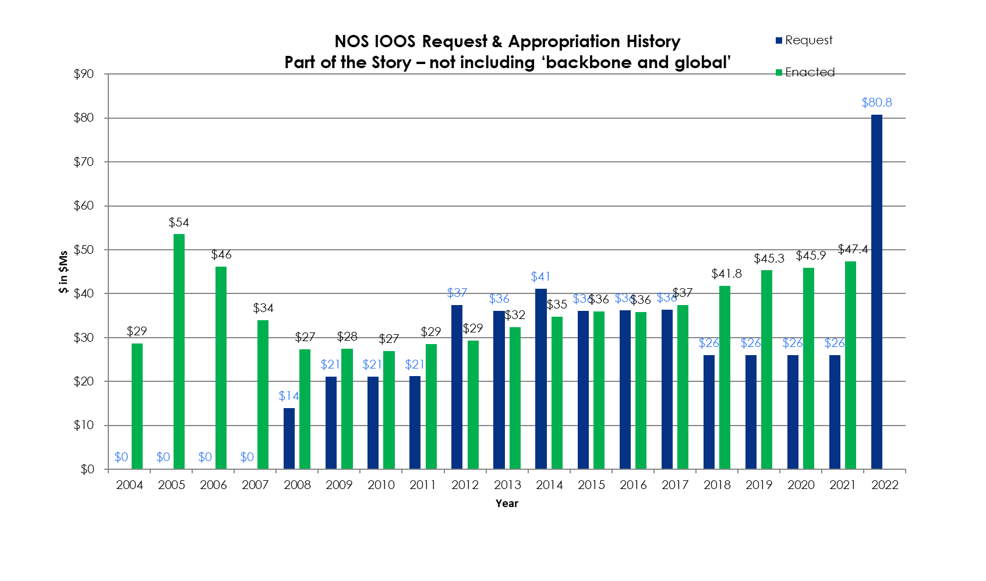
U.S. IOOS Enacted and President’s Budgets FY04–22
NOAA National Ocean Service
Navigation, Observations, and Positioning: ‘National IOOS’ component FY18 Omnibus $6.8M & ‘Regional IOOS Observations’ $35M
Estimated Enacted levels are ‘post rescission’ totals for each year
‘Request’ = the President’s Budget Request
FY22 House Mark is first, next is Senate Mark, then Conference…
6
Notes:
This slide shows the historical timeline specific to the presidential budget request (blue columns) compared to actual appropriations (green column).
The FY2021 appropriations passed in December and we have been busy distributing those of which you will see with the new awards.
As mentioned previously the work of environmental justice, equity, diversity, and inclusion is a priority for the incoming administration and core to what we do and how we operate.
The IOOS Office is committed to this effort.
As a first step, we’ve set aside Fiscal Year 2021 funding from our national line to match funding from the regions to build an approach for tackling this issue and promoting diversity, equity, and justice.
This is something that we see for the long term and is only the first step.
Now we can turn our attention to the FY22 budget. As noted, the Office has been busy, and specifically in compiling and providing information on needs to the new administration.
We are looking to the new presidential budget to begin working with the regions, GCOOS directly.
These forthcoming priorities and numbers will pave the way for discussions between us.
And I am optimistic, as just alone from the skinny budget, we see over a 1billion dollar increase to NOAA.

Slide 7
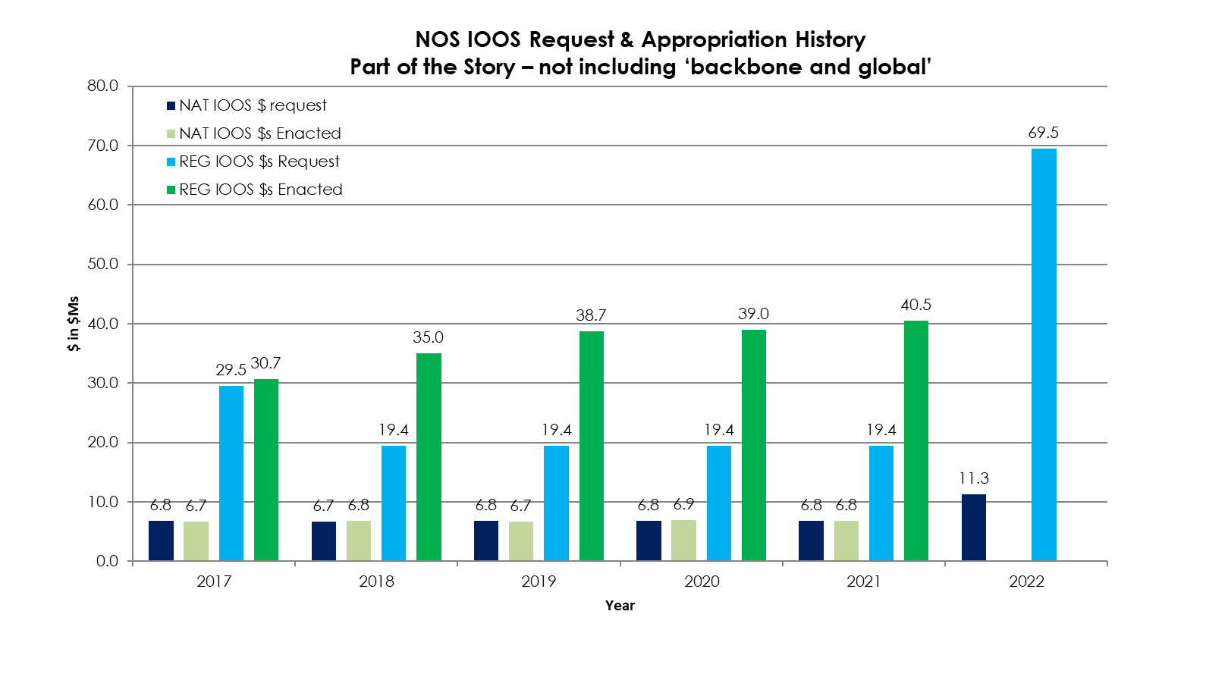
U.S. IOOS Enacted and President’s Budgets FY17-22
Enacted totals 2017 = 37.5, 2018 = 41.8, 2019 = 45.3, 2020 = 45.9, 2021 = 47.4
NOAA National Ocean Service - Navigation, Observations, and Positioning:
‘National IOOS’ & ‘Regional IOOS Observations’
Estimated Enacted levels are ‘post rescission’ totals for each year
‘Request’ = the President’s Budget Request
7

Slide 8
FY22 PresBud Requests: IOOS Summary
Congressional Justification (CJ) Program Change Summary (PCS) Title | CJ Page # | Reg Obs ($M) | NavObsPos ($M)
Monitoring Ecological Change Through Observation Systems | NOS-53 | $ 15.0
Coastal Moorings with Ecological Monitoring | NOS-61 | $ 4.0
Fostering Ecological Resilience through Conservation Action | NOS-39 |  | $ 2.0
Advancing Coastal and Ocean Modeling and Prediction | NOS-57 | $ 10.0
Data Management and Cyberinfrastructure | NOS-44 |  | $ 2.0
Complete National Coastal Modeling Coverage (CO-OPS lead; $5M total) | NOS-34 |  | 0.25
TOTAL: |  | $ 29.0 | $4.25

Slide 9
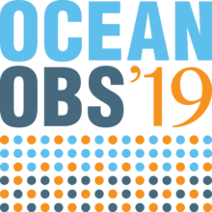
Looking forward
UN Decade of Ocean Science for Sustainable Development
Programs: Ocean Observing Co-design / CoastPredict / Observing Together / Marine Life 2030
1 June kick off event to the Decade - https://oceandecade.org/events/88/High-Level-Launch-of-the-Ocean-Decade---First-international-Ocean-Decade-Conference
Series of “Ocean Decade Laboratories” - provide interactive sessions from mid-2021 - mid-2022 to catalyze partnerships and co-design Decade Actions.
Predicted Ocean Laboratory - Sept 15-16
The 7 participatory Laboratories - foster dialogue on Ocean Decade themes: inclusivity, solutions-based ocean science, regional action, and resource mobilization, among others.
GOOS Regional Alliance Activities
Continuing to support and implement OceanObs’19 recommendations
IOOS continues to connect Global and Coastal observations
Notes:
IOOS is still in the stages of determining our role in the UN Decade - how we in the US participate and how IOOS can fit in.
When our ideas will coalesce into specific actions is still to be determined, but we need to start having these discussions. We need to begin discussing this this year, and what we should be prioritizing working together.
You all, the RA, can help determine what we should prioritize and the Office is relying on this.
In June we kick off the UN Decade with the High-Level Launch of the Ocean Decade - First international Ocean Decade Conference
Overall this process is an opportunity to showcase GCOOS, the Regional Associations, our wares etc.
Although yes, one can self select into events, it would be good to be coordinated within the IOOS community and we will be working on that
Another item directly linked to the Decade is Biology, in particular through the submission of an Ocean Shot by NASA and BOEM with IOOS participation. IOOS is a co-lead of the Marine Life 2030 Program recently endorsed by the Decade.
This is a priority for us
Background: The United Nations Decade of Ocean Science for Sustainable Development creates a foundation to strengthen the international cooperation needed to develop research and innovative technologies that connect ocean science with the needs of society. Held from 2021-2030, this global, collaborative program strives to expand scientific partnerships to support effective science, ocean management, and sustainable development. The Intergovernmental Oceanographic Commission (IOC) of UNESCO serves as the coordinating agency for the implementation of the Decade.

Slide 10
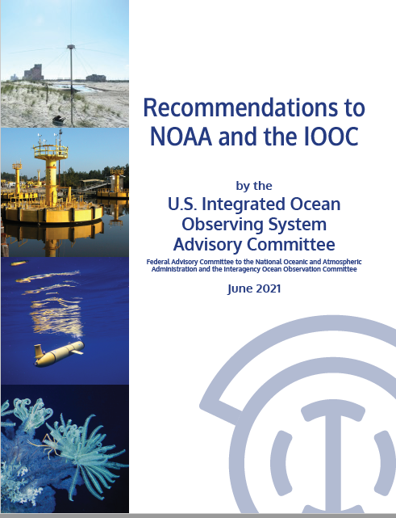
IOOS Advisory Committee Recommendations
High-level Recommendations:
Ensure sustained observations to respond to changing ocean and climate conditions
Capitalize on technological innovation to enable Smart Coastal Oceans and Great Lakes
Maintain/Build on existing partnership models - particularly to mitigate aging infrastructure.
Use partnerships to accelerate innovation and inclusivity
Leverage non-IOOS data initiatives
Benchmark and ensure active management of requirements, including analysis, traceability, allocation, and guidance, to ensure effective annual and long-term budget formulation.
Tie requirements management to infrastructure investments.

Slide 11
New Hires in the RB&P Division/IOOS Office
Erick Lee: Financial Management Specialist
Jessica Pereira: IOOS Office Manager
Catie Tobin: Knauss Sea Grant Fellow

Slide 12
IOOS Operations Division Updates
Derrick Snowden, Operations Division Chief

Slide 13
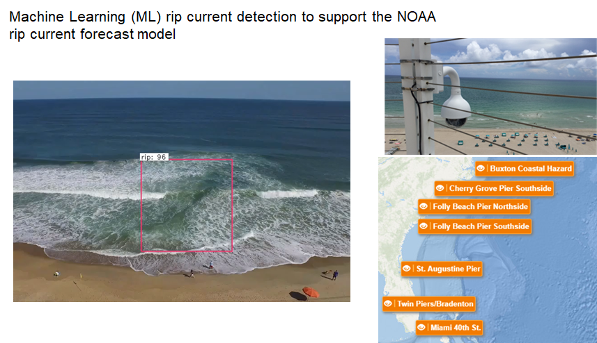
NOS AI in Action- Rip current detection in coastal imagery
For more details : De Silva et al. (2021)
https://www.sciencedirect.com/science/article/pii/S0378383921000193 or https://ioos.noaa.gov/project/ott-webcoos/ for a description of the SECOORA OTT project funding this work.
Notes:
●NOS is partnering with scientists from UC Santa Cruz to train a Convolutional Neural Networks (CNNs) to detect rip currents in coastal imagery
●The approach can identify rip currents relying on video from drones or webcams, and the result support transition and improvement of NOAA rip current forecast model
● This is one component of the webcams for coastal observations and operational support (WebCOOS), a partnership between NOS, SECOORA, USGS, Surfline and Academia.
For more details please check the recent paper by De Silva et al. (2021). “Automated rip current detection with region based convolutional neural networks”. Coastal Engineering.
https://www.sciencedirect.com/science/article/pii/S0378383921000193

Slide 14
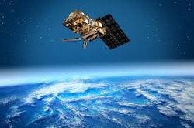
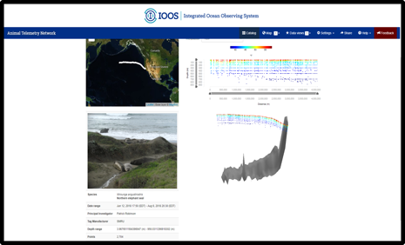
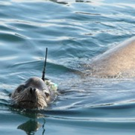
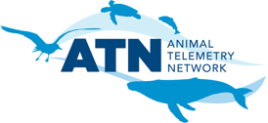
MAKING R/T OCEAN PROFILES FROM ANIMAL TAGS AVAILABLE FOR ASSIMILATION INTO GLOBAL OCEAN FORECAST MODELS
Operationalizing the Approach Successfully Implemented by SMRU/MEOP
U.S. ATN DATA ASSEMBLY CENTER
GTS
NOAA
(NDBC)
Real-Time Quality Control
Convert to WMO BUFR Format
Insert onto the GTS via NOAA
https://ioos.noaa.gov/project/atn

Slide 15
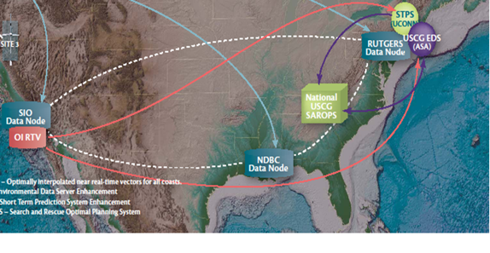
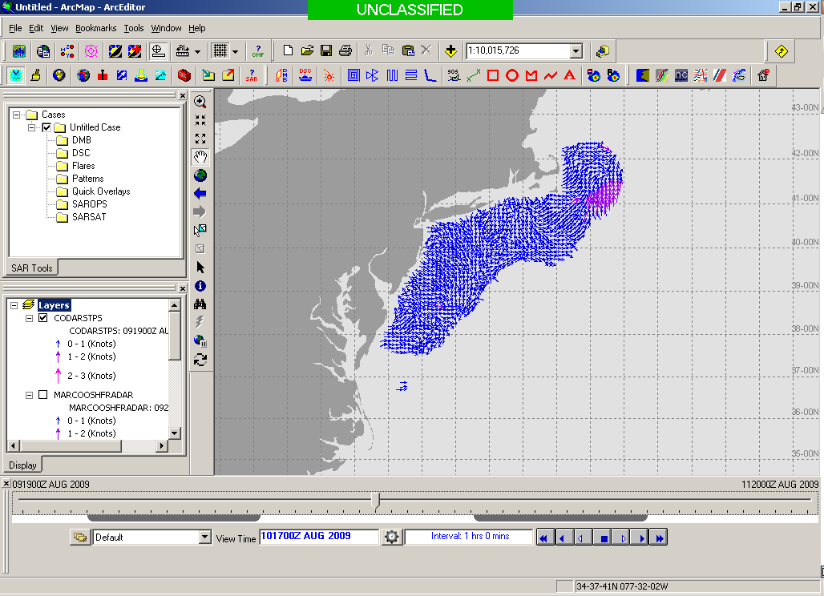
HFR Data Flow and Augmentation of STPS
NDBC Server
Thredds
6 Km vectors
UConn STPS
Scripps Server
Short Term Predictive System (STPS):
HFR Total Vector Files are retrieved hourly from NDBC/SCRIPPS.
https://hfrnet-tds.ucsd.edu/thredds/catalog.html
Hourly 24 hr. predictions from current time are made using STPS.
STPS results saved as NetCDF for accessibility through THREDDS server http://nopp.dms.uconn.edu:8080/thredds/catalog.html.
Expanded domains to deliver HFR-derived predictions nationwide to SAROPS now in progress.
Thredds
USCG Operational Server
EDS
Developmental Server
On a separate note… HFR Radials ERDDAP server at MARACOOS/RPS:
In the process of operationalizing.
Will rename URL http://3.219.116.209/erddap/info/index.html and post to IOOS website.
Assimilating radials into models, instead of totals, has the potential to significantly improve HFR data utilization, spatial coverage, and forecast accuracy.
HFR Range Series server at AOOS/Axiom:
Server under development to archive “raw” HFR data for QA/QC enhanced surface current reprocessing and extraction of additional products beyond surface velocities (e.g., waves, winds) from HFR data.
http://ioos-hfradar.axds.co/
SAROPS Operator

Slide 16
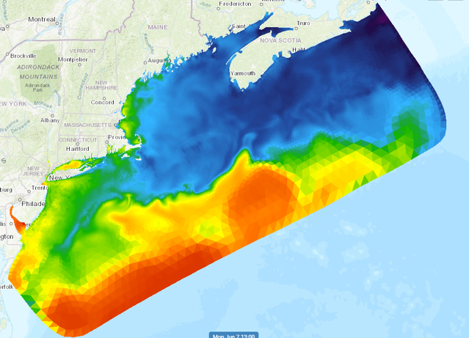
NECOFS reanalysis into the NOAA Big Data Program (BDP)
NERACOOS - Tom Shyka and Dr. Chen
40-year hindcast
Domain extended in 2017
45TB now
Additional 1.9TB/year
Submitted to BDP in
December
Still sorting out AWS credentials for Dr. Chen’s graduate student to do the upload
Other BDP datasets - https://www.noaa.gov/organization/information-technology/list-of-big-data-program-datasets
Description | Format | Size | Years | Size
WRF Hourly fields for a year (1978-2006) | NetCDF | 26GB/year | 29 | 0.754TB
WRF Hourly fields for a year (2007-2017) | NetCDF | 13GB/year | 11 | 0.143TB
WRF Hourly fields for a year (starting in 2017) with an updated version | NetCDF | 36GB/year | 1 | 0.036TB
FVCOM Hourly fields for a year (1978-2016) | NetCDF | 1.1TB/year | 39 | 42.12TB
FVCOM Hourly fields for a year (starting in 2017 with an updated version | NetCDF | 1.8TB/year | 1 | 1.8TB
Notes:
Data are ready to upload once credentials issued.
BDP program very sanguine about amount of data that need to be uploaded

Slide 17
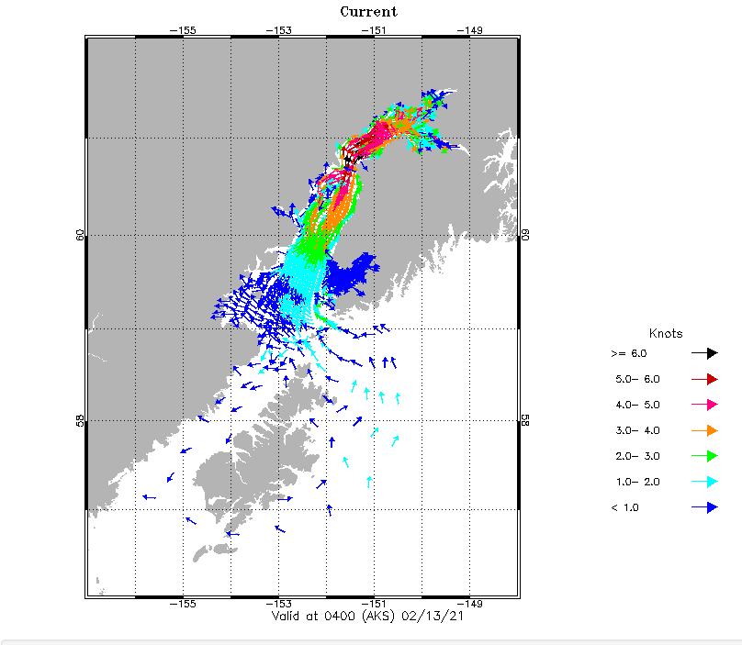
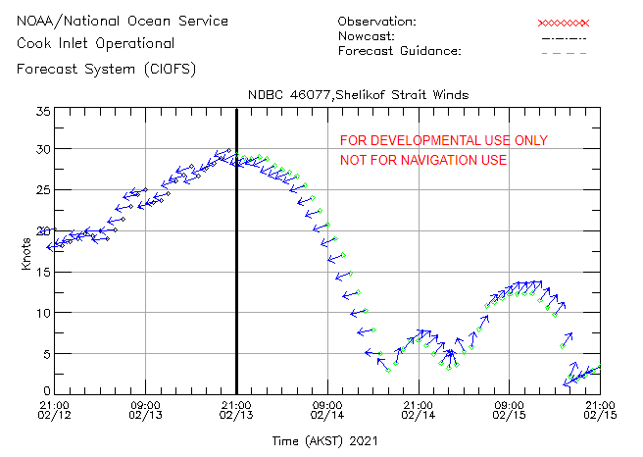
Hindcasts and the IOOS Sandbox
Small project with AWS and Kris Holdereid (NOS) to explore running hindcasts.
Test plan, AWS granting some credits to run tests.
Asked for credits to run a one year Cook Inlet (CIOFS) hindcast. Year TBD based upon availability of forcing data.
Eventually want to be able to run 40 years
Prototype for NWI modelers who may want to run hindcasts and Climate/Fisheries modelers who want hindcasts as part of ecosystem models.

Slide 18
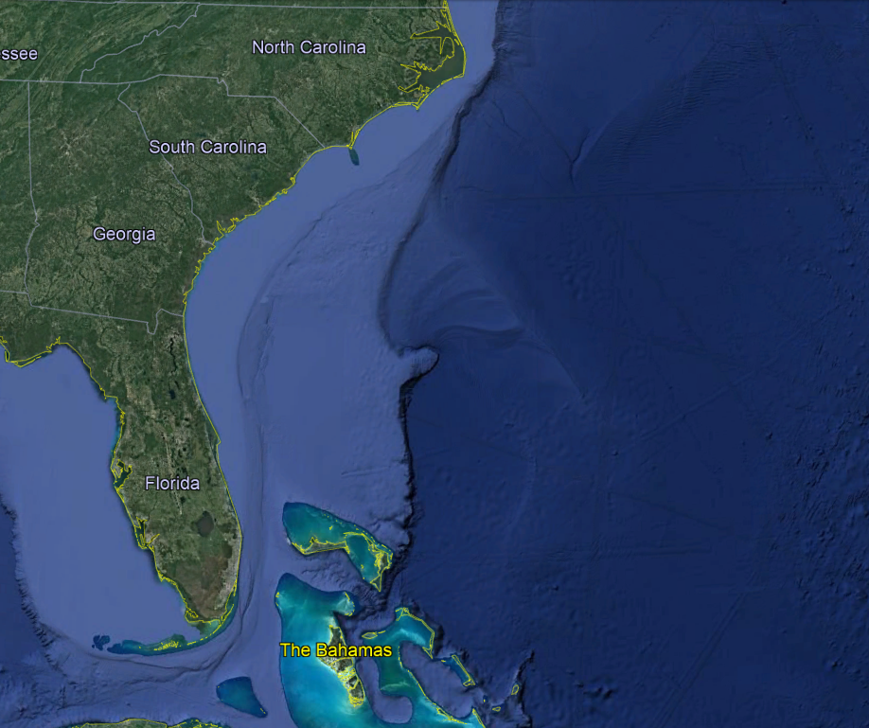
South Atlantic Bight + Bahamas
Essential Ocean Feature: Gulf Stream
Glider Line: Multiple 200m Gliders per line; 1000-m gliders crossing Gulf Stream
Missions: 7 glider missions planned; 2 Saildrone mission planned
Navy - SECOORA - AOML
SECOORA: SkiO (X2)
GOMO:WHOI (X3)
2021 Plan Details
Saildrone - PMEL-AOML
Saildrone - PMEL-AOML
Planned NOAA/Partner
CEI - CIMAS - AOML
Planned Saildrone
Planned Navy
Pending Availability
Notes:
SECOORA deployments: 2 in the water at all times.
Strategy - deploy glider every 2 weeks off cape canaveral 30-40 d deployments w/rechargeable batteries. If less funding, deploy in later half of season.
OMAO Proposal: Given the large geographic area and potential for biofouling in the warm, shallow shelf water of the SAB, SECOORA will conduct two 4-6 week deployments during hurricane season. Gliders will be jointly operated by observatory members from multiple institutions, with deployments and recoveries coordinated among the member institutions. To mitigate funding limitations, deployments will be concentrated in the later half of hurricane seasons, when storms are more likely to make landfall along the US East

Slide 19
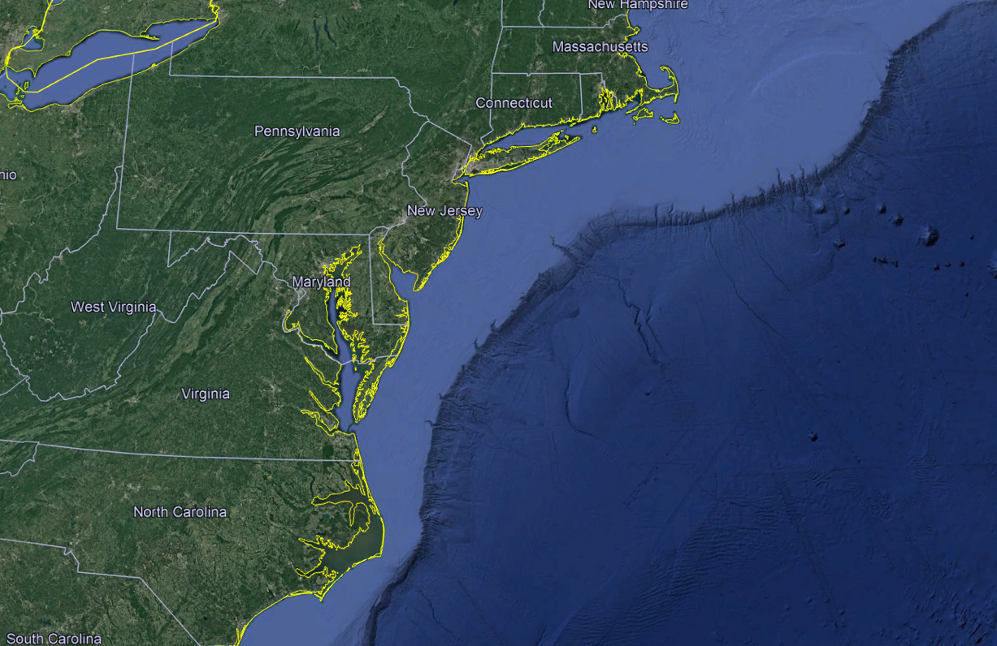
Mid-Atlantic
Essential Ocean Feature: Mid-Atlantic Cold Pool, Gulf Stream
Glider Line: Multiple 200m Shallow Gliders, Multiple 1000-m Gliders in Gulf Stream
Missions: 9 glider missions planned, 8 are funded
MARACOOS: UMASS
Navy
MARACOOS: RU
2021 Plan Details
Hurricane Gliders & Other Mission Gliders
Navy
MARACOOS: RU
MARACOOS:RU
GOMO: WHOI (X3)
MARACOOS: UD/VIMS
MARACOOS: VIMS/UD
Planned NOAA/Partner
Rutgers - OCOVI (Vetlesen)
Planned Navy
Pending Availability
Notes:
Navy glider goes in early

Slide 20
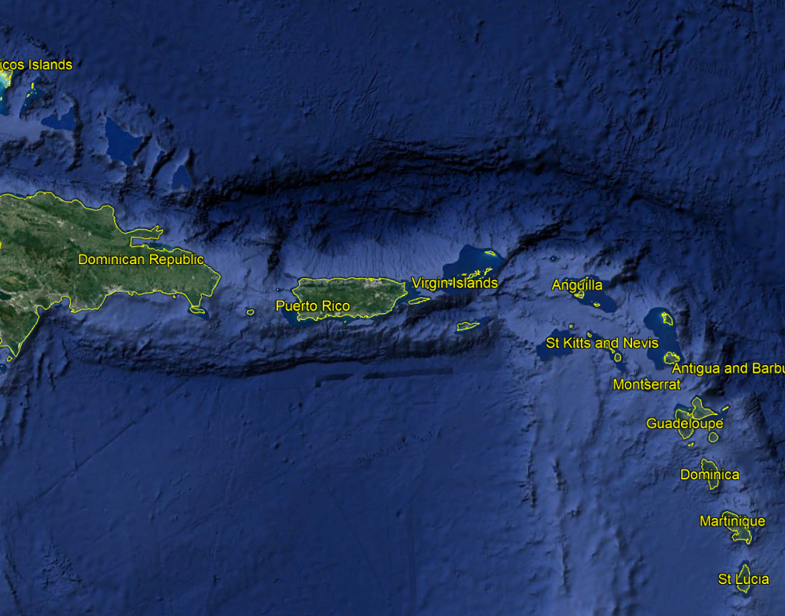
Caribbean Region
Essential Ocean Feature: Warm Pool, Fresh Water Barrier Layers, Freshwater Inflow
Glider Line: One 1000m Glider per line
Missions: 10 glider missions planned, 8 are funded; 3 Saildrone missions planned
Planned NOAA/Partner
Planned Saildrone
AOML - CARICOOS - CIMAS
Rutgers - OCOVI (Vetlesen)
Planned Navy
Pending Availability
Saildrone - PMEL-AOML
Other Mission Gliders
Navy - CARICOOS
Saildrone - PMEL-AOML
2021 Plan Details
2020 Hurricane Glider Plan
AOML - CARICOOS - CIMAS
ANAMAR - CARICOOS - CIMAS - AOML
CARICOOS - AOML
Navy -
CARICOOS - OCOVI
AOML - CARICOOS - CIMAS
Saildrone - PMEL-AOML
Rutgers U - OCOVI (Vetlesen)
Notes:
1st time ocean and atmosphere measured simultaneously with autonomous vehicles!
Need priority order of Navy gliders - which line should be dashed?
RU29 (green) international mission begins July 1, per State Department permissions.
Bahamas line only doing if OMAO funding - shipped glider today
All blue lines in water for at least 3 months
Each line = 1 glider
CARICOOS bought glider but arranged for AOML
AOML owns 7 gliders
CARICOOS owns 1
DR - mid-July
Other 4 in South - one of

Slide 21
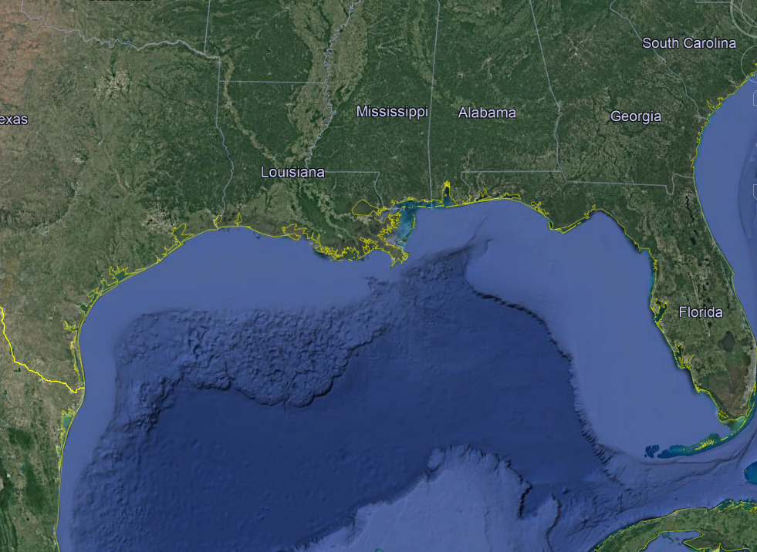
Gulf of Mexico
Essential Ocean Feature: Loop Current & Eddies, Freshwater Barrier Layers
Glider Line: One 1000m Glider per line
Missions: 10 missions planned, 6 are funded
2021 Plan Details
GCOOS:TAMU
Shell: USM
Shell: USM
GCOOS - SECOORA: USF and Mote (2)
Navy
Navy
Navy
GCOOS:TAMU
Shell: TAMU
Planned NOAA/Partner
Rutgers - OCOVI (Vetlesen)
Planned Navy
Pending Availability
Other Mission Gliders
Notes:
Gulf of Mexico: Deploying 2 within the next week (6/8) as long as I have a weather window - 1 western-most GCOOS:TAMU (Shell funded), and 1 eastern-most Navy.
Deeper shell line pending confirmation from shell
Shelf GCOOS line - regional talk w/NWS they wanted this line - put in for 2 glider deployments /wGCOOS - 1 offshore, 1 shelf;
or offshore line
Can do 1 GCOOS line, not both
Targeting EOFs - left Shell track happens to be in eddy
Offshore gcoos - 3 month mission, 1 glider - lithium Shelf gcoos - targeted 3 month mission - rechargeable

