Slide 1
GCOOS/Woods Hole Group, Inc.
UGOS-1 Informing the LC Campaign: Data Compilation to Improve Understanding, Simulation and Prediction of the LCS
Quality Assurance Screening of NTL Ocean Current Profile Data to improve data accessibility and useability
Bruce Magnell
Scientific Director
Oceanography and Measurement Systems

Slide 2
The NTL Program
An extensive B.S.E.E.-mandated data collection program known as the NTL (Notice to Lessees) has produced massive quantities of current profile data in the northern Gulf of Mexico
NTL data are collected using Acoustic Doppler Current Profiler (ADCP) instruments deployed from deep-water offshore oil industry Mobile Drilling Units (MODUs) and Fixed Production Platforms (FPFs)
The NTL program has operated since 2005 and continues to provide near-real-time 20-minute ADCP profiles from near-surface to depths up to 1000m. 20 – 50 stations are active at any one time
NTL data are transmitted in near-real-time to NDBC (through about mid-2020) or now to GCOOS, where the data are processed and subjected to real-time record-by-record automated QA screening

Slide 3
Key Take-Aways from this Presentation
The NTL data comprise a massive archive of high-quality deep-water current profiles, which is valuable for numerical model validation and calibration, analytical studies, and structural design and installation engineering
The NTL program is decentralized and suffers from a lack of attention to quality control. There is no equivalent to a Principal Investigator, nor any Standard Operating Procedures (SOP), and documentation is deficient
Post-processing QA screening by qualified oceanographers has been found to be necessary to detect and correct metadata errors and weed out invalid data
To date, it has not been possible to weed out invalid data on a real-time basis using automated QA screening
Contrast this to other operational data agencies, such as NDBC

Slide 4
Quality Assurance Screening of NTL Current Profile Data
The BSEE NTL real-time ocean current observation program
  Program structure and organization
  Data flow and processing
  Who is responsible for data quality?
NTL data quality issues
Post-processing QA screening methodology
Results
  2005-2010 NTL data (Deepstar)
  2001-2018 NTL data (UGOS-1)
  2019 – 2020 NTL data (UGOS-1 Extension)

Slide 5
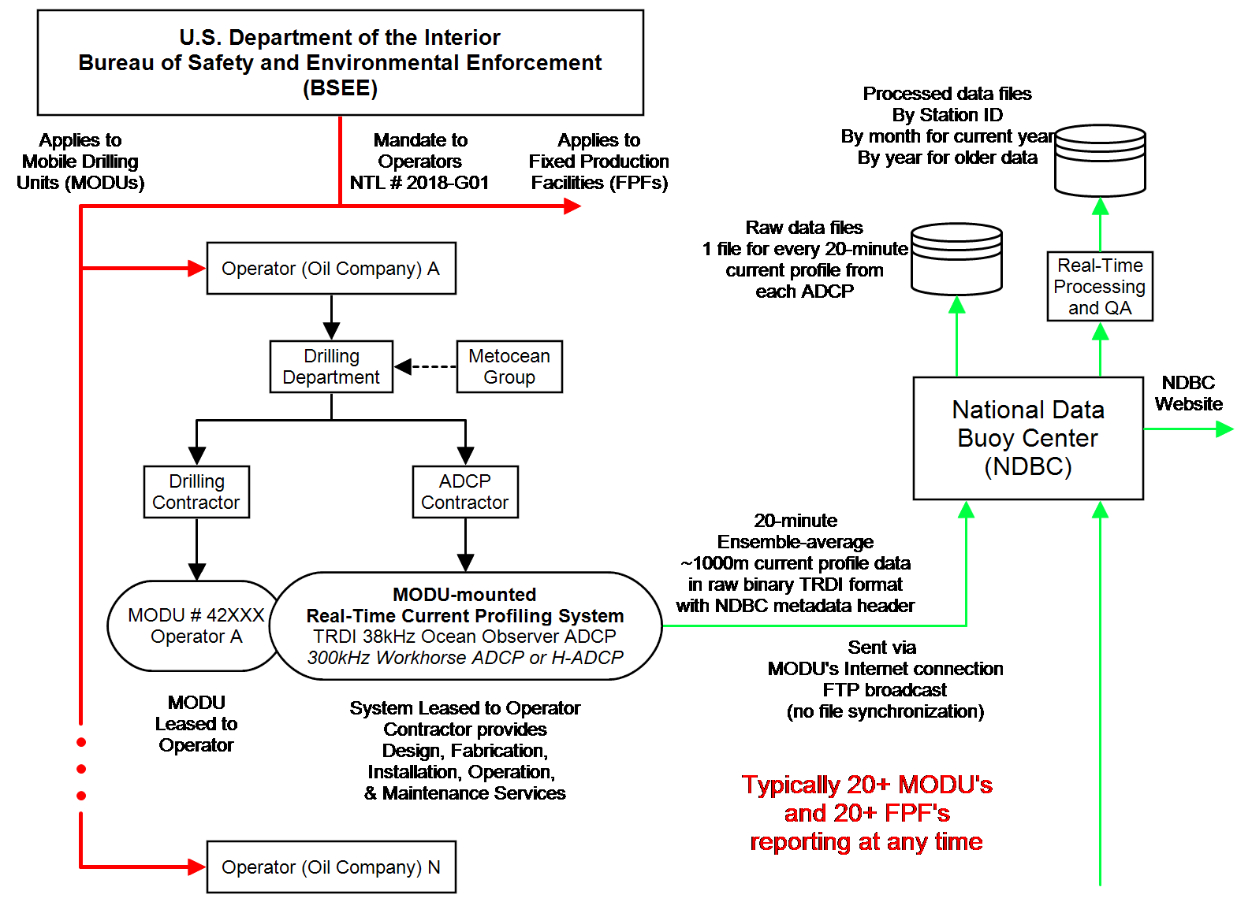
The B.S.E.E. Notice to Lessees (NTL) Real-Time Ocean Current Profile Program

Slide 6
Historical NTL Data Quality Control
Known and newly uncovered issues with NTL data quality
Most common issues related to ancillary parameters (metadata):
  Incorrect station position data when entered manually – Operator’s error
  Incorrect ADCP attitude (pitch and roll) values entered manually – Operator’s error
  Incorrect external ADCP heading information – System integrity failure or Operator’s error
Most common issues related to the ADCP data itself
  One acoustic beam turned off, but the setup allows 4-beam solutions – Operator’s error
  Acoustic signal interference with underwater false targets – Poor system design
  Low quality compass heading data for single-wire systems – Poor system design
Deficiencies of Data Telemetry
  Near-real-time 20-minute current profiles are sent to NDBC over Internet using FTP transmission protocol, but in broadcast mode, not file synchronization. There is no way to fill data gaps at NDBC due to telemetry delays or outages.

Slide 7
Historical NTL Data Quality Control
Known and newly uncovered issues with NTL data quality
Deficiencies of existing real-time QA/QC methodology
  QA/QC screening is based primarily on automated examination of ADCP internal quality parameters
      Meta-data (location, water depth, operator, rig/platform name, etc.) is not examined or screened
  Screening is performed in near-real-time on a record-by-record basis
      No trend or feature assessment
      Some key properties of the ADCP data are not examined (i.e., echo intensity profiles)
  The real-time data QC process can be substantially improved if more information is available, such as station water depth, distance to false targets (platform hull, for example) and/or sea surface, etc.
Data accessibility issues
  NDBC ID# is assigned to each measurement platform and processed data are organized by ID
  But MODU’s move! So processed time-series records may contain data from multiple measurement sites

Slide 8
GCOOS/WHG Approach to Data QA/QC in Post-Processing
Start with raw, single-ensemble ADCP binary files to split data into station-deployments:
  The software checks Lat/Lon information of each consecutive ensemble until platform position changes beyond a certain threshold (typically 3 km)
  The station position data are verified using RigLogix and BSEE Bore Hole rig position data
  A quality flag is generated for each parameter based on prescribed thresholds
  All station-deployment ancillary data, ADCP quality indicators, velocity data, and applied quality flags are written into a *.csv file.
The data are then converted into Matlab format and forwarded to GCOOS for conversion to NetCDF file format and insertion into Gulfhub database
Time-series of ancillary parameters and data are generated for each station-deployment and reviewed by a qualified oceanographer, who trims the profiles and generates a FINAL ‘mask’
The data are then checked against LC/LCE frontal positions to identify possible gross speed and direction errors

Slide 9
WHG Post-Processing NTL Data Quality Control
Quality flags:
Position change equivalent to: 25cm/s rig move velocity (bad), 10cm/s rig move velocity (suspect)
Echo signal-to-noise ratio: 1.1 and must decrease with range
Error velocity: >20cm/s (bad), > 10cm/s (suspect)
Echo intensity: < 20 (bad), < 50 (suspect)
Correlation magnitude: < 30 (bad), < 80 (suspect)
Percent of good pings: < 25 (bad), < 75 (suspect)
Current speed: bad if > 250cm/s

Slide 10
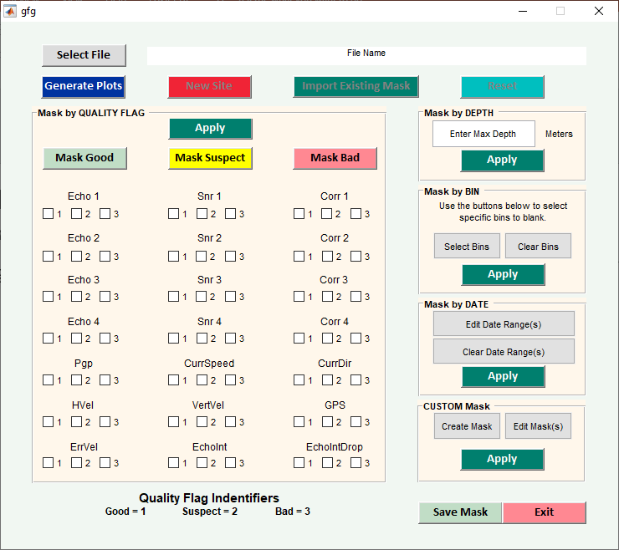
WHG Post-Processing NTL Data Quality Control
Data review and ‘mask’ application GUI:

Slide 11
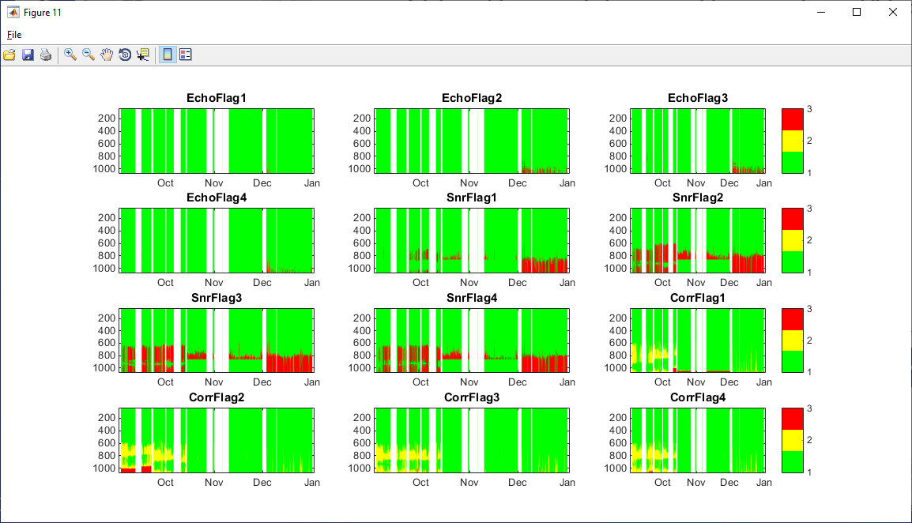
WHG Post-Processing NTL Data Quality Control
Example Echo, Signal-to-Noise, and Correlation data review plots

Slide 12
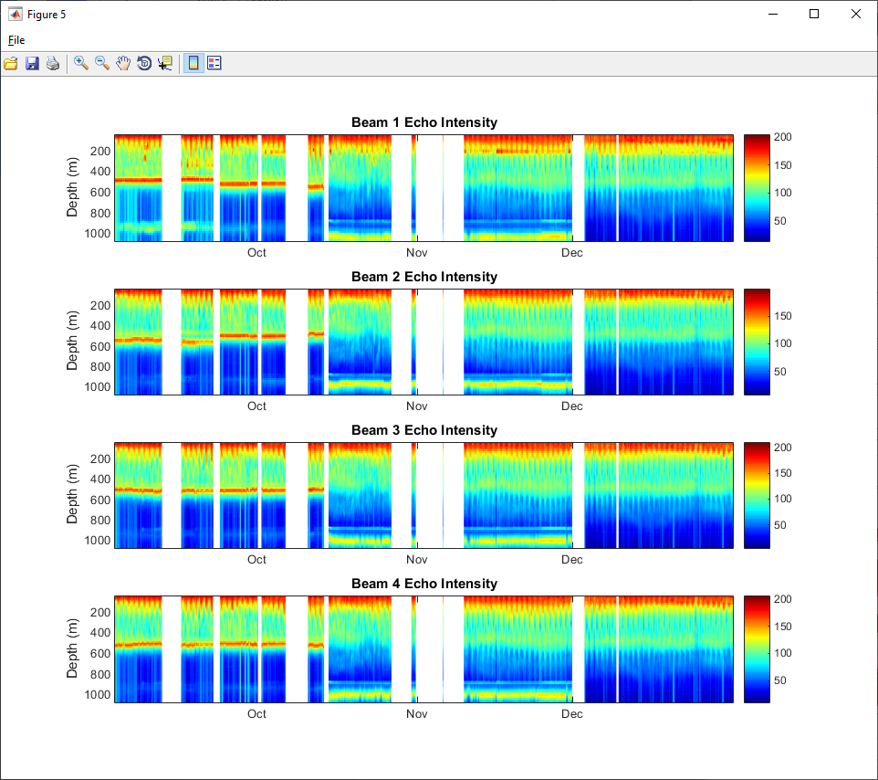
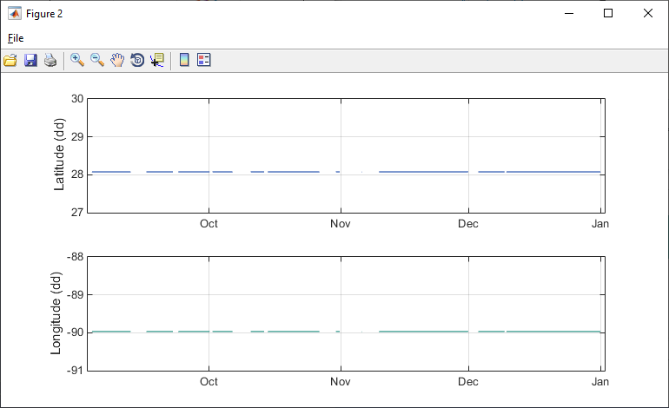
WHG Post-Processing NTL Data Quality Control
Wrongful rig position example (correct positions yet to be established):
Reflections from the seabed (left) suggest changes in position, but Lat/Lon is the same

Slide 13
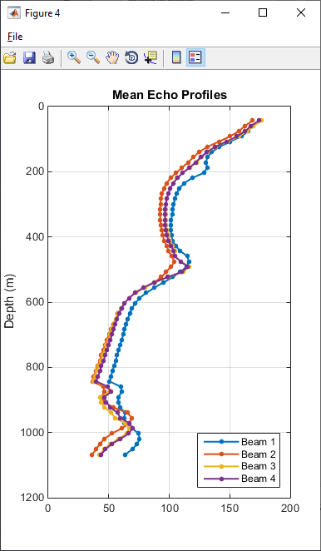
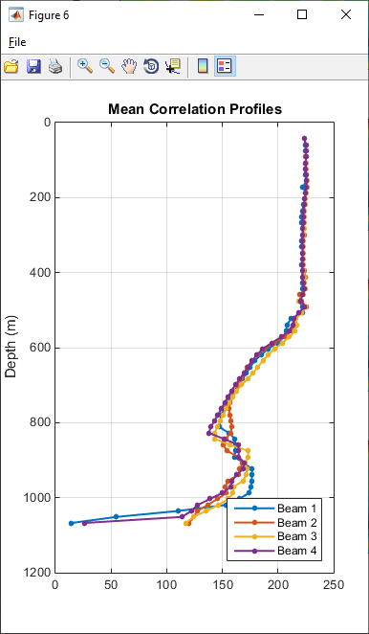
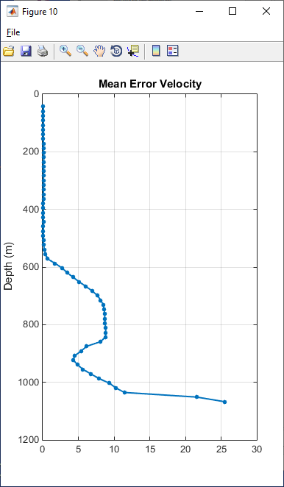
WHG Post-Processing NTL Data Quality Control
Example mean Echo, Correlation, and Error Velocity profile plots

Slide 14
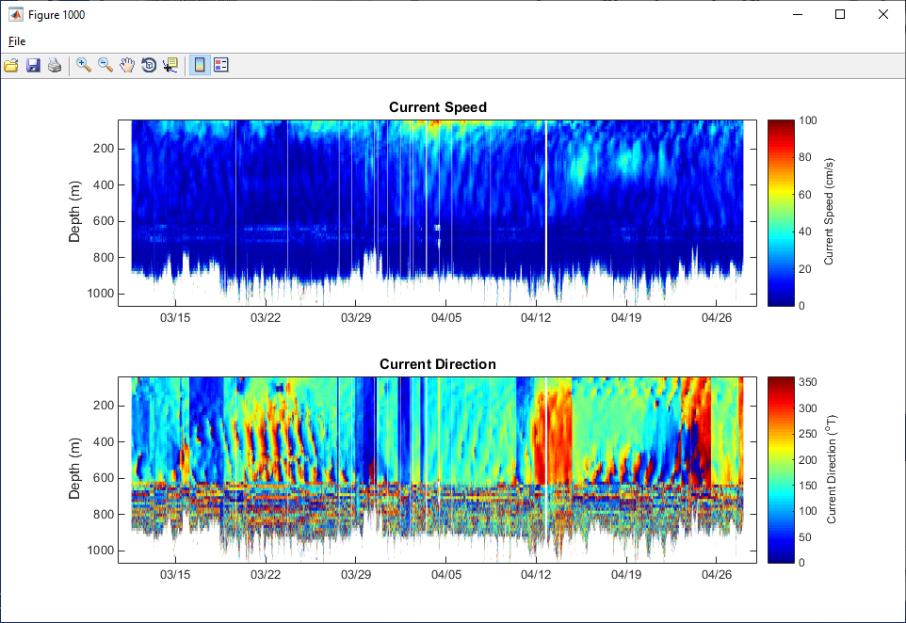
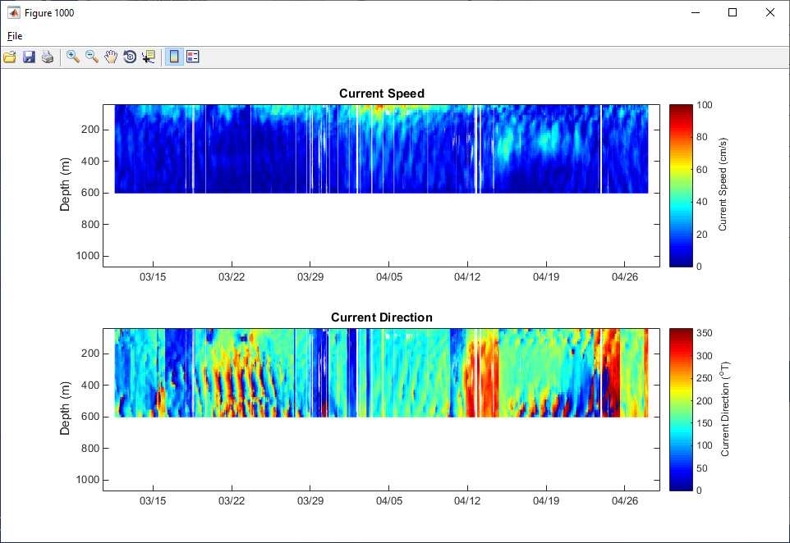
WHG Post-Processing NTL Data Quality Control
ID 42888: Using GUI to clean and trim speed and direction profiles. Also shown as an example of wild changes in current direction, most probably due to poor system design

Slide 15
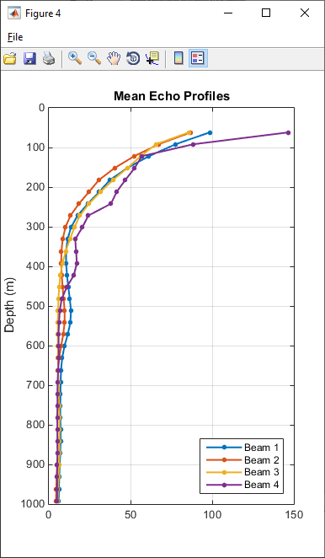
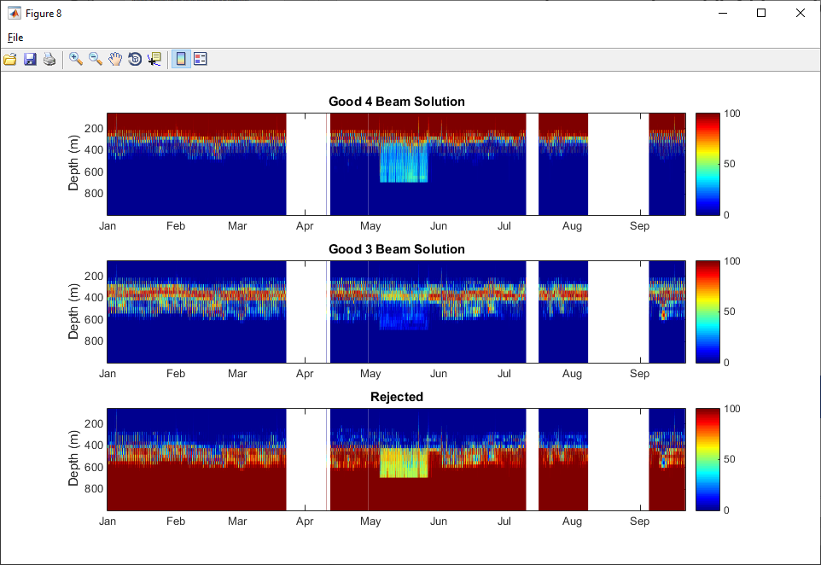
ADCP Acoustic Beam Interference
ID 42370: Beam 4 data contaminated (left) but 4-beam solutions (right) - data discarded

Slide 16
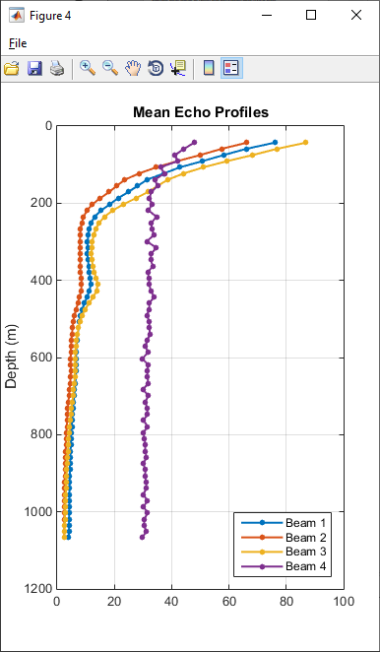
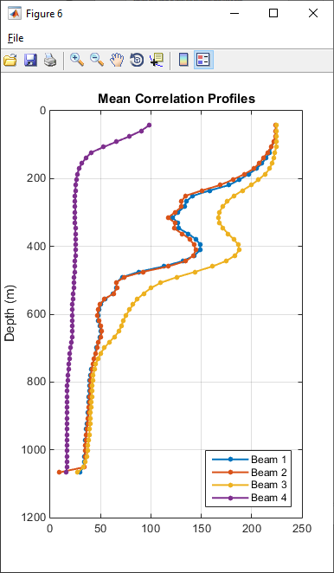
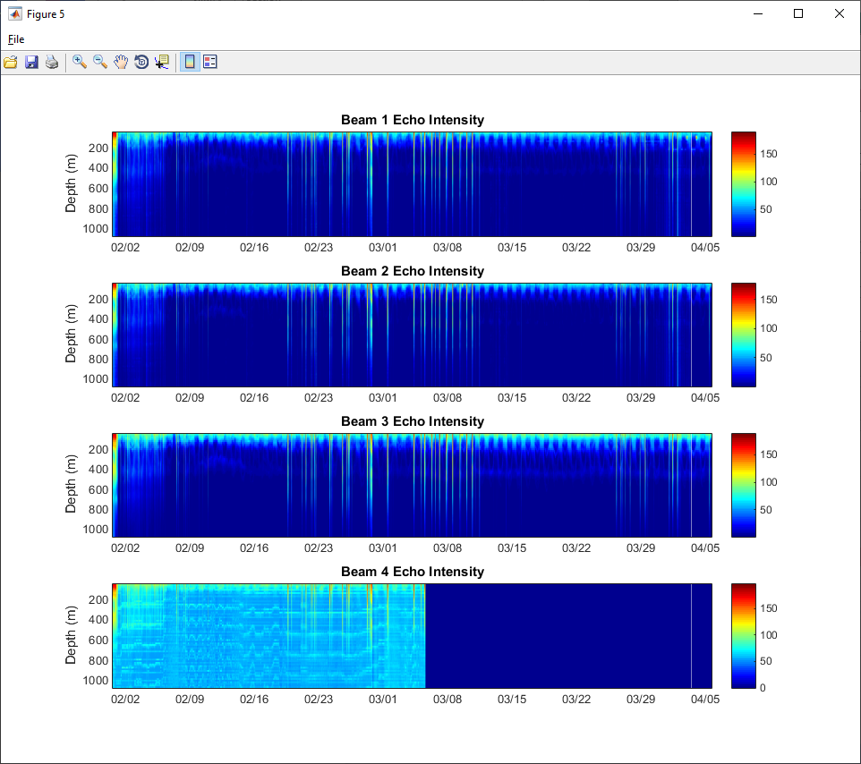
Un-noticed Instrument Failure
ID 42936: An example of ADCP failure (same ADCP redeployed at 3 locations)

Slide 17
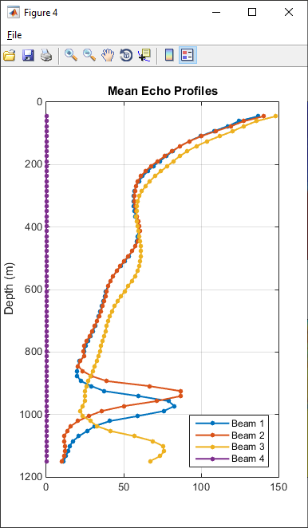
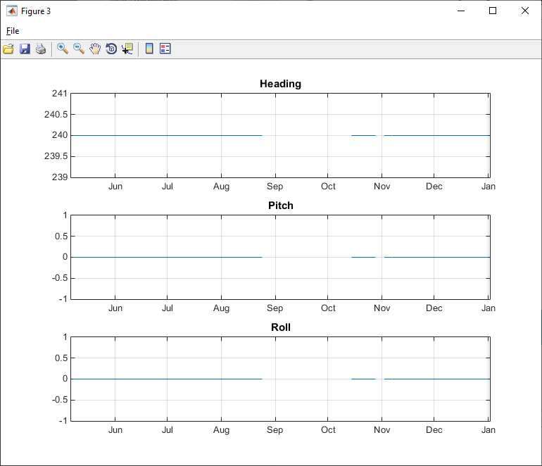
ADCP Set-up Check
ID 42362: Echo profiles show significant ADCP Pitch (left), but entered value = 0. Such errors are difficult to catch because the quality indicators are all good

Slide 18
Location Check (Sample Table)
All Processed Files with Accepted Data Quality
RIG NAME | DATE |  | NTL METADATA |  | RIG LOGIX POSITION |  |  | BSEE BORE HOLE
 | START | END | LAT (deg) | LON (deg) | LAT (deg) | LON (deg) | DIST (km) | LAT (deg) | LON (deg) | DIST (km)
Noble Globet | 20-Oct-19 | 6-Nov-19 | 26.44 | -90.77 | 26.0934 | -94.9032 | 414.6299 | 26.4525 | -90.7755 | 1.4902
Noble Globet | 15-Jul-19 | 16-Oct-19 | 28.03 | -89.44 | - | - | - | 28.0373 | -89.4443 | 0.9164
Noble Globet | 16-Sep-13 | 9-Mar-14 | 28.15 | -87.59 | 28.1517 | -87.5989 | 0.8911 | 28.0555 | -87.7761 | 21.0687
Noble Globet | 8-Nov-19 | 14-Nov-19 | 28.15 | -89.09 | 26.0934 | -94.9032 | 619.6799 | 28.1513 | -89.0886 | 0.2017
Noble Globet | 16-Nov-15 | 28-Feb-16 | 28.42 | -88.08 | 28.4222 | -88.0886 | 0.8807 | 28.4604 | -88.1047 | 5.0931
Noble Globet | 30-Sep-16 | 29-Jan-17 | 28.43 | -88.1 | 28.4375 | -88.1016 | 0.8451 | 28.4222 | -88.0886 | 1.4111
Noble Globet | 9-Mar-14 | 22-Jul-14 | 28.46 | -87.96 | 28.4603 | -87.9620 | 0.1977 | 28.4608 | -87.9609 | 0.1287
Noble Globet | 3-Mar-16 | 24-May-16 | 28.53 | -88.21 | 28.1258 | -88.2162 | 44.7961 | 28.5158 | -88.2049 | 1.6510
Noble Globet | 21-Aug-14 | 21-Aug-15 | 28.58 | -87.84 | 28.5852 | -87.8435 | 0.6678 | 28.6069 | -87.9009 | 6.6628

Slide 19
Comparison of NTL Time Series against External Information
01_Amirante-2803-9002-110220-110324-42866-0

Slide 20
Comparison of NTL time series with external information
01_Deepwater As-2831-8817-150417-150507-42874-0

Slide 21
Direction Check (Sample Table)
ADCP vs Frontal Analysis
FILE NAME | DATE OF CLOSEST APPROACH (DCA) | NTL DATA |  |  |  | FRONTAL DATA |  |  | DISTANCE AT DCA (km)
 | DATE | LAT (deg) | LON (deg) | DIR (deg) | BIN DEPTH (m) | LAT (deg) | LON (deg) | DIR (deg) | MIN DIST (km)
01_Amirante-2803-9002-110220-110324-42866-0 | 08-Mar-2011 | 28.03 | -90.02 | 276.48 | 51.69 | 27.12 | -89.00 | 48.83 | 142.67
01_Amos Runner-2749-9284-111005-111024-42875-1 | 12-Oct-2011 | 27.50 | -92.85 | 336.97 | 84.47 | 26.90 | -92.57 | 69.45 | 72.40
01_Atwood Advan-2870-8859-140423-140518-42860-1 | 02-May-2014 | 28.70 | -88.60 | 50.69 | 79.37 | 27.28 | -87.63 | 62.01 | 183.88
01_Blackhawk-2889-8794-171120-171123-42884-0 | 20-Nov-2017 | 28.90 | -87.94 | 334.15 | 43.13 | 28.42 | -87.75 | 72.29 | 56.14
01_DISCOVERER E-2907-8801-111210-120623-42868-2 | 27-Mar-2012 | 29.08 | -88.01 | 90.52 | 77.89 | 29.08 | -88.01 | 86.54 | 0.13
01_Deepwater As-2831-8817-150417-150507-42874-0 | 29-Apr-2015 | 28.31 | -88.17 | 103.56 | 36.66 | 28.30 | -88.17 | 90.99 | 0.87
01_Deepwater As-2886-8855-170610-170906-42874-1 | 19-Aug-2017 | 28.86 | -88.56 | 62.67 | 79.44 | 27.31 | -87.55 | 62.85 | 198.71
01_Deepwater Pa-2819-8879-110323-120309-42921-1 | 29-Jul-2011 | 28.20 | -88.79 | 70.07 | 69.43 | 28.21 | -88.80 | 65.84 | 1.26
01_Amirante-2803-9002-110220-110324-42866-0 | 08-Mar-2011 | 28.03 | -90.02 | 276.48 | 51.69 | 27.12 | -89.00 | 48.83 | 142.67

Slide 22
Temporal Distribution
All Processed Data (738 Files) 2011-2018 (+ some from before and after)

Slide 23
Spatial Coverage NTL data 2011-2018

Slide 24
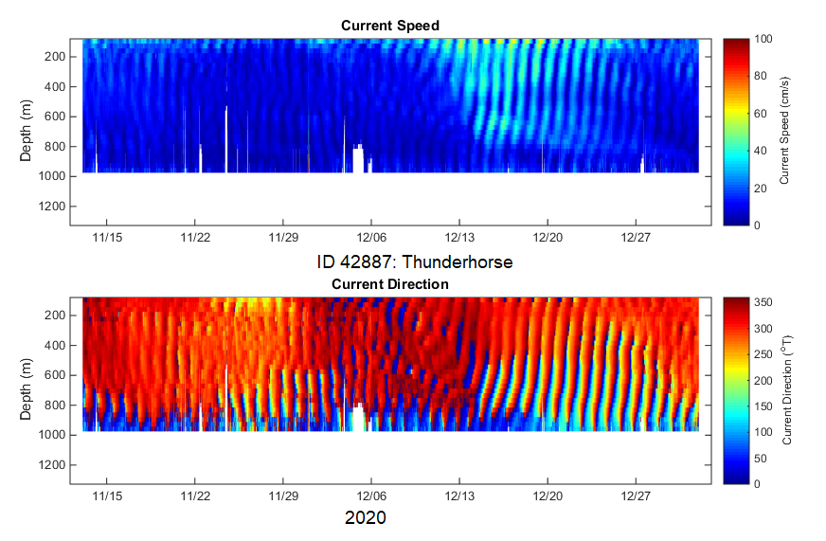
What does good QA’d data look like?

Slide 25
UGOS-1 NTL Data Summary
2005-2010 NTL Data (Deepstar)
  Total data processed: ~230 ADCP-years (estimated)
  Percentage Good QA’d data: ~ 65%
  Good QA’d data: ~ 151 ADCP-years
2011-2018 NTL Data
  Total data processed: 186 ADCP-years (67,946 instrument-days)
  Percentage Good QA’d data: ~ 60%
  Good QA’d data: ~116 ADCP-years (42,317 instrument-days)
2019-2020 NTL Data (QA still in process)
  Total data collected: 31 ADCP-years (11,266 instrument-days)
  Percentage Good QA’d data: ~ 60%
  Good QA’d data: ~18.6 ADCP-years (~ 6,790 instrument-days)
2050-2020 total good data: ~ 286 ADCP years

Slide 26
Conclusions
The NTL data comprise a massive archive of high-quality deep-water current profiles, which is valuable for numerical model validation and calibration, analytical studies, and structural design and installation engineering
The NTL program is decentralized and suffers from a lack of attention to quality control. There is no equivalent to a Principal Investigator, nor any Standard Operating Procedures (SOP), and documentation is deficient
Post-processing QA screening by qualified oceanographers has been found to be necessary to detect and correct metadata errors and weed out invalid data
To date, it has not been possible to weed out invalid data on a real-time basis using automated QA screening
Contrast this to other operational data agencies, such as NDBC

