Slide 1
Leadership in Coastal Resilience A Study by the NOAA Science Advisory Board
in collaboration with the Ecosystem Sciences
and Management Working Group (ESMWG)
Molly McCammon
Co-Chair, ESMWG
Director, Alaska Ocean Observing System
June 14, 2021

Slide 2
Context
Coastal Resilience: identified by NOAA Science Advisory Board (SAB) as potential Long-Term Priority; named as Goal 5 within Decadal Vision for America’s Oceans; and pillar of NOAA’s Blue Economy.
US ocean, coasts and Great Lakes: comprise a trillion-dollar property market; provide intermodal transportation hubs for global trade; and support ecosystems, harbors, and facilities essential to fisheries production, including growing interest in aquaculture.
Coastal areas are essential to the Blue Economy.
Changes at the coast can have cascading impacts to broader national economy and national security readiness.

Slide 3
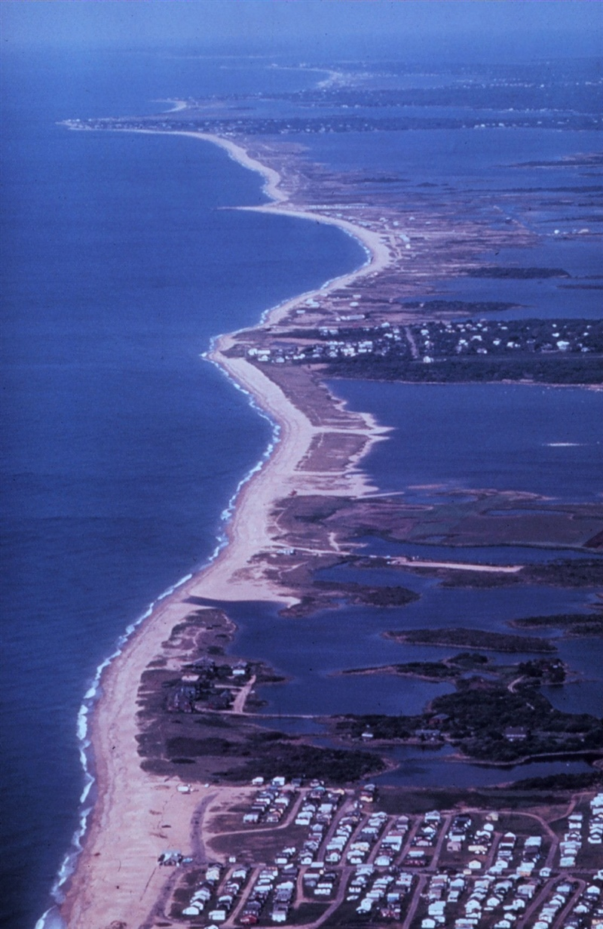
Study Goals
To support NOAA’s national leadership role in coastal resilience, NOAA SAB is:
Developing White Paper that recommends long-term (3-10 years out) research and development (R&D) agenda for NOAA to
Ensure that our nation’s coasts and coastal infrastructure, and those who rely on them, are resilient to both acute and chronic threats.

Slide 4
Study Goals
The R&D needs recommended will be:
Practical - that support the future needs of coastal decision makers and managers across multiple facets of coastal resilience.
Ambitious - that seek to advance holistic understanding of interacting social, ecological, and physical dynamics and their response to both acute and chronic threats.
Aspirational - activities that we cannot presently undertake due to limited data, knowledge, or integrative tools.

Slide 5
Timeline
JULY - AUG //
GATHER INPUT
Focus Groups
Stakeholder meetings
Interviews
MAR - APR // PLANNING
Map NOAA programs
Identify stakeholders
Develop questions
SEPT - NOV //
DEVELOP REPORT
Identify recommendations for future R&D activities
MAY - JUNE // CONTACT / PREP
Contact stakeholders
Share background
Schedule meetings
AUG - SEPT // SYNTHESIZE
Findings from NOAA Mapping
Findings from stakeholder engagements
NOV // TRANSMIT TO SAB
Present recommendations at SAB meeting

Slide 6
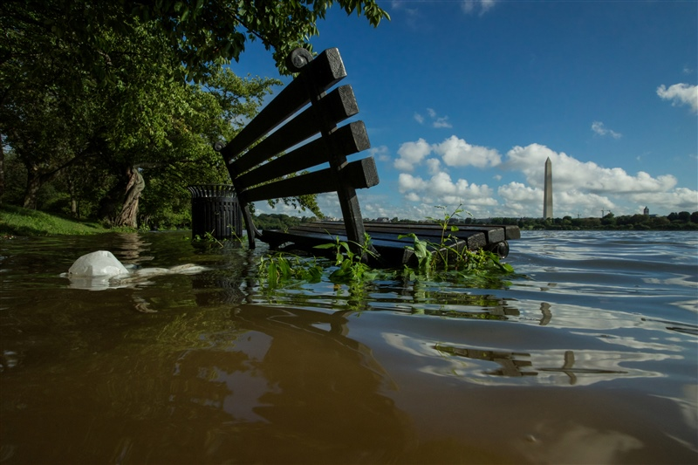
Today’s Purpose
Developing a Coastal Resilience R&D agenda will be driven by future challenges confronted by coastal resilience practitioners; emerging science and technology; and skills and expertise of NOAA and partners.
We are seeking your input as knowledgeable individuals and technical experts to help the SAB recommend the R&D agenda that meets a variety of future needs.

Slide 7
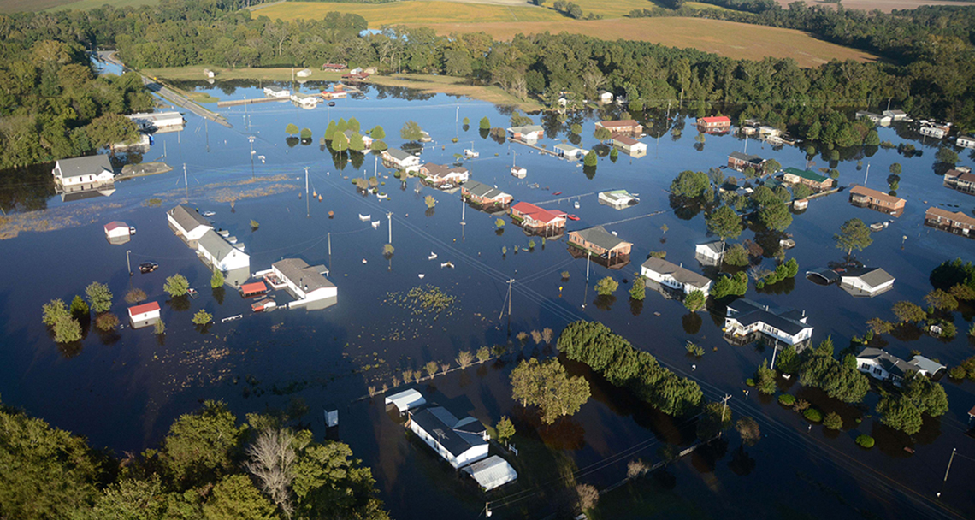
Coastal Resilience Definition
“The ability to prepare for, absorb, recover from, and successfully adapt to change. Change can be at multiple timescales and change can be physical, biological, or ecological. This can be specific events (storms and hurricanes, pollutant spills, Harmful Algal Blooms) or ongoing change (ocean warming, shifting Great Lakes water levels, sea level rise).”
- Mark Osler, Senior Advisor for Coastal Inundation and Resilience, NOAA

Slide 8
Questions for Consideration
What is the most important long-term challenge to coastal resilience that NOAA should assist with? How should NOAA assist?
What are the decisions that need to be made for which the necessary information or tools are not available that NOAA should provide?
What are vital R&D contributions for NOAA to make in this space, as compared to contributions from other federal agencies, local governments, academia, or the private sector?
How might emerging and future technologies (i.e., AI/machine learning, innovation in satellite observations, autonomous platforms) be used to further coastal resilience?
Where do we want the nation to be in terms of coastal resilience in 10 years, and what do we need to get there?

Slide 9
Additional Focus Groups
If you, or someone you know, would like to provide additional feedback for this project, we have four upcoming focus groups scheduled:
Tuesday, July 13, 5:30 - 7:30pm ET
Wednesday July 14, 1:00-3:00pm ET
Monday, July 26, 5:30 - 7:30pm ET
Thursday, July 29, 2:00 - 4:00pm ET
You can register for one of the above focus group discussions at this link.
Thank you!

