Slide 1
Google Summer of Code 2012
SafeFromHome
Tuesday, June 15th
Micah Wengren
Matt Biddle
Filipe Fernandes

Slide 2
Google Summer of Code (GSoC) is a global program focused on bringing more student developers into open source software development.
Students work with an open source organization on a 10 week programming project during their break from school.

Slide 3
16,000+ STUDENTS, 111 COUNTRIES
16 YEARS, 715 OPEN SOURCE ORGANIZATIONS
38,000,000+ LINES OF CODE

Slide 4
GSoC and Met/Ocean and related Sciences:
Clear Climate Code
52North
OPeNDAP
ESIP
Probably more…

Slide 5
Changes in GSoC 2021 Edition
1. Reduced Time Period for Coding: 175-hour project over a 10-week coding period.
2. Reduced Stipend: Almost half of the stipend given last year.
3. Eligibility: Students enrolled in post-secondary academic programs along with who are graduated between December 1, 2020, and May 17, 2021. And, all those students who are studying in licensed coding schools. Applicants should not have participated in GSoC more than once because.
4. Reduced Evaluation: From 2021, the number of evaluations is also reduced from 3 to 2.

Slide 7
Qi Zeng: ERDDAP Translation
Second year computer science & math undergraduate student in Georgia Institute of Technology.
Will be working on translating ERDDAP's user interface to other languages to improve the oceanic data's accessibility to non-English countries.

Slide 9
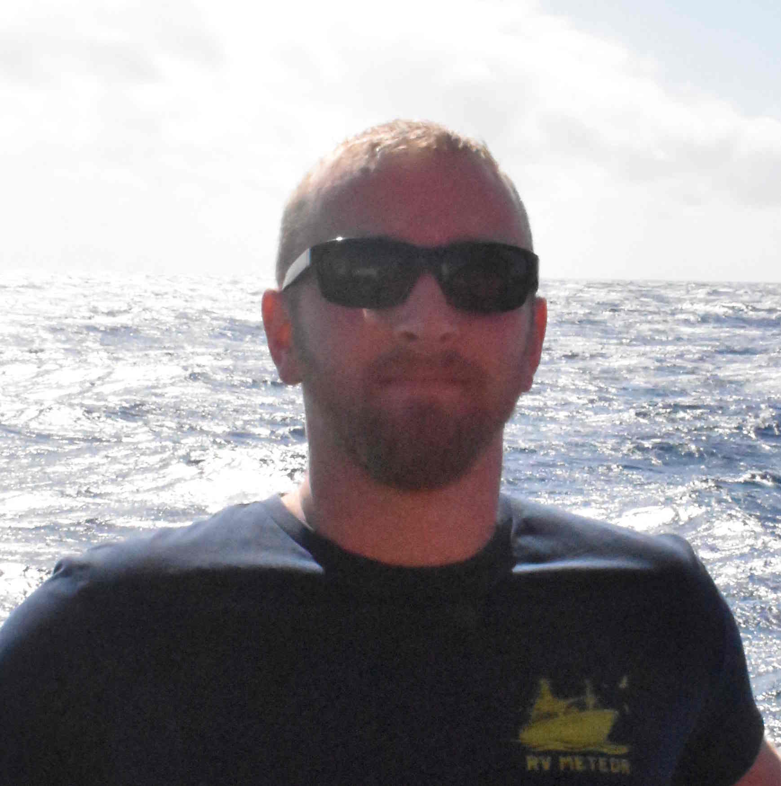
Callum Rollo: erddapy/gliderpy
PhD student with the glider group at the University of East Anglia, UK.
PhD is focused on the use of an ADCP on an autonomous marine glider.
Lead a Python users group and teach introductory Python at UEA and online with The Carpentries.
Contributor to GliderTools, a Python toolbox for glider data processing.
Outside of work I kayak, cycle tour and try to learn Spanish.

Slide 10
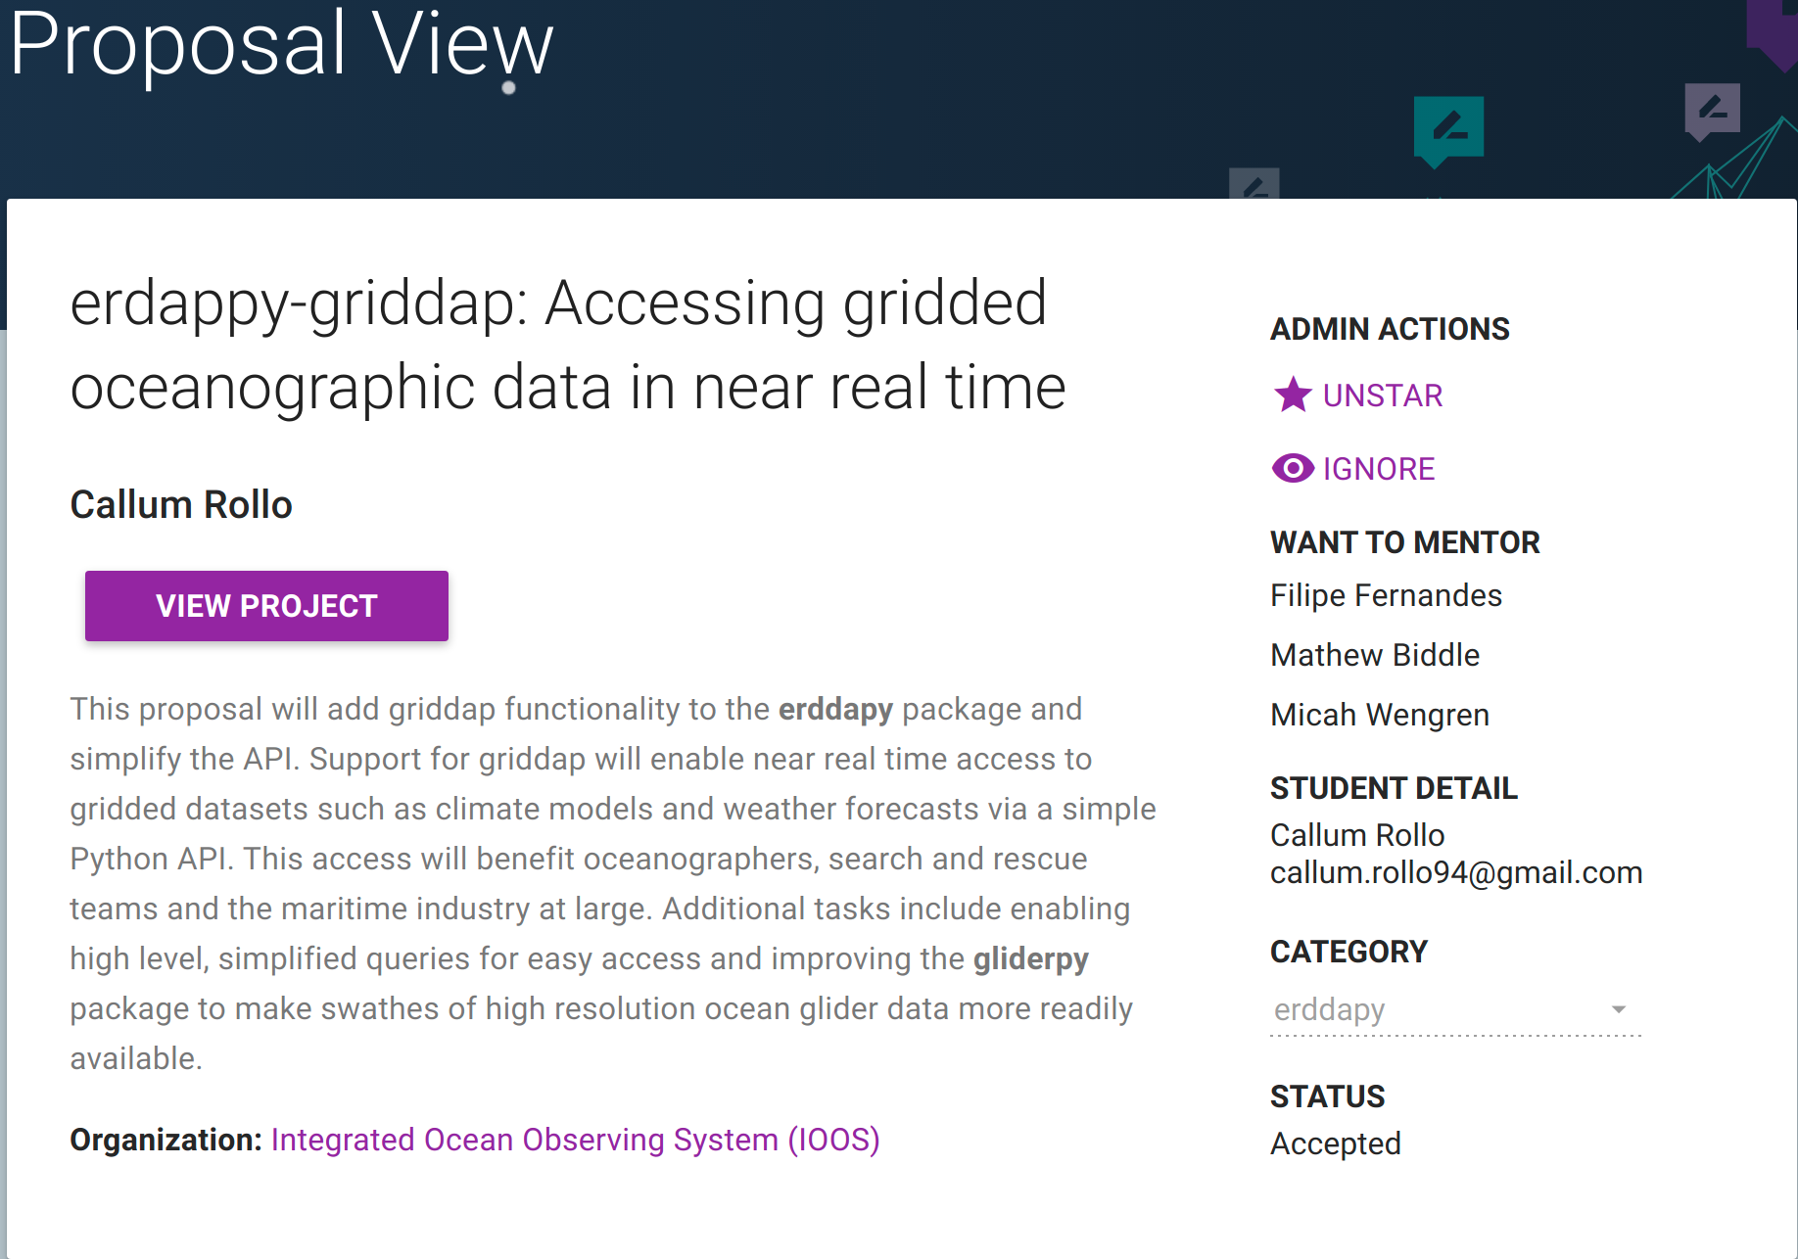

Slide 11
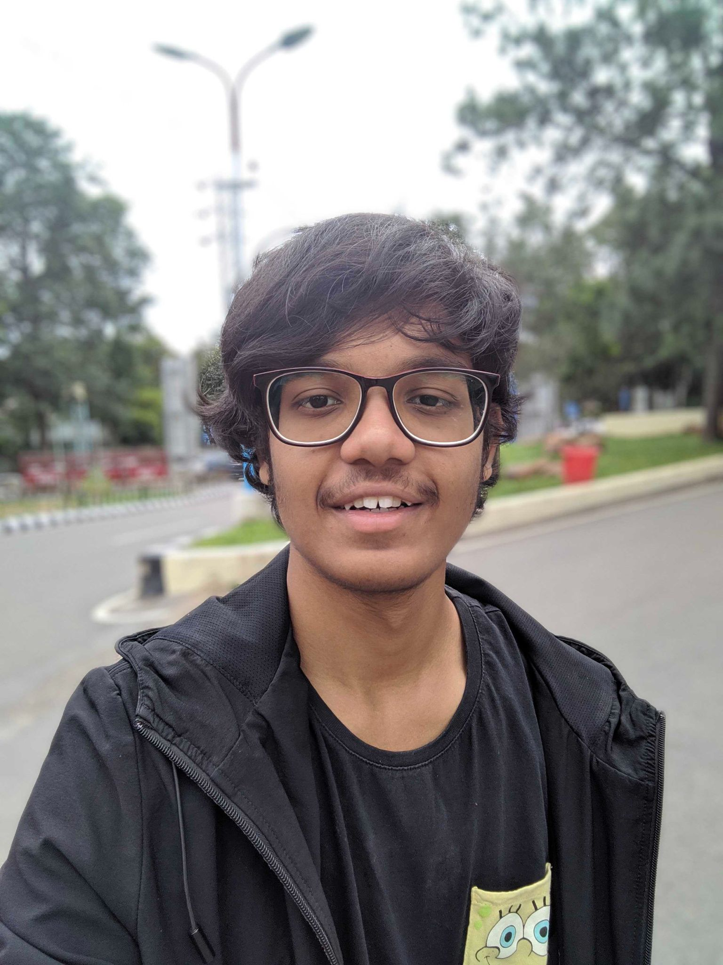
Munakala Lohith: ML/JupyterBook
3rd Year computer science undergraduate from Indian Institute of Information Technology Kalyani.
Specialising in computer vision and image processing.
Deep learning enthusiast.

Slide 12
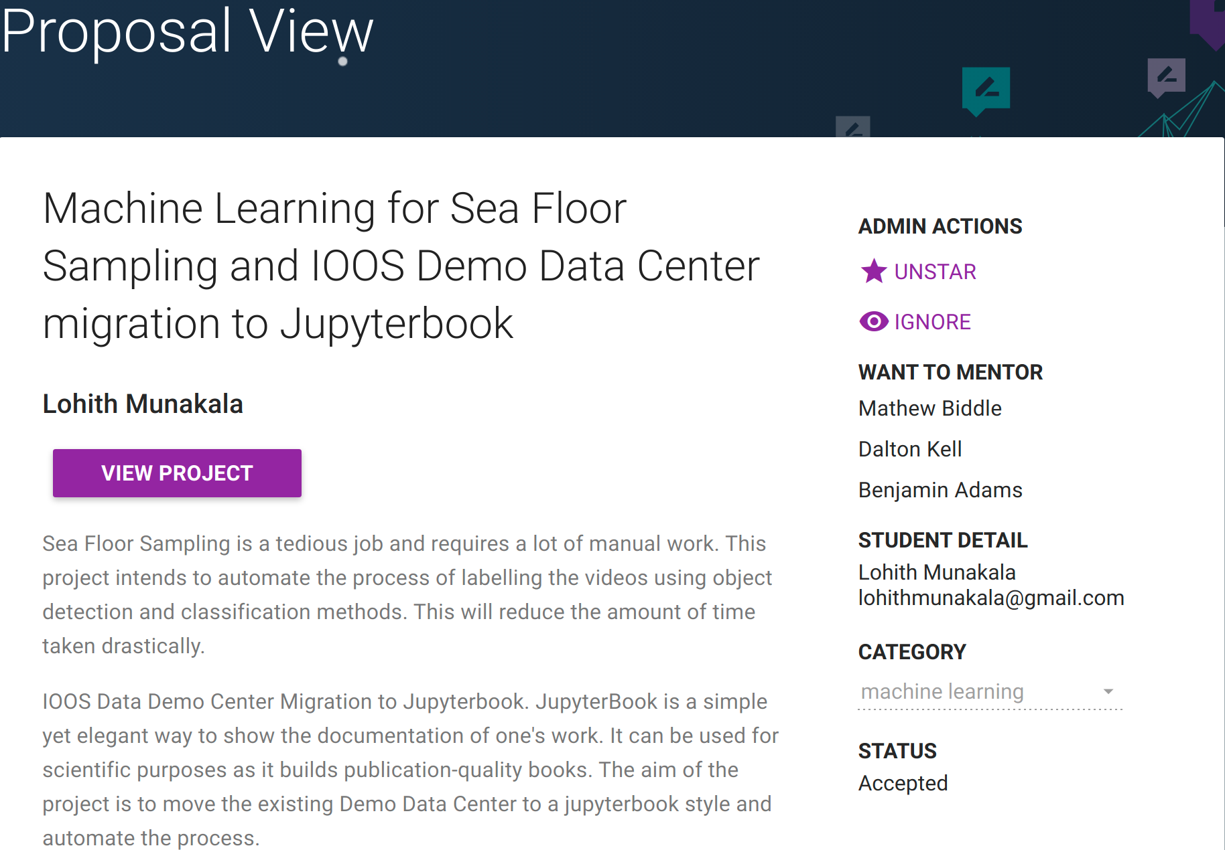

Slide 13
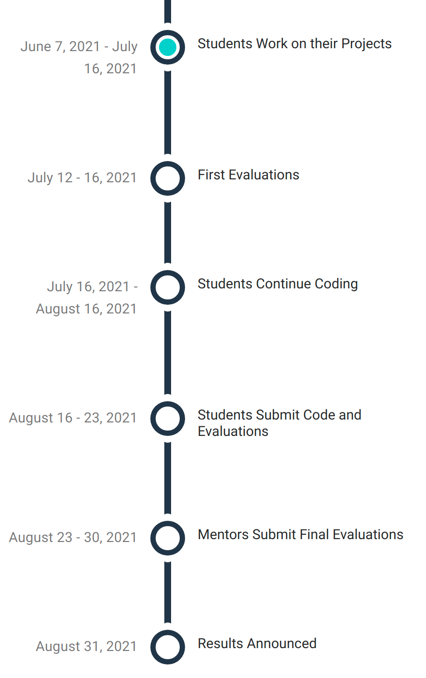

Slide 14
Thank you!
Google for granting 3 slots
Micah Wengren for the support with the application
Mathew Biddle, Benjamin Adams, Dalton Kell, and Bob Simons

Slide 15
Extra Slides
Can we do more than GSoC?
Outreachy
Hacktoberfest
Google Code-in

