Slide 1
Faster Visualization of Gridded Data
Luke Campbell

Slide 2
Introduction

Slide 3
Acknowledgements

Slide 4
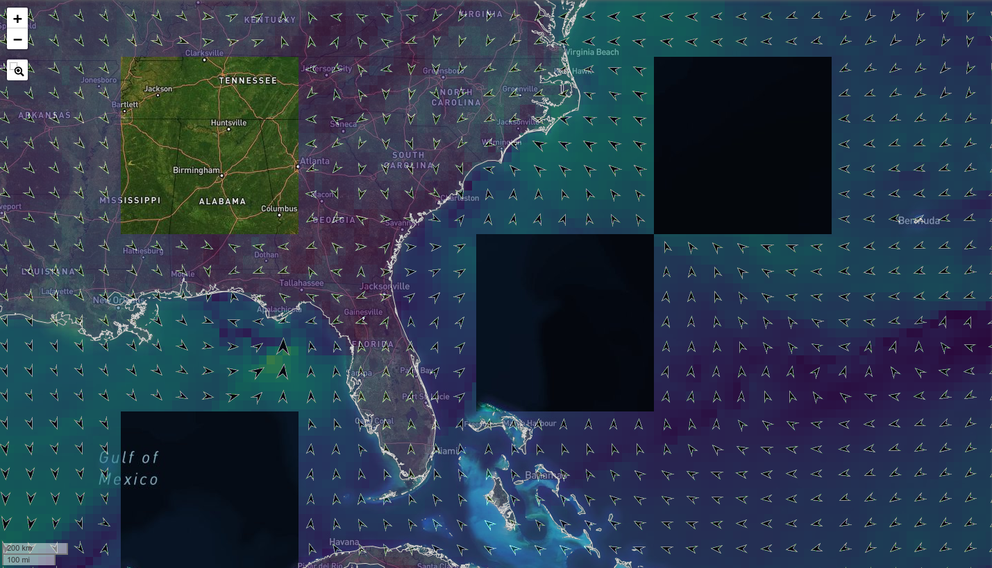
Problem

Slide 5
What We Want
Scalable
Reliable
Styleable
Fast

Slide 6
What We Want: Scalable
Scalable means tiles.
Scalable means we can make more services instead of making one service better.
Concurrent HTTP Requests
Aggressive Caching
Storage Efficient

Slide 7
What We Want: Reliable
We don’t want holes in our map.
We don’t want half the map to load slower than the other half.
We don’t want half the map to look different than the other half.
Most importantly: we want it to just work.

Slide 8
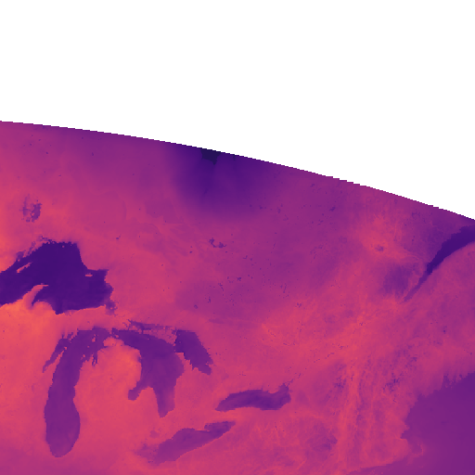
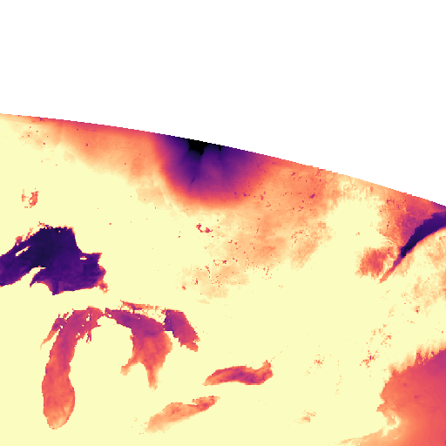
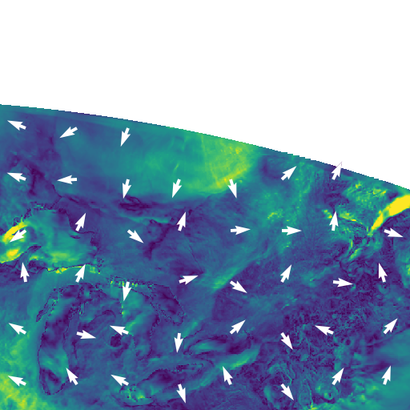
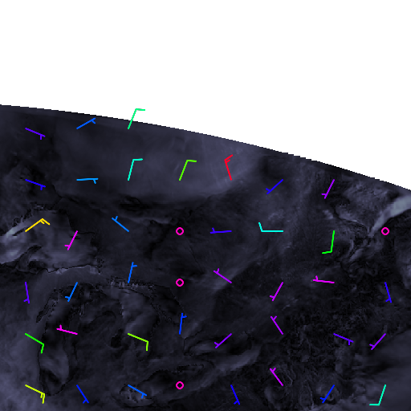
What We Want: Styleable
Client specified color maps
Client specified color map ranges
Wind Barbs for vectors
Quivers for Vectors
Show only barbs/quivers
Color mapping for the barbs/quivers

Slide 9
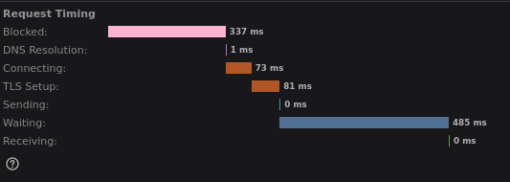
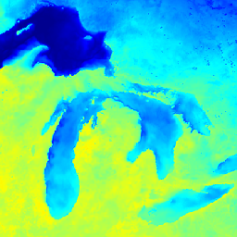
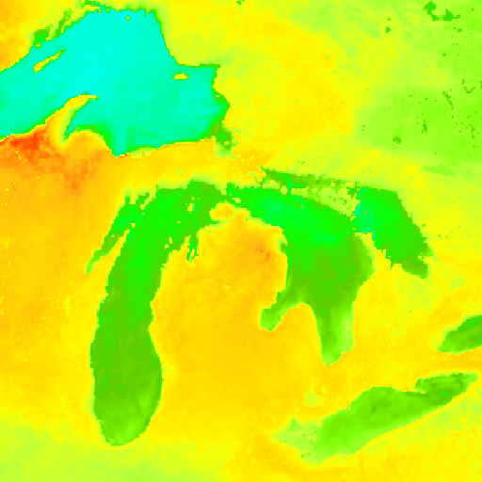
What We Want: Fast
The entire map of the viewport should be loaded in under 1s. Ideally under 500 ms.
Goal: Tiles should load in under 350 ms.
ncWMS
Newgrids

Slide 10
What We Want: Fast
The entire map of the viewport should be loaded in under 1s. Ideally under 500 ms.
Goal: Tiles should load in under 350 ms.
ncWMS
Newgrids

Slide 11
Grid Types

Slide 12
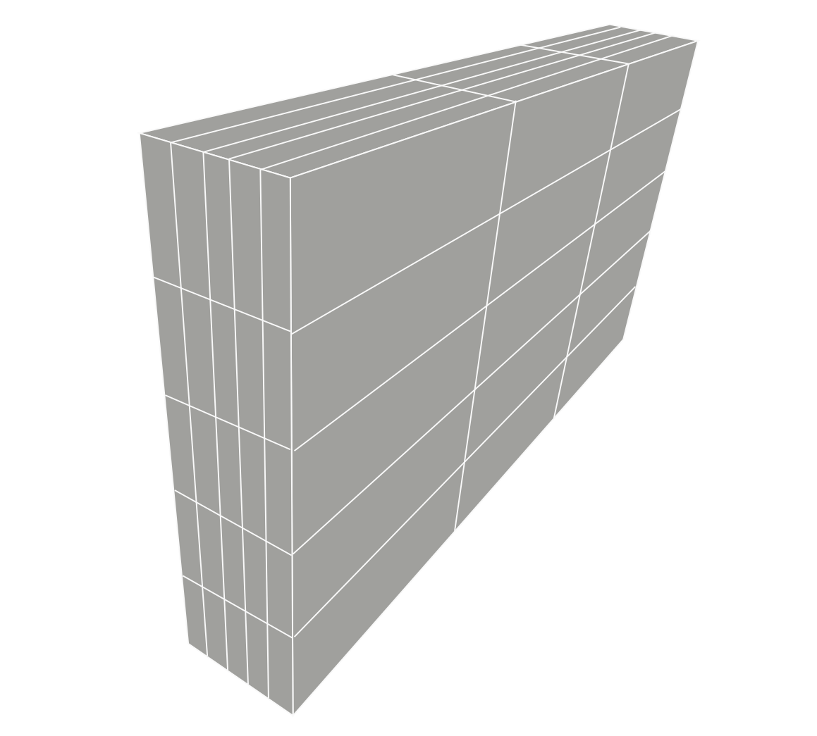
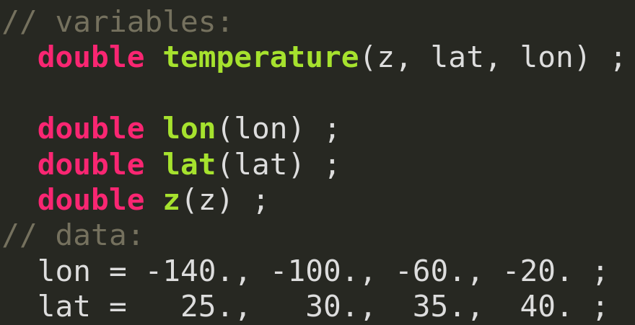
Rectilinear Grid
HYCOM
Satellite Imagery Bands
GFS
GFSv16 Wave
WAVEWATCH III

Slide 13
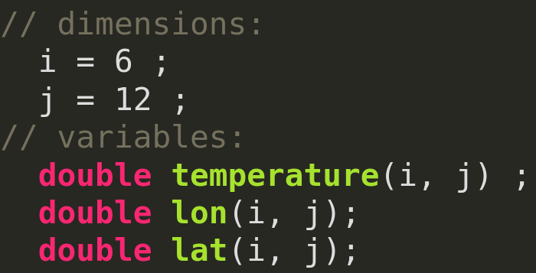
Curvilinear
ROMS (Arakawa Staggered C-Grid)
HRRR Projected from LCC
COAMPS Projected from LCC
HYCOM Regional Products
HIOMAS
Radial Data

Slide 14
Unstructured Grid
FVCOM
ADCIRC
SWAN

Slide 15
Historical Approaches

Slide 16
Historical Approaches: Tile Mosaics
Styling is limited: Only some browsers can colormap images using CSS.
No vector quiver/wind-barbs.
Inefficient space.
Huge inode counts.
Only works with rectilinear grids in EPSG:4326 coordinates.
No antimeridian support.

Slide 17
Historical Approaches: GeoServer
Slow
Larger burden on operations
Lots of custom Java code needed
Version lock-in

Slide 18
Newgrids

Slide 19
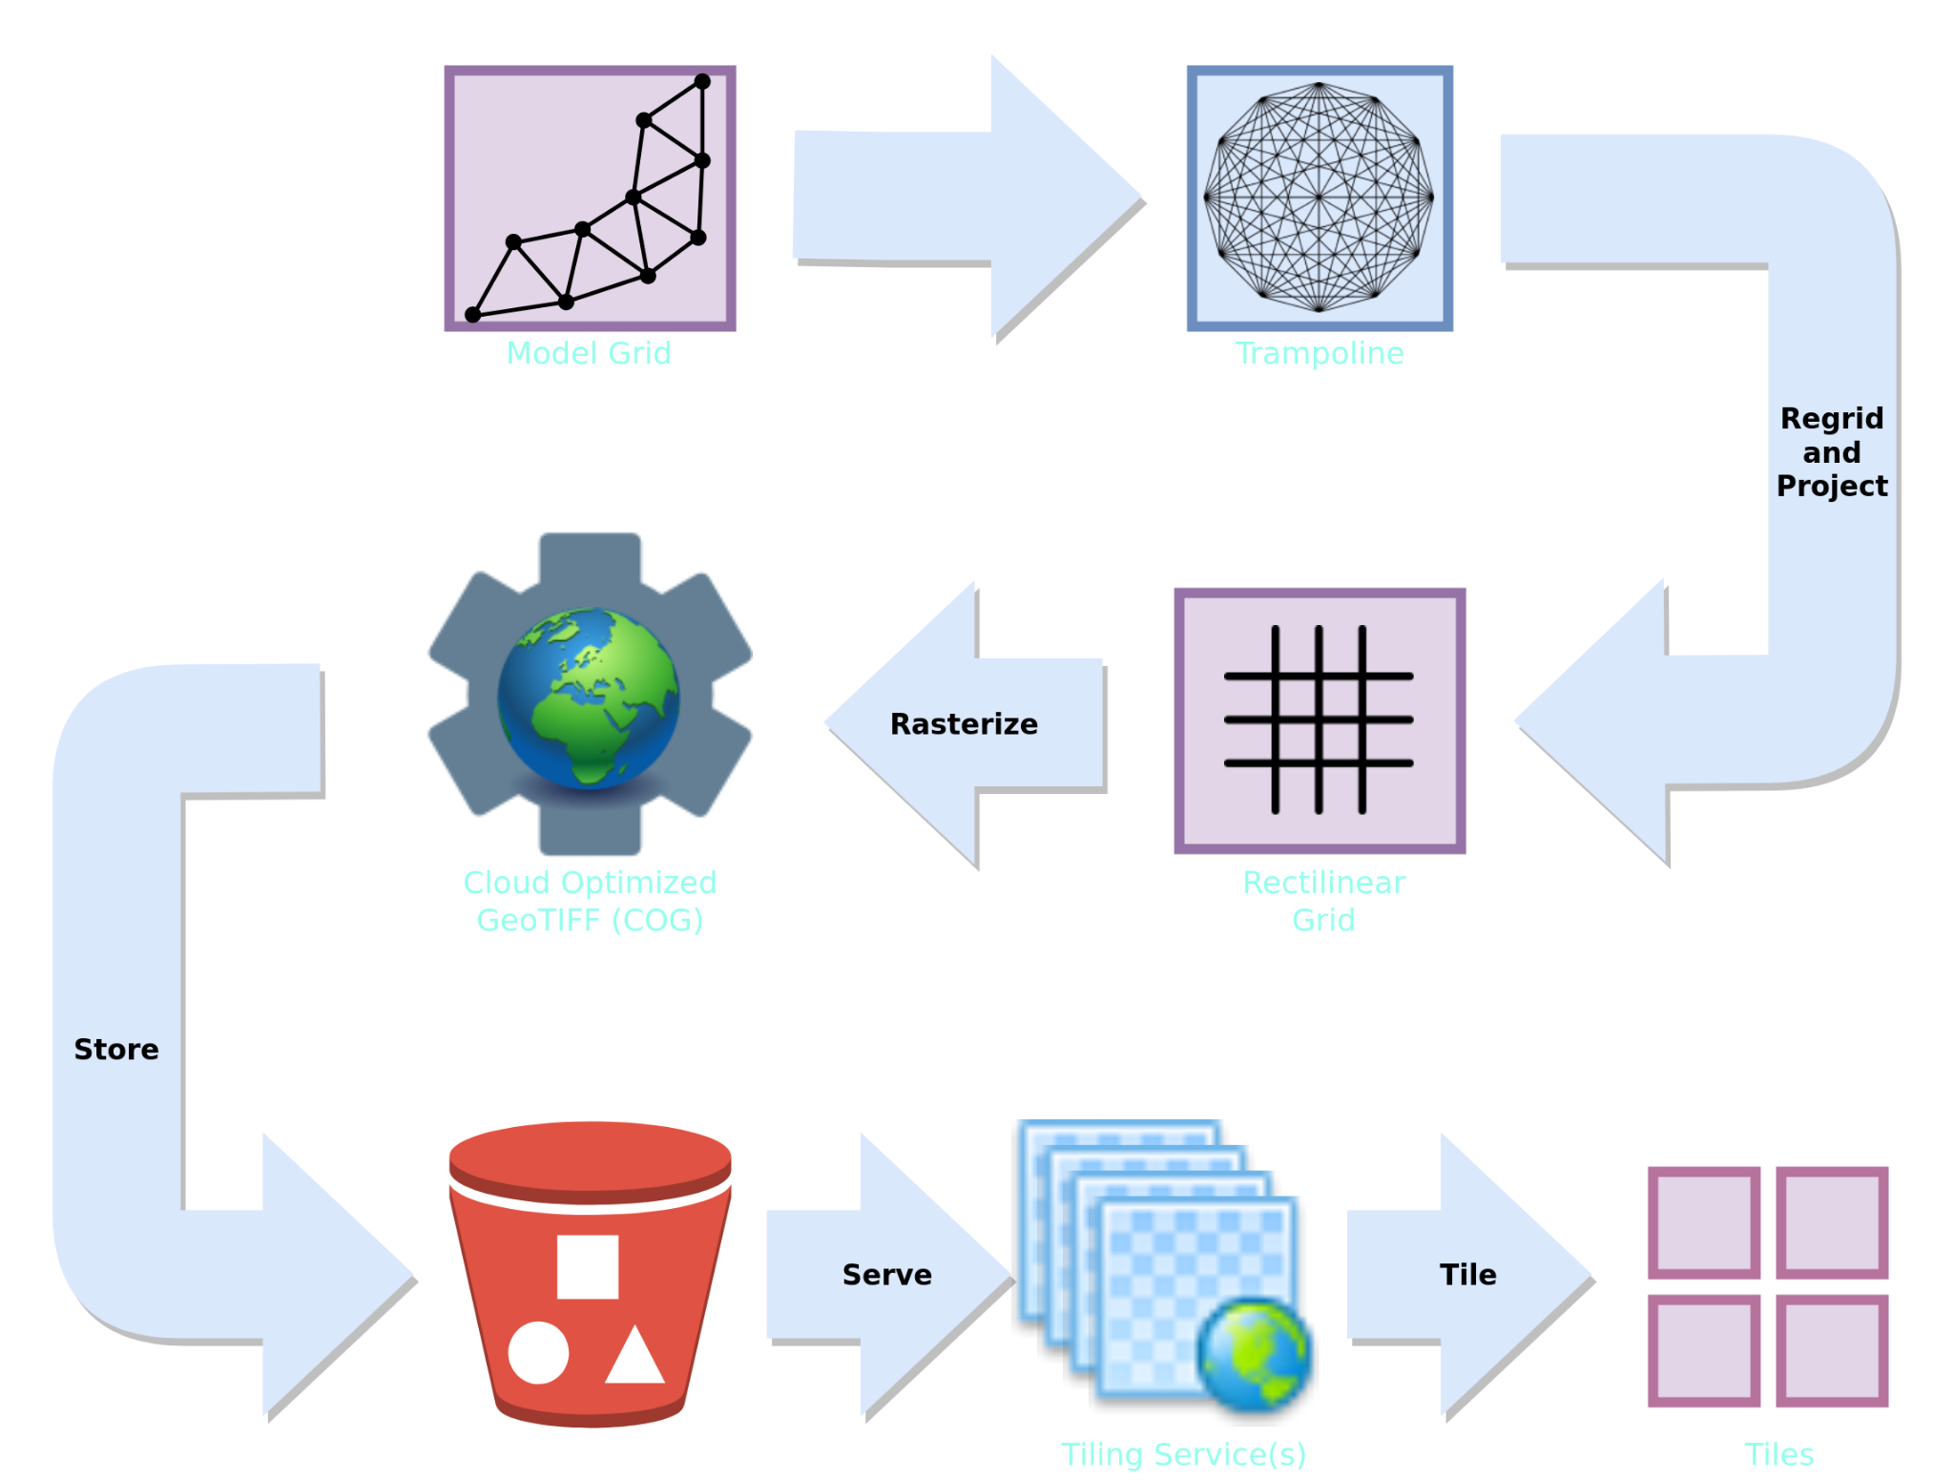
Newgrids

Slide 20
Rasterization
Step 1. Download netCDF
Step 2. ?
Step 3. Profit
Notes:
Rasterization is the answer to the question: How do I convert model gridded data in netCDF to a Cloud Optimized GeoTIFF?

Slide 21
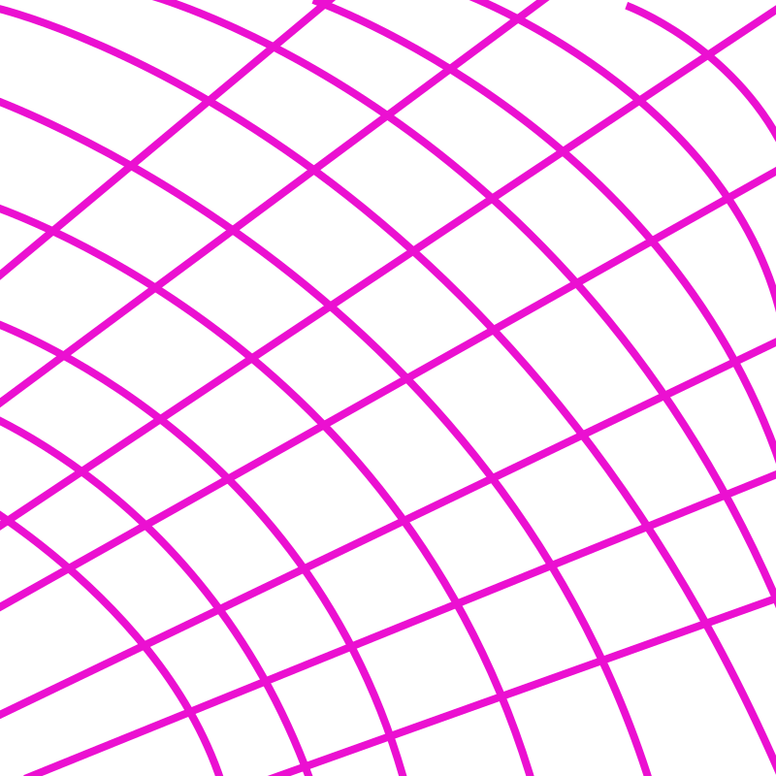
Sampling and Shape Function

Slide 22
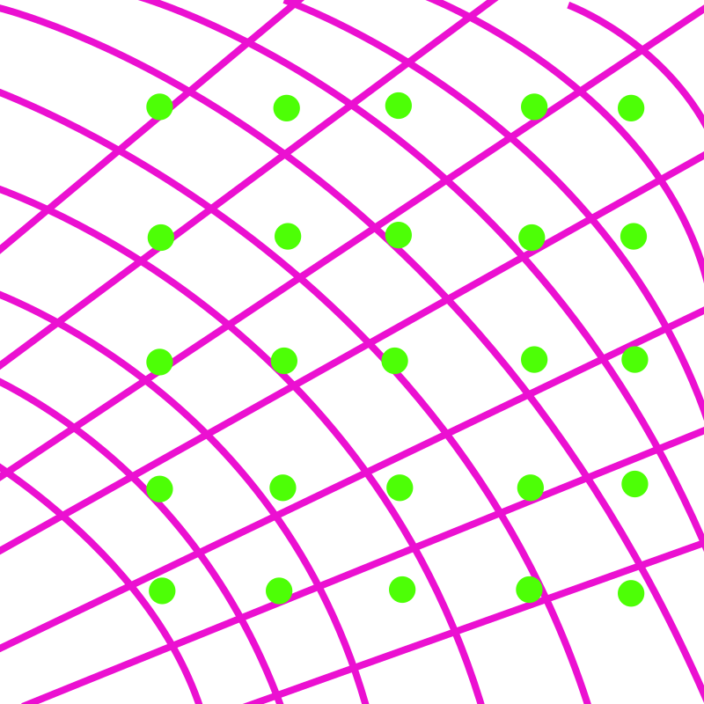
Sampling and Shape Function
The grid is sampled at each pixel of the output raster image, using a shape function appropriate for the grid.
Vector components are transformed based on the coordinate transform.
Notes:
Shape functions for rectangular grids are usually bilinear interpolation, and bivariate splines. The shape function for curvilinear and unstructured grids is a barycentric interpolation. Each grid we process is specifically configured and the configurer can elect specific strategies for sampling.

Slide 23
Sampling and Shape Function
The sampling and interpolations are performed with custom C code that is highly optimized for this specific case.
Notes:
We found that scipy, qhull, and CGAL were just too slow for sampling.

Slide 24
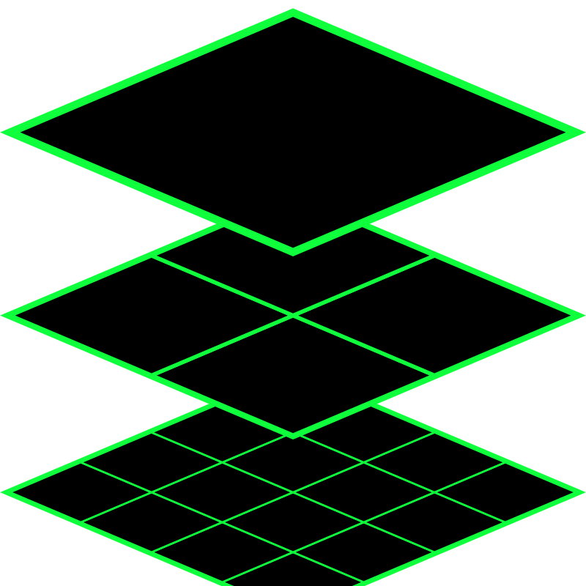
Cloud Optimized GeoTIFF (COG)
Cloud Optimized GeoTIFFs are the perfect delivery vehicle for map raster images, especially tiles.
The two main techniques that COGs take advantage of are tiling and overviews.

Slide 25
Cloud Optimized GeoTIFF (COG)
The high resolution raster image is chunked into 512x512 pixel tiles.
Clients only need to read the tiles they are interested in, and can skip directly to the tile. Tiles can be directly copied from disk to memory to network without any manipulations.

Slide 26
Cloud Optimized GeoTIFF (COG)
Each COG has overviews. Each overview is a downsampled version of the same image, as if it were “zoomed-out.”
Clients can jump to the resolution of the tile they want without reading the entire file.

Slide 27
Cloud Optimized GeoTIFF (COG)
The last major advantage is that clients can take advantage of HTTP GET Range requests to read tiles for a COG. This means COGs can be hosted over HTTP just as effectively as a file system.

Slide 28
Tiling Services Capabilities
Dynamic Styling and Colormap Selection
Color Range for the Colormap
Overlaying Vector Glyphs (Wind barbs and Quivers)
Can be scaled
Can be proxied

Slide 29
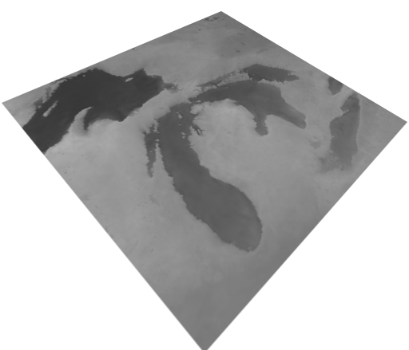
Tiling Services Capabilities

Slide 30
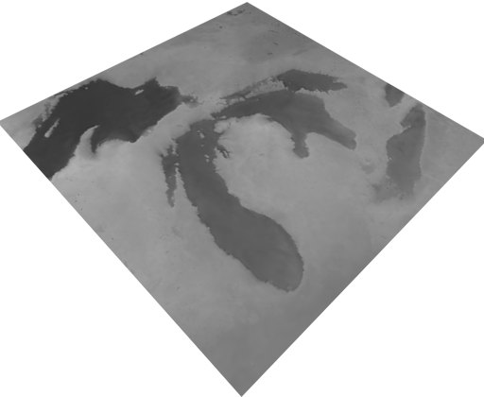
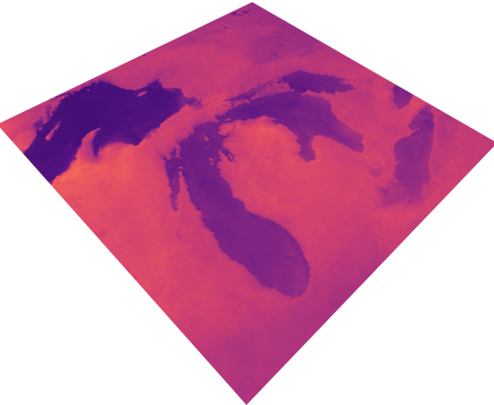
Tiling Services Capabilities

Slide 31
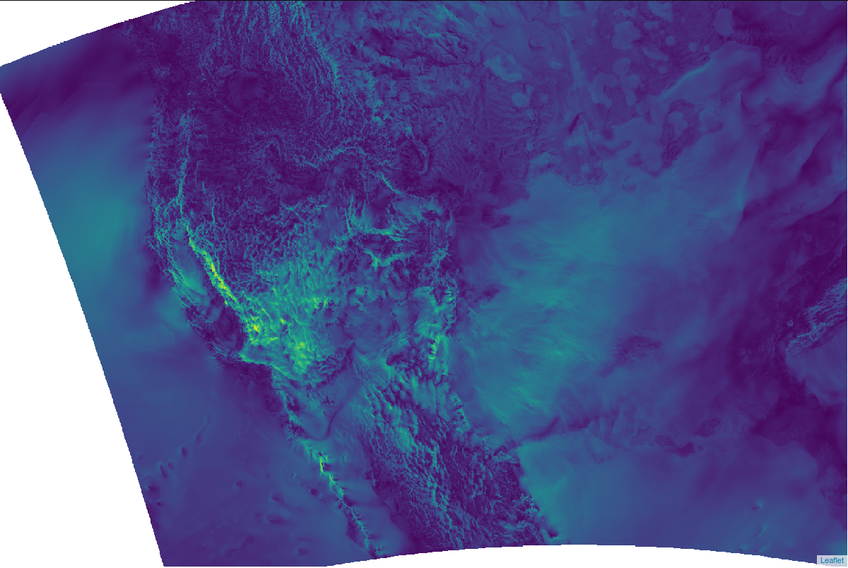

Slide 32
So, What is Newgrids?
Bespoke regridding strategy defined uniquely for each model.
Raster sampling is performed in each projection supported: EPSG:4326, EPSG:3857 (Web Mercator), EPSG:3571 (North Pole LAEA Bering Sea)
COGs are stored on AWS S3, Gluster, or even local caches for even faster reads.
Tiles can be served through dynamic styling service.
Aggressive caching, and proxies can radically improve User Experience.

Slide 33
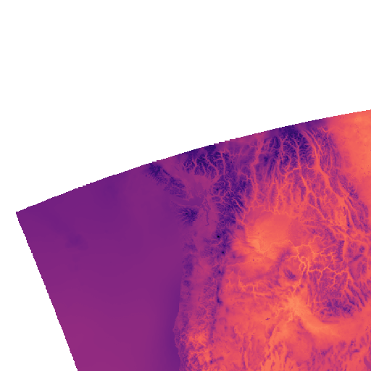
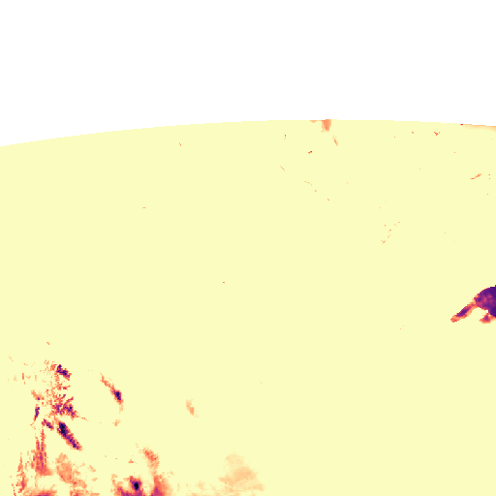
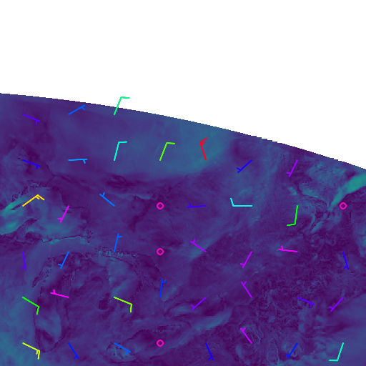
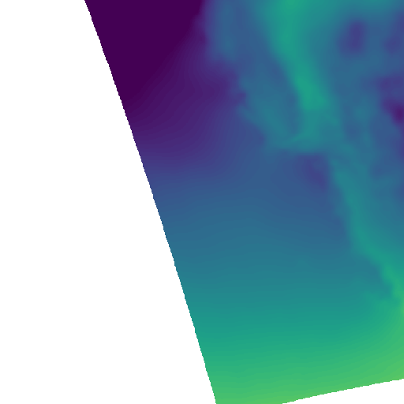
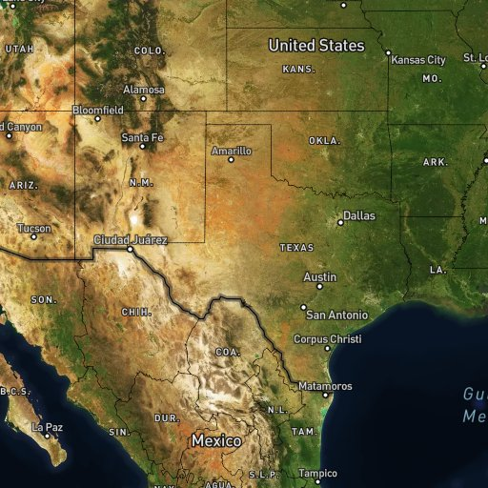
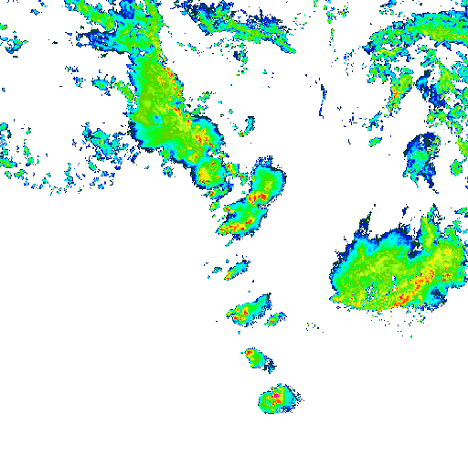
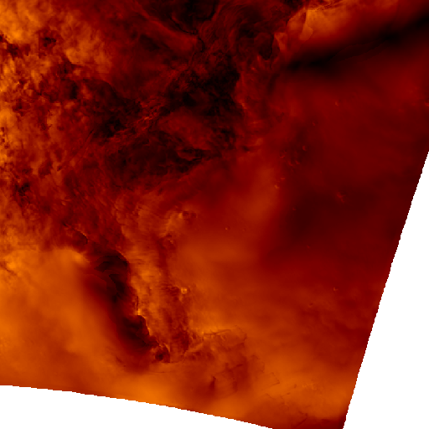
Notes:
HRRR CONUS, 2m Air Temp, 2m Dew Point Clamped, 10m Winds, 1000-500 mbar Thickness clamped, composite reflectivity, 10m wind gust.

Slide 34
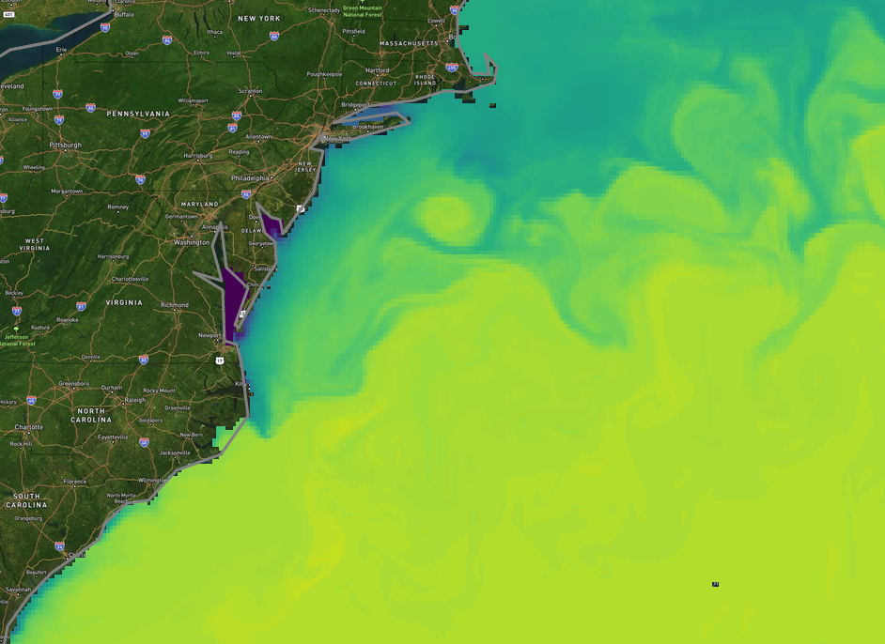
Notes:
HYCOM Surface Salinity

Slide 35
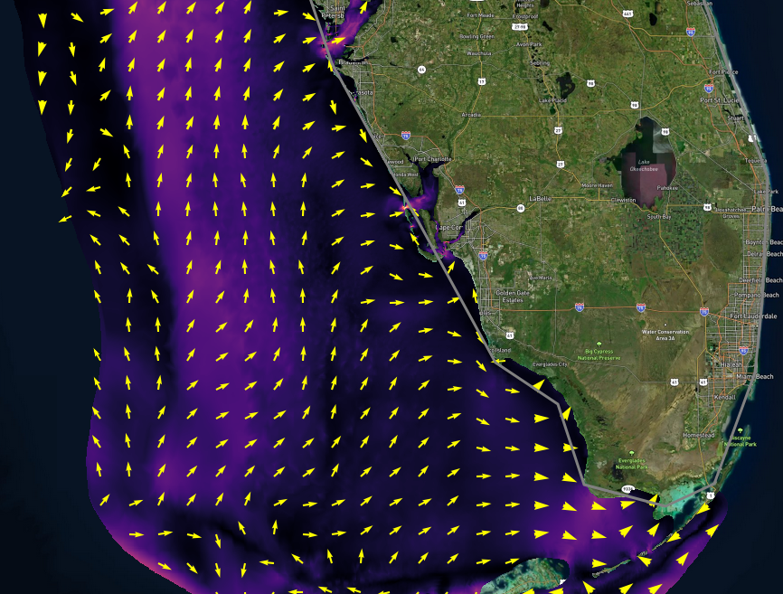
Notes:
USF FVCOM Surface Currents; Enhance

Slide 36
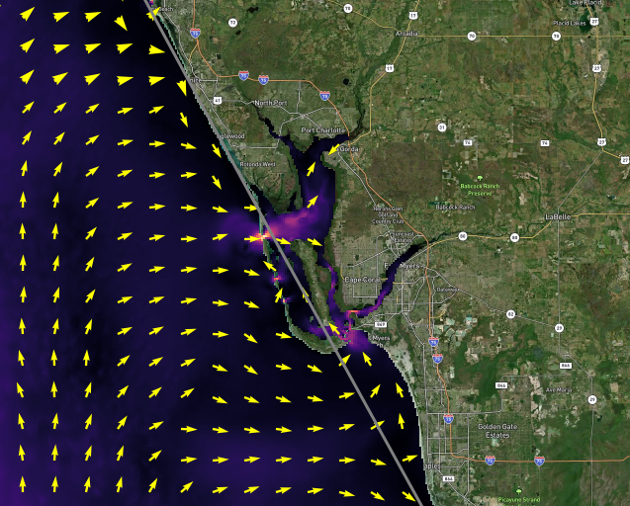
Notes:
Enhance

Slide 37
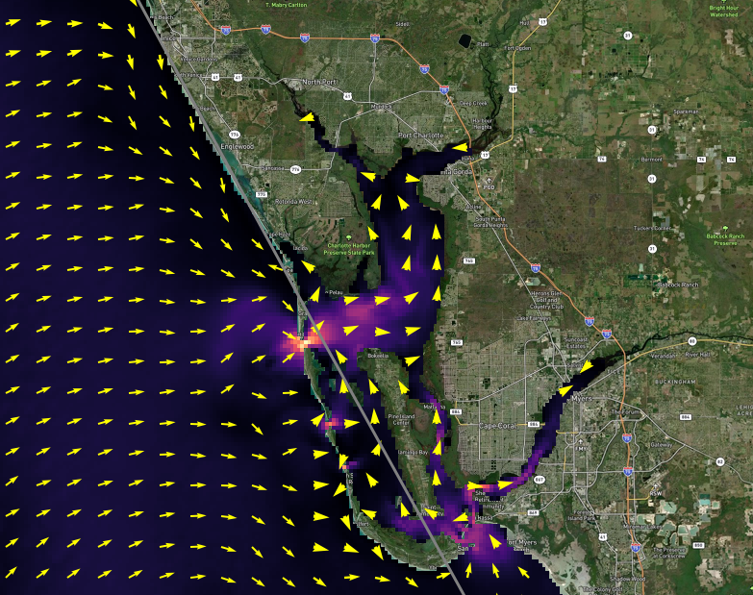
Notes:
Enhance

Slide 38
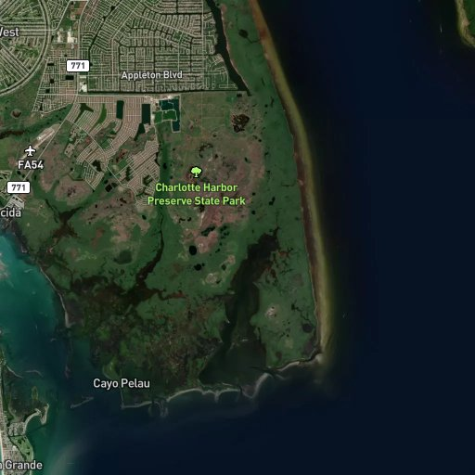
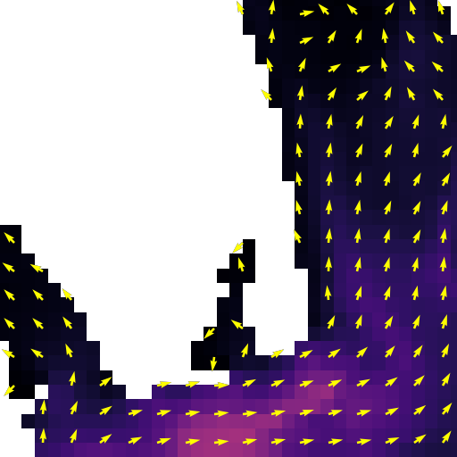

Slide 39
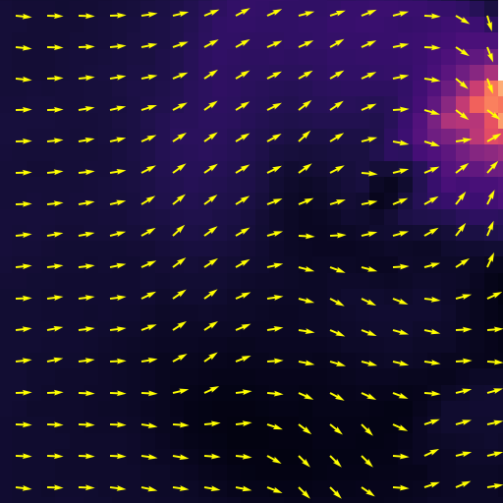
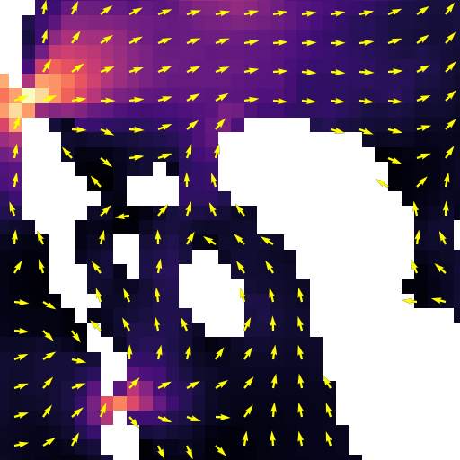
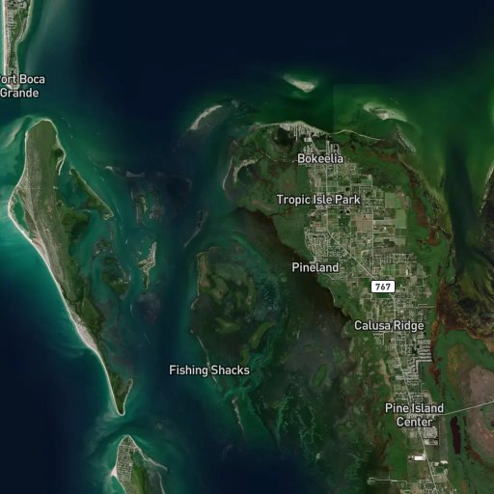
Notes:
More FVCOM

Slide 40
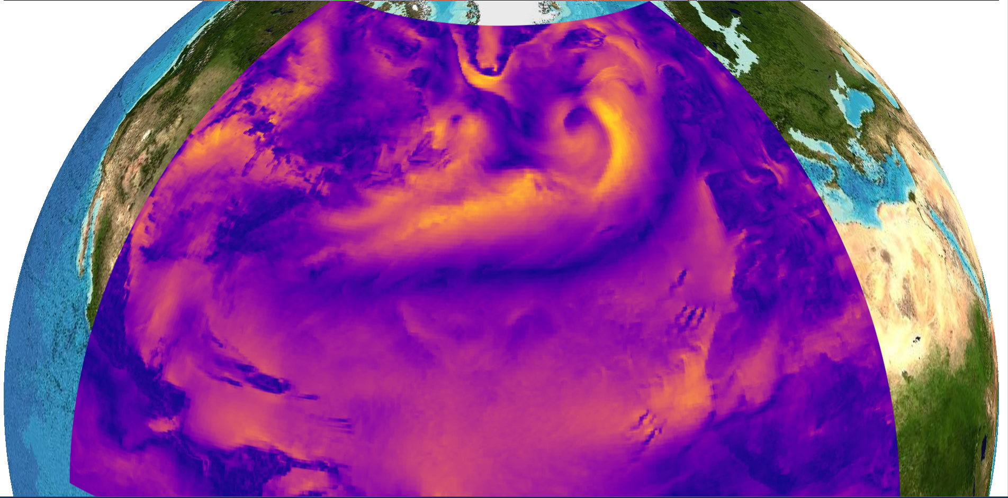

Slide 41
We’re only just getting started.

