Slide 1
IOOS FY22 President’s Budget Request Overview
Carl Gouldman, IOOS Office
June 14, 2021

Slide 2
Overview
The FY22 PresBud presents an extraordinary opportunity for the IOOS Enterprise
Largest PresBud Request for NOAA in history: $6.9B; an increase of $1.6B!
Largest increase request for the National Ocean Service + $223M over FY21
Largest increase request ever, for the U.S. IOOS Office and Regional Observations = +$54M above FY21 President’s Budget Request
‘Rebaseline’ includes + ~$21M
...plus Program Changes + ~$33M
https://www.commerce.gov/sites/default/files/2021-06/fy2022_noaa_congressional_budget_justification.pdf
NOS page # references - NOS- 34 IOOS with OCS and CO-OPS, 39, 44, 53, 57, 61

Slide 3
Summary overview - Big “Buckets”
Observations and Science: $21 M
Features:
Expanded observations to document climate impacts on marine life
Coastal Ecological moorings network build-out
Establish IOOS Marine Life Program and Data Assembly Center
Partnerships with NCCOS and Office of National Marine Sanctuaries (ONMS) on observation-based climate assessments of MPAs
U.S. IOOS Office - Staff, Data Mgmt, Prog. Mgmt, & Coordinating Science and Technology
Modeling and Data Management: $12
Features:
West Coast OFS Hindcast and Reanalysis
OFS development along the entire US Coastline*
Expanded COMT Award funds and modeling in RAs
U.S. IOOS Office Staff
*NOS lead CO-OPS and OCS and some IOOS involvement
Notes:
Assessing Ecological Change through Observation Networks

Slide 4
Refresh: IOOS Budget within National Ocean Service
Navigation, Observations, and Positioning PPA
Office of Coast Survey (OCS)
Center for Operational Oceanographic Products and Services (CO-OPS)
National Geodetic Survey (NGS)
U.S. IOOS Office “National Line”
Office Staff, performance monitoring, travel
U.S. IOOS Advisory Committee travel
Projects - DMAC, Science and Tech Coordination, Implementation workshops, studies, reports, etc.
IOOS Regional Observations PPA
IOOS Regional Associations
Coastal Ocean Modeling Testbed (COMT)
Ocean Technology Transition (OTT)
Biological Observations (NOPP and IOOC/ATN)
HABs
DMAC - Data Assembly Centers and co-development with RAs

Slide 5
FY22 PresBud Requests: IOOS Summary
Congressional Justification (CJ) Program Change Summary (PCS) Title | CJ Page # | Reg Obs ($M) | NavObsPos ($M)
Monitoring Ecological Change Through Observation Systems | NOS-53 | $ 15.0
Coastal Moorings with Ecological Monitoring | NOS-61 | $ 4.0
Fostering Ecological Resilience through Conservation Action | NOS-39 |  | $ 2.0
Advancing Coastal and Ocean Modeling and Prediction | NOS-57 | $ 10.0
Data Management and Cyberinfrastructure | NOS-44 |  | $ 2.0
Complete National Coastal Modeling Coverage (CO-OPS lead; $5M total) | NOS-34 |  | 0.25
TOTAL: |  | $ 29.0 | $4.25

Slide 6
Cross-NOAA Non-Satellite Ocean Observing
 | FY21 Enacted ($M) | FY22 PresBud ($M)
Navigation, Observations, and Positioning | 229.7 | 236.6
IOOS Regional | 40.5 | 69.5
IOOS National | 6.8 | 11.3
CO-OPS | 34.9 | 49.5
OCS (Base) | 56.2 | 60.1
OCS (Hydrographic Survey Contracts)
Sustained Global Ocean Observing (Global Ocean Monitoring and Observing Program) | 45.5 | 68.5
National Data Buoy Center | not in CJ | not in CJ

Slide 7
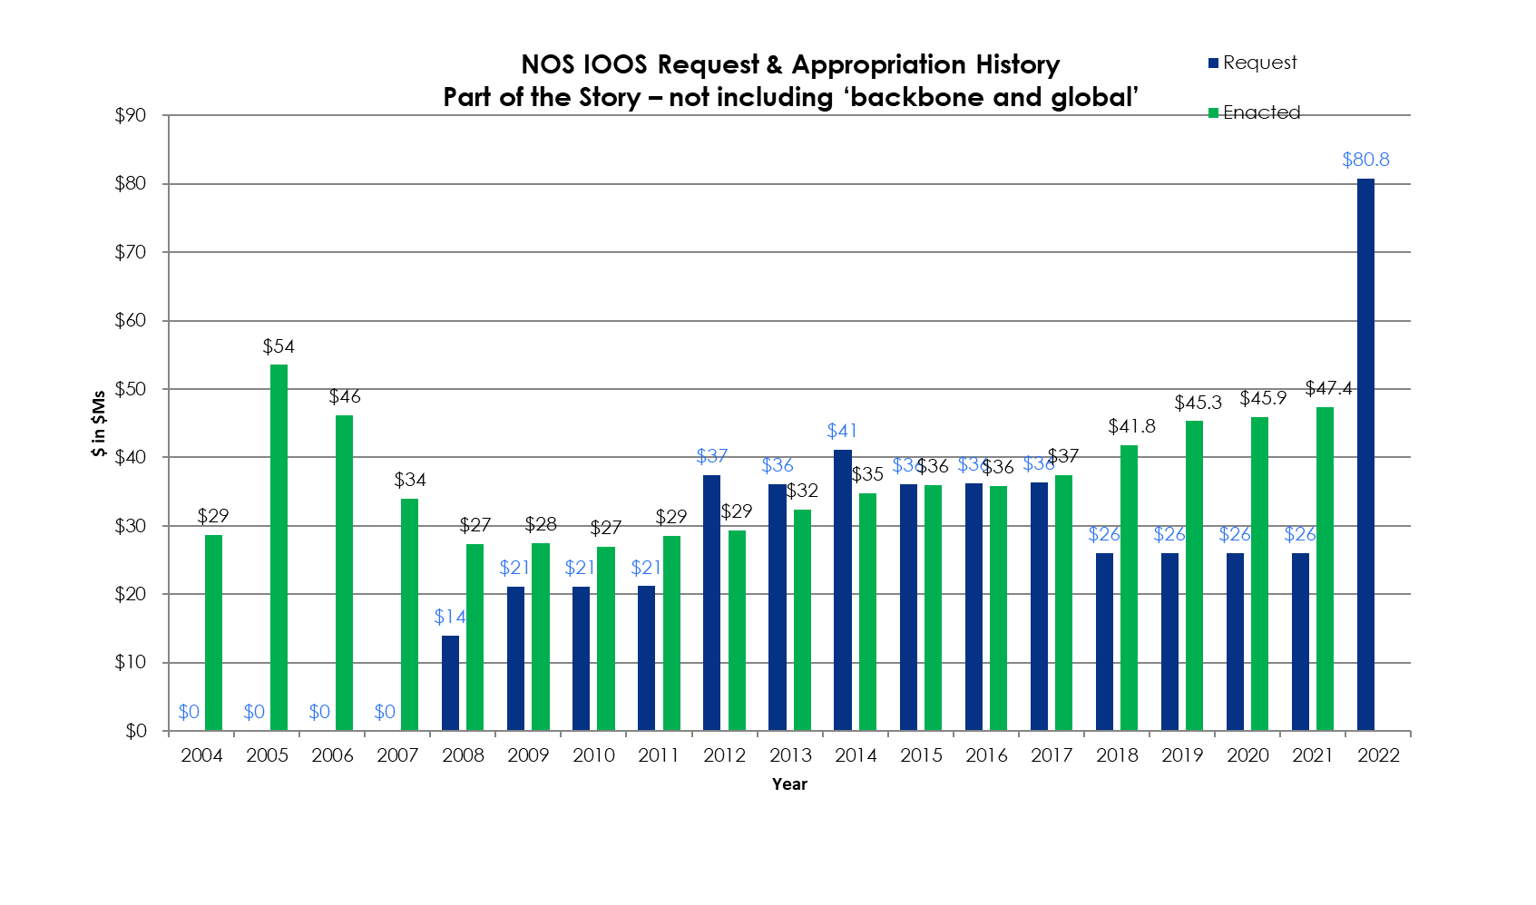
U.S. IOOS Enacted and President’s Budgets FY04-22
NOAA National Ocean Service
Navigation, Observations, and Positioning: ‘National IOOS’ & ‘Regional IOOS Observations’ added together
Estimated Enacted levels are ‘post rescission’ totals for each year
‘Request’ = the President’s Budget Request
‹#›

Slide 8
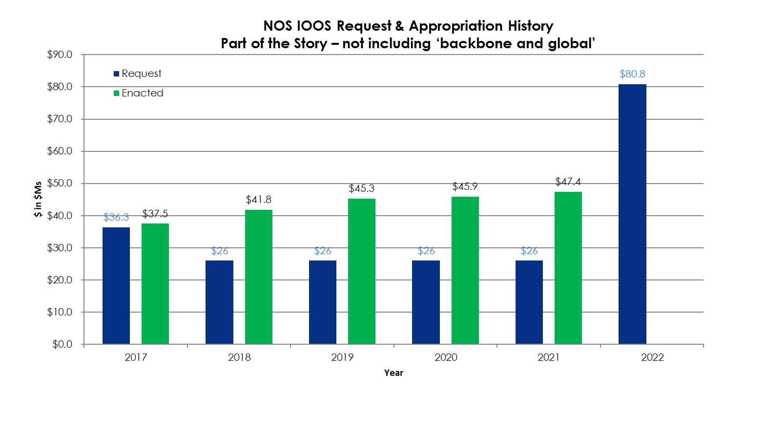
U.S. IOOS Enacted and President’s Budgets FY17-22
NOAA National Ocean Service
Navigation, Observations, and Positioning: ‘National IOOS’ & ‘Regional IOOS Observations’
Estimated Enacted levels are ‘post rescission’ totals for each year
‘Request’ = the President’s Budget Request
‹#›

Slide 9
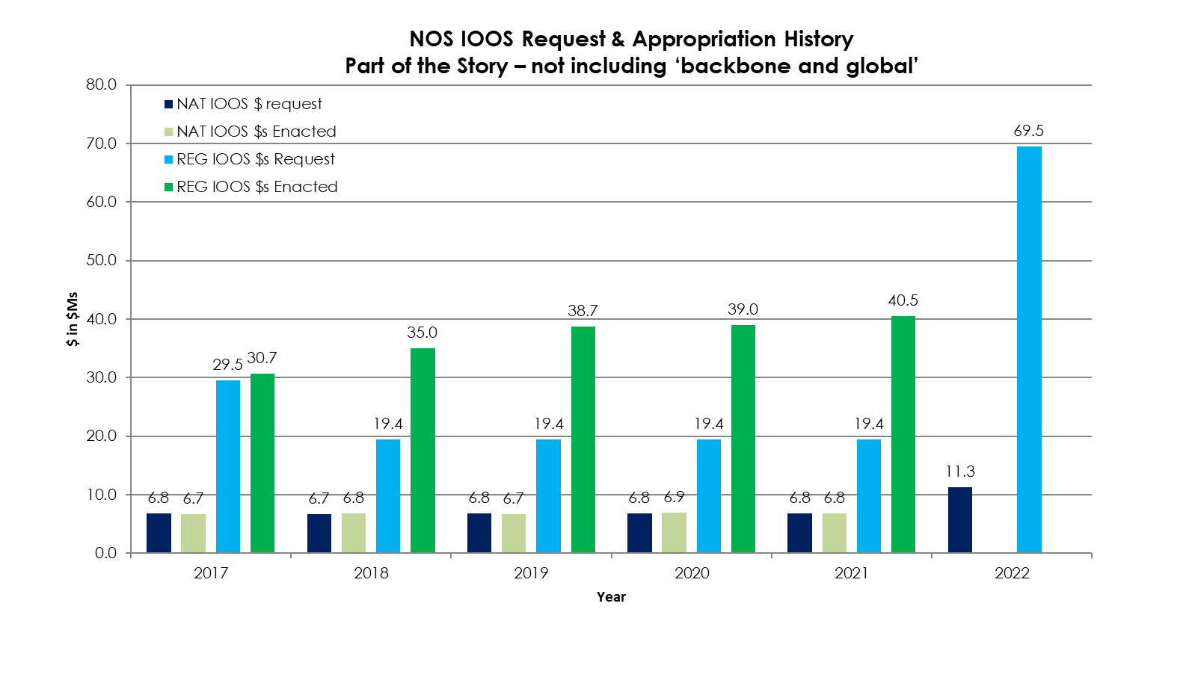
U.S. IOOS Enacted and President’s Budgets FY17-22
Enacted totals 2017 = 37.5, 2018 = 41.8, 2019 = 45.3, 2020 = 45.9, 2021 = 47.4
NOAA National Ocean Service - Navigation, Observations, and Positioning:
‘National IOOS’ & ‘Regional IOOS Observations’
Estimated Enacted levels are ‘post rescission’ totals for each year
‘Request’ = the President’s Budget Request
‹#›

Slide 10
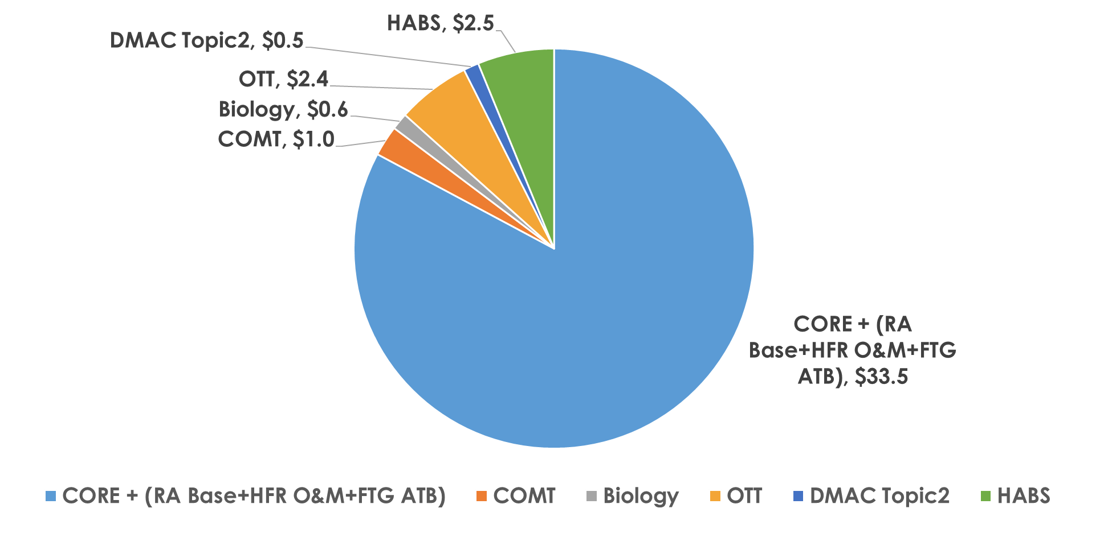
FY 21 IOOS Regional $40.5M – by categories
‹#›

Slide 11
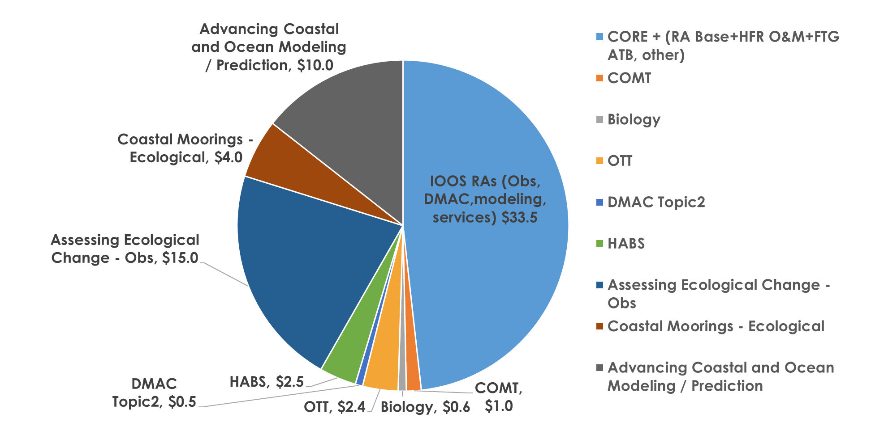
FY 22 IOOS Regional Observations $69.5M - spend categories DRAFT
‹#›
Notes:
‹#›

Slide 12
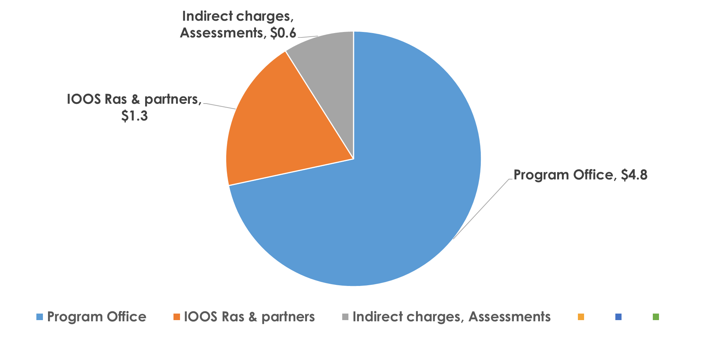
FY 21 IOOS “National” $6.8M
‹#›
Notes:
‹#›

Slide 13
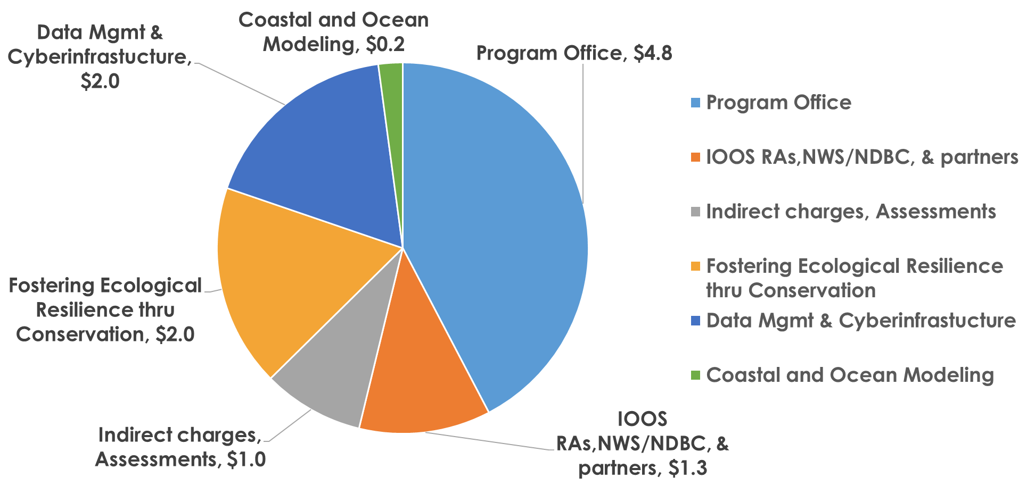
FY 22 IOOS “National” $11.3M - Draft spend plan categories
‹#›
Notes:
‹#›

Slide 14
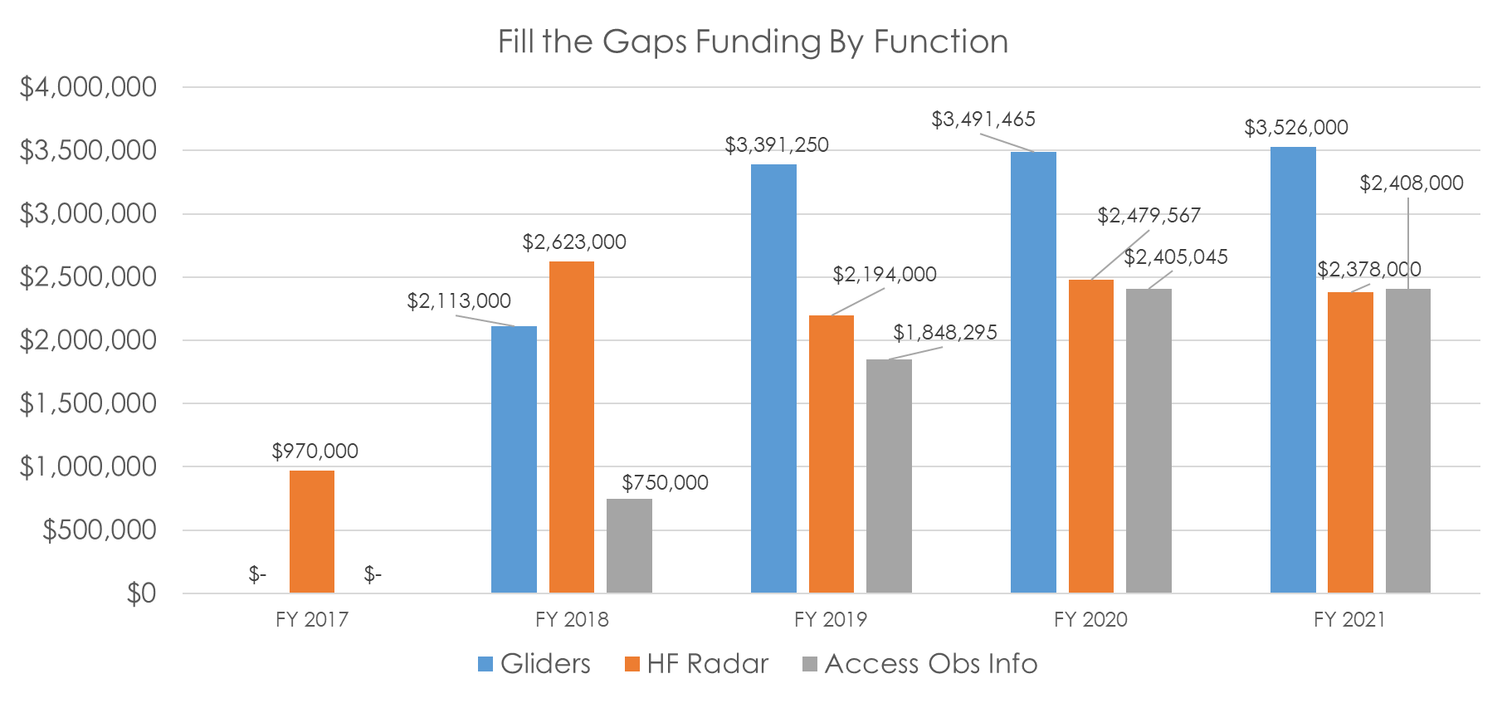
IOOS Fill The Gaps Funding 2017- 2021
Totals over the years: 2017= $970,000 2018= $5,486,000 2019= $7,443,545 FY2020 = $8,376,077 FY21 = $8,312,000
‹#›
Notes:
Totals over the years:
2017: $970,000
2018: $5,486,000
2019: $7,443,5454 ( did not display MBON $10,000)
2020: $8,376,077- $398K- Wind Turbine project funded from FTG (Woods Hole Oceanographic Institution, Software Tools for the Mitigation of Wind Turbine Interference in the U.S. IOOS Network)
‹#›

Slide 15
Next Steps
US IOOS Office + RAs work together on implementation scenarios and strategies
Determine working meetings, workshops, reports etc??
Coordinate on messaging
IOOS Office and RAs engage with other programs on other funding increases

Slide 16
Backup Slides

Slide 17
Monitoring Ecological Change Through Observation Systems
Summary:
Expand the collection of marine life observations
Support analysis of marine life data and information products
Forecast the implications of climate change on living resources and ecosystems
Support for MBON and ATN
Tools to inform adaptation strategies
By the Numbers
$15 M - Regional Obs PPA
Partnerships with: MBON, ATN, NOPP

Slide 18
Fostering Ecological Resilience through Conservation Action
By the Numbers
$2 M - NavObsPos PPA
Partnerships with: NCCOS, ONMS
Summary:
Establish a Marine Life Program within IOOS
Contribute to x-LO vulnerability and adaptation strategies
Operational Marine Life DAC

Slide 19
Coastal Moorings with Ecological Monitoring
Summary:
Improve NOAA’s infrastructure to monitor, predict, and understand environmental conditions driving ecosystem variability and change
A five year deployment plan identifying planned ecosystem moorings that includes new moorings and/or enhancements to existing moorings, +O&M
Completed operations and maintenance on all moorings that contribute to ecosystem monitoring
By the Numbers
$4 M - Regional Obs PPA
Partnerships with: n/a

Slide 20
Advancing Coastal Modeling and Prediction
Summary:
Enhance integrated coastal modeling applications to benefit marine navigation and protect human health
Foster a collaborative approach between internal scientists and external non-federal scientists to accelerate the transition of innovation into NOAA operations
Develop a national backbone of ocean prediction systems and delivering decision support information to coastal stakeholders
Long historical hindcasts and reanalyses of regional Operational Forecasts System conducted and made accessible to enable development of climate applications for Living Marine Resources management needs
By the Numbers
$10 M - Regional Obs PPA
Partnerships with: NMFS (fisheries model applications), CO-OPS, OCS

Slide 21
Data Management and Cyberinfrastructure
Summary:
Enhance data management, data processing, and product development integral to creating an environmental time series that can be used to analyze climate change
Expanded capacity to integrate climate-related observations
Adequately staffed data assembly centers and cloud-hosted data store
Enhanced Regional IOOS expertise for stakeholder engagement and co-development of IOOS decision support products and services
By the Numbers
$2 M - NavObsPos PPA
Partnerships with: n/a

