Slide 1
2021 DMAC Annual Meeting
Welcome!
Agenda: https://ioos.noaa.gov/project/dmac/
Tues/Wed Schedule (Eastern Time):
1 - 3:30: Plenary presentations - two 30 minute Q&A + break periods
3:30 - 4:45: Breakout discussion sessions
4:45 - 5: Report-outs from breakout sessions
5 - 6: Virtual happy hour
Thursday: no breakouts, meeting ends @ 3:45 PM
Recording: Meeting will not be recorded or made available online by NOAA (so please plan to join live for any sessions of interest)

Slide 2
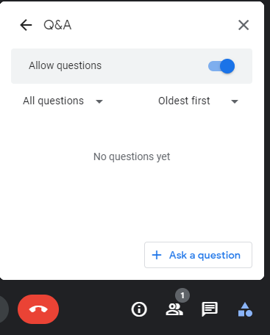
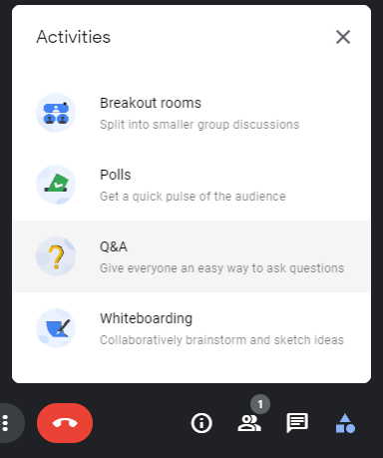
Virtual Meeting Guidelines/Etiquette
Please remember to mute! (or we may have to mute you)
Q&A will take place during the first 15 minutes of break time for all presentations in the previous session
Please use the Meet Q&A feature to pose and vote up questions (see screenshots) & include presenter name in your question
Moderators will ask questions from the top of the list
We will not be using the raised hand feature; chat is for discussion only
Turning video on is encouraged, especially during breakout discussions and Q & A

Slide 3
Breakout Discussions
Tuesday/Wednesday 3:30 - 4:45 PM ET
Tuesday:
Modeling and Data Science in the Cloud
Data Products and applications to meet user needs (challenges & lessons learned)
Wednesday:
Advancing marine life data management
AI/ML-based applications in NOS and IOOS
Reminder: Breakout session leads will give short 5 - 7 minute report-outs at the end of each day to the main meeting room.

Slide 4
Slack and Virtual Happy Hours
Slack Discussion:
DMAC community Slack workspace: https://ioos.slack.com/
Use this link or https://bit.ly/3vbVUaB to join
Virtual Happy Hour (Tuesday, Wednesday):
Informal get togethers themed by breakout session topic, check the agenda for details and connection info.

