Slide 1
IOOS ERDDAP Deployment Update
Kathleen Bailey
Annual DMAC Meeting
10/14/20

Slide 2
Background: NDBC GTS Harvest - data flow
Current pathway:
IOOS RA DAC
Web services distribution (ERDDAP, etc)
NDBC website
PI data store
Format to XML, push via FTP
Global Telecommunication System
Data made available to operational elements of the NWS and modeling communities, and global weather enterprise
NDBC
[Auto QC, produces GTS message]
Format to XML, push via FTP
via NWS Telecommunications Gateway
Changing to ERDDAP harvest:
NDBC pull via RA ERDDAP
PI data store
IOOS RA DAC
Web services distribution (ERDDAP, etc)

Slide 3
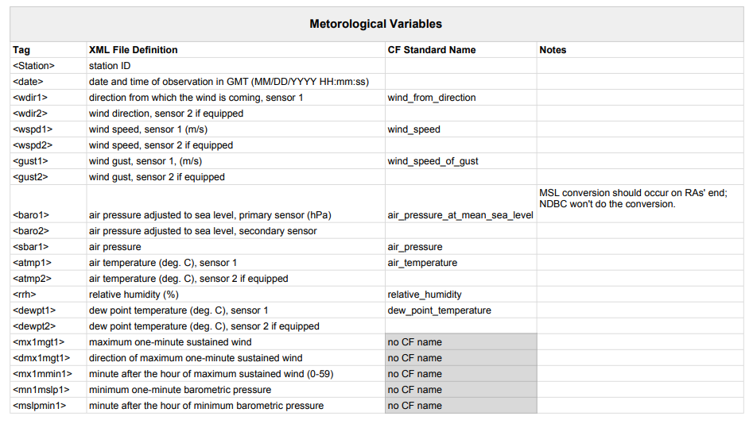
Updates since March DMAC Tech Webinar
IOOS Metadata Profile v1.2 updates - https://ioos.github.io/ioos-metadata
Added CF DSG featureType guidance to use for different platform instrumentation scenarios
Requirements for the Vertical Coordinate Variable
Instrument attributes (accuracy, precision, resolution, make/model, etc)
XML to CF Standard Name Mappings
New water level CF standard names accepted in v76 today!
tidal_sea_surface_height_above_mean_lower_low_water
tidal_sea_surface_height_above_mean_higher_high_water
reference_epoch (to identify the tidal datum epoch)
IOOS Compliance Checker v4.3.3
Includes checks for NDBC/GTS requirements - variable names, etc
Make sure you run your datasets through Compliance Checker!
XML to CF Standard Name Mappings
Notes:
TESAC message requires salinity accuracy, OOI desired way to describe instrument information

Slide 4
NDBC/GTS test status
Goal for transitioning from XML/FTP to ERDDAP: March 2021
Completed | Remaining | N/A
PacIOOS (WQ buoys) | GLOS - Oct/Nov 2020 | AOOS (CDIP*)
SECOORA (1 station done, rest on hold for hurricane season) | GCOOS | MARACOOS (federal/none sent to NDBC)
CeNCOOS (Axiom FTP account) | NANOOS
 | NERACOOS
 | CARICOOS
 | SCCOOS
*NDBC harvests CDIP stations directly from CDIP, not from RA

Slide 5
Background: NDBC GTS Harvest - data flow
Current pathway:
IOOS RA DAC
Web services distribution (ERDDAP, etc)
NDBC website
PI data store
Format to XML, push via FTP
Global Telecommunication System
Data made available to operational elements of the NWS and modeling communities, and global weather enterprise
NDBC
[Auto QC, produces GTS message]
Format to XML, push via FTP
via NWS Telecommunications Gateway
Changing to ERDDAP harvest:
NDBC pull via RA ERDDAP
PI data store
IOOS RA DAC
Web services distribution (ERDDAP, etc)

