Slide 1
IOOS Cloud Sensor
Data Ingest Project
DMAC Annual Meeting 2020
Thursday Oct 15
Micah Wengren, Bob Fratantonio, Bob Fleming
Sneha Bhadbhade, Tim Kearns, Alex Kerney, Dylan Pugh, Jim Potemra
:

Slide 2
Project Goals
Develop a community of practice within DMAC to enable sensor-direct-to-commercial cloud data ingest pipelines
Integrate with DMAC processes/services (QA/QC, ERDDAP)
Develop a flexible/adaptable architecture, open source tools, and best practices that could be used by multiple RAs
Investigate new data delivery capabilities offered by commercial cloud
Project team: RPS, NERACOOS, GLOS, PacIOOS, IOOS PO
Photo credits: Rutgers

Slide 3
AWS Data Pipeline
AWS IoT Core
A managed AWS service to connect devices (sensors) to the cloud
Supports MQTT, HTTP, and Websocket Protocols.
Sensors are registered in IoT Core as “Things”.
Authentication via certificates
MQTT
Notes:
MQTT (Message Queuing Telemetry Transport) is a Client Server publish/subscribe messaging transport protocol. It is light weight, open, simple, and designed so as to be easy to implement. These characteristics make it ideal for use in many situations, including constrained environments such as for communication in Machine to Machine (M2M) and Internet of Things (IoT) contexts where a small code footprint is required and/or network bandwidth is at a premium.

Slide 4
AWS Data Pipeline
Kinesis Data Streams
Massively scalable real-time data streaming service.
IoT kinesis:PutRecord writes data from MQTT message to Kinesis Stream
24 hr data retention period (for stream processing)
Notes:
24 hr data retention period (how much data can be considered for stream processing)

Slide 5
AWS Data Pipeline
Lambda Functions
Run code (Python/Javascript) to process Kinesis Streams.
Automatic event driven triggers from Kinesis
Manage connections, post data.
We could also manage alerts, send texts, etc

Slide 6
AWS Data Pipeline
API Gateway
Expose a public facing WebSocket API for web apps to consume
API Gateway maintains the persistent connection to handle bidirectional message transfer.

Slide 7
AWS Data Pipeline
Web Client
A demo React.js app to visualize streaming data
Site hosted on AWS S3.
http://ioos-sensor.s3-website-us-east-1.amazonaws.com/Orono.WX2.Airmar

Slide 8
IoT Device Configuration
simulating what a datalogger (with support of mqtt/https) might do
Met sensors, Gill MaxiMet 501 & Airmar WX300 streaming 1Hz data
Get certificates (.pem files) for the AWS IoT Endpoint
(a317ofrhyjggr7-ats.iot.us-east-1.amazonaws.com)
Simple python script
Read serial data from sensors
Wrap output into MQTT messages
Publish to MQTT endpoint (QOS level 0, topic: IOOS/* )
MQTT protocol is not currently supported by widely used data loggers from Campbell Scientific and NextSens

Slide 9
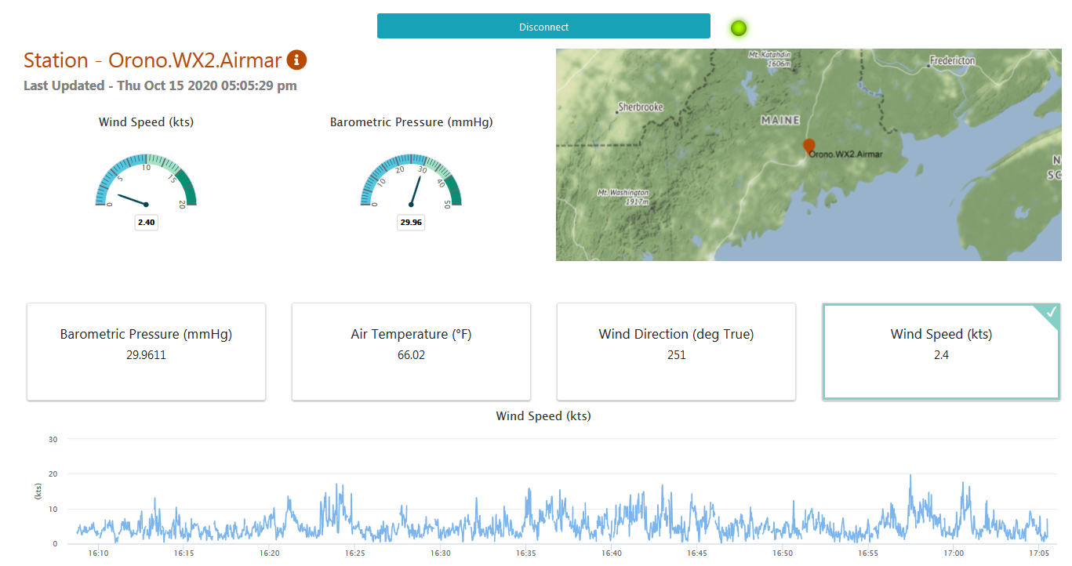
Demo - Met Sensors streaming 1 Hz data
http://ioos-sensor.s3-website-us-east-1.amazonaws.com/Orono.WX2.Airmar

Slide 10
Issues, Questions
Issues, questions
Missing, mangled packets
Quality of Service -QOS Level 0 vs QOS level 1 (no QOS level 2 support)
Testing
logging messages at both ends for comparison
message stream forked to a local mqtt broker for comparison with AWS IOT Core
Why would a data provider be interested?
can I replace my on-site telemetry endpoints and proprietary software?
will the publish/subscribe architecture help me when refactoring my processing and notification chain?

Slide 11
Next Steps
Milestone | Date
Initial Prototype AWS native services for streaming data Monitoring dashboard | September 2020
Commercial Data Logger Testing Compatibility with cloud ingest service(s) | June 2021
Full-feature Data Ingest Platform Pub/Sub topic design & subscription capability Data decoding & message formatting QA/QC Alerting/notification Traditional DMAC connections (netCDF-CF files, ERDDAP) | September 2021
Do-It-Yourself Sensor Evaluation Raspberry Pi Open source software sensor platform frameworks Educational module | September 2021

Slide 12
Get Involved
IOOS participants welcome!
Join or follow #sensor-data-ingest on IOOS Slack:
https://ioos.slack.com/archives/C0139V94DFT

