Slide 1
DMAC Data Services:
Past, Present, and Future
DMAC Annual Meeting 2020
Tuesday Oct 13
Micah Wengren, Kyle Wilcox

Slide 2
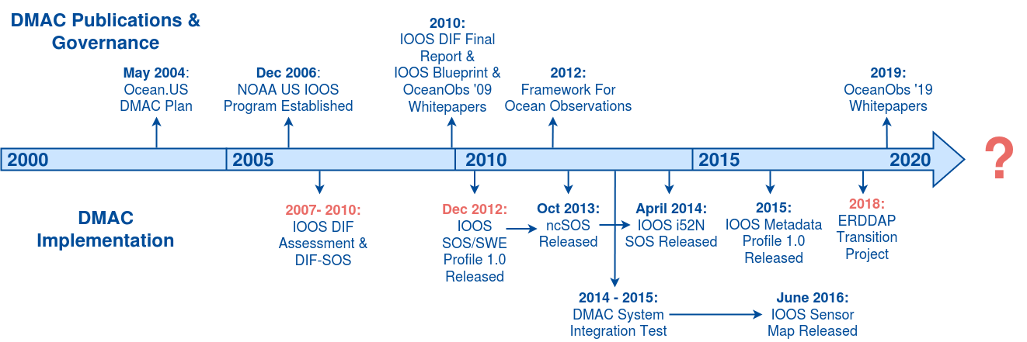
DMAC Technical Design & Implementation Chronology

Slide 3
DMAC Implementation History
Early Days (2006 - 2010):
NOAA IOOS Program Office formed
IOOS DIF SOS, THREDDS/OPeNDAP, WCS/WMS recommendations
SOS Period (2010 - 2018):
IOOS SOS/SWE Profile release
ncSOS & i52N SOS
ERDDAP Era (2018 - Present - ?):
IOOS Metadata Profile 1.2 release
ERDDAP Transition for NDBC/GTS dissemination, SOS deprecation
The Future:
...

Slide 4
Breakout Session
Join our breakout session immediately following to discuss:
Current DMAC status and potential activities in the areas of:
Data Services Usability/Interoperability - ERDDAP, OPeNDAP, WMS, etc
Cataloging
Marketing DMAC & User Outreach

