Slide 1
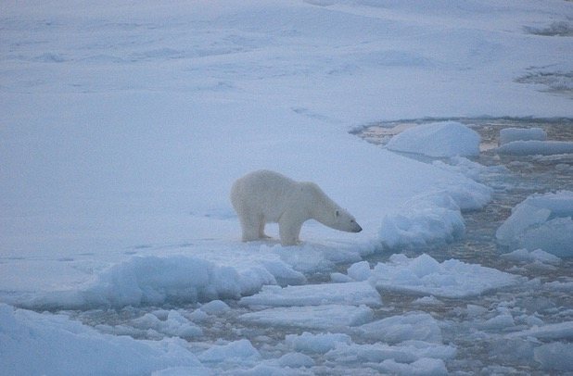
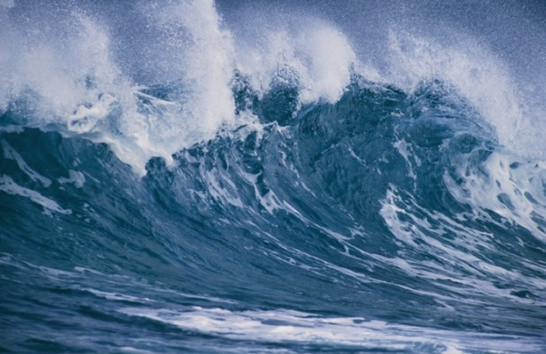
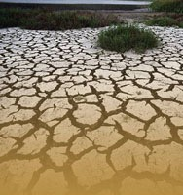
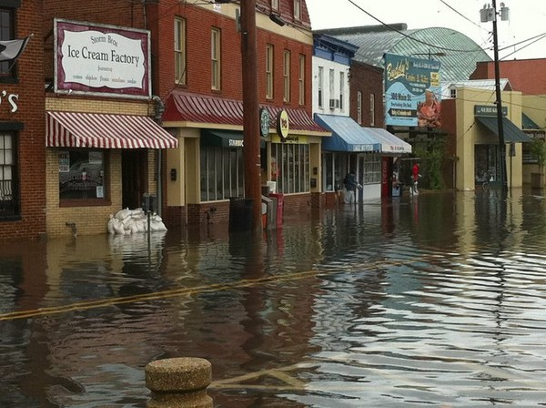
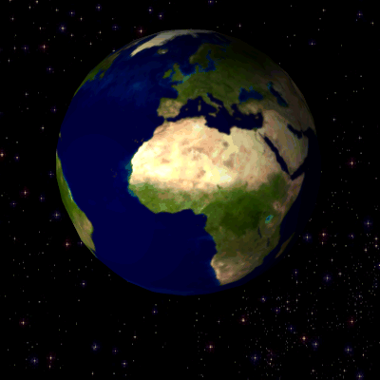
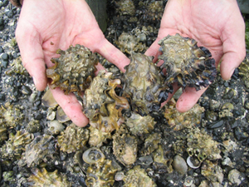
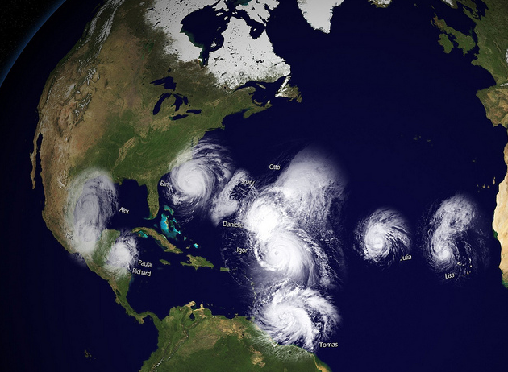
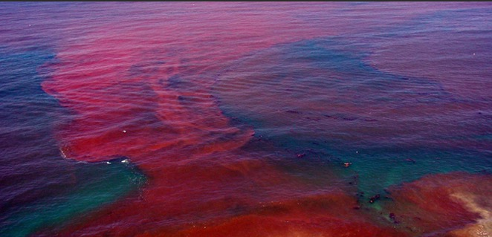
A Clear View of Tomorrow
Our Planet is Changing
We need advanced tools to understand and monitor our coasts and Great Lakes
U.S. Integrated Ocean Observing System (IOOS)
Notes:
Good Afternoon, I am the Director of the US Integrated Ocean Observing system or IOOS.
During my talk today, I will give you a high level view of how IOOS connects to Blue Tech & Blue Jobs.
IOOs is a National enterprise that works! IOOS as a brand stands for enabling decision making and underpins scientific advances

Slide 2
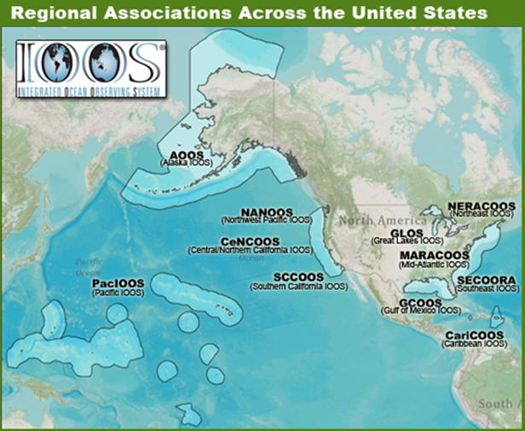
U.S. IOOS: Program Overview
WHO
WHAT
Observation
Data Management
Modeling & Analysis
Research & Development
Education
WHY: 7 Societal Goals, 1 System
Predictions of climate change and weather
Safety and efficiency of maritime operations
Forecasts of natural hazards
Improve homeland security
Minimize public health risks
Protect and restore healthy coastal ecosystems
Sustain living marine resources
WHERE
Global
Coastal (EEZ to tidal waters)
Enables Decision making and Science
Notes:
Oceans are critically important to our society and affect the lives of all Americans regardless of whether they reside along the coasts.
IOOS has a Federal and non-Federal footprint. The logos of the Federal Agencies you see hear all contribute to IOOS and have responsibilities in our Oceans, Coasts and Great Lakes. Federal participants oversees the global and national aspects. The 11 IOOS Regional Associations extend our reach to the regional and local stakeholders. Regional Associations are comprised of State, Local, Tribal governments, academia and industry. The Alliance for Coastal Technologies provides for new sensor evaluation.
The strategy allows us to maintain a local connectivity but ensuring a National Consistency.
IOOS® is a solution to increasing observing assets, seamlessly stitched together thought this national data management with models and analysis that extend sparse data both spatial and temporally to provide products that are tailored and driven by the user community
While the program has 7 goals it is really about integrating the information so that the same observing systems can be used to support all 7 goals.
The ocean knows no boundaries therefore US IOOS is not only a national endeavor but it is also part of a global framework, where the United States funds 50% of the global ocean observing system.

Slide 3
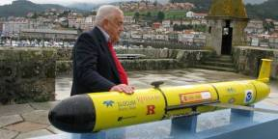
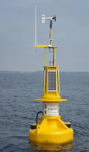
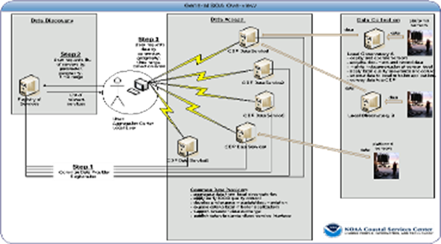
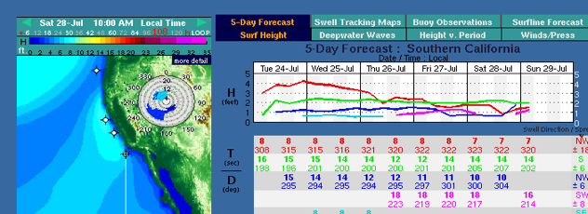
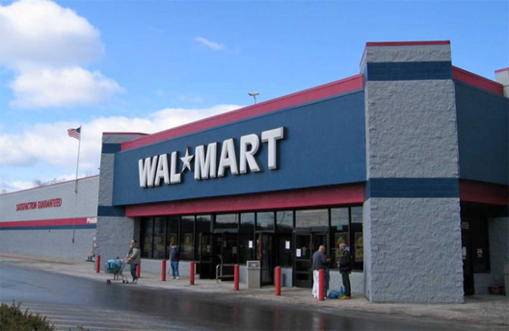
Industry Engagement
Providers: observing system infrastructure
Intermediate users: Tailor IOOS data or information for a specific end-use;
End-users: activities or businesses benefit from IOOS data and information
3
Notes:
3
We are connected to the blue economy in 3 primary ways. There are a number of companies and academia which are developing the tools we use and also starting to provide observing services.
For example the United States leads the world in glider production. One glider was developed and is manufactured right here in San Diego by Scripps Institute of Oceanography. A second glider developed by the University of Washington was licensed by Irobot and a the slocum glider shown here was developed by Doug Webb of Teledyne Webb research is now being used operationally by the United States Navy.
The “weather enterprise” According to National Academies – Fair Weather: Effective Partnerships in Weather and Climate Services (2003 – “There are about 400 commercial weather companies and independent contractors in the United States,4 with revenues of about $500 million,” that includes large companies such as AccuWeather and the Weather Channel. The ocean enterprise is still in the nascent but is growing. IOOS seeks to make information available easily to grow the value add companies.
Finally there are the businesses that might not know that they rely on ocean observing. Manufacturers also benefit from integrated observations in terms of moving supplies to retail stores. Earlier and more accurate forecasts mean a company can make more informed decisions about whether to ship hurricane supplies or beach towels or extra snow shovels to local stores in preparation for a coming season. These seasonal forecasts very much depend on ocean observing.

Slide 4
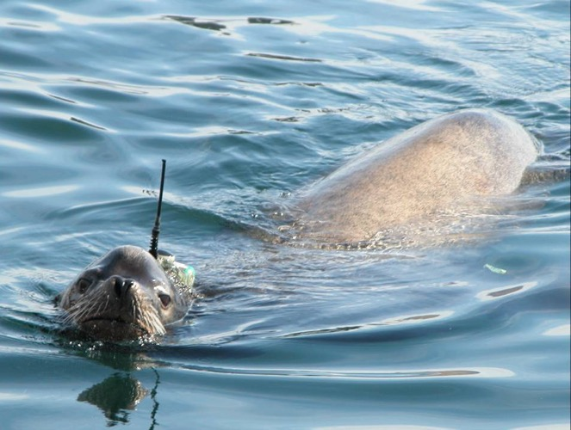
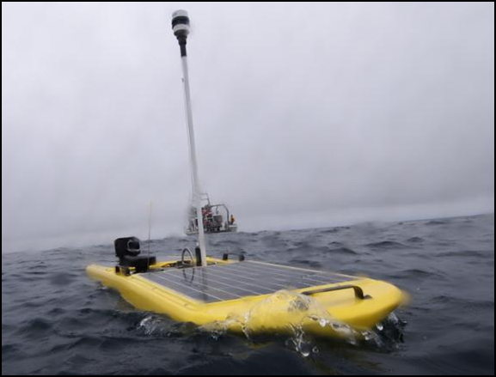
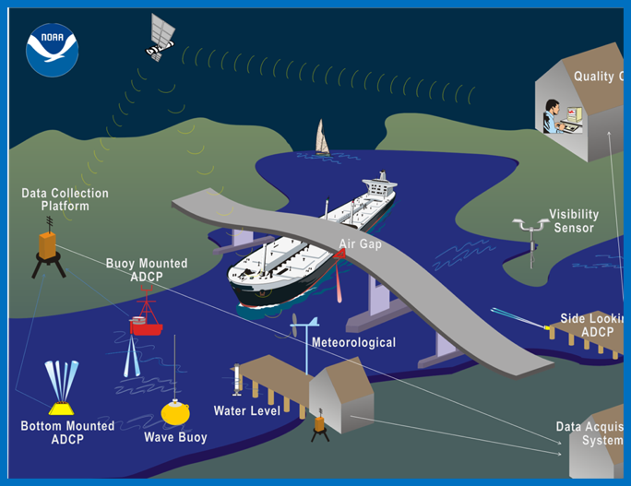
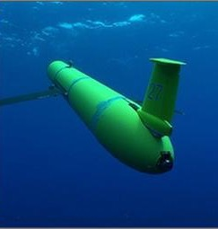
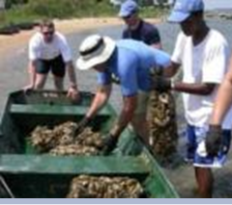
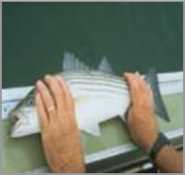
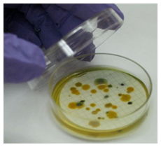
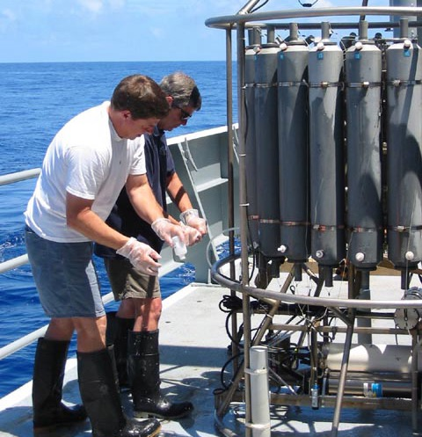
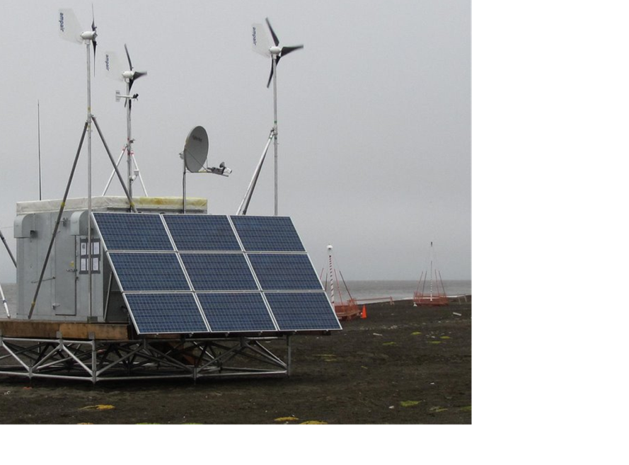
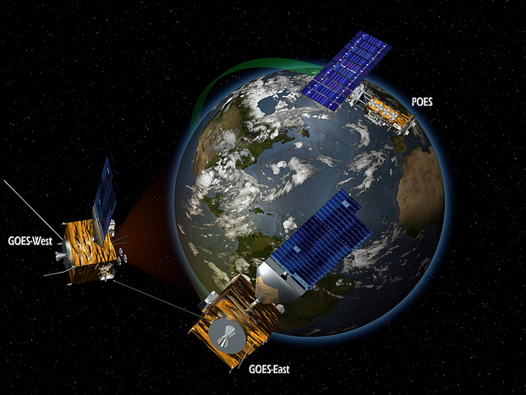
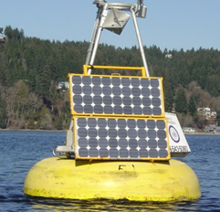
A Clear View of Tomorrow
Observing
Systems
U.S. Integrated Ocean Observing System (IOOS)
Notes:
For the atmospheric and terrestrial observations, satellites are a primary observing system. Bot for the ocean, which makes up 70%, satellites are crucial but because they can only see the surface of the oceans we need a number of systems to observe in three dimensions.
Ocean observing means both continuous and automatic observations from buoys, gages, HF Radars and marine animals and fish
It means systems like NOAA’s PORTs system is a cost-shared partnership program that (1) implements a real-time capability and (2) integrates a range of observations into a single “nowcast” service for mariners.
BUT
Observing in and around the coasts is difficult. Salt water is often unkind to observing systems, and bio-fouling means constantly needing to clean the gear. And we must observing in all kinds of conditions - this is a special structure in the Arctic for HF Radar – since you can’t plug in.
BUT there a number of areas when need discrete measurements and human power. NOAA and fishing industry has large numbers of fish observers, we need to take water samples to labs to measure water quality. This is labor intensive and often in the case of beach closures means closing a beach based on yesterday’s lab results
THEREFORE we need new technologies for ocean observing.

Slide 5
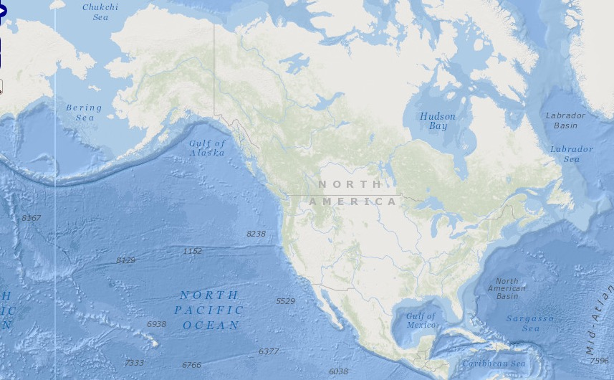
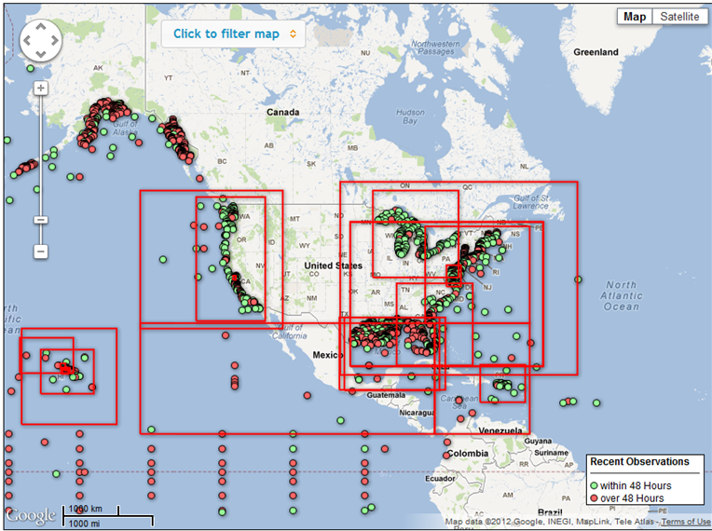
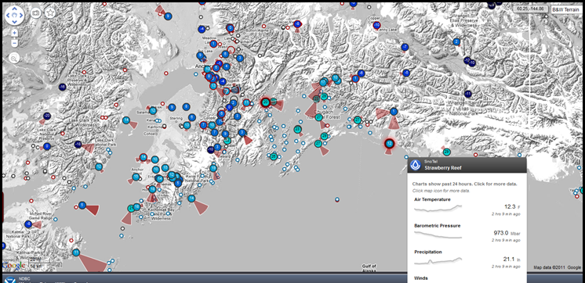
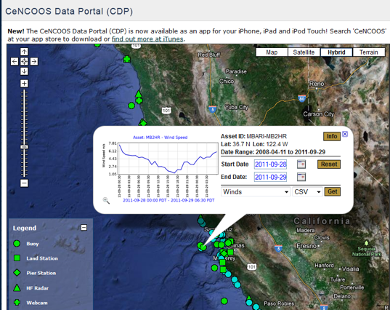
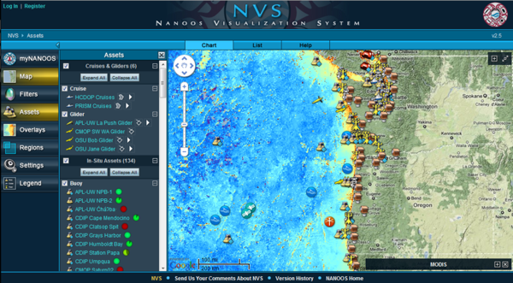
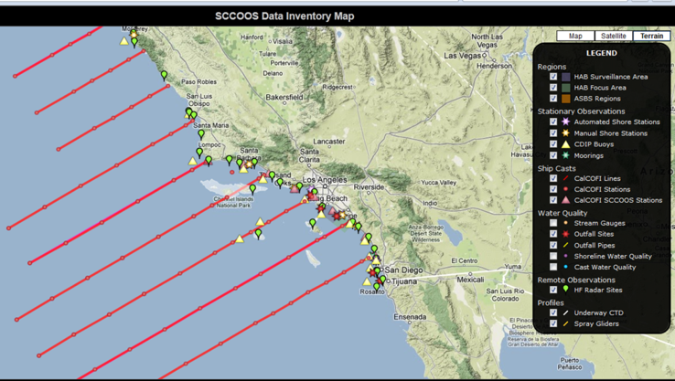
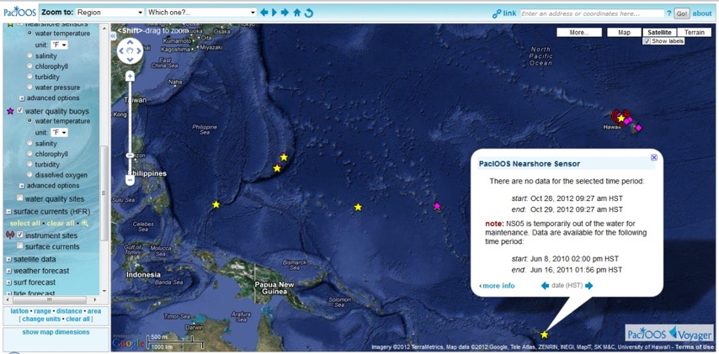
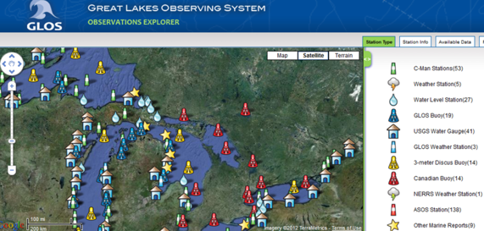
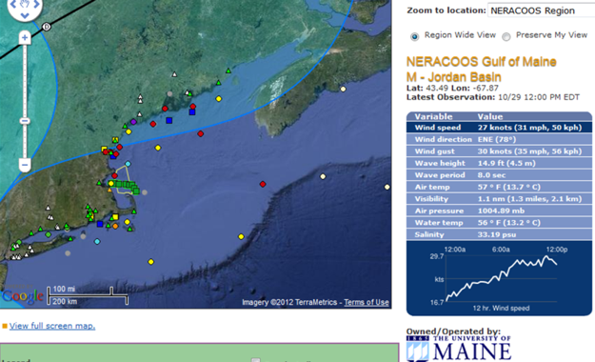
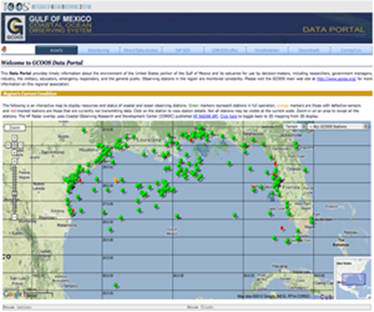
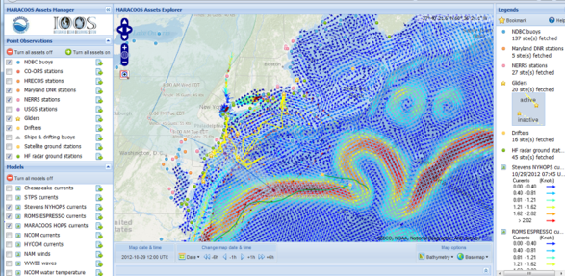
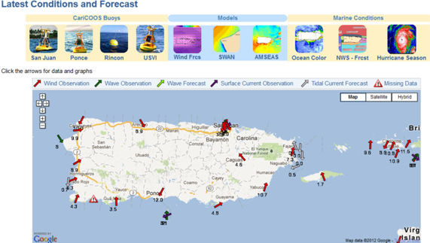
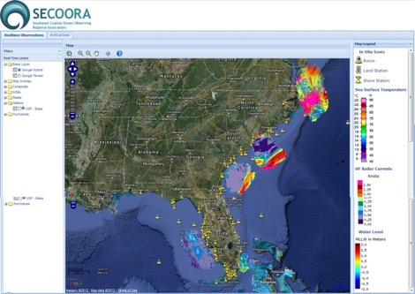
Exposing Ocean Information
Notes:
Data management is a key part of what IOOS is and what IOOS can be
Data management under IOOS is here now!
The 11 Regions are collecting and finding new data to make them accessible and usable, which has resulted in thousands of new data sets being exposed.
Nationally, my office is the system architect, but we work with our regional partners to make this a reality that supports both national and regional goals.
We are developing Sensor Observation Service as the language for sharing data and developing 2 software systems that will allow easy and consistent implementation. We are developing a catalog to know what is out there, and are developing data discovery tools. Additionally we established a quality control and assurance program, which will allow us to build trust into the system by providing reliable and quality data.

Slide 6
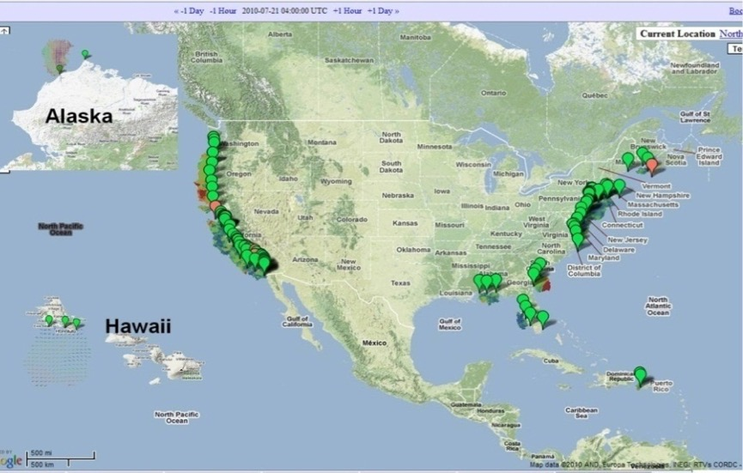
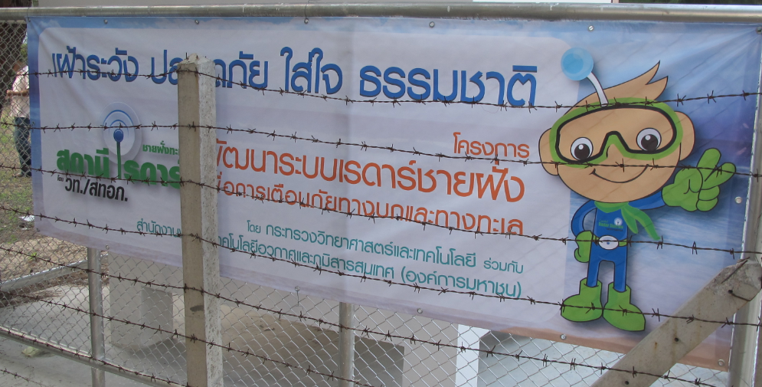
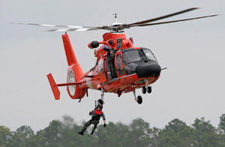
High Frequency Radar Network
Stakeholders
> 30 institutions operate HF Radars; represents a Federal/State investment of $55M in last 15 years
Used by >40 government/private entities
Largest producer (80% of the world market) is US-based CODAR Ocean Sensor
Who Depends on it
USCG Search and Rescue: Oil spill response
Water quality; Criminal forensics
Commercial marine navigation
Offshore energy; Harmful algal blooms
Marine fisheries
Emerging - Maritime Domain Awareness
Emerging – Tsunami
Decreases search area by 66% in 96 hours
Notes:
128 HF Radars operating in the network now. Includes 2 HF Radars on the East Coast of Canada operated by the Canadian Coast Guard.
Oil Spill Response: Operationally used for Cosco Busan, 2007; Deepwater Horizon, 2010.
Search and Rescue (SAR): Integrated into the operational US Coast Guard SAR operations (SAROP) program; deployed in the mid-Atlantic in 2009 – Extension Nationwide in 2011-2012.
Emerging Homeland Security needs: The Maritime Security Technology Program (MTP) of DHS S&T includes a project to expand the use of HF Radar to provide increased Maritime Domain Awareness (MDA) and Homeland Security.
Issue: Frequency Allocation
HF Radars have been operating on experimental licenses for 30 years, but now need primary frequency allocation for 24x7 stable operations.
DOC, on behalf of NOAA, has been working through the Federal Frequency allocation process for primary frequency allocations the past 5 years, culminating with the World Conference in 2012.
January 2011, draft Federal position unacceptable to US IOOS. DOD (Air Force) opposed to primary frequency allocation. Has been elevated to the National Ocean Council, and issue remains an open item.

Slide 7
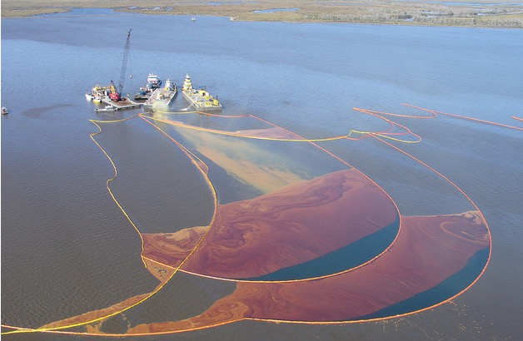
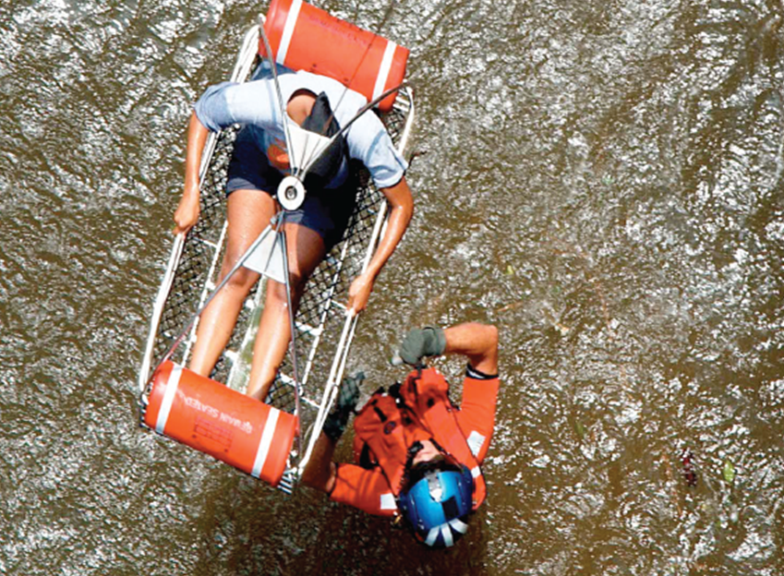
A Clear View of Tomorrow
IOOS mobilizes technologies to hasten response to oil spills and harmful algal blooms
Improves the quality of life at home and around the globe
Surface current data, continuous and in near real time, inform models
People lost at sea are found faster
Pollution can be tracked and ecosystems better assessed
U.S. Integrated Ocean Observing System (IOOS)
Notes:
HF Radar has been incorporated into the Coast Guard’s operational search and rescue system and over 96 hours we can decrease the search area by 66%, which translates to lives saved.
HF Radar has been used to understand the movement of oil in spills when the M/V Cosco Busan in November 2007 struck the Oakland-Bay Bridge in San Francisco Bay, spilling an estimated 58,000 gallons of bunker fuel. Working in partnership with the state-funded Coastal Ocean Currents Monitoring Program, IOOS partners assisted with spill tracking as well as with using HF Radar systems to provide real-time information on ocean currents to the response teams.
Because the IOOS partnership is in place during Deep Water Horizon in 2010, HF Radar, gliders and exposure of data from non-Federal sources were all available immediately available for use by the Federal and Industry response team. This included gliders from IOOS Region here in Southern California
Off the coast of New Jersey HF Radar was used to successfully prosecute a Dentist who dumped medical waste off the side of his boat and washed up on the Jersey shores.
Gliders, buoys and HF Radars are used to monitor HAB which occurring with increasing regularity along our Coasts and Great Lakes

Slide 8
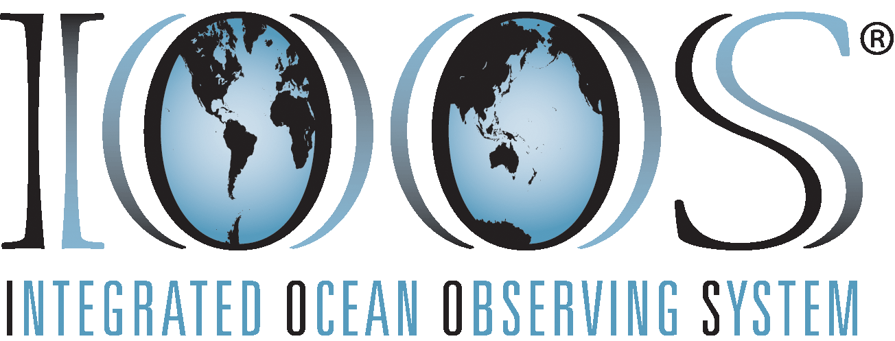
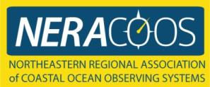
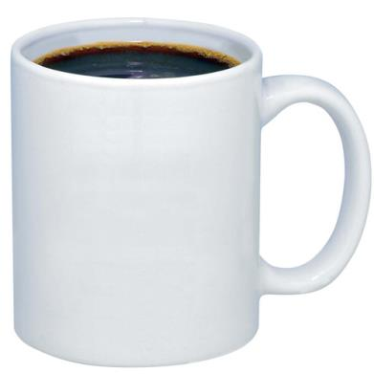
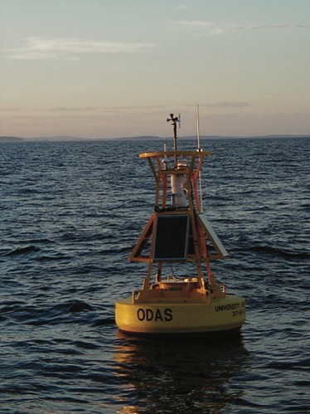
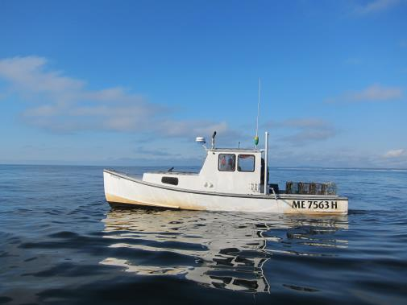
+ +
"I trust the weather buoys with my life. Thank you." - Maine Fisherman; "Love your service…I believe your service is a lifesaver. Thanks!" -Dave, Pilot; and "I would like you to know that information you are providing us not only aids us in our work, it almost certainly has saved lives." -Roy Atkinson, Fisherman.

Slide 9
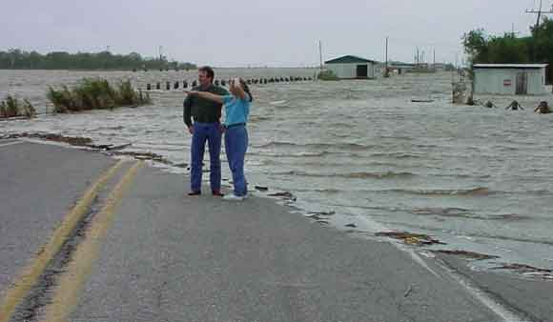
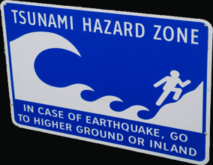
A Clear View of Tomorrow
Storm-driven flood predictions accurate to a city block
Tsunami evacuation zone details available online
Around-the-clock data and other information before, during and after hurricanes
U.S. Integrated Ocean Observing System (IOOS)
Notes:
Ocean Observing is critical to Hurricane Forecasting and Tsunamis: Non-Federal of US IOOS augmented NOAA’s observing and forecasting capabilities. NOAA used the buoys from Caribbean, Southeast, Mid Atlantic and Northeastern Regions of IOOS to track the Hurricane, initialize and verify forecasts. USCG, National Hurricane Center, and multiple WFOs used RA models to support local forecasts. As Irene progressed up the East Coast the Mid-Atlantic Regional distributed a dedicated hurricane blog with updates on the storm, especially with regard to high frequency radar data, glider routes and the phytoplankton bloom monitoring. MARACOOS delivered new forecasts to the New Jersey Board of Public Utilities. Underwater glider RU-16 collected an unprecedented 3D dataset from Irene that which will inform forecast model development (particularly intensity) well into the future.
Japanese Tsunami – March 2011: IOOS played a part in the warning and information flow of the tsunami wave’s reach to the United States. Nationally the DART buoys and tide gauges provided vital information for adequate warning. At the Regional level RAs saw five to ten-fold increases in web-traffic proving that the public trusts and look to their IOOS RA for local guidance during national and international distress. Pacific Island Ocean Observing System (PacIOOS) provided real-time water level (tsunami arrival) and turbidity (debris) measurements for Waikiki. The Northwest Association featured their “Tsunami Evacuation Zones for the Oregon Coast,” which has now been expanded to the Pacific Northwest Tsunami Evacuation Zones online portal and free app that provides an at-a-glance view of tsunami hazard zones along the coasts of Oregon and Washington. Southern California Coastal Ocean Observing System (SCCOOS) measured the tsunami signal documented by the NOAA tide gauge on the Scripps Institution of Oceanography pier and by pressure sensors at the four SCCOOS Automated Shore stations: Scripps Pier, Newport Pier, Santa Monica Pier, and Stearns Wharf. Central and Northern California Ocean Observing System (CeNCOOS) captured the tsunami passage using the Monterey Accelerated Research System, Humboldt, San Francisco, and Morro Bays. CODAR SeaSonde HF radars located in Japan and California detected and measured tsunami current flows, representing the first such tsunami observations occurred with any radar, between 10 and 45 minutes prior to its arrival at neighboring tide gauges.

Slide 10
IOOS Works!
U.S. Integrated Ocean Observing System (IOOS)
Notes:
IOOS and NOAA are supporting the shell fish growers in the Pacific. One of my favorite quotes is from Mark Wiegart co-owner of Whiskey Creek Shellfish Hatchery in Oregon who said “Putting an IOOS buoy in the water is like putting headlights on a car. It lets us see changing water conditions in real-time.” Beginning in 2005, production at some Pacific Northwest oyster hatcheries began declining at an alarming rate, posing severe economic impact and challenging a way of life held by shellfish growers for over 130 years. Oyster production represents 76 percent of the $110 million West Coast shellfish industry, which supports more than 3,000 jobs. By 2008, oyster losses at Whiskey Creek, a supplier to about 75 percent of West Coast oyster farmers, reached 80 percent. At the same time, corrosive acidified seawater was reaching the Pacific Coast. NOAA and IOOS got involved and by 2010 the industry had rebounded 70 percent and now is part of daily business.
Calcofi – gliders, 1949 sardine collapse. Now ecosystem, gliders funded by NOAA climate program, IOOS

Slide 11
IOOS Works!
U.S. IOOS partners sent the first glider across the Atlantic Ocean, calibrating ocean models and collaborating with scientists and students in the U.S., Canada, Spain and Portugal
Graduate and Undergraduate students are integrated – good for IOOS now and good for industry for future employees
Teaching the next generation
U.S. Integrated Ocean Observing System (IOOS)
Notes:
worldwide, from the mission that went across the Atlantic, not only increased technology but is part of a growing international partnership of students learning about the importance of ocean observing. A hallmark of IOOS regions is the integration of undergraduate and graduate students into their operations. Additionally all of the IOOS regions are providing classroom curriculum, and ocean kiosks at aquarium and ocean education centers nationwide.

Slide 12
A Clear View of Tomorrow
A Clear View of Tomorrow
A Clear View of Tomorrow
US IOOS works!
US IOOS enables decision making and underpins scientific advances
U.S. Integrated Ocean Observing System (IOOS)
Notes:
I hope during this talk you will agree the IOOS works and become part of US IOOS

