Slide 1
Synergies being developed for IOOS with EPA and NWQM Network
Zdenka Willis
Director, U.S. IOOS Program Office
GCOOS Board of Directors Meeting
26 – 27 September 2012
Corpus Christi, TX

Slide 2
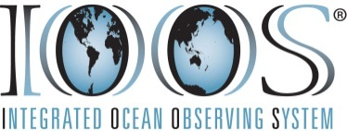
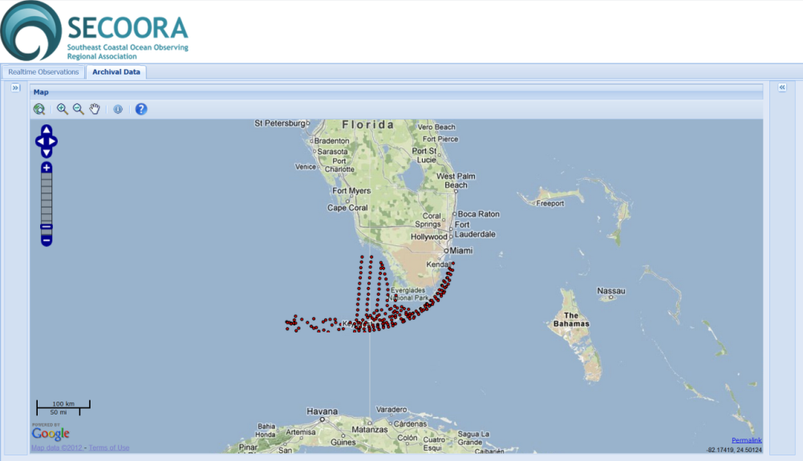
NCCOS Water Quality Data Project
A partnership between U.S. IOOS and NCCOS, SECOORA, FIU and UNCW.
Reconciled FIU water quality variable terms with the CF Standard Names Table and IOOS Parameter Vocabulary terms
Resulting in improved access to water quality station data sets from the Florida Keys National Marine Sanctuary and surrounding waters.
Completed
Notes:
The National Center for Coastal Ocean Sciences (NCCOS) approached IOOS to improve access to data from more than 150 water quality stations in the Florida Keys National Marine Sanctuary (FKMNS).
The underlying purpose of the collaboration is to provide climate ecosystem decision support tools and information for the regional science and management constituency in South Florida, including the FKMNS, but also accessible to other users in the region for other purposes.
In this project, vocabulary terms used by FIU were reconciled, following IOOS guidance, with terms in one of the identified IOOS recommended Vocabularies: the CF Standard Names Table or the IOOS Parameter Vocabulary v2.0. The IOOS Parameter Vocabulary v2.0 is an update to an earlier version originated by Matt Howard (GCOOS) and Stephanie Watson (SEACOOS).
The Result: Before this project, the data was collected and managed by FIU, but only accessible by downloading a static MS Excel spreadsheet off their Website. And now, the FIU water quality data set is accessible through an SOS service and searchable with a query tool developed by the University of North Carolina – Wilmington; the water quality data is visible on the SECOORA data portal.
This project was completed in April 2012 through key partnerships with SECOORA, UNCW, NCCOS and FIU to facilitate the data access.
It should be mentioned the vocabulary work help to launch a more significant vocabulary effort in the IOOS Program that has expanded to the IOOS RAs (involvement from Emilio Mayorga (NANOOS) and Sara Haines (SECOORA)) and MMI, which is needed to advance DMAC interoperability.

Slide 3
EEA Eye on Earth – U.S. IOOS Collaboration
The intent of this project is to show how we can seamlessly bring together global data sets.
U.S. IOOS, SECOORA and NANOOS are piloting the integration of water temperature, salinity and water level data with the Eye on Earth platform.
The outcome will be visibility of IOOS data on a global data portal.
Evaluate
Notes:
The collaboration with Eye on Earth began after a discussion with Jacqueline McGlade, the Europe Environment Agency (EEA) Executive Director, and Gary Foley (EPA) at the GEO Plenary in Instanbul, Turkey in Nov. 2011. This collaboration has been incorporated into a draft of the GEO Work plan for 2012 – 2015.
If you have never heard of Eye on Earth, Eye on Earth is a ‘global public information network’ for creating and sharing environmentally relevant data and information online through interactive map-based visualizations. It is a project that was developed jointly by the EEA and Microsoft and ESRI.
The overall goal is to improve the environment by sharing information and knowledge. We believe ‘sharing is everything’ - by sharing relevant information, we can expand and improve our knowledge about the environment, to understand better what’s happening, and to underpin the need for actions to improve the environmental situation.
The project to pilot the integration of U.S. IOOS data with the EEA Eye on Earth platform formally started in May of this year after a meeting of project partners (EEA, SECOORA, NANOOS, IOOS , ESRI and EPA) involved in this effort.
Data sets for water temperature, salinity and water level data were agreed to be the first variables integrated with the platform.
The pathways into Eye on Earth have been identified as well as formats for delivering data to the platform.
Emilio Mayorga (NANOOS ) and Dan Ramage (SECOORA) have been generating KMLs of the water temperature, salinity and water level data. The data is being submitted data to Eye on Earth through ArcGIS Online.
The outcome of the collaboration will be U.S. IOOS data integrated with and visible on the WaterWatch viewer of the Eye on Earth platform in November 2012.

Slide 4
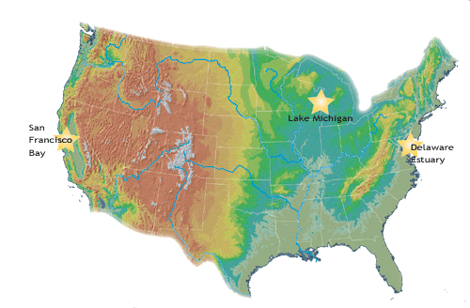
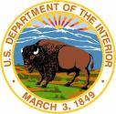
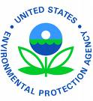
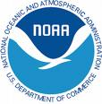
IOOS and the National Water Quality Monitoring Network
2008 – 2009: U.S. IOOS established relationships with EPA and USGS that did not result in any outcomes.
NWQM Conference 2012: Jan Newton, NANOOS Exec. Dir., served on a panel and presented a very well received brief.
Result of Jan Newton’s participation: Dr. Bernice Smith, EPA Coastal Management Branch Chief, approached IOOS about participating on a new NWQMC work group.
Reinvigorated
Notes:
In 2008, the U.S. IOOS Program approached EPA and USGS about integrating data. These were technical discussions that did not have concrete results but paved the way for further discussions.
These smaller, technical discussions spawned a series of higher-level discussions that involved IOOS, NWQMC Co-Chairs (EPA, USGS) and several Regional Associations (SECOORA, MARACOOS, NERACOOS).
In 2010, there was a workshop (a direct outcome of the high-level IOOS and NWQMC meetings) to address key water quality issues: hypoxia and nutrient enrichment, Beach health, and HABs through integrated science based solutions, near Baltimore, MD.
An actionable outcome was to develop a multi-region water quality project centered on one of the three water quality issues. A project to improve beach health through data integration was a consensus pick at the workshop.
A project was scoped, but never implemented due to funding.
In 2012, Jan Newton, NANOOS Executive Director, served on a panel at the National Water Quality Monitoring Conference in Portland, OR for Advancing the implementation of a National Water Quality Monitoring Network (the Network) for U.S. Coastal Waters and their Tributaries. Jan’s brief on IOOS and water quality activities elicited a great response and follow-up from EPA.
In July 2012, EPA’s Dr. Bernice Smith, Coastal Management Branch Chief, approached U.S. IOOS on further NWQMN collaborating opportunities.
The NWQMC is being reinvigorated and a new work group is being established to help the Council better address coastal water-quality monitoring issues.
U.S. IOOS (Rob Ragsdale and Jan Newton) will be represented on this new work group.
Map: Highlights the regions where the first three NWQMN demonstration projects were implemented. Two new demonstration studies were implemented in Puget Sound and Albemarle Sound (NC).

