Slide 1
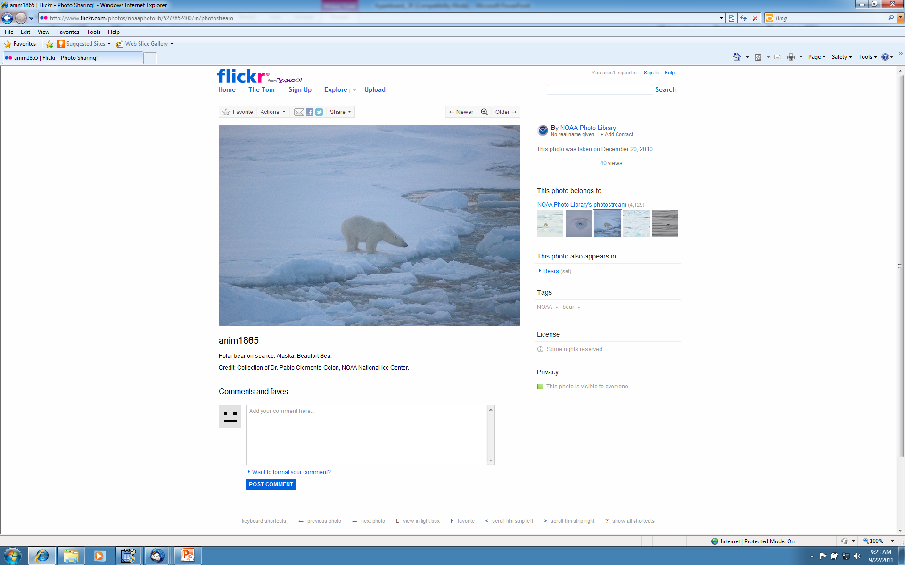
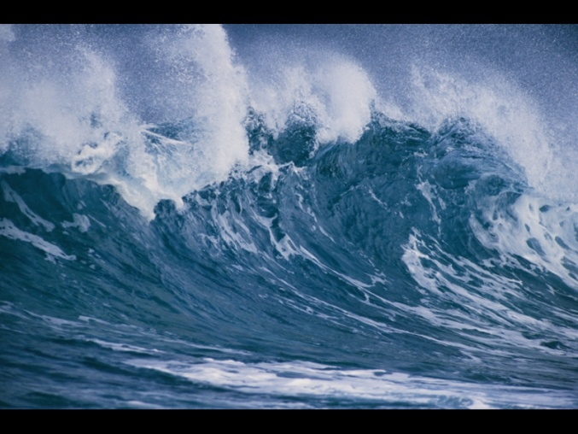
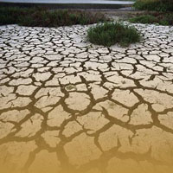
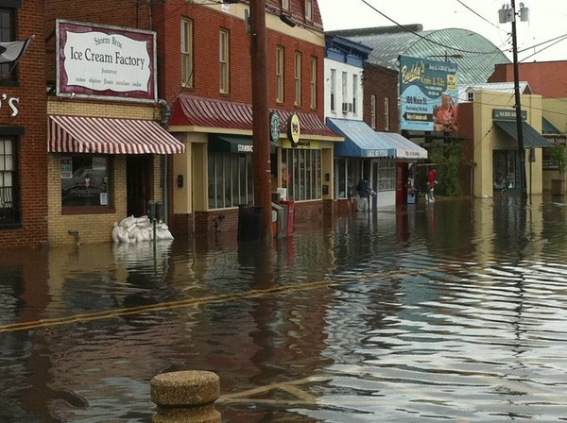
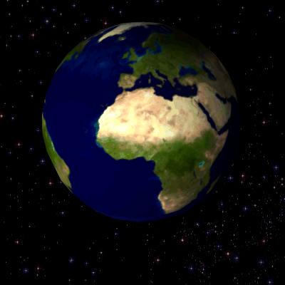
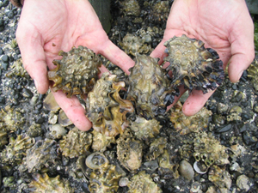
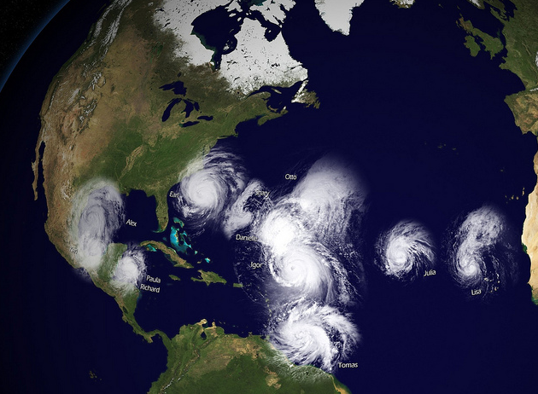
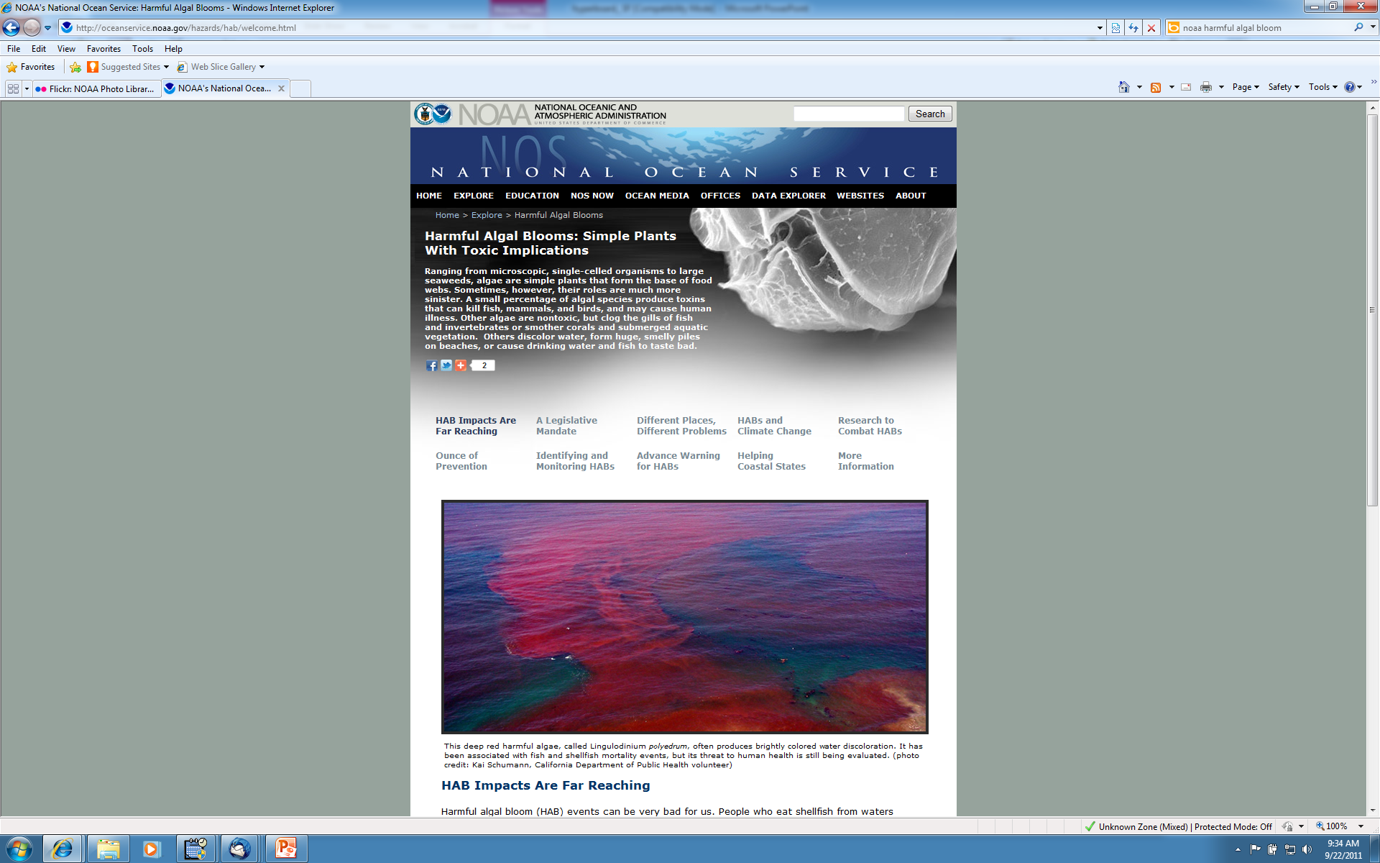
Balancing Ocean Observing Infrastructure with Ocean Research
Our Planet is Changing
We need advanced tools to
understand and monitor our
oceans, coasts and Great Lakes
Carl Gouldman, Acting Deputy
Director, US IOOS Program Office
US IOOS Perspective
Notes:
Briefing given to the ORAP Advisory Committee
1/14/13 C.Gouldman

Slide 2
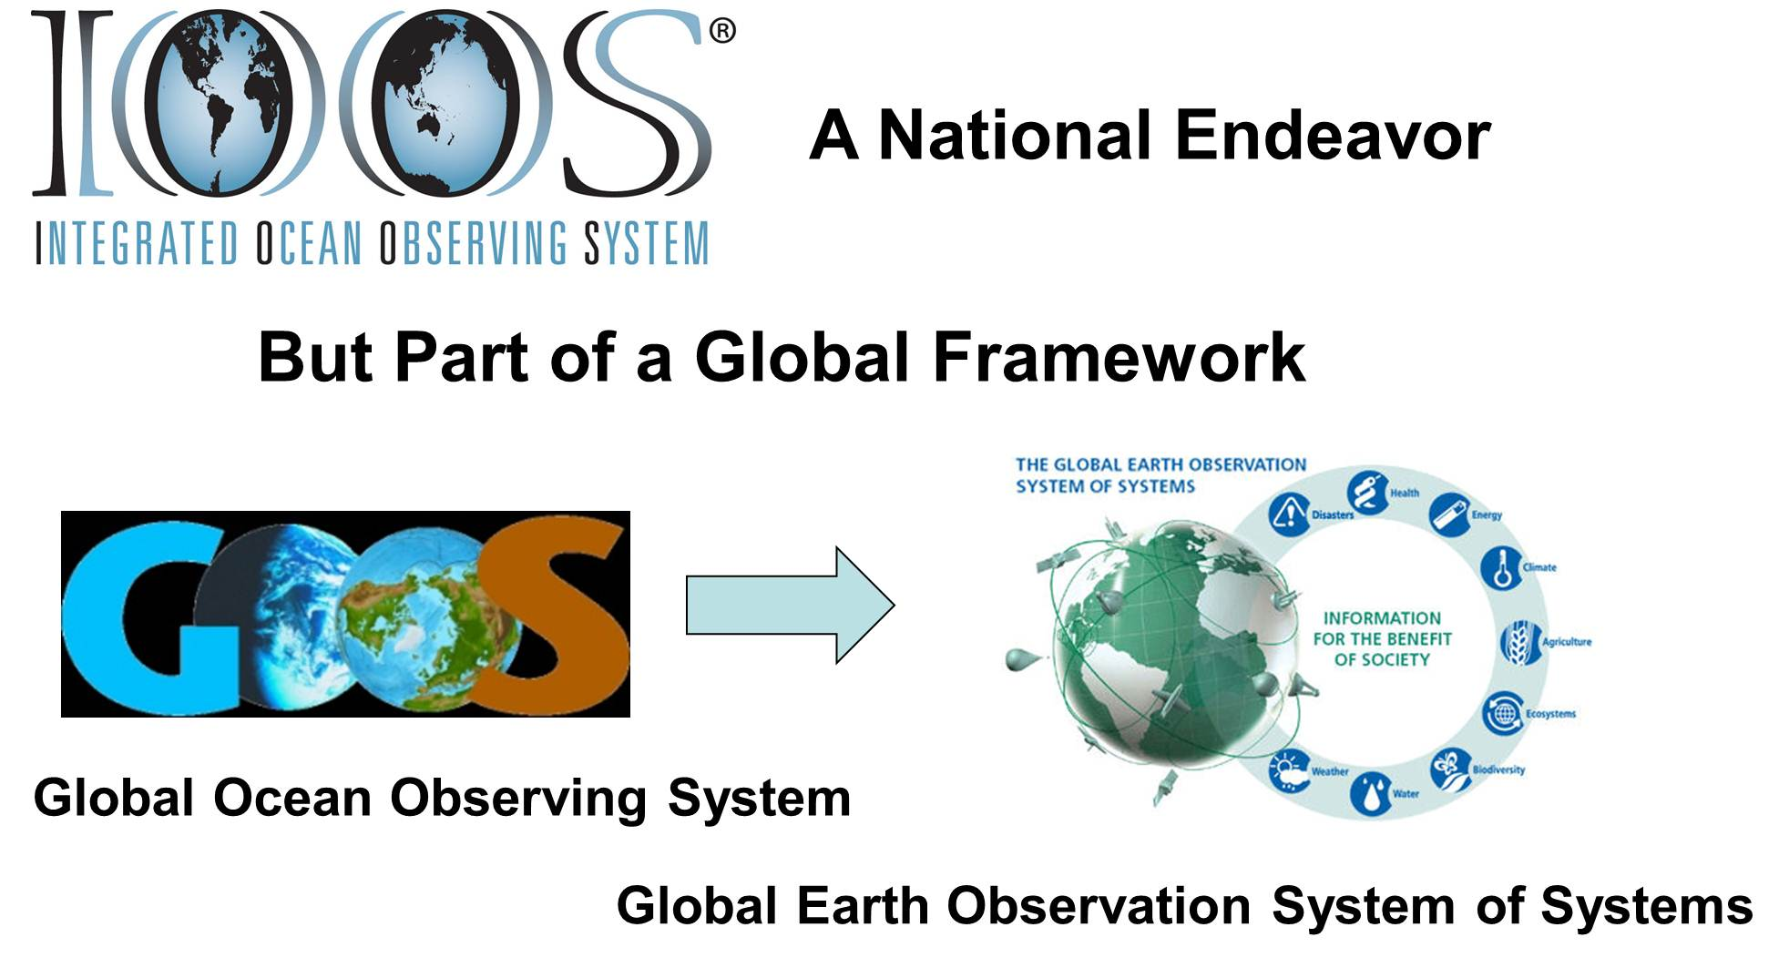
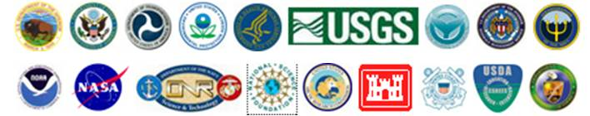
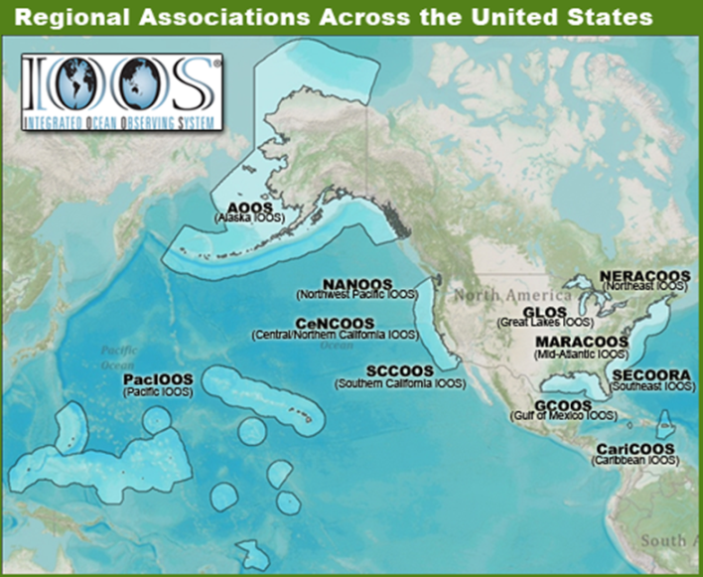
U.S. IOOS: A System of Systems
WHO
WHAT
Observation
Data Management
Modeling & Analysis
Research & Development
Education
        WHY: 7 Societal Goals, 1 System
      Predictions of climate change and weather
      Safety and efficiency of maritime operations
      Forecasts of natural hazards
      Improve homeland security
      Minimize public health risks
      Protect and restore healthy coastal ecosystems
      Sustain living marine resources
WHERE
Global
Coastal (EEZ to tidal waters)
Enables Decision making and Science
Notes:
(2 part slide with animation)
Part I
IOOS is a partnership for Lives and Livelihoods.
IOOS is a solution to increasing observing assets, to coordinate and connect disperate ocean, coastal and Great Lakes data so that information that is comprehensive, usable, and available at the right scale to inform decision making.
Organizationally, IOOS is comprised of two components: Global and Coastal
The logos and the Map you see are the who of US IOOS. The National Agencies, Regional entities
The what of US IOOS: 6 subsystems:
Observing, Data Management and Communications (or as we like to say supply chain management of all oceanographic data); Modeling/Analysis/Products/Services. Underpinned by Research and development and Education and Outreach. Over that we have a governance and management schema
US IOOS is about providing the right information in the right format across 7 societal goals through a single system. The 7 societal goals are listed at the lower right.
Need to stress that IOOS has both a regional and a federal footprint
This strategy allows both:
Local connection with regional stakeholders
National consistency
Regional presence is via 11 Regional Associations, who collaborate together under the IOOS Associations (formerly NFRA)
Federal agencies also contribute to IOOS; the US IOOS office in NOAA funds and coordinates the RAs
Part II
Note that this system is part of a larger context globally.

Slide 3
ORAP Questions Posed:
How does IOOS motivate U.S. investment in ocean observing?
How IOOS envisions moving forward with the community to balance funding IOOS infrastructure AND support ocean research needs?
How IOOS envisions moving forward with the community to balance funding IOOS infrastructure against ocean research needs?
Notes:
The questions I was asked to consider within the framework of Balancing Ocean Observing Infrastructure with Ocean Research
As we have heard, the importance of sustained observations is key and supporting science and decision-support needs are key functions of our observing systems.
I took the liberty of editing question #2 from balancing infrastructure “AGAINST” research needs to “AND support” because it can not be either or, or yes but… it must be yes and.

Slide 4
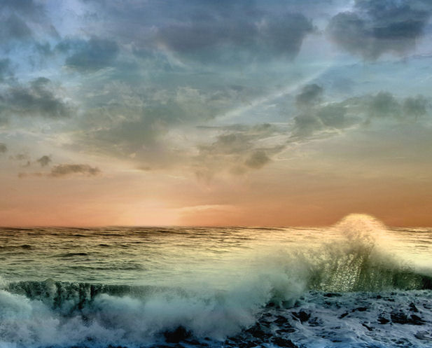
How does IOOS motivate U.S. Ocean Observing Investment?
Demonstrating results and value through integration & interdependence
at global, national, and regional scales
Notes:
IOOS has been maturing and growing for the last decade and we have come a long way.
We have grown at the global scale and the national and regional scales.
We have improved our ability to conduct “supply chain management” of ocean data and developed an extensive network of partnerships, observing technologies, and scientific capabilities.
A few examples follow…

Slide 5
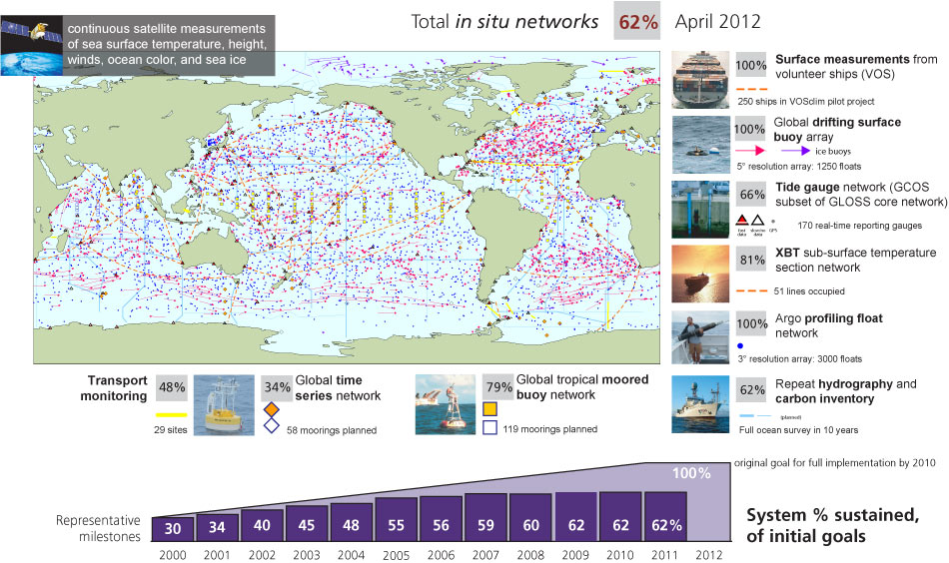
Ocean Observations Data: National to Global
Notes:
Brief TPs for ORAP:
Many of our efforts are focused on integration and interdependencies. The GOOS program is a prime example of both.
Most of you have seen this graphic before, and I show it to highlight two things – the interdependencies among partners including nations to meet the needs and requirements set at international levles.
Within the U.S. we are doing the same…. Next slide
Background TPs:
The most successful component of GOOS over the past decade has been the climate component of GOOS, the global observing system that is required for climate research, monitoring, forecasting and long-term projections of climate variability and change.
It is quite a complex system, and you can see a cartoon of its in situ components here, it is made up of observations from many different types of platforms: research and volunteer ships, moorings, profiling floats, surface drifters and tide gauges. The cartoon map in the center shows you a snapshot of where these observations are taken in the global ocean (the North Atlantic is particularly well-observed compared to many other regions). There are measurements (clockwise starting from top right) of the marine meteorology and near-surface ocean from volunteer observing ships (VOS), the DBCP global array of 1250 surface drifting floats measuring temperature, near-surface currents and in many cases barometric pressure, the GLOSS tide gauge network at the coasts, a network of Ship-of-Opportunity (SOOP) XBT sections, the Argo profiling float network, GO-SHIP repeat hydrography lines for physical, carbon, and biogeochemical variables extending to the deep ocean, the tropical moored arrays TAO-TRITON in the Pacific, PIRATA in the Atlantic, and RAMA in the Indian Ocean, and the OceanSITES-coordinated network of time series sites at moorings and key transport measurements. These are of course complemented by surface observations of the ocean physics and colour from satellites.
The requirements for these systems, expressed in plans of the Global Climate Observing System and GOOS and oriented towards Essential Climate Variables, have been reported to and accepted by the UN Framework Convention on Climate Change (UNFCCC), which provides a high-level basis for asking for country participation.
The observations themselves are funded by national research and other ocean observing funding, and many of these networks are coordinated through the Joint WMO-IOC Technical Commissions for Oceanography and Marine Meteorology (JCOMM) which identifies best practices and standards, and coordinates amongst observing networks.
The growth of a number of observing networks (particularly Argo, surface drifters, and tide gauges) led to a strong rise over the last decade in implementation of this system, but other components have not grown to the requirements expressed by climate science, and implementation has stalled somewhat.

Slide 6
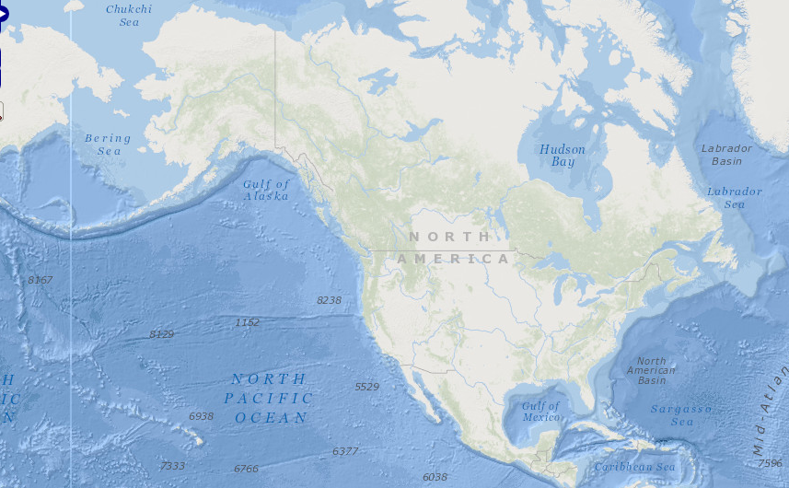
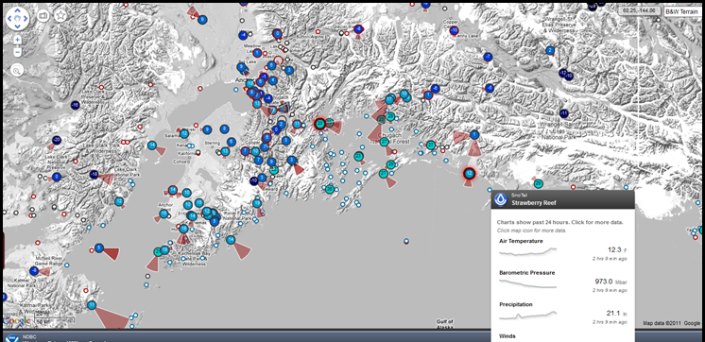
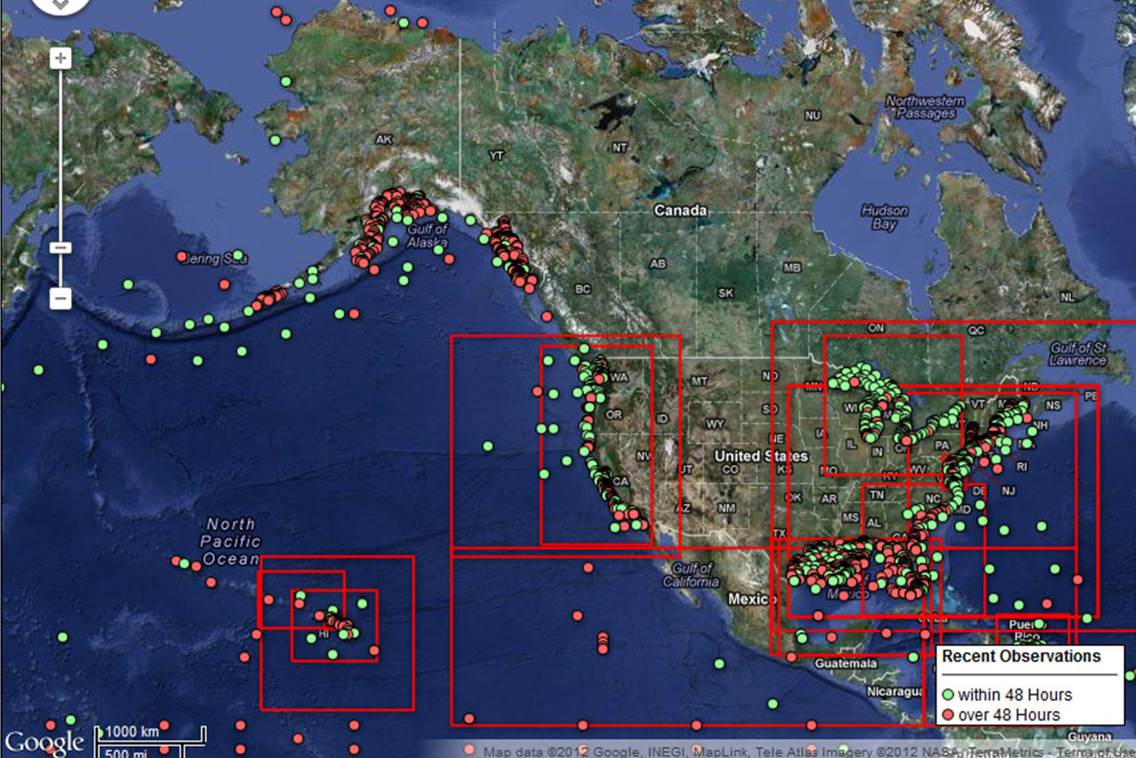
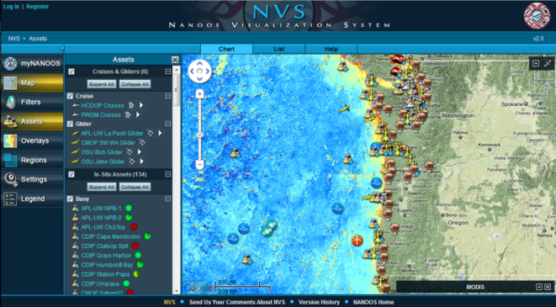
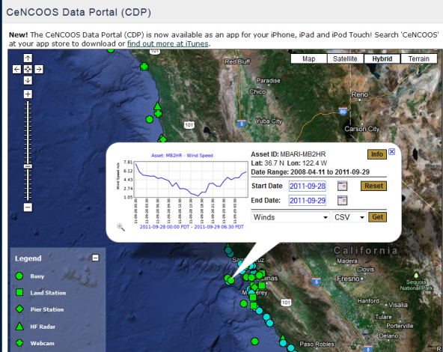
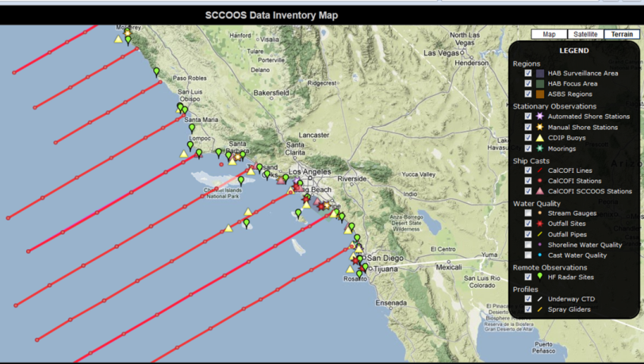
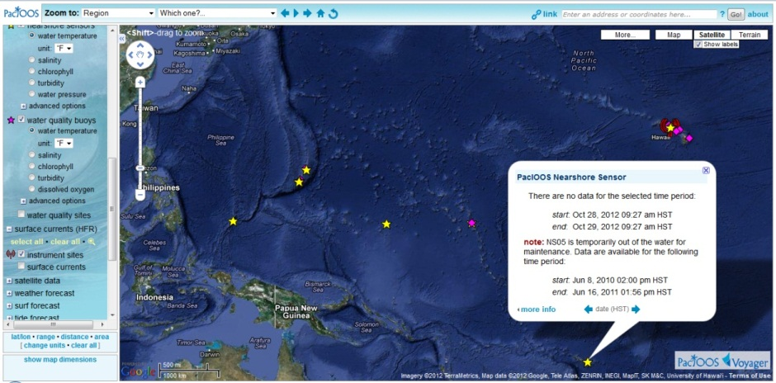
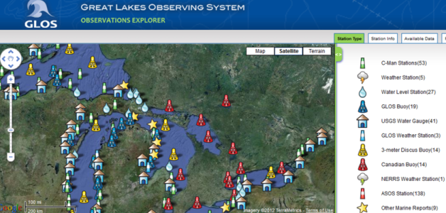
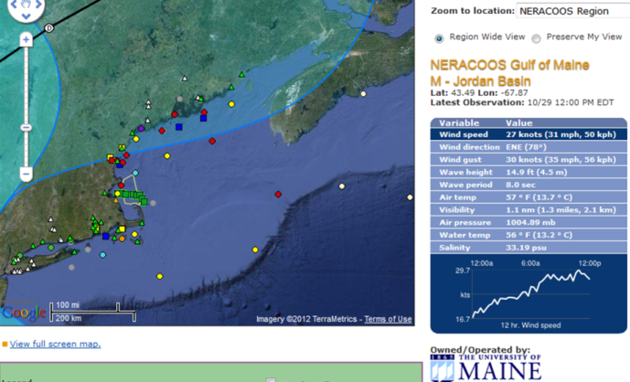
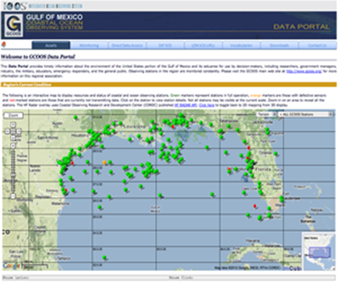
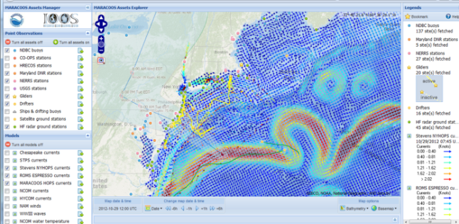
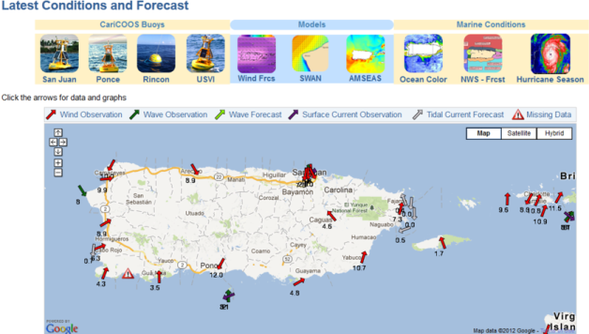
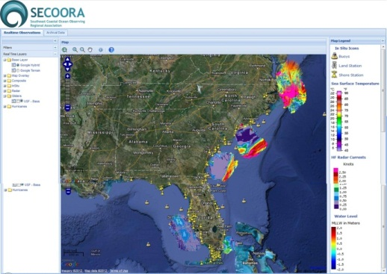
Exposing Ocean Information
Notes:
Within the U.S. we have developed a network of regions that have matured into a nationally consistent network which exemplifies the ability to link and leverage capabilities at all levels to maximize benefits even in fiscally constrained times.
Each image in this slide is just a snapshot of each of the 11 regions.

Slide 7
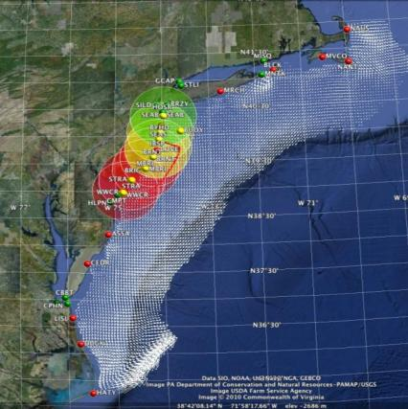
U.S. IOOS® : Highly Leveraged/Interdependent
Mid Atlantic
NANOOS awarded funds for this buoy array through the Murdock Foundation because of the IOOS infrastructure in place and NANOOS ability to provide O&M
IOOS – White
DHS – Green
DoD – Yellow
NJ DEP - Red
IOOS provides the backbone; others can take advantage of the network
Notes:
This is an HFR example where multiple entities are supporting various radars, but they are all available to the national network because the US IOOS program provides the funding for the national data management effort for HFR.
NANOOS, with the Murdock Foundation, deployed a buoy system off the coast of La Push, Washington which measures meteorological quantities, chlorophyll, turbidity, dissolved oxygen, temperature, salinity, partial pressure carbon dioxide (pCO2) and pH. NANOOS was successful in this competition because of the backbone could provide. NGOs will typically provide for the capitol costs but not the enduring O&M. It is now important for NANOOS to continue to be funded to be able to maintain the system.

Slide 8
(2) How IOOS envisions moving forward with the community to balance funding IOOS infrastructure AND support ocean research needs?
IOOS works, therefore ‘we’ should:
continue to demonstrate success & value
collaborate through linking and leveraging
stay flexible, evolve, and seize opportunities as they arise
Examples: Ocean Acidification & Gliders
Notes:
I am using a recent phrase we have been using “IOOS Works” because we have been demonstrating success at many levels including advancing science and technology across the nation.
When I use the word “we” I mean the community of IOOS including all 6 subsystems at all organizational levels.
Specifically in light of the ORAP charge, I think it is important to highlight some of the vision for IOOS in the next decade that came out of the US IOOS Summit in November 2012.

Slide 9
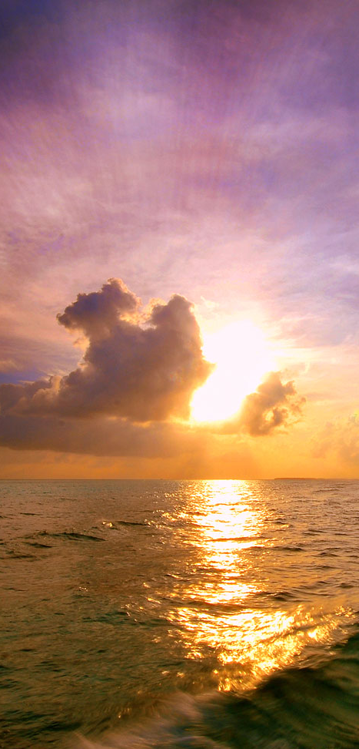

IOOS Summit 2012: A New Vision for IOOS
Major Highlights (ten year perspective)
Enhanced focus on regional/national/global integration
New research and operation models driven by public-private partnerships
Enhanced outreach and communications strategies
More incorporation of biological information
Develop a series of System Integration Pilot Projects
  Ecosystem health as a candidate unifying aim/theme
  Long-term as well as rapid-response to catastrophic events
  Capitalizing on existing infrastructure/activities, e.g., the OOI and remote sensing
Requirements “marketplace” (as match.com of requirements)
Summit report targeted for release ~ March, 2013
SUMMIT 2012
A New Decade for an
Integrated and Sustained
Ocean Observing System
November 13-16, 2012
Hyatt Dulles | Herndon, VA
Notes:
The community has recently met to set the vision for the next decade and beyond.
Some highlights from the IOOS Summit are displayed here.
Note the continued emphasis on partnerships and integration. There is a growing discussion within the community of the need to create more rapid ability to match capabilities and requirements more efficiently and holistically moving forward.

Slide 10
Mechanisms that Work
National Ocean Policy
National Ocean Council structure with functioning Interagency Ocean Observation Committee
  Coordinating on NOPP funding opportunities (e.g. Multi sensor integration of Sea Surface Temperature)
We are actively working for national ocean policy goals and objectives – national plans (Ocean Acidification, Ocean Research, & Observing Networks, etc.)
Legislation & IOOS implementation
We have established the IOOS Advisory Committee
  That committee is reviewing the business model for the regions to ensure we are as effective as possible in the next decade.
  Will coordinate with HSRP, ORAP, and MPA FACs
National program office working to implement the ICOOS Act in partnership with federal and regional partners as well as the states, localities, tribes, and industries that make IOOS work
Notes:
What I think is working in terms of Balancing Ocean Observing Infrastructure with Ocean Research
National Ocean Policy including the National Ocean Council structure with the IOOC other interagency working groups and the NOPP
we are identifying requirements through national plans (Ocean Acidification, Ocean Research Priorities, Observing Networks (Waves, HF Radar, Gliders, etc.)
Legislation helps - ICOOS Act in partnership with federal and regional partners as well as the states, localities, tribes, and industries that make IOOS work.
We have established the IOOS Advisory Committee
That committee is reviewing the business model for the regions to ensure we are as effective as possible in the next decade.
We are implementing the ICOOS Act and reporting to Congress regularly on progress. Partners are actively engaged with decision makers and business leaders to educate them to the importance of BOTH science and infrastructure.

Slide 11
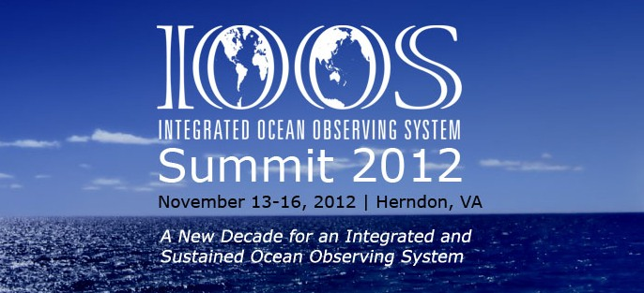
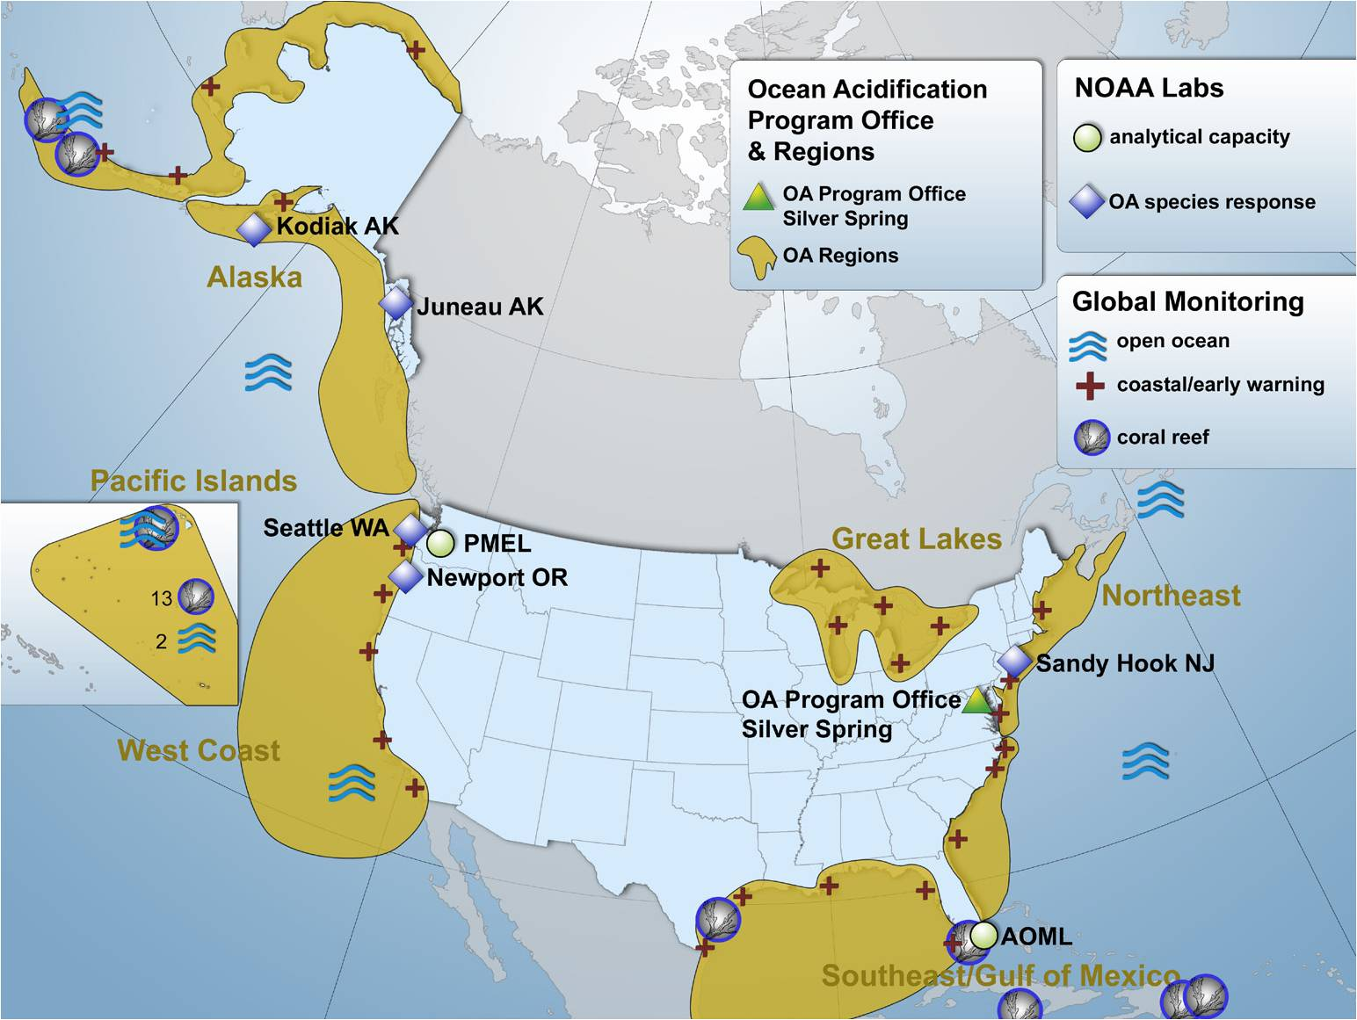
User Engagement Steps
Example:
Ocean
Acidification
(OA)
Regional
Approach
User Requirements
from US IOOS Summit (Hernandez/Wilson 2012)
from NOAA Ocean and Great Lakes Acidification Research Plan, 2010
Notes:
I put up this example because it is extensive in terms of the integration of technologies, science, programs, partnerships, and impacts.
Ocean Acidification is a global issue. Science needs have been laid out in a national plan. The Ocean Acidification program is funding research, funding operational sensors being hosted on regional platforms.
West Coast governments (federal, state, and county), universities, and IOOS regions are coordinating to maximize the benefits to science, data solutions, and economies.

Slide 12
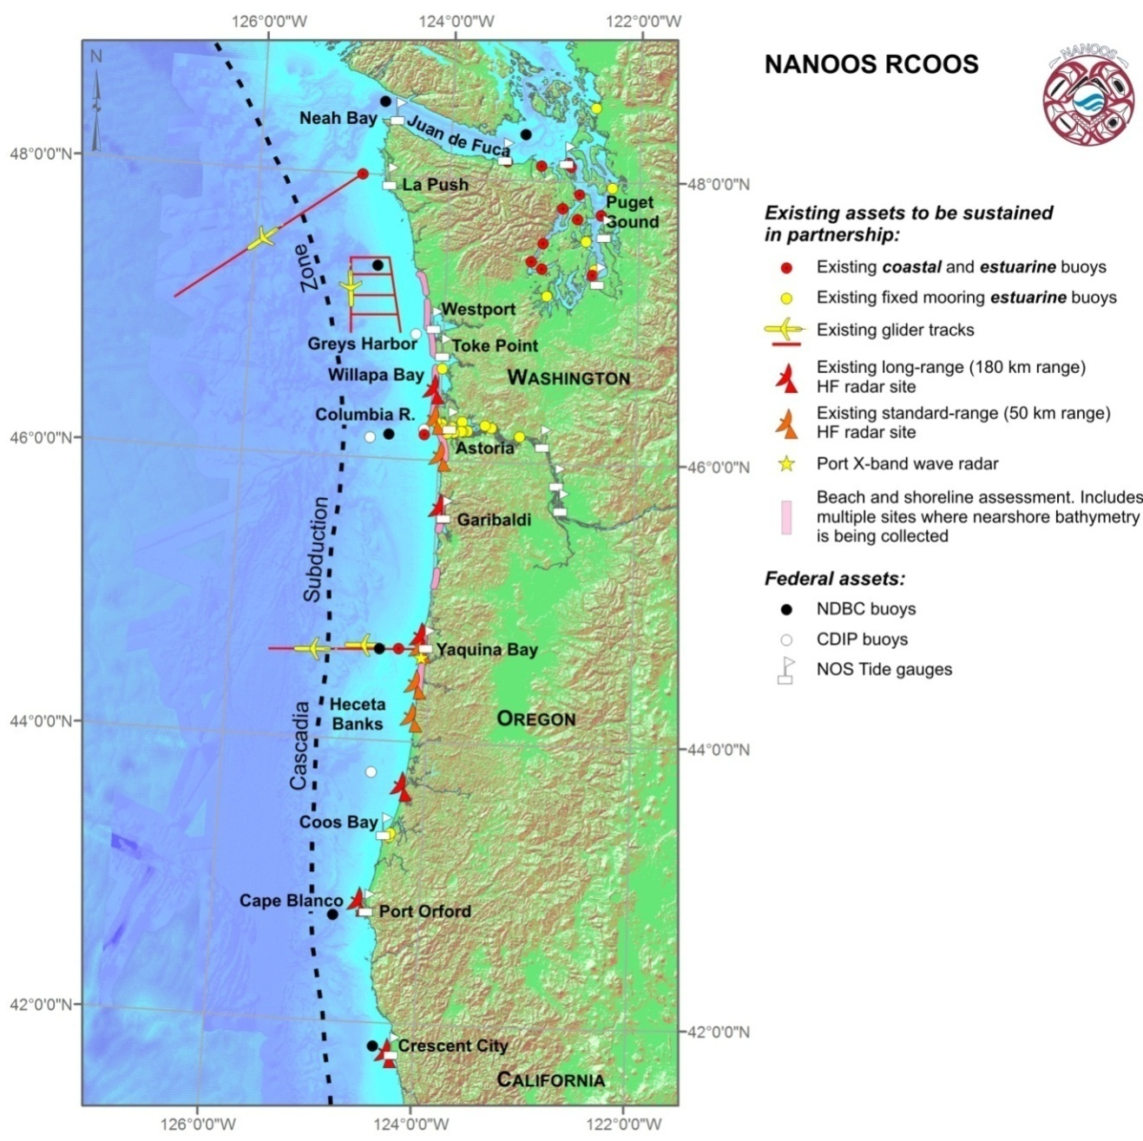
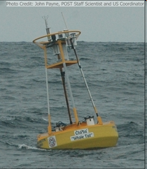
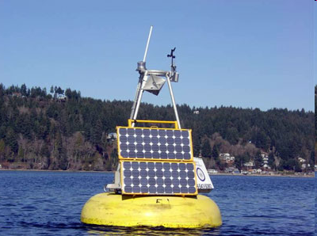
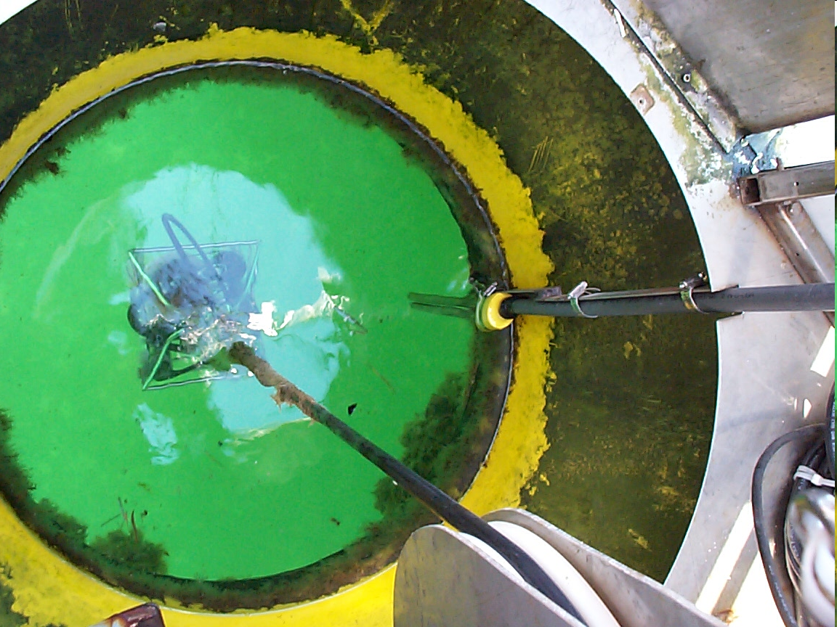

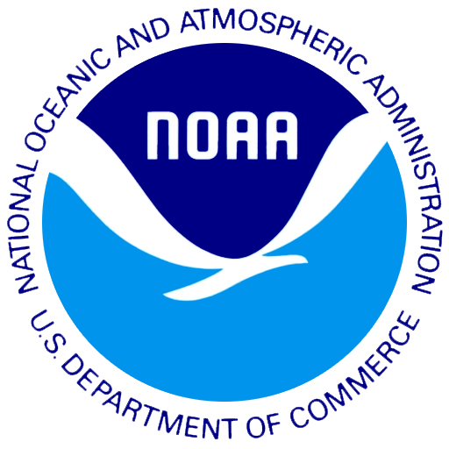
Increase Ocean Acidification Observations
NOAA
pCO₂
equilibrator
Sensor
Package
Notes:
This is just ONE example, but highlights a portion of the partnerships supporting Ocean Acidification needs.
NANOOS has responded to local and regional needs, to invest in partial support for observing platforms for OA monitoring off coast and in Puget Sound, in collaboration with UW, NOAA, OSU and others.

Slide 13
Conclusions
Leveraging resources yields positive results
Multi-sector approach is a hallmark of IOOS and Ocean Science but adds complexity
As we are now interdependent both from a fiscal, science and operational perspectives loss of any 1 funding stream means significant risk to the entire enterprise
What is needed?
  Unified portrayal of why ocean observing and ocean research are critical and complimentary
  Coordinated messages supporting ocean science and infrastructure
  Continued mutual engagement (follow OA example)

