Slide 1
OA: What products and tools are we using now?

Slide 2
Data insert from NOAA PMEL Carbon Program

Slide 3
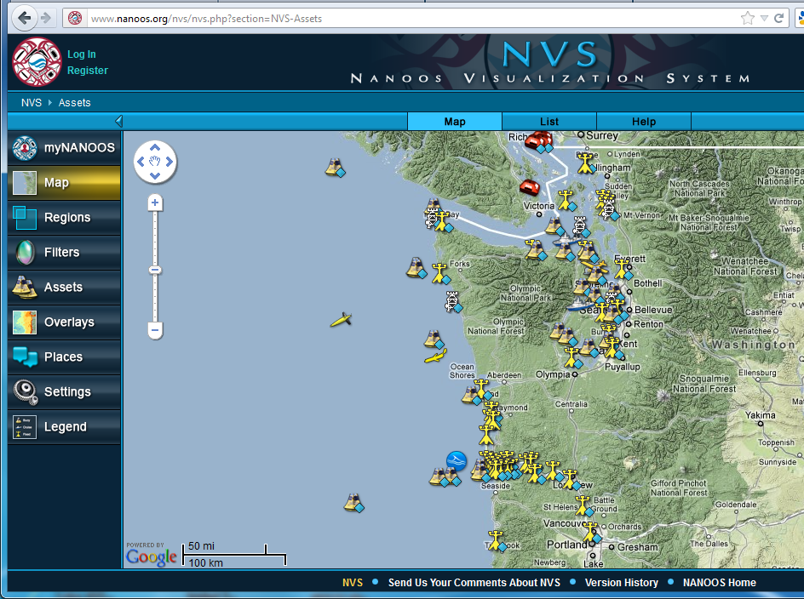
Seattle Aquar.
UW-NOAA
Seattle Aquar.
Taylor Inc.
http://nvs.nanoos.org
Notes:
NANOOS has also produced a data delivery and visualization system, the NANOOS Visualization System (NVS) that is capable of meeting user needs. The value of the NVS for users is its service of data from a wide diversity of data providers, including coastal ocean data from a UW buoy operated with NOAA; from the Taylor hatchery (one of the PCSGA sites), and from King Co at the Seattle Aquarium. We serve all of the PCSGA sites. NANOOS continues to expanding our service of new datastreams.

Slide 4
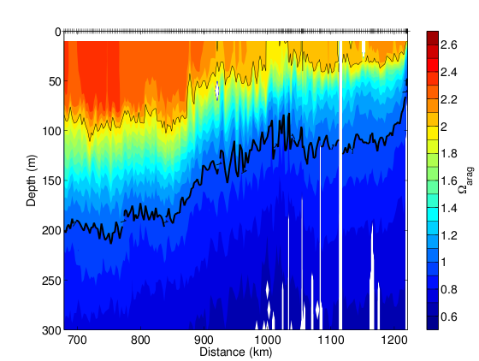
Using relationships developed by scientists at Scripps Institution of Oceanography, NOAA Pacific Marine Environmental Laboratory, Universidad Autonoma de Baja California, and University of Washington, the glider data have been used to estimate pH and aragonite saturation. Aragonite is important to organisms that form shells, as saturation levels below one may lead to dissolution of the shells.

Slide 5
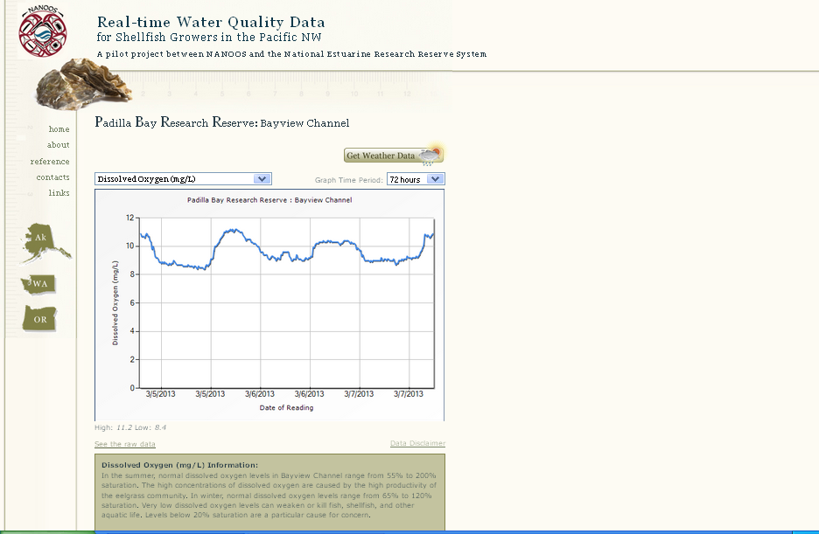
Designed by shellfish growers
Flexible units, time scale
Narrative of what to expect
NANOOS revisiting with NERRS and PCSGA

Slide 6
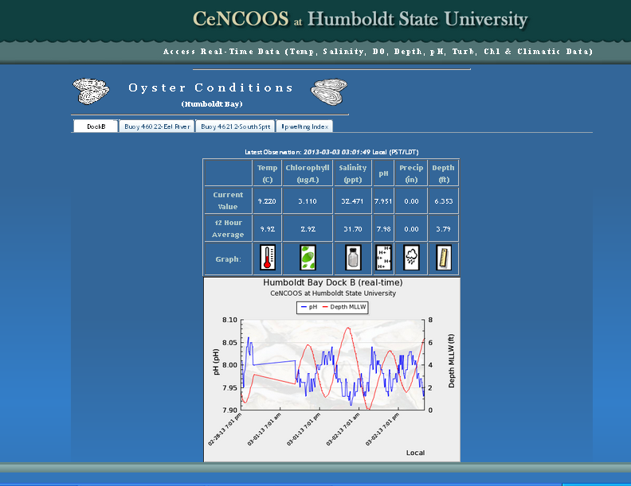
Shows composites, statistics, and indices

Slide 7
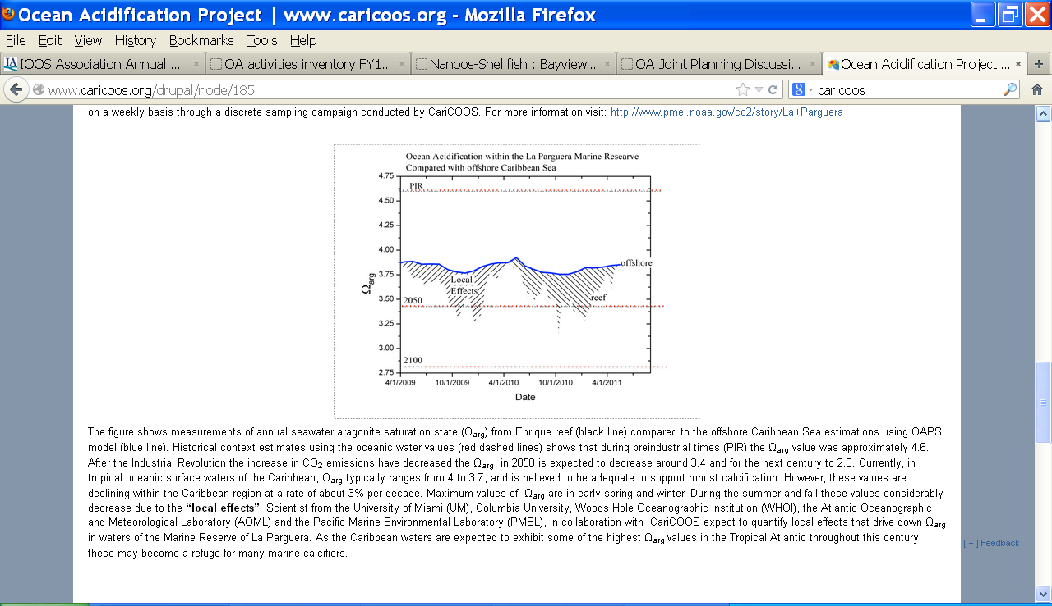
Compares reef and ocean states and in terms of omega aragonite

Slide 8
Caveat
I may have missed others’ products !

Slide 9
Considerations
For growers, perhaps follow one’s advice “keep it simple…like looking at the weather report”
But is that all we need ?
How variable are needs nationally ?

Slide 10
Discussion
Can the RAs help by doing needs assessments with regional users and stakeholders to identify what products and tools are needed?
Can the RAs help with data synthesis and development of those products and tools?
How can RAs support these efforts and coordinate and leverage their own education/outreach efforts with these?

