Slide 1
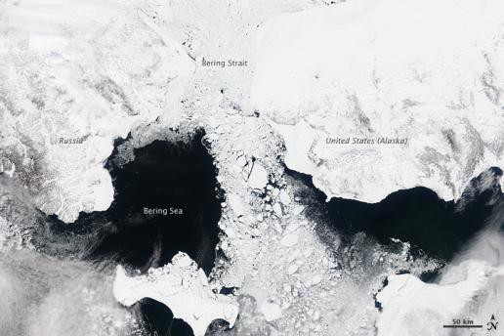
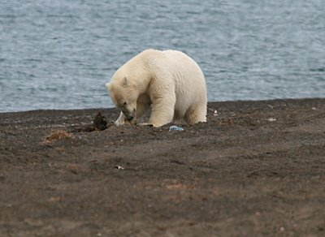
Future needs and plans for ocean observing in the Arctic AOOS Arctic Town Hall Futur
Zdenka Willis
Integrated Ocean Observing System
National Program Office
August, 2013

Slide 2
U.S. IOOS®
Enables decision making everyday
Fosters advances in science and technology
By:
Linking Federal Agencies with IOOS Regions to increase the # of observations
Leverage information from disparate sources into tailored products
A national program comprising 17 federal agencies
11 Regional Coastal Ocean Observing Systems
Observing, Data management, modeling and analysis
2
Notes:
IOOS as a concept dates to 1998, codified in legislation in 2009. NOAA was named as the lead Federal Agency and established the IOOS Program Office in 2007.
Key Elements:
Federal Agencies have observations in the oceans, coasts and Great Lakes based on their missions and are considered contributions to IOOS.
What is unique and makes IOOS a success are the 11 RCOOS that encompass our Ocean, Coasts and Great Lakes and extends our reach to the stakeholders.
Because they are part of a National Program, there is national consistency.
The IOOS Program Office is about coordinating the Federal Agency contributions and the RCOOS so that 1 + 1 is greater than 2

Slide 3
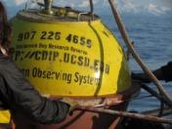
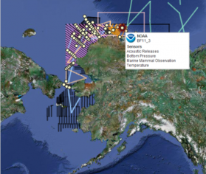
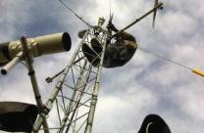
What is AOOS?
IOOS Region with the mission of observing the ocean in 4-D and providing easy access to marine data
Governed by board: state & federal
agencies, research entities, industry
Primary Activities:
Host a centralized data clearing house with web-based tools and data products
Work with marine users to fill gaps in ocean monitoring
Foster collaborations to meet multiple stakeholder needs
Notes:
IOOS RCOOS is a partnership between State, Local, Tribal governments; academia, industry and NGO.
Regions are end to end which means they put in observation platforms, data management, models, products, education and outreach.
It is important to note that AOOS does not have funding to do it all and rely on many partnerships.
IOOS Regions augment and complement the Federal observations.

Slide 4
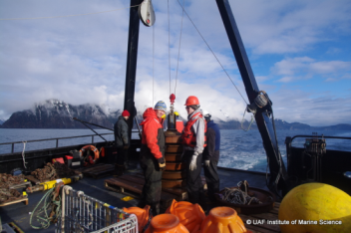
AOOS Goals in the Arctic
Increase ocean & coastal observations in U.S. Arctic; fill the gaps
Make Arctic data more accessible and useful
Develop information products for stakeholders & decision-makers
Notes:
AOOS’s goals extend to the Arctic.
Important point is that AOOS is policy neutral and stakeholder driven.
AOOS is seeking to meet the needs of many
Goal is to help people find relevant information and tools to meet their needs

Slide 5
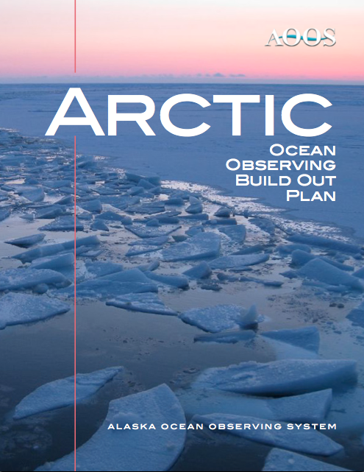
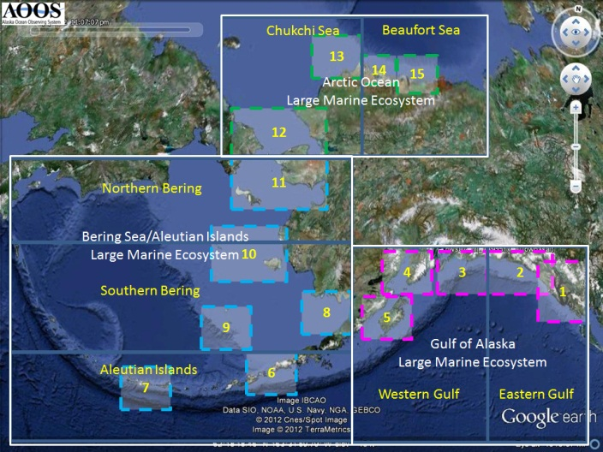
Arctic Observing Plan
Notes:
As part of the Legislation, we needed to produce an Independent Cost Estimate and AOOS produces a 10 year build out plan.
From there they focused on the Arctic and have put together a conceptual build out plan for the Arctic.
Prioritizes core monitoring platforms and activities for safe marine operations, improved storm and hazard response, and integrated data products for ecosystems assessments and climate trends

Slide 6
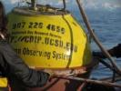
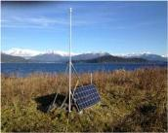
What does AOOS do?
Marine Operations
Maintain weather stations, wave buoys, radars & forecasts
Add weather stations to AIS transmitters
Coastal Hazards
Support tide gauges, wave buoys, coastal beach profiles
Develop electronic sea ice atlas: 1850s to present
Piloted harbor observing systems in Seward & Kodiak
Ecosystems & Climate Trends, Fisheries & Water Quality
Support Seward Line: longest time series in AK
Ocean acidification: support mooring network; pilot OA
forecast in Gulf of Alaska, test sensor at Seward hatchery
Support glider lines & new mooring in Chukchi: test glider hydrophone to record marine mammal calls
Facilitating animal tagging network for Arctic
Notes:
Based on stakeholder input
AOOS activities can be broken into three themes:
Marine Operations
Coastal Hazards
Climate Trends and Ecosystems
Activities listed….
Subsequent slides go in details on some of the activities.
Let me draw your attention to Ecosystem
Test sensor at Seward Hatchery is part of the new IOOS Marine Sensor Innovation project
Pushing the limits of technology – with the glider efforts

Slide 7
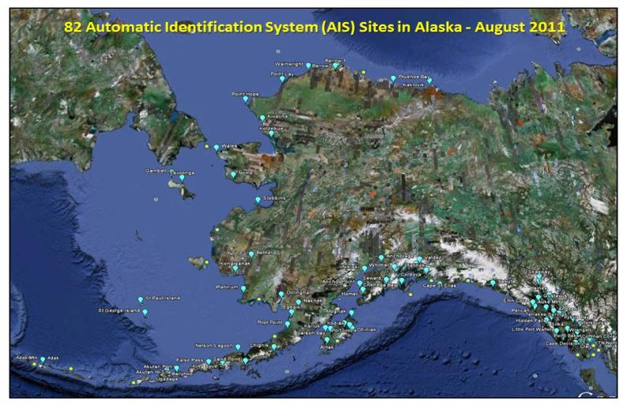
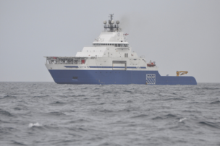
Adding weather to AIS stations
Notes:
AOOS has a project with the Marine Exchange of Alaska to “push out” local weather conditions through the land-based AIS (Automated Identification System, which tracks vessels). Vessel operators thus do not have to listen to entire regional marine weather forecast by VHF radio, but rather, can get very tailored, specific information for a smaller region.
Improves effectiveness and safety of operations.

Slide 8
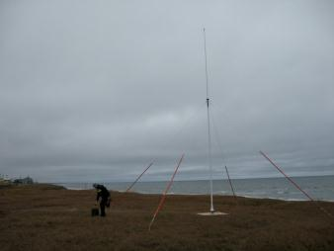
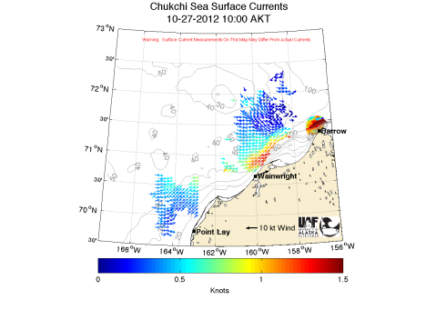
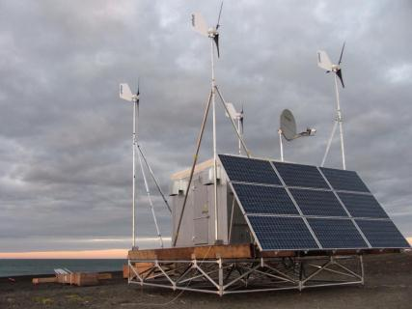
High Frequency radars
Notes:
HF radars part of a larger network. There are 130 Radars, in Lower 48, HI, Puerto Rico
Unique characteristics is not electrical power outlets in Barrow so UAF has come up with the HF Radar shed using both wind and solar power.
With funding from BOEM, Conoco-Phillips, Shell, AOOS – UAF has conducted three years worth of HF Radar, drifters, glider studies to understand the 3Dimesional circulation pattern to understand what would be needed in response if there would be an oil spill
Data input to NOAA’s Oil Spill tracking software and USCG operational Search and Rescue system. We have done tests that using HF radar data and short term forecasting we can decrease the search area by 2/3irds over 96 hours.
Post DWH we received 5M for O&M and that basically keeps the 130 Radars going in the network, we have no money for further capitalization and full O &M costs.
HF radars, which map surface currents, are currently in place at 3 locations in the Chukchi Sea: Barrow, Wainwright, & Pt. Lay. For increased vessel traffic through the Bering strait, should probably install these at that location. And ideally, along the Beaufort Sea coast. These are expensive, and to operate and maintain over the long-term, would require a joint funding consortium. Based on the OSE (observing system experiment) AOOS conducted in Prince William Sound in 2009, the use of HF radar data significantly improved ocean circulation forecasts.

Slide 9
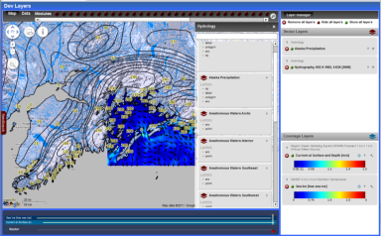
AOOS Ocean Portal
Linking AOOS data applications
View multiple types of data on one interface
Sensors
Models
Remote Sensing
GIS & project data
In-situ observations
View time ranges for each layer
Download data sets simultaneously
Follow links to data sources
Useful for government & industry planning
Public access to industry data
Organized by LMEs: Arctic, Bering Sea/Aleutians,
Gulf of Alaska
Notes:
This system will allow users to visualize, query and integrate data from multiple source types (sensors, models, remote sensing, GIS data layers and in situ observations) on a single platform.
→planning and management
This is the heart of AOOS is the data portals. AOOS portal makes real-time data, models, satellite imagery from many sources available in an easy to use format that can be combined in ways to support decision making
Polar projection. Handles many data types, over 200 layers.

Slide 10
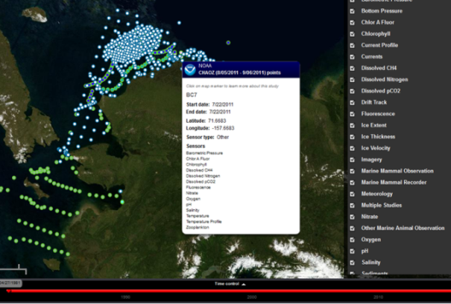
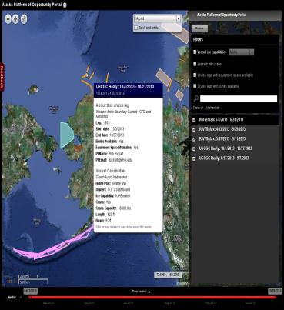
Research Assets Map
What instruments are deployed and what are they collecting?
Goals of the map
Assist research planning
Reduce duplication of effort
Avoid collisions
See holistic picture
Started in the Arctic,
now expanding statewide
Includes Platform of Opportunity:
Research vessel schedules &
opportunities
Notes:
Developed in response to agency request – difficult to keep track of who is doing what, where
Includes: Buoys, moorings, vessel tracks, aerial transects, sampling locations, etc.
Searchable by project name, sensor type, or host
Time-slider allows view of different time periods
Updated each spring, and after the field season

Slide 11
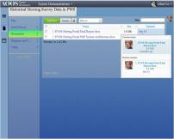
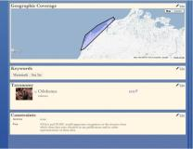
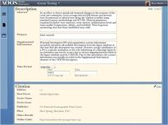
Research Workspace
Web-based data management system for assembling, storing, and sharing data between members of biological and physical oceanography communities.
Users can:
Create projects
Create metadata
Upload data (drag and drop)
Share or download data
View all projects, folders, and files uploaded by other group members
Track history of data management within the project
Next steps: automated archive to NODC, incorporate data into AOOS Ocean Portal Search Tool, publish to completely public access
Groups: Gulf Watch AK, GOAIERP, RUSALCA, DBO, Arctic EIS
Notes:
Collaborative file sharing with large or small inter disciplinary groups
Currently 150 users and over 2,000 files in the system
Existing groups using the Workspace include
North Pacific Research Board’s Gulf of Alaska Project
GulfWatch Alaska – the long term monitoring program of the Exxon Valdez Oil Spill Trustee Council
Prince William Sound Science Center

Slide 12
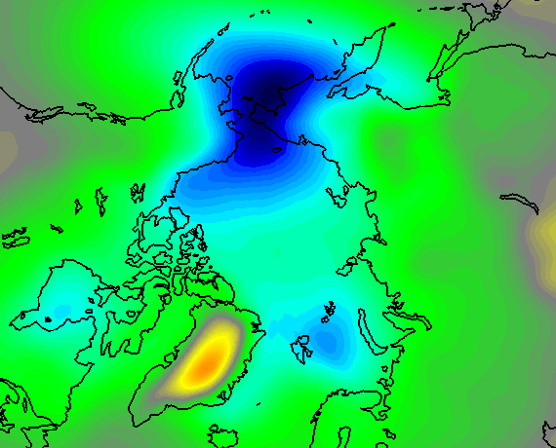
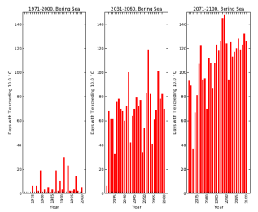
Downscaled climate model projections
High-resolution spatial fields of temperature, precipitation and wind for entire Alaska coast
Downscaled future scenarios for 21st-century time-slices
Addresses potential impacts of these changes in context of a changing sea ice cover
Partnership with AK Center for Climate Assessment & Policy: Available in December 2013
Notes:
Climate models exist at the small scale – large area
AOOS is funding to take these large area models to downscale to be regionally specific for Alaska
There will be forecasts available for 2030, 2070, 2100 and will include error bars.
These models can be used for planning and as overall climate modeling improves, then these models will be improved and reflected in the error bars

Slide 13
Notes:
Partners are AOOS, ACCAP, National Weather Service, National Snow and Ice Data Center, NOAA’s Pacific Environmental Marine Laboratory.
Again to take the Arctic wide effort and provide the Alaska view.
Sea Ice grids and digital maps of sea ice concentration.
Monthly mid-19th century to 1952; weekly 1953 to present
Should be completed by the end of December 2013

Slide 14
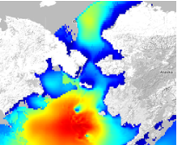
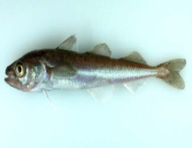
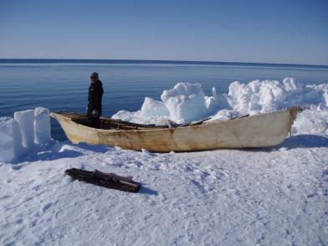
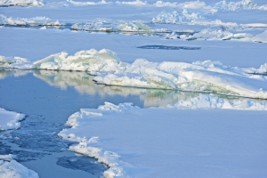
STAMP Project
Spatial Tools for Arctic Mapping & Planning
Strong state support for data integration
Data for decision support: human uses,
20 year climate scenarios, environmental (physical, biological, chemical)
Based on: What info do stakeholders need to plan for
potential commercial fisheries in Arctic?
What tools do decision-
makers need? Scenarios?
Cumulative impacts?
No. Bering &
Chukchi Seas
Includes socio-
economic data
Notes:
As a result of AOOS’ strong data management efforts, they received money from another part of NOAA through NOAA’s Regional Ocean Partnership Program.
Goal: collect, synthesis of spatial data into a suite of visualization tools for long-term collaborative planning in Alaska for a wide range of coastal uses

Slide 15
Final thoughts
Need to coordinate & integrate the Arctic data portals, including at international level
Need to develop clear operational needs for Arctic observations
No one entity can do it all: need partnerships

