Slide 1
US IOOS® is…
Vision:
IOOS is an innovative public/private enterprise of integrated national and regional ocean, coastal, and Great Lakes observations that equips the nation to face natural and manmade risks to economic growth, prosperity, and survivability, and to ensure a safe, productive, and resilient ocean and coastal zone
A national program comprising 17 federal agencies
11 Regional Coastal Ocean Observing Systems
Links ocean sensing information together to provide real-time data to enhance the United States’ predictive capability and decision support infrastructure.
Strategically positioned and aligned with:
Broader regional, national and international ocean, coastal and inland water stakeholder groups
Enables Decision Making; underpins scientific & technology advancement
1
Notes:
In March 2009, Congress passed the Integrated Coastal and Ocean Observation System Act , which formally established US IOOS.
IOOS provides a coordinated local, regional, national and international network of ocean and coastal observations, modeling, data analysis and communications that is helping to protect life and property, sustain economic vitality, safeguard ecosystems and advance the quality of life for all people living nearby the sea and the Great Lakes.
As we’ll discuss later, IOOS also has linkages with DHS, the Navy and the USCG that merge ocean science ISR with the military ISR. Some are calling this a “hybrid” ISR.
We all need good information about climate change and physical oceanographic processes as we venture ever farther in the Arctic.

Slide 2
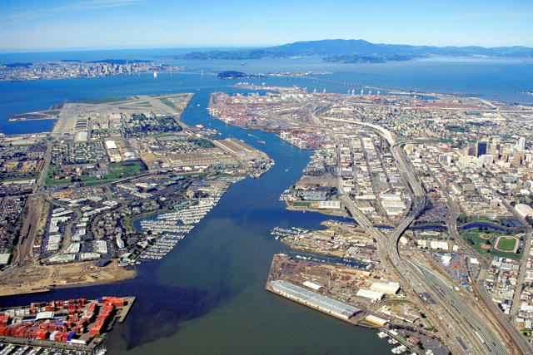
Coastal Communities: Vital to U.S. and International Economies
45 percent of the U.S. national gross domestic product is contributed by coastal communities.
51 million jobs
Coastal counties contain 53 percent of the nation’s population—but account for only 17 percent of U.S. land area (excludes Alaska).
Coastal habitats help reduce impacts of floods, storms, and climate change on coastal communities by absorbing water, wave energy, and other stressors.
Notes:
The coasts is the economic engine of America.

Slide 3
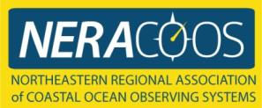
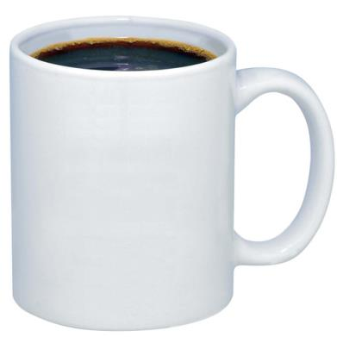
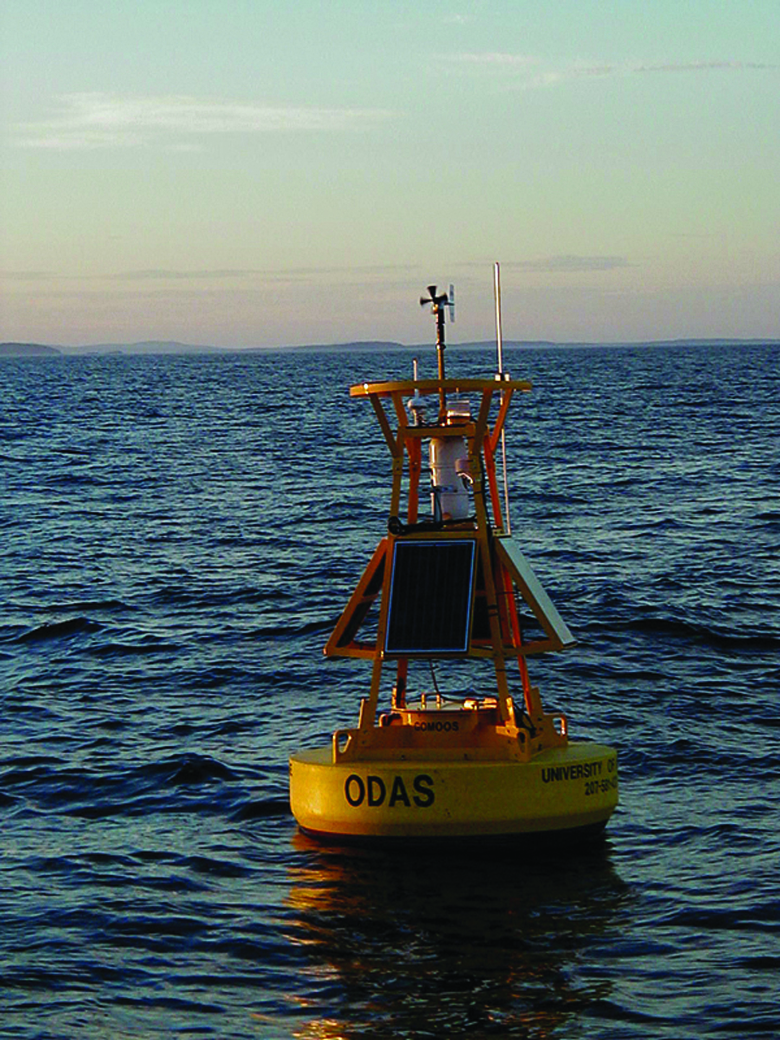
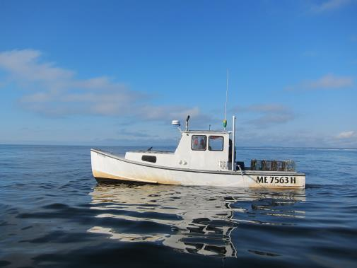
IOOS in Motion Everyday
+ +
"I trust the weather buoys with my life. Thank you." - Maine Fisherman; "Love your service…I believe your service is a lifesaver. Thanks!" -Dave, Pilot; and "I would like you to know that information you are providing us not only aids us in our work, it almost certainly has saved lives." -Roy Atkinson, Fisherman.
U.S. Integrated Ocean Observing System (IOOS)
Notes:
So you might ask how are a cup of coffee, a buoy and a boat related.
Well when you look at the plot of hits to the NERACOOS website you see that it peaks at 4 am. In talking with fisherman they get up, get a cup of coffee, look at the conditions and determine whether they go out to see.
Both a lives and livelihood issue. Lives in ensuring the safety of lives – see the quotes and livelihoods because if it helps them to run an efficient fishing business.

Slide 4
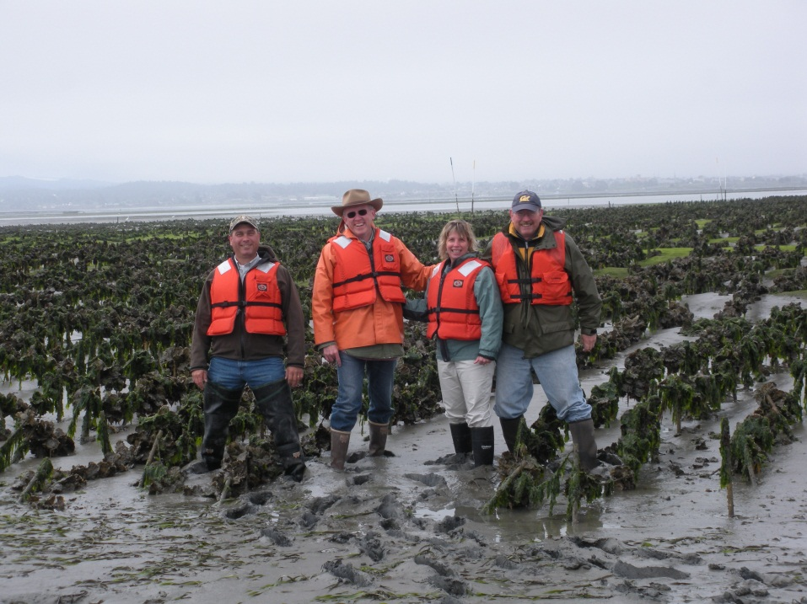
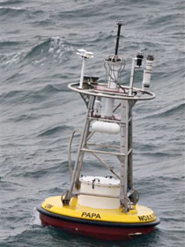
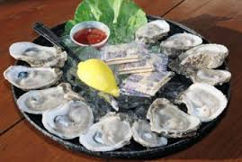
Oysters on the Half Shell
+ +
2008 Whiskey Creek Hatchery lost 100% of oyster larvae
Ocean Acidification was the cause
Real-time Observing System established
By 2010 productivity was back to 70%
Notes:
$111 million West Coast shellfish

Slide 5
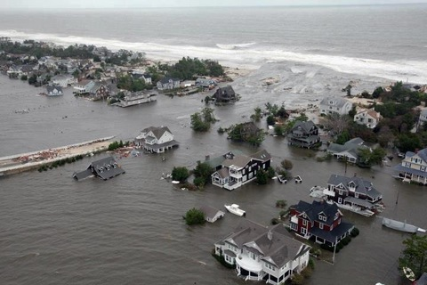
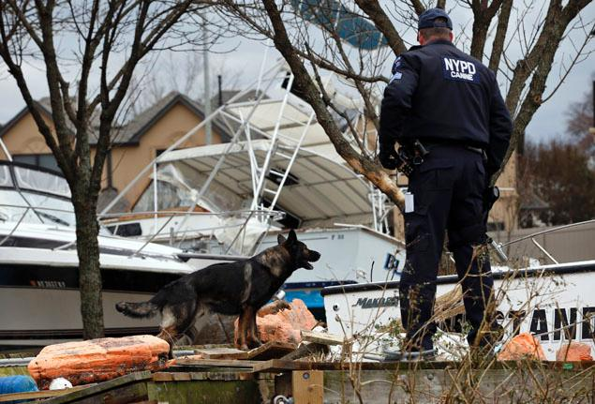
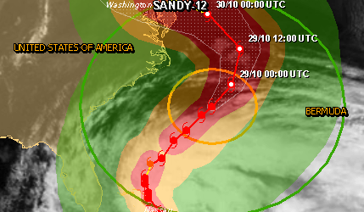
IOOS® Response to SuperStorm Sandy
IOOS partners’ buoys, gliders and other sensors generated hourly updates
Wind velocities, wave heights and periods, water levels
Air and water temperatures
40+ High Frequency Radars
Ocean current data
Information shared with National Hurricane Center
Generated time critical warnings for local public officials
Storm path and flooding updates
5
Notes:
Without a doubt, America’s security was gravely at risk by SuperStorm Sandy last year.

Slide 6
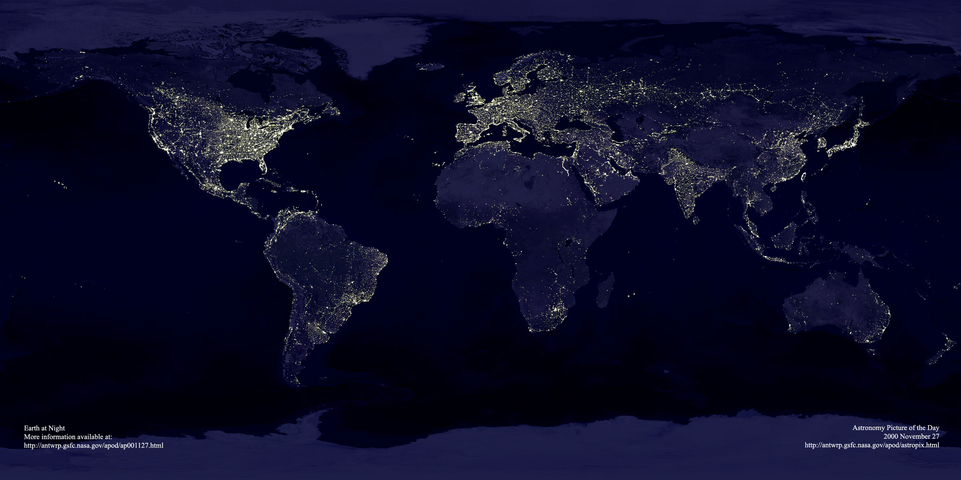
Coastal Vulnerability Around the World
Notes:
Currently, 19 out of 20 major cities are located on the coast.
Our nation’s bountiful coastal resources have influenced American history and culture, and have drawn a substantial portion of our country’s population to the coast. The concentration of people and economic activity at the coast places pressures on ecologically sensitive coastal ecosystems and also leaves residents and visitors vulnerable to coastal hazards, such as hurricanes, erosion, and sea level rise.
In 2010, 39 percent of the U.S. population lived in Coastal Shoreline Counties (less than 10 percent of the total land area excluding Alaska).

