Slide 1
IOOS DMAC 2019
AOOS AIS Projects
ADAC AIS PAC (AIS for Prioritizing Arctic Charting)
Arctic Oil Spill Risk Assessment
https://ais.axds.co/
https://aoos.org/ais-4-bathy/
https://osra.axds.co/
https://arctic-osra.aoos.org/
Jessica Austin
Axiom Data Science May 2019

Slide 2
AIS Approach

Slide 3
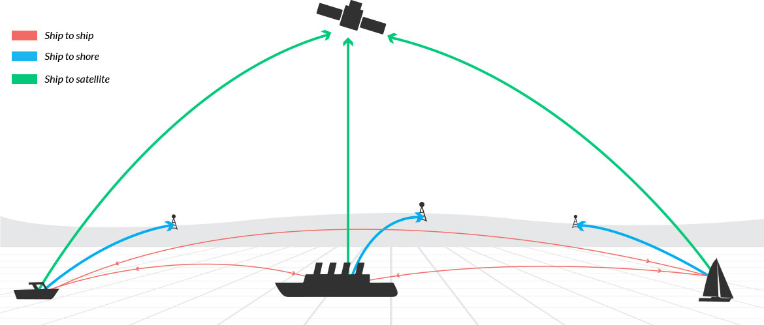
The Automatic Identification System (AIS)
On-board tracking system, transmitting over VHF
AIS equipment integrates with vessel navigation systems, such as GPS
AIS position message includes: ship MMSI (identifier), lat, lon, speed, heading, etc
Other AIS-equipped ships can see traffic in the area
Land-based (and satellite) receiver networks can collect data for an entire region
Increasing interest in analyzing historic datasets
Prioritizing bathymetric surveys
Predicting probability and impact of oil spills
Quantifying interaction with marine wildlife
etc
https://sat-trak.com/
http://ais.axds.co
Notes:
The Automatic Identification System (AIS) is a system of shipboard transmitters and land-based and satellite-based receivers that allow vessel locations to be broadcast and recorded.
While traditionally used for real-time maritime applications, there is increasing interest in using these rich datasets to provide insight into a wide array of oceanographic problems, such as prioritizing hydrographic surveys, predicting the probability and impact of oil spills, quantifying the amount of vessel interactions with marine wildlife, and more.

Slide 4
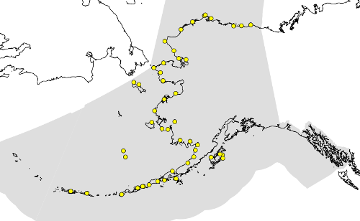
Marine Exchange of Alaska: Arctic AIS Data
MXAK maintains the only terrestrial AIS network in Alaska
Over 100 AIS receivers, 48 of which are in the Arctic
MXAK also maintains an arctic-specific vessel catalog, which has been quality-checked for valid vessel categories
Arctic AIS dataset
5 years: 2013-2017
1.4 billion raw messages
http://ais.axds.co

Slide 5
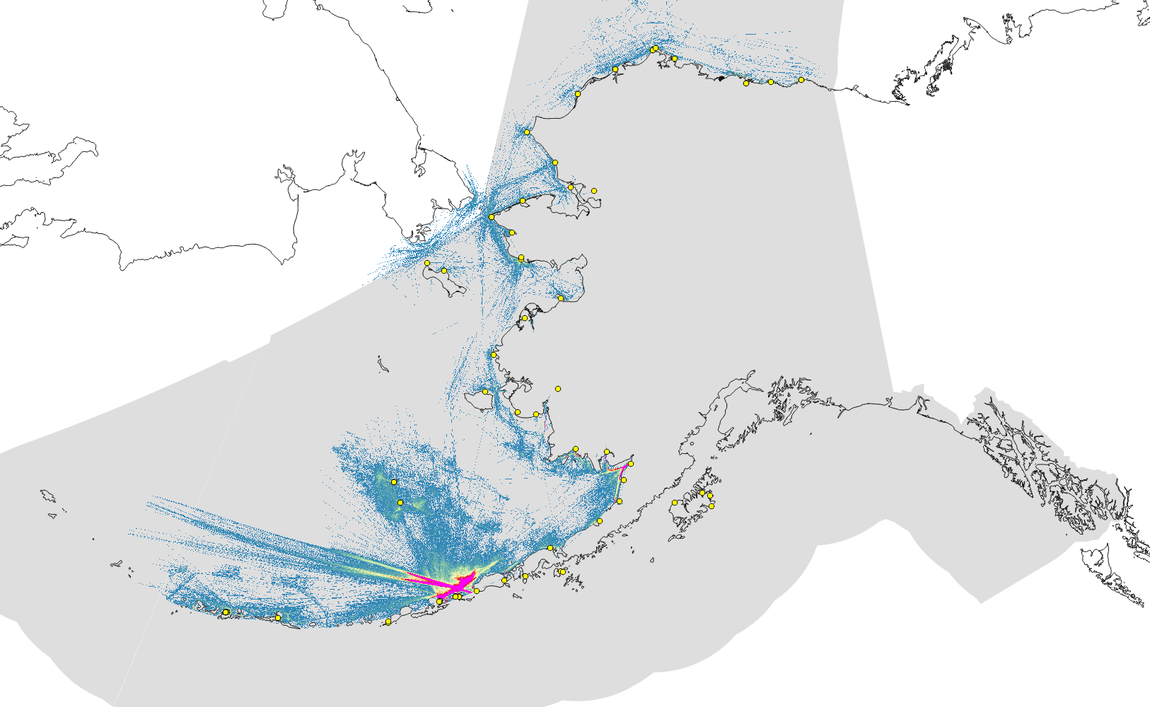
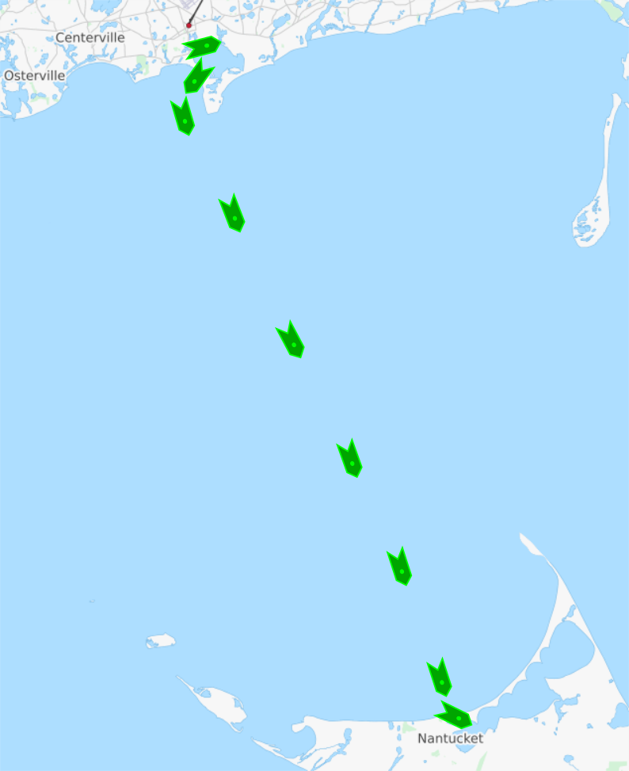
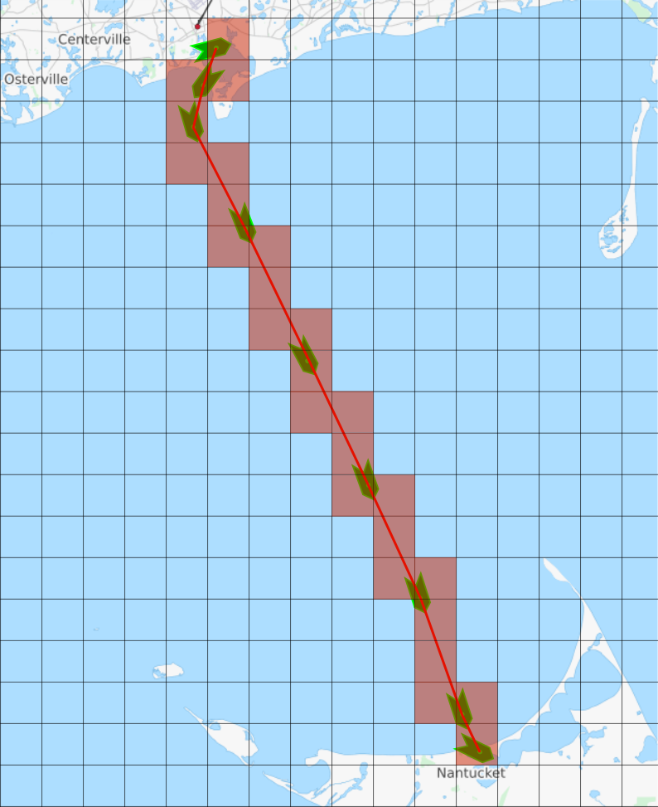
Marine Exchange of Alaska: Arctic AIS Data
Vessel data processing:
Raw messages turned into vessel pings
Vessel pings into vessel voyages
Filter voyages into ship type
Generate vessel traffic heatmaps
http://ais.axds.co

Slide 6
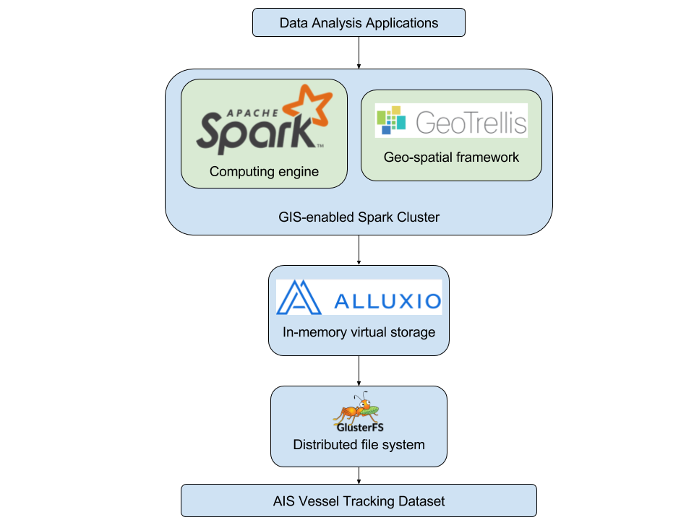
AIS is Big Data!
Problem: Due to immense size of these datasets—typically 10s of billions of raw messages per year—and limitations on infrastructure and computing power, AIS data must currently be processed in small temporal or spatial subsets.
Solution: Develop cluster computing infrastructure and applications to analyze the data across many machines in parallel
Results: Generating vessel traffic heatmaps from raw AIS data:
Previous workflow: single machine, small subset ⟶ days to weeks to process
Our workflow: compute cluster
Arctic data for one year ⟶ 90 minutes
All US waters for one year ⟶ 48 hours
12 computers
144 total cores
1152 GB available memory (RAM)
http://ais.axds.co
Notes:
Due to immense size of these datasets—typically 10s of billions of raw messages per year—and limitations on infrastructure and computing power, AIS data must currently be processed in small temporal or spatial subsets. This has proven inadequate for decision-making that requires analysis on a national or global scale over an entire year.
For example, for the specific process
And as you'll see, the bulk of this processing time is up-front to parse and clean the raw AIS messages. Once the data has been analyzed once, we can run ad-hoc queries to get vessel tracks or vessel traffic heatmaps for a specific region and time frame in a matter of minutes to hours.

Slide 7
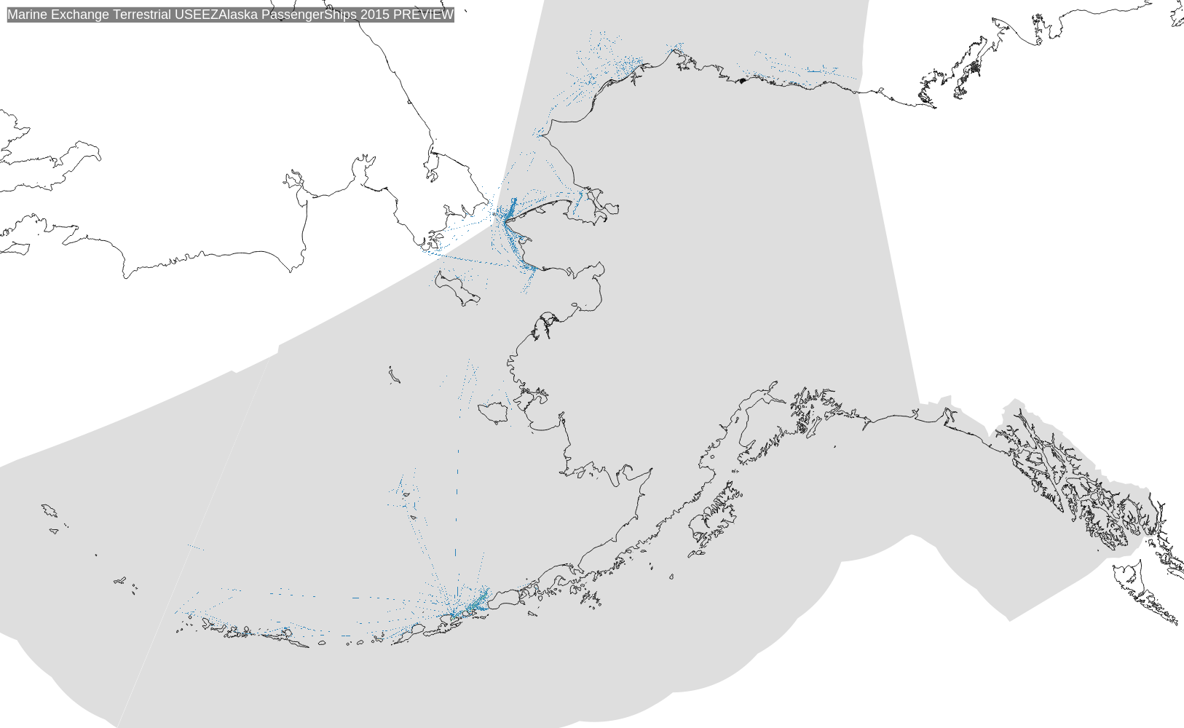
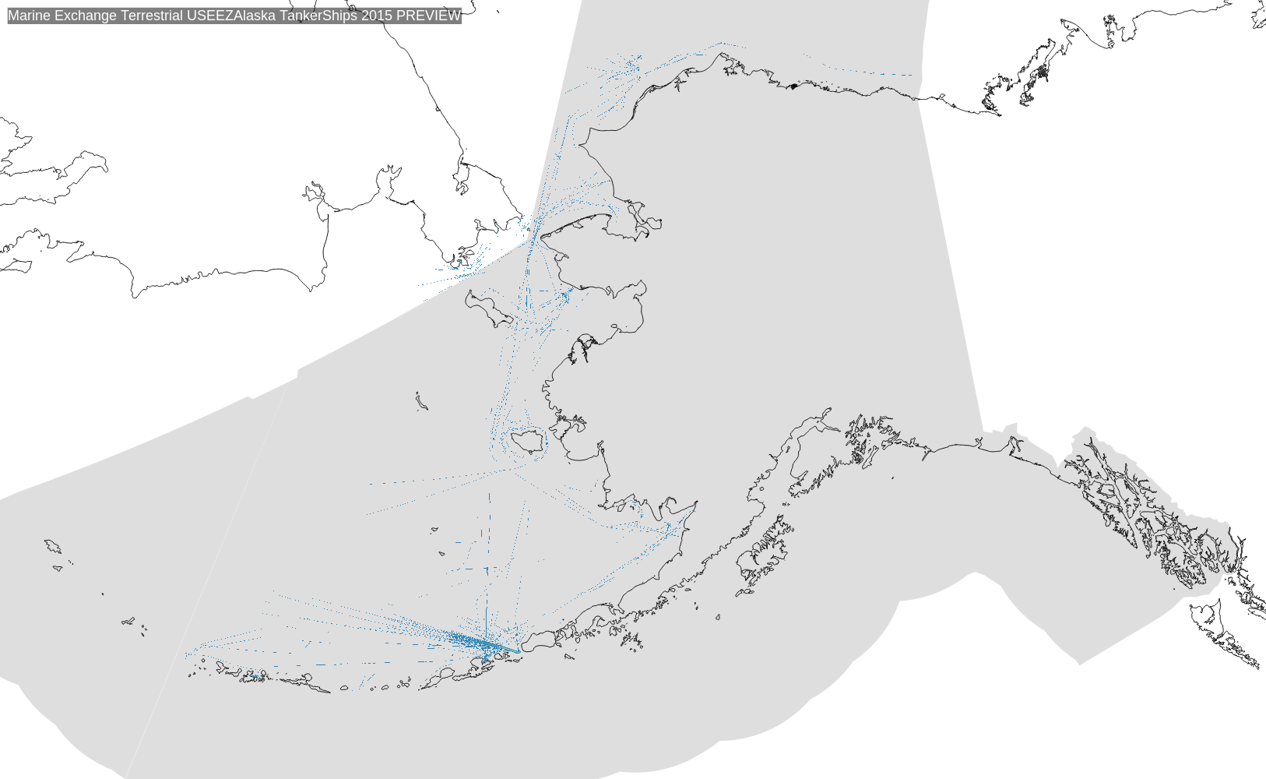
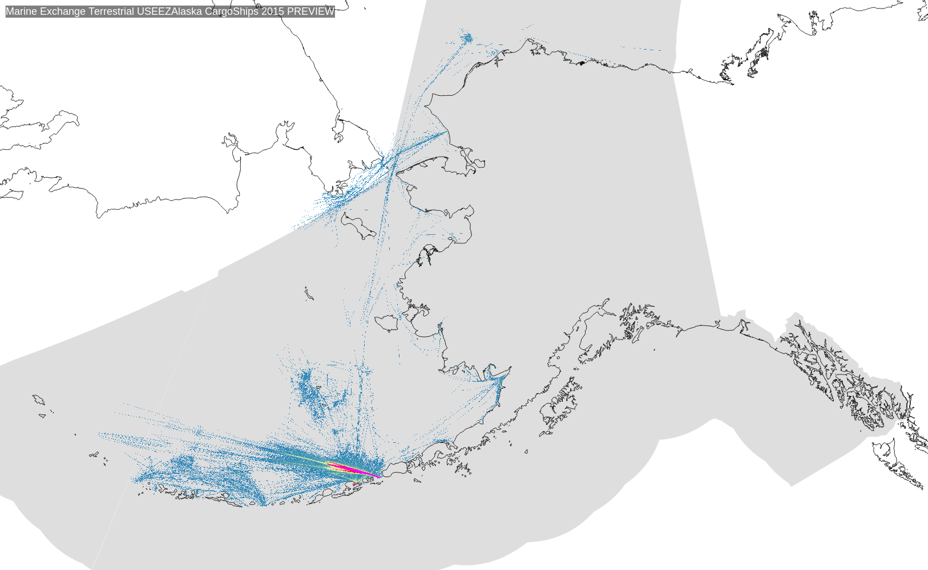
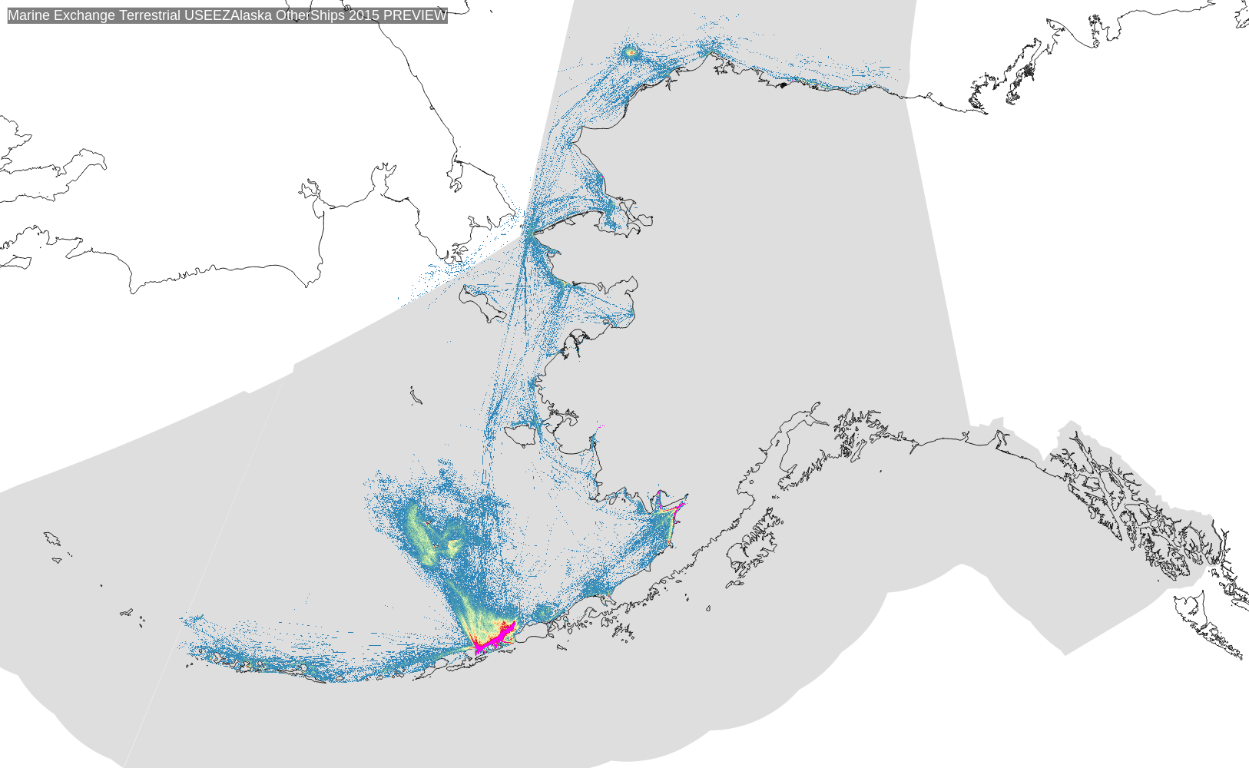
Sample Results: 2015, by ship type
Passenger
Tanker
Cargo
Other
More info and data portal: https://aoos.org/ais-4-bathy/

Slide 8
Example usage:
Vessel count within ROI over time

Slide 9
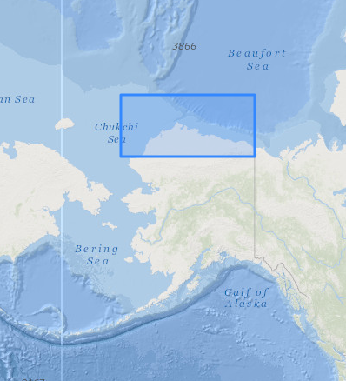
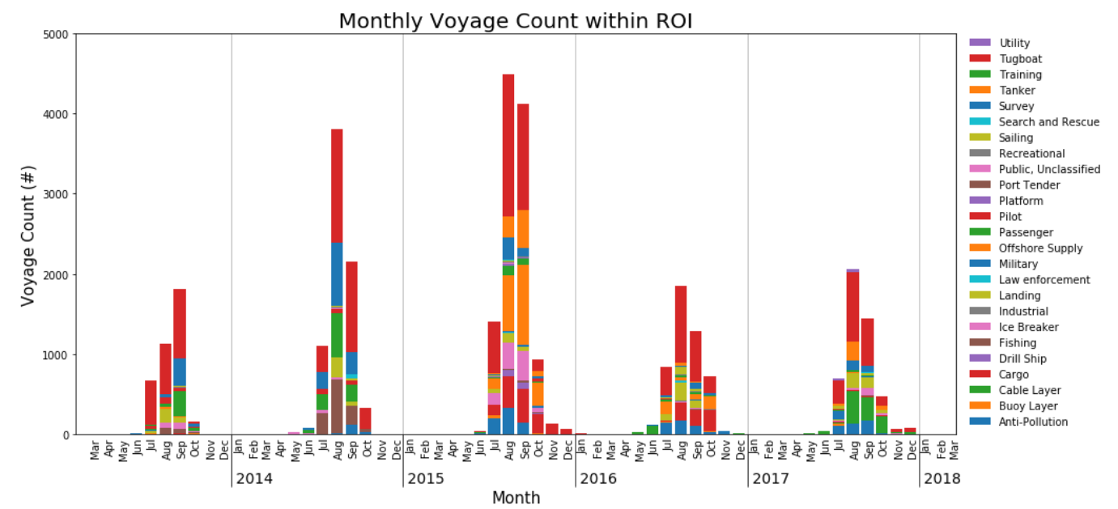
Voyage count within Region of Interest (Jupyter Notebook analysis)

Slide 10
Example usage:
Arctic Oil Spill Risk Assessment

Slide 11
Assessing Risk to Arctic Subsistence Harvesting Areas from Marine Oil Spills
Background: http://osra.axds.co
Data portal: https://arctic-osra.aoos.org/
Molly McCammon (AOOS)
Will Koeppen, Jesse Lopez, and Rob Bochenek (Axiom)
Stephen R Braund and Associates
National Academy of Sciences

Slide 12
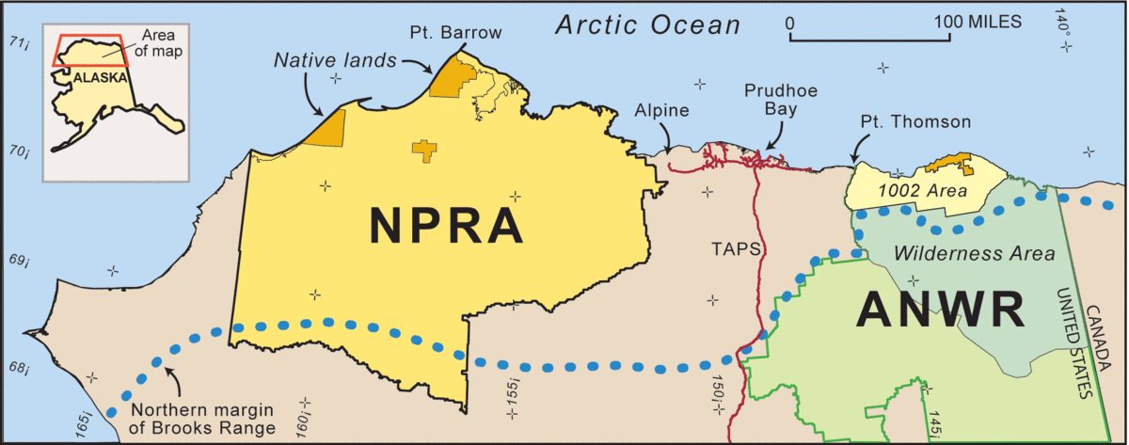
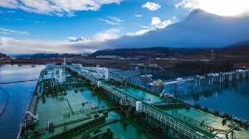
Project overview
Funded by National Academy of Sciences, "Synthesis" Program
Goal: Develop analysis tool to assess risk from vessel-based marine oil spills to subsistence harvests in:
Utqiagvik / Barrow
Nuiqsut
Kaktovik
The method combines:
Ship density from AIS
Subsistence harvest data
GNOME oil spill particle tracking
The analysis could be used in similar situations in the Gulf of Mexico or other regions with high potential for vessel accidents.
http://osra.axds.co / https://arctic-osra.aoos.org/
Notes:
This was a research project that was funded by the National Academy of Sciences under their pretty broadly-defined "synthesis grant". It's specifically for integrating existing observations and methods.

Slide 13
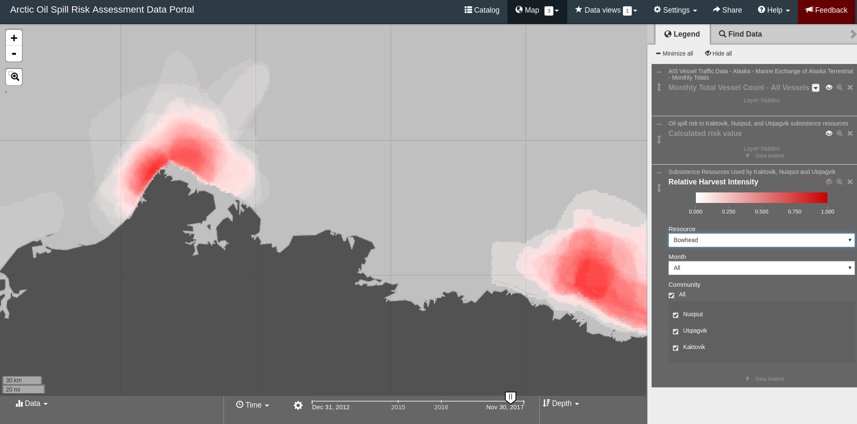
Subsistence for bowhead in September 2017
http://osra.axds.co / https://arctic-osra.aoos.org/

Slide 14
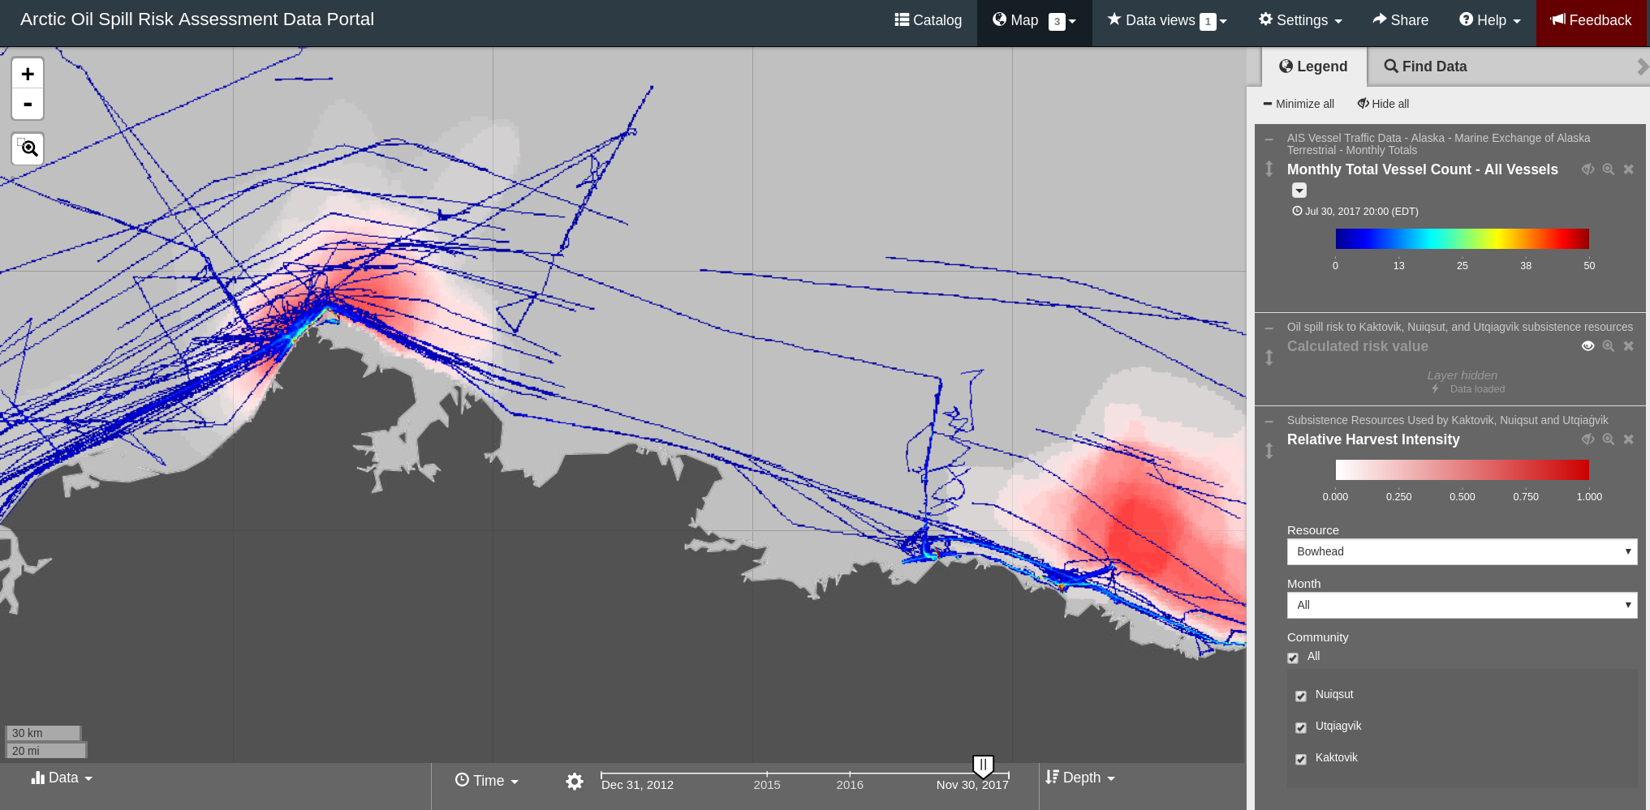
Subsistence for bowhead in September 2017
With AIS tracks (all vessel types)
http://osra.axds.co / https://arctic-osra.aoos.org/

Slide 15
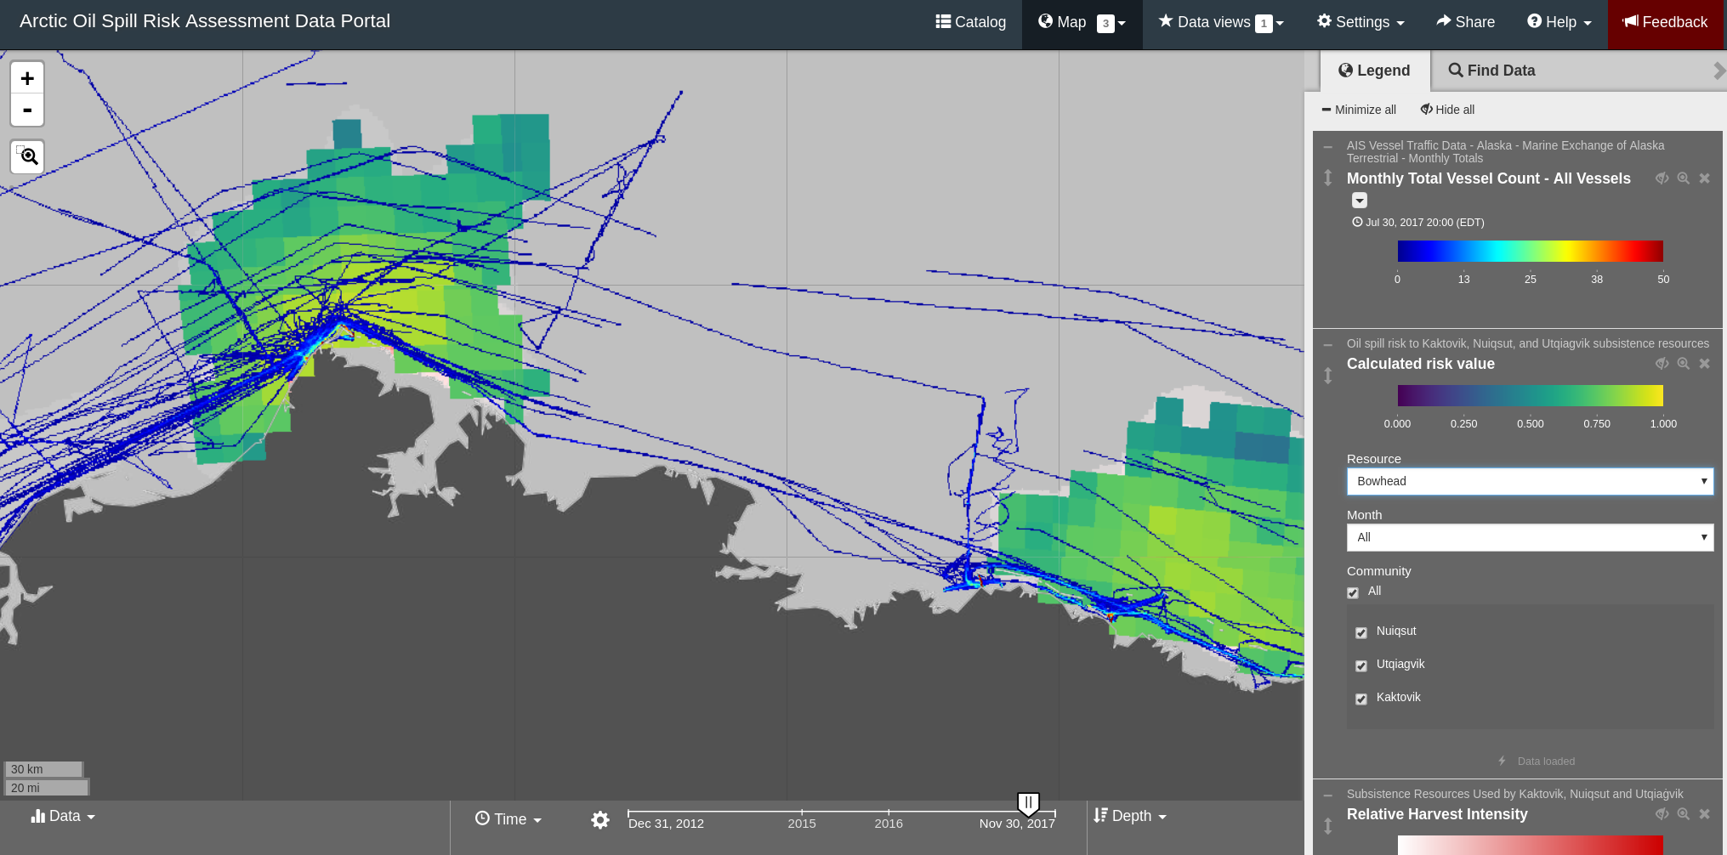
Subsistence for bowhead in September 2017
With AIS tracks (all vessel types)
With risk analysis - intersection of use and where modeled particles end up
http://osra.axds.co / https://arctic-osra.aoos.org/

Slide 16
Future Work

Slide 17
Future AIS work
Accepted:
NPS, Vessel Drift and Oil Spill Trajectories in the Bering & Chukchi Seas (PI: Tahzay Jones)
Develop vessel drift & simulation models
Incorporate new community subsistence datasets
Simulate hundreds of oil spills to predict risk
Aleutian Islands & Bering Sea LCC- Aleutian AIS Regions of Interest
Seasonal vessel track summaries for regions of interest in the Aleutian Islands, AK
Pending:
NSF Science Diplomacy, Navigating the New Arctic (PI- Paul Berkmann)
Big data processing: Danish Marine Authority & US Arctic
Satellite/ terrestrial data cross-validation
U.S Coast Guard/AOOS
static analytical data products (similar to ROI analysis)
end-user tools for custom analytical products
Arctic Domain Awareness Center (ADAC), U.S. Department of Homeland Security (DHS)- custom analytical data products for vessel tracking and bathymetry

