Slide 1
GLOS Cloud Migration
and DMAC 2.0
May 2, 2019
IOOS DMAC Annual Meeting
Silver Spring, MD

Slide 2
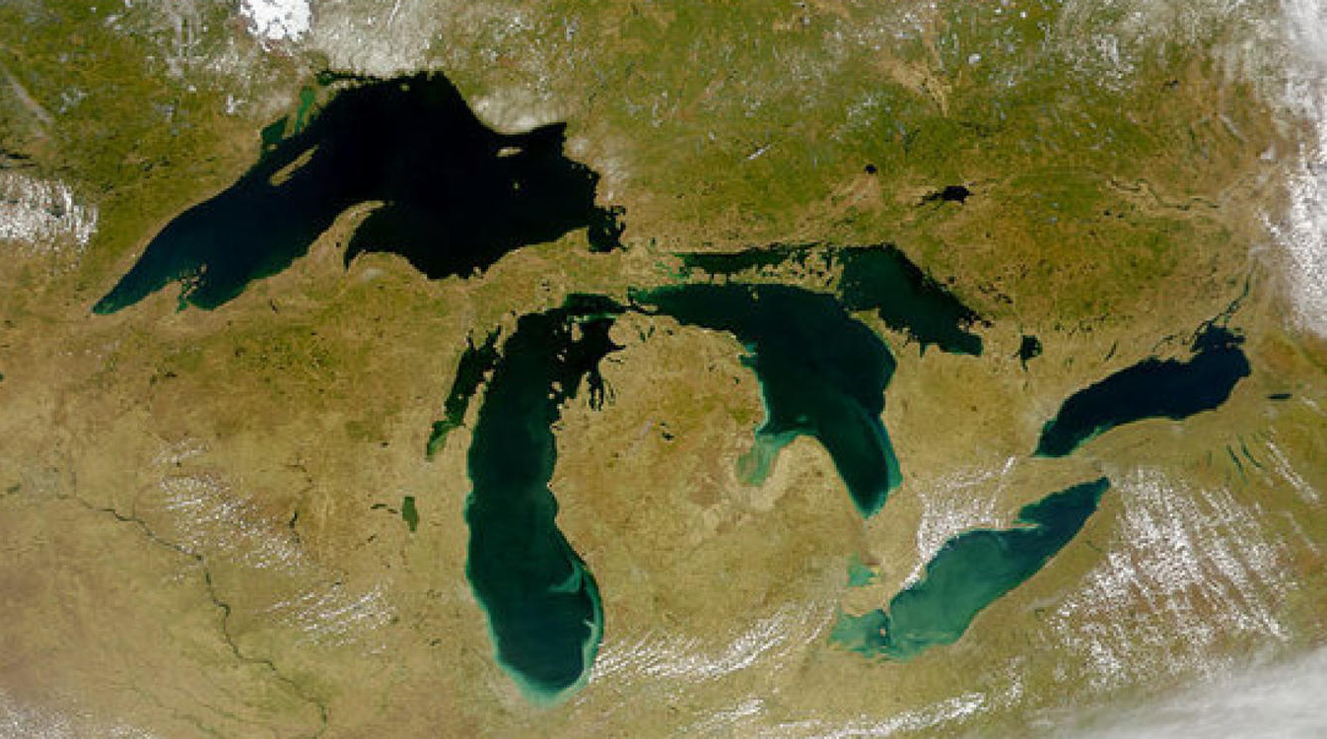

Slide 3
DMAC 1.0
A Disconnected Network
Consisting of Partners, Providers, Projects, Data, Users, Collaborators & Technology Providers.
Contributors
Grantees
Collaborators
Public
Products
Science &
Research
Special
Projects
Support &
Technology
Providers
A result of multi-nodal efforts spanning years of development and initiatives.

Slide 4
DMAC 2.0
A Connected Ecosystem
Transitioning GLOS DMAC to a technology platform focused on the next generation.
Contributors
Grantees
Collaborators
Public
Products
Science &
Research
Special
Projects
Support &
Technology
Providers
An intuitive, single entry point for all users with potential for growth, flexibility and scale.

Slide 5
GLOS DMAC 1.0 - Evaluation
STRENGTHS of 1.0
IOOS Certified
Data hub for Great Lakes region
Data is available and accessible to end users
Products provide value
Buoy Portal
Point Query Tool
HABs
Models
RISKS for 2.0
Data pipeline problematic
Infrastructure is old and not scalable
User apps poorly developed
Duplicated data services
Notes:
Infrastructure not robust/scalable/flexible
Not optimized
Not robust
Duplicated data services
Not ready for the future
Next Generation services(IOT)

Slide 7
Why Cloud?
Drivers | Infrastructure state(Pre Cloud) | Gain / Loss? | Potential Cloud Advantages
Operational costs | Approx. 16k(2018/19), Approx. 25k(for 2019/20) |  | Estimated costs - 16k - 20k(still TBD)
Workforce Productivity | Approx. 40 hrs spent monthly for reporting and maintenance |  | Approx. 10 hours of maintenance and governance required (75% reduction)
Operational Resilience | Avg. 95% uptime due to recurrent issues(Disk space, Memory Overload) |  | Improved uptimes; multiple availability zones; lower risks
Future GLOS DMAC | Limited operational agility; not robust/scalable/flexible |  | Scalability, Load Balancing, Other potential services(Streaming, Event driven)

Slide 8
A Phased Approach
Switching from Old
to New
A New Architecture
Moving to the Cloud would be more than a “lift & shift” and we needed to design a new architecture to reflect the needs of the old and new DMAC stack.
With the Cloud environment set up and the old infrastructure ready to be deprecated, GLOS and partners made the switch in Feb. 2019.
INVENTORY
DESIGN
PLAN
CUTOVER
MAINTENANCE
Data and Moving Parts
Timing is Key
Troubleshooting
With historical, data, scripts and processes in place, GLOS needed to fully account for everything in the current stack.
With the Government Shutdown in full swing and Buoys out of the water, the middle of winter made good sense to cutover.
Most data, scripts and processes were fine. However, new development and altering processes ensued.
Notes:
AWS vs Other Cloud Platforms
AWS - higher costs but smaller learning curve
Comfort
More options
Deciding a vendor
Expertise with GLOS data and products was important
Creating a AWS Transition plan
Evaluation of the current infrastructure
Creating an inventory of the data servers, datasets, services and products
Strategy Development for the transition
Cutover activities
Post migration support plan

Slide 9
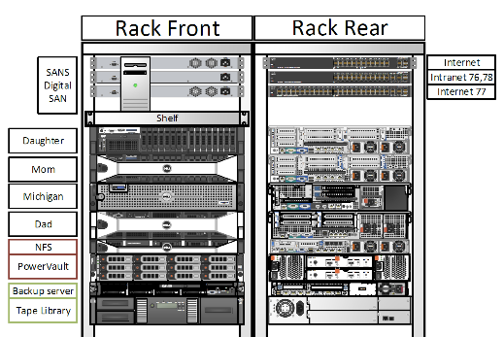
Infrastructure State - Pre Cloud
Hosting(Rack)
2 Virtual Hosts
10 machines
Network File System
Backup
Back up server
Tape Drives
Fixed Contractual Bandwidth
Avg. Annual Costs - 15k
Cloud
3 AWS EC2 instances

Slide 10
AWS Transition Strategy
Category | Strategy | Pre State | AWS
Cloud Instances | Rehost | Instances already hosted on AWS | Migrate as is using AMI
GLOS Services(TDS, Data Ingestion, etc.) | Replatform | 8 Virtual machines hosted by 2 virtual hosts | 8 ECS services; multiple availability zones; auto scaling
Databases | Replatform | 2 Virtual Machines( MySQL; Postgres) | 2 RDS instances optimized with Aurora
Data Storage | Replatform | NFS | Amazon S3
Data Archival | Replatform | Backup server; Tape Drives | Amazon Glacier
Old deprecated instances | Retire | 4 deprecated instances | Not to be moved

Slide 11
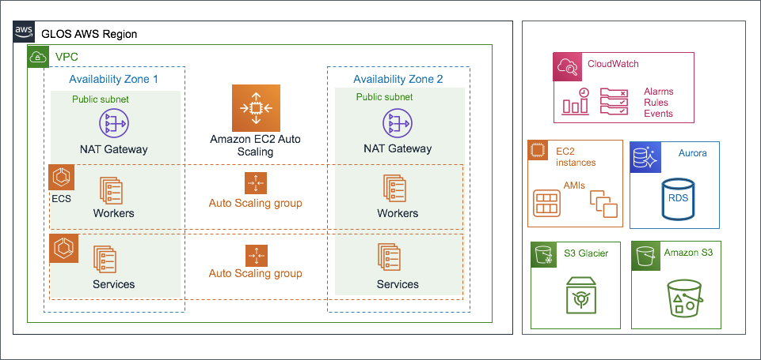
GLOS AWS LAndscape

Slide 12
Storage on Cloud
Intelligent Tiering - Usage driven
S3 Standard
Ideal for General purpose
High throughput
High availability
Low latency
S3 IA
Designed for Infrequent access
Low storage cost; retrieval fee
Ideal for backups
Low latency
S3 Glacier
Ideal for long term archives
Cheapest storage
Retrieval time - minutes to hours

Slide 13
Post Migration
Issues
THREDDS
Not optimized for S3 FS
Slow
User Applications
Unnecessary internal requests
Dependent on THREDDS
Much slower
Unable to handle large dataset requests
Evaluation
Investigating usage patterns
Economics of providing public access to data in cloud
Latest data vs historical data
Commercial vs research purposes
Evaluating our user applications
Multiple access points vs single access point
User stories

Slide 14
Recommendations
Evaluate
Today vs Future
Beyond Infrastructure - User Applications, Services, Data Usage
Evaluate critical applications and bottlenecks
Evaluate data flow patterns(internal and external)
Evaluate data Storage needs(Short term/Long term)
Strategize
A mixed strategy - Rehost, Replatform, Re-architect and Retire
Time criticality vs flexibility
Platform
Learning Curve vs Costs
Comfort
Be ready
Expect challenges pre/post migration
Be patient

Slide 15
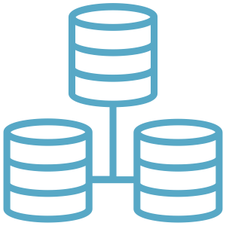
The GLOS Future: DMAC 2.0
DATA MGT.
A platform for the future
Simplistic and Streamlined
Supporting Next Gen. technology
Handling more diverse data
USERS
Data Driven Applications
Data Streams
Event Programming
Creating Value from information
BIG DATA
IoT
EDGE
AI/ML
ROBOTICS
TIME
SERIES
VISUAL
Notes:
Building a platform for the future
IOT
Simplified streamlined processes - Ingestion, processing & delivery
Handling larger/scientific datasets
Volume
Variety
Velocity
Veracity
USER DRIVEN Applications
Building data driven services
Data streams
Time series data
Subscription to the data streams
Visualizations
Event Programming - Data Ingestion, QA/QC
Creating value
Making data access easy
Enabling decision making

Slide 16
Data Driven Services
OTT HABs EWS Prototype
Data Processing
Real time, Frequent Data
Individual Streams
Stream driven services

Slide 17
THANK YOU
Sneha Bhadbhade
Mgr. Data Services
sneha@glos.us
Tim Kearns
Senior Advisor
tim@glos.us
glos.org

