Slide 1
CIOOS Update
U.S. IOOS 2019 DMAC Annual Meeting
May 1, 2019
Ray Brunsting, Brad Covey
ray@tula.org, coveyb@ogsl.ca

Slide 2
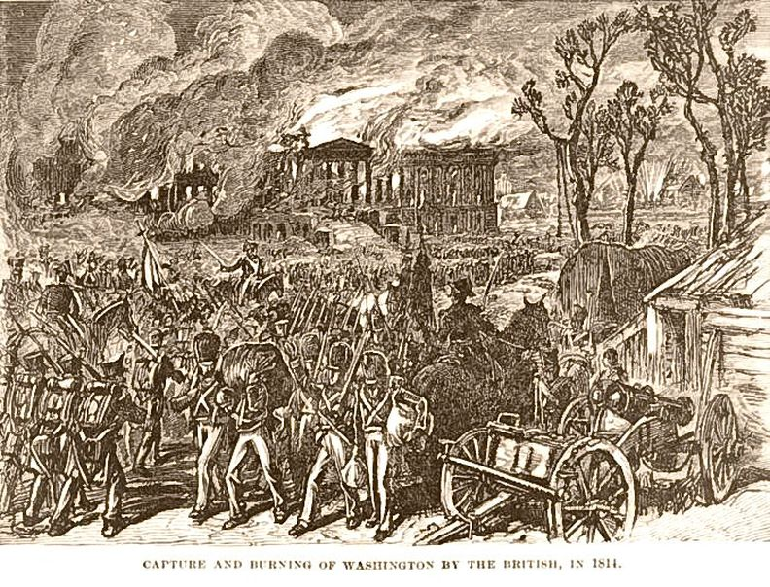

Slide 4
table of contents
Past
Present
Future

Slide 5
Stage t-4: Community of Practice on Ocean Data Management (ODM CoP)
The CoP on Ocean Data Management connects Canadian ocean data centres to share and mobilize expertise and best practices, promote cooperation and alignment, and develop a shared vision for ocean data management in Canada.
http://www.oceansdata.ca

Slide 6
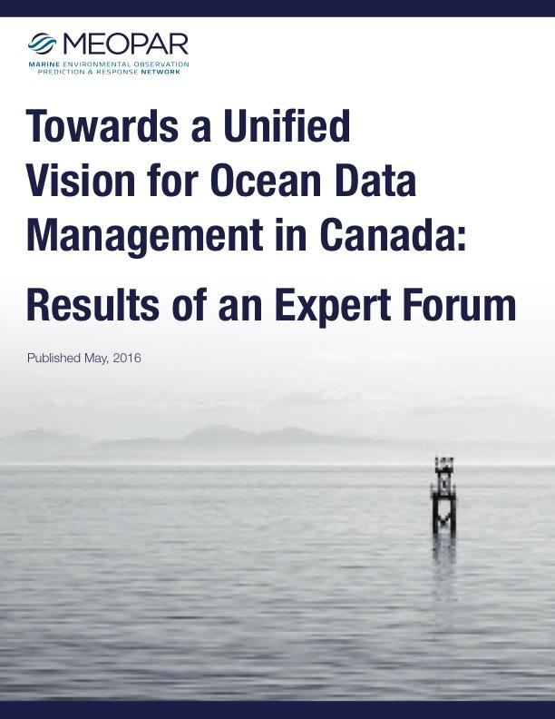
Stage t-3
Expert Forum in Montreal, Nov 2015
Notes:
Emilio & Derek Snowden

Slide 7
Stage t-2
Task Team of federal and non-federal ocean observing experts formed (November 2016)
MEOPAR renewed for five years with advancing ocean data in Canada a significant part of their strategic objectives.

Slide 8
Stage t-1
DFO funded Investigative Evaluations (IEs) to move CIOOS from the concept state to the design stage
Observation and Data
Cyber Infrastructure
Visualization Tools and Platforms
Notes:
Jessica Snowden seconded to Ottawa
Our Investigative Evaluation included fact-finding trip to NERACOOS, Axiom
Zdenka Willis coordinated
Beginning engagement with stakeholders in Canada, including Karl and Ru

Slide 9
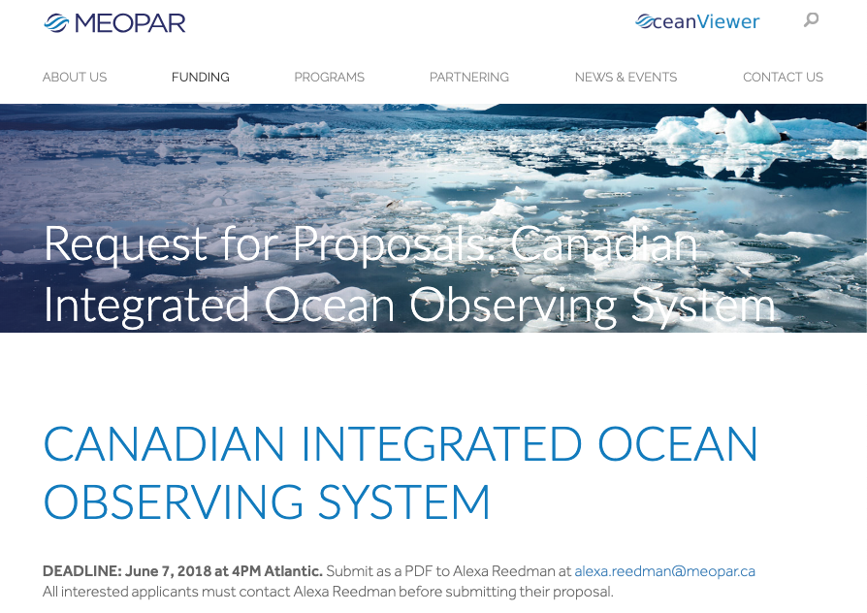

Slide 10
table of contents
Past
Present
Future

Slide 11
CIOOS Face2Face Kickoff
Victoria, BC
January, 2019

Slide 12
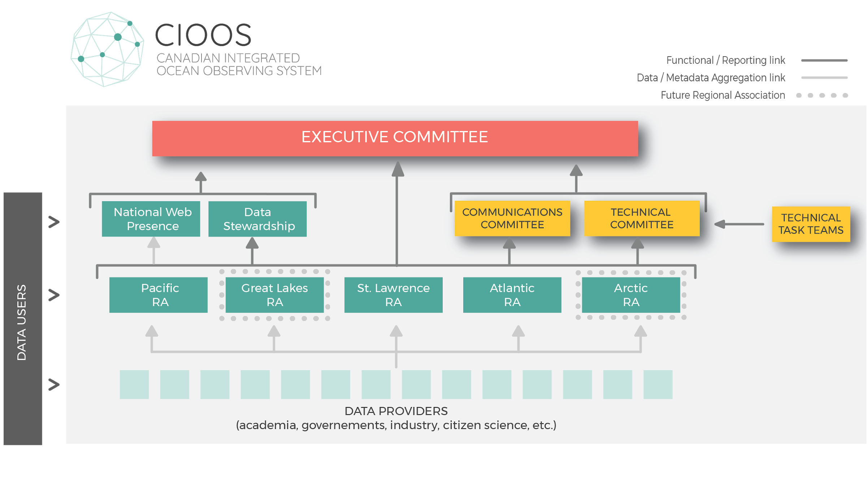
Notes:
Community led initiative at this point; no staffed program office, cross-RA work is committee/task team led

Slide 13
Outreach and Engagement
Role of regional associations
Meet regional data producers (academic, private, NGOs, …)
Meet regional data users
Foster their participation in CIOOS
Communicate and collaborate continuously with partners and other RAs.
+ data = + robust information system
Regional Association (RA)
Data producers
Data users

Slide 14
Data and metadata
Role of regional associations
Adopt metadata standards common to the 3 RAs
Develop a metadata validation tool
Aggregate data for access and download
Visualization, search, and filter tools
Cartographic visualization tool common to the 3 RAs;
Regional and inter-regional data catalogue (ex. common dataset for St. Lawrence & Atlantic RA)
Regional Association (RA)
Data producers
Data users

Slide 15
table of contents
National Presence
16

Slide 16
National Portal
Role of National Web Presence
Data users
Meet and collaborate with national and international partners
Develop a common look and feel between the 3 RAs and the national portal
Aggregate metadata and redirect to each RA for data access
Develop and maintain the national web presence
National portal

Slide 17
National Portal
Role of National Web Presence
Data users
The national web presence will include:
General information about CIOOS
Links to each of the RAs
Data discovery through a CKAN catalog with metadata aggregated from the RAs
Data discovery through a cartographic metadata visualization
National portal

Slide 18
Essential Ocean Variables - Phase 1
Essential Ocean Variables
Primary
Temperature
Salinity
Oxygen
Water Level
Currents
Nutrients
Derived/related
Seawater Density
Potential Temperature
Potential Density
Speed of Sound
Nutrient Concentrations
Nitrate (NO3-) & Nitrite (NO2-)
Phosphate (PO4)
Silicic Acid (Si(OH)4)
Notes:
d) pH (and other Carbon constituents, i.e. pCO2)
e) waves (sea state)
f) wind speed and direction (including wind stress)
g) ice cover (including age and thickness)
h) air-sea fluxes (heat and momentum)
i) fluorescence/chlorophyll
j) optical properties/turbidity
k) CDOM

Slide 19
Metadata Standards and Best Practices
Metadata Standards and Best Practices
Scope: ISO 19115 profile development, controlled vocabulary and terminology adoptions, persistent identifiers applications, timestamp and datum conventions, data policy/licensing guidance, dataset granularity definitions, metadata workflows and tools, quality control flags, and documentation guidelines.
Current status:
dataset granularity practices surveyed -
decision: limit datasets to per instrument or platform deployments (not to combine platforms/stations)
CTD casts less clear - individual casts, repeated casts at same station within time window (e.g., a year), all casts in an expedition, ...
profile definition and pilot implementations underway

Slide 20
Metadata Standards and Best Practices
Metadata Standards and Best Practices
Specific Challenges
bilingual support
instrument/platform provenance and controlled vocabularies - relates also back to dataset granularity
compatibility with North American Profile (NAP) which is based on the ISO 19115:2003 while we are using ISO 19115: 2014
how to adequately and consistently represent lineage and data quality
interplay with ERDDAP and CKAN
Focussed on instrument-based measurements, although physical samples for target EOVs in scope (e.g., O2 from water samples). Human/machine observation/annotation based measurements out of scope for pilot phase.

Slide 21
Solution Architecture
Solution Architecture
Plan
Status
Open questions

Slide 22
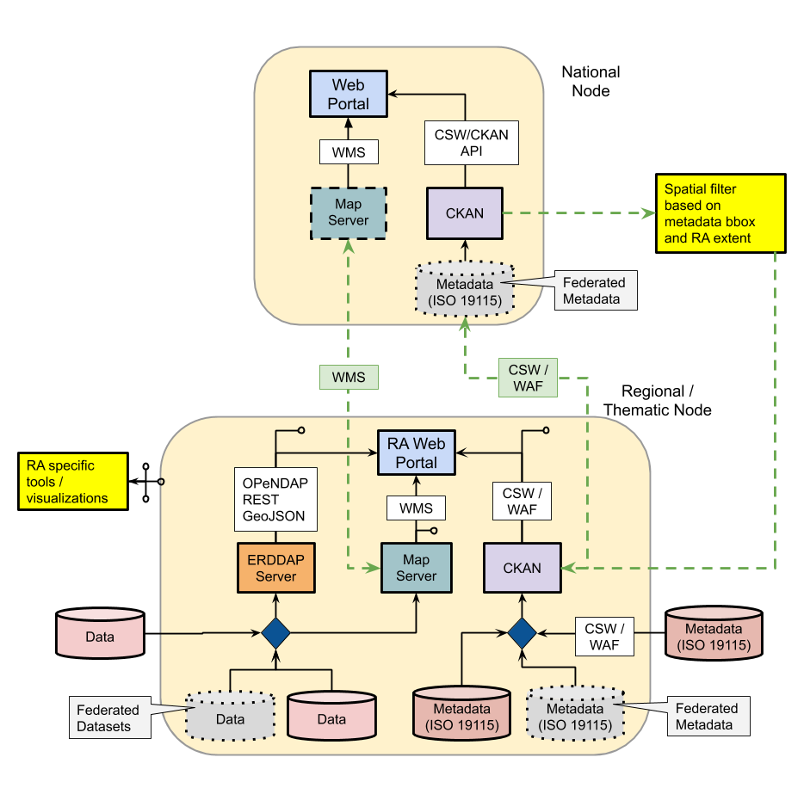
Solution Architecture

Slide 23
Status
Solution Architecture
Hardware allocated
CKAN catalogues deployed
Bilingual support integrated
Still to be customized and populated

Slide 24
Open Questions
Solution Architecture
Catalogue aggregation
Customized CKAN aggregator?
External aggregation tool?
Metadata creation tools
Metadata validation tools
Currently looking to use the IOOS compliance checker with a custom profile

Slide 25
Visualization Tools
Visualization Tools
National and Regional association
Simplified metadata visualisation tool ( asset map )
Regional association only
Cartographic visualization tool

Slide 26
Asset map
Visualization Tools
Goal is to direct the user to better tool / interface for data visualization / extraction
Built on top of CKAN API with geoextent
Embedded on the landing page of all Websites
National and each of the 3 RAs

Slide 27
Cartographic visualization tool
Visualization Tools
Available only at each RAs
Still exploring possible candidate
TerriaJS
SLGO’s internal OCTO
Requires multilingual support
English and French mandatory with Indigenous languages support
Real-time data ( à la Sensor Map ) is out of scope for now

Slide 28
table of contents
Past
Present
Future

Slide 29
IOOS/CIOOS Interactions
Goal: identify at least one specific opportunities to start or strengthen IOOS/CIOOS collaboration
Data from Canadian waters
What data is already flowing into IOOS (and how)
How can CIOOS leverage what has already been done
How can CIOOS help improve the current situation
Standards and best practices
What is appropriate for CIOOS to adopt immediately
How can IOOS and CIOOS work together to define
Access to IOOS data
Architectures and technologies
What is appropriate for CIOOS to adopt immediately
How can IOOS and CIOOS work together on this
Open Source software
Other

Slide 30
cioos.ca | siooc.ca
@cioos.siooc
@cioos_siooc
Ray Brunsting, Brad Covey
ray@tula.org, coveyb@ogsl.ca

