Slide 1
2018 Annual Report to the IOOC on U.S. IOOS

Slide 2
U.S. IOOS 2018 Annual Report
IOOC Monthly Meeting
March 11, 2019 | Carl Gouldman
Notes:
2

Slide 3
Agenda
ICOOS act - “report annually to the Interagency Ocean Observing Committee on the accomplishments, operational needs, and performance of the System to contribute to the annual and long-term plans…”
Approach - FY18 accomplishments - and FY19 look ahead
Strategic vision, mission, and goals
Portfolio updates and agency highlights
IOOS Program office items

Slide 4
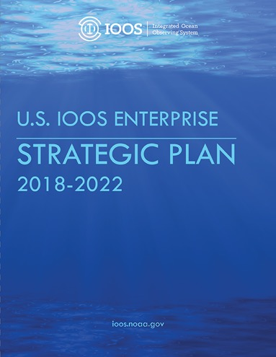
IOOS Strategic Plan
Vision - Improve lives and livelihoods with ocean,
coastal, and Great Lakes information
Mission - To produce, integrate, and communicate
high quality ocean, coastal and Great Lakes
information that meets the safety, economic, and stewardship needs of the nation.
Five Strategic Goals: Goal 1: Sustain long-term, high-quality observations of ocean, coastal, and Great Lakes
environments to address local, regional and national needs.
Goal 2: Deliver standardized, reliable, and accessible data.
Goal 3: Support model predictions that address a wide range of user requirements.
Goal 4: Provide integrated, user-driven products and tools.
Goal 5: Increase the reach and effectiveness of IOOS through partnerships, stakeholder
engagement, and Enterprise excellence.
4
https://cdn.ioos.noaa.gov/media/2018/02/US-IOOS-Enterprise-Strategic-Plan_v101_secure.pdf
Notes:
Five Strategic Goals:
Goal 1: Sustain long-term, high-quality observations of ocean, coastal, and Great Lakes environments to address local, regional and national needs.
Goal 2: Deliver standardized, reliable, and accessible data.
Goal 3: Support model predictions that address a wide range
of user requirements.
Goal 4: Provide integrated, user-driven products and tools.
Goal 5: Increase the reach and effectiveness of IOOS through partnerships, stakeholder engagement, and Enterprise excellence.

Slide 5
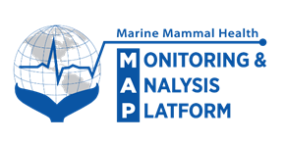
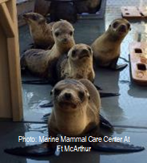
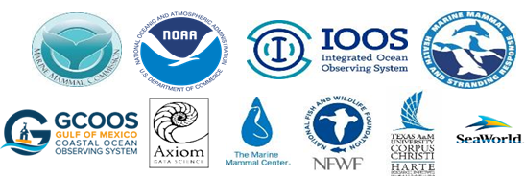
Marine Mammal Health Monitoring and Analysis Platform
Health MAP vision:
For everyone to observe spatial and
temporal interactions among marine
mammal health, ocean health, & human activities
CY18 Activities and Accomplishments:
Further development of a prototype data platform in the Gulf of Mexico (Gulf MAP)
Gulf Environmental Benefit Fund through NFWF
Implementation of the standardized, basic and initial health data fields
Development of a project plan for Health MAP infrastructure realization as part of projects under consideration for restoration.
Partners:
Updates available: https://www.mmc.gov/priority-topics/marine-mammal-health-and-strandings/

Slide 6
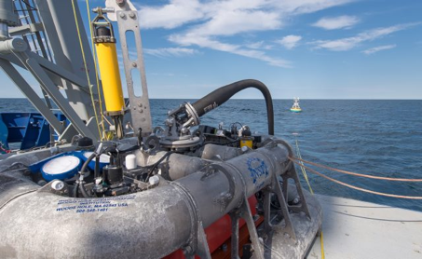
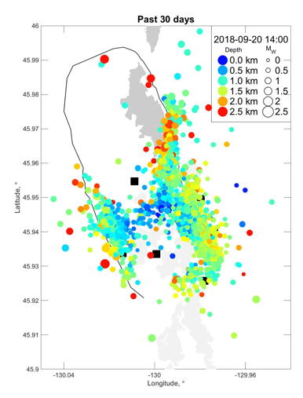
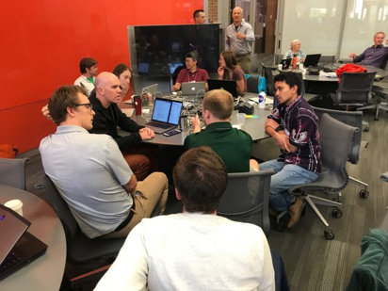
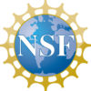
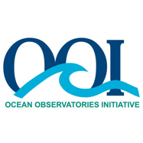
Ocean Observatories Initiative (OOI)
NSF Awards Contract to WHOI to Lead
OOI Program Management (Sept 2018)
Community Tools available on the OOI website to examine the Axial Volcano
Community Engagement
Early Career Workshops (Spring & Summer 2018)
Deep Ocean Observing Workshop (Aug 2018)
Cabeled Array Hackweek (Feb 2018) and OceanHackweek (Aug 2018)
Notes:
The National Science Foundation (NSF) announced that it has awarded a coalition of academic and oceanographic research organizations a five-year contract to operate and maintain the Ocean Observatories Initiative (OOI). The coalition, led by the Woods Hole Oceanographic Institution (WHOI), with direction from the NSF and guidance from the OOI Facilities Board, will include the University of Washington (UW), Oregon State University (OSU), and Rutgers, The State University of New Jersey.
Community Engagement:
Early Career Workshops: OOI hosted five workshops (Interdisciplinary, Physics,Geology, Chemistry, Biology) for early-career scientists interested in learning more about the infrastructure and how to use data from the program in their work.
Deep Ocean Observing Workshop: The goal of the workshop was to expand and connect the deep-ocean user community toward developing realistic proposals and hypotheses to carry forward deep ocean observations on the OOI Cabled Array and in the broader NE Pacific. The workshop comprised three main features: informational presentations about NE Pacific assets, DOOS science questions, and EOVs relevant to the deep ocean; lightning talks by the participants about their individual research pursuits; and small working groups.
OceanHackWeek: Fifty participants, ocean scientists both early in their career and more established, mechanical engineers, roboticists, and computer scientists, convened at the University of Washington for this 5-day hands-on “learning hackathon”. The workshop aimed at exploring, creating and promoting effective computation and analysis workflows for large and complex oceanographic data. The event was a collaboration between the Ocean Observatories Initiative and the University of Washington with organizers from the UW eScience Institute, Applied Physics Laboratory, and School of Oceanography.
Cabeled Array Hackweek: The goal of the Hackweek was to build a stronger user community around the Cabled Array, and to create and promote effective computational data analysis workflows of the real-time data stream.
For three days, hackweek participants devoted themselves to OOI data and collaborative group projects. The hackweek was structured with tutorials focused on “how tos” for data mining, processing, and visualization techniques, while most of the time was spent in small groups hacking away on their own individual projects.
Community Tools available on the OOI website to examine the Axial Volcano - Since the 2015 eruption of the Axial Seamount, the Cabled Array has continued to collect data surrounding the seamount. Work continues to explore the dynamics of the Axial Seamount through the intensive OOI infrastructure and other NSF-funded expeditionary research, making it the most advanced underwater volcanic observatory in the world ocean. In addition to their own work, members of the OOI science community have created tools for anyone to use to visualize OOI data.
Picture (Top): The Multi-Function Node of a Pioneer Surface Mooring prepared for launch on the fantail of the R/V Armstrong. Pioneer Array moorings are recovered and replaced with refurbished components twice per year. (Photo credit: OOI CGSN)
Picture (Middle, right): Map of detected earthquakes in the past 30 days (from Sept. 20). (Credit William Wilcock)
Picture (Bottom, center): Group at OceanHackweek

Slide 7
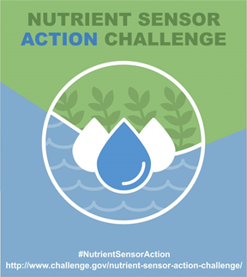
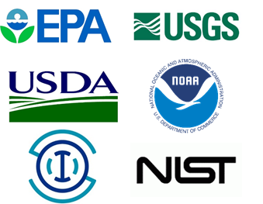
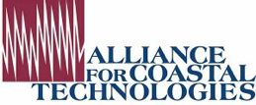
EPA and Nutrient Sensors
Nutrient Sensor Action Challenge
Technology-accelerating water quality challenge for demonstrated use of nutrient pollution sensors
Stage II launched in March 2018
Stage II results submitted Feb 2019
Winners to be announced this Spring (April)
Challenging Nutrients Coalition
Held Nutrient Reduction Visioneering II Meeting in June 2018
Working to foster new and bold ideas that address excess nutrients in our nation's waterways.
Evaluating Nutrient Sensor Operational Status
Alliance for Coastal Technologies (ACT) is assessing commercially available nutrient sensors deployed in the Gulf of Mexico and Long Island Sound.

Slide 8
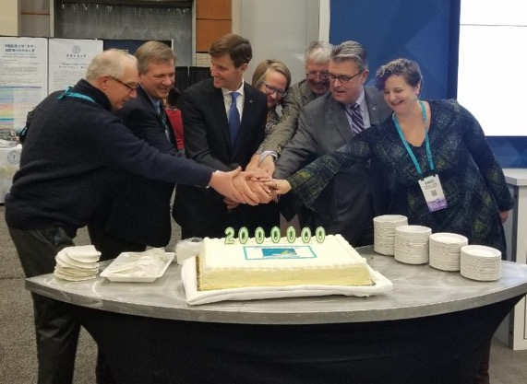
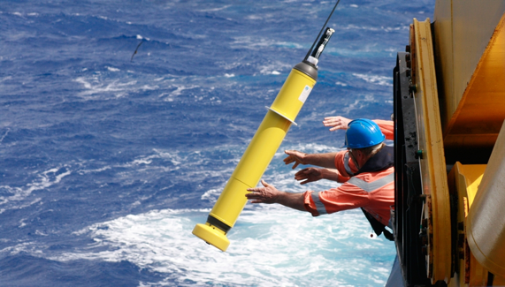
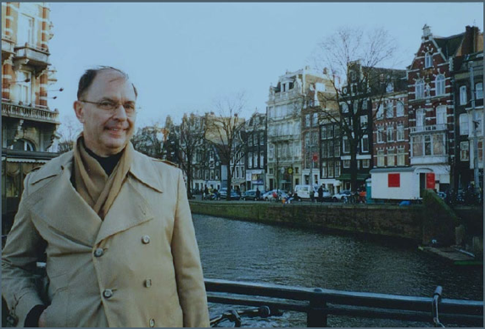
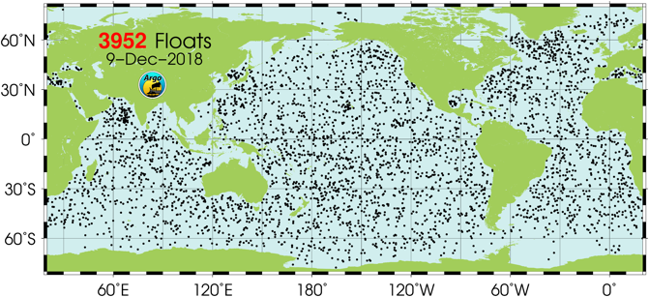
Argo Program
2 Millionth Argo profile recorded!
New Argo Float Testing
Deep Argo
Biogeochemical Argo
Steve Piotrowicz memorial float
deployed July 2018

Slide 9
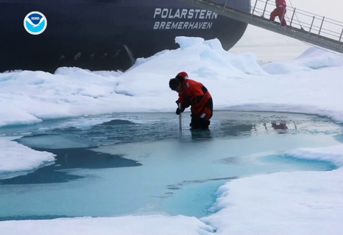
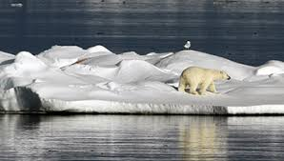
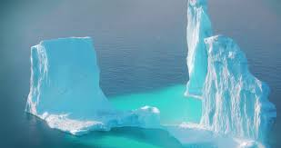
2018 Arctic Report Card Released
NOAA's Arctic Report Card (www.arctic.noaa.gov/Report-Card/) reflects on a range of land, ice, and ocean observations made
throughout the Arctic during 2018
Highlights
Surface air temperatures continued to warm at twice the rate relative to the rest of the globe.
Atmospheric warming in the terrestrial system continued to drive broad, long-term trends
Herd populations of caribou and wild reindeer have declined by nearly 50% over the last two decades
Sea ice remained younger, thinner, and covered less area
Observations suggest long-term decline in coastal landfast sea ice
Spatial patterns of late summer sea surface temperatures are linked to regional variability
Considerably higher ocean primary productivity levels
Expansion of harmful toxic algal blooms
Microplastic contamination is on the rise

Slide 10
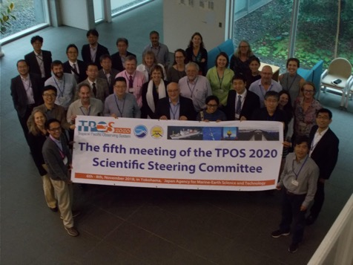
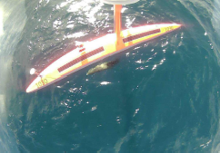
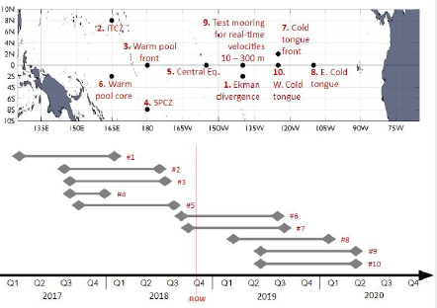
TPOS 2020
5th Steering Committee Meeting (SC-5) held November 2018
TPOS 2020 Projects:
Saildrone - four Saildrones launched in Oct 2018 from Honolulu, HI to begin six-month research mission. Testing new technology for improving weather forecasts.
Enhanced Moorings - aims to improve measurement of ocean surface boundary layer by deploying additional instrumentation on existing TAO moorings.
Pre-field modeling studies - NOAA's Climate Variability and Predictability program funded 8 pre-field modeling studies.
Notes:
NOAA’s CVP (Climate Variability and Predictability)
Pre-field modeling studies - Funded projects include:
State estimates for the tropical Pacific: a reanalysis for evaluating the model, observations, and mass, heat, and salt fluxes
Use of high resolution ocean model to assess sampling strategies for TPOS 2020 process studies Understanding coupled ocean-atmosphere processes at the eastern edge of the warm pool in support of TPOS 2020
Understanding processes controlling near-surface salinity in the tropical ocean using multiscale coupled modeling and analysis
Multi-timescale near-surface salinity variability at the eastern edge of the warm pool: A modeling and an OSSE study in support of TPOS 2020
Improved understanding of air-sea interaction processes and biases in the tropical western Pacific using observation sensitivity experiments and global forecast models
A pre-field modeling study of scales, variability and processes in the near surface eastern equatorial Pacific ocean in support of TPOS
Simulations and analysis of mesoscale to turbulence scale process models to facilitate observational process

Slide 11
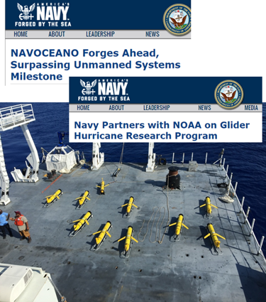
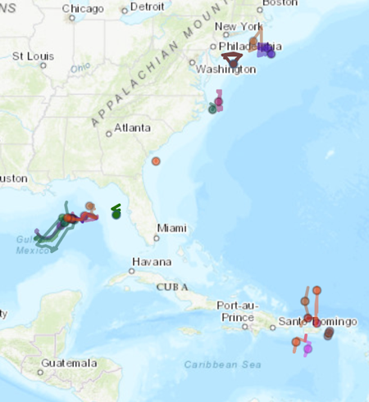
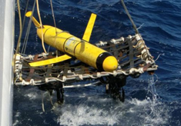
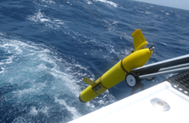
U.S. Glider Network
FY18 (Increase to fill gaps +$2M)
Deployments: Picket Line, HAB/Marine Mammal Monitoring, CalCOFI Lines, SAB Shelf work.
Post-Doc: Model comparisons for hurricane intensity work
DAC: Navy glider data made public, Improved QA/QC, IOOS $$
7,047 Glider Days 137 Glider Deployments
Navy Partnership: 30+ Gliders available to the nation. Navy gliders increased available ocean profile data 1,000 fold in USVI!!
NOAA Navy MOU for glider support to hurricanes 2018-2023
FY19 (Increase to fill gaps + $2.5M)
International: “Best Practices” Workshop, Global Data Synchronization
National: Glider coordination plan
DAC: Support New Variables, Improve Data Flows
Impact Assessments: Investigate glider data impacts on operational models
2018 “Picket Line”
https://gliders.ioos.us/

Slide 12
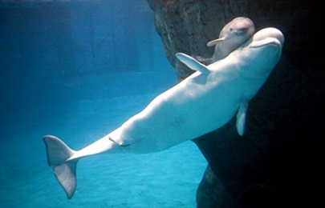
U.S. Animal Telemetry Network (ATN)
FY18 Accomplishments and Funding
Three Workshops:GCOOS, PACIOOS, West Coast (NANOOS/CeNCOOS/SCCOOS)
Transitioned ATN DAC from research environment to operational location - Axiom
Hired Data Coordinator to be the primary interface between telemetry community and ATN DAC; posted at CeNCOOS
Animal Telemetry Baseline infrastructure support: Two regional acoustic network Data Wranglers (FACT & ACT); Georgia Coastal Acoustic Receiver Array; Argos satellite fees payment program; Develop Next generation animal movement analysis tools; Satellite/Acoustic Telemetry Asset Inventory
$1.35M Total investment from ONR, BOEM, NOAA
https://ioos.noaa.gov/project/atn/

Slide 13
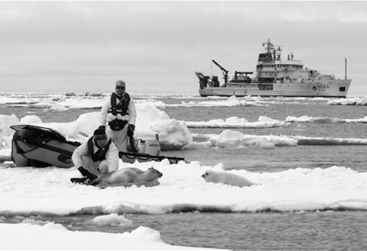
U.S. Animal Telemetry Network (ATN)
FY19 Plans and Funding
Greater stakeholder interaction and advocacy
Increase number of federal agencies supporting ATN and using DAC management capabilities for PARR compliance
Expand multi-agency collaborative baseline observations and infrastructure support
Expand and promote the use of animals as biological sensors
Innovative analytical and visualization tools & data products
Anticipated FY-19 total funds ~$1.45M
Next Steps
Complete Workshop reports; Distill & combine all workshop conclusions into actionable items
Maintain strong collaboration with MBON to implement a sustained IOOS Bio-observing component

Slide 14
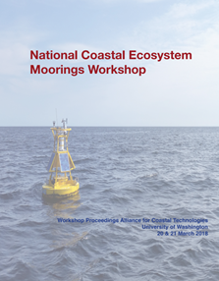
National Coastal Ecosystem Moorings
FY18 Accomplishments
Workshop held March 2018
Community of experts from academia, private industry, and federal agencies (NOAA, EPA, BOEM)
Produced recommendations to define coastal ecosystem moorings
Three-tiered mooring approach outlining levels of measuring requirements
Discussed best practices for mooring deployments, operations and maintenance
Report available: http://www.act-us.info/Download/Workshops/2018/Ecosystem_Mooring_Workshop_Report.pdf
FY19 Next Steps
OceanObs’19 - CWP (Coastal Mooring Observing Networks and their Data Products: Recommendations for the Next Decade) and engagement with community to continue dialogue on moorings
Notes:
We provide 10 recommendations for moorings operators and programs to guide regional planning, with an emphasis on stakeholder and science-driven needs: 1. Increase investment in coastal mooring observing networks 2. Collect stakeholder priorities through targeted and continuous stakeholder engagements 3. Include complementary systems and emerging technologies in implementation planning activities 4. Sustain water column ecosystem moorings in coastal locations 5. Coordinate with operators and data managers across geographic scales 6. Standardize and integrate data management best practices 7. Provide open access to data 8. Promote environmental health and operational safety stewardship and regulatory compliance 9. Develop coastal mooring observing network performance metrics 10. Monitor and assess the design of coastal mooring observing networks routinely
Way forward:
Needs assessment
Identify high priority gaps
Fill gaps
IOOS Identifies Monitoring Requirements for National Coastal Ecosystem Moorings
(supports NOS priority - preparedness and risk reduction)
In 2017, the National Strategy for a Sustained Network of Coastal Moorings revealed that only 10% of the federal and nonfederal coastal moorings are capable of basic ecosystem monitoring. As a result, IOOS and regional partners convened the National Coastal Ecosystem Moorings Workshop in Seattle, Washington on March 20-21, 2018, sponsored by the Alliance for Coastal Technologies, to advance the Strategy recommendation to sustain ecosystem moorings around the coast. The workshop consisted of a diverse community of experts across academia, private industry, and federal agencies (NOAA, EPA, BOEM). The workshop participants defined use cases and requirements for ecosystem monitoring from moorings, identified current and emerging sensors to meet those requirements as well as technical needs and deployment logistics, and identified data management considerations for integration with complementary observing systems. The participants successfully produced a three-tiered mooring approach that outlines three levels of measuring requirements for ecosystem moorings: 1) a minimum suite of variables required for basic monitoring, 2) a medium suite (recommended for current implementation by the group), and 3) an upper-level/robust suite, which includes variables measured by newer sensor technologies that are still in development. This tiered approach will be used by operators as guidance for regional planning.

Slide 15
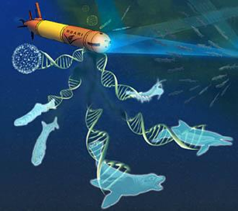
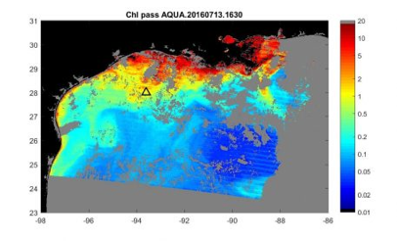
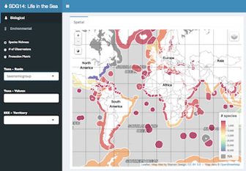
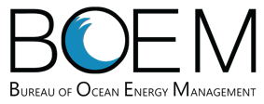
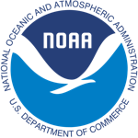
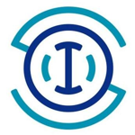
U.S. Marine Biodiversity Observation Network (MBON)
FY18 Accomplishments and Funding
eDNA best practices and demonstrations, including in AUVs
MBON remote sensing-based seascapes products launched at CoastWatch
Ongoing development of applications and ‘infographics’ for National Marine Sanctuary managers and regional Integrated Ecosystem Assessment (IEA) teams
$2.7M total investment from NOAA, NASA and BOEM
FY19 Plans and Funding
New projects to be announced in Summer 2019
Partnership with NOAA, NASA, BOEM + new partner ONR; working towards a unified MBON-ATN and joint FFO in FY22
Anticipate $1.5-2M per year for multiple projects
Oceanography special issue: MBON methods & technology
Notes:
MBON represents a strong partnership among NOAA, NASA, and BOEM with investments totaling over $2M per year since FY14.
MBON projects have been central in developing best practices for environmental DNA and demonstrating its utility for biological ocean observing; using a single water sample, eDNA can be used to detect organisms ranging from microbes to zooplankton, fish, and whales. This was highlighted at the first US national eDNA conference in November 2018.
In addition to development of the molecular aspects, MBON projects have also advanced the means to collect samples for eDNA analysis using autonomous underwater vehicles. This combination will eventually revolutionize our ability to develop required baselines and time series for life in the sea on regional to global scales.
MBON is also developing a dynamic seascape classification for the global ocean, characterizing the extent to which seascapes are dynamic on temporal and spatial scales. Seascapes are being identified using model and satellite remote sensing data that are updated regularly and time series that provide a historical context for reference against which to measure change; they are available on an operational basis at NOAA CoastWatch.

Slide 16
Program Office Highlights and Priorities
Highlights and Priorities
FY19 Plans
Budget info
Certification
Observing and Data Management
QARTOD
HABs
Modeling
Implementation
Next 10 Years

Slide 17
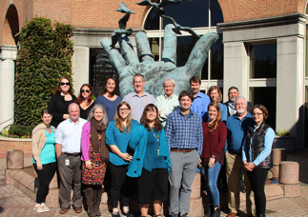
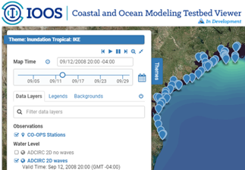
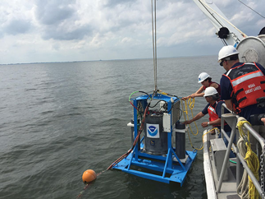
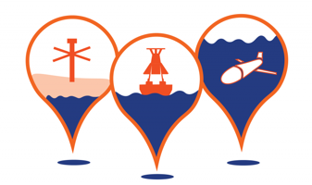
FY2019 IOOS PO Highlights
IOOS Advisory Committee - new members and new chair
NOAA Weather Act – weather and water prediction
Blue Economy – innovation is boosting our blue economy
Modeling: through COMT - Revolutionize Water Modeling, Forecasting, and Prediction – Wx Act 2017 = NOAA priority! IOOS in key role for community approaches.
Ocean Technology Transition – 2 new projects – geographic balance – late summer 2019 for next FFO for award in FY2020
IOOS partnering and leveraging – Ocean Acidification Program, Marine Biodiversity Observation Network, Animal Telemetry Network, National Weather Service, National Ocean Service, Regional Ocean Partnerships
Filling IOOS gaps
FY19 $7.5M gap filling
ICOOS Act reauthorization
17

Slide 18
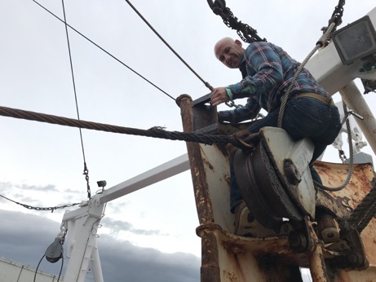
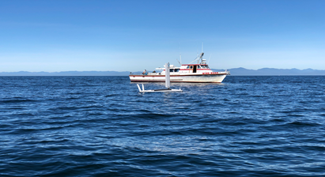
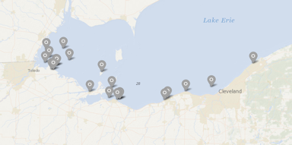
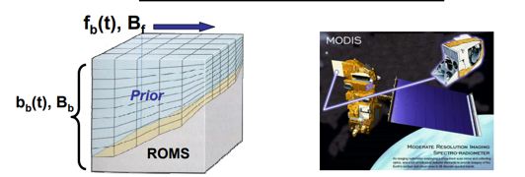
Ocean Technology Transition Program
FY18 ($2.5M)
3 ongoing projects
Lake Erie HABs/Hypoxia (GLOS)
West Coast HABs (UCSC/ SCCOOS/CeNCOOS)
Gulf of Maine Lobster Industry (NERACOOS)
2 new projects
MARACOOS/U of Delaware [Data Integration and Web-based Model Validation Tool for NOAA CO-OPS]
U of Notre Dame [Building Coupled Storm Surge and Wave Operational Forecasting Capacity for Western Alaska]
Bio data pilot ‘seed’ projects
Submaran ASV/UUV
deployment
FY19 (~$2.75M)
4 ongoing projects & new call for proposals
Lake Erie HABs/Hypoxia,
West Coast HABs
MARACOOS/U of Del,
U of Notre Dame/Alaska
https://ioos.noaa.gov/project/ocean-technology-transition/

Slide 19
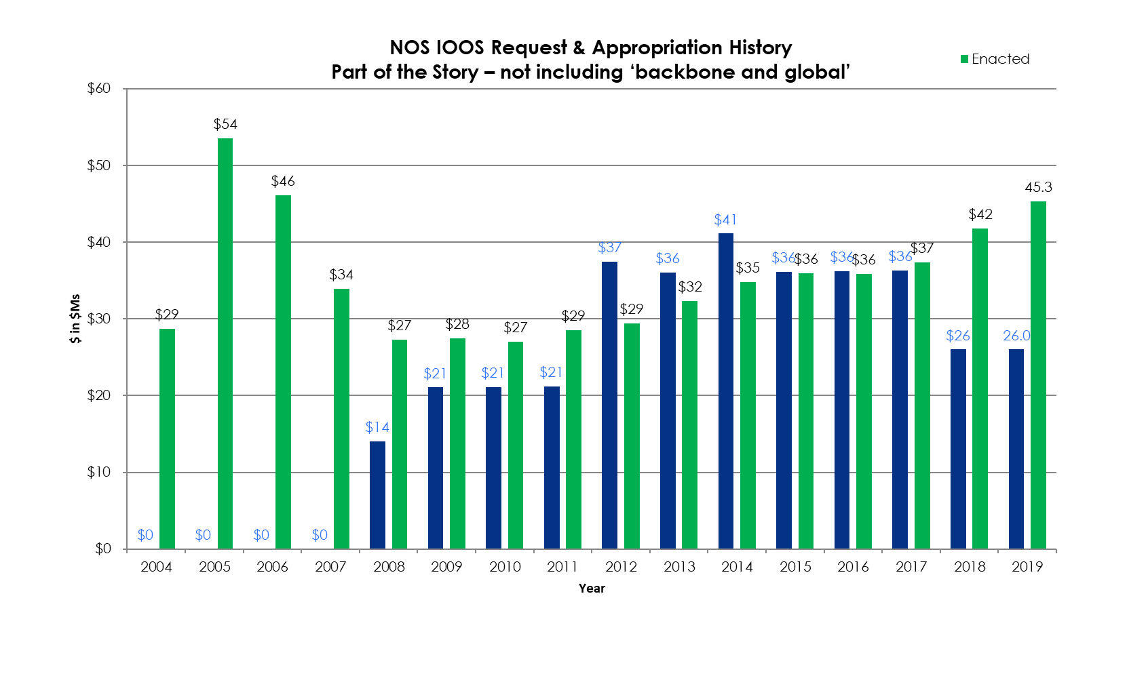
U.S. IOOS Enacted and President’s Budgets FY04-19
NOAA National Ocean Service
Navigation, Observations, and Positioning: ‘National IOOS’ component FY19 Omnibus $6.8M & ‘Regional IOOS Observations’ $38.5M ($1.5M for Reg.Oc Prtnrships)
Estimated Enacted levels are ‘post rescission’ totals for each year
‘Request’ = the President’s Budget Request
19

Slide 20
Regional Grants Actions Summary FY18 V 17
Regional Grants Action Summary
Task/Activity | FY 2017 | FY2018
Total funding moved by IOOS Office | $34,285,461 | $44,586,791
Funding moved via Cooperative Agreements | $32,820,943 | $41,909,281
Funding moved via transfers/direct cite/contract | $1,464,518 | $2,677,510
Number of Award Renewals submitted to GMD | 17 | 16
Number of New Awards submitted to GMD | 5 | 10
Lines of Funding for procurement awards | 105 | 171
Hurricane Supplemental funding actions | 0 | 5
Late actions requested | 0 | 9
# incoming Transfers/direct cites processed | 11 | 14
# outgoing Transfers / direct cites processed | 14 | 25
Number of Interagency Agreements | 6 | 8

Slide 21
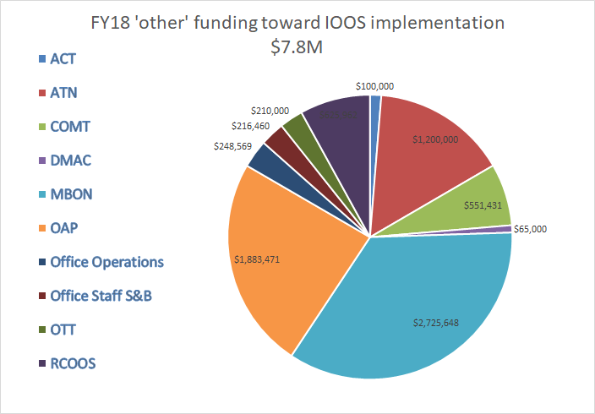
U.S. IOOS FY18 partner funding totals
Funds from partners either process through the IOOS Office, or funded to projects by IOOS partner agencies (e.g. MBON projects through the NOPP)
ACT = Alliance for Coastal Technologies, ATN = Animal Telemetry Network, COMT = Coastal and Ocean Modeling Testbed, DMAC = Data Management and Communications, MBON = Marine Biodiversity Observation Network, OAP = Ocean Acidifcation Program, OTT = Ocean Technology Transition, RCOOS = IOOS RAs coastal ocean observing system
21

Slide 22
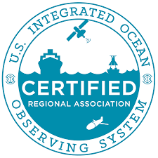
Certification of all non-federal IOOS Regions
Integrated Coastal and Ocean Observation System Act of 2009 (ICOOS Act)
IOOC defined high level criteria
Conveys formal recognition of IOOS Regional Associations
Extends civil liability coverage for data use
Establish minimum criteria for how a RICE operates
Adherence to data management best practices
Enhance delivery and quality of data and information
All 11 IOOS Regions are now certified! (Aug 2018)
Re-certification of regions will begin in 2020
Program Office developing process for recertification
22
Notes:
22

Slide 23
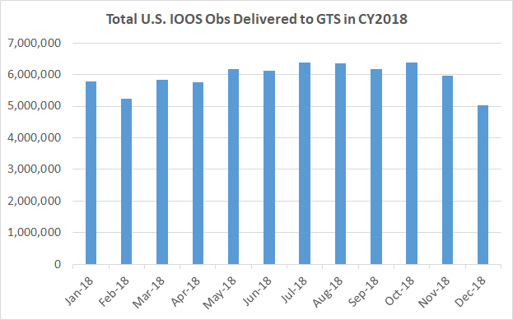
Flow to the GTS across the IOOS Enterprise
Sum of in situ obs delivered over CY2018: 71,211,630
All observations from NDBC + non-NDBC partner + IOOS-regional.
Does not include HF Radar, Gliders.
Does not include water level or biogeochemical data
Notes:
https://www.ndbc.noaa.gov/ioosstats/
IOOS Stations = RA-owned + RA partners. Nonfederal stations served through RA portals.
NDBC Stations = Coastal Weather Buoys + CMAN
non-NDBC Partner Stations = Other federal: NOS (CO-OPS), CBIBS, GLERL, ICON, EPA, NERRS, NWS Regional, NPS, OOI, USACE. Other nonfederal: Scripps, Everglades National Park

Slide 24
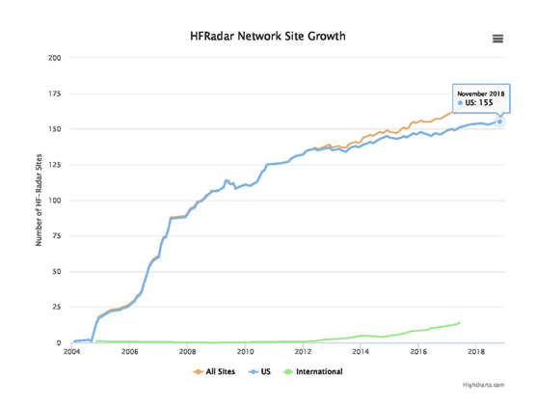
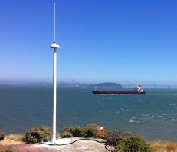
HF Radar Network Development
Filling gaps - new radars in FY18
2 in Alaska
4 in Southeast
Site selection for FY17 funded 4 radars in Gulf of Mexico and Pacific Northwest
FY19
New Restore Act funds ‘Gulf Loop Current Study’ - 7 new sites LA/MS, Mexico, FL straights
5 New sites in 3 IOOS regions
Pacific Islands
Northeast
Caribbean
https://ioos.noaa.gov/project/hf-radar/

Slide 25
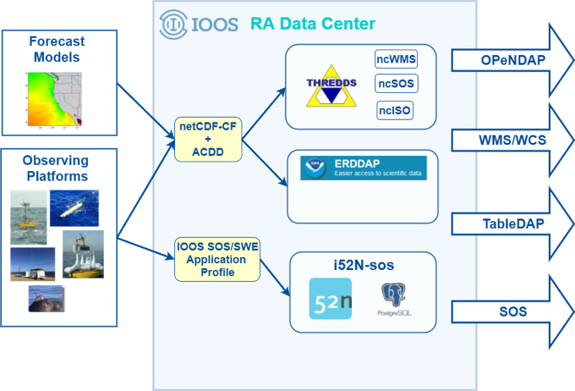
National DMAC
FY18 ($1.4M - National DMAC)
Progress toward IOOS-wide common ERDDAP implementation - simpler and more approachable interface to access IOOS data
OceanObs’19 Community Whitepapers:
Cloud Computing, Global Data Interoperability, Coastal Moorings, Global BioDiversity Observations, Quality Assurance Vision
Community Building, Training, and Technical Outreach Efforts:
IOOS Biological Data Training #1, Seattle, WA February 2018
Planning for IOOS Code Sprint #1 (to be held in Ann Arbor, MI October 2019)
IOOS Data Demo Center: making IOOS data & services accessible and usable
Held DMAC Annual Meeting with 95% positive feedback (e.g. ‘One of the best DMAC meetings to date’)

Slide 26
QARTOD
FY18 QARTOD manuals completed and published to ioos.noaa.gov:
New Stream Flow Manual (Sept 2018)
Update to Dissolved Nutrients manual (Feb 2018)
Update to Dissolved Oxygen manual (Aug 2018)
FY19 QARTOD manuals planned/completed:
Update to in-situ surface waves manual. Completed/published Feb 2019
New QA Manual, development in partnership with AtlantOS, ACT, JCOMM
In review with Frontiers in Marine Science research topic Best Practices in Ocean Observing. If accepted, will be published in Frontiers and published to ioos.noaa.gov.
New pH manual. Est complete by Aug 2019
Update to in-situ currents manual. Est complete by August 2019
All manuals are included in the Ocean Best Practices repository.
https://ioos.noaa.gov/project/qartod/

Slide 27
HAB forecasting ‘system’
GCOOS new exp. respiratory forecast for Pinellas county FL https://gcoos.org/red-tide-forecast/

Slide 28
Modeling Advancements
NOAA Water Initiative
New product development
National Ocean Service
Modeling Portfolio Manager
EDS Model Viewer Advancements
IOOS Coastal & Ocean
Modeling Testbed
Ocean Modeling Sandbox
and Cloud Computing
Notes:
This is a growing area and we are open to hear input.
•IOOS-funded Coastal and Ocean Modeling Testbed presents opportunities to unify NOAA modeling via engagement with the research community. (external community innovation) These opportunities include
•coupled modeling (e.g. National Water Model-coastal-wave; sea ice-atmosphere)
•nesting (Southeast US project to evaluate systematic nesting capabilities in ROMS; project to explore potential of SCHISM model to run on large scale grids of the US coastal waters) Semi-implicit Cross-scale Hydroscience Integrated System Model
•data assimilation (WCOFS)
•cloud computing (NCCOS predictive ecosystem modeling for making spatial decisions, OFS development exploration) benefits: scalability, efficiency, accessibility, portability, reproducibility, agility, flexibility, vast resource base (e.g. Linux environments); drawbacks: budgeting/planning, low latency interconnect
•unified data frameworks
•model transitions, precision navigation
•COMT can be expanded based on need
•Designed to transition modeling/modeling tools from research to operations (R2O)

Slide 29
IOOS Implementation
IOOS Office Annual Guidance Memo AGM - planning process March-May Seeking IOOC input!
Ocean Technology Transition
Governing plans and documents:
DMAC Plans
Coastal Moorings Strategy
Waves Plan
HF Radar/Surface Currents Plan
Coastal Modeling Strategy - (IOOC TT Report published in Journal of Operational Oceanography)
NOAA Water Initiative - https://www.noaa.gov/water/
ATN Implementation Plan (2016-2021)
Toward a US IOOS Underwater Glider Network Plan
NOAA’s Ecological Forecasting Roadmap
QARTOD Project Plan (2017-2021)
NOAA ‘Omics Roadmap(2019 draft out very soon)
Noise
NOAA Ocean Noise Strategy Roadmap https://cetsound.noaa.gov/road-map
OST TF on Ocean Noise and Marine Life draft work plan

Slide 30
Looking forward
Connecting Global and Coastal observations
OceanObs’19 - Regional - Coastal - Global
Essential Ocean Variables and Communities of Practice development
UN Decade of Ocean Science for Sustainable Development
OSTP’s Science and Tech for Oceans: A Decadal Vision

Slide 31
U.S. IOOS – Back up slides
Notes:
The IOOS Regional Associations operate observing assets and leverage others from State, Local, Tribal governments, academia, non-profit organizations and industry.
45% of the network of coastal moorings is operated by the RAs
The IOOS Regions offer unique observations, like the 130 plus stations of the High Frequency Radar system, operated by 30 academic institutions. High frequency radars are unique in their ability to measure surface currents in large areas at once with the detail required for important ecological, economic, and safety applications.
Gliders monitor water currents, temperature, and conditions that reveal effects from storms, impacts on fisheries, and the quality of our water. The profiling gliders are predominantly operated by IOOS Regional partners and academic institutions funded by a variety of Federal and State dollars.
Some systems are hybrids, such as the wave buoy network which is operated by NOAA, US Army Crops and IOOS Regional Associations.
Emerging observing systems include the tagging of marine animals and fish.
IOOS is developing a framework for integrating biological observations from animal tagging. ATN is important for tracking animal movements and provides understanding of animal responses to changing ocean conditions. Important for examining ecosystem dynamics.
MBON is important for understanding the variety of life, which impacts our coastal ecosystems. Critical for sustaining human and ecosystem health.
31

Slide 32
NATIONAL COASTAL ECOSYSTEM MOORINGS WORKSHOP
University of Washington
March 20 - 21, 2018
Notes:
This workshop was organized and hosted by the Alliance for Coastal Technologies (ACT) and sponsored by IOOS. ~40 participants – NOAA, BOEM, EPA, RAs (all but SCCOOS), Industry, Academia, State (Texas)
The Steering Team was led by Margaret McManus (Lead), with participation from:
Kathy Bailey (IOOS)
Gabrielle Canonico (IOOS)
Jan Newton (NANOOS)
Ru Morrison (NERACOOS)
Uwe Send (Scripps)
Josie Quintrell (IOOS Association)
Dan Schar (ACT)

Slide 33
U.S. IOOS Enacted and President’s Budgets FY15-19
NOAA National Ocean Service
Navigation, Observations, and Positioning: ‘National IOOS’ component FY19 Omnibus $6.8M & ‘Regional IOOS Observations’ $38.5M ($1.5M for Reg.Oc Prtnrships)
Estimated Enacted levels are ‘post rescission’ totals for each year
‘Request’ = the President’s Budget Request
33

Slide 34
U.S. IOOS: Program Timeline
1990s – US ocean observing community planning for IOOS
2000-2001 Navy, NASA, NSF, NOAA (4 “Ns) EPA, USCG, USACOE, et. al
Signing MOU to establish Ocean.US
2002 - IOOS planning Summit – “aka Airlie House Report”
2004 - Pew and US Commissions on Ocean Policy & First US IOOS Development Plan
2006 – NOAA IOOS Office and program established
2008 & 2009 – “IOOS” in President’s Budget & ICOOS Act passes PL 111-11
2012 – US IOOS Summit
2018 – US IOOS Enterprise Strategic Plan
2019 – Ocean Obs ‘19 global and coastal observing coming together
2021-30 - UN Decade of Ocean Science

Slide 35
“IOOS” budget 2010-2019

Slide 36
IOOS refreshed Core Variables
PHYSICS
Bathymetry
Bottom character
Currents
Heat flux
Ice distribution
Salinity
Sea level
Surface waves
Stream flow
Temperature
Wind speed and direction
BIOGEOCHEMISTRY
Acidity
Colored dissolved organic matter
Contaminants
Dissolved nutrients
Dissolved Oxygen
Ocean color
Optical properties
Pathogens
Partial pressure of CO2
Total suspended matter
BIOLOGY & ECOSYSTEMS
Biological vital rates
Coral species and abundance
Fish species/abundance
Invertebrate species and abundance
Marine mammal species/abundance
Microbial species/abundance/activity
Nekton diet
Phytoplankton species/abundance
Sea birds species/abundance
Sea turtles species/abundance
Submerged aquatic vegetation species/abundance
Sound
Zooplankton species/abundance
https://cdn.ioos.noaa.gov/media/2018/02/US-IOOS-Enterprise-Strategic-Plan_v101_secure.pdf
36

Slide 37
Growing Navy Collaboration - Navy Glider Operations
Largest Glider Fleet in the world.
Used to collect oceanographic data in data deprived environments.
Data is being assimilated into operational ocean models.
100 simultaneous glider milestone reached.
37

Slide 38
NAVOCEANO Support for Hurricane Gliders
2018 Tropical Atlantic Hurricane Gliders
Puerto Rico
4 NOAA/AOML
5 NAVOCEANO
USVI
5 NACOCEANO
38

Slide 39
Delivering Observations: Environmental Sensor Map
Integrates regional, national, and global real-time data (past 4 hours) across the IOOS enterprise – federal and nonfederal sources. (~40,000 stations, 120,000 sensors)
Hexagonal bins provide data summary, ease visualization and load time
Choose base layer, units
Dynamic graphs of values at a location.
FY2018
ERDDAP server for access to underlying data
Customized “data views” for events or
themes
4-D data views
Optimized searches
19
sensors.ioos.us

Slide 40
Regional applications of integrated observations
West Coast HABs
Lake Erie HAB/hypoxia
Gulf of Maine lobster industry
Drinking water impacts
Subsurface observations from GLOS/GLERL buoys
Informs municipal water districts/intake managers
Maine’s largest commercial fishery
NERACOOS buoys: only source of real-time subsurface water temperatures
Forecast start date of lobster fishery to optimize the harvest
Emergency closures of crab fisheries
Environmental Sample Processor (new technology) used to detect toxins
HAB bulletins, forecasts vital to shellfish growers, fishermen, marine mammal rescue groups
“We receive valuable and complex information in real time with these buoys. That data is an important addition to our treatment tool kit.”
- City of Cleveland Water Dept
Photo credit: Stephanie Moore
Map: CeNCOOS/SCCOOS
Image: Gulf of Maine Research Institute
Photo credit (left): Brad Woolhiser
Lower photo credit: Dave Zapotosky

Slide 41
What is U.S. IOOS?
U.S. IOOS is a cooperative, coordinated network of federal and non-federal observing networks.
Thousands of gigabytes of observing data are gathered every day by agencies, researchers, and others in the process of meeting their own missions and goals.
Before U.S. IOOS, there was no coordinating body to oversee the integration and open availability of those data.
U.S. IOOS works across and with regional, national, and international entities to gather, integrate, and disseminate that data in service of our seven societal goals.
U.S. IOOS takes a leadership role in ensuring that observing infrastructure is operated and maintained in pace with current technology and in service of stakeholder needs.
41
Notes:
IOOS meets the nation’s need for ocean coastal, and Great Lakes information by integrating across seven societal benefit areas.
Improve predictions of climate and weather and their effects on coastal communities and the nation;
Improve the safety and efficiency of maritime operations;
More effectively mitigate the effects of natural hazards;
Improve national and homeland security;
Reduce public health risks;
More effectively protect and restore healthy coastal ecosystems; and
Enable the sustained use of ocean and coastal resources.
41

Slide 42
Flow to the GTS: CY2018
https://www.ndbc.noaa.gov/ioosstats/
IOOS Stations = RA-owned + RA partners. Nonfederal stations served through RA portals.
NDBC Stations = Coastal Weather Buoys + CMAN
non-NDBC Partner Stations = Other federal: NOS (CO-OPS), CBIBS, GLERL, ICON, EPA, NERRS, NWS Regional, NPS, OOI, USACE. Other nonfederal: Scripps, Everglades National Park
# observations by category
# stations by category
(Future effort: lump/split differently to show federal vs nonfederal)

Slide 43
MBON Tools @ mbon.ioos.us
Infographics
MBON Data portal
MBON Curated Data Views
Audience:
public, managers, educators
Audience:
Scientists, technical experts
Audience:
Advisory groups, researchers, teams
Notes:
MBON has been converting static conceptual models into live interactive infographics for MBNMS and FKNMS - this effort is scalable and expanding to additional sites (Sanctuaries, IEAs, other study or management areas), and for additional types of users (e.g. fishery management councils)
Interactive Conceptual Models, or Infographics, enable users to click on elements to simple plots and maps and build on work done by IEA and Sanctuaries
Curated Data Views, available through the MBON Portal, pre-determined, customized data views that integrate biological with envrionmental data to tell a story, allow investigators to replicate analysis, etc
The MBON data portals enables deeper data exploration and visualization of available data layers
IOOS and MBON are funding expansion of this work to new Sanctuaries and for the California Current and Florida Keys Integrated Ecosystem Assessment programs

Slide 44
MBON User Needs to Date
BOEM:
Environmental Studies Program long term monitoring
Products to support platform decommissioning in California, oil and gas development in the Arctic
MBON Portal to search/download data in a region of interest
States:
Screening tools for toxic algae (eDNA - Florida)
Data for ecosystem-based management (eg forage species, environmental conditions)
Sanctuaries:
Web-enabled updates to ONMS condition reports
Data products for outreach and management
Early warning of anomalous conditions
IEA:
Web-enabled updates into IEA conceptual models
Notes:
States: Florida FWC is active in the Florida MBON projects, on the west coast ONMS provides a connection to state needs.

Slide 45
Early warning and alert system for Sanctuaries
Anomaly detection
Detection of anomalies in CHL, SST, Turbidity
FGBNMS, FKNMS, others
Dashboard and email alerts in real time
Stetson Bank
Notes:
MBON is also building early warning and alert tools to notify managers of anomalous conditions.
Managers have asked for these types of tools and notifications.
This is an example of a tool that was prototyped in response to the 2016 coral mortality event in Flower Garden Banks – IOOS and MBON are funding further development of the tool for the Flower Gardens and for Florida Keys
See http://www.marinebon.org/

Slide 46
MBON Seascapes: Global, regional, operational
Classification of dynamic seascapes from satellite variables: SST, chl-a, SSS, tau, SSH, nFLH, CDOM
Soon to be produced operationally by NOAA/CoastWatch, NASA COVERAGE
Local to global
Applications for cruise planning, feature tracking
Also fisheries management, OA, HABS, characterizing Arctic habitat
46
Notes:
Working with NASA and NOAA to produce these dynamic seascape maps (at regional and global scales) operationally so that the global community can monitor habitat shifts in their region of interest, and objectively compare drivers and responses of ecological communities across regions.

Slide 47
US MBON and eDNA
MBON is developing and testing eDNA methods to scope potential for operations
Comparing results across trophic levels, regions, and time scales
Peer-reviewed, documented best practices and methods
MBON eDNA efforts are helping:
Florida improve screening for toxic algae,
Monterey Bay partners assess vertebrate diversity at oceanographic stations, and
Flower Garden Banks scientists detect diversity of corals, sponges, and brittle stars from spawning events.
Notes:
Quote in a paper from the Monterey Bay team: “eDNA provides a realistic census of marine vertebrates in Monterey Bay National Marine Sanctuary” and offers “enormous potential for biomonitoring”

Slide 48
Submaran deployment for HAB sampling
Submaran being deployed to test as a platform for taking water samples for HAB organisms
Submaran S-10 is a wind and solar-powered surface/subsurface vehicle
Joint NANOOS, APL, NMFS. and OceanAero project
3 days of cruises - 9/25 - 9/27 - from Neah Bay, WA
Collecting water samples and associated metocean data
Samples to be analyzed at the Makah tribal lab.
X

Slide 49
THREE ATN COMPONENTS
BUILD ALLIANCES AND COLLABORATIONS
PROVIDE TELEMETRY DATA MANAGEMENT & DELIVERY WITH AN OPERATIONAL DAC
SUPPORT STAKEHOLDER
BASELINE ANIMAL TELEMETRY OBSERVATIONS
ACT
Notes:
Building Alliances and Collaborations is critical to establishing credibility and trust in the community.
The DAC provides the important National Data repository to enable national needs to be addressed and to provide the potential for “Big Data” projects that are integrated among regions……cross-species investigations, etc.
Supporting/funding high priority Stakeholder baseline animal telemetry observation capabilities is the manifestation of our motto: “We help to keep existing efforts going and add to them as needed and defined through our Workshops and our ATN Steering Group.”

