Slide 1
IOOS® and the Blue Economy
September 21, 2016 MTS Oceans Monterey
Jennifer Patterson, CeNCOOS Information Manager
Notes:
Good morning and thank you for inviting me to speak to you today
I have 2 messages I would like to convey:
1. Communicating that Ocean Observing matters to everybody; everyday
2. To reach policy makers we might need to cast our ocean observations in different terms

Slide 2
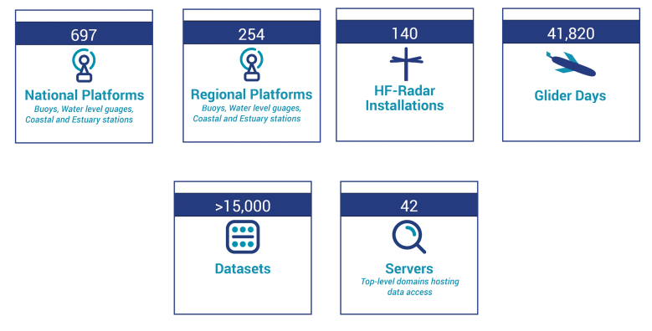
What is IOOS?
observing and predictive tools
benefit economy, environment, public safety
Notes:
IOOS is a sustained ocean observing system for the United States. Through IOOS I am responsible to coordinate the observing programs from a number of national agencies within the United States who observe for their own mission. What is unique is that in addition to the Federal Agencies, I lead 11 Regional Associations that are made up of State Local and Tribal governments, academia, and industry responsible for observing locally, coordinating data and providing services at local levels but remain cohesive because they are part of one system IOOS.

Slide 3
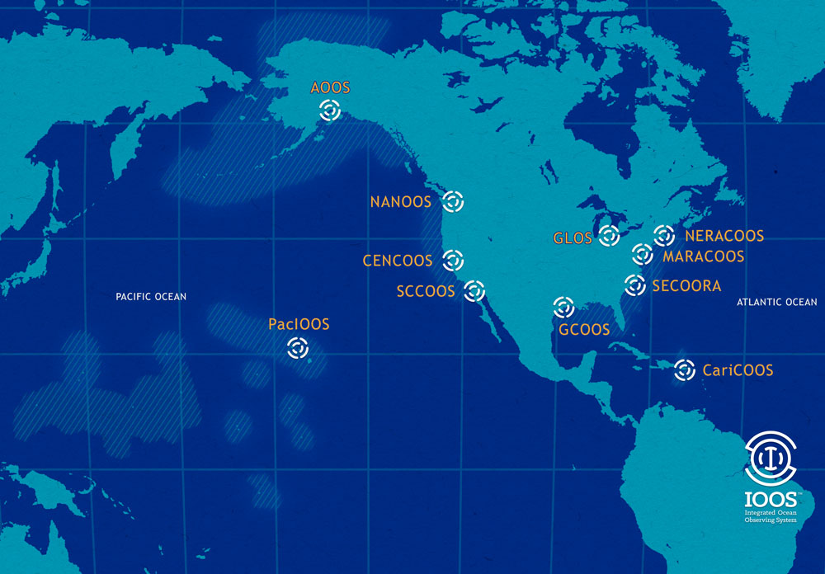
How Big is IOOS
11 Regions in the U.S.

Slide 4
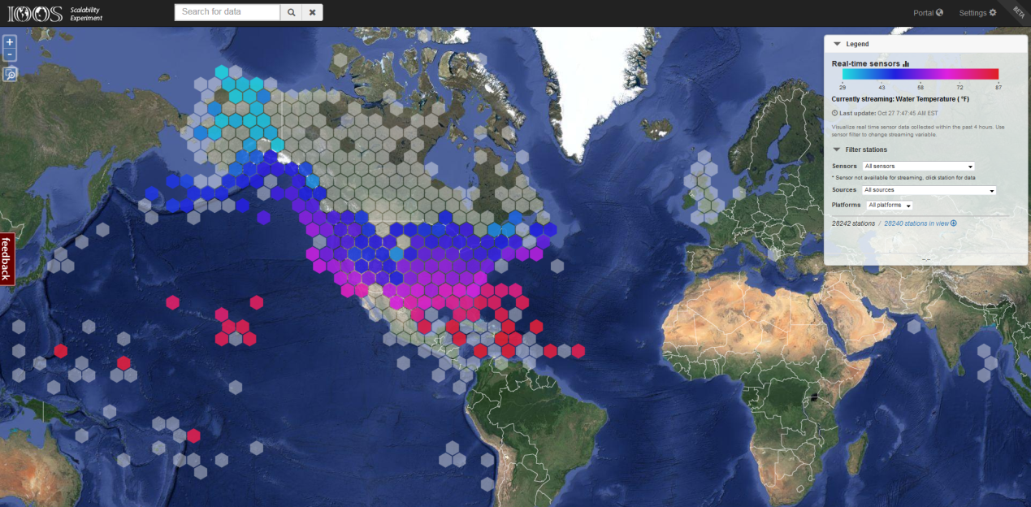
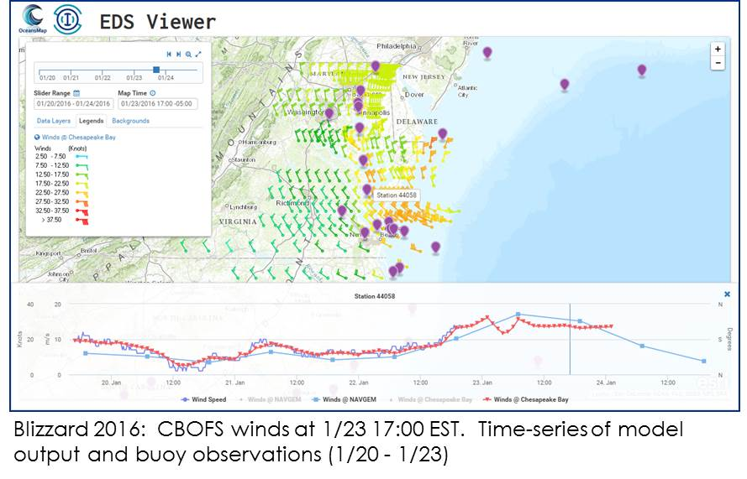
IOOS Data is BIG data
Petabytes
of
Open Data
29,755
stations
93,734
sensors
37
national sensor networks
38,716,733
sensor observations
Per week
Notes:
Quantity, quality, open, discoverable, standards based access
29,755 stations - 93,734 sensors; 37 national sensor networks; 69 unique parameters; 38,716,733 sensor observations for last week
GCOOS/SECOORA/NERACOOS/NANOOS/OceanSITES nearly complete
AOOS, CeNCOOS completed.
Continuing enhancements of the Environmental Data Server and an “IOOS subscription” of the visualization that accesses and displays images of data from the server.
Outcome: The visualization will be plugged into the IOOS web environment (data.ioos.us) for public access to integrated model output (regional/national/global). Ultimately provides forecast tools to the operational oceanographic user community.
Partnership: An important part of this project is the partnership developed with CO-OPS, an operational office in NOS. This is important because IOOS and CO-OPS leadership recognized the need for increased collaborations between the 2 offices. EDS provided this opportunity - it provides IT solutions that CO-OPS could eventually leverage

Slide 5
Data Application Examples

Slide 6
Without Shipping…
…we wouldn’t have:
24% of wine
99% of shoes
Almost all personal electronics
97% of clothes
Notes:
The United States is a maritime nation. More than 90% of everything we consume, wear, eat, drive and construct is brought to us via ships through the North American port system
Vickerman and Associates (this includes trans-shipping within the U.S.).
In 2011 we had 570 billion dollars in exports.
Maritime activity expected to triple in the next 20 years, Post Panamax ships in 2015 and we also know the ports infrastructure will not be able to keep pace

Slide 7
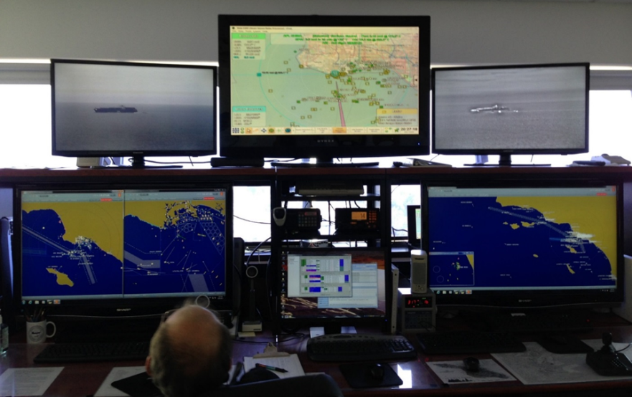
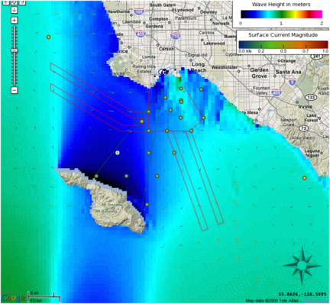
We couldn’t move…
…without ocean observations and forecasts
Increase safety
reduce risk of accidental grounding
Increase efficiency
enable ship owners and masters to adjust arrival times
Reduce emissions
enable larger ships to carry more cargo, reduce overall emissions
Notes:
. Without ocean observing, we can’t get the ships in and out of port – it is just that simple.
Through the IOOS Regions – we support buoys along the coasts that support the pilots as they meeting the ships to bring them into port. They rely on them for their safety as well as the safe passage of the large vessels. Forecasts are needed but knowing the conditions right now are critical.
"The coast of Maine supports multimillion dollar fishing & tourism industries so when making decisions about bringing a 700 foot tanker full of fuel into port we need the best ocean and weather information possible, which is why we depend on IOOS buoy observations and forecasts to ensure safety and efficiency of these critical operations."
We are working with the Port of Long Beach in southern California and provides a tangible example of the potential benefit to the economy. By using its new underkeel clearance decision support system fed by realtime wave observations and high resolution models, the port will save an estimated $10M per year by eliminating the need to offload cargo from vessels offshore before they enter the port.

Slide 8
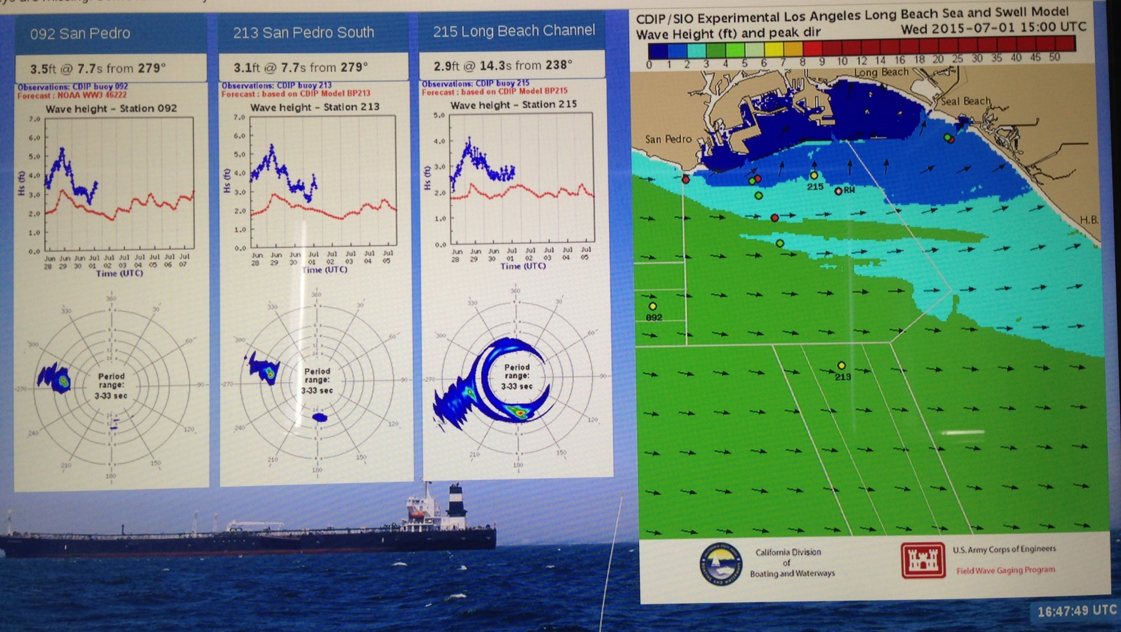
Display at Marine Exchange.
Buoys update every 30 minutes

Slide 9
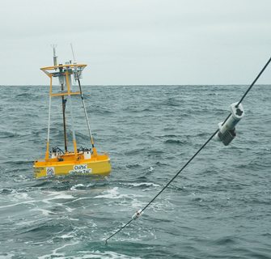
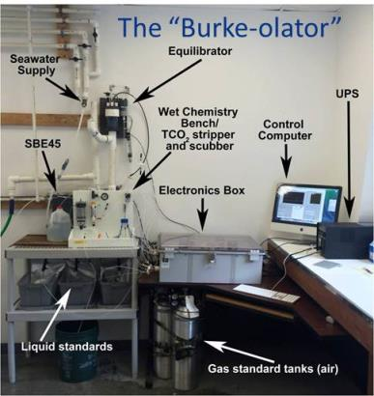
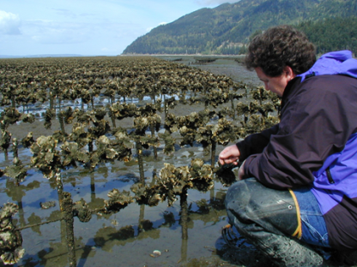
Oysters on the Half Shell
Shellfish industry:
$111 million on West Coast
At risk from ocean acidification
Real-time data informs industry management decisions
Humboldt Bay Oyster Conditions Dashboard
Provides easy access to ocean information for the region’s mariculture industry.
Notes:
Yesterday the session focused on measurements of ocean acidification. While as scientists you understand the importance of observing and understanding ocean acidification, but it was not until it affected our oyster industry did policy makers and importantly politicians take interest and increase funding.
A short story about the Whiskey Creek Hatchery in Netarts Bay Oregon operated by Mark Wiegart and Sue Cud. In 2008 they thought they were going to lose the business. As Mark says “What happens in the ocean affects my business” The picture of me in the lower left may look like dirty water but it is actually 100 million larvae. When the larvae was put into the sea water they had zero survival. They had no idea what the problem was. Working with IOOS and NOAA’s Ocean Acidification Program we determined it was a changing ocean chemistry that was the issue. By installing ocean observing equipment along the coast and in the hatcheriers, I am glad to tell you the West Coast, shellfish industry , worth about $111 dollars and providing thousands of jobs in Oregon and Washington is thriving once again.
Mark is famous for saying - Without the IOOS we would be driving blind – it is like putting the headlights on.

Slide 10
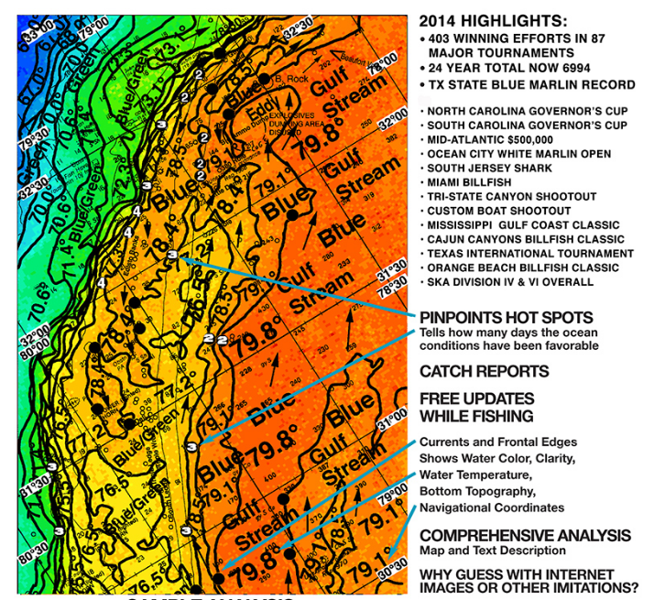
Entrepreneurs using data
Recreational and Sport Fishing

Slide 11
Enabling Decision Making Advancing Science Fostering Technology Advances
www.noaa.ioos.gov www.cencoos.org
@usioosgov @cencoos
https://www.facebook.com/usioosgov
Notes:
Let me leave you with this quote from my boss – Dr. Kathy Sullivan, NOAA Administrator
“Smart investments in monitoring and observations pay off in building community resilience before, during, and after hazards strike. Resilience reduces the costs of uncertainty and supports renewed vitality and recovery with fewer negative impacts. Observations are essential in providing the environmental information that underpins this resilience, and as the bedrock of ready, responsive, and resilient communities.”

