Slide 1
Frederic Terral, President / CEO
BrandArchitectureInc.com

Slide 2
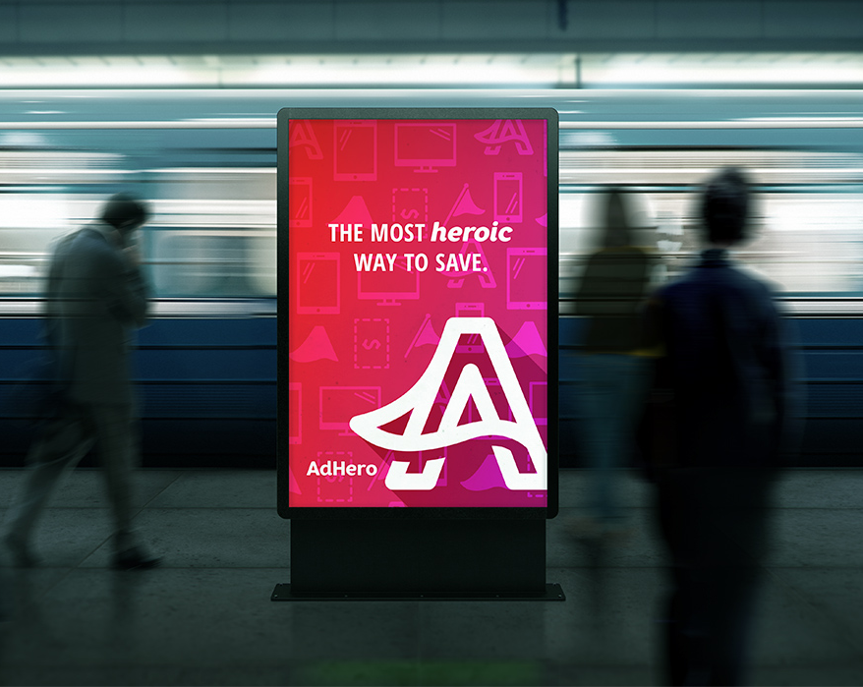
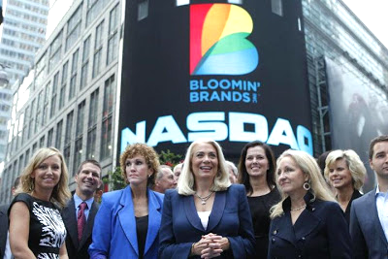

Slide 3
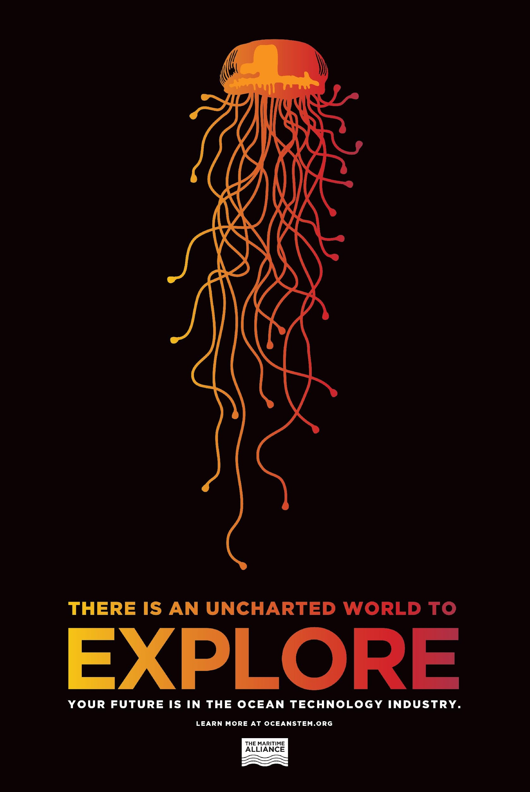
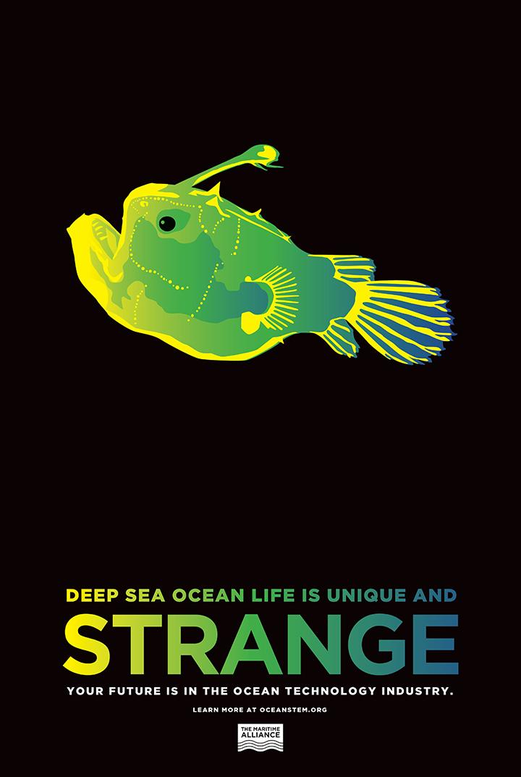
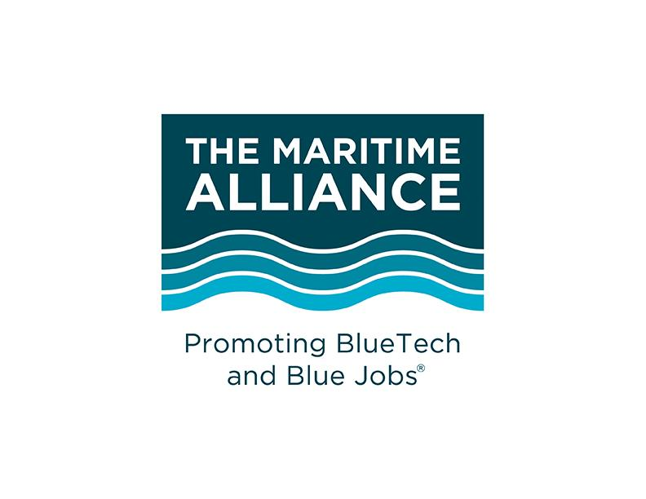
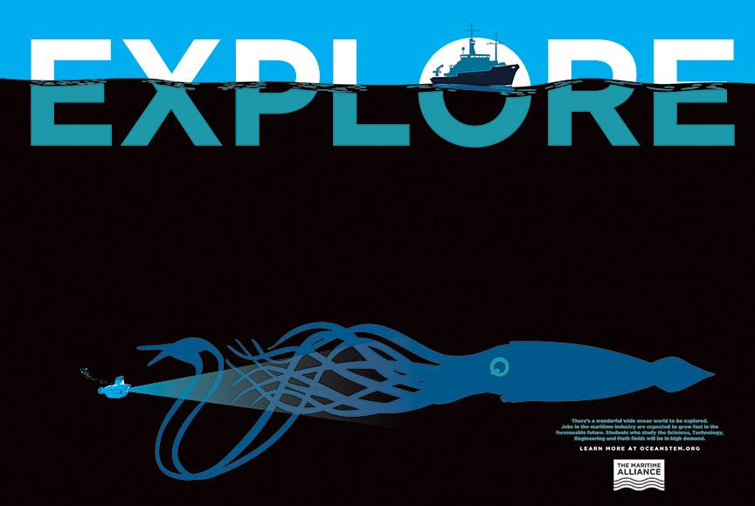
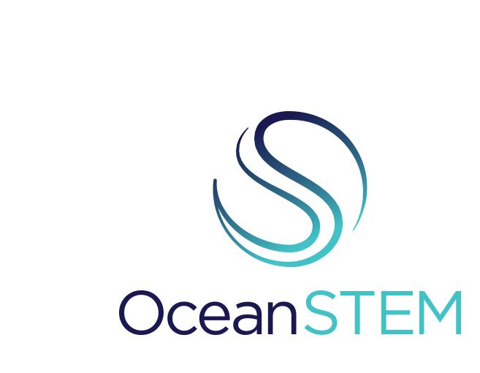
Notes:
Using our powers for good.

Slide 4
THE NEW IOOS...
Notes:
An integrated system of lines that form the letter IOOS from the inside out. Subtle surprises: S suggestive of a propeller. The inside I/O forms are also suggestive of a radar signal, the ripple of a wave and an eye.

Slide 5
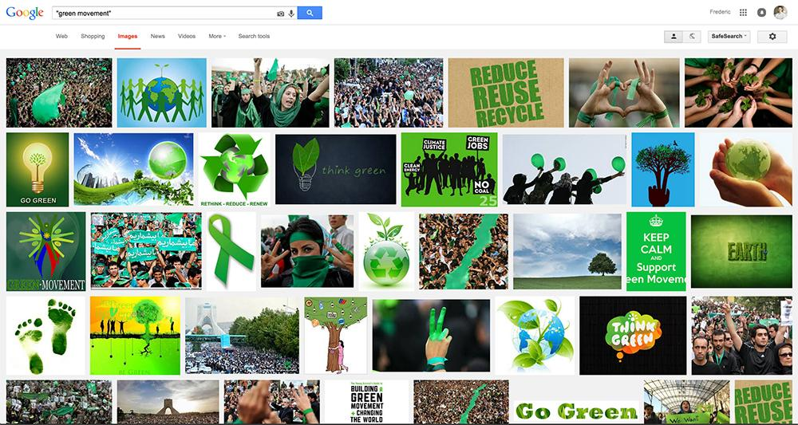
2015 Google SEARCH: “GREEN MOVEMENT”

Slide 6
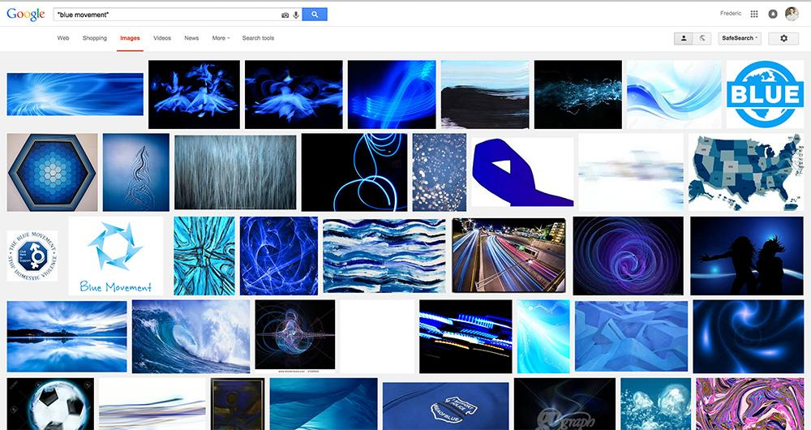
2015 Google SEARCH: “BLUE MOVEMENT”
Notes:
1-year later: Green still stealing market share from Blue. // No people in this result. Make note to talk about this… the missing piece of the movement??? - ss // Great point. - ft

Slide 7
FOUNDER’S BIO
ONE (BLUE) VOICE
There is no common language or unified messaging for the ocean like there is for the “green” movement, in popular culture.
There is no symbol to represent the “blue” movement (like the recycle symbol).
Blue tech, blue economy, blue movement, blue voice… all have no meaning to the general population.
?

Slide 8
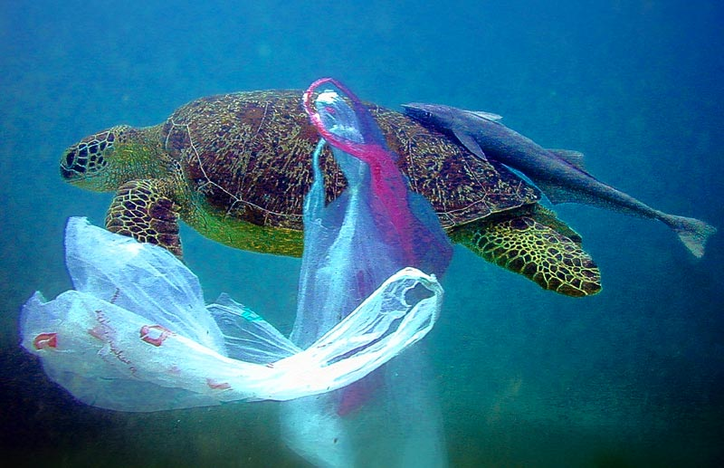
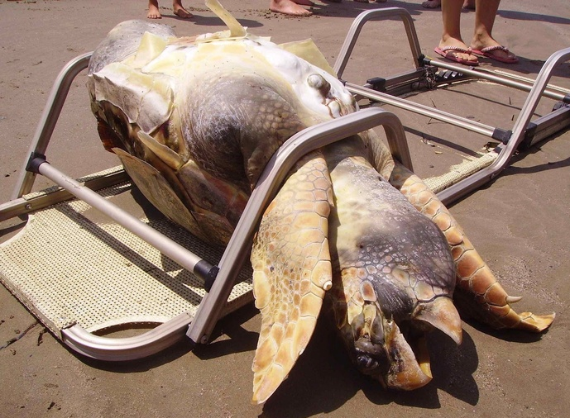
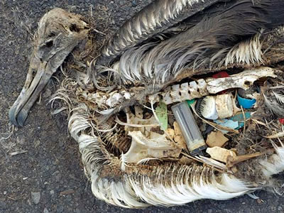
ONE (BLUE) VOICE
Mainstream PUSH messaging doesn’t seem to connect with the population enough to motivate them to take action.
We are shouting at people, making them feel guilty and it’s not working.
We need to stop shouting.

Slide 9
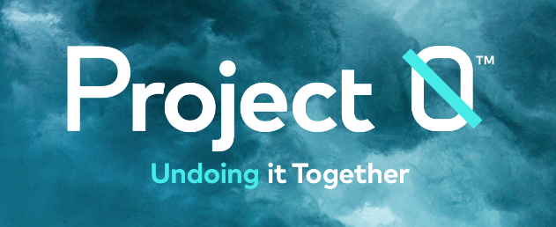
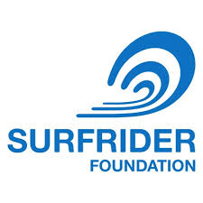
BLUE VOICE. ONE VOICE. (There are many voices)
Notes:
No central portal or voice

Slide 10
We need ALL eyes on the ocean
and ONE voice.

Slide 11
BLUE VOICE. ONE VOICE.
Clear, authentic & UNIFIED messaging
Compelling visual brand platform
Relevant, meaningful & impactful to…everyone
We need to PULL people in, not PUSH (them away)
Notes:
‹#›

Slide 12
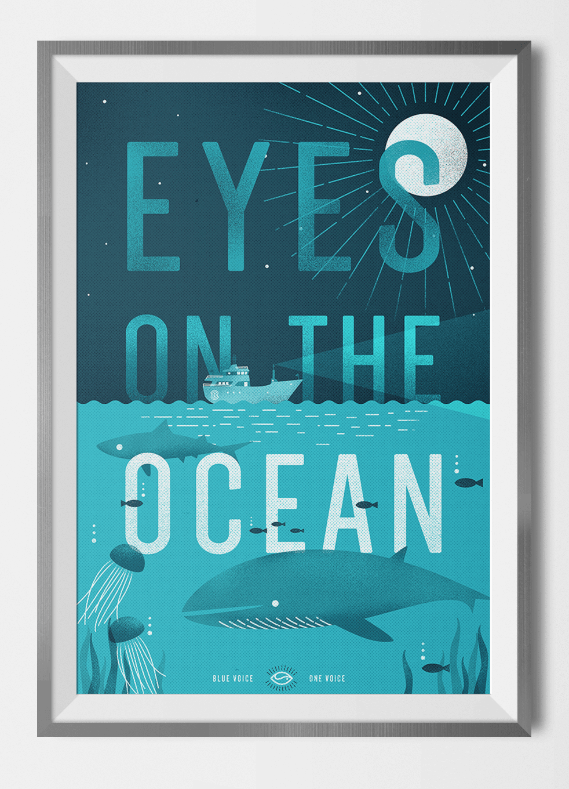
Notes:
Inspired by Michael Jones & Zdenka Willis, we’ve initiated some exploratory work

Slide 13
Frederic Terral, President / CEO
BrandArchitectureInc.com

