Slide 1
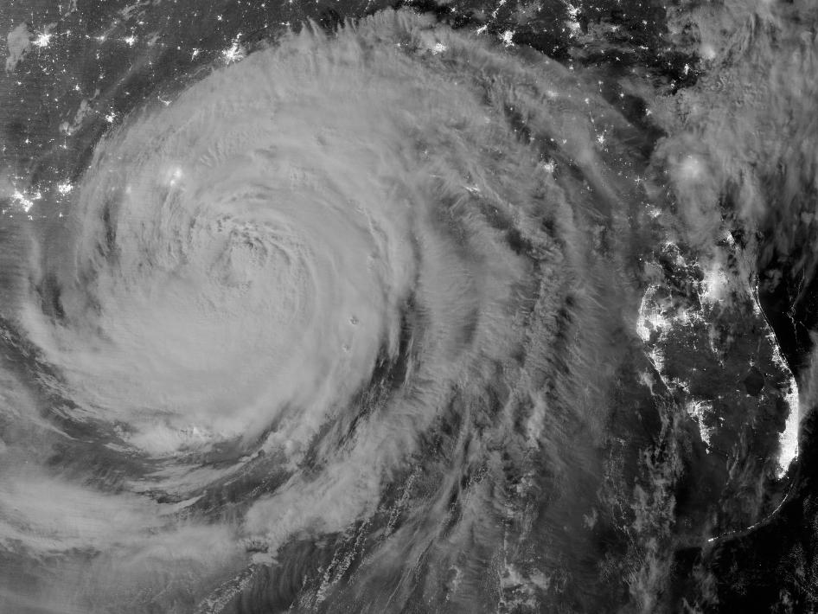
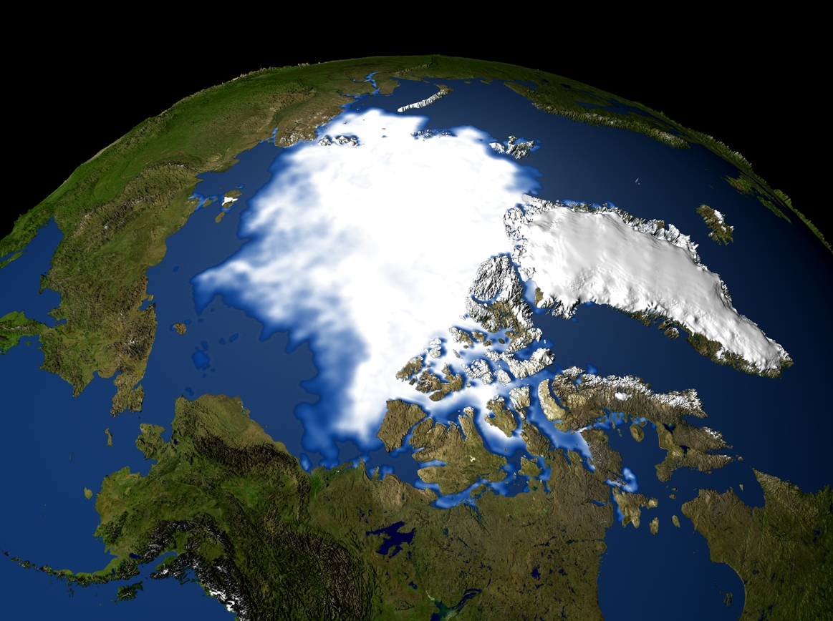
Addressing Ocean Observing Needs in Energy Exploration and Development

Slide 2
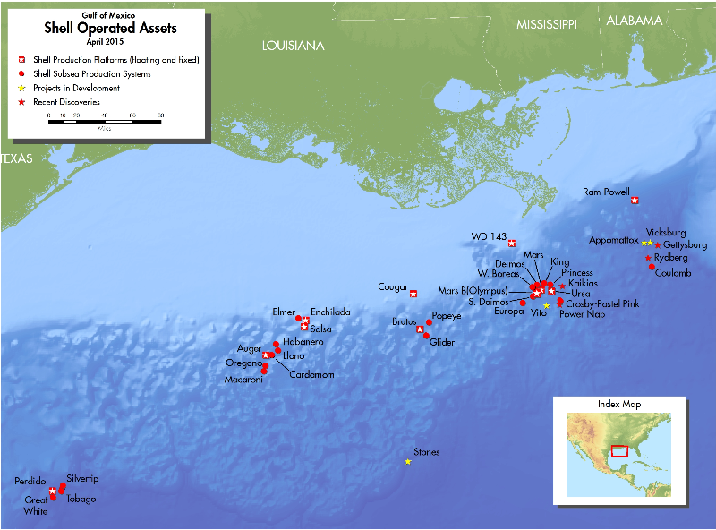
Shell’s Interests and Activities in US Coastal Oceans
Shell has been actively engaged in the exploration and development of oil and gas reserves on the US continental shelf since the 1940s
Shell produces 225K barrels per day from current GoM assets (2.5% of total US daily production)
The U.S. produces 9.2 million barrels of oil per day, 17% of daily US oil production is from the GoM
As we speak Shell has a group of vessels moving into position in Alaska offshore

Slide 3
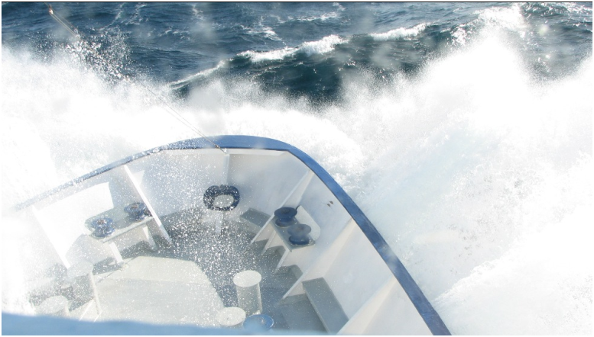
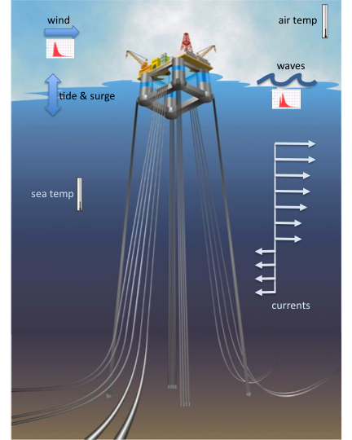
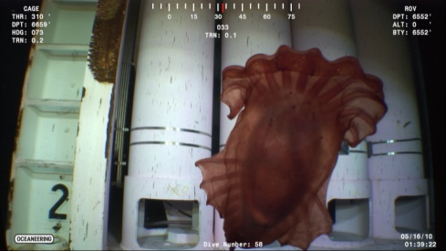
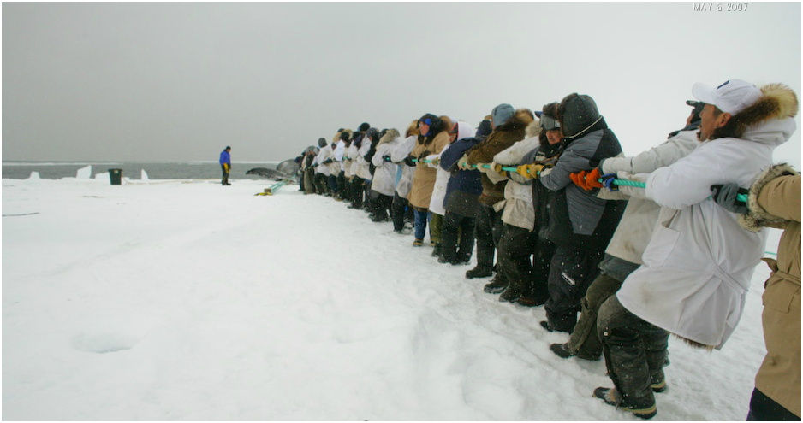
Roles of ocean observing in industry
Provide the knowledge base that will allow energy to in the offshore operate:
  Safely & responsibly,
  In a manner that is in compliance with regulations,
  In a manner that fulfills standards and commitments,
  In a manner that is protective of the environment and respects people
Provide critical data that will accommodate design and operations and protection of people and infrastructure
Notes:
Figures from Metocean team (shows metocean parameters relative to infrastructure)

Slide 4
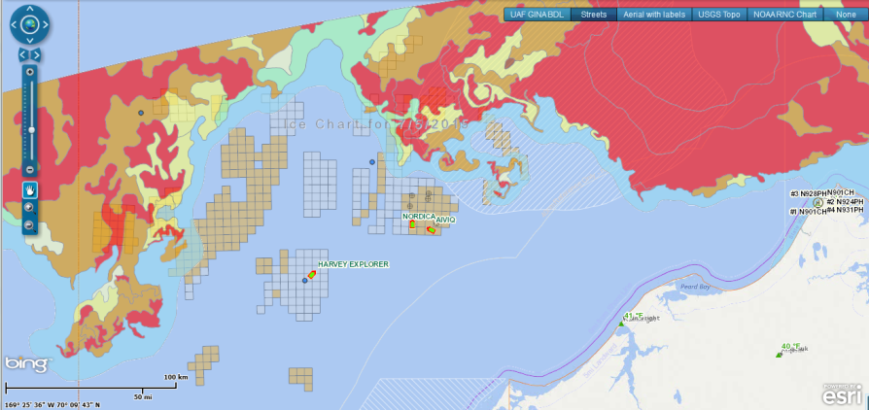
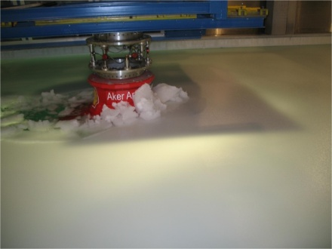
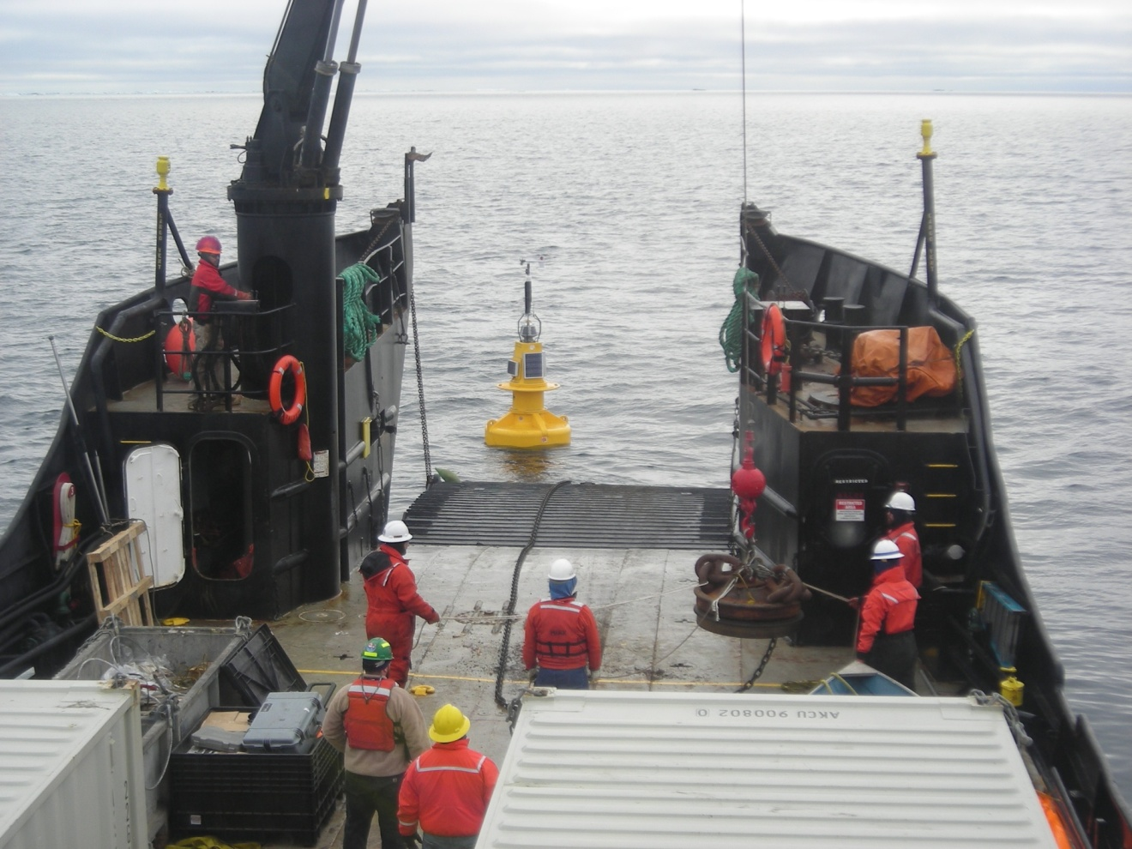
Metrological & Oceanographic Observations
METOCEAN PARAMETERS ARE CRITICAL TO SAFETY, PLANNING, OPERATIONS, AND PLATFORM DESIGN
Need baseline & real-time field data to
  Support real time situational awareness
  Support lifetime of a project (30+ yrs)
  Model conditions of ocean & infrastructure
Met with integrated networks of ocean observing platforms (drifters, buoys, AUVs, remote sensing, moorings, models)
Achieved by collaborative data sharing and accessibility to shared metocean databases
Notes:
New images – Stones Buoy deployment
Glider image from NOAA/Kongsberg

Slide 5
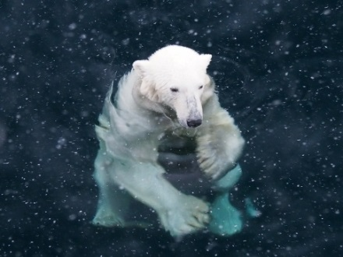
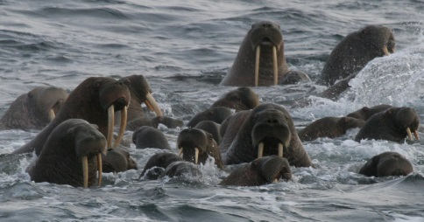
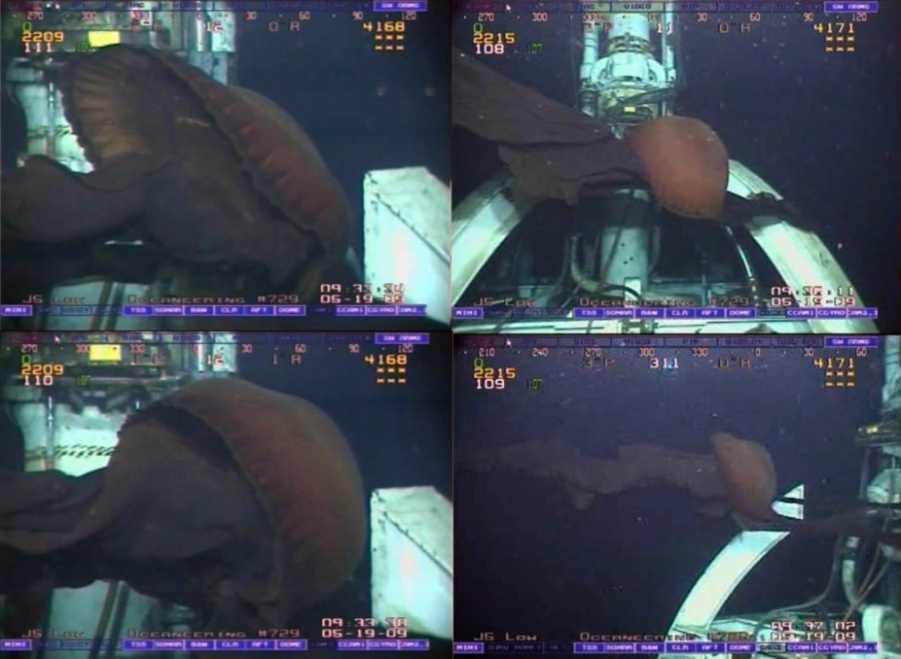
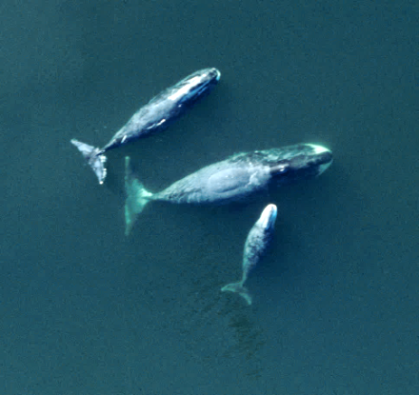
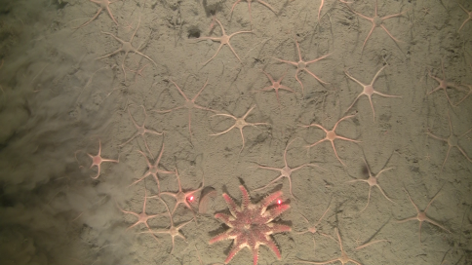
Physical and biological oceanography – baseline
Develop an understanding of the flora, fauna, and ecology that our operations will interact with
  Enables us to develop plans and carry out operations that are protective of the environment
  Provide the information needed to acquire permits
  Provide capacity for long term monitoring and evaluation of impacts status and trends

Slide 6
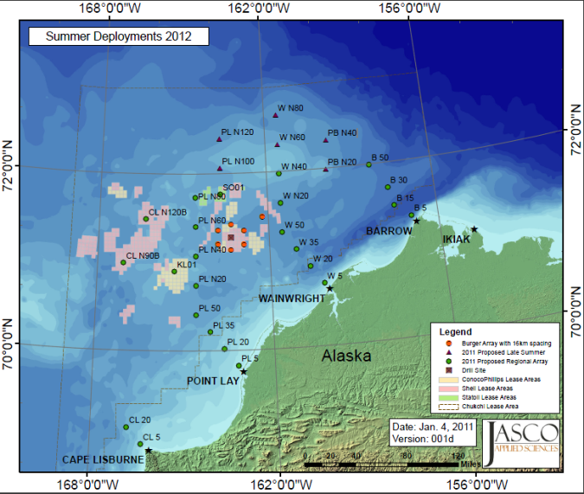
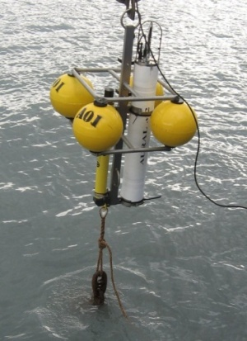
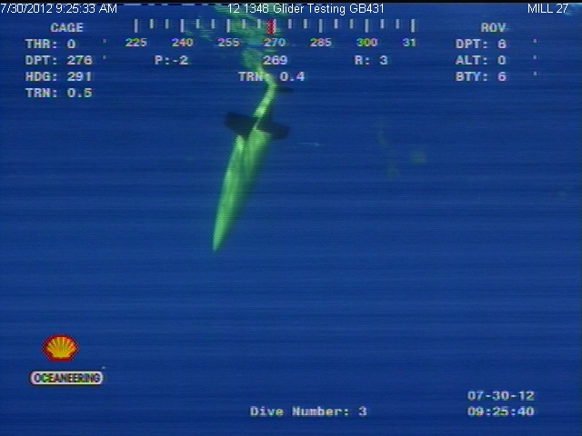
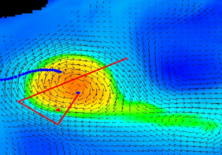
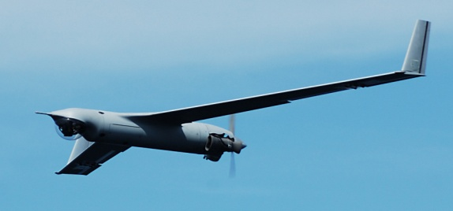
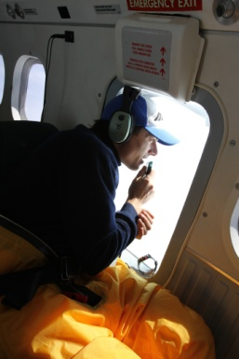
Use of New and Emerging Technologies
Ocean observing in remote locations benefits from new and emerging technologies
  Increase quality, timeline, and density of observations
  Reduce safety risks associated with ocean observation
Developing technologies
  Acoustics arrays
  Gliders
  Unmanned Aerial Systems
Incorporate Traditional Knowledge

Slide 7
Shell’s Participation in Ocean Observing
Since 2007 Shell has funded in excess of $100 million of ocean science in Alaska Arctic offshore
Have agreed with NOAA to make data available to the Agency and the scientific community as a whole
  Data are housed in Alaska Ocean Observing System
  Buoy data are served real time to NDBC and NOAA for use in forecasting
Collaboration
  Industry, governments, stakeholders
    North Slope / Northwest Arctic Boroughs
  Chukchi Sea Environmental Studies Program
    Arctic Marine Biodiversity Observing Network

