Slide 1
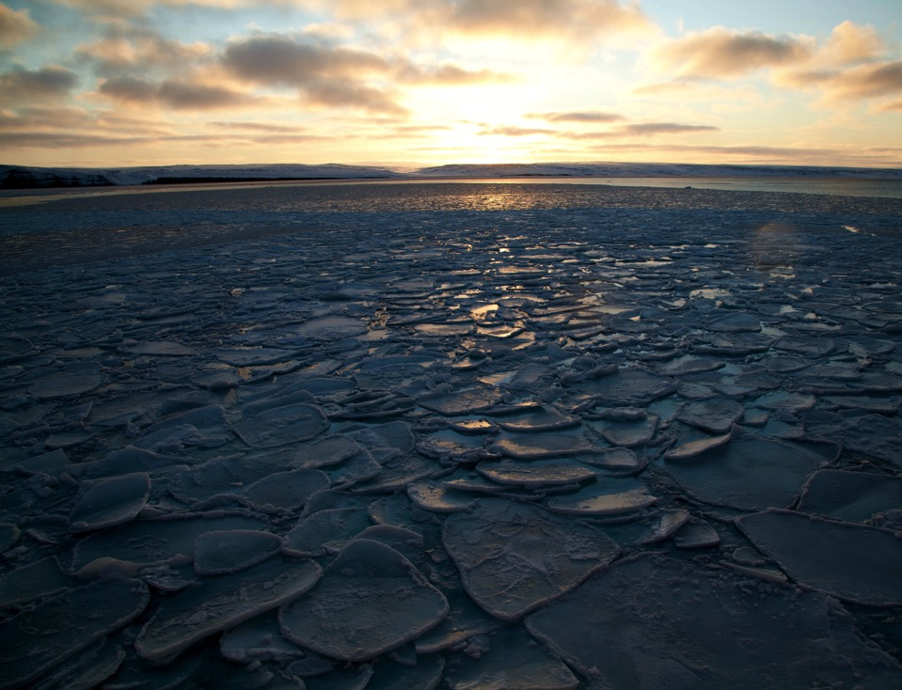

Arctic 2020: How Technology is Going to Change Observing
Jeremy T. Mathis, Ph.D.
Director –Arctic Research Program
Climate Program Office
Notes:
20 slides, 5 minutes, 15 sec per slide

Slide 2
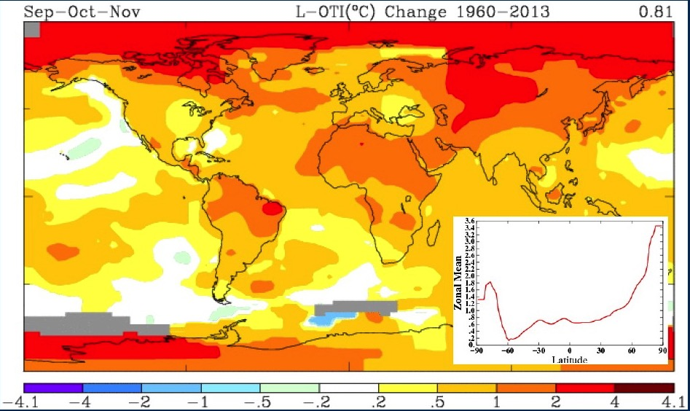

Temperature Amplification in the Arctic
Notes:
Recent Arctic warming is greater than for the globe as a whole. This is best expressed in autumn and winter.

Slide 3
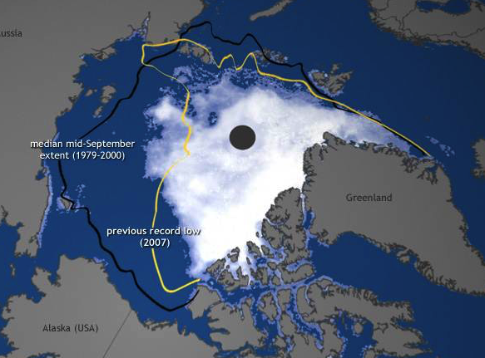

Slide 4
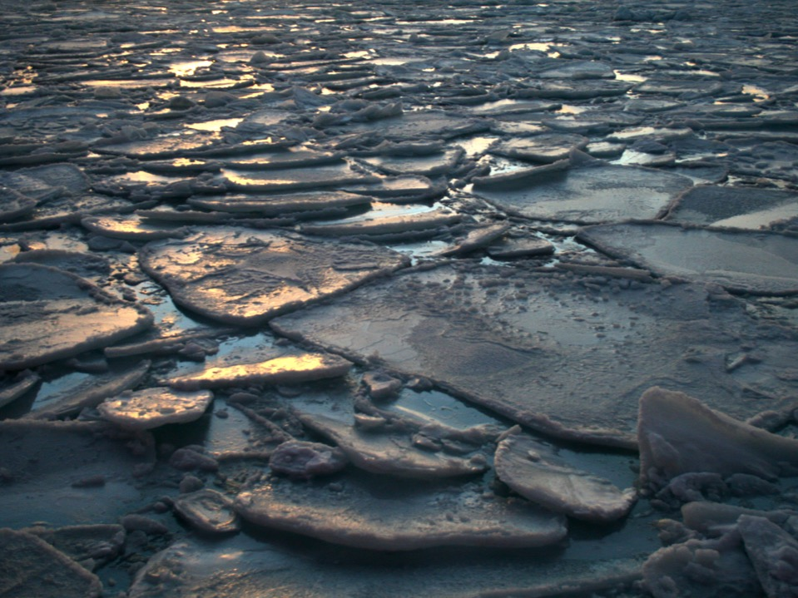

The Loss of Multi-Year Sea Ice

Slide 5
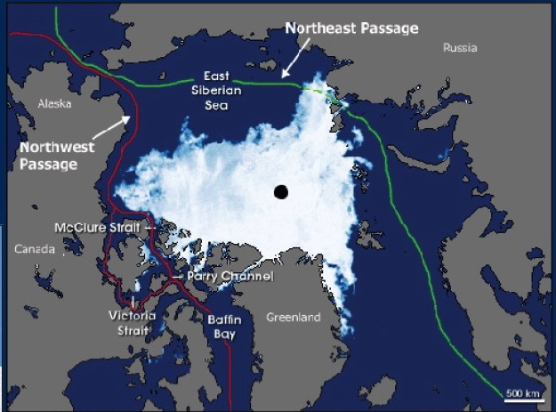
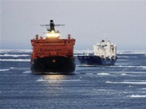


Slide 6
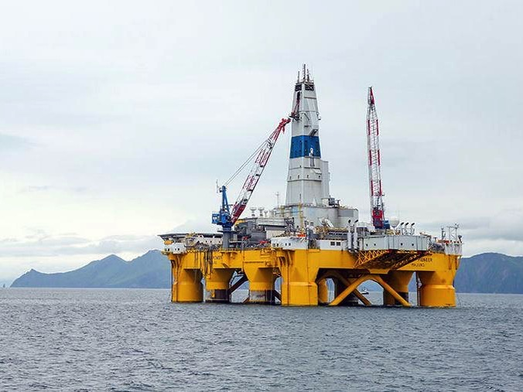


Slide 7
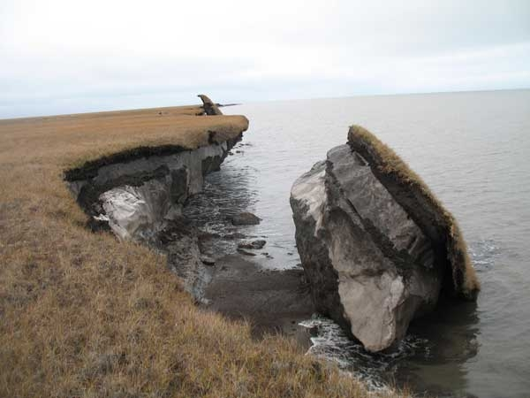


Slide 8

Ocean Acidification
Bering Sea
OA Indicator
(Aragonite Saturation State)
Beaufort Sea
Chukchi Sea
Average

Slide 9
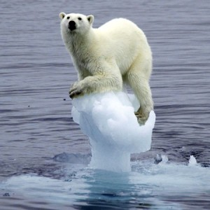


Slide 10
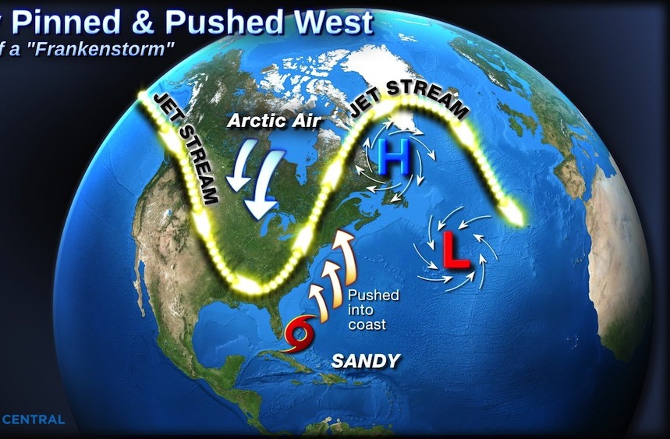
Arctic-Mid Latitude Linkages

Slide 11
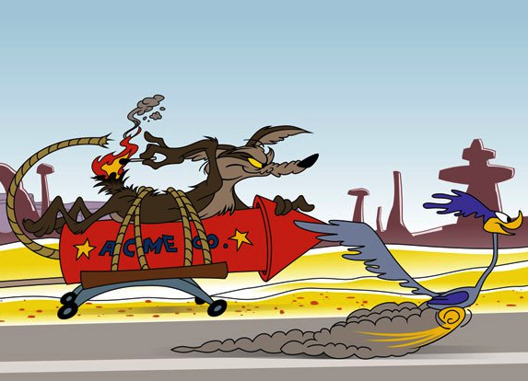
Our Current Monitoring Strategy for the Arctic
Notes:
We’ve tied ourselves to old technology and methods with a strategy that’s not going to catch something that is always going to be moving faster than we are. We can keep lighting our tails on fire, but it’s not going to accomplish our objective.

Slide 12
Sustained Arctic Observing Network
Environmental Intelligence Cycle
1
Collection
5
2
Application
Transmission
4
3
Analysis
Corroboration

Slide 13
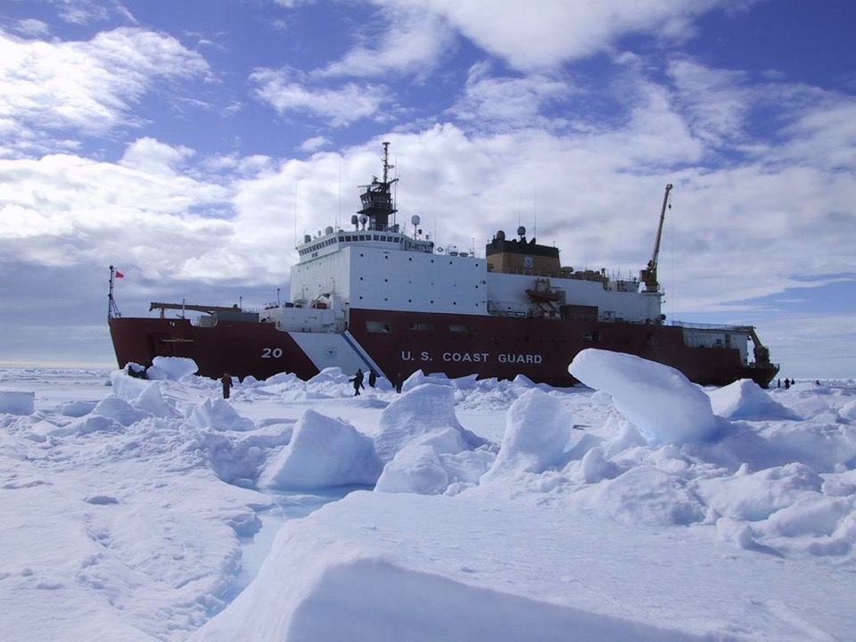

Slide 14
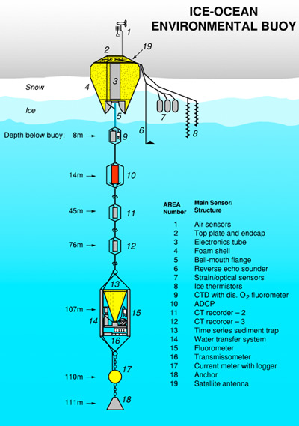
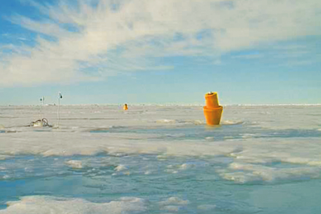

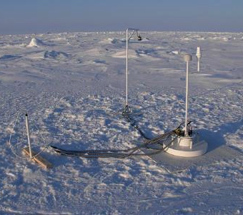


Slide 15
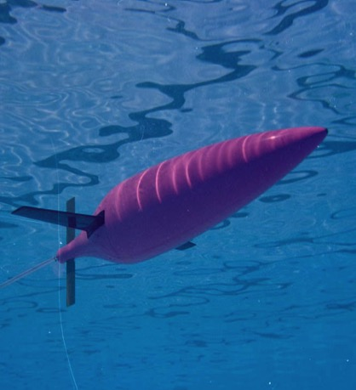
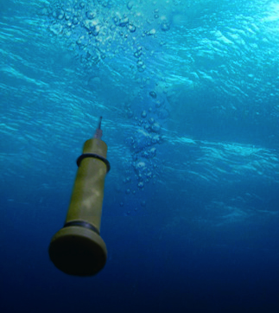
Underwater Profilers

Slide 16
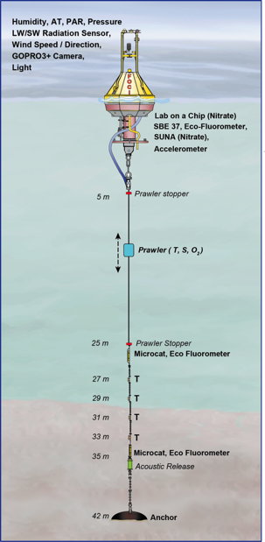
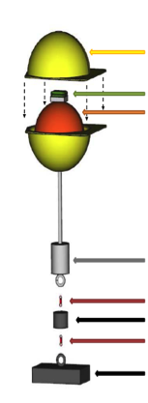
New Mooring Configurations
#1
#2
#3
Prototype
Hard Hat
Satellite Tag
Trawl Float
Counter-Weight
Release #2
Weight
Release #1
Anchor

Slide 17
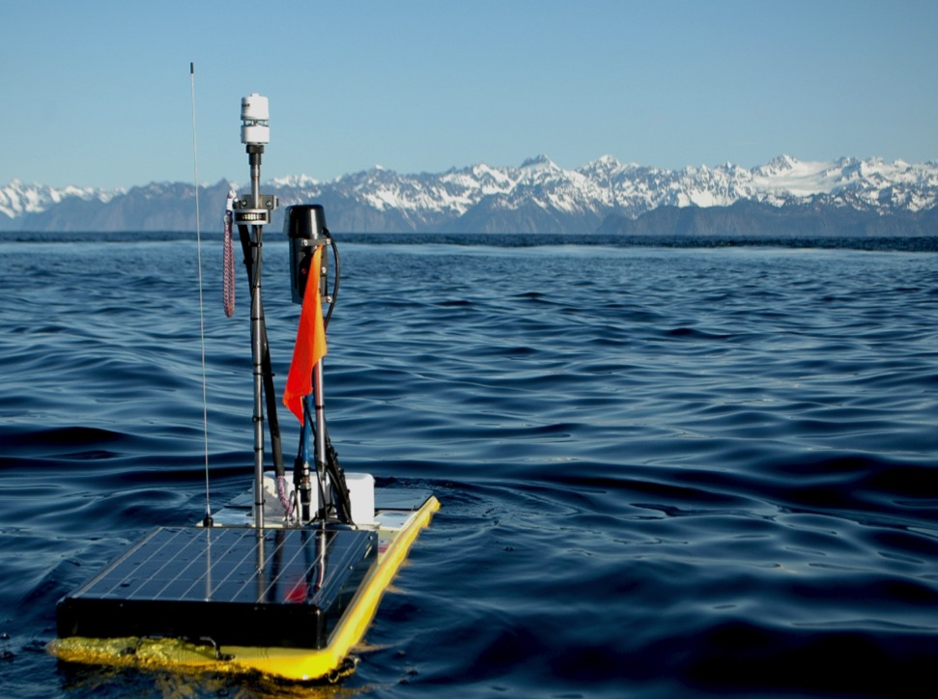
The Wave Glider

Slide 18
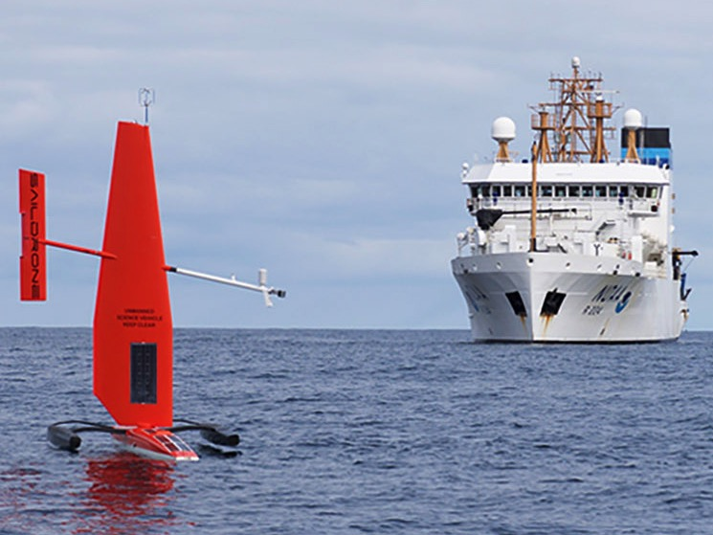
The Sail Drone

Slide 19
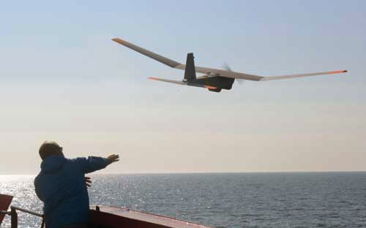
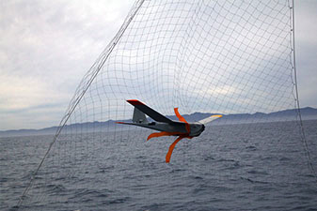
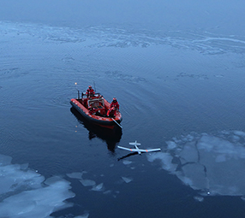
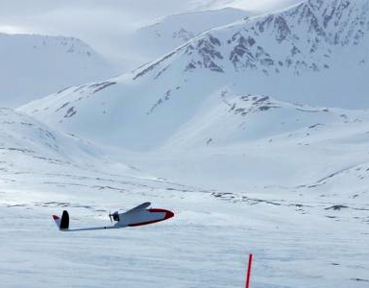


Slide 20
