Slide 1
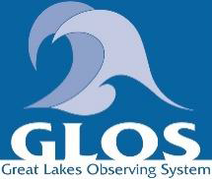
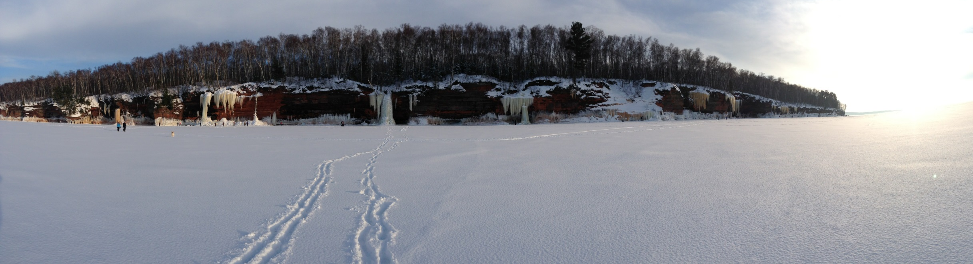
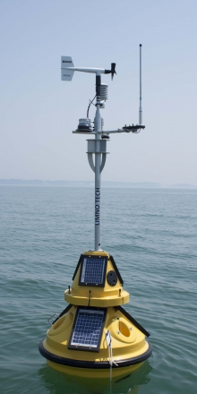
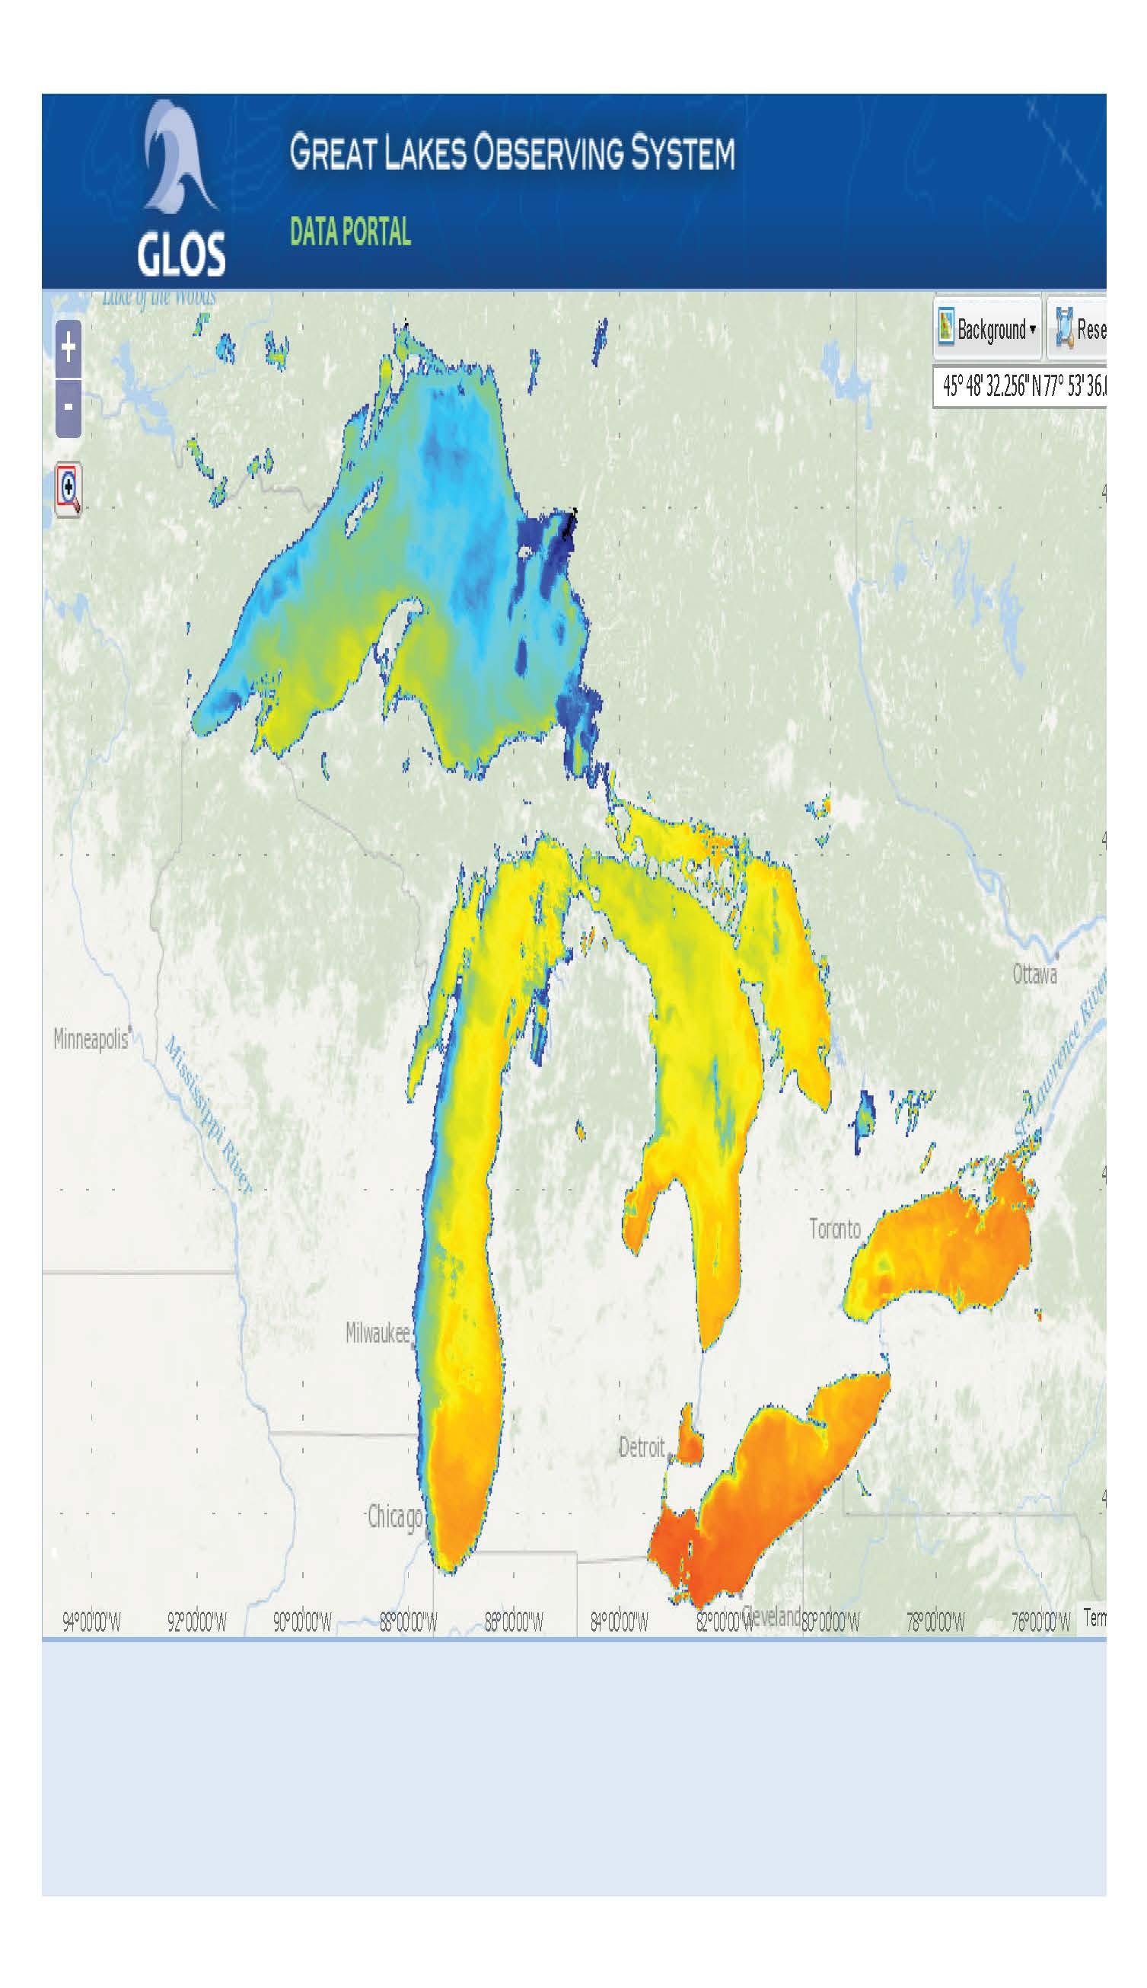
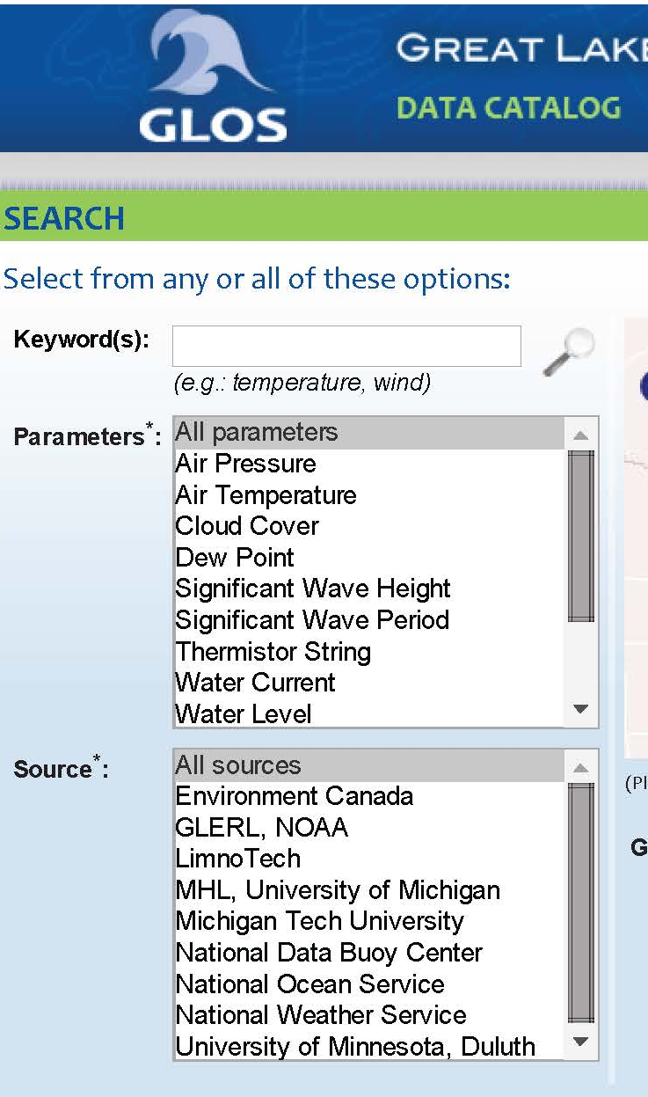
U.S. IOOS Update
GREAT LAKES OBSERVING SYSTEM - Annual General Meeting
Zdenka Willis
IOOS Program Director
October 7, 2015

Slide 2
Congratulations!
Thank you for these successes in 2014-15
GLOS continues to build observing capacity in the Great Lakes
  New observing assets leveraging NOAA Coastal Storm Program funds
Expanding data management capacity
  Implementation of Data Management Mini Grants
HAB Information Portal
Certification Application
  Received September 25
  Currently under review
Once an IOOSian . . .
  Kelli Paige successfully transitions to Executive Director
  New staff Andrea Maguire and Kristin Schrader
Notes:
New observing assets in place – leveraging Coastal Storms Program funds:
“A coastal hazard observing system for Southeastern Lake Superior” - Norma Froelich, Northern Michigan University
“Real-time data gathering buoy in the Illinois waters of Lake Michigan” - Tomas Hook, Purdue University
GLOS held a data management mini grants competition. The purpose is to support the development and enhancement of data management programs across the Great Lakes region, with the goal of increasing and improving access to data for a wide range of data users and stakeholders. Funded projects include:
“A Harmful Algal Bloom and Water Quality Data Management Program for Western Lake Erie”
Thomas Bridgeman, University of Toledo
“An Open Standards Data and Metadata Pipeline for the Natural Resources Research Institute Great Lakes Data”
Terry N. Brown, University of Minnesota, Duluth
“Aiding management and advancing Great Lakes ecology: Combining 50+ years of data with the 2013 Lake Ontario Cooperative Science and Monitoring Initiative”
Lars Rudstam, Cornell University
“Building a Great Lakes Adaptation Data Suite (GLADS) for Informed Decision Making in the Great Lakes Region”
David Schwab and Catherine Riseng, University of Michigan
Certification – we received the GLOS application on September 25. We are currently reviewing the material. Approval would make GLOS the second certified RICE
In addition to Kelli taking over as Executive Director, GLOS hired two new staff; Andrea Maguire – Program Coordinator; Kristin Schrader – Communications Manager

Slide 3
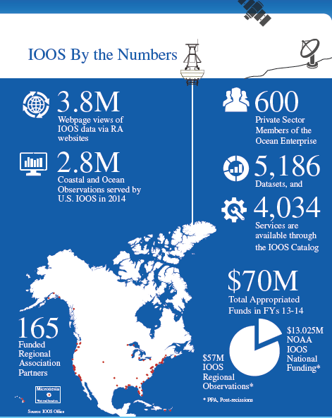
IOOS By the Numbers
Notes:
It is always hard to characterize IOOS, so I have three slides that try to capture what is IOOS.
This talks about IOOS in terms who, and how much data is passed through the system.
In talking about IOOS – people say wow there are a lot of logos and that is part of what IOOS really is – we are like the conductor of the orchestra that brings all of the individaul pieces together to be the symphony.

Slide 4
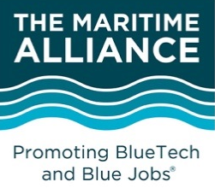
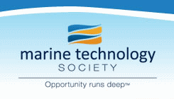
National Ocean Council
(NOC)
Key:
Direct Relationship
Advisory
Coordination
Global Earth Observation System of Systems
(GEOSS)
Subcommittee on Ocean Science & Technology (SOST)
U.S. IOOS Enterprise
Global Ocean Observing System (GOOS)
Interagency Ocean Observation Committee (IOOC)
IOOS Advisory Committee
NOAA
Federal Agencies
US IOOS Program Office
(within NOAA)
IOOS
Association
http://www.ioos.noaa.gov/about/governance/summit2012/ioos_summit_report.html
Alliance for Coastal Technologies (ACT)
IOOS Coastal and Ocean Modeling Testbed (COMT)
11 Regional Associations (RAs)
Notes:
The graphic was developed with our Interagency Ocean Observation Committee in 2012.
The point of this graphic is important to convey how IOOS participates in a larger context. Yes it is complex but that is what the IOOS Program Office works hard at. US IOOS is a national endeavor and spans from global to coastal.
Stakeholder Engagement:
Federal Agencies: Interagency Ocean Observation Committee: NASA, NSF and NOAA are 3 co-chairs and additionally the IOOS office holds the NOAA representative seat at the table.
Non-Federal: Constant contact with:
Regional Associations - each has a board and stakeholder council
IOOS Association (coordinates nationally and advocates)
Industry - through societies like Marine Technology Society and Alliance for Earth Observations
Participation with Regional Ocean Governance bodies like MARCO, NROC, and WGA
Congressional: Biennial briefings on ICOOS Act implementation
Globally: Through Inter-governmental Oceanographic Commission – GOOS program
GEO and GEOSS with many other international linkages
S&T tech transfer best practices and common standards
Also that while what you do in the Region transcends into the international landscape
It represents an overview of where our office fits organizationally within the IOOS enterprise.
I say “within” the enterprise but we often have to pay very close attention to our language, such as saying an agency “contributes” versus is “part of”.
I’ve highlighted 4 key boxes, three of which have identified leadership responsibilities in the ICOOS Act. The IOOS Association is NOT part of the ICOOS Act, but has been invaluable to us in bringing the 11 regions together in a cohesive network and they have the ability to advocate for IOOS in a way a Federal office cannot.
TMA and MTS are trade associations we also work with extensively. We are closely aligned with them and frequently coordinate with them on IOOS related communications, conferences, and technical issues.

Slide 5
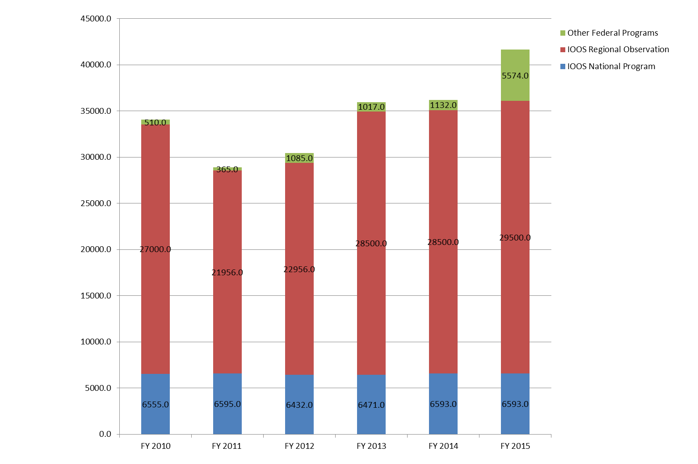
U.S. IOOS®: Program Office
IOOS Office Primary Roles:
Provide Programmatic Leadership
Foster Operational Capability
Forge Robust Partnerships
Champion Regional and Stakeholder Interests
IOOS Budget History: FY 2010 - 2015
$ in Thousands
Notes:
NOAA’s role in US IOOS brings added value to the National effort through our ability to actively leverage both our national investment and our stakeholder interest.
The five primary roles we have are listed there and I’ll describe what we mean by each
Provide Programmatic Leadership: Build the structure and support necessary to advance implementation and recognition of U.S. IOOS, including participation in the Federal budget process to secure additional resources.
Foster Operational Capability: Lead and coordinate Federal and non-Federal contributions to U.S. IOOS
Forge Robust Partnerships: Initiate and sustain relationships for participation in IOOS by Federal agencies, non-Federal groups and industry
Champion Regional and Stakeholder Interests: Connect Regional products and services to national needs, and connect Federal groups to Regional entities

Slide 6
Staffing and Leadership Update
IOOS Office Changes: New faces and roles
Carl Gouldman: Deputy Director - June 2014
George Jungbluth: Regions Budget & Planning Division Chief - November 2014
Derrick Snowden: Operations and Communications Division Chief - January 2015
Kathy Bailey: Oceanographer – March 2015
Dr. Jennifer Bosch: Oceanographer – June 2015
Kate Culpepper: Communications Specialist – August 2015
LCDR Eric Johnson: NOAA Corps Officer – August 2015

Slide 7

Forward Look FY2016
IOOS Program Office Over-Arching Priorities
  DMAC and Modeling Progress
  Marine Sensor Innovation
  Marine Biodiversity Observation Network (BON)
  Ocean Enterprise Study
  IOOS Advisory Committee
  Certification
  FY16 Federal Funding Opportunity
  Interagency Ocean Observation Committee
  Communicating IOOS successes to Agency Leaders and on the Hill
Notes:
Data Management and Communications (DMAC) is the foundation of IOOS. Easy access to data in a single location is still the number one request our office receives. The results of the DMAC system integration test will guide our next steps.
NOS published its Roadmap in May 2014. The US IOOS Office’s national input will be through DMAC and connection of the IOOS Regional activity to the NOS, NOAA’s Ecological Forecasting and Storm Surge Roadmaps and NOAA’s Unmanned Systems (UxS) working group. In additional to those offices we share a budget line with, we will maintain our strong partnership with the National Data Buoy Center, Ocean Acidification Program, and Coastal Storms Program.
We will push for the inclusion of High Frequency Radar (HFR) data into more NOAA models and systems and support the Glider and the prototype Animal Telemetry Network Data Assembly Centers (DAC).
The US IOOS Office’s national input will be through DMAC and connection of the IOOS Regional activity to the NOS, NOAA’s Ecological Forecasting and Storm Surge Roadmaps and NOAA’s Unmanned Systems (UxS) working group. In additional to those offices we share a budget line with, we will maintain our strong partnership with the National Data Buoy Center, Ocean Acidification Program, and Coastal Storms Program.

Slide 8
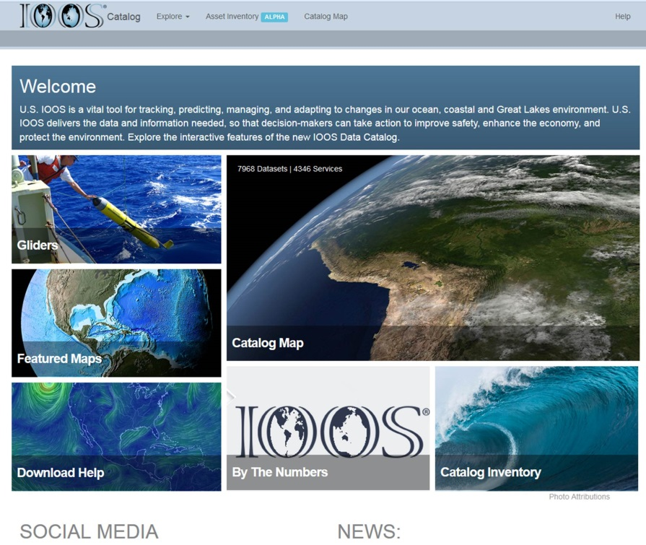
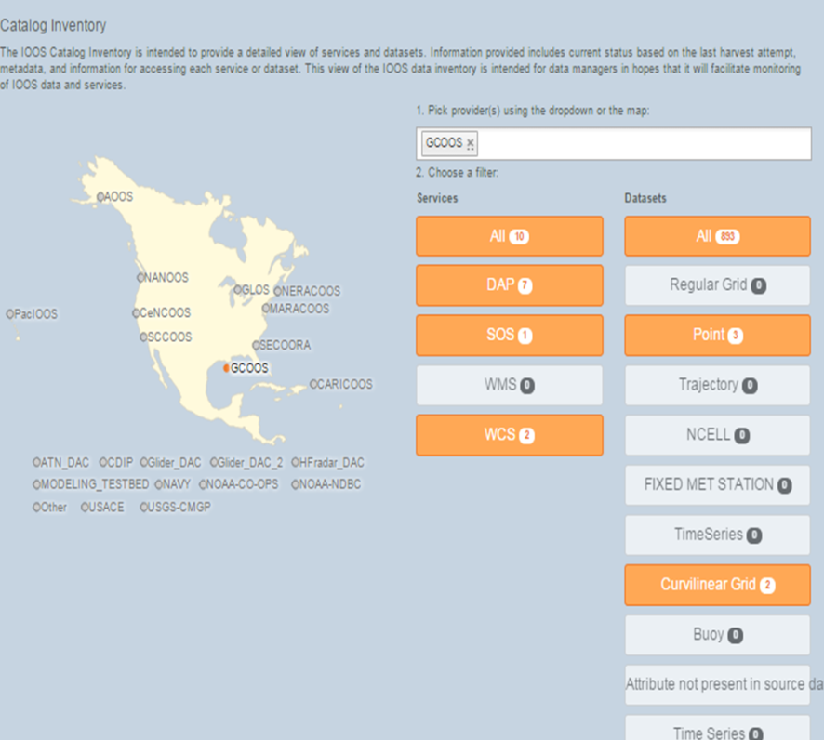
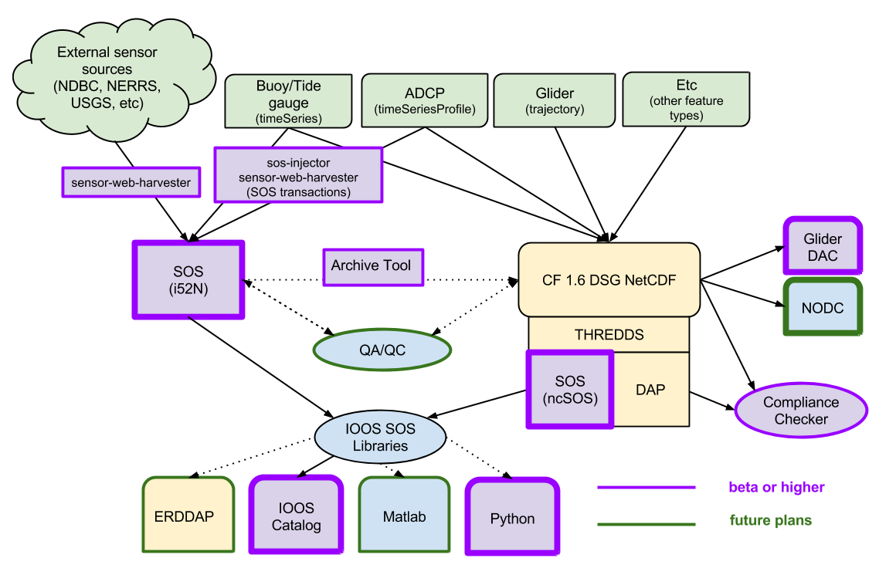
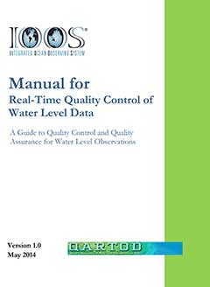
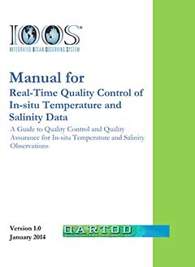
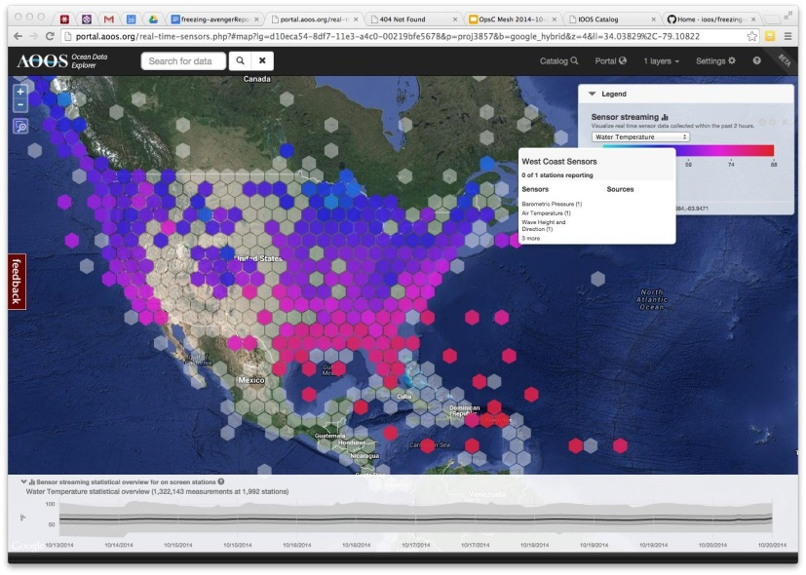
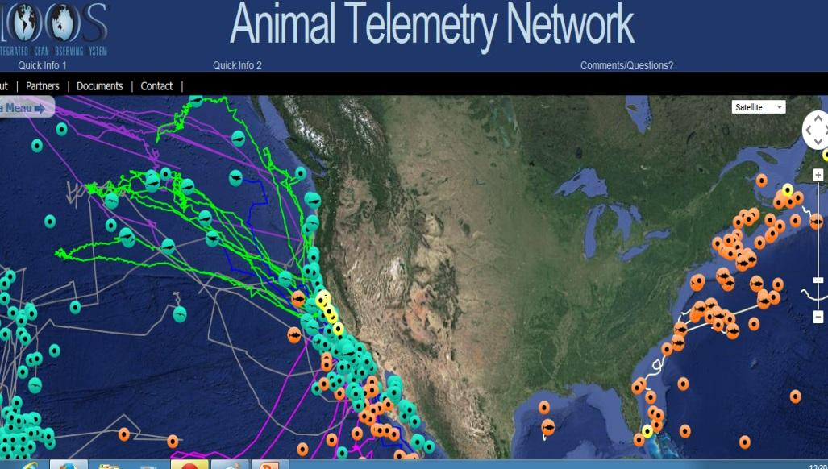
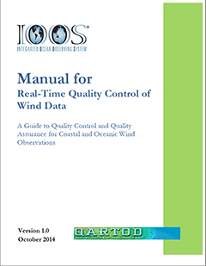
DMAC – Keep on Moving
Notes:
Upper left: working with each of the regions to standardize the data access and dissemination. All are providing data in with the same recipe and in 2015 we improved the recipe and we all changed to the new one together in short order
Image Upper Center and Upper Right: First comprehensive catalog of regional/Fed data available via services. Why: Demonstrate the scope of data integration efforts; test concepts to be implemented in the distributed system; serve as a program mgmt tool. Outcomes: Recognized evidence of what sets IOOS apart.
Imager lower left: QARTOD effort, being used nationally and internationally.
Image Lower center – broker testing
What: Rolling cache of federal backbone datasets; initial analysis tools; brokering SOS service
Why: Determine the performance tradeoffs between an entirely distributed vs centralized system; broker federal sources which do not implement DMAC standards.
Who: Axiom Data Science LLC
Outcomes: “All” Federal sensor observations visible and available in one place.
Imager lower right :ATN: Who: IOOS PO, NOAA, NAVY, Stanford Univ., UCSC, CenCOOS and other RAs.
Outcome: DAC ready to ingest new ATN data from different regions around the nation, including a variety of different species and tag types.
Brokering Test:

Slide 9
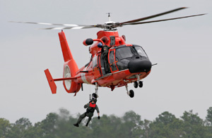
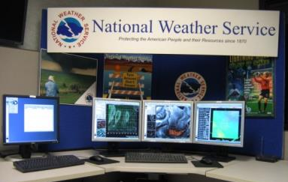
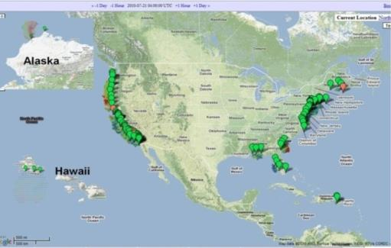
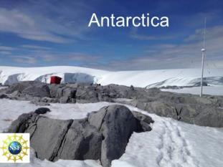
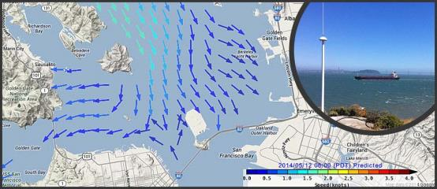
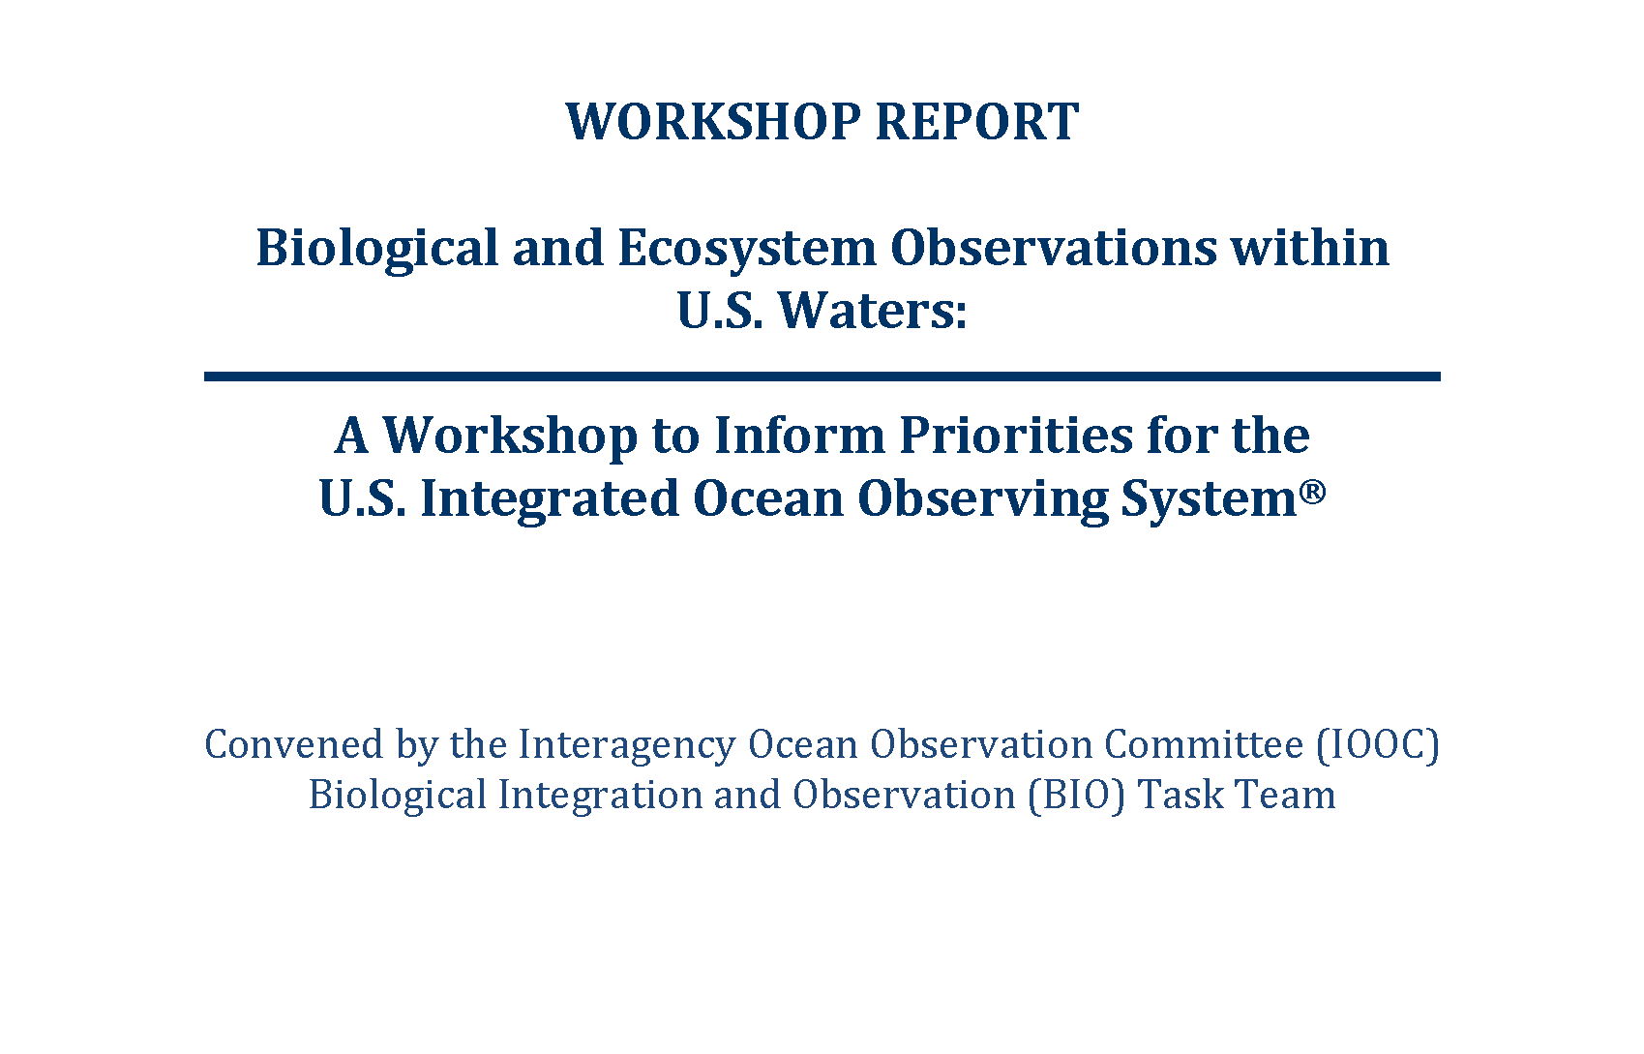
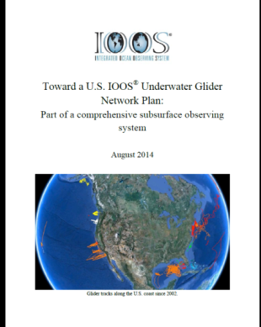
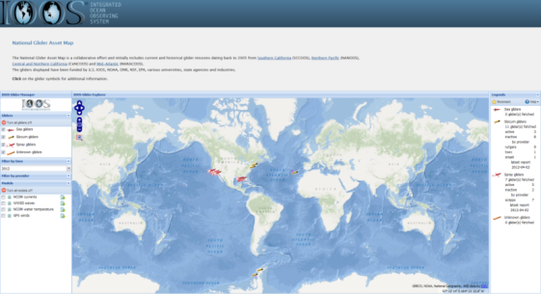
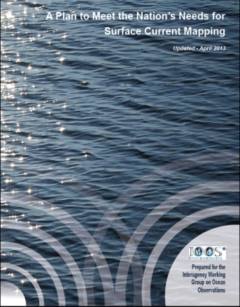
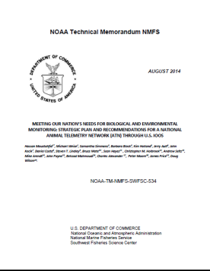
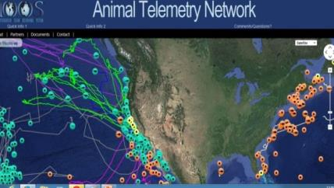
IOOS: Advancing Communities
Biological Variables
& BIO TT
HF Radar:
Gliders:
Wave Measurements:
Animal Telemetry:
Notes:
Another niche we’ve created is in the area of “communities of practice”. In each of these examples we are actively engaged in projects to improve a communities ability to deliver information for societal benefit.
Here are five areas we have endeavored to bring the community together. This is not to indicate that other observing platforms such as buoys and guage
High Frequency Radar:
130 radars run by academic institutions, Program Office manages on the data management
Create a national network from individual operators
Data into PORTS® and NWS data tanks (AWIPS).
Expanded radars to Antarctica
Gliders:
Common Operating Standards
White Paper Towards a National Glider Network published in August 2014
Glider Data Assembly Center capability
Starting a Task Team under the IOOC
ATN:
This is in early stages for US IOOS. Within the United States the tagging efforts are in response to scientific research as Regional basis and much of it being done in our academic community. There is not a national tagging program within the United States.
The US IOOS is supporting the coordination of data coming from the community of taggers. Current focus is on data management and building an ATN Data Assembly Center (in collaboration with US NAVY , NOAA and TOPP program). The DAC will have the capability to integrate most Animal Telemetry Technology (Acoustic, Archival and Satellite tags).
Waves – National Plan with NOAA, IOOS and USACE. IOOS Regions have increased the number of data well buoys in particular in Caribbean and Insular Pacific. USACE fund the data management central system and is a contribution to IOOS.
Biological Integration and Observation (BIO) Task Team BIO TT–National Plan with NOAA, IOOS and USACE. IOOS Regions have increased the number of data well buoys in particular in Caribbean and Insular Pacific. USACE fund the data management central system and is a contribution to IOOS.

Slide 10

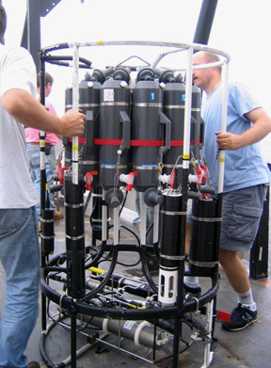
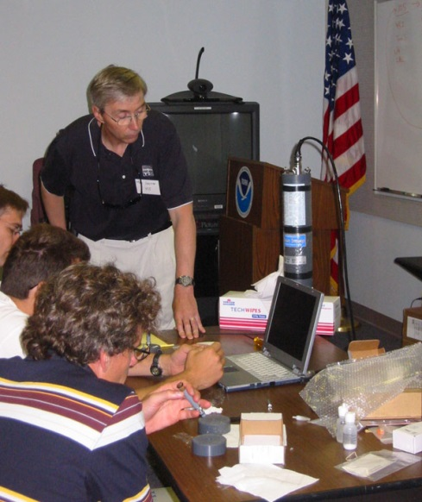
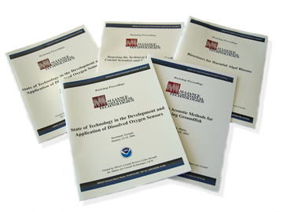
Alliance for Coastal Technologies
(FY2015/2016)
ACT Services
A third-party testbed for evaluating technologies
  PH Sensors (2013/2014) – 7
  DO Sensors II (2014/2015) – 10
A forum for capacity and consensus building
An information clearinghouse for environmental technologies

Slide 11
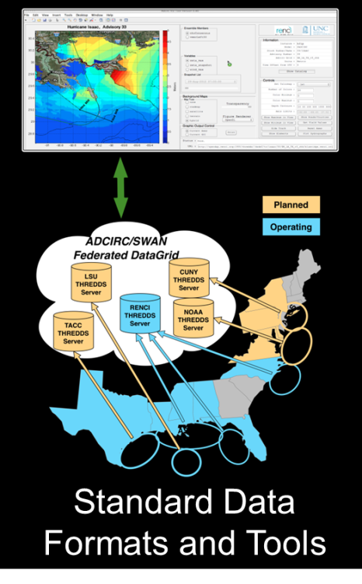
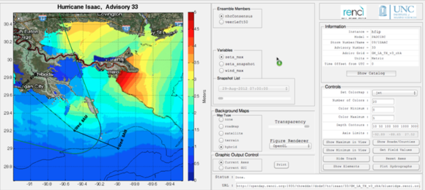
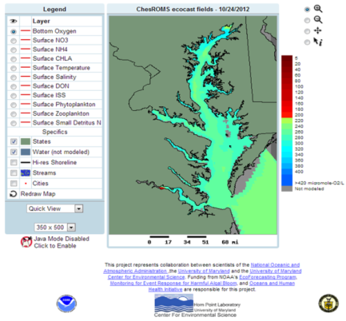
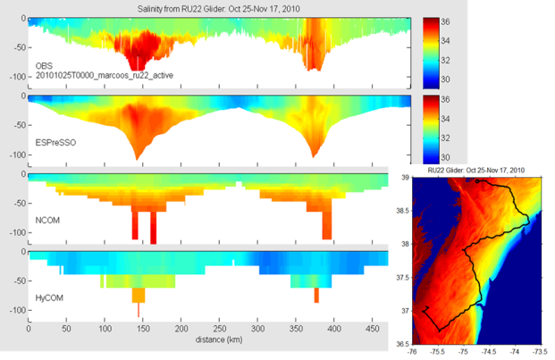
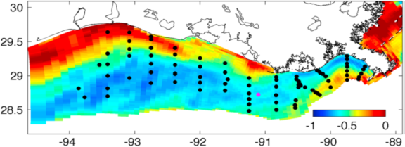
US IOOS Coastal & Ocean Modeling Testbed
Venue to facilitate testing and transitions into operations.
Improving ties to different NOAA and partner Agency modeling efforts.
5 projects; Hypoxia in Chesapeake Bay and Gulf of Mexico, Inundation in PR/USVI, West Coast Operational Forecast System, CI tools for comparing models/data
Notes:
To use applied research and development to accelerate the transition of scientific and technical advances from the coastal ocean modeling research community to improved operational ocean products and services (i.e. via research to operations and also operations to research).

Slide 12
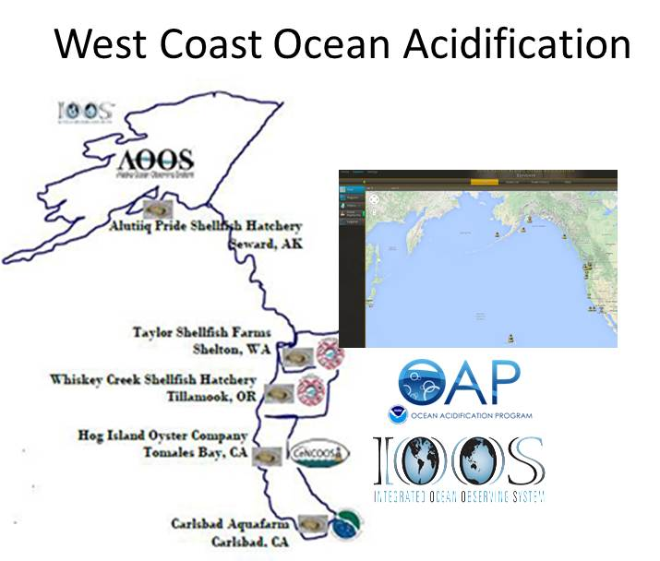
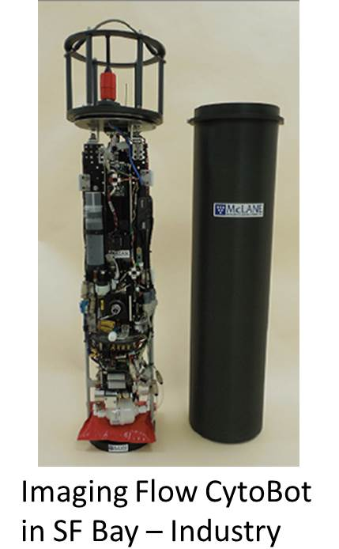
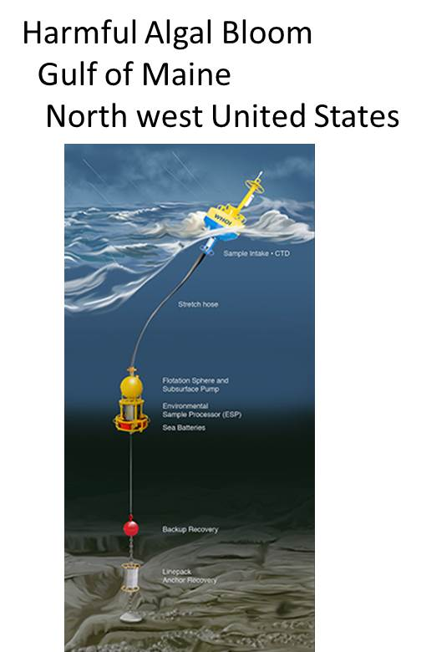
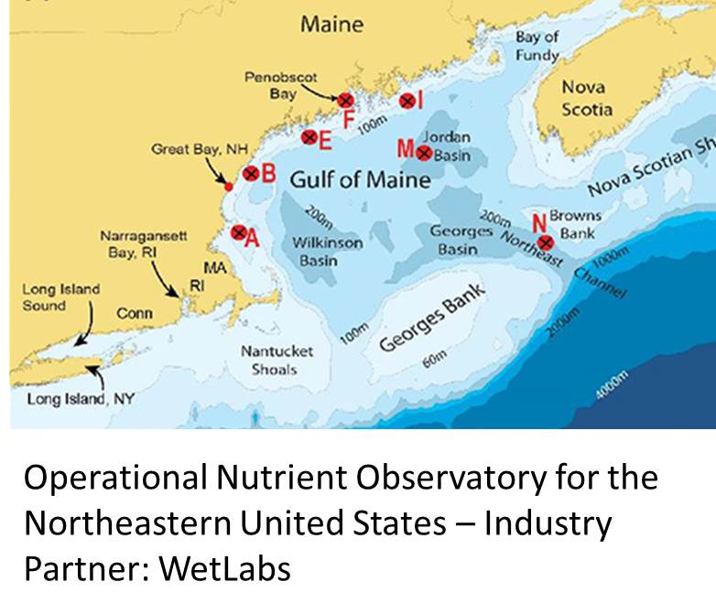
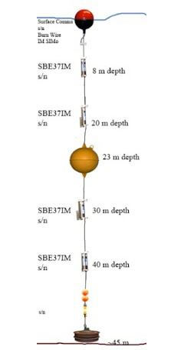
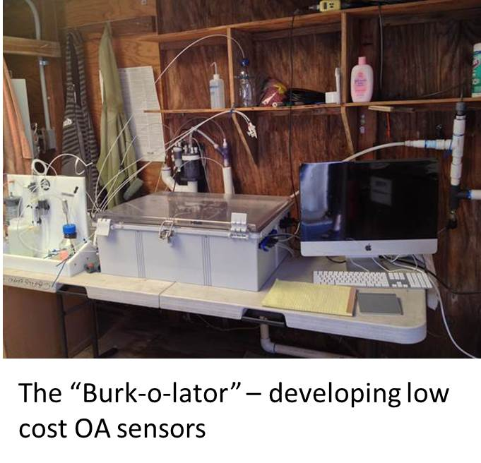
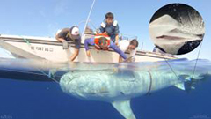
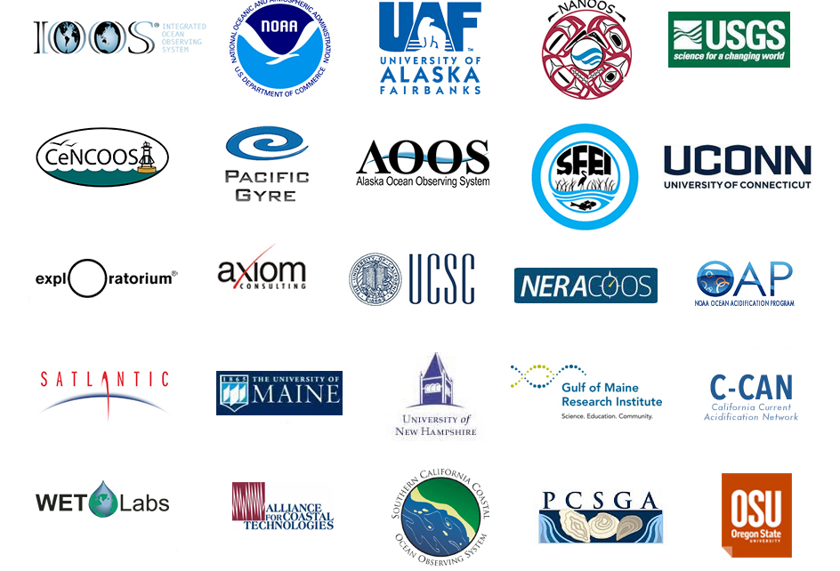
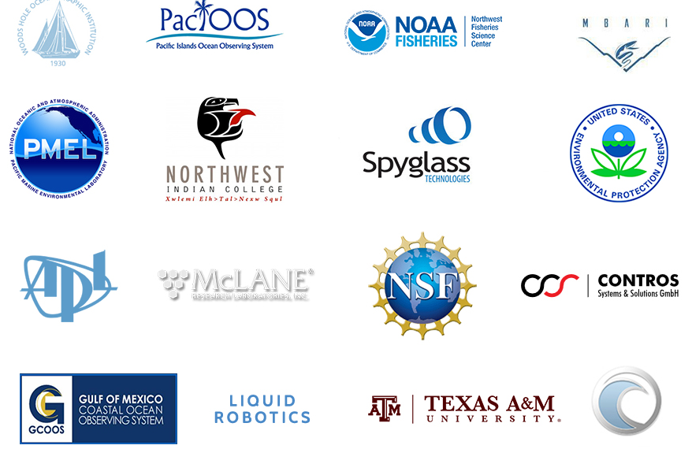
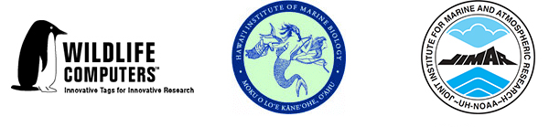
Ocean Technology Transition
Fostering the transition of advanced observing technologies to operations mode.
Detecting
Arctic Freeze Up
Real-Time
Notes:
The Ocean Technology Transition project sponsors the transition of emerging marine observing technologies, for which there is an existing operational requirement and a demonstrated commitment to integration and use by the ocean observing community, to operational mode. Operational mode is defined as the actual application of the technology in its final form and under mission operations. Ocean Technology Transition is envisioned as a multi-year effort that transitions marine observing technologies to operations in a stepped, parallel, and scalable process that includes stakeholder engagement from industry, government, academia and others invested in the monitoring and assessment of the nation’s ocean and coastal regions.
This part of IOOS specifically calls out industry. How can we leverage your R&D goals to bring these systems to market?

Slide 13
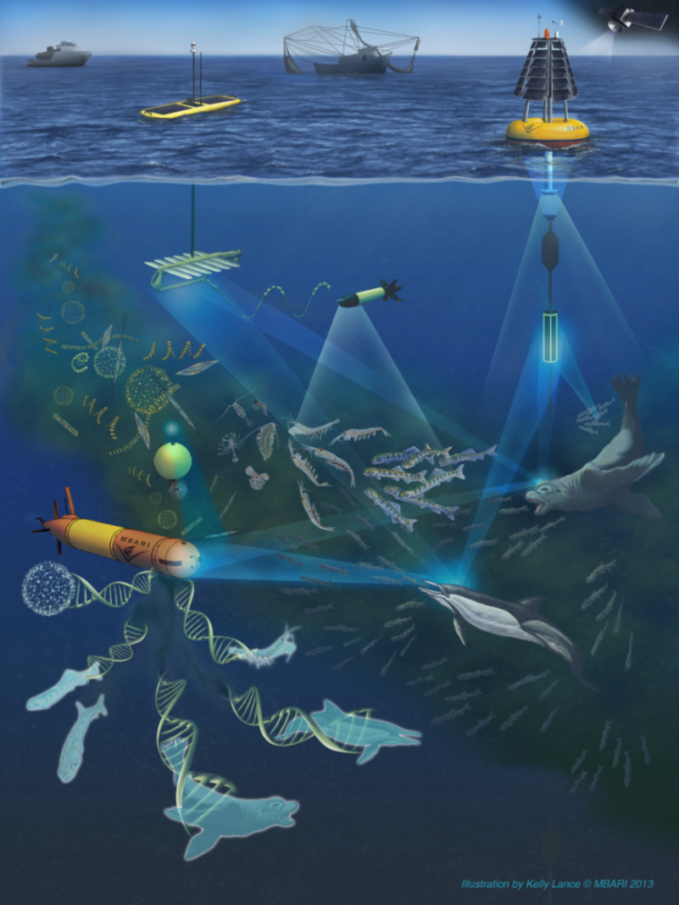
Marine Biodiversity
U.S. launched 3 Marine Biodiversity Observation Network projects to show marine and coastal data could be integrated into the system
U.S. contribution to GEO BON is focused in in four regional geographies: the Florida Keys, Monterey Bay, Channel Islands, and the U.S. Chukchi Sea continental shelf.
http://www.ioos.noaa.gov/biodiversity/welcome.html
Credit: MBARI
GEO BON - Group on Earth Observations Biodiversity Observation Network
Notes:
IOOS is also contributing to advancing understanding of marine biodiversity. Gabrielle is in our office but wears the NOAA hat in the interagency working groups. This is a wonderful example of persistence paying off from an initial workshop to now where we have 5 year awards in place with other agency funds, strong NASA money, good BOEM money, weak NOAA $s. Also very cool is inclusion of industry funding – shell money is being transferred to NOAA for the projects in the Arctic.

Slide 14

Competitive Awards & Certification
Next Five Year Funding Cycle
5-Year Funding Opportunity Published February 2015
Proposal Deadline August 31, 2015
Merit panel review - November 2015
Decisions - January/February 2016
Certification
Open for Certification - July 2014
PacIOOS approved – August 2015

Slide 15
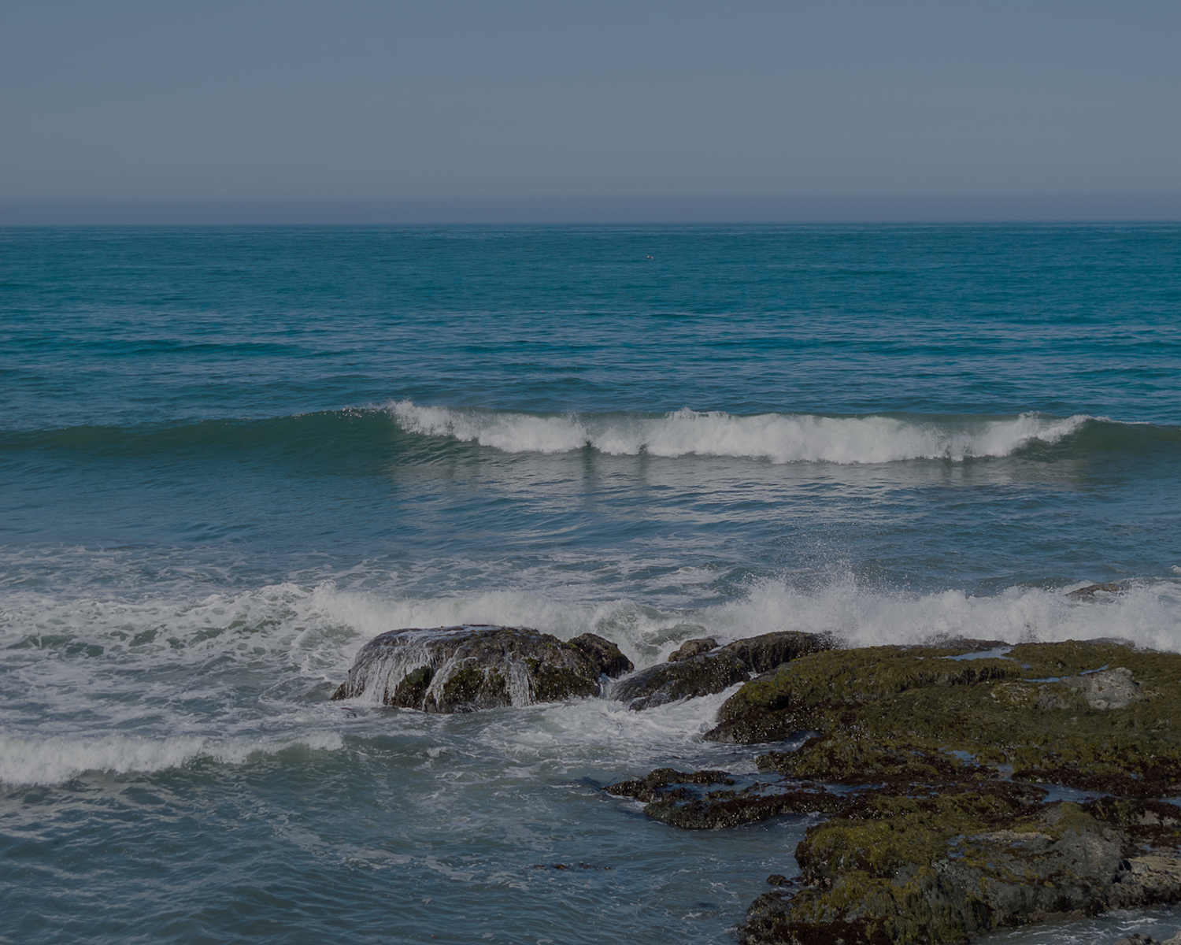
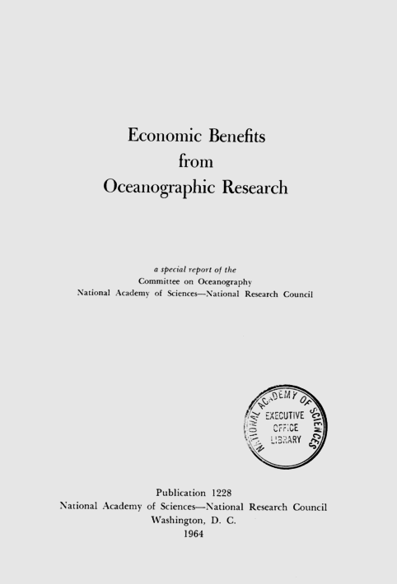

1964
Oceans as non-finite
Extractive
Exploitative
“A 50 percent improvement in the accuracy of long-range weather forecasting might well produce savings of $2 billion per year.”
Notes:
Message: Fifty years ago – 1964, this is how some smart people were thinking about the critical issue of the economic benefits of the ocean:
Ocean as non-finite (list of ‘products’)
Extractive (NAS)
Exploitative - We were trying to think of ways to faster, more efficient ways to treat sewage being dumped into the ocean. They got this right!
No Clean Water Act
No Clean Air Act
No Stratton Commission
No NOAA
Segue: What’s changed in the last 50 years?

Slide 16
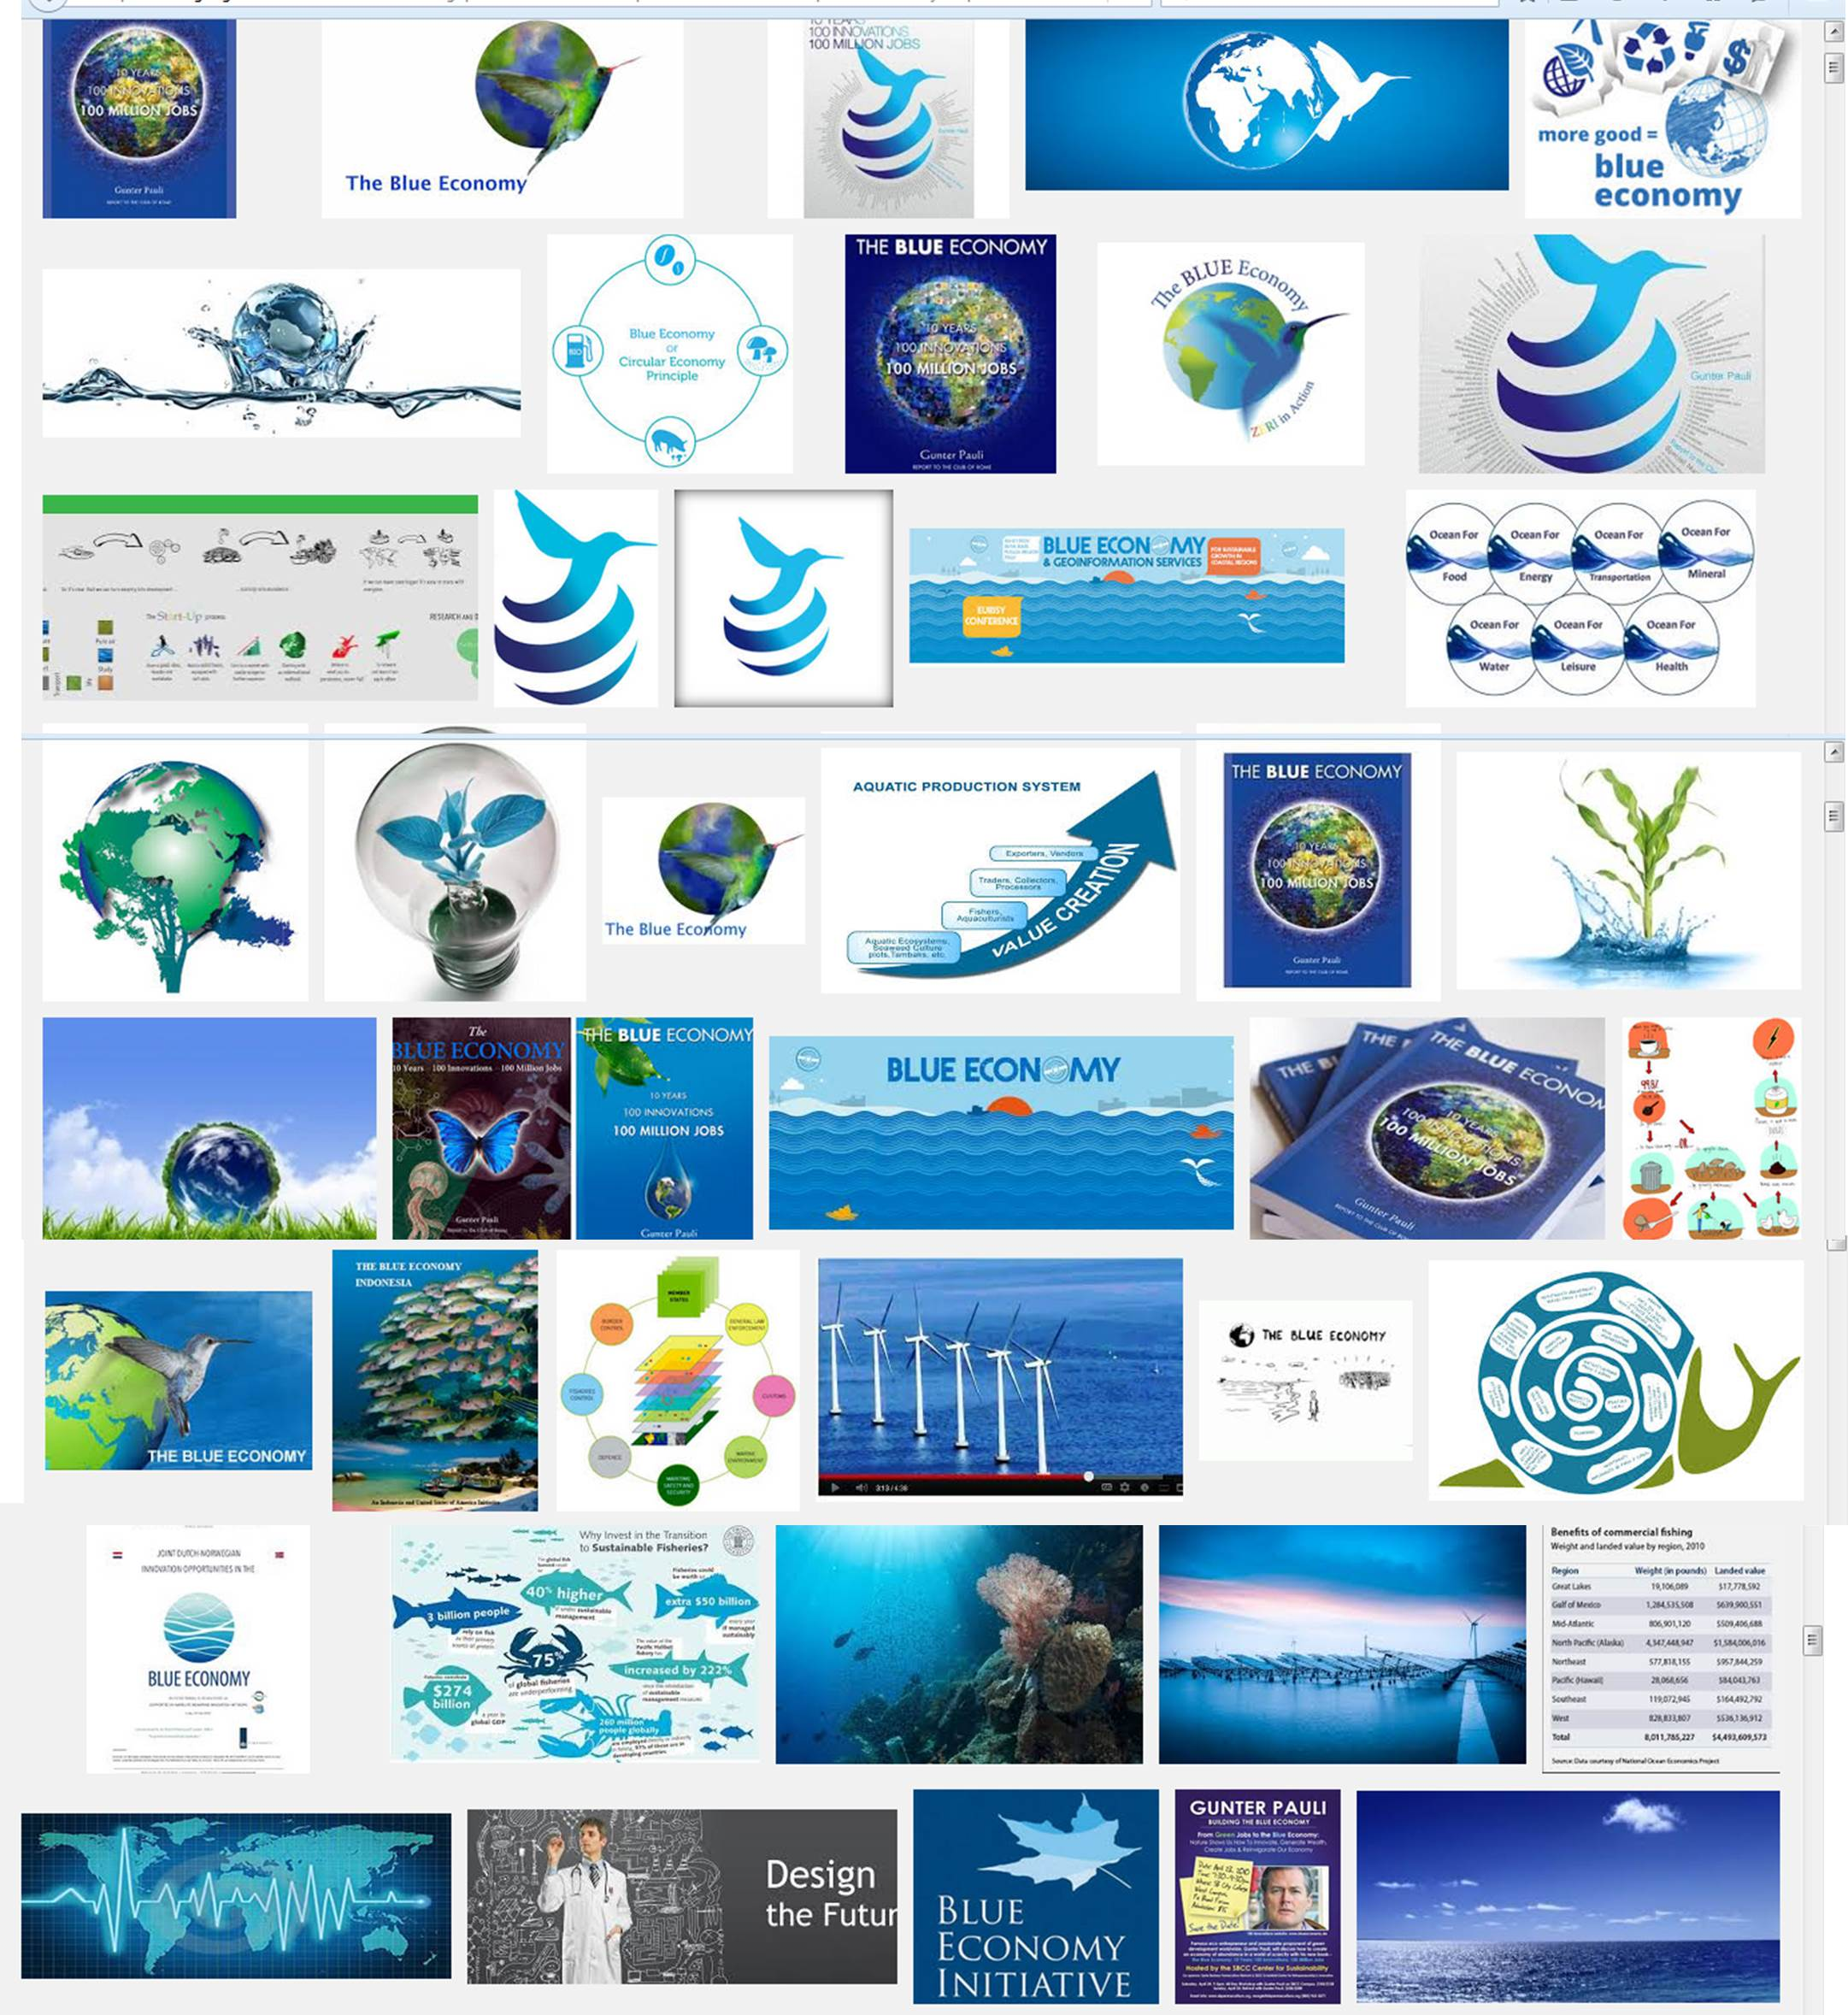

TODAY
Notes:
The 2012 NAS report how focuses our attention on ECOSYSTEM SERVICES and CHARTING A PATH TO SUSTAINABILITY.
Content: Natural environments provide enormously valuable, but largely unappreciated, services that aid humans and other earthlings. It is becoming clear that these life-support systems are faltering and failing worldwide due to human actions that disrupt nature's ability to do its beneficial work.
Conversation has shifted:
Ocean as no longer thought of as a non-finite resource.
Ocean as finite
Sustainability
Ecosystem services
Ocean health
The Millennium Ecosystem Assessment directed our focus to sustainability of ecosystems services.
Overfishing is recognized as the biggest threat to marine fisheries.
We don’t want to increase the capacity of the ocean to take up waste.
Rather, we talk about the ocean as a shared resource we need to manage regionally, nationally, and worldwide for ocean health (e.g. NOP, Ocean Health Index).
The other big discussion is the BLUE Economy: No internationally agreed definition
Different terms used interchangeably or to mean different things: blue economy, blue growth, blue-green economy, ocean economy, etc.
Common theme: importance of ocean/coastal ecosystems and resources to our economies
EC - The 'blue' economy represents roughly 5.4 million jobs and generates a gross added value of almost €500 billion a year. However, further growth is possible in a number of areas which are highlighted within the strategy.
So our challenge is how do we position the observing technologies and services so we are part of the Blue Economy in a meaningful way and be a part of sustainably developing the New Blue Economy.
Segue: So what does the Ocean Enterprise look like and how can we measure it, we took a lesson from the weather enterprise.

Slide 17
The Ocean Enterprise
Public, Private, Non-Profit, Research, Academia
Information, Services, Infrastructure
ISSUES: Oceans – Ecosystems – Climate
Notes:
Message: Is there an Ocean Enterprise? Yes. This flow chart shows you how we are thinking about it.
We can set up the same structure – the issues are slightly different.
We also have Public, private, non-profit, research and academia, who provide information, services and infrastructure BUT to Oceans, Ecosystems and Climate
Segue (go to next slide)- but unlike the short hand for the Weather Enterprise – we have NOT articulated the value of the private Ocean industry.

Slide 18

Ocean Enterprise Study
Phase I – completed Nov 2014
  >550 private sector firms
  Most companies < 10 employees
  83% providers;
  9% intermediaries
Phase 2
  Expand/Refined list of companies identified in Phase 1
  Conduct survey
Analyzed results (27 May - 17 August)
Publish final report – 15 October
Sponsored by NOAA and US IOOS
Notes:
http://www.ioos.noaa.gov/ioos_in_action/ocean_enterprise_study.html

Slide 19




Voices – collective is better
The Marine & Oceanographic
Technology Network
IOOS Federal Advisory Group
Notes:
There are many voices out there but are we using the groups that exits in a strategic way to carry the message.
Ocean Observing, everybody, everyday.
We have societies and associations like MTS, COL and IOOS Association
Industry Clusters – bringing their efforts together
The Advisory Committee
On the Hill a coordinated message resonates much more powerfully than many voices. By the end of the day the aides get confused. Working together we can make an impact

Slide 20

Continue the Discussion
  Ignite
  TownHall
Promoting Sustainable Usage of the Oceans—Security, Collaboration and Development Monday, October 19, 2015/ SAIS – Washington DC
Ocean Enterprise Study Results Released
IOOS Re-Branded – Roll Out at MTS 2015

Slide 21



A Clear View of Tomorrow
Eyes on the Ocean
US IOOS enables decision making
underpins scientific advances
www.noaa.ioos.gov
https://www.facebook.com/usioosgov
@usioosgov
Notes:
I hope during this talk you will agree the IOOS works and my sincere congratulations to CaRA on a job well done and being part of this national success

