Slide 1
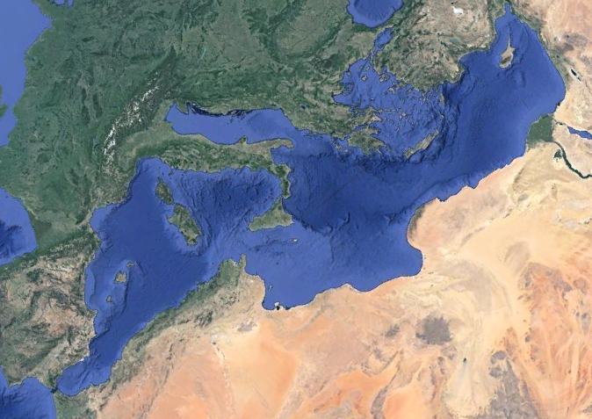
What We are Talking About
Normal: stratified, top and bottom separate
Overturned: top and bottom mixed
Oil
Vinegar
The Mediterranean

Slide 2
The Tool for this is a Biogeochemical Float
Notes:
Basic ARGO float (CTD) plus oxygen, chlorophyl, backscatter, dissolved organic matter, nitrate, pH

Slide 3
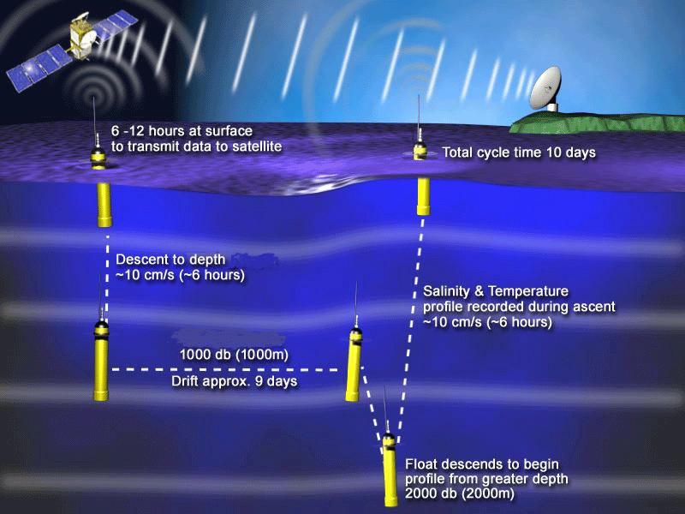
How Floats Work
http://www.argo.ucsd.edu/How_Argo_floats.html
Notes:
Basics in the diagram
But you can:
Park shallow
Cycle daily
Time the cycle with daylight

Slide 4
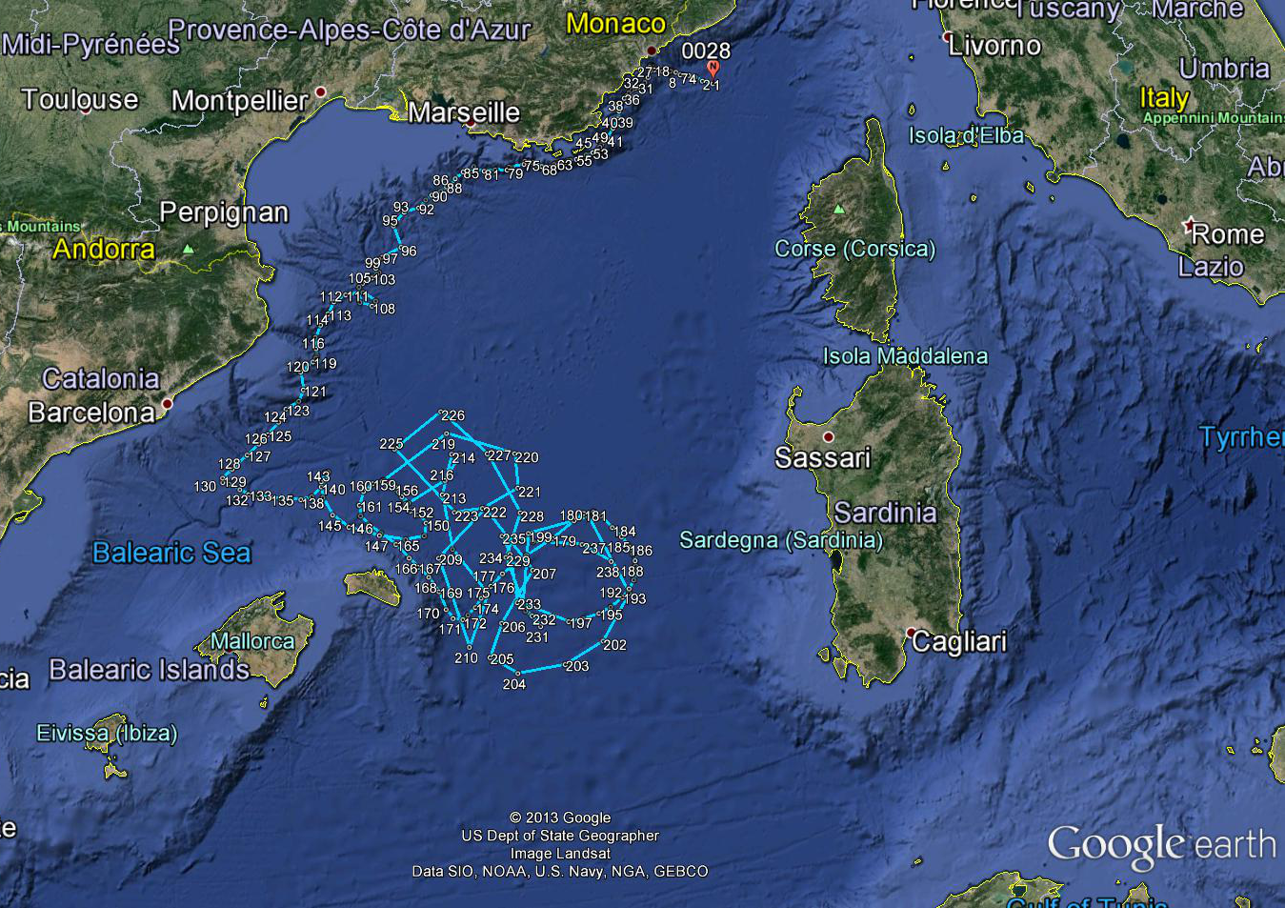
We Launched a Float in the Mediterranean Sea

Slide 5
What We Saw
An overturn of the Mediterranean
An event that occurs when the sea surface temperatures cool to become dense enough to sink
Top to bottom mixing – of everything!
Observed in:
Temperature & Salinity & Density
Oxygen
Chlorophyll
Particles

Slide 6
This is Interesting Because:
This event is a pulse of oxygen and carbon in the form of chlorophyll and particles to the bottom
Think about
How much kinetic energy is dissipated
The effect on the seafloor geochemistry
Carbon sequestration
This is the inverse of upwelling

Slide 7
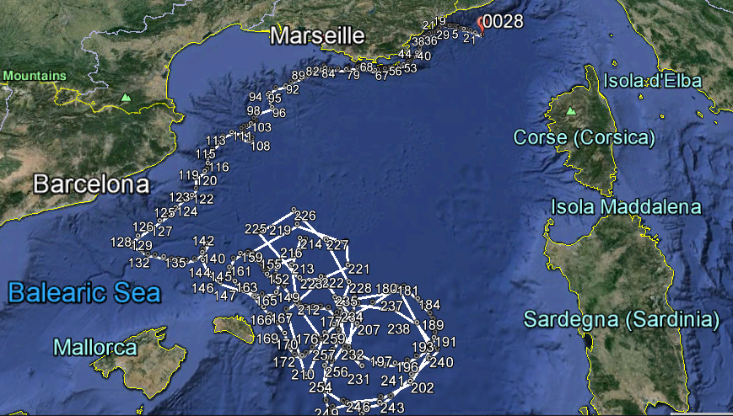
Where the Event Occurred
35 Daily Profiles: Event lasted more than a month

Slide 8
Easy to See in Temperature
Before
During
After

Slide 9
Density Becomes Constant as the Overturn Occurs
Before
During
After

Slide 10
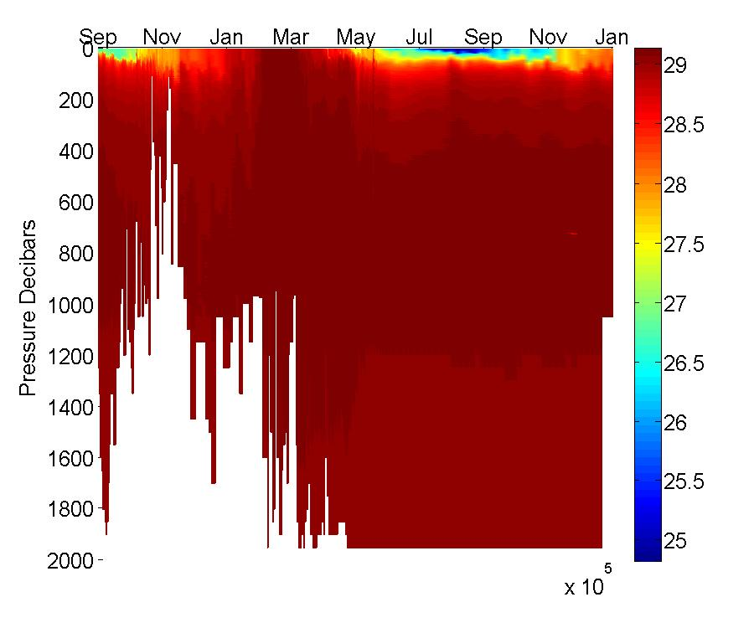
Sigma T Shows Overturn Event in March
Float hits bottom or grounds

Slide 11
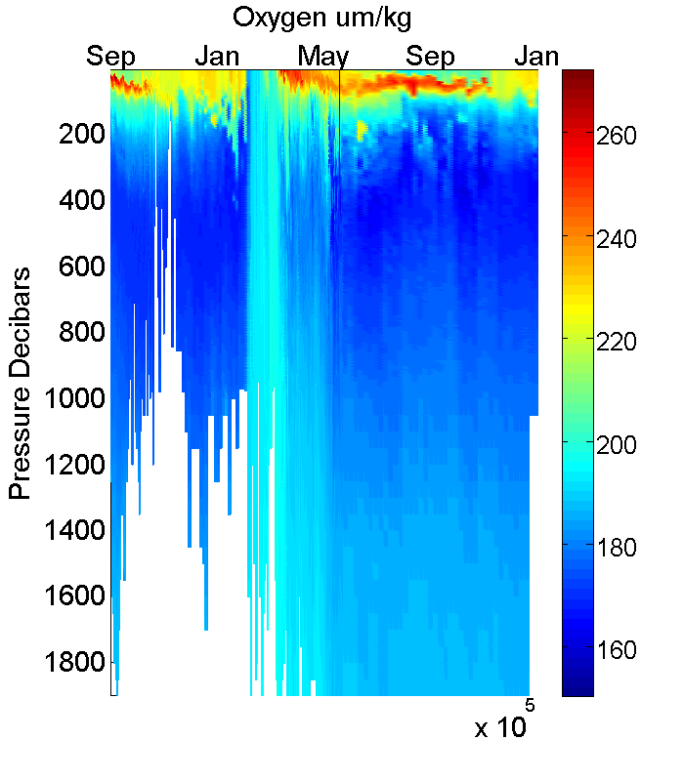
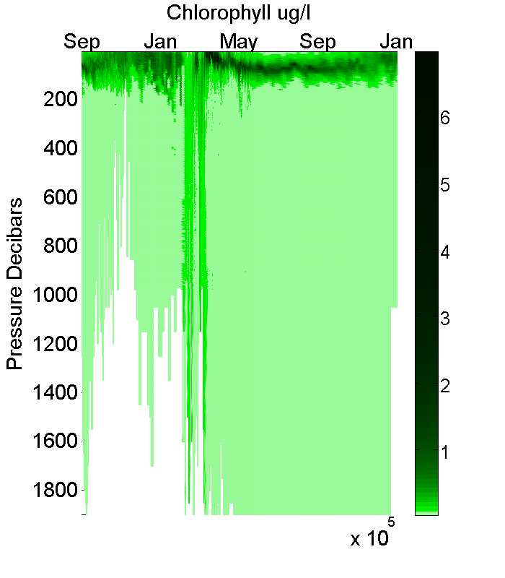
Oxygen and Chlorophyll Concentration

Slide 12
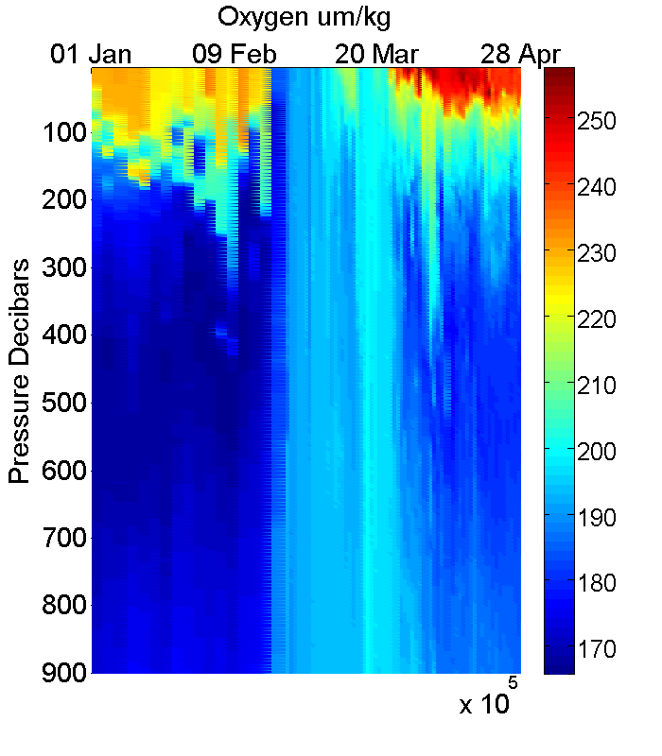
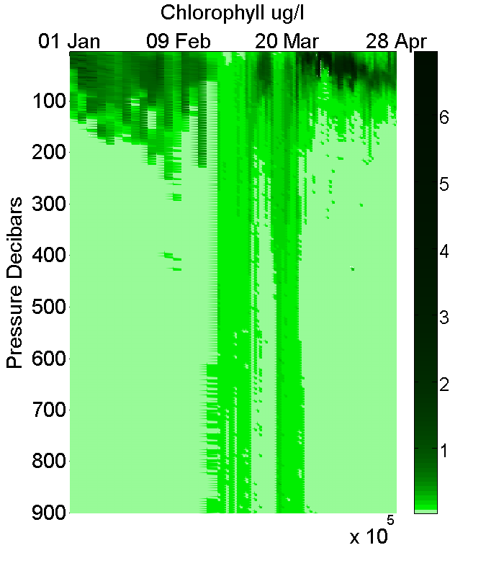
Close Up of the Overturn

Slide 13
Close Up of the Overturn

Slide 14
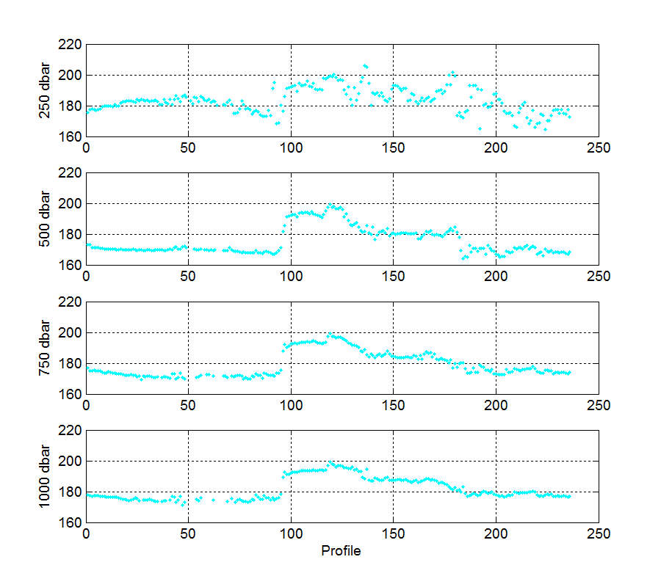
Oxygen Time Series
Shallow
Deep
Days
Notes:
Averages of 100 meter bins
A point is collected every day
Look how rapidly oxygen mixes

Slide 15
Oxygen Time Series
Shallow
Deep
Days
Notes:
Averages of 100 meter bins
A point is collected every day
Look how rapidly oxygen mixes

Slide 16
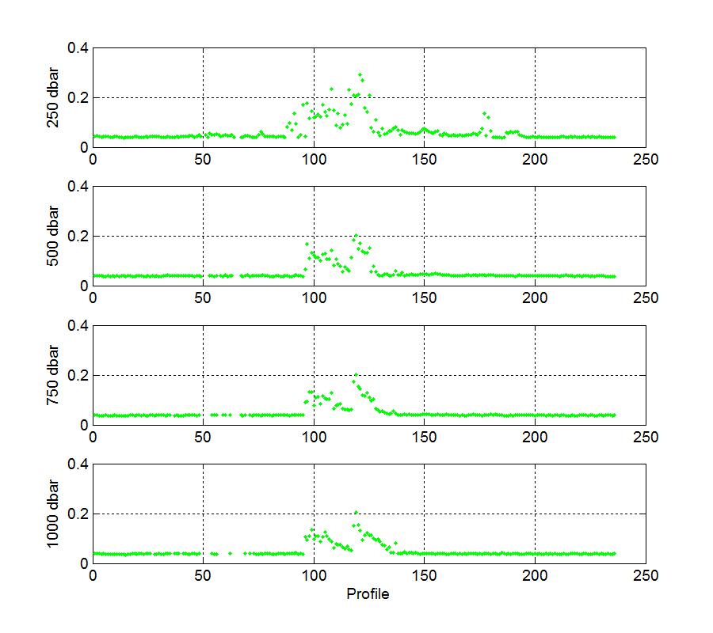
Chlorophyll Time Series
Shallow
Deep
Days
Notes:
Same data processing as before
Chlorophyll mixes more slowly
Chlorophyll does not persist past mixing event

Slide 17
Chlorophyll Time Series
Shallow
Deep
Days
Notes:
Same data processing as before
Chlorophyll mixes more slowly
Chlorophyll does not persist past mixing event

Slide 18
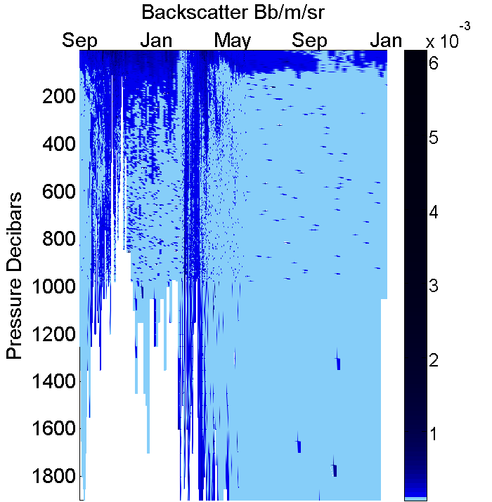
Backscattering
Notes:
Backscattering = particles
Plankton
Sediments
Gunk
Dark blue = lots
Light blue = few

Slide 19
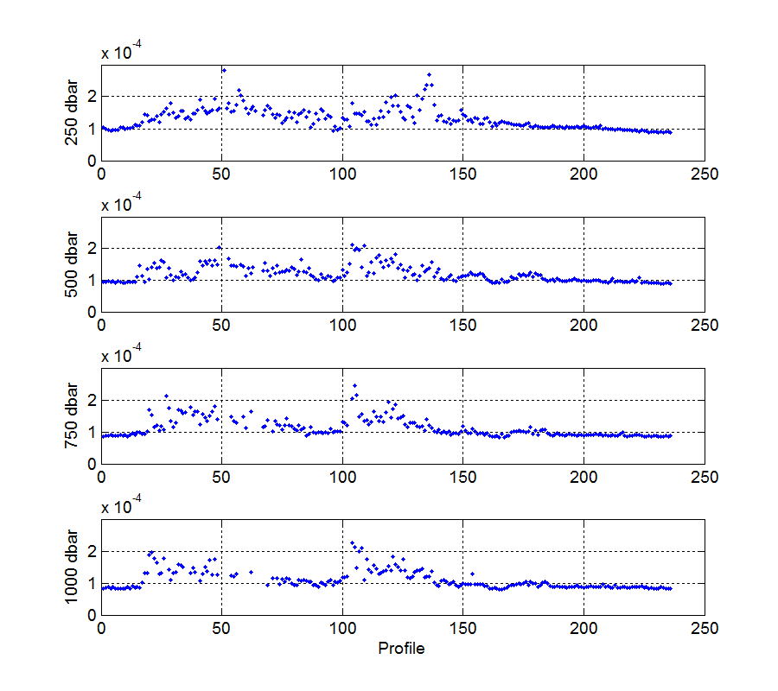
Backscattering = Particles
Shallow
Deep
Days
Notes:
Early profiles are very close to coast and show particle flux
Less particles after the overturn
Can see mixing events in deeper bins

Slide 20
Thank you!
I hope you are as excited by this new tool as I am
More of these floats are being launched all the time
The International ARGO program is preparing to make the data publicly available

