Slide 1
US IOOS®
Zdenka Willis
Directora, US IOOS
Notes:
Presented at the NOAA, National Ocean Service meeting in Cuba

Slide 2
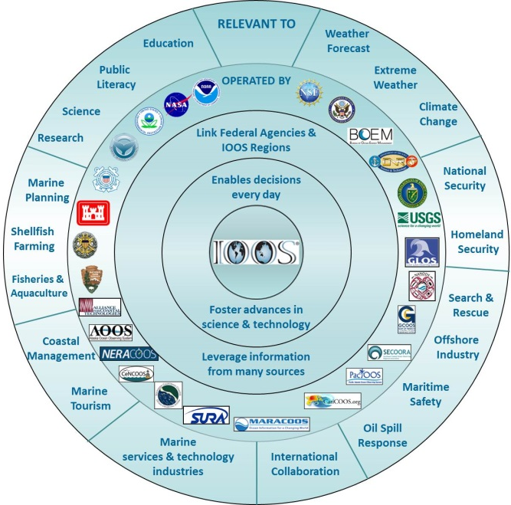
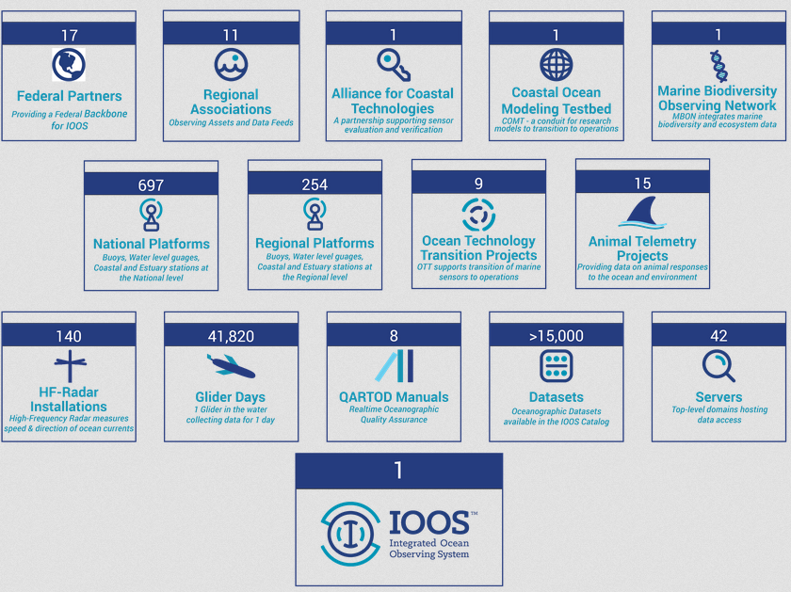
U.S. Integrated Ocean Observing System (IOOS®)
Responde a usuarios - Basado en Ciencia
Notes:
US IOOS is a national program
NOAA is the lead national agency but many national agencies are involved
Unique with the 11 IOOS Regional Associations that understand what is needed regionally and locally but remain connected by being part of larger national program
IOOS is more than observing, it is also about data integration, modeling through to products and services
IOOS has many contributions but is coordinated under one program
IOOS is user driven, scientifically based and policy neutral

Slide 3
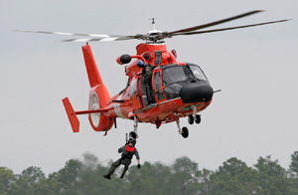
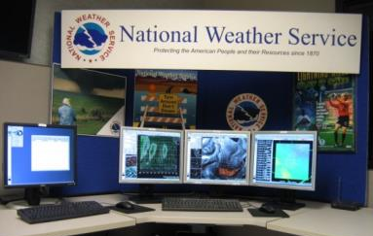
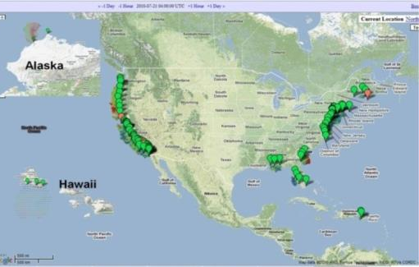
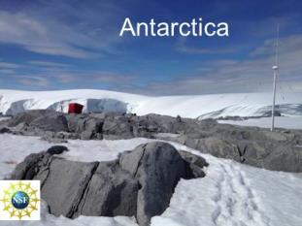
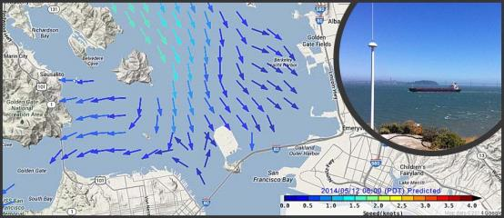
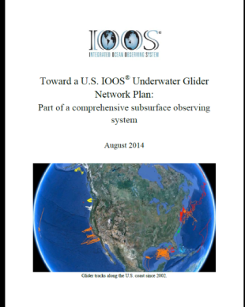
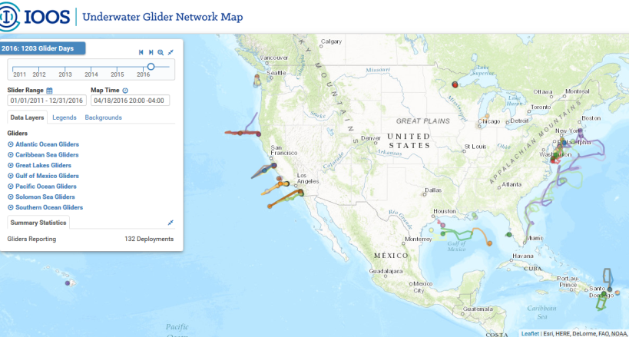
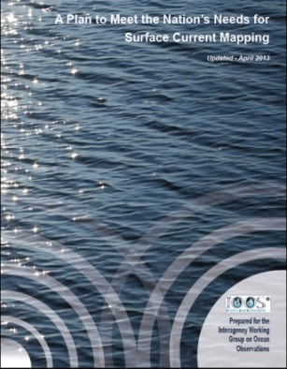
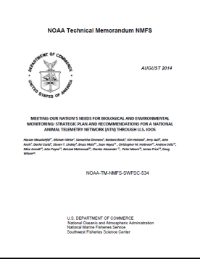
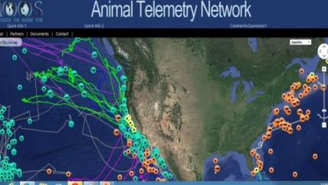
IOOS: Asistiendo Comunidades de Usuarios
Radares HF:
(Corrientes)
Variables Biológicas
& BIO TT:
Gliders:
(Planeadores)
Mediciones de olas:
Telemetría Animal:
3
Notes:
A niche we’ve created for ourselves is in the area of “communities of practice”. In each of these examples we are actively engaged in projects to improve a communities ability to deliver information for societal benefit.
Here are five areas we have endeavored to bring the community together.
High Frequency Radar:
140 radars run by academic institutions, Program Office manages on the data management
Create a national network from individual operators
Data into PORTS® and NWS data tanks (AWIPS).
Expanded radars to Antarctica
Gliders:
Common Operating Standards
White Paper Towards a National Glider Network published in August 2014
Glider Data Assembly Center capability
Starting a Task Team under the IOOC
ATN:
This is in early stages for US IOOS. Within the United States the tagging efforts are in response to scientific research as Regional basis and much of it being done in our academic community. There is not a national tagging program within the United States.
The US IOOS is supporting the coordination of data coming from the community of taggers. Current focus is on data management and building an ATN Data Assembly Center (in collaboration with US NAVY , NOAA and TOPP program). The DAC will have the capability to integrate most Animal Telemetry Technology (Acoustic, Archival and Satellite tags).
Waves – National Plan with NOAA, IOOS and USACE. IOOS Regions have increased the number of data well buoys in particular in Caribbean and Insular Pacific. USACE fund the data management central system and is a contribution to IOOS.
Biological Integration and Observation (BIO) Task Team BIO TT–National Plan with NOAA, IOOS and USACE. IOOS Regions have increased the number of data well buoys in particular in Caribbean and Insular Pacific. USACE fund the data management central system and is a contribution to IOOS.

Slide 4
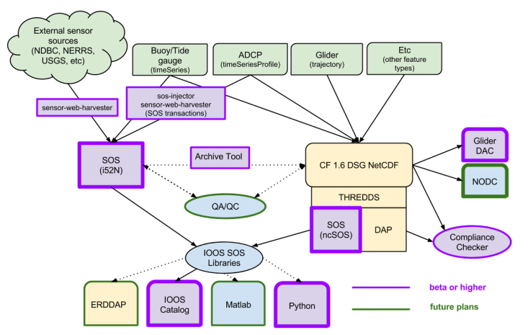
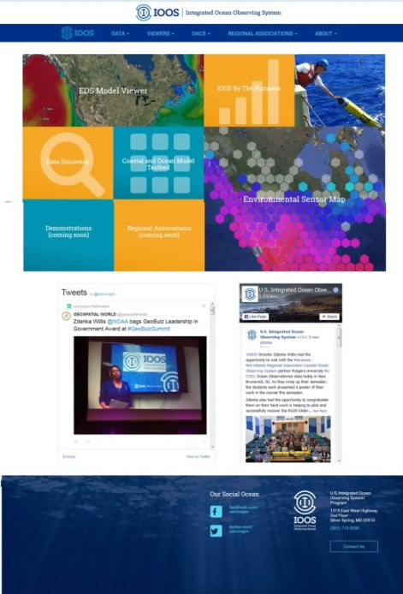
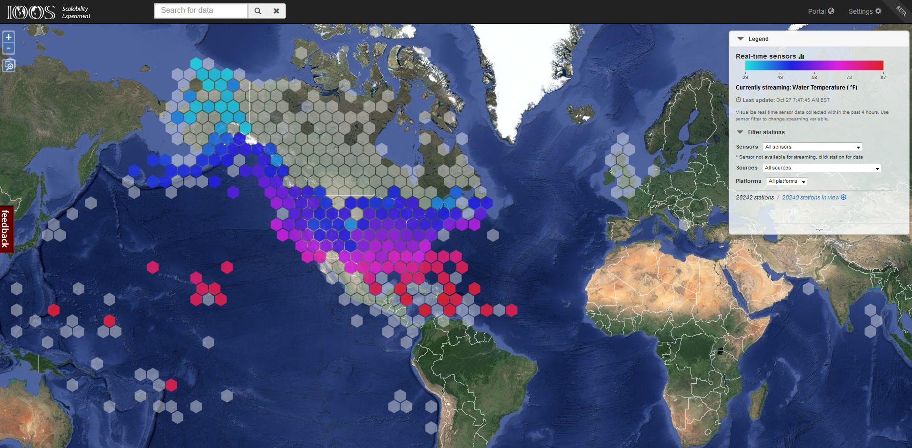
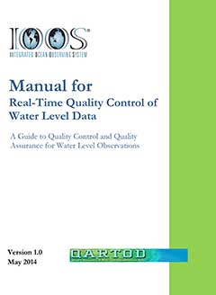
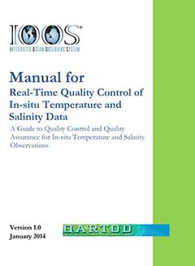
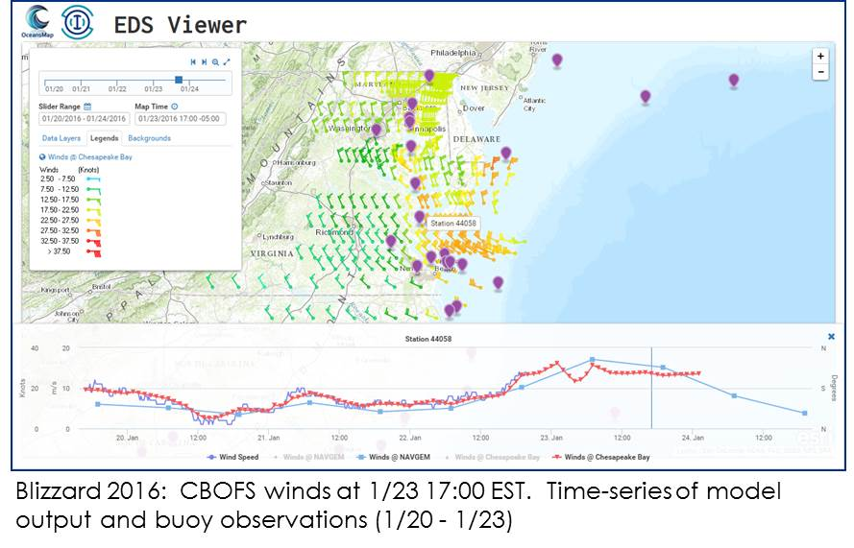
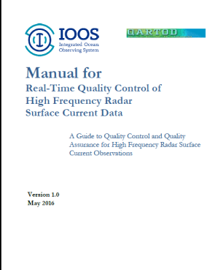
Acceso a Datos y Productos
Estándares
Caché de 2 semanas de observaciones en tiempo real
Accesible en:
http://ioos.us
Control de
Calidad
Acceso a datos modelados
4
Notes:
Upper left: working with each of the regions to standardize the data access and dissemination. All are providing data in with the same recipe and in 2015 we improved the recipe and we all changed to the new one together in short order
Image Upper Center: We have consolidated all the data products for IOOS under a single website.
Image Upper Right: Developed a national sensor map that allows us to show 2 weeks of data and do averaging of the data – produced by Axiom
Imager lower left: QARTOD effort, being used nationally and internationally.
Image Lower Right – access to models and data for comparison between models and observations – PRS-ASA product

Slide 5
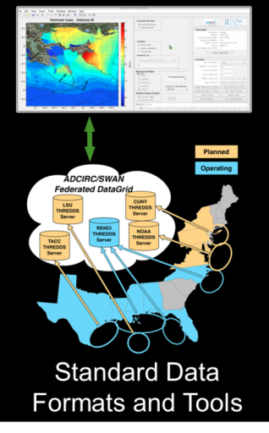
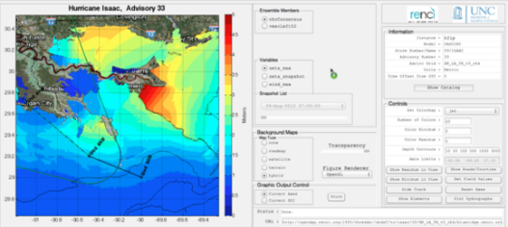
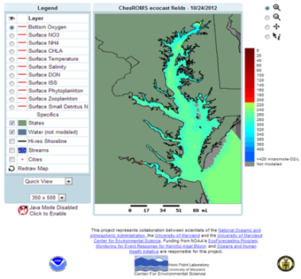
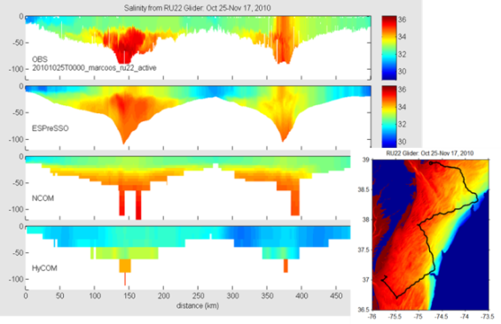
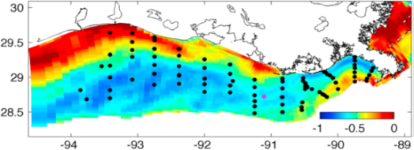
Banco de Pruebas US IOOS para Modelaje de Costas y Océanos
Facilita las pruebas y transición a uso operacional.
5 proyectos; Hipoxia en el Golfo de Méjico y Bahía Chesapeake, Inundación en PR/USVI, Sistema Operacional de Pronósticos para la Costa Oeste y Herramientas de Integración Continua (CI) para la comparación de modelos/datos Radares.
Notes:
To use applied research and development to accelerate the transition of scientific and technical advances from the coastal ocean modeling research community to improve operational ocean products and services (i.e. via research to operations and also operations to research).

Slide 6
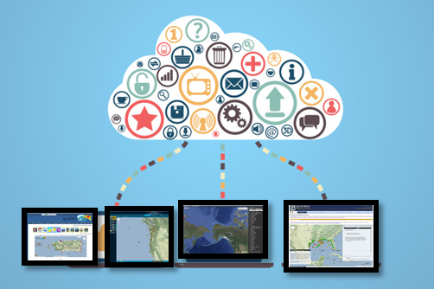
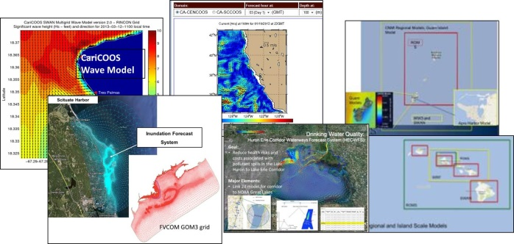
Regiones de IOOS
Observaciones
11 Regiones
Acceso a Datos
Modelos numéricos
Nuestros usuarios
Estados, Locales, Gobiernos Tribales,
Industrias con y sin fines de lucro
Académicos e investigadores
Educación
& Alcance
Producir | Integrar | Comunicar
Notes:
Regions of IOOS – are full services from observations to education and outreaach

Slide 7
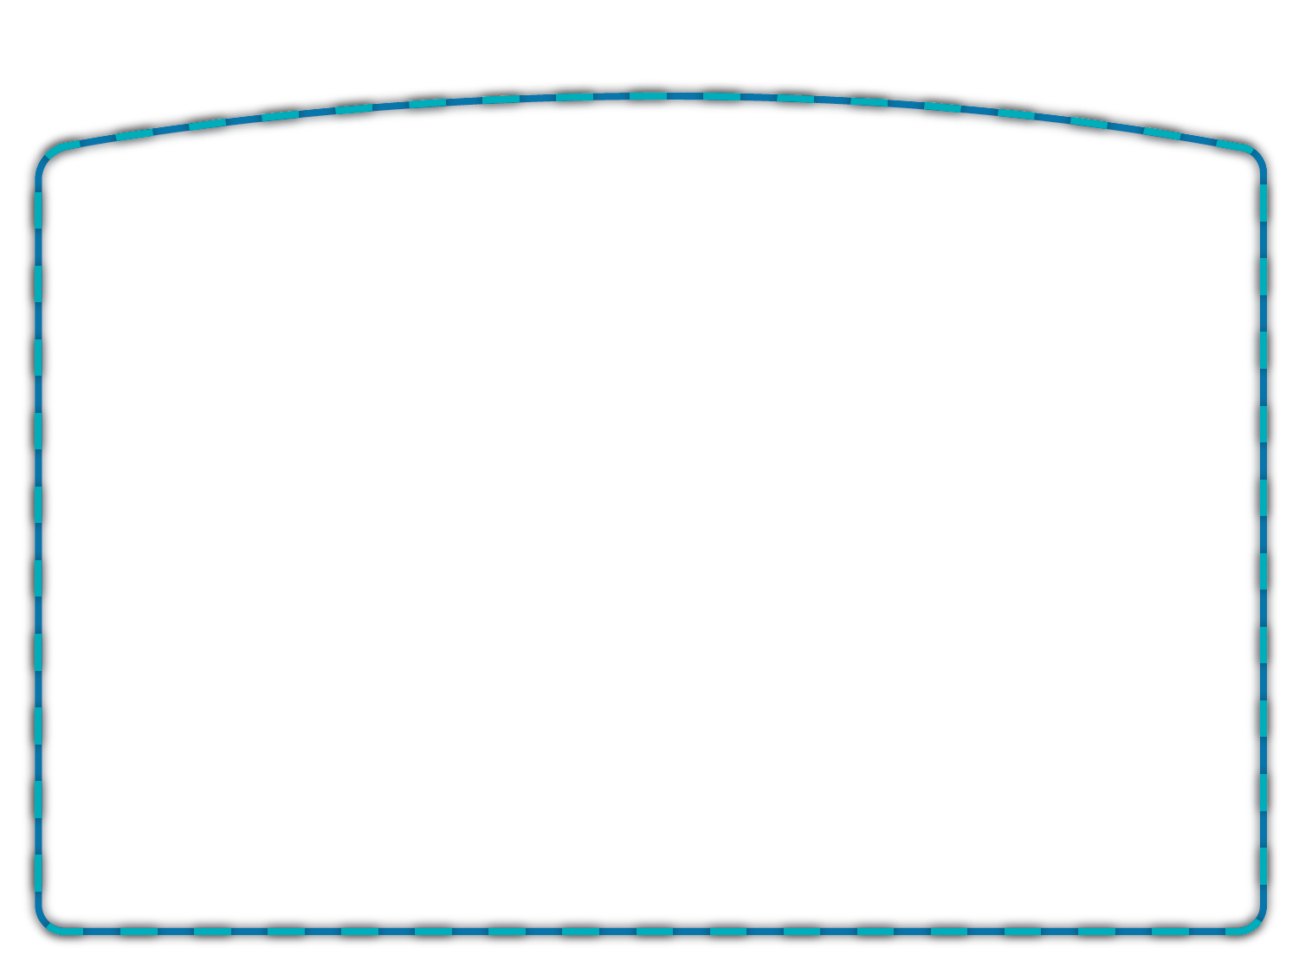
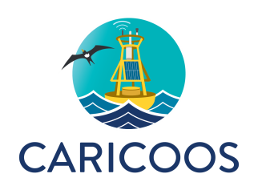
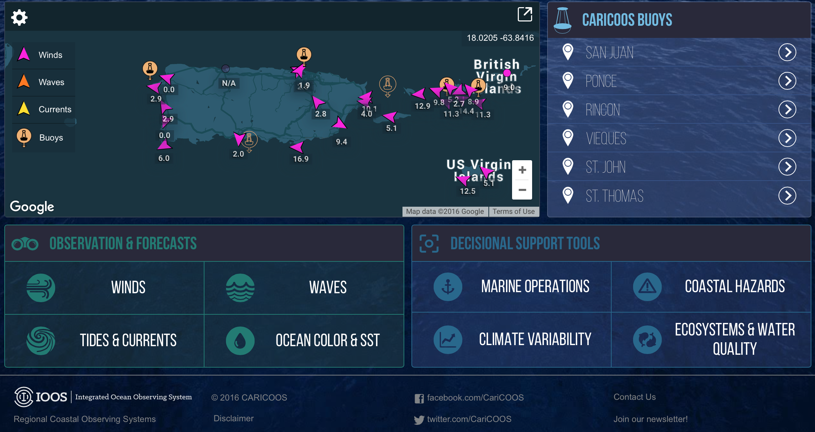
MISIÓN: OBSERVACIONES Y PREDICCIONES DEL OCÉANO – 24/7 –
PARA APOYAR SUS ACTIVIDADES MARINAS

Slide 8
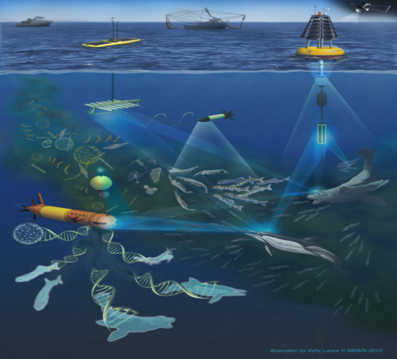
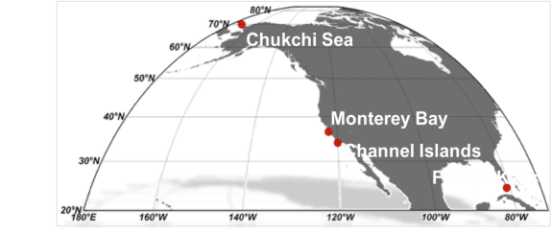
Red para la Observación de Biodiversidad Marina en E.U
Agencias colaboradoras :
Subvenciones de NOAA, NASA, BOEM; USGS (en especie)
Smithsonian Institute: Tennenbaum Observatory
Metas de la Red para la Observación de Biodiversidad:
•Aumento de eficiencia y aumento de cobertura
•Integrar observaciones biológicas y ambientales
•Integrar percepción remota con observaciones “in situ”
•Automatizar muestreos
•Desarrollar indicadores de biodiversidad marina
•U.S. MBON/ Global MBON
Credit: MBARI
Notes:
2 views on this slide – first U.S. projects and then a picture of the Global MBON collaborations.
RAs directly involved in MBON demonstration projects:
GCOOS (Barb Kirkpatrick, Matt Howard)
AOOS/Axiom
CeNCOOS (Dave Anderson, Francisco Chavez)
SCCOOS
Demo project PIs, project titles, and and funding agencies:
Arctic MBON (AMBON – U.S. Chukchi Sea) PI Katrin Iken, University of Alaska Fairbanks: “Initiating an Arctic Marine Biodiversity Observing Network” (NOAA, BOEM)
Santa Barbara Channel (SBC) MBON (including Channel Islands National Marine Sanctuaries) PI Bob Miller, University of California Santa Barbara: “Demonstrating an Effective Marine Biodiversity Observation Network in the Santa Barbara Channel” (NOAA, NASA, BOEM)
Sanctuaries MBON (Florida Keys, Flower Garden Banks and Monterey Bay National Marine Sanctuaries) PI Frank Muller-Karger, University of South Florida: “National Marine Sanctuaries as Sentinel Sites for a Demonstration Marine Biodiversity Observation Network” (NOAA, NASA)

Slide 9
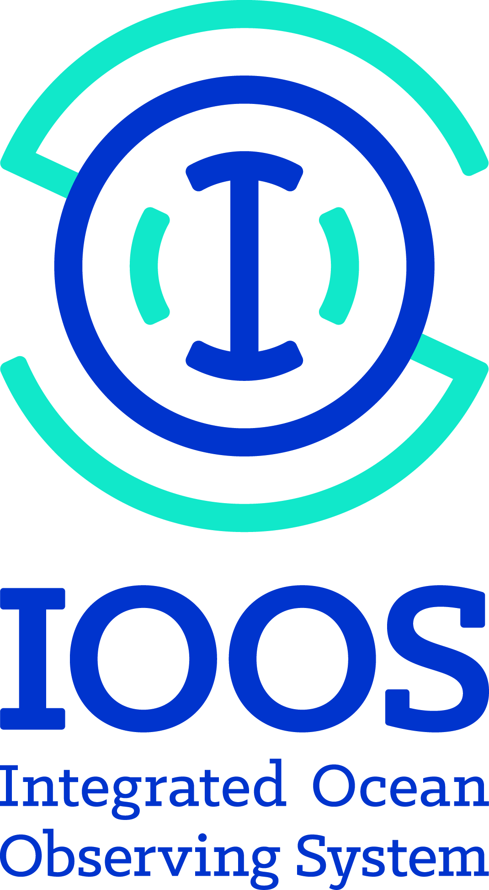
Participación Global
Notes:
IOOS is a sustained ocean observing system for the United States.
IOOS is also part of the Global Ocean Observing System
IOOS is part of the Group on Earth Observations
We invite Cuba to work with us under these structures

Slide 10
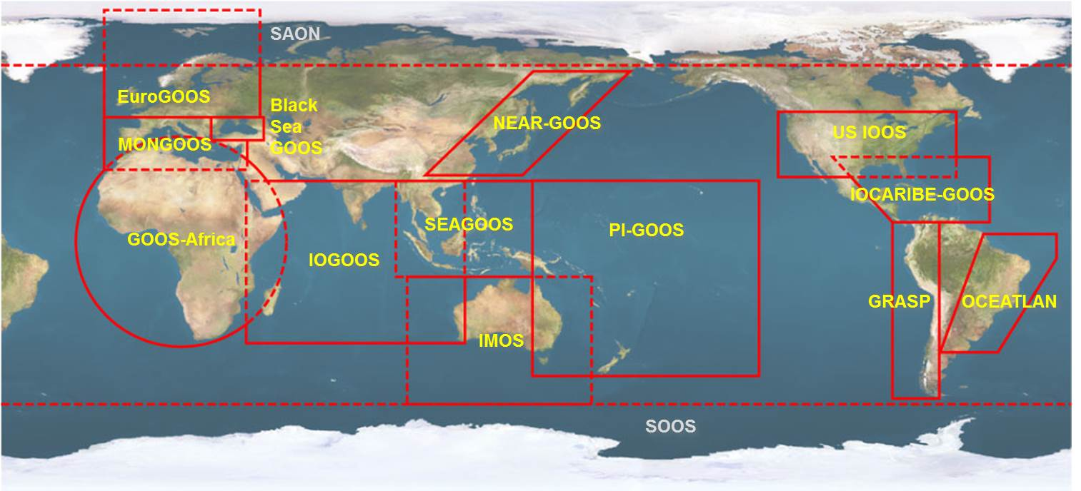
GOOS: Alianzas Regionales
Notes:
US IOOS and Cuba through IOCARIBE-GOOS are part of GOOS

Slide 11
Preguntas?
Apoya la toma de decisiones
Fomenta el avance de la Ciencia y la Tecnología
https://ioos.noaa.gov
https://www.facebook.com/usioosgov
@usioosgov

