Slide 1
The Monterey Bay Aquarium Research Institute
The ‘Blue Silicon Valley’ Emerges from the ‘Serengeti of the Sea’
September 21, 2016
Chris Scholin

Slide 2
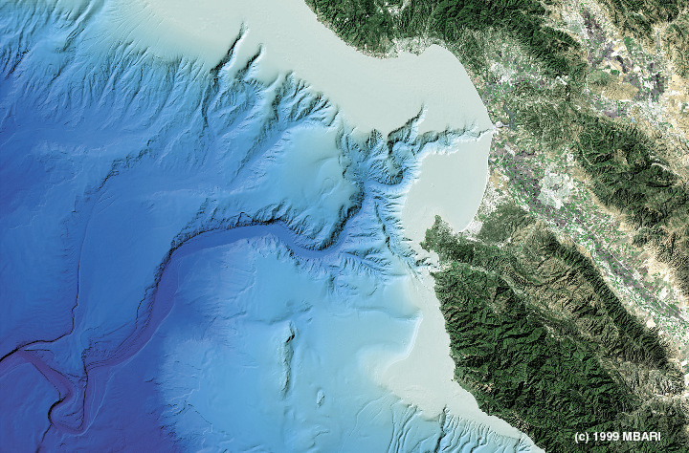
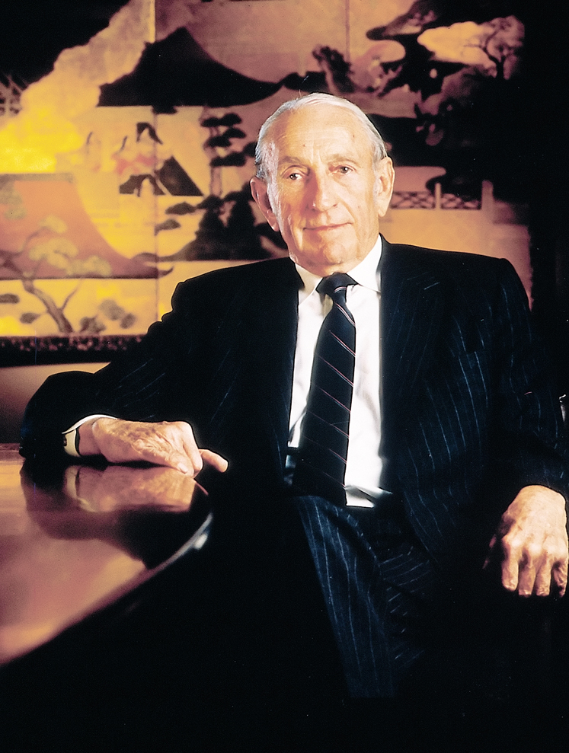
MBARI’s mission and founder
X
MBARI
X
you are here
David Packard
“…achieve and maintain a position as a world center for advanced research and education in ocean science and technology … through the development of better instruments, systems, and methods ….”

Slide 3
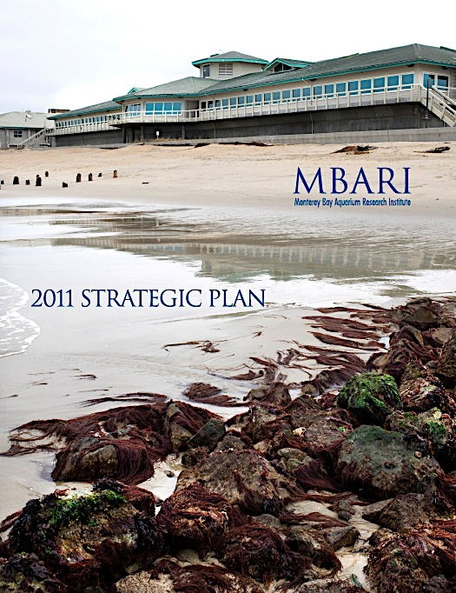
MBARI’s Strategic Plan
Research Themes
Exploration and discovery
Ocean Visualization
Ecosystem Processes
Biogeochemical cycles
http://www.mbari.org/about/vision/

Slide 4
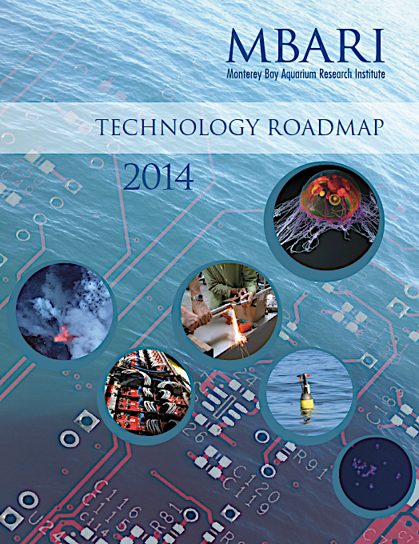
MBARI’s Technology Roadmap
Engineering Initiatives
Taking the laboratory into the ocean
Enabling targeted sampling
Advancing a persistent presence
http://www.mbari.org/about/vision/

Slide 5
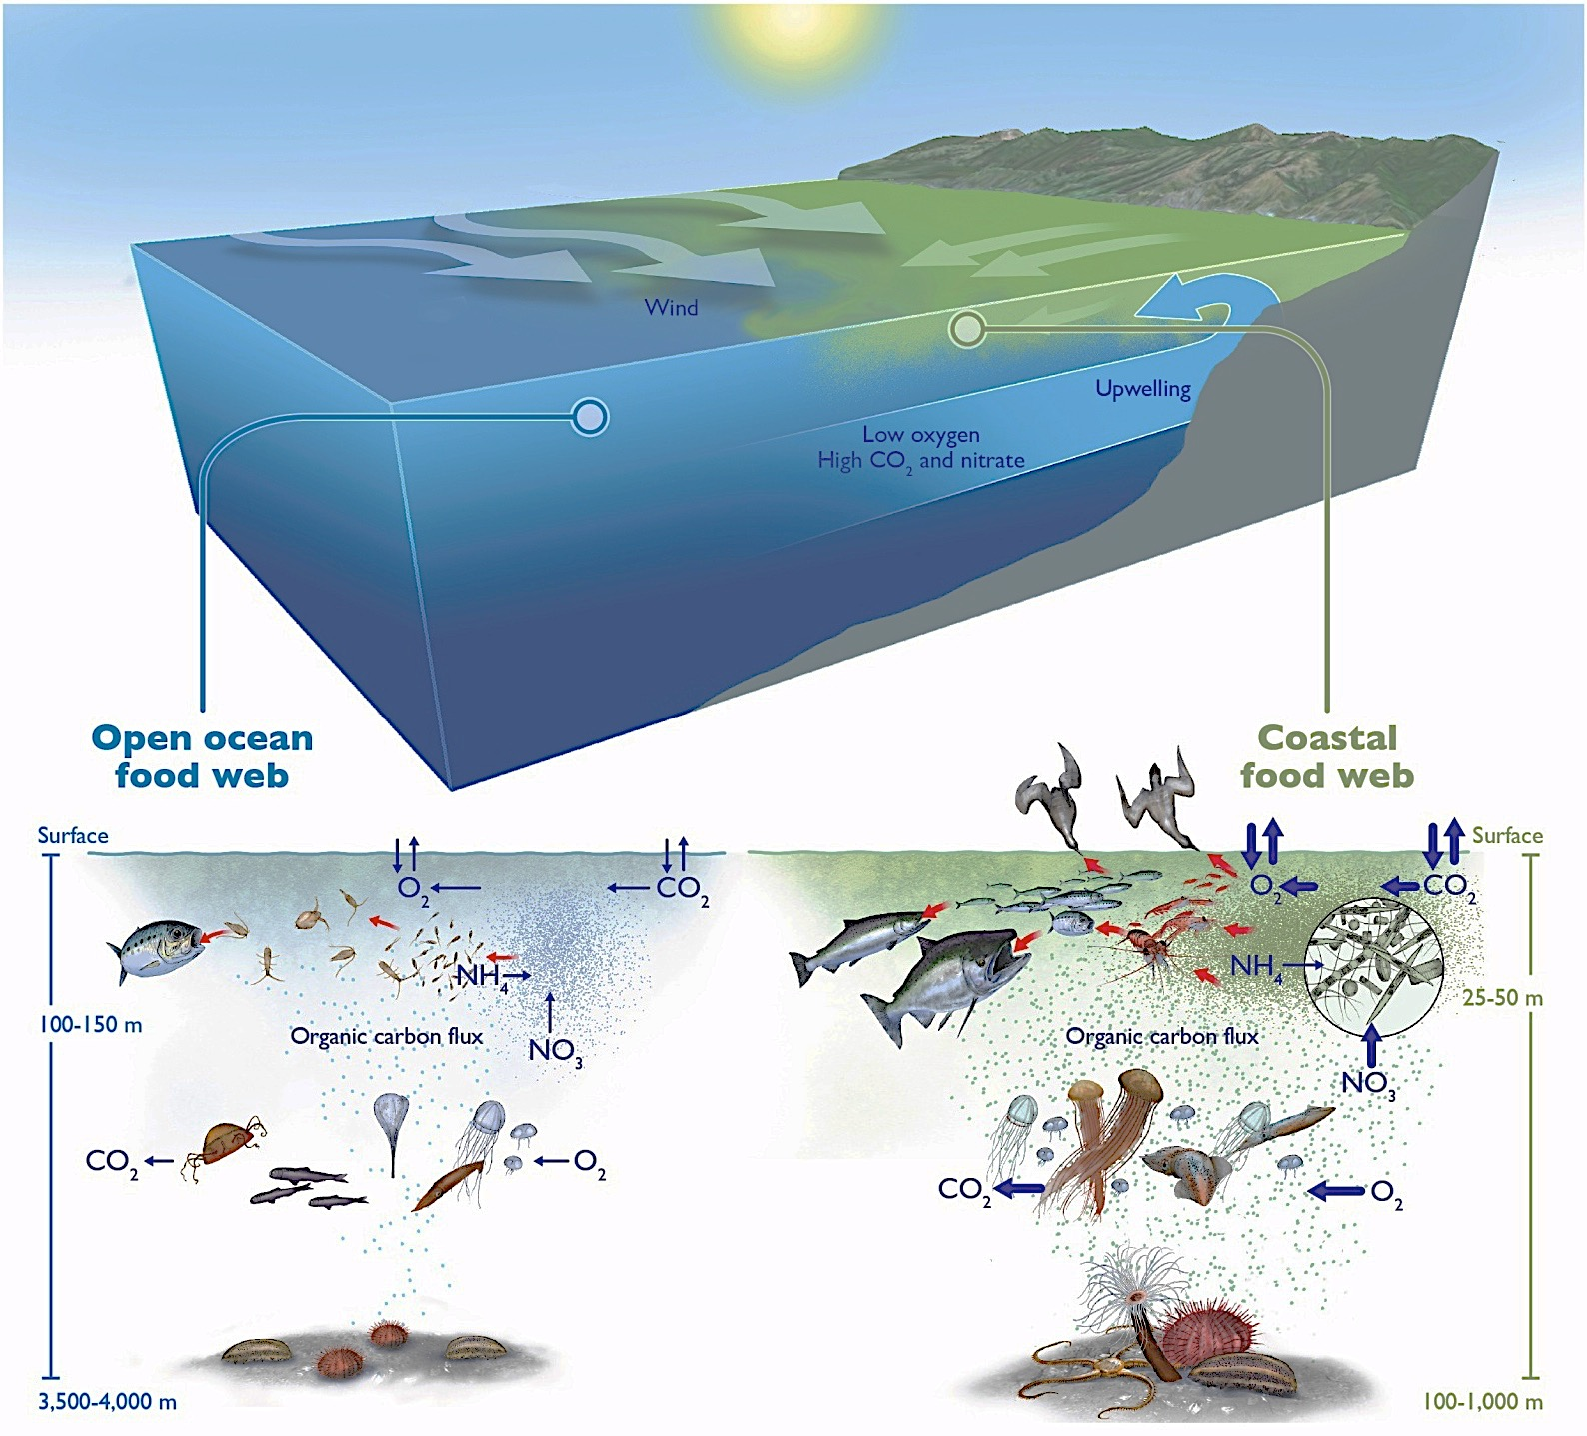
Key elements of MBARI’s strategy
“Ocean change” and societal relevance serve as organizational principles
R&D themes build from a systems perspective
Problem statements define scientific challenges and technology needs

Slide 6
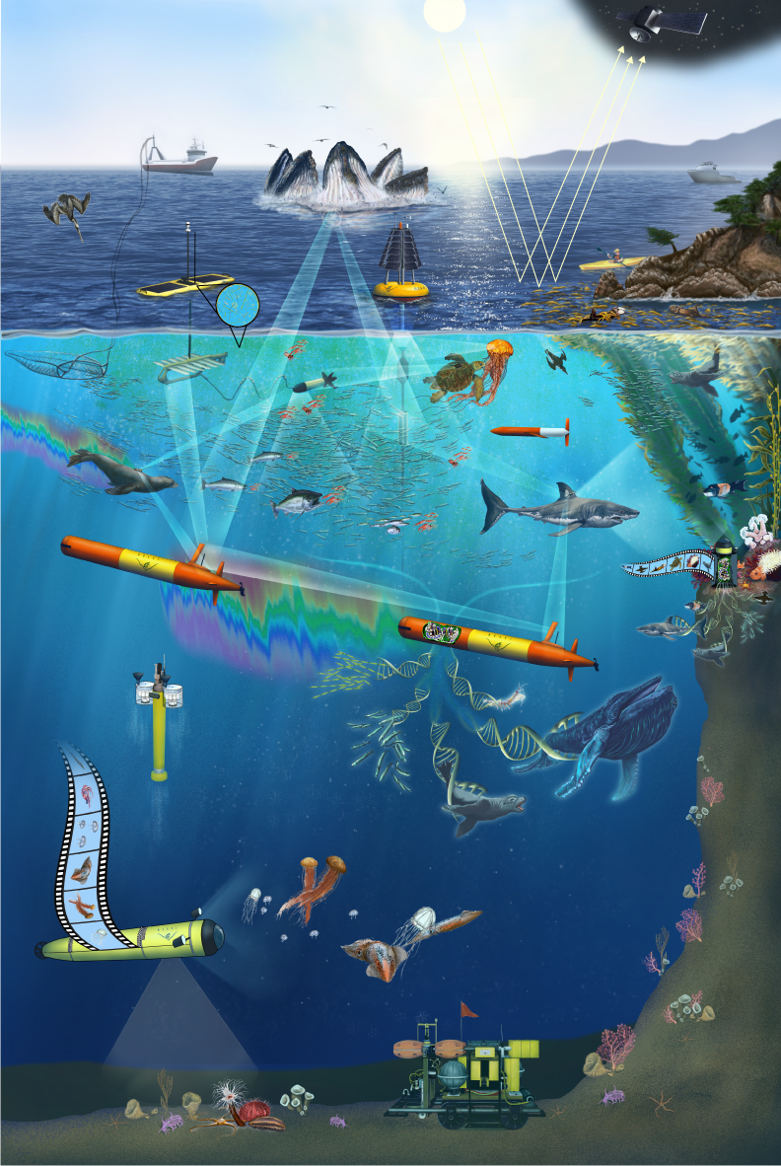
Some exemplar technological foci
Autonomy
Genomic sampling/sample processing
Machine learning
Big data

Slide 7
MBARI and technology transfer
Open source
e.g., data systems, instruments
Royalty-free licenses
e.g., images, video, instruments, and platforms
Commercial licenses
e.g., instruments and platforms

