Slide 1
Building A Marine Tech Innovation Ecosystem
Brad Barbeau,
The Institute for Innovation and Economic Development
College of Business, CSU Monterey Bay

Slide 3
The iiED Mission:
Develop the knowledge, expertise and financial resources needed to create and support a vibrant entrepreneurial community and successful, growing businesses and social ventures in the Tri-county region
Collaborate with regional and global public and private institutions to develop and deliver programs and events for the university community and the region to connect the local economy to the global market place

Slide 4
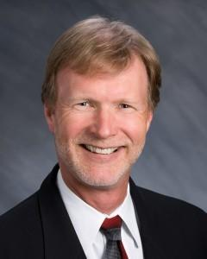
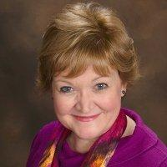
iiED Personnel
Executive Director - Dr. Brad Barbeau (College of Business)
Director - Dr. Eric Tao (School of Computing and Design)
Program Manager - MaryJo Zenk
Faculty Associates and Community Volunteers!

Slide 5
6:30pm 2nd Tuesday of the month at the Press Club

Slide 9
New Venture Competition
Venture, Main Street, Student Divisions
Over $50,000 in prize money
Workshops and Mentoring for Participants
Applications Due March 13th
Qualifying Round April 7th
Final Round/Otter Tank/Venture Showcase May 12th

Slide 10
Visit our new website for startups!
Startup Monterey Bay is a project of the Institute for Innovation and Economic Development at CSU Monterey Bay. Created under a grant from the U.S. Economic Development Administration.

Slide 11
Upcoming iiED Projects
Regional Commercialization Center
Provide mentoring and training for entrepreneurs
Expanded Entrepreneurship Programs
Entrepreneurship Capstone
Real Estate Venturing
Student Incubator

Slide 12
Building A Marine Tech Innovation Ecosystem
Brad Barbeau
Institute for Innovation and Economic Development
College of Business
CSU Monterey Bay

Slide 13
Idea to Company
1: Create idea
2: Develop commercialization approach
3: Build initial sales
4: Active scaling
Empire
Active Planning
Sales Curve
Idea Stage
Startup
Growth
1
2
3
4

Slide 14
Entrepreneurship Is Creating New Realities
Important customer problems
Entrepreneurial Ideas
Match Problems to Solutions
Identify
To Create New Realities
Apply
Technology-based solutions
Notes:
Talk about each of these concepts
What are alternative methods of:
Value Proposition: McDonald’s vs. Montrio
Value Creation:
Value Delivery: Internet vs. Brick and Mortar

Slide 15
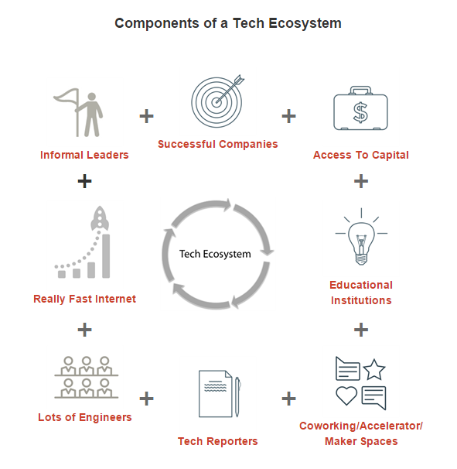
MBEP Model for Tech Ecosystem
Mix All Of These in the
Crucible Of Community
http://www.mbep.biz/About-Us/MBEP-Initiatives/Tech-Resources.aspx

Slide 16
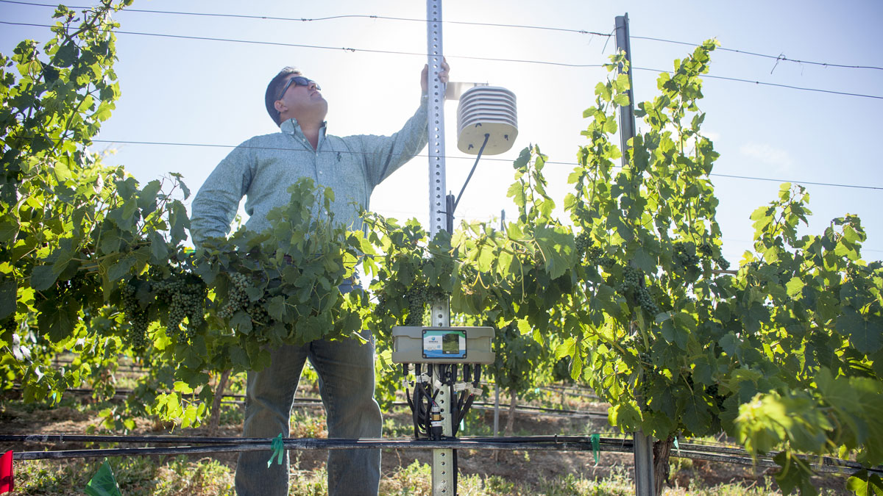
The AgTech Ecosystem
5+ Years in the making
Started to get traction only last year
Still in the formative stage

Slide 17
AgTech Ecosystem Drivers
Steinbeck Innovation Foundation
Early efforts to engage Silicon Valley and Ag
Very slow responses
City of Salinas
Human and Financial Resources
Has made AgTech a strategic priority
Silicon Valley Group (SVG Partners)
Understood promotion and partnering
Western Growers Association
Came late but brought beer

Slide 18
AgTech Ecosystem Drivers
Key Ag Firms As Leaders and Funders
Agtech Insight
Founded the Salinas AgTech Meetup
Very Effective Public/Private Partnerships

Slide 19
But: What’s Different In the MarineTech Ecosystem?
In AgTech, the key task has been to join the Tech folks (solution providers) with Ag (solution needers)
The Salinas AgTech community started with the growers problems – water, food safety, labor
They needed to be convinced that technology could answer those problems
The Tech community had cool solutions, but didn’t understand the problems well
They needed to be educated to “speak Ag”
So the challenge has been to apply technology to an existing commercial ecosystem

Slide 20
MarineTech Is Different
A community that is developing new technology in pursuit of studying, not commercializing
Like the space program
So there are two types of opportunities
Applying MarineTech to improving the marine commercial ecosystem
Finding new applications for MarineTech to solve other (non-marine) problems

Slide 21
Entrepreneurship Is Creating New Realities
Important customer problems
Entrepreneurial Ideas
Match Problems to Solutions
Identify
To Create New Realities
Apply
Technology-based solutions
Notes:
Talk about each of these concepts
What are alternative methods of:
Value Proposition: McDonald’s vs. Montrio
Value Creation:
Value Delivery: Internet vs. Brick and Mortar

Slide 22
Think Like An Entrepreneur
Entrepreneurs engage in discovery and creation
Discovering unmet needs and unseen opportunities
Creating new markets

Slide 23
Think Like An Entrepreneur
“No battle plan survives first contact with the enemy” – Helmuth von Moltke the Elder
“No business plan survives first contact with the customer” – Steven Gary Blank

Slide 24
Silicon Valley Entrepreneurship
TM
Be
Bold
Get
Out
Think
Wrong
Make
Stuff
Bet
Small
Move
Fast
http://www.futurepartners.is/#innovationfirm

Slide 25
Be
Bold
Have a Big Vision
Netscape: Make the entire web visible
Google: Own the Internet
Facebook: Connect the planet

Slide 26
What Do We Mean By “Fail Fast”?
NOT “Bankrupt Your Company”
To “fail” is to discover what doesn’t work
By testing it in the marketplace
Test early and often
Learn from failures
Build
Measure
Learn

Slide 27
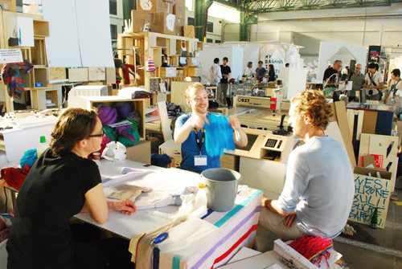
Make
Stuff

Slide 28
Bet
Small

Slide 29
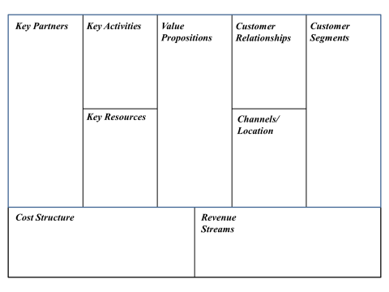
Business Design Tool: The Business Model Canvas
Notes:
Have them fill this out for Starbucks – in small groups, then discuss and fill out on the board.

Slide 30
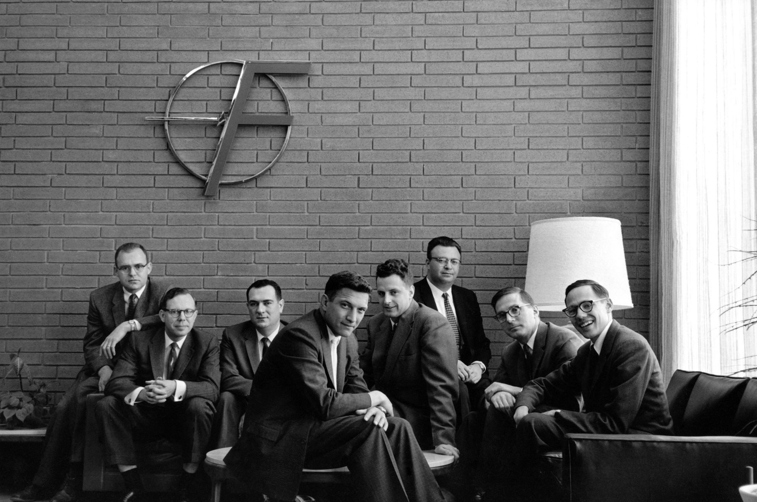
Who Will Be The Blue Silicon Valley “Traitorous Eight”?

Slide 31
The Silicon Valley Environment
Radically new technologies
Creating radically new markets
Driven by engineers (hardware/software) not product managers
With a mission to change the world

Slide 32
Contact Information
Brad Barbeau, Ph.D.
Associate Professor,
CSU Monterey Bay College of Business
Executive Director,
Institute for Innovation and Economic Development
bbarbeau@csumb.edu
831.582.4288

