Slide 1
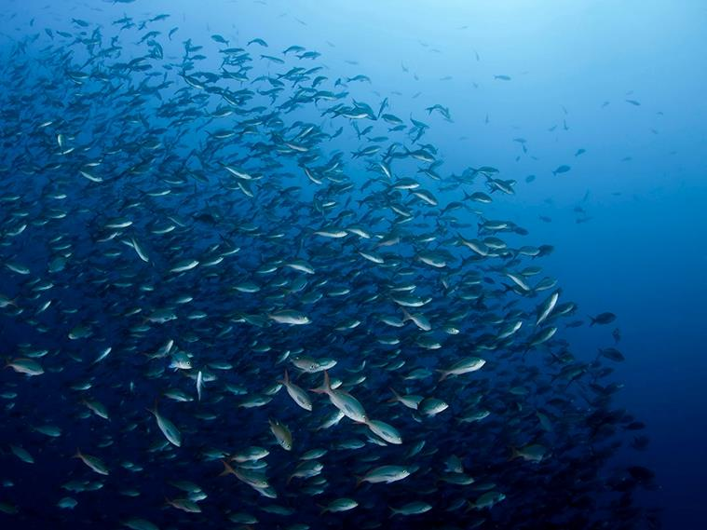


Animal Telemetry a Key Part of Ocean Observing Systems
Name: Zdenka Willis
Institution: US IOOS®
Contact info. Zdenka.S.Willis@noaa.gov
Notes:
Good afternoon,
We have heard some great science that is being done with animal tagging.
I will speak to the importance of incorporating data from electronic tags attached to marine animals into both the national IOOS and the international Global Ocean Observing System (GOOS). Data from these animals are transforming the way scientists study our waters and opening up new data sources that will allow information to be provided more readily to the state and federal officials who need it most.
Presented for Zdenka, by Fred Whoriskey –OTN. Zdenka unable to travel due to weather

Slide 2
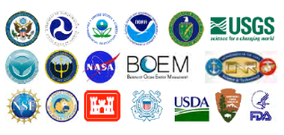
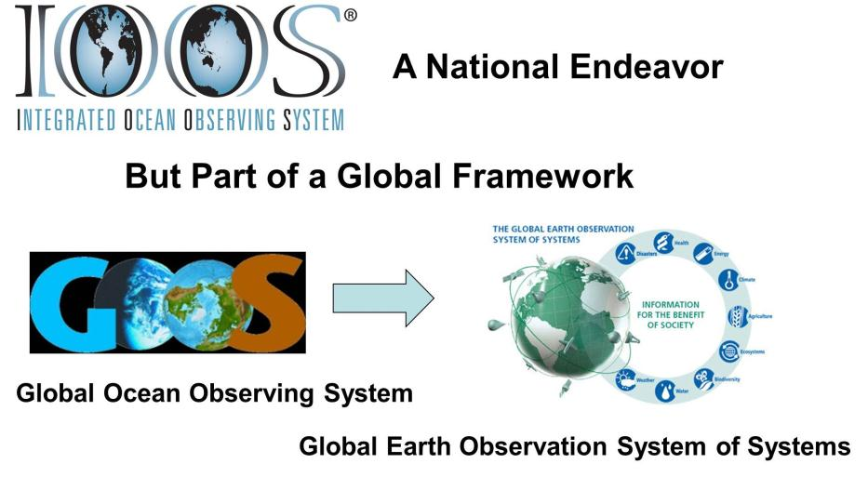
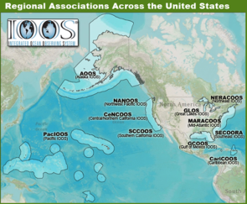
U.S. IOOS: Program Overview
WHO:
WHAT:
Observation
Data Management
Modeling & Analysis
Research & Development
Education
Management & Governance
        WHY: 7 Societal Goals, 1 System
      Predictions of climate change and weather
      Safety and efficiency of maritime operations
      Forecasts of natural hazards
      Improve homeland security
      Minimize public health risks
      Protect and restore healthy coastal ecosystems
      Sustain living marine resources
WHERE:
Global
Coastal (EEZ to head of tide)
Enables decision making & science
Notes:
The title of the talk is how does animal tagging work within an ocean observing system, so let me start with describing an observing system.
Here is the US Integrated Ocean Observing System.
The US IOOS is the US ocean observing plan. Each National Agency in the United States has missions to observing our oceans, coasts and Great Lakes and they are contributors to US IOOS.
This is extended to a partnership of 11 IOOS Regions that extend our reach to the Regional and Local levels. They are comprised of State, Local and Tribal Government, academia and industry. They respond to regional stakeholders but are nationally consistent by being part of the larger program.
US IOOS is an end to end system and we focus greatly on the “I” in IOOS. So while you see 7 goals the real power of IOOS is to expose ocean information from many sources and “measure once use many times.”
Mouse Click
The oceans know no boundaries so the US IOOS is our contribution to the Global Ocean Observing System (GOOS). GOOS is the ocean contribution to the Global Earth Observation System of Systems – which looks across atmospheric, terrestrial and marine observation for societal benefits.

Slide 3
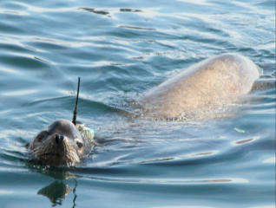
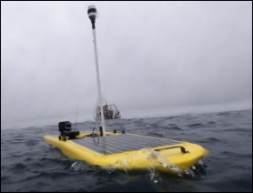
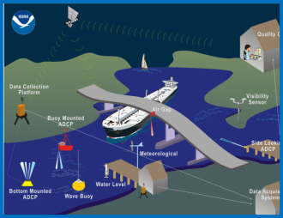
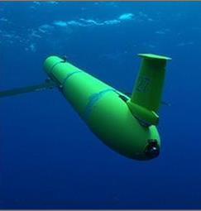
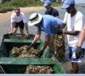

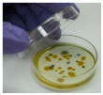
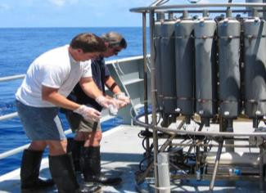
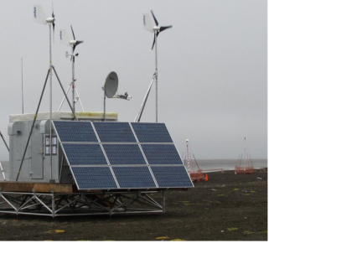
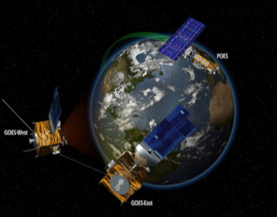
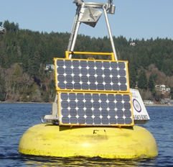
Eyes on the Oceans, Coasts and Great Lakes
Observing
Systems
U.S. Integrated Ocean Observing System (IOOS)
Notes:
We need many types of observing systems.
Satellites are important observing systems but they are only able to see the surface of the ocean.
Ocean observing means both continuous and automatic observations from buoys, gages, HF Radars and now seeing how animal telemetry can be part of the solution.

Slide 4
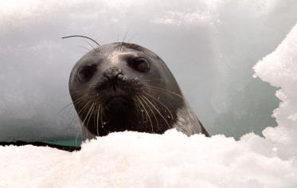
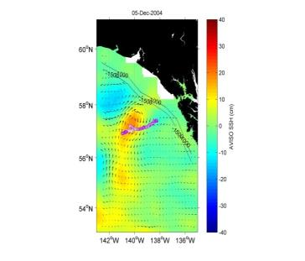
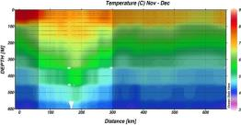
Animal Telemetry: Why is it Significant?
Animals record the ocean environment and fine-scale behavior of individuals even in the most remote regions of the world’s oceans (polar oceans or remote atolls)
Provide vertical oceanographic profiles throughout the upper 1500 m of the water column and in some cases deeper (3000m)
Provide unique datasets for resource management, ecosystem health and ocean modelers
Photo: NOAA
Cross section of the eddy that the female elephant seal swan through. Showing its down welling nature.
(Courtesy: Costa, UCSC)
Notes:
Animal telemetry is the science of elucidating the movements and behavior of animals as they move through the world’s oceans, coastal rivers, estuaries and Great Lakes.
Animal telemetry devices (tags) yield detailed data regarding animal responses to the coupled-atmosphere and physical environment through which they move.
Animals are particularly adept at helping scientists identify critical habitats, spawning locations, and important oceanographic feature (e.g. fronts, eddies and upwelling areas)
They also provide important insights into regions of the oceans that are difficult and expensive to monitor.

Slide 5
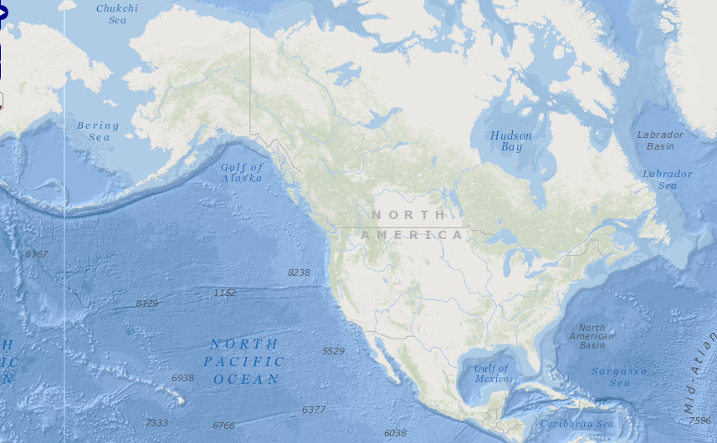
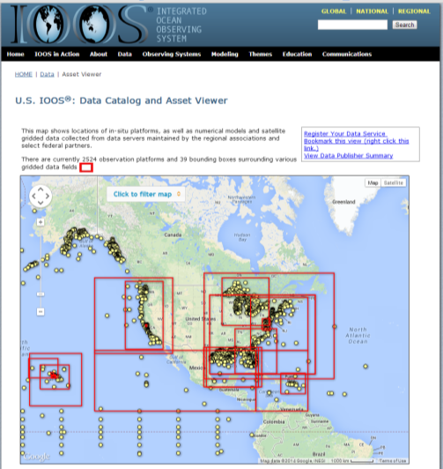
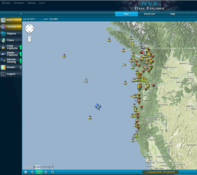
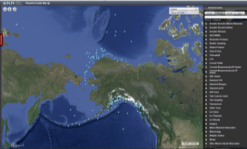
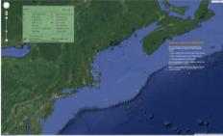
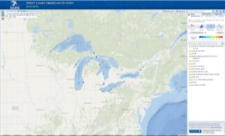
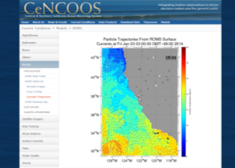
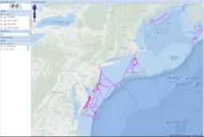
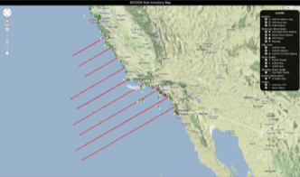
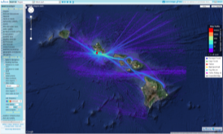
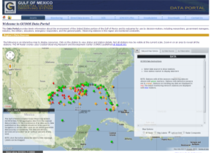
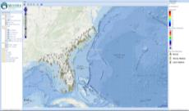
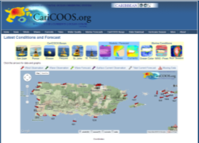
Exposing Data
Notes:
When the slide comes up – hit the mouse once and the remainder of the animations will take care of themselves. You are seeing examples of the data portals.
US IOOS is focused on data management. The IOOS Regions have the responsibility for helping us expose data from State, Local, Tribal governments; academia, and industry.
We have developed a single “recipe” for the Sensor Obsevation Service (SOS) and deployed 2 software i.e. THREDDS, 52N and ncSOS. Go the IOOS website to find out more information.

Slide 6
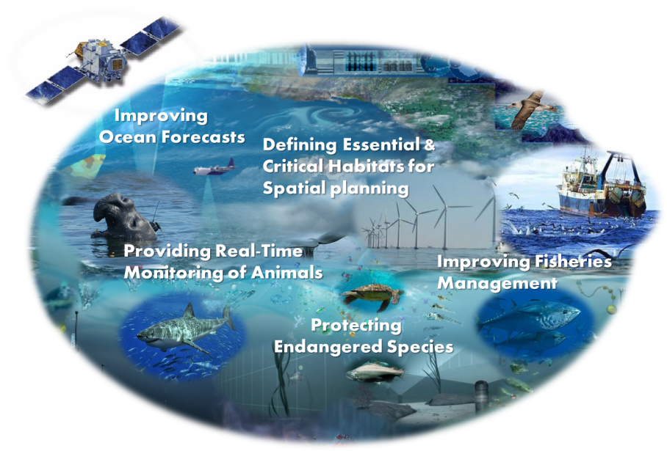

BENEFITS OF AN US ANIMAL TELEMETRY NETWORK (ATN) THROUGH US IOOS
Notes:
This is in early stages for US IOOS. Within the United States the tagging efforts are in response to scientific research as Regional basis and much of it being done in our academic community. There is not a national tagging program within the United States.
The US IOOS is stepping in to try to support the coordination of data coming from the community of taggers. For the US we will look across three broad categories of tags:
Archival, satellite and acoustic
Beneficiaries
Federal and state agencies
Fisheries, marine mammal, sea turtle and bird conservation and management communities
Tribal communities
Energy sector
Tourism sector
General public
Educational institutions
Private industry

Slide 7
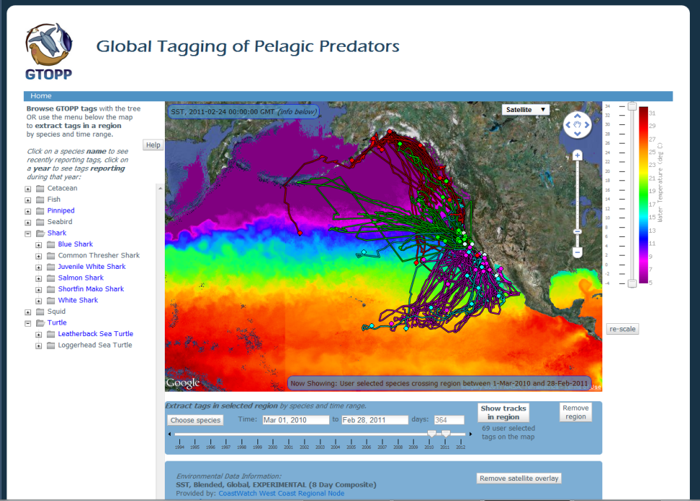
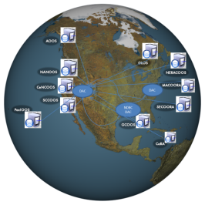




Building a New Generation of Animal Telemetry Data Portals : Ingest the Diverse Animal Tag Platforms
NDBC
Operational Forecasting Systems
Research Modeling Systems
e.g., EBM, MPA etc.
Archival tags
ATN DAC
RDBMS
Tracking data
ATN data &
Products
Research
education& training
Satellite tags
Other Users
Acoustic Receivers
Data
OTN, GOOS
Courtesy of Barbara Block, Stanford Univ.
Notes:
Based on technical recommendations from two U.S. IOOS Program (IOOS) hosted national Animal Telemetry Network (ATN) workshops, and a recent successful collaboration between IOOS, the U.S. Navy and NOAA’s National Weather Service on improved access to observations from tagged marine animals, IOOS, including Regional Associations, and the U.S. Navy (Naval Oceanographic Office and Office of Naval Research) have identified the need for a national and publicly accessible ATN data management capability, including the sustained delivery from anywhere in the world of real-time/near real-time marine animal telemetry data to a web-accessible portal with data visualization tools and timely data delivery to IOOS Data Management and Communications (DMAC) web services and the WMO Global Telecommunication System (GTS).
This new generation of animal telemetry data portal will have the capability to ingest data the diverse animal tag platforms (Archival, satellite and Acoustic). It will build on substantial existing capabilities of the TOPP program and SWFSC/ERD data management and distribution tools including recent refinements funded by NOAA to support the Damage Assessment, Remediation and Restoration Program (DARRPA) phase of the U.S. Government’s response to the Deepwater Horizon Oil Spill in the Gulf of Mexico. GTOPP and GulfTOPP.
Gulf TOPP is not publicly open system at this point. it’s protected under the NRDA confidentially agreement.
IOOS is fully committed to establish a long-term and sustainable capacity to deliver animal telemetry data to the ocean observing community.

Slide 8
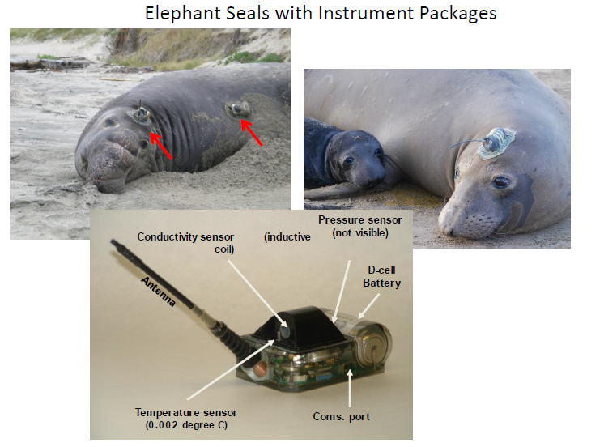
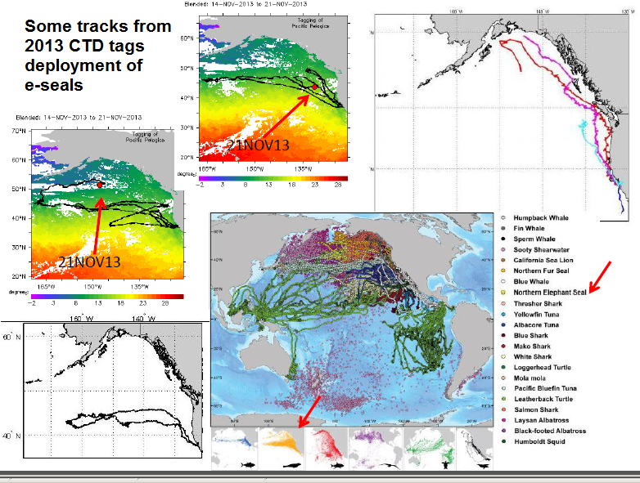


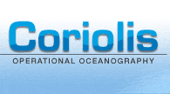

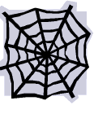

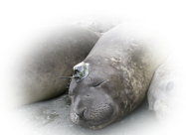





From Animals to GTS to Ocean Modelers
Real-time data flow
user
In 2012 IOOS PO/ONR co-sponsored a collaboration with the Stanford Univ., NAVOCEANO and NOAA NCEP to improve data interoperability tools and assimilation of ocean observations from tagged animals into NAVO’s global (HYCOM) and region (NCOM) models.
GTS
Courtesy: Dan Costa UCSC.
Notes:
When the slide comes up you will see a data schematic. This schematic is the notional concept on how we will put the ATN in place. US IOOS, in FY13, began funding this effort. The lead is Stanford Marine Lab.
Mouse click
The US ATN will be based on the excellent work of GTOPP and leveraging this effort gives US IOOS a head start.
Slide 8: From Animals to GTS to Models
When the slide comes up:
Data from CTD SRDL tags (Sea Mammal Research Unit (SMRU), Univ. St Andrews, Scotland) has been sent routinely to GTS via British Oceanographic Data Centre (BODC).
Mouse click – text box will appear
To link these ocean observations from tagged marine animals to ocean models, IOOS Program Office and US Navy – Office of Naval Research, in 2012 co-sponsored a collaboration with the Stanford Univ., Naval Oceanographic Office (NAVOCEANO) and NOAA National Center for Environmental Prediction (NCEP) to improve data interoperability tools and assimilation of these ocean observations into NAVO’s global (HYCOM) and region (NCOM) models. We did this by providing 3000 historical tags into a format that Navy could use. They used the historical data to calibrate their models and thus generated an interest in this capability.
Mouse Click – you should see images
In late February (2012), two elephant seals were tagged in Año Nuevo with SMRU tags that provide real-time CTD uplinks. The data was sent to GTS and were assimilated in real time into the Navy HYCOM models. In May the two CTD tags that were deployed on elephant seals in February 2012 were recovered by the UCSC field team and these same two tags were redeployed on two different female elephant seals in early June 2012. These tags are currently providing real-time CTD data through Stanford server. This shows that the animal telemetry is operational and can contribute to augmenting observing data access by modelers.
Mouse click:
In 2013, NAVO sponsored purchase of more CTD tags to deploy on elephant seals (by Costa team). Here some tracks from 2013 deployment. The observations were delivered to NAVOCEANO through GTS and also was made accessible through Stanford data access services.

Slide 9

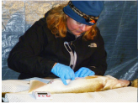
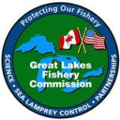
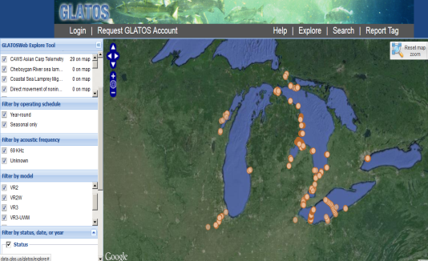
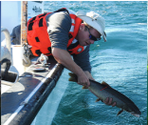

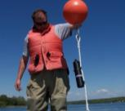

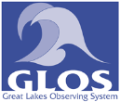

To Advance the Protection and Recovery of Great Lakes Fishes
Network of more than 400 Acoustic Receivers
More than 2300 fish have been tagged
  Green Bay Lake Sturgeon, Walleye, Lake Trout, River Sea Lamprey)
http://data.glos.us/glatos/explore
Notes:
Great Lakes Observing System (GLOS) is one of 11 IOOS Regions
GLATOS compiles acoustic telemetry project information and helps users learn more about ongoing acoustic telemetry projects in the Great Lakes. Scientists have been implanting Great Lakes fish with transmitters and have been tracking fish movement through a network of receivers placed on the bottom of the lakes. The purpose of GLATOS is to help scientists and the public learn more about Great Lakes acoustic telemetry projects and their contribution to research.
The network consists of more than 400 receivers anchored near the bottom of the lakes. More than 2300 fish have been tagged with transmitters. To date, more than 54 million pings have been recorded. With each ping, researchers learn more about fish movements, migration patterns, habitat use, and survival.
Receivers have been placed in key areas of the Great Lakes to help investigate specific research questions—for instance, walleye movement patterns in Lake Huron and the Huron-Erie corridor and lake trout spawning around Drummond Island, Lake Huron. Any scientist with the right tags can take advantage of this network. As the network grows—either through GLRI projects or otherwise—the information and, perhaps, linkages among projects—grows as well!
Take home message: To date GLATOS data has provided important information to control sea lampreys and to restore native fishes.

Slide 10


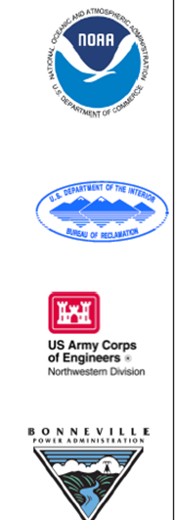
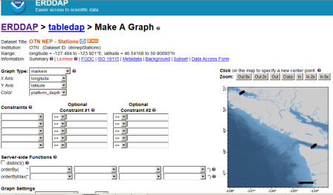
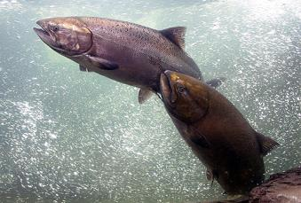
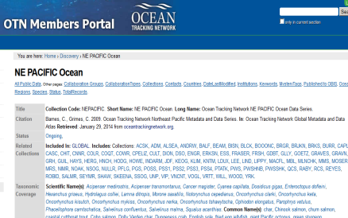
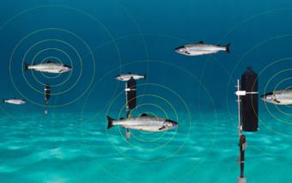


Animal Telemetry Supports Adaptive
Management of Salmon and Steelhead
Photo: NOAA
Source: Vemco, inc
Salmon tagged with Acoustic tags
Underwater Acoustic receivers
Notes:
2012-2013, IOOS Program office O sponsored another collaboration with the Pacific Ocean Shelf Tracking (POST) now part of OTN, NANOOS, OTN, IMOS Australia. NOAA Fisheries and other agencies to improve access to Animal Acoustic Telemetry Data needed for managing the operation of the Federal Columbia River Power System and determining if performance standards required in the Biological Opinion are being met.
These data can now be publicly accessible through NANOOS and OTN data services and are used to guide management decisions and provide feedback on how a particular action has improved conditions for fish.
As part of the IOOS Animal Telemetry Network efforts, in 2012-2013 NANOOS co-led a community needs assessment and data-access technology development project on animal acoustic telemetry data. While the project used Pacific NW data, it brought together not only regional partners such as the NOAA Northwest Fisheries Center and the Hydra system, but also national, Canadian and Australian collaborators. Core project partners included IOOS, the Pacific Ocean Shelf Tracking Project (POST) now part of OTN, and Ocean Tracking Network (OTN). The primary outcomes were the development of data exchange standards and best-practice data delivery systems that are now being implemented at a wider scale by OTN to provide access to their OTN Northeast Pacific data node, which includes POST data.

Slide 11
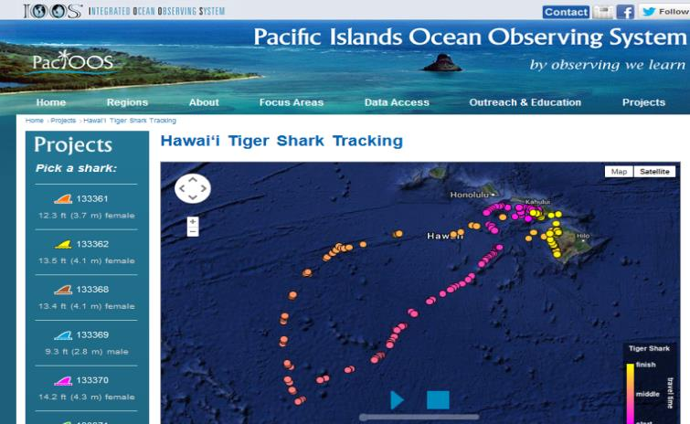









Management Response:
Tiger Shark Case in Hawai’i
Notes:
PacIOOS Voyager map shows the movements of several tiger sharks who were fitted with satellite tags near Maui in late 2013.
These data is critical for decision makers to select appropriate management responses to Shark attacks in Maui waters.
Story.
Issue: Maui has witnessed a higher number of unprovoked shark attacks than in previous years, and local spear fishers report increasing boldness of large sharks encountered in Maui waters.
Animal Telemetry information will help determine whether sharks around Maui are more resident (more "site-attached") than they are around the other Hawaiian Islands and whether they exhibit greater use of inshore habitats than in other locations.
With funding from the State of Hawaiʻi Department of Land and Natural Resources (DLNR) Division of Aquatic Resources (DAR), these data were collected by Principal Investigators Carl Meyer, Ph.D. and Kim Holland, Ph.D. along with other members of the Shark Research Team of the Hawaiʻi Institute of Marine Biology (HIMB) of the School of Ocean and Earth Science and Technology (SOEST) at the University of Hawaiʻi at Mānoa (UH)

Slide 12



Southern Ocean: Using all sources
Animal Tagging
Traditional Sources
Notes:
Self explained. Data from CTD, Argo float etc. i.e. Conventional sources.

Slide 13

Animal Telemetry for Assessing Ecosystem Health
Figure from Guinet et al. 2013)
Notes:
Tags are becoming more sophisticated. The new animal Borne Fluorometer Tag has only recently become commercially available. Deployed in 2012 and 2013 on elephant seals in southern Ocean, the tags successfully collected Chl a as the seal moved through the water column.
Top: female Southern elephant seal (SES) equipped with a CTD-FLUO-SRDL and section to the track followed by a juvenile SES female between January–April 2009.
Bottom: Interpolated fluorescence profiles provided by this SES along its track. The abrupt change in Chl a concentration (km 2400) coincides with sea-ice formation which took place in mid-march. These data show both the latitudinal change in the phytoplankton concentration along a north south transect performed during the inward trip (i.e., 1600km south of Kerguelen 500m isobath) and the transition in phytoplankton concentration in Antarctic waters from summer to fall (from km 1600 to 2400). Figure from Guinet et al. 2013. Christopher Guinet is a French scientist (Centre d'Etudes Biologiques de Chizé-CNRS), and he is a member of the SOOS team.

Slide 14




Reduce Bycatch of Loggerhead Turtles in Hawaii
in Longline Fishery
http://sos.noaa.gov/Datasets/dataset.php?id=181#
Notes:
When slide comes up you will a picture of turtles along the front and when you do a mouse click the front will move north and the turtles follow
Animation (2 figures)
The animation represents a daily climatology showing the Loggerhead turtle daily movement, independent of the year. The background is a daily climatology of satellite remotely-sensed sea surface temperature.
Animal telemetry data has shown that Loggerhead sea turtles use surface chlorophyll and temperature gradients to determine their migration habits. In this dataset, the turtles generally remain in a narrow temperature band and move north and south seasonally with that temperature band. Also, the eastern region of the Kuroshio Extension Current near Japan represents an important mid-oceanic foraging hotspot, where many of the turtles in the dataset can be viewed.
This information from animal telemetry helped NOAA. Fisheries to develop an operational TurtleWatch product that longline fisherman can use to reduce turles bycatch.
Mouse click - NOAA TurtleWatch figure:
The current operational TurtleWatch product. The red-blue color scale depicts gradation in average sea surface temperature for the most current 3-day period. The grey arrows represent the direction and velocity of ocean surface currents for the latest 7-day period. The brown band across the middle represents the "TurtleWatch Zone", or the surface temperature range (63.5°-65.5°F) where fishers are advised to avoid deploying shallow-set gear. POC: Jeffery Polovina, NOAA, Pacific Island Fisheries Science Center
Jeffery Polovina, NOAA, PIFSC

Slide 15





Fishing for Hurricanes
What Do Hurricanes and Tarpon Have in Common?
They all prefer SST greater than 26 ºC = 78.8 ºF.
Data collected by Sat Tags on Tarpon, i.e. could help meteorologists make more accurate hurricane forecasts.
Migration track and vertical
temperature profile of Tarpon 86
Migration track and vertical
temperature profile of
Tarpon 116
Daily average temperatures (black dots) and associated monthly frequency distribution (histogram bars).
Courtesy: Jerry Ault and Nick Shay
Notes:
From a paper by Nick Shay, University of Miami and Jerry Ault, Rosenstiel School
Shay, professor of meteorology and physical oceanography, plots the depth and location of the 26° C isotherm—a zone of warm water equal to 78.8° F—on his website.
Meteorologists find the data useful, since hurricanes are known to intensify after passing over pockets of warm water in the ocean. The deeper the warm water goes, the more intense a storm becomes.
The problem with Shay’s satellite model was that it had trouble defining the boundaries of the isotherm. This kind of data can be obtained by gliders. But, in the strong currents off the Gulf Coast, gliders may be less effective. “The Gulf current moves at around 6 or 7 miles per hour, whereas gliders move at about half a knot, or .6 miles per hour”. Animals like Tarpon, on the other hand, travel at sustained speeds of 35 miles per hour. They can go up to 50. They’re not going to get washed out to sea by the Gulf Stream.
Jerry Ault Rosenstiel School recently discovered that tarpon adhere to the 26° C isotherm during their annual migration through the Gulf of Mexico and the Caribbean Sea. By using Ault’s fish to gather temperature and depth data about the 26° C isotherm, they could essentially fill in the gaps of Shay’s satellite model. The fish, in other words, could help meteorologists make more accurate hurricane forecasts – this is a hypothesis not an active program in NOAA

Slide 16


Gulf of Mexico Habitat Restoration Effort
Mapping Spawning Habitat of Bluefin Tuna in the Gulf of Mexico
Critical Area Intersects Deepwater Horizon Oil Spill.
Credit: NOAA
Courtesy: Barbara Block, Stanford Univ.
Notes:
This is funding from the National Resources Damage Assessment work and that is still under wraps. I understand Barbara is doing a press release at 11 am on some of the results of the work.
Important point is to say that tagging of fish is being used to understand the effects of the DWH spill and will be part of the science used to understand and restore the Gulf of Mexico.
Important note: The GulfTOPP was developed by Stanford University and NOAA .Fisheries with NRDA funds. It’s not open to public yet. It’s still under NRDA Confidentially Agreement.

Slide 17





Gliderpalooza
17 deployments; 403 days in the water – 8140 kilometers covered
14 Partners:
  Ocean Tracking Network, Canada;
  University of Maine; Woods Hole Oceanographic Institution, University of Massachusetts, Rutgers University, University of Delaware, University of Maryland, North Carolina State University, University of Georgia, Teledyne Webb Research Corporation
>25,000 profiles
Dec 2013
Notes:
More than just gliders – the goals include
Provide a unique data set to modelers
Provide standardized dataset a over ecological scales and information on fish/mammal migrations
Provide a 3-D snapshot of the MAB cold pool
Provide an extensive distributed network through the peak period of fall storms, demonstrating "surge" capacity
Demonstration of a national glider network
Proof of data flow through IOOS to NDBC via DMAC
Engage undergraduates in ocean observing efforts.

Slide 18



Notes:
GOOS is the Global Ocean Observing System. A single, contiguous, body of water encircles the globe. From the Arctic ice through the warm equatorial waters to the Antarctic Circumpolar Current all the Earth's oceans, seas, bays and inlets are connected. They form one body of water, the one Global Ocean. GOOS is designed and being implemented to embrace the oceans as a single entity, to provide a global view of the ocean system.
GOOS is a permanent global system for observations, modelling and analysis of marine and ocean variables to support operational ocean services worldwide. GOOS provides accurate descriptions of the present state of the oceans, including living resources; continuous forecasts of the future conditions of the sea for as far ahead as possible, and the basis for forecasts of climate change.
GOOS is a system of programmes, each of which is working on different and complementary aspects of establishing an operational ocean observation capability for all of the world's nations. UN sponsorship and UNESCO assemblies assure that international cooperation is always the first priority of the Global Ocean Observing Sytem.
GOOS is the oceanographic component of GEOSS, the Global Earth Observing System of Systems .
GOOS is designed to:
Monitor, understand and predict weather and climate
Describe and forecast the state of the ocean, including living resources
Improve management of marine and coastal ecosystems and resources
Mitigate damage from natural hazards and pollution
Protect life and property on coasts and at sea
Enable scientific research

Slide 19



Engage the International Community
Notes:
IOOS rep on Ocean Tracking Network Council (Zdenka) is helping to engage the international community.

Slide 20



IOOS ATN Contribute to MBON and GEO BON
IOOS ATN to provide data and information on Marine Biodiversity (Aquatic species presence and abundance) to meet:
1- National MBON and Biodiversity Targets
2- International Biodiversity effort such as GEO BON and CBD Aichi Biodiversity Targets 2020.
Notes:
In addition to GOOS, we are also trying to support the Us national and international Bio-Diversity community with the use of animal telemetry

Slide 21




ATN in Apps
Source: NOAA
Shark Net
Source: GTOPP, Stanford Univ.
Notes:
In addition to our traditional websites, we are communicating this information in new ways that spark the public’s interest

Slide 22

Questions

Slide 23


Ocean Tracking Network
Dalhousie University
Halifax, Nova Scotia
Canada
otn@dal.ca
+1 902.494.2357
oceantrackingnetwork.org
@OceanTracking
NAME: Zdenka Willis
INSTITUTION: U.S. IOOS
CONTACT: Zdenka.S.Willis @noaa.gov
Please Visit the U.S. IOOS Website
ioos.noaa.gov
Notes:
CBS Cape North

