Slide 1
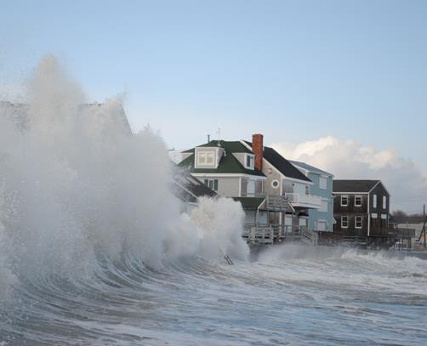
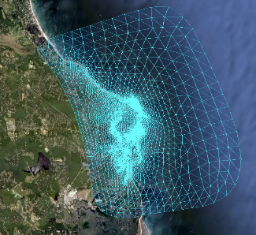
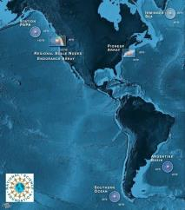
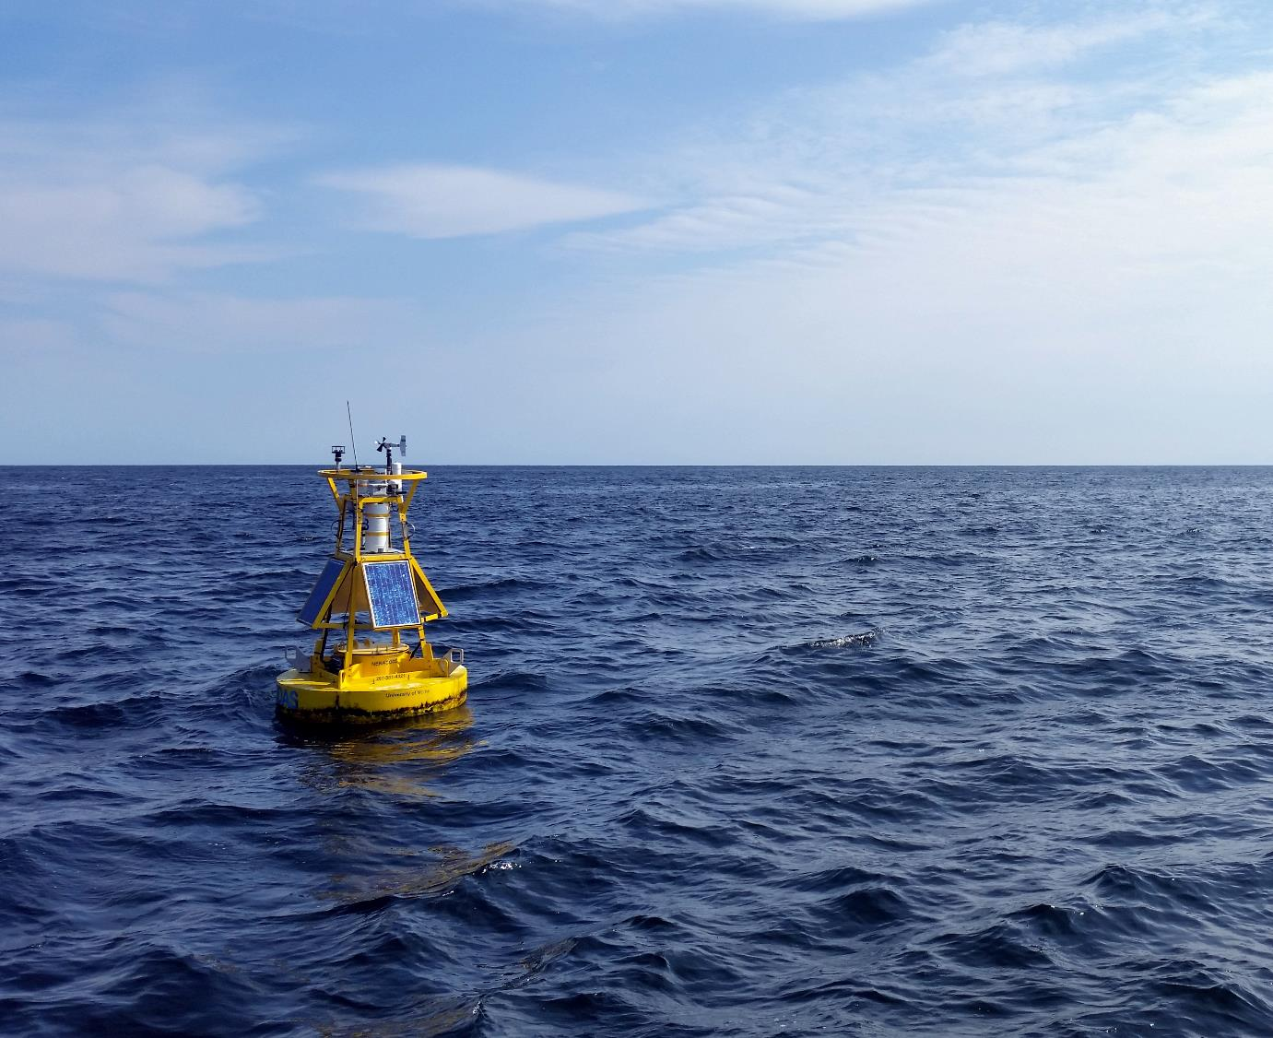
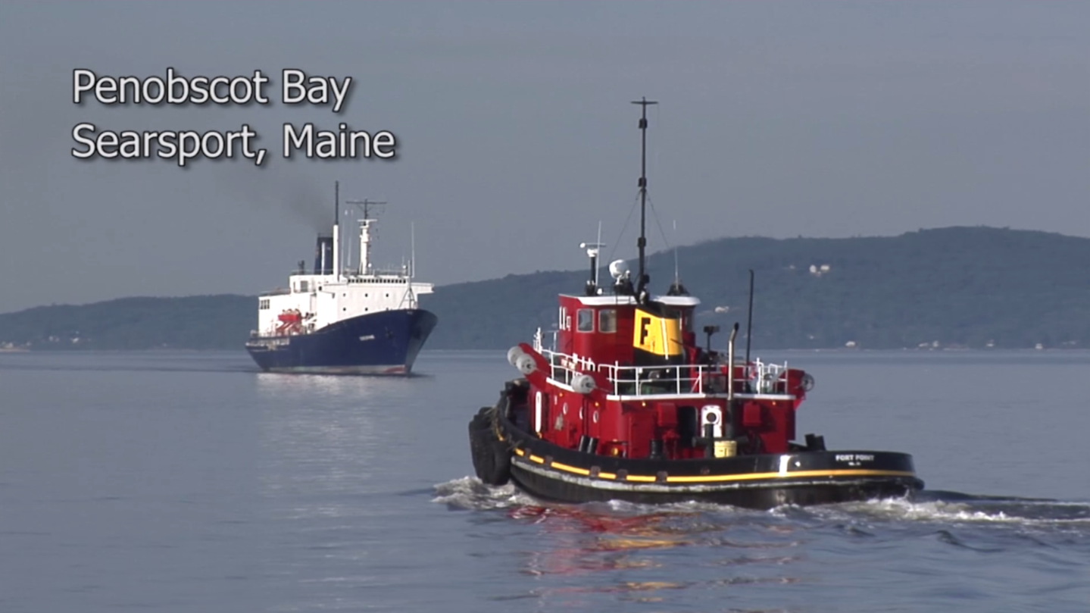
Zdenka Willis
IOOS Program Director
December 4, 2014
Notes:
Presented at the NERACOOS Annual Meeting Dec 4, 2014

Slide 2
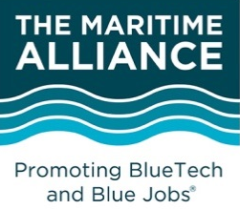
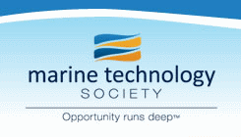
National Ocean Council
(NOC)
Key:
Direct Relationship
Advisory
Coordination
Global Earth Observation System of Systems
(GEOSS)
Subcommittee on Ocean Science & Technology (SOST)
U.S. IOOS Enterprise
Global Ocean Observing System (GOOS)
Interagency Ocean Observation Committee (IOOC)
IOOS Advisory Committee
NOAA
Federal Agencies
US IOOS Program Office
(within NOAA)
IOOS
Association
http://www.ioos.noaa.gov/about/governance/summit2012/ioos_summit_report.html
Alliance for Coastal Technologies (ACT)
IOOS Coastal and Ocean Modeling Testbed (COMT)
11 Regional Associations (RAs)

Slide 3
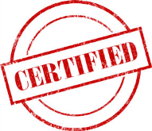

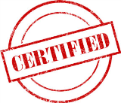

Competitive Award & Certification
Open for Certification - July 2014

Slide 4

FY2016 RA Federal Funding Opportunity
Timeline:
NOAA Approval - ~January 2015
Publish Announcement – ~January 2015
Proposal Close date – ~July 2015
Merit Review – ~September 2015
Forward Recommendations - ~March 2016
Make Awards – 1 June 2016

Slide 5
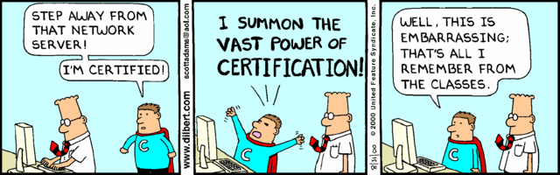
IOOS Certification
For the purposes of determining liability “arising from the dissemination and use of observation data” a certified RICE is considered part of NOAA
Drivers:
Certification is a requirement of ICOOS Act
Provides formal recognition to regional partners
Extends civil liability coverage for data use
We believe it is a good thing
Notes:
The IOOC shall:
“develop contract certification standards and compliance procedures for all non-Federal assets . . . to establish eligibility for integration into the System . . .
NOAA shall:
“promulgate program guidelines to certify and integrate non-Federal assets . . . into the System to provide regional coastal and ocean observation data that meet the needs of user groups from the respective regions”
Discussions go back years – certification referenced in the First U.S. IOOS Development Plan (2006)

Slide 6
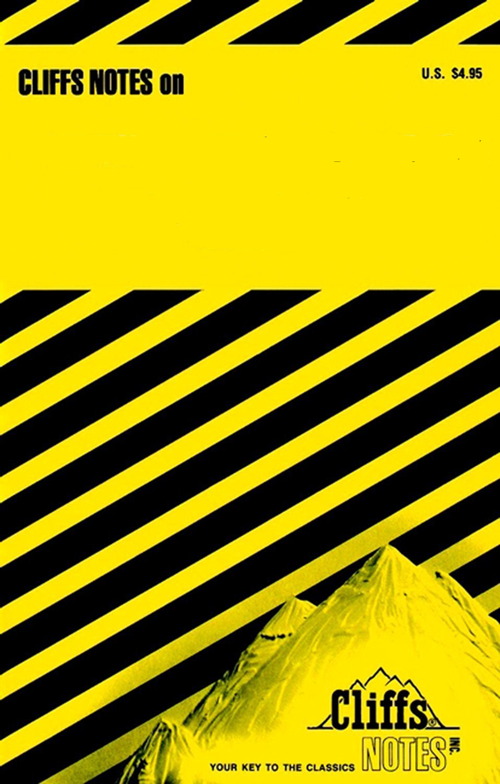
Cut to the Chase - Five Key Points
Establishes minimum criteria for how a RICE operates
RICE = RA
Civil liability applies to observation data
Certification is not connected to funding
Avoids being prescriptive when possible
RICE CERTIFICATION

Slide 7
Approach
Credible – recognize NOAA’s responsibility for ensuring data quality and assumption of liability risk
Reasonable – develop program guidelines in accordance with RA capabilities as supported by Program Office funding
A stand-alone process
Take advantage of existing documents & resources
Applicants will have to create some new documents
Notes:
That said, use all the existing documents & resources you have to show how you meet the requirements.
There will be some parts that will need to be created, particularly with some of the Strategic Operational Plan requirements – think DMAC

Slide 8
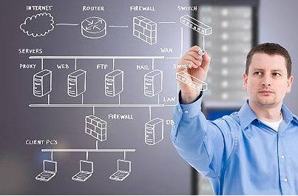
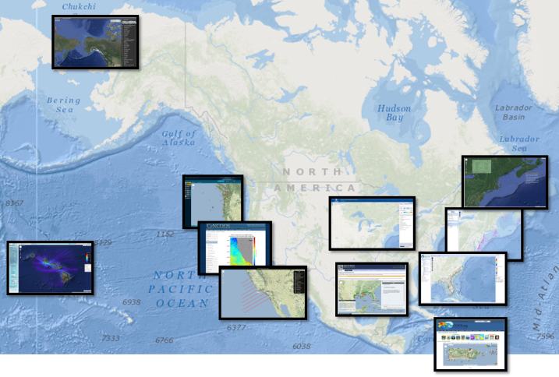

US IOOS Program Office: DMAC Focus
Image courtesy proactive IT
Technical solutions
Technical solutions
Implementation across the
enterprise
Image courtesy steve-dale.net
Building community
Technology
Process
People
Notes:
Activities aimed at technical solutions (requirements/standards/software)
Activities aimed at large scale implementation
Activities aimed at developing community
IOOS is not a standards body, but we often make choices about how best to do something, so as to optimize the layered architecture
Standards are necessary, but not sufficient

Slide 9
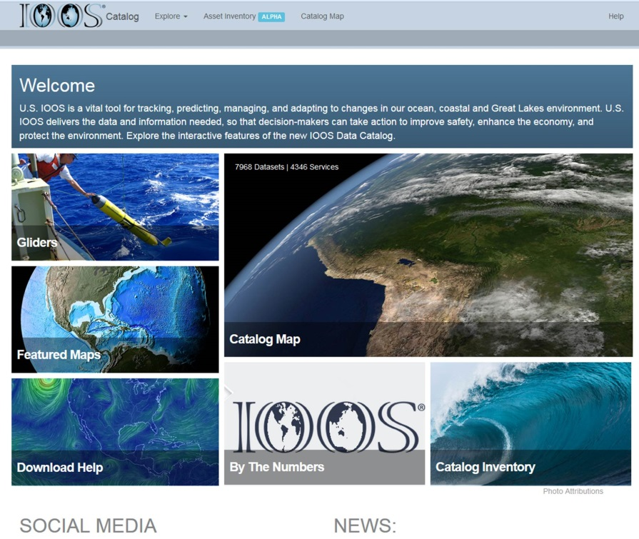
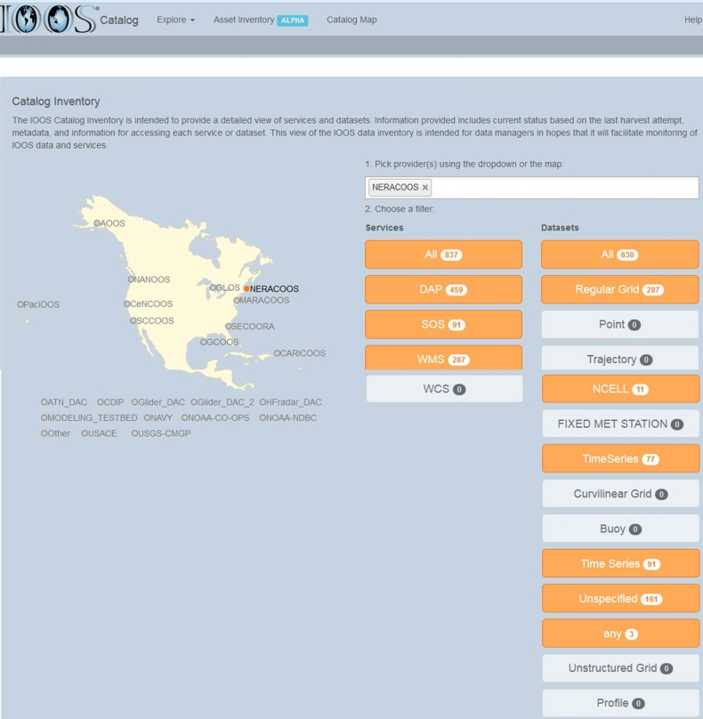
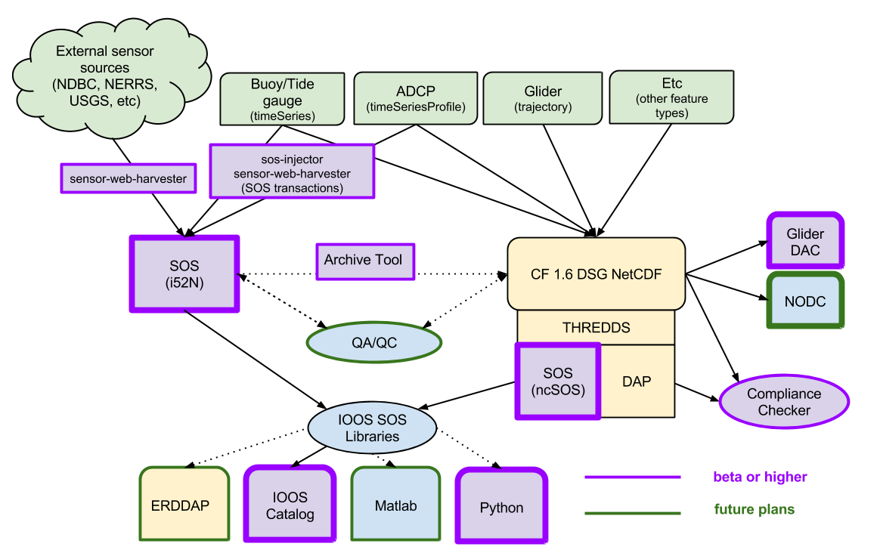
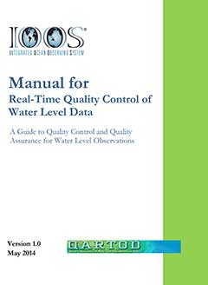
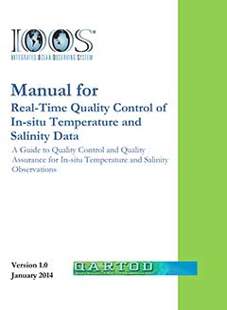
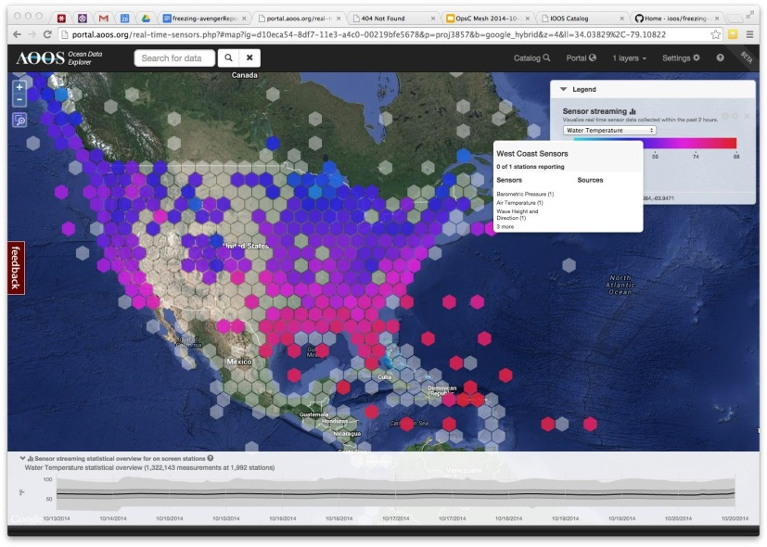
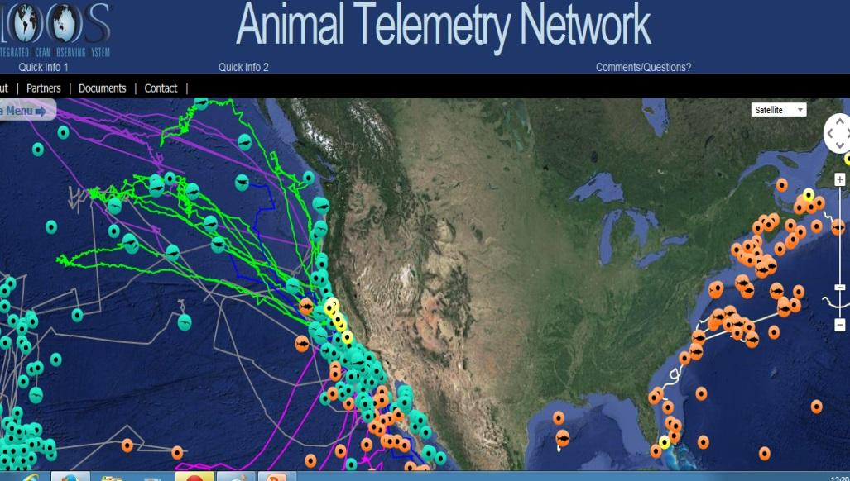
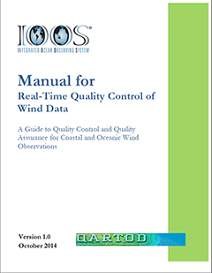
DMAC What’s New
http://catalog.ioos.us
http://www.ioos.noaa.gov/catalog
Notes:
Catalog: What: First comprehensive catalog of regional/Fed data available via services
Why: Demonstrate the scope of data integration efforts; test concepts to be implemented in the distributed system; serve as a program mgmt tool.
Outcomes: Recognized evidence of what sets IOOS apart.
ATN: Who: IOOS PO, NOAA, NAVY, Stanford Univ., UCSC, CenCOOS and other RAs.
Outcome: DAC ready to ingest new ATN data from different regions around the nation, including a variety of different species and tag types.
Brokering Test:
What: Rolling cache of federal backbone datasets; initial analysis tools; brokering SOS service
Why: Determine the performance tradeoffs between an entirely distributed vs centralized system; broker federal sources which do not implement DMAC standards.
Who: Axiom Data Science LLC
Outcomes: “All” Federal sensor observations visible and available in one place.

Slide 10
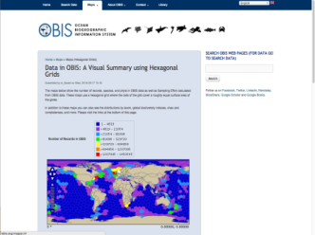
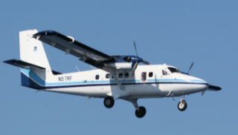
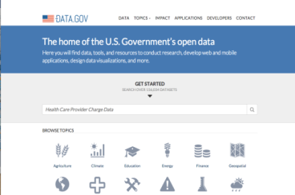


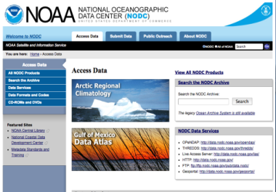
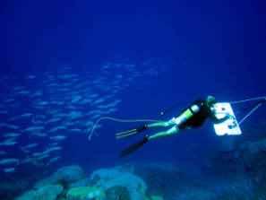

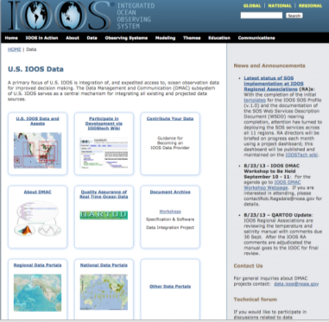
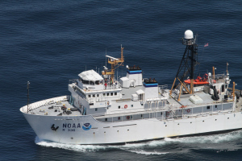
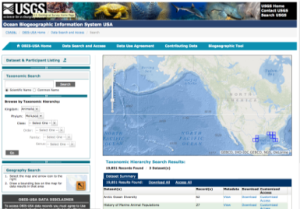
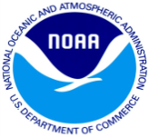
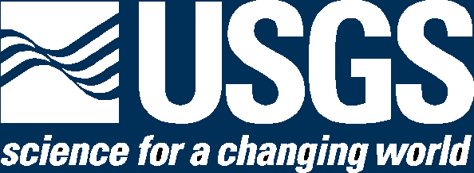
Improving Access to Federal Biological Data
Collect
Publish/Preserve
Access Products
DMAC-based process
Best Practices /
Data Standards
Metadata
Terminology
Web Services
Tools
Data Sources:
Federal
Academic
State
NGO
Data Include - Species (or taxon)
presence
absence
abundance
Safe Ocean Operations
Healthy Oceans
Sustainable Use
Hazard Protection
Economic Support
Notes:
Many agencies have a requirement to provide public access to agency data and emerging federal policies have highlighted the need for improving open access to data generated with federal funding. Several agencies need to access and analyze marine biological data to meet legislative requires such as the Marine Mammal Protection Act, Endangered Species Act, and the National Environmental Policy Act.
In an effort to meet these needs and requirements, OBIS and IOOS are working together and with partners at NOAA’s National Oceanographic Data Center (NODC) to improve the availability and accessibility of marine biological data collected by federal agencies or by others with federal funding .
This slide is based upon the Federal Marine Biodiversity Data Architecture:
Integrates with Federal data architecture
Includes data and metadata
Data Flow is from origination to US Products, Archive and to international commitments
USGS / IOSS Share role as both as a Partner and Federal Architecture steward
USGS provides expertise in biological informatics and data management and technology integration;
IOOS provides linkages to the Observing community and the technology framework;
Standards give access to integration using existing Global tools
Process DMAC-based:
Metadata – FGDC & ISO
Data Terminology – Based on Darwin Core International Standard
Tools – Based on US and International Data publishing tools
This partnership helps to address a key IOOS imperative – include data on our marine biodiversity and enable the integration of marine biodiversity data with other oceanographic data.

Slide 11
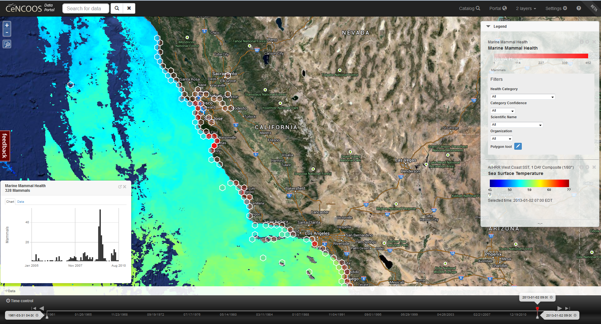
Biological and Physical Data Integration
Emerging capability: Beta version of emerging marine mammal health mapping tool
Notes:
Marine mammal stranding on the west coast overlayed on top of AVHRR Sea Surface Temperature.
Through a concerted focus on data management analysis tools like this are becoming prevalent across IOOS. Our focus on standards development and commonality of approaches is what makes this technology transferrable between regions, between federal agencies and between businesses.
Under Development not yet public, but just the sort of thing we are doing.

Slide 12
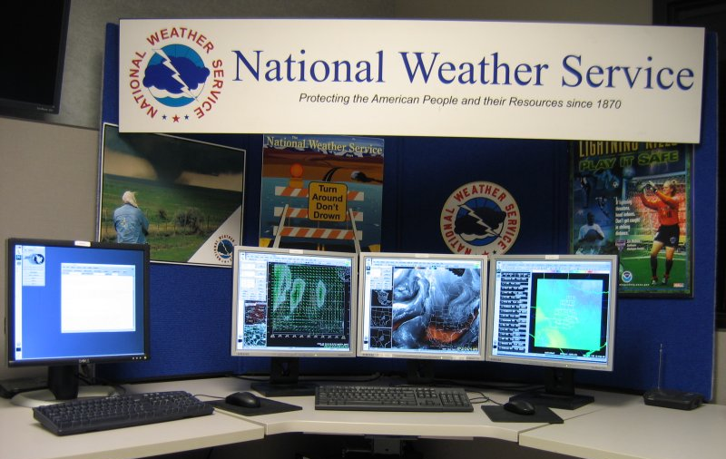
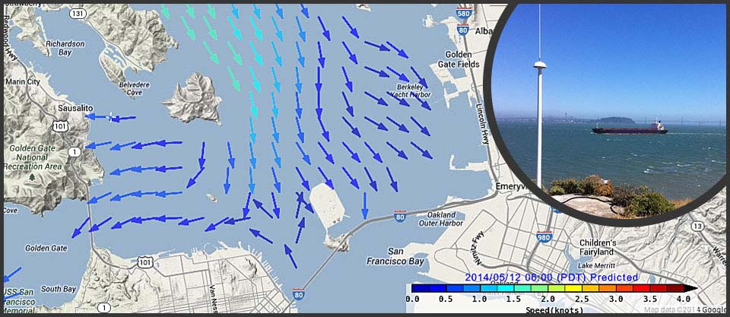
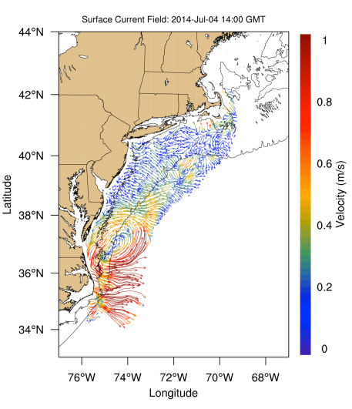
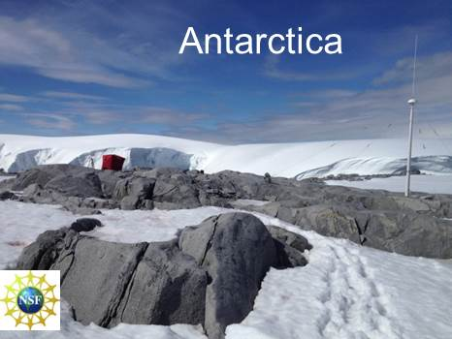
HF Radar Updates
Notes:
New web product offers broad spatial coverage of surface currents in areas that are vital to both commercial and recreational navigation.
Now operational in Chesapeake and San Francisco Bays, the web tool offers interactive maps and time series plots of surface currents, and complements PORTS
http://oceanservice.noaa.gov/news/may14/radar.html
HF Radar – also now in National Weather System used by the Weather Forecast Offices
Through National Science Foundation – deploying to Antarctica

Slide 13
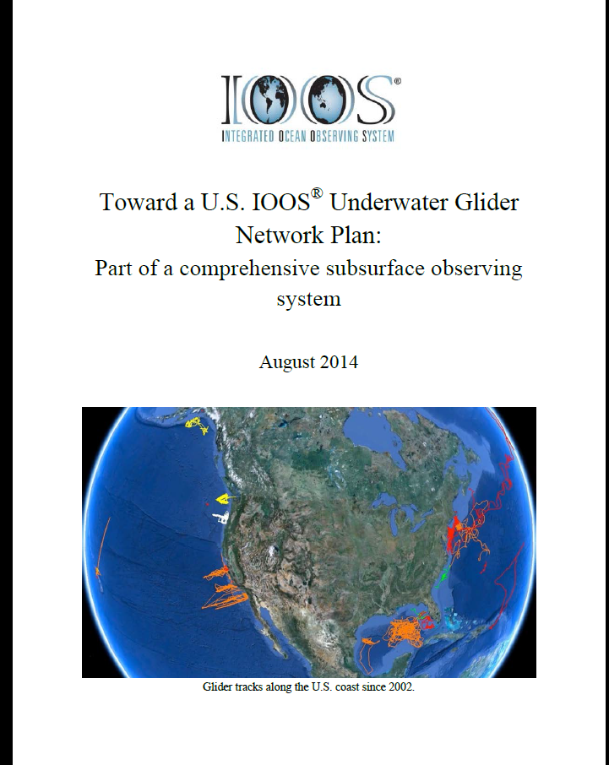
Glider - New
Glider DAC 2.0
Glider DAC review
IOOC – Glider Task Team
Deployments:
  Gliderpalooza 2014
  NOAA/AOML – Sandy Supplemental
  NOAA/IOOS – GCOOS glider – Hypoxia
  NOAA – Gliders pacific equatorial
  And many others

Slide 14
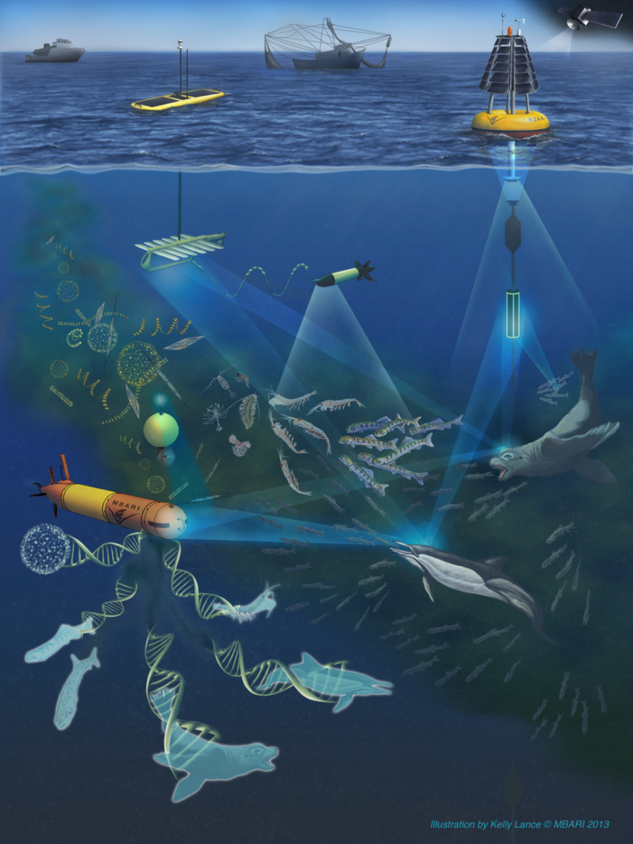
Marine Biodiversity
3 Mbon projects to show how marine and coastal data could be integrated into the system
This U.S. regional contribution to GEO BON is focused in in four geographic areas: the Florida Keys, Monterey Bay, Channel Islands, and the U.S. Chukchi Sea continental shelf.
http://www.ioos.noaa.gov/biodiversity/welcome.html
Credit: MBARI

Slide 15
Is there an Ocean Enterprise?
Public, Private, Non-Profit, Research, Academia
U.S Private Sector Weather Industry valued at $3B/annum
The Weather Enterprise
Information, Services, Infrastructure
ISSUES: Weather – Water – Climate
Notes:
This is a visualization of the Weather Enterprise. But what do we mean by an Enterprise?
The overall enterprise is comprised of Public, Private, non-profit, research and academic entities, who provide Information, Services and Infrastructure in the areas of Weather, Water, Climate
This definition comes to us from the National Academies of Science – Fair Weather: Effective Partnerships in Climate and Services in 2003 and continues to be the definition today.
Also in that study they put a value on the private sector – or weather industry. And in many follow on studies the word “enterprise” has been short hand for the Private Sector.
Click to Animate: Message: The Private weather industry is now valued at $3B/annum in the US and $6B/annum globally (with much larger values for derived products, e.g weather risk products ~8B/annum.
Segue: So can we make the same analogy for the Ocean Enterprise?
Extra Info:
The National Academies defines the “enterprise” includes all entities in the public, private, non-profit, research, and academic sectors that provide information, services, and infrastructure in the areas of weather, water, and climate. The public sector includes the NWS as well as other weather-related line offices within NOAA, other federal agencies, and state and local governments.
The studies when referring to the size of the “enterprise” uses the shorthand of referring to the “enterprise” as just those that elements outside NOAA that it can draw on in its mission. Within this, the private sector is present in two major areas: 1) services companies providing a broad range of data, forecasts, warnings, and value-added products to consumers and businesses, and 2) infrastructure companies providing systems such as satellites. The private began in the 1950s and grew data being a public good, directly out of NOAA’s NWS. This is truly a public-private enterprise.
According to National Academies – Fair Weather: Effective Partnerships in Weather and Climate Services (2003 – “There are about 400 commercial weather companies and independent contractors in the United States, with revenues of about $500 million.” The most recent data on the private sector input is by David Spiegler, 2007, who identified $1.65 to $1.8 billion of activity associated with weather-based services. The National Academies of Science defines the “enterprise” includes all entities in the public, private, non-profit, research, and academic sectors that provide information, services, and infrastructure in the areas of weather, water, and climate. The public sector includes the NWS as well as other weather-related line offices within NOAA, other federal agencies, and state and local governments. But in most reports “enterprise” is often used as shorthand to refer to those enterprise elements outside NOAA that it can draw on in its mission. Within this, the private sector is present in two major areas: 1) services companies providing a broad range of data, forecasts, warnings, and value-added products to consumers and businesses, and 2) infrastructure companies providing systems such as satellites.

Slide 16
The Ocean Enterprise
Public, Private, Non-Profit, Research, Academia
Information, Services, Infrastructure
ISSUES: Oceans – Ecosystems – Climate
Notes:
Message: Is there an Ocean Enterprise? Yes. This flow chart shows you how we are thinking about it.
We can set up the same structure – the issues are slightly different.
We also have Public, private, non-profit, research and academia, who provide information, services and infrastructure BUT to Oceans, Ecosystems and Climate
Segue (go to next slide)- but unlike the short hand for the Weather Enterprise – we have NOT articulated the value of the private Ocean industry.

Slide 17
The Ocean Enterprise – Private Sector
PROVIDERS
SERVICES
INFRASTRUCTURE
INTERMEDIARIES
VALUE-ADDED
PRODUCTS
ISSUES: Oceans – Ecosystems – Climate
Notes:
Message: While there have been several studies that have looked at the private weather enterprise within the United States, there have been no equivalent studies for the marine/ocean enterprise. In other words, we don’t know how to value the Ocean Enterprise, particularly in the private sector!
First: We needed to define the Private Sector in a similar way to the Weather Enterprise and have done that by categorizing the private sector into:
Providers: Infrastructure companies providing systems such as buoys, gauges, unmanned vehicles, cyber infrastructure, services such as bathymetric collection
Intermediaries: Provide a broad range of data, forecasts, warnings, surveys, and value-added products to consumers and businesses
As I said we do not know the value of the Ocean Private Sector; however, we do know that based on the San Diego Maritime Industry Report 2012 the maritime industries in the San Diego region are out, showing a direct economic impact larger than any other sector besides defense. With Total Employment: 46,000 jobs and Total Revenues: $14 billion (2011).
The Maritime Alliance and ERRIS were involved in the San Diego Study
In that study in the areas of Ocean Observing and Science and Robotics and Submarines as growth areas of greater than 10% in the next 10 years.
Segue: Based on the San Diego study and a study of United Kingdom business by the Society of Marine Industries- NOAA launched a study to articulate the economic impact of the Marine Industries of the Ocean Enterprise
Additional information
It is important to recognize that an organization can occupy multiple roles in this complex landscape. Even NOAA represents this framework - NOAA can be a provider, an intermediate user, and an end-user in different parts of the organization. So here, the private sector can be providers and intermediaries.
NOAA through the U.S. IOOS program did an RFP and ERISS and The Maritime Alliance won the award. funds to do a study that will articulate the economic impact of the ocean observation sector in the U.S., focused on the private sector.

Slide 18
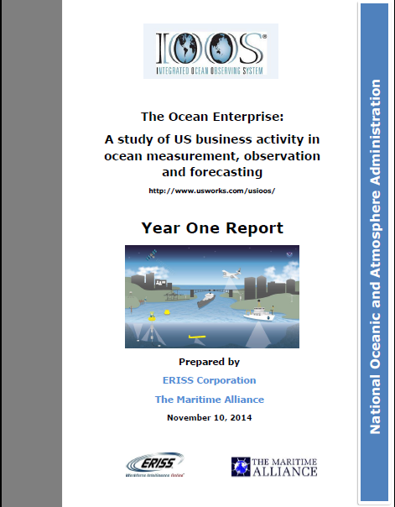
Ocean Enterprise Study of U.S. Businesses
>600 private sector firms
Most companies < 10 employees
83% providers;
9% intermediaries
Input Needed: http://www.usworks.com/usioos/

Slide 19
Marine Sensor Innovation
Sensor Evaluation
Coastal Modeling Test bed
Ocean Technology Transfer
Notes:
Sensor Evaluation: The lead organization is the Alliance for Coastal Technologies (ACT), a partnership of research institutions, resource managers, and private sector companies dedicated to fostering the development and adoption of effective and reliable sensors and platforms for use in coastal, freshwater, and ocean environments. ACT’s goals include: (a) rapidly and effectively transitioning emerging technologies into operational use; (b) maintaining a dialogue among technology users, developers, and providers; (c) identifying technology needs and novel tools and approaches to meet those needs; (d) documenting technology performance and potential; and (e) providing U.S. IOOS with information required for the deployment of reliable and cost-effective networks.
COMT: The COMT mission is to use applied research and development to accelerate the transition of scientific and technical advances from the coastal ocean modeling research community to improved operational ocean products and services (i.e., via research to operations and also operations to research). The COMT is envisioned as a national capability to enhance the accuracy, reliability, and scope of the Federal suite of operational ocean modeling products to meet the needs of a critical and diverse user community.
Ocean Tech Transfer: Sponsors the transition of emerging marine observing technologies, for which there is an existing operational requirement and a demonstrated commitment to integration and use by the ocean observing community, to operational mode. Effort is focused on developing and improving observation technologies for ocean chemical, biological, and physical parameters at multiple spatial and temporal scales to monitor changing conditions in the oceans coasts and Great Lakes. Marine observation technologies include hardware and software platforms, sensors, and data transfer technologies that collect observations in the marine and Great Lakes environments.

Slide 20
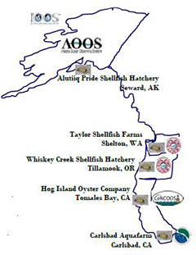
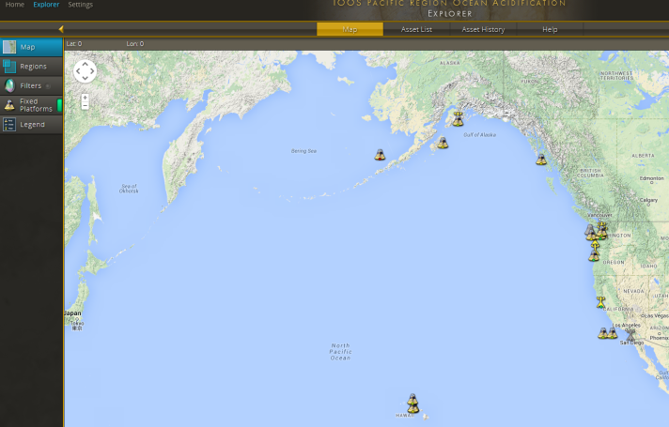
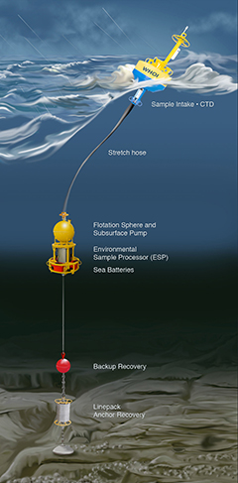
Ocean Technology Transfer – FY13
West Coast Ocean Acidification
Predicting Harmful Algal Blooms
Accomplishments
  Expanded Gulf of Maine ESPs
  Enhanced Reaction & Filter Puck
  Model Integration
  Data Delivery thru NERACOOS
Notes:
Enable real-time reporting from ESP
Use ESP data to evaluate the accuracy of model forecasts and hindcasts
Integrate ESP data to IOOS through the NERACOOS website
Data available through NERACOOS.org
Convert the hulls of
two ORCA moorings to allow the integration of the Battelle mapCO2 sensor package
Deploy monitoring equipment prototypes in Puget Sound (Dabob, Twanoh, Hood Canal or South Puget Sound)
Install beta aragonite saturation prototypes (burk-o-laters) 2 locations in CA and 1 location in AK
Enhance one of the ORCA moorings to allow measurement of pH profiles, byintegrating a SeaFET pH sensor with a profiling Seabird CTD.
Add capability to measure deep pH (50 m depth) to the Cha Ba mooring and provide realtime data access for these new measurements
Re- fit the NH10 mooring to accept
the NOAA-PMEL MAPCO2 and SeapHOx PCO2, pH, and O 2 measurement systems
Aggregate WA, OR, AK, CA, and HI real-time OA data streams, that are compliant with the IOOS Sensor Observation Service, into one portal
Open Water testing of DIC analyzer in Hawaii

Slide 21
Ocean Technology Transfer FY14
NERACOOS;Satlantic: Transitioning State-of-the-Art Nutrient Sensing.
NANOOS, UW, NOAA/NMFS/NWFSC; Spyglass: Operational Ecological Forecasting of Harmful Algal Blooms in the Pacific Northwest using an Environmental Sample Processor.
CeNCOOS, UCSB; McLain & Axiom: Integration of the Imaging Flow CytoBot into a 40-year Time Series for San Francisco Bay
AOOS, UAF; Pacific Gyre: Real-Time Sensor System for Detecting Freeze-up on Arctic Shelves
NANOOS, AOOS, CeNCOOS, SCCOOS, PacIOOS, NOAA/PMEL; Sunburst Sensors: Improving an Ocean Acidification Observation System in Support of Pacific Coast Shellfish Growers – continuation of FY13 project
Notes:
transition state-of-the-art nutrient sensing technology to develop an Operational Nutrient Observatory for the Northeastern United States;
develop an operational ecological forecasting capability for Harmful Algal Blooms in the Pacific Northwest using an Environmental Sample Processor
support water quality analysis and the integration of the Imaging Flow CytoBot data into an existing 40-year time series for San Francisco Bay;
develop an economical sensor package, using existing sensors in a new manner to accurately predict the onset of ice formation in the Arctic;
enhance an ocean acidification observation system in support of Pacific coast shellfish growers.
NE Nutrient Observatory: Satlantic
PNW ESP: Spyglass and MBARI
San Francisco Bay Imaging Flow Cytobot: McLain and Axiom
Detecting Arctic Ice Formation: Pacific Gyre
FY14 OA Project: Sunburst Sensors

Slide 22
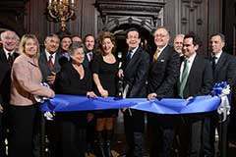
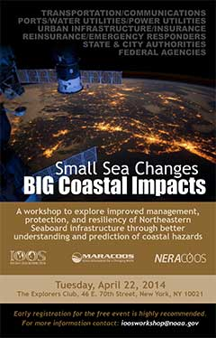

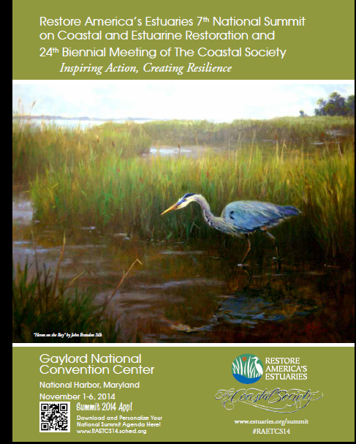
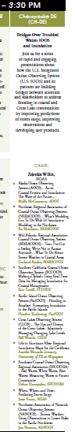
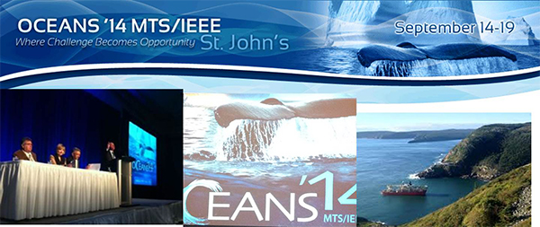
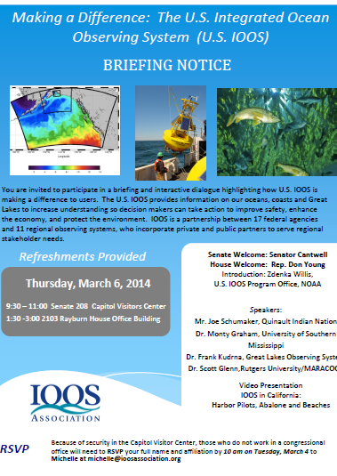
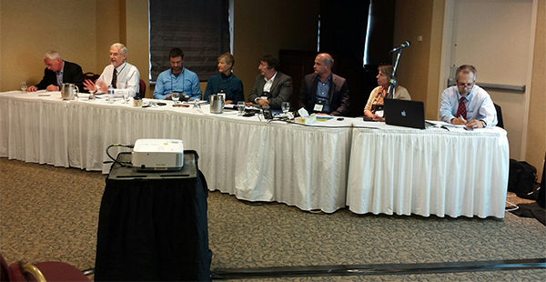
Key Events
Northeastern Seaboard Workshop
GEO Unanimously Endorsed for Another 10 Years
Launch of Institute for Community Resiliency and Climate adaptation University of Connecticut Avery Point
Hill Events (2)
Hearing to Focus on New Ocean Technologies May 21, 2014
IOOS IGNITE
Notes:
Hill Visit in May
Thomas W. Altshuler, Ph.D., Vice President & Group General Manager, Teledyne Marine Systems
Chuck Benton, CEO, Technology Systems, Inc.
Casey Moore, President, Sea-Bird Scientific
Dean Rosenberg, CEO, PortVision
Commander David M. Slayton, Research Fellow, Hoover Institution - Stanford University
Eric J. Terrill, Ph.D., Director, Coastal Observing Research and Development Center, Marine Physical Laboratory - Scripps Institution of Oceanography

Slide 23
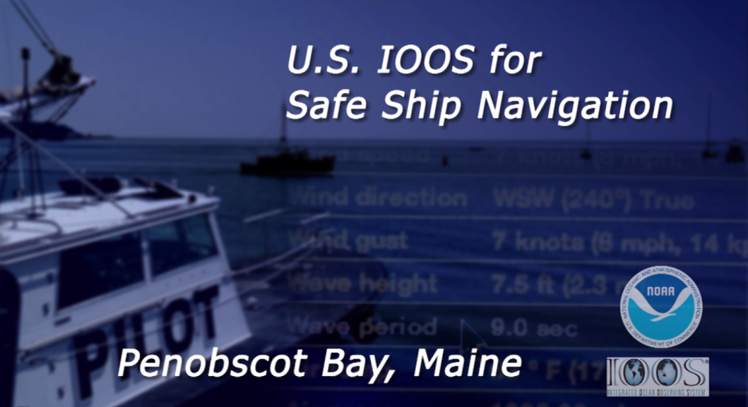



Communications
Video – 2 Videos
Web Site: www.noaa.ioos.gov
https://www.facebook.com/usioosgov
@usioosgov – New this Year
USGEO exhibit storymap: http://www.ioos.noaa.gov/understanding_earth/index.html
Press Release:
Pacific Portal
MBON
MARES
HF Radar into PORTS
Notes:
I am excited to share with you today the first of two videos that highlight how IOOS data is being used for Safe Ship Navigation.
In this video, we get to take a peek into the day to day operations of the Penobscot Bay Pilots Association and hear from Capt. David Gelinas on how IOOS data is used daily to safely transport hazardous materials such as oil, gas, petroleum, and other cargo.
Navigating large ships on an uncertain ocean is no easy task, but the real time observations provided by IOOS and NERACOOS are helping to reduce that uncertainty, supporting lives and livelihoods.

Slide 24
US IOOS at Work
Enables decision making
Fosters Advances in Science and Technology
www.noaa.ioos.gov
https://www.facebook.com/usioosgov
@usioosgov

