Slide 1
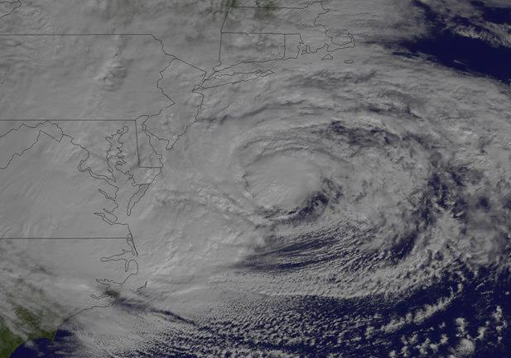
Coastal Impacts Response & Resiliency Presented by Joseph Picciano, P.E. Deputy Director for Preparedness NJ Office of Homeland Security & preparedness Big Coastal Impacts Tuesday, April 22, 2014 The Explorers Club New York, NY

Slide 2
What would Help?
(last slide first!)
Facility/type specific surge and unique weather warnings and recommendations –(for both immediately projected events and future climate implications)
Building NOAA/NWS warning systems into existing State and City Fusion Centers treating weather threats similar to security threats
Regional forecasts with recommendations that build in the implications of interdependencies (i.e. regional surge impacts on petroleum distribution and related power grids)
Greater exercising/coordination through public/private partnerships consistent with Presidential Directive 21 as it relates to resiliency

Slide 3
At Risk Facilities
Ahead
Storm and Hurricane Impacts a test of resiliency for New Jersey’s Critical infrastructure

Slide 4
Impacts for NYC and Urban NJ
Coastal Impact is measured in “consequences”
Consequences tests resiliency of critical infrastructure
We have more of everything in New Jersey as the nation’s most populated state and connected to the nation’s biggest city.
The US Gulf Coast has a combination of tourist attractions, supporting infrastructure, residential and business communities just inland and along its thriving coast – Katrina devastated Louisiana, Mississippi and Alabama
NJ has a similar mix of development. THE DIFFERENCE?
New Jersey has THREE TIMES the population density and even a greater proportion of critical infrastructure – Sandy, not even a hurricane, almost equaled the damage to critical infrastructure
In the end, population density drives vulnerability

Slide 5
Preparedness before Response
What's driving New Jersey’s efforts in protecting critical infrastructure and building preparedness?
The need to prepare and respond at levels not seen in our State
The need to regionalize our planning to prepare more effectively and respond by involving all levels of government and the Private Sector
The need to support county and local emergency management organizations with resources to enhance catastrophic planning
The recognition that planning must include the owners/operators of critical infrastructure, both public and privately owned

Slide 7
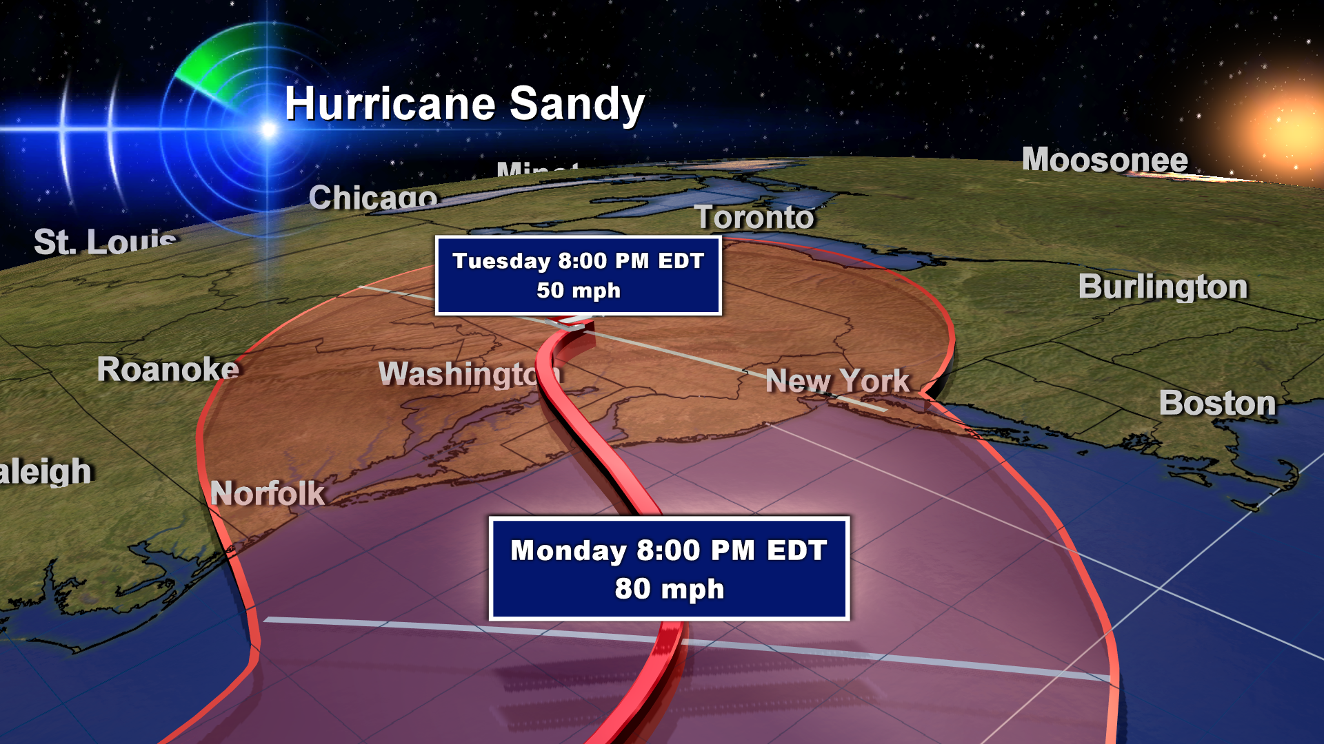
Category 1
Sustained Winds 85mph / Gusts 105mph
Storm surge > 14’
1,100 miles wide

Slide 8
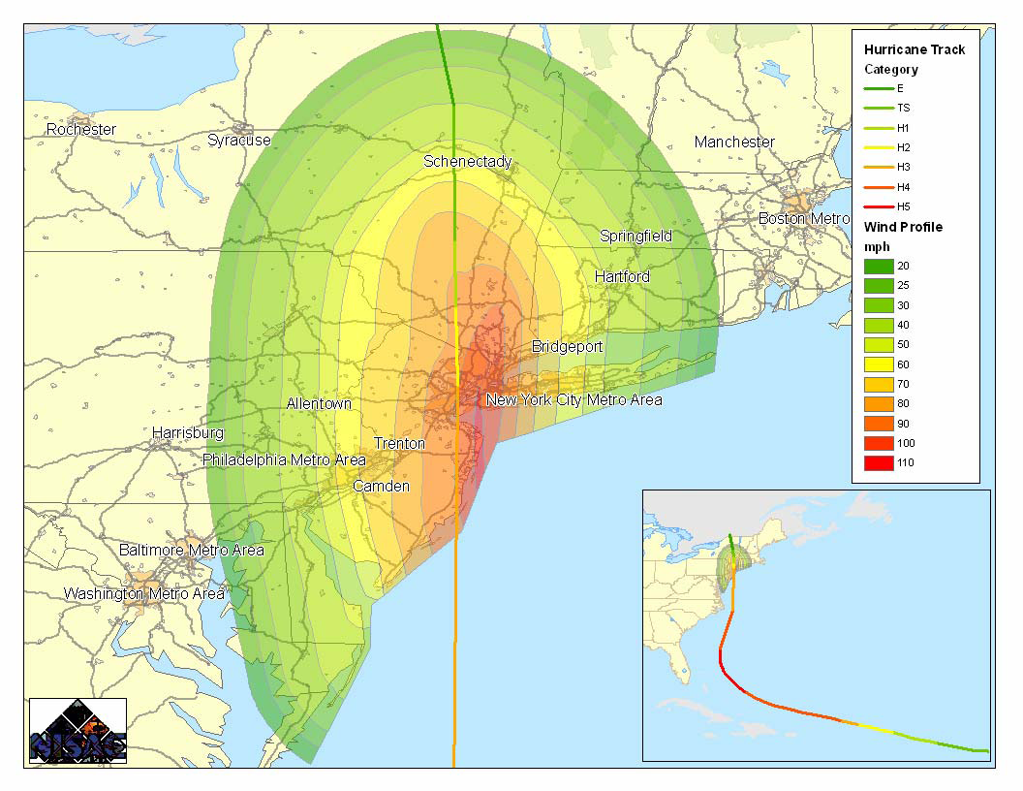
MODELED Hurricane Track and Wind Profile
Notes:
Past modeling done by OHSP in 2008. These models were similar to the impacts that Sandy brought.

Slide 9
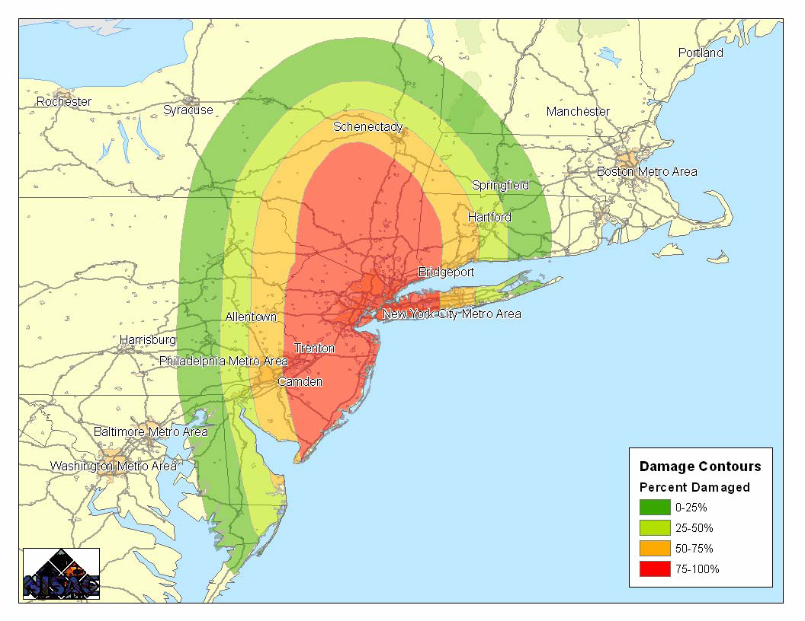
MODELED Electrical Power Failure Weeks or in some cases longer to restore power
Notes:
An estimate for electric power system damage is calculated based upon wind speeds, and
estimates of damage to above ground substations and transmission/distribution poles that
occurred in historic storms. The results are then used to project the areas likely to experience
power disruptions, and the duration of the potential power outages.
Hurricane damage to the electric power system is usually due to wind (impacting low-voltage
electric distribution components, and to a lesser degree transmission towers/lines) or water
(assets that are flooded). Figure 4-1 illustrates estimated electric power outages determined
for this hurricane scenario. Four outage zones are calculated; 0-25% (dark green) implying
that up to 25% of the customers are without power, 25-50% (light green) implying that up to
50% of the customers are without power, 50-75% (orange) implying that up to 75% of the
customers are without power, and 75-100% (red) implying that up to 100% of the customers
in this area are without power.

Slide 10
MODELED Beyond Wind --- Storm Surge
Notes:
Because the MODELED hurricane was a Category 5 storm over the Atlantic, a potential exists for very high storm surge in the New York City area. Inundation areas and inundation depths for this storm were estimated using reported information on historic storm surges, Saffir-Simpson storm surge ranges, local coastal shelf depths, and digital elevations models. When immediate response is required and coordination with NOAA or US ACE is not feasible, NISAC approximates surge extent based on a fixed set of buffers of the coastline and projected storm surges for the strength of the storm. The New York storm surge inundation was generated assuming a peak storm surge for the event of 19 feet. Figure shows the results of our surge inundation estimation for the scenario hurricane. Wide areas of Long Island, Brooklyn, Manhattan and the New Jersey coast are projected to have flooding problems.

Slide 11
Moonachie - Bergen County
Areas in blue and supporting critical infrastructure will be impacted by storm surge

Slide 12
Keansburg - Monmouth County

Slide 13
Seaside Heights “Think Commercial Sector Recovery”

Slide 14
Atlantic City

Slide 15
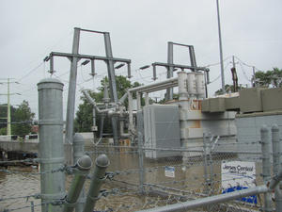
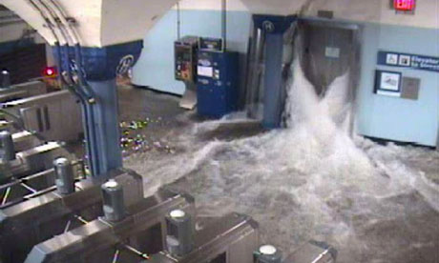
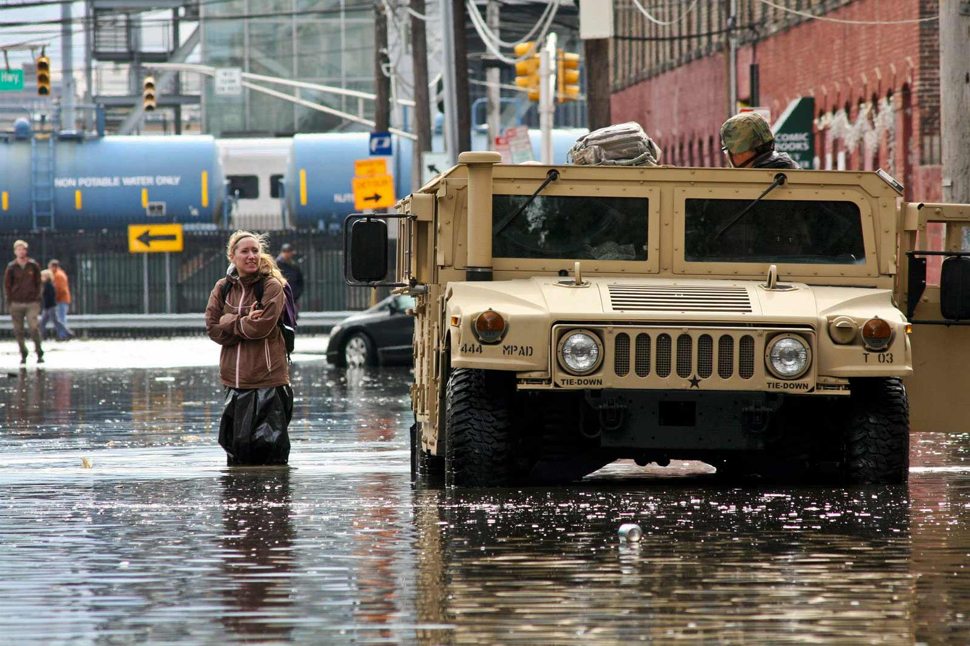
Other Critical Infrastructure Impacts
Flooded Electrical Substation – 14’ Surge
PATH – Hoboken Train Station
Petroleum Refinery Without Power
Critical Rail Outage

Slide 16
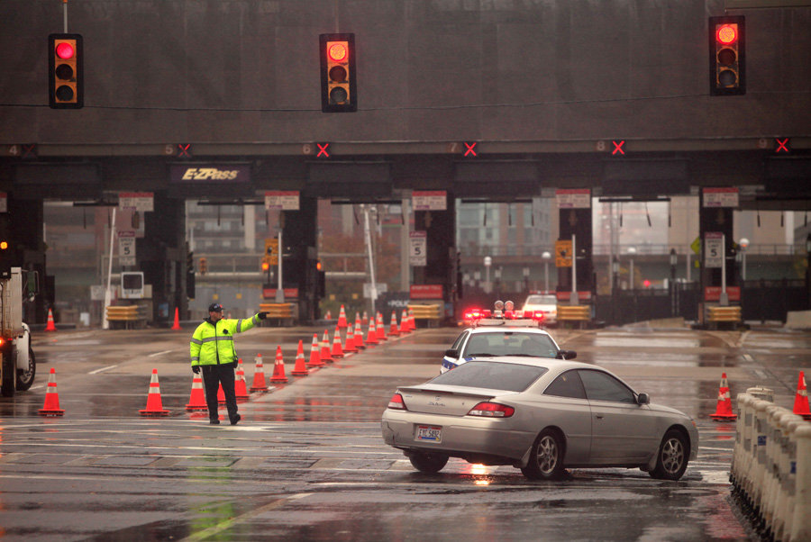
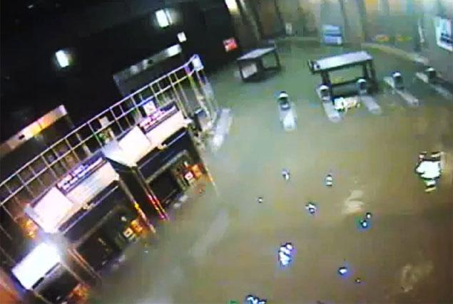
NY/NJ Tunnels Flooded
Major Train Stations
Flooded

Slide 17
Examples of New Jersey Initiatives built on the foundation of Prevention, Protection and Resiliency
Catastrophic Statewide Integrated Planning for Counties including identification of critical facilities
Integrating planning with the Food, Energy, Telecom and Commercial owners and operators insuring resiliency and limiting recovery time losses
Fuel distribution planning for emergencies with the three key legs of the petroleum sector, production, distribution and retail
Funding facility specific notification and warning systems
Fusion Center operations insuring timely and secure distribution of information as well as products identifying specific threats
Supporting programs for law enforcement and emergency management organizations in protecting critical facilities

Slide 18
Programs and Initiatives supporting Critical Infrastructure Protection and Building Resiliency in New Jersey

Slide 19
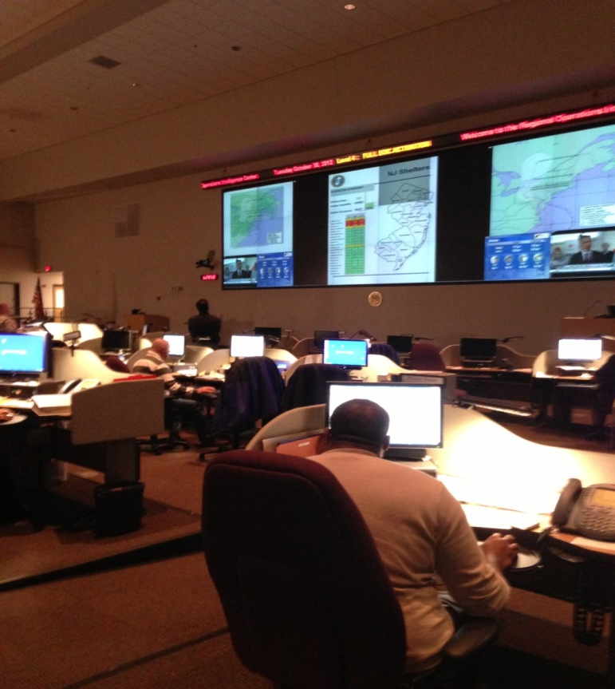
Information Sharing with Critical Sector Owners and Operators
PSD
Private Sector Coordination Desk

Slide 20
Critical Infrastructure Programs and Initiatives
OHSP management of FEMA Homeland Security Grant Programs supporting prevent and protect projects
FEMA’s Non Profit Grant Program
Mall security
Active Shooter Training
School Security
Regional Resiliency Assessment Program
Infrastructure Advisory Committee
Sector Working Groups
NJ Exit 14 and NY/NJ Port Decision Support Tool
Cyber Intrusion
Port Security

Slide 21
Critical Infrastructure Programs and Initiatives
Transportation Security
Critical Sector Exercise Program
Multi-State Coordination
All Hazard Consortium Sector Integration
Fleet Management
Regional CATEX exercises with sectors
CADET
Domestic Security Preparedness Act
Protective Security Advisors
Site Area Visits
Site Assessments

Slide 22
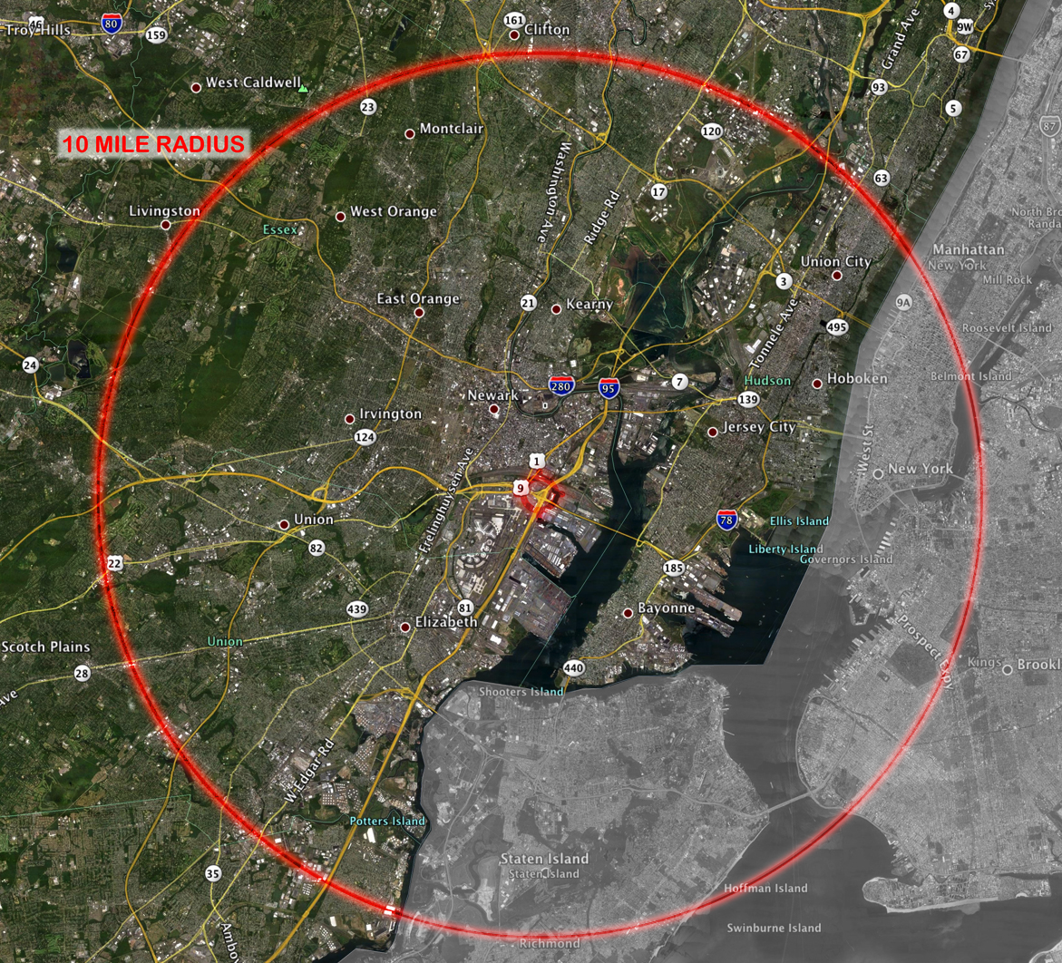
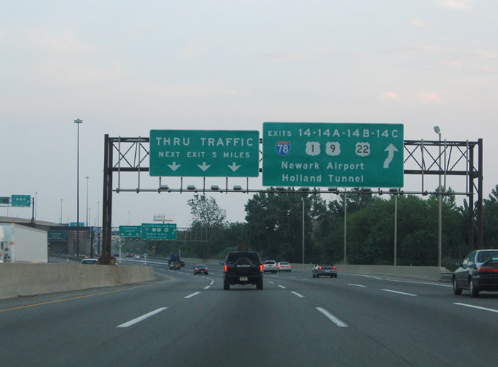
NJ Exit 14 and Port of NJ/NY Project
Decision Support Tool Basics

Slide 23
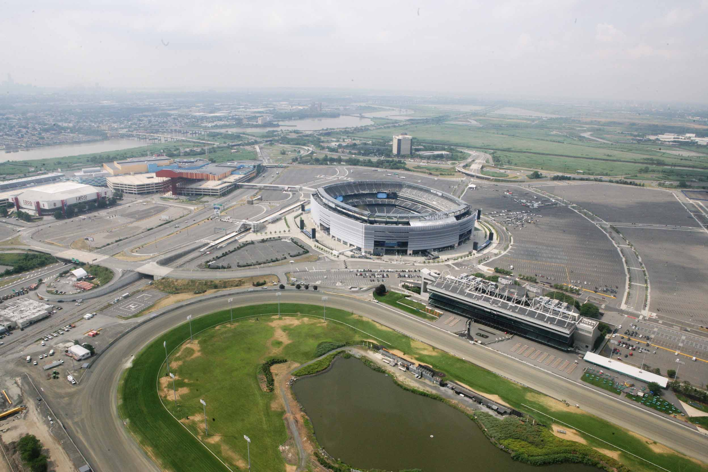
Site Assistance Visits (SAV)
A team assessment in cooperation with facility owners and operators to conduct on-site visits to identify gaps and recommend potential mitigation measures in an attempt to protect critical infrastructures from natural or man-made hazards.

Slide 24
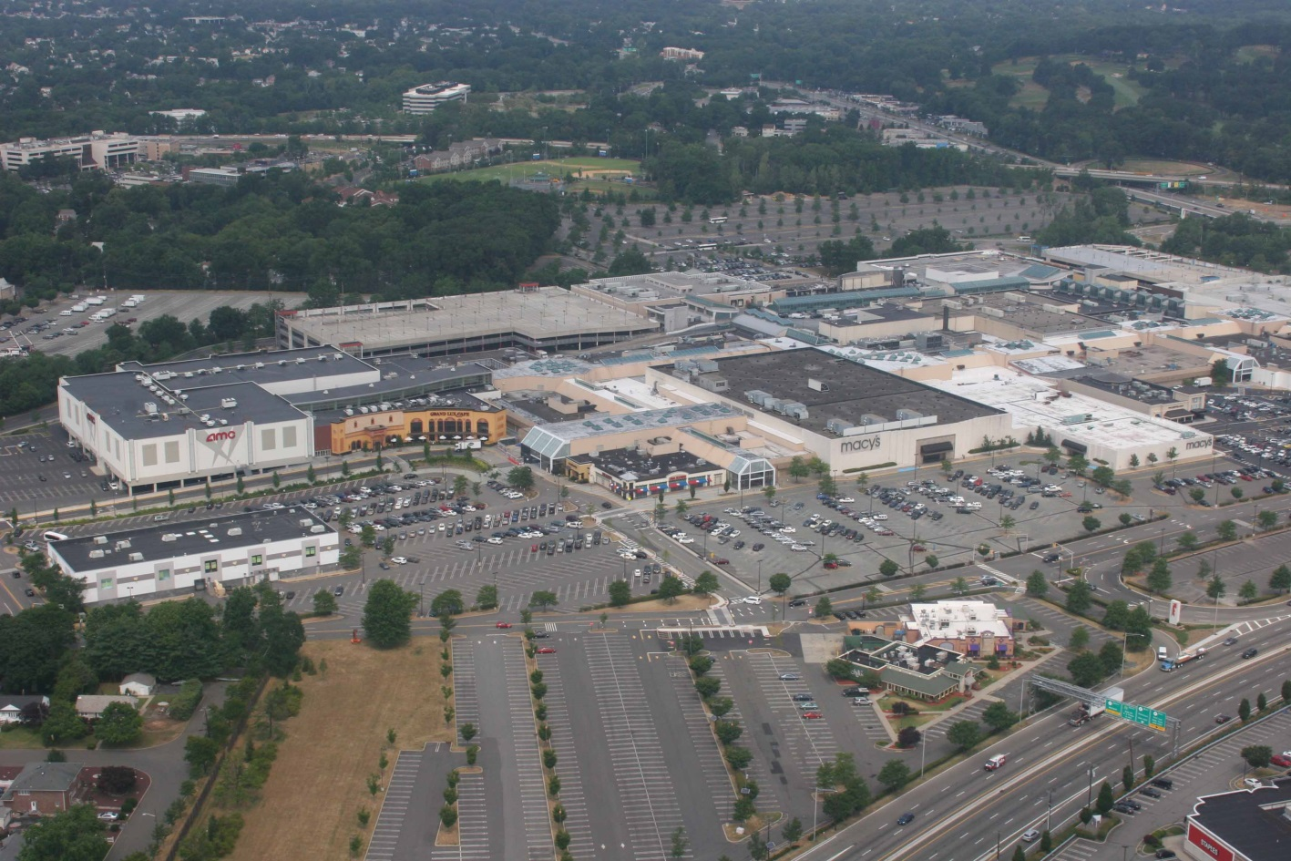
Computer Assessment Data Enhancement Tool
(CADET)
CADET uses computer software that incorporates 360-degree photo and video imagery with geospatial data and other forms of facility related information into one comprehensive package.
CADET allows planners and responders to visually present the data gathered and thereby make informed decisions quickly and with confidence.

Slide 25
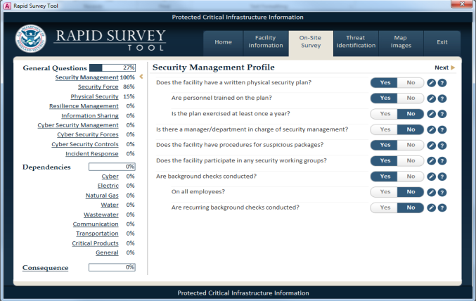
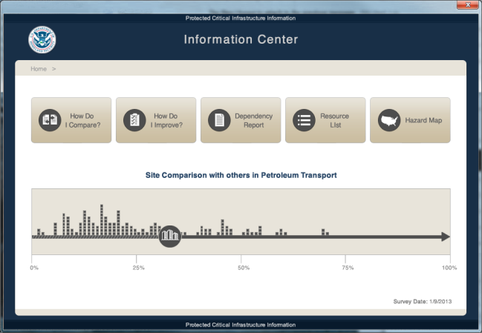
Rapid Infrastructure Assessment Tool (RST)
A high-quality data collection tool to support comparative analysis and risk mitigation by a broad and diverse user community.
Data collection that can be used to support situational awareness and incident response.
An ability for State/County infrastructure teams to prioritize facilities for longer surveys (SAVs, ISTs) or assessments based on RST results.

Slide 26
Questions?
Joe Picciano – Deputy Director
New Jersey Office of Homeland Security & Preparedness
609-584-4346
joseph.picciano@njhomelandsecurity.gov

