Slide 1
Port of NY & NJ Sandy 2012
Small Sea Changes: Big Coastal Impacts
April 22, 2014
Dennis Lombardi, Deputy Director, Port Commerce Department

Slide 2
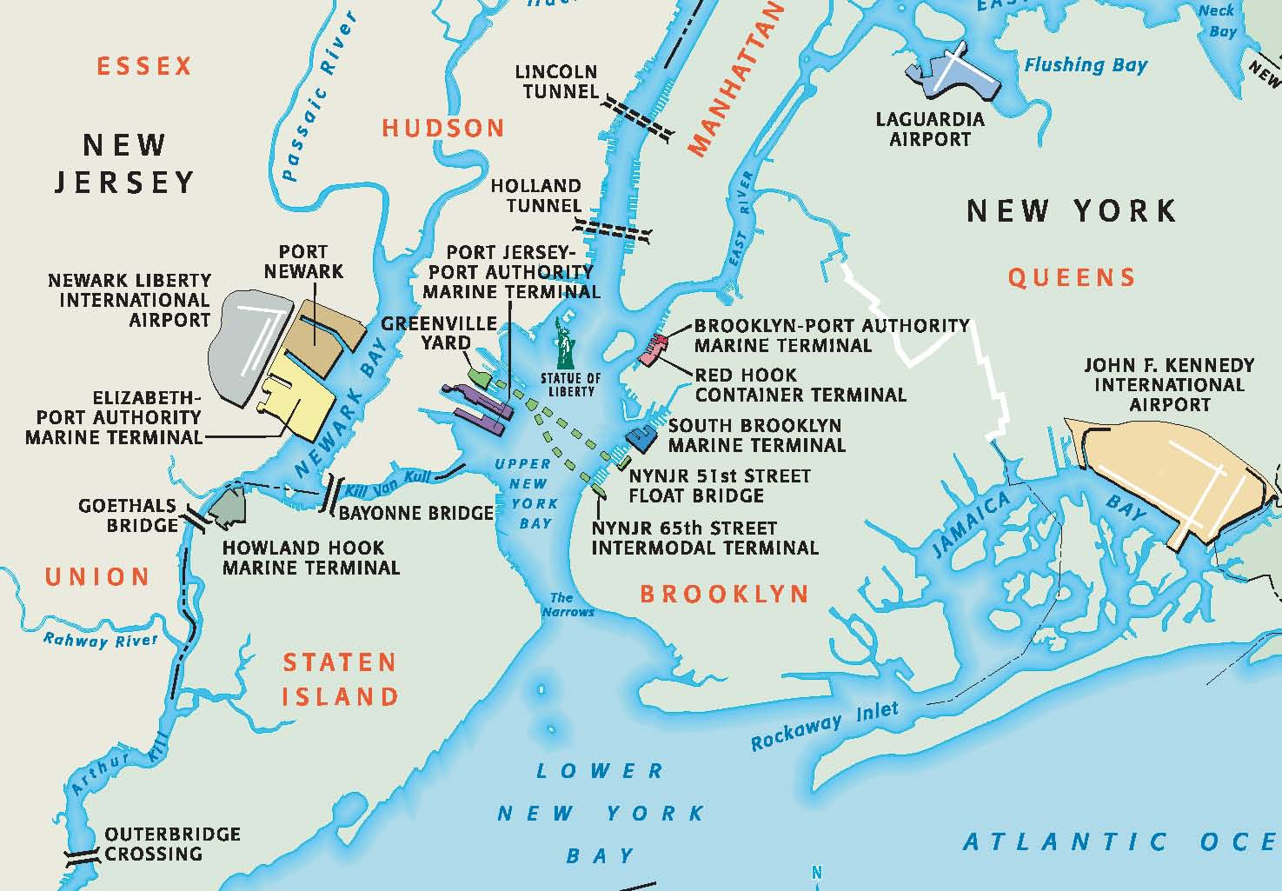
The Port Authority of NY & NJ
Bi-State Agency created through a compact between the States of New York and New Jersey and approved by an Act of the US Congress on April 20, 1921.
The First and only State Agency of its kind in the country.
Notes:
2

Slide 3
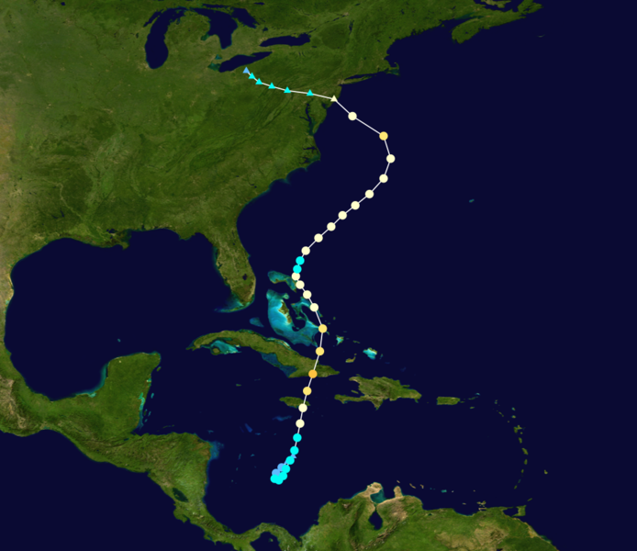
Sandy was Unique
Took a dramatic left turn
Mixed with a frontal system
Hit just North of Atlantic City NJ as a post-tropical cyclone with hurricane force winds
Came very late in the season

Slide 4
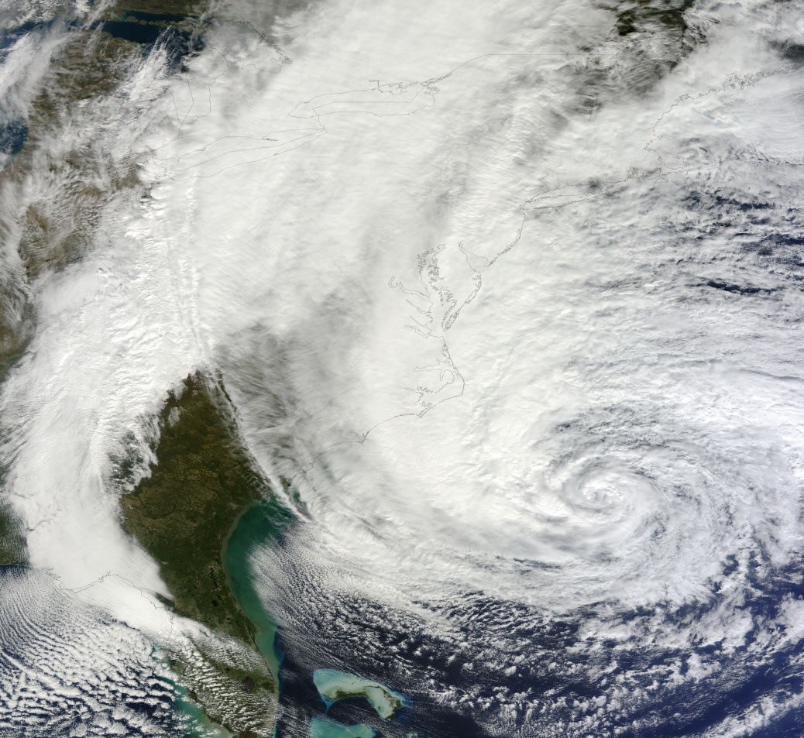
Sandy was Unique
Largest Atlantic storm in history
1,100miles across affecting 24 states
Peak storm surge occurred at high tide and created a 13.8 ft water level rise
Did over $75B in damage in the region

Slide 5
Preparation
Notification to tenants began Thursday, Oct. 25
PA Emergency Operations Center activated on Sunday Oct. 28
Until Sunday, Oct. 28th, there was a false sense of security
Oct. 28 National Weather Service briefing indicated surge of 6-11’ above normal high tide
Closed the Port by 2359 hours
Closed and Secured the Port
Mon., Oct 29 – 2000 hours --- NOAA reported winds @ 80-90 mph; surge 13 -14’.

Slide 6
During the Storm
Not much could be done
Keep staff safe
Ride out the storm

Slide 7
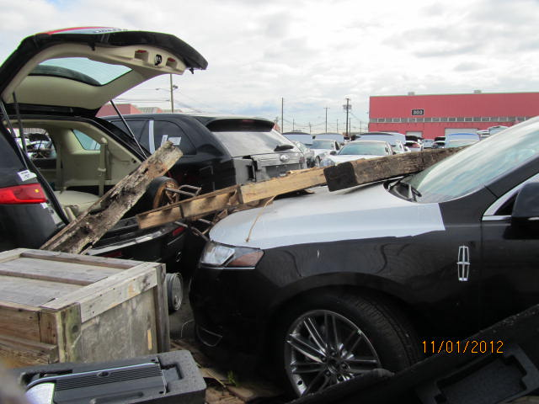
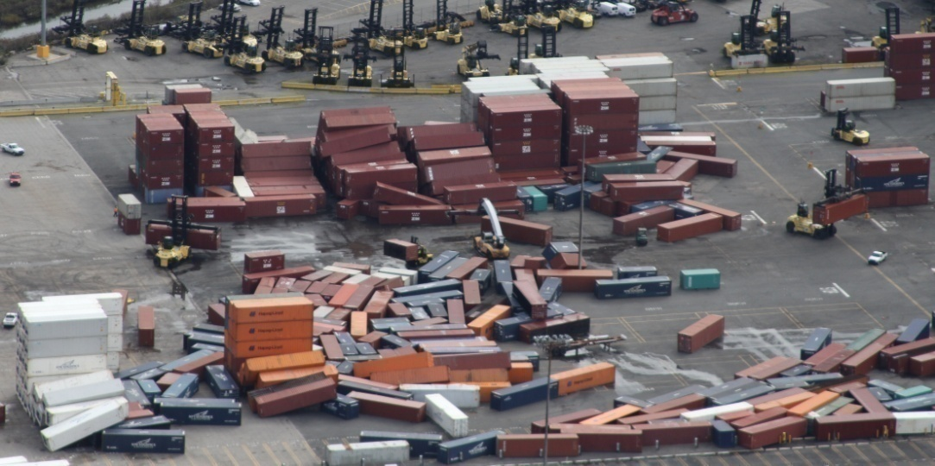
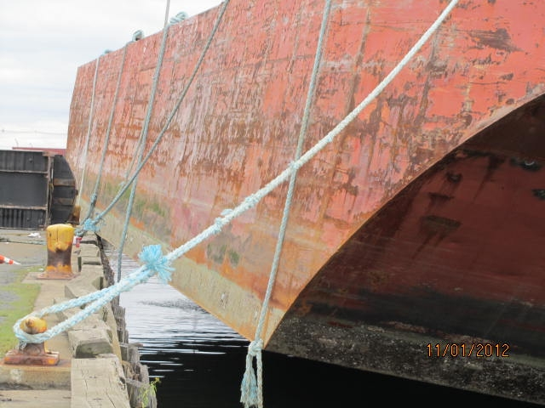
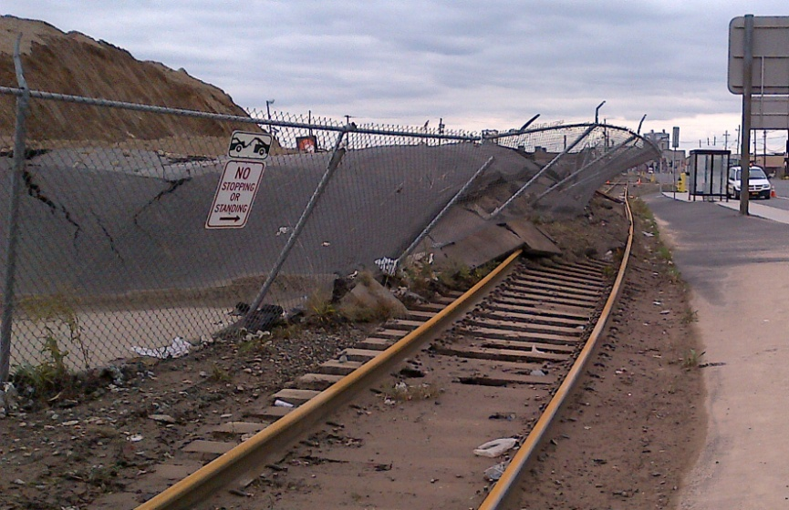
Sandy’s Aftermath

Slide 8
Damages Incurred
Extensive infrastructure damage
Cargo impacts
Cruise Passenger Auto Damages
Ancillary Effects

Slide 9
Container Terminals

Slide 10
Crane Wheel Motor Housings

Slide 11
Typical Fence Line Damage

Slide 12
Red Hook Barge “New York” Sitting on Berth 6

Slide 13
Fence / Rail Damage Port Newark

Slide 14
Chassis Took a Huge Hit

Slide 15
Port Drayage Trucks

Slide 16
Auto Damage

Slide 17
The Access Road at Port Jersey

Slide 18
Greenville Yards Jersey City

Slide 19
Rail Car Float Broken in Half

Slide 20
Recovery Timeline
Tues, Oct. 30 - Assessment, response, recovery and restoration begins
Friday, Nov. 2 – USCG re-opens Port to deep draft commercial traffic
Friday, Nov. 2 - First vessel arrival at PA facilities = Brilliance of the Seas at Cape Liberty
Sat. Nov. 3 - Power restored at Elizabeth
Sun. Nov. 4 – Maher / APM work 5 vessels
Mon. Nov. 5 – Truck gates at all container terminals opened for business
Mon./Tues. Nov. 5 & 6 – All remaining container terminals work their first vessels

Slide 21
Estimated Diversions
57 vessels diverted to other US East Coast ports
Estimated Cargo lost:
Containers = 25,000
Autos = 9,000
1 cruise ship diverted from PA’s Brooklyn Cruise Terminal to the Manhattan Cruise Terminal.

Slide 22
November 7 Nor’easter

Slide 23
What We Learned
We can do a better job protecting some critical infrastructure but will not be able to prevent all threats
Fuel and Electrical Power were key to restoration
Keeping all personnel out of harms way until after the storm allowed us to quickly get refocused and response was effective
Communications with other government agencies, tenants and our own work force was vital
Effective control over the port by Port Authority Police resulted in no deaths or serious injuries and no criminal activity during restoration
Hurricane Plans, based on previous sever weather events were useful but needed updating.

Slide 24
What Will We Do Differently
Future builds based on cost-benefit considerations.
Traffic Lights and Street lights essential
Localized power/electric stations essential
Relocate overhead electric lines
Attempt to prevent auto damage / look into vertical parking structures
Protect pump stations and other fire protection systems from flooding
Increasing elevations of port facilities under development – where we can.

Slide 25
What Will We Do Differently
Develop contingency plans for moving goods, supplies and materials
Prioritize and expedite Capital plans
Communication within the region / outside the region:
Pre-stage and/or store more fuel to combat shortages
Work closer with more Federal, State, and Local Agencies
Work with MARAD to obtain a blanket Jones Act waiver that automatically goes into effect during Disaster situations.

Slide 26
Next Steps
Repair, Restore, Replace
Undertake certain mitigation measures now
Take a long term view with Resiliency as our goal
Work with Regional, State and Federal Agencies
Take advantage of outside resources
Establish Agency Steering Committee
Prioritize projects and integrate into future operating and capital budgets

Slide 27
RESILIENCE

Slide 28
 | THE PORT OF NY & NJ IS OPEN FOR BUSINESS.
We wish to thank you for your patience as the port recovered from Hurricane Sandy, and express our gratitude to the entire New York and New Jersey port community for its extraordinary effort in bringing this vital resource back on line.

