Slide 1
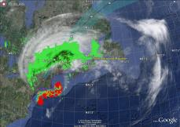
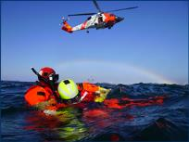
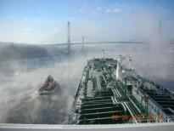
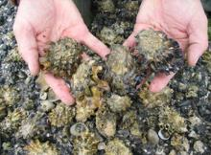
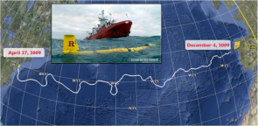
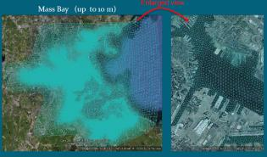
U.S. Integrated Ocean Observing System (IOOS®)
Zdenka Willis, Director, U.S. IOOS Program
July 10, 2014

Slide 2
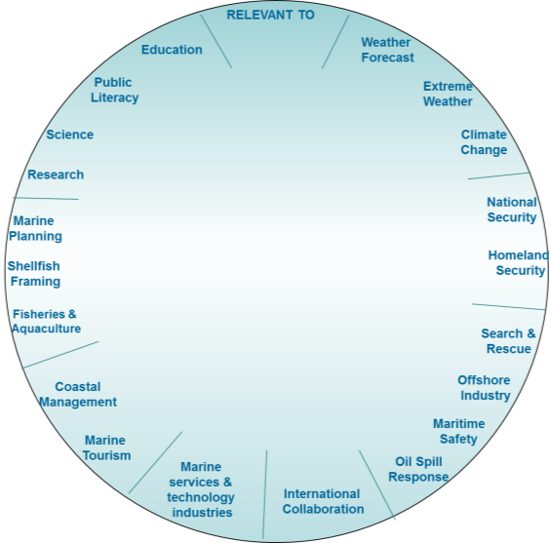
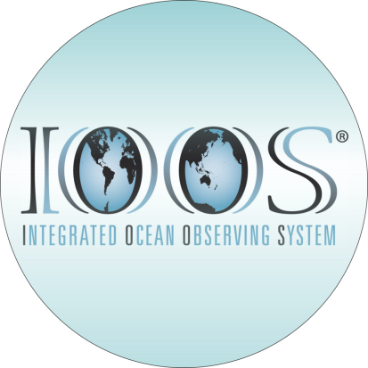
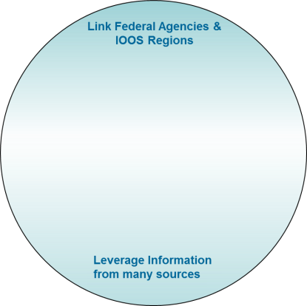
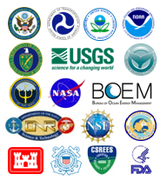
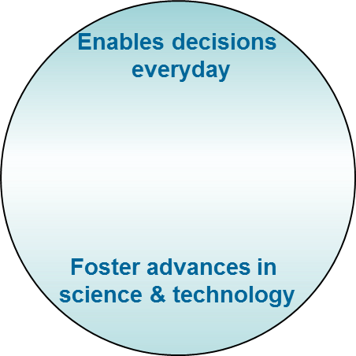

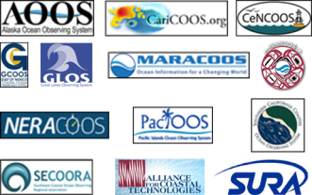
IOOS at Work!
Operated By:
Federal Component:
Regional Component:
Notes:
Mouse Click 1: Lets Start with Why we have IOOS – We enable decision making everyday and foster advances in science and Technology.
Mouse Click 2: Whether you realize it or not each and everyone of you relies on IOOS. And today’s panel will show you how.
Mouse Click 3: To make this work, we coordinate the ocean, coasts and Great Lakes observing efforts of Federal Agencies who all observe to meet their own mission requirements. We link them with a network of Regional Associations and capabilities that connect us to the stakeholders. By being part of a national program such as IOOS, we are able to leverage all of this tremendous capacity and provide solutions to many sectors.
Mouse Click 4: From weather forecasting, to the movement of commerce, to response to national hazards, to safe drinking water, safe swimming conditions, to ensuring there are oysters to enjoy, to spurring new businesses. IOOS works!

Slide 3
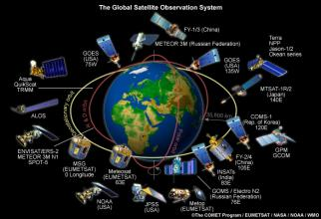
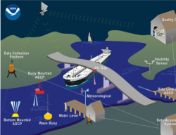
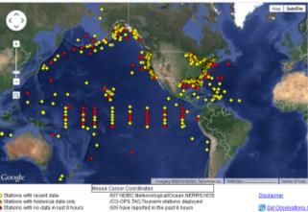
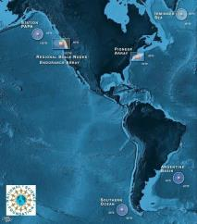
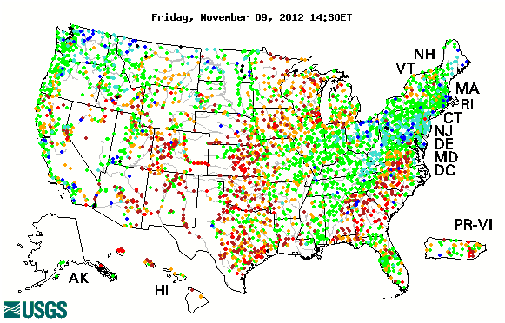
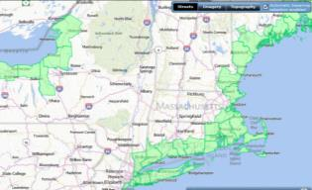

IOOS - National Backbone
607: Buoys, Water Level Gauges, Coastal and Estuary stations
Satellites
PORTS®
Stream Gauges
Water Quality
Research Infrastructure
Notes:
Observations take many forms. The Federal agencies observe to meet their mandates. From the NASA, NOAA and commercial companies we use the satellites overhead that give us a picture at the global scale of the ocean’s surface.
NOAA maintains 607 Buoys, shore stations, water level gauges, estuarine systems, that collect physical, chemical and biological information.
NOAA operates specialized systems such as the Physical Real-Time Oceanographic System or PORTS at 23 US Ports so ships move safely and efficiently.
NOAA maintains the National Water Level Monitoring Network and the United States Geological Service operate the Nation’s stream guages
EPA maintains a beaches program that indicates whether the water quality is safe
The National Science Foundation’s is deploying a series of global buoys, regional cabled arrays and coastal nodes that will provide a strong research infrastructure.

Slide 4
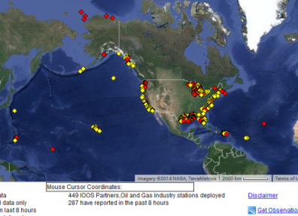
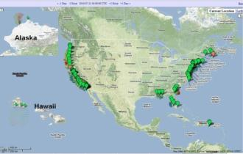
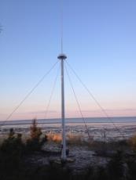
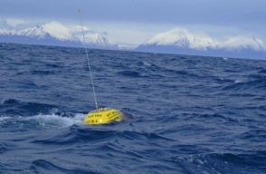


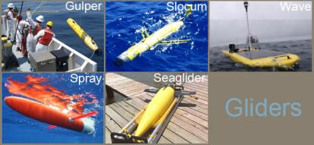
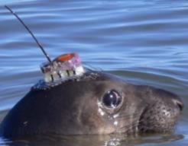
IOOS – Regional Component
High Frequency Radar
449: Buoys, Water Level Gauges, Coastal and Estuary stations
Tagging
Waves
Notes:
The IOOS Regional Associations operate observing assets and leverage others from State, Local, Tribal governments, academia, non-profit organizations and industry.
They provide another 449 assets and in some of the Regions provide a majority of the coastal buoys.
The IOOS Regions offer unique observations, like the 130 plus High Frequency Radar system, operated by 30 academic instructions. The largest in the world, operating at better than 75% uptime. 95% of the US HF Radar and over 80% of the global HF Radar systems are provided by one of our sponsors CODAR.
The profiling gliders are predominantly operated by IOOS Regional partners and academic institutions funded by a variety of Federal and State dollars.
Some systems are hybrids, such as the wave buoy network which is operated by NOAA, US Army Crops and IOOS Regional Associations.
Emerging observing systems include the tagging of marine animals and fish.

Slide 5
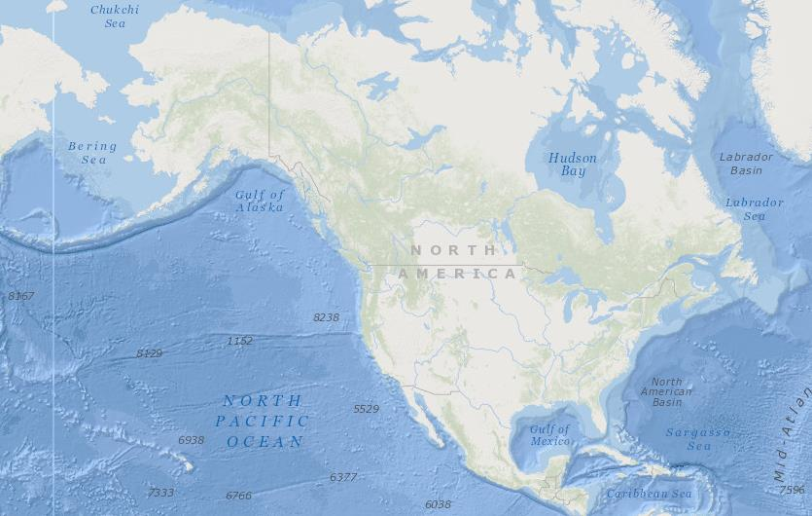

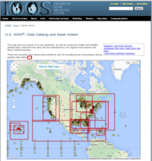










Exposing Data!
Notes:
We focus heavily on the “Integration” in Integrated Ocean Observing System or IOOS, and through our Regional Associations we bring together data from state, local, tribal governments, academia, and industry. This data is also aggregated nationally and delivered in tailored ways to many users.
So while McDonalds services up 1B hamburgers; IOOS serves up millions and millions of observations!

Slide 6
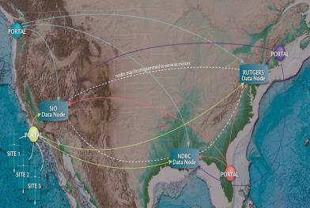
U.S. IOOS - High Frequency Radar Network
Stakeholders
Operated by 30 institutions under IOOS
Industry Partner: CODAR
Who Depends on it
USCG Search and Rescue
Oil spill response
Water quality
Criminal forensics
Commercial marine navigation
Offshore energy
Harmful algal bloom warnings
Marine fisheries
Maritime Domain Awareness
Tsunami prediction
Notes:
130 HF Radars operating in the network now. Includes 2 HF Radars on the East Coast of Canada operated by the Canadian Coast Guard.
Oil Spill Response: Operationally used for Cosco Busan, 2007; Deepwater Horizon, 2010.
Search and Rescue (SAR): Integrated into the operational US Coast Guard SAR operations (SAROP) program; deployed in the mid-Atlantic in 2009 – Extension Nationwide in 2011-2012.
Emerging Homeland Security needs: The Maritime Security Technology Program (MTP) of DHS S&T includes a project to expand the use of HF Radar to provide increased Maritime Domain Awareness (MDA) and Homeland Security.
As part of the GEO work plan 2012-2015 we have launched the global HF radar task. We have held 2 meetings to date and have 10 countries signed up. See www.ioos.gov for more information

Slide 7
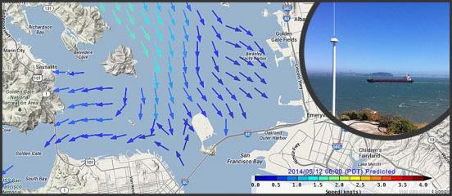
HF Radar and PORTS®
New web product offers broad spatial coverage of surface currents in areas that are vital to both commercial and recreational navigation.
Now operational in Chesapeake and San Francisco Bays, the web tool offers interactive maps and time series plots of surface currents, and complements PORTS
http://oceanservice.noaa.gov/news/may14/radar.html

Slide 8
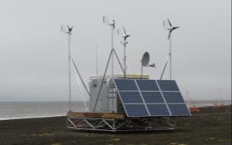
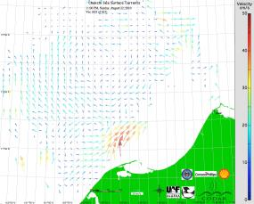
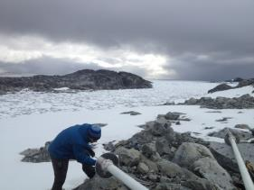
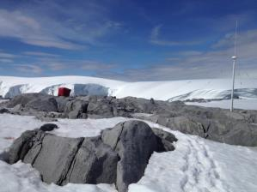


At the Poles
Ocean dynamics in harsh environments
Surface ice transport
Arctic
Ruggedized power and communications module
Solar and wind power
Mobile platform for rapid deployments
Antarctica
Notes:
A portable, modular power and communications system designed to provide data transfer and electrical power to HF radars along remote arctic and sub-arctic coastlines using solar & wind energy. The lack of power is the only limitation to widespread use of HF radar along Alaska’s coasts. This system has delivered 100% of the power required from wind alone. It is easily deployed anywhere in Alaska.

Slide 9
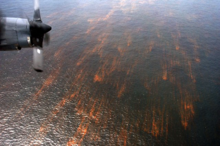
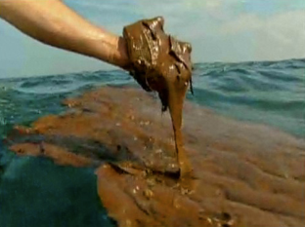
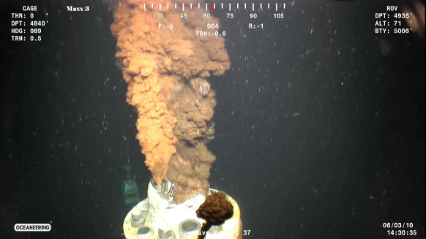
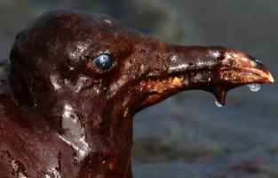
Deepwater Horizon
Blowout started on April 20, 2010
Well declared sealed on Sept 19, 2010.
4.9 M Barrels of Sweet Heavy Crude Released.

Slide 10
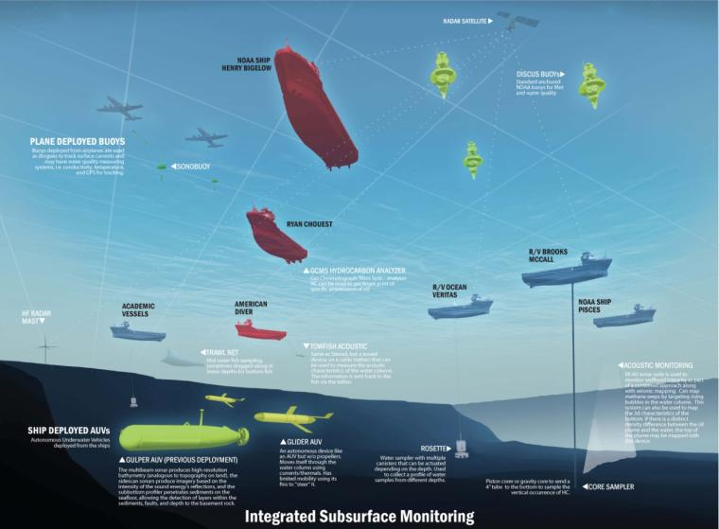
Adaptive/Integrated Ocean Observing Approach

Slide 11
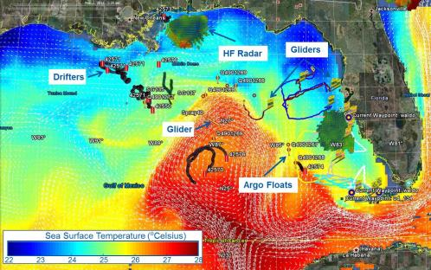
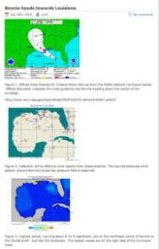
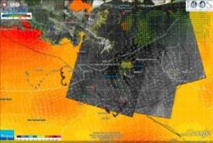
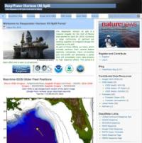
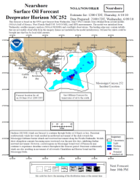
US IOOS Response to DHW
U.S. IOOS partnership demonstrated ability to:
Quickly deploy technologies: Gliders and HF radar, saving resources/improving safety
Models/Imagery ingested into NOAA/Navy models
Data assimilation improved spill response decision-making and public understanding
USM HFR
TS Bonnie
USF HFR
HFR validation of SABGOM Forecast with satellite detected oil slicks
HFR data informed NOAA trajectory forecasts
Web Portal
Briefing Blog
Notes:
Response to DWH showed that the IOOS business model, although complex, can delivery capacity in a crisis and in an organized fashion.
With the stand up of the US IOOS program within NOAA and the leadership we bring to make the non-Federal component a cohesive structure of Regional Coastal Ocean Observing Systems, the US IOOS DWH response provided:
7 of 9 gliders provided from 5 US IOOS Regions, industry partnership
HF Radar capability reestablished in northern Gulf of Mexico, east of Louisiana ‘bird’s foot’; made feasible by collaborative partnerships built over years across US IOOS
HF Radar data automatically ingested into NOAA’s Oil Trajectory Model because of standard data formats
Three-dimensional, high-resolution ocean circulation model
Support to the Unified Command Structure, including personnel
Stand up of the sub-surface monitoring unit.
2 important take aways that made this successful:
We had worked many years prior with the designated Federal agencies so that the data was already being used in the official models
By having this partnership, linked through a Federal Agency we were able to understand how to check into the official crisis response infrastructure and therefore we were helpful and did not get in the way.

Slide 12
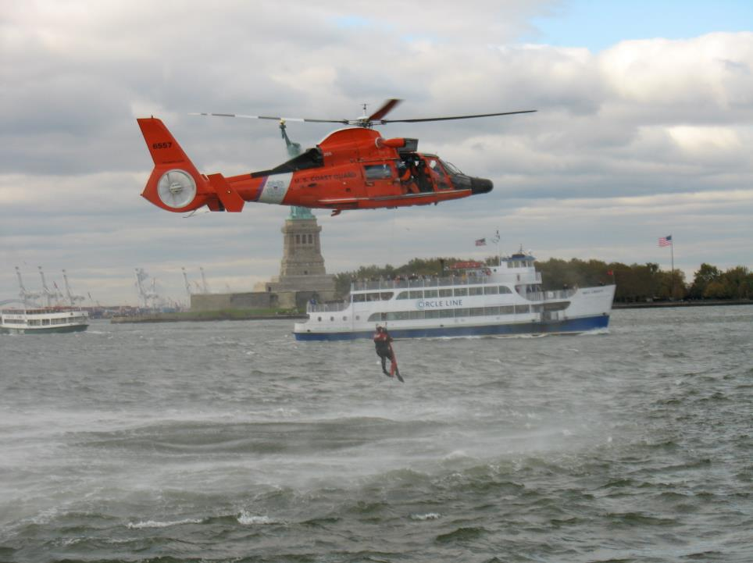
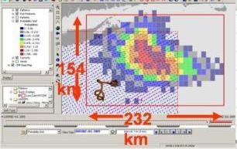
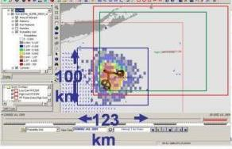
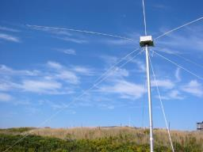
HF Radars Decreases Search Area
96 hr: Without HFR (36,000 Km²)
96 hr: With HFR (12,000 Km²)

Slide 13
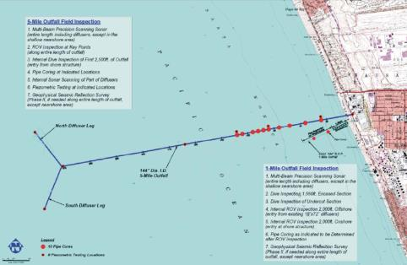

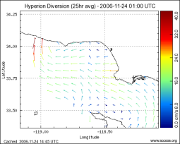
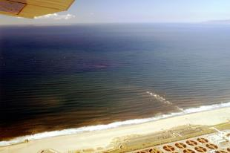
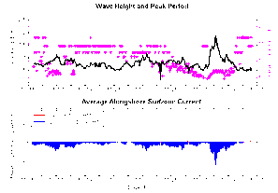

Support for Water Quality Projects
Inspection of Hyperion Outfall Pipe
~Billion gallons of sewage to be diverted to an in-shore outfall
Concern about extent of impact and public health risks
Offshore and surf zone circulation had to monitored
Real-time trajectory tool implemented at surfacing outfall

Slide 14








SCCOOS Observations
Shore Stations
Observational assets include:
Shore stations
Gliders
High Frequency Radar Derived Surface Currents
Ship-based surveys
Models
Harmful Algal Bloom Monitoring Program
HFR
Gliders
Models
HABs
Cruises
Notes:
Examples of applications from these assets – hyperlinks to SCCOOS website imbedded in tags
Gliders – El Niño index
HFR – Tijuana Plume tracker
Shore Stations – Is a part of the longest time series in the pacific rim
Cruises – Seabird Reports
ROMS model – Subsurface modeling and point source profiles
HABS – Coordinated HABs monitoring throughout California (partnership with CeNCOOS)

Slide 15





ECONOMICS – Commercial Shipping
Santa Monica
Buoy
CDIP provides wave observations, nowcasts, and forecasts.
SCCOOS provides HF Radar
surface currents
San Pedro Buoy
Dana Pt Buoy
USACE - LAD
Catalina Express
Los Angeles Bar Pilots
Long Beach Bar Pilots
NOAA - Navigation
San Pedro Marine Exchange
Sause Brothers
US Coast Guard
Notes:
Combined the ports of Los Angeles/Long Beach are the 5th largest in the world.
Over the last decade, the Los Angeles Pilots have safely completed more than 52,000 vessel movements.
Last year, Long Beach Pilots made approximately 8,000 ship moves.
Operational Stakeholders
Suggestions for MOP
output
Since 2000, more than 6 million
passengers have visited
Catalina Island through the
Port of LA.

Slide 16




COASTAL HAZARDS
Shoreline protection needed for flooding and erosion
3.5m
Water Level Forecast – D0587
D0587
Cardiff State Beach, California
Nowcast and Forecast of waves and tide - Torrey Pines Inundation
Leucadia, California

Slide 17





HUMAN AND OCEAN MAMMAL HEALTH
Monitoring of Water Properties and Harmful Algae Blooms
HABs Sampling Sites
Santa Cruz Wharf
Monterey Wharf
CalPoly Pier
Goleta Pier
Stearns Wharf
Santa Monica Pier
Newport Pier
Scripps Pier
Domoic Acid Poisonings
Psuedo-nitzschia
Red Tide
Alexandrium spp.
Notes:
SCCOOS & CeNCOOS support HAB detection/monitoring in CA
Now we do work together and we are able to track the flow of the blooms
Samples taken from 8 piers (La Jolla to Santa Cruz)
Most concerning is Psuedo-nitzschia (paralytic shellfish poisining) & Alexandrium (red tide) b/c of toxin that can be transferred to higher organisms (us)
samples taken once a week for HAB species, water temp, salinity, and nutrients
Objective to collect and compare data a regional stations, provide timely updates on HABs events, and aid in understanding in timing, extent, and impact of these events on humans and the ecosystem.
SCCOOS is expanding to CeNCOOS region and we will have better coverage/ increase visibility for the HAB program.
Visualization is framed so it can be insert into their router
GO TO WEBSITE: You can either plot one HAB and plot against all locations or you can take one site an plot parameters in the near real time environment – like both spp to look for correlations

Slide 18






Climate & Ecosystem:
Long-term Monitoring
Data collected include:
Temperature & salinity (SIO since 1916)
Chlorophyll fluorescence &
turbidity or transmissivity
Dissolved oxygen, pH, & water
level
Meteorological variables
Phytoplankton & algal toxins to
detect Harmful Algal Blooms
Santa Monica Pier
Scripps Pier
Stearn’s Wharf
Newport Pier
Notes:
Make sure to plug Manual shore stations - Scripps temp record from 1916
They are the backbone for so much of the info that we have today.
You can locate the metadata on this site by link or by information called out below (location, operator, funder, parameters, instrumentation)
There is a link to bookmark this page
You can access current information (time stamped) as well a previous observations (one month displayed
Download option for longer time series inquiries

Slide 19





Climate & Ecosystem: Long-term Monitoring
SCCOOS funds nearshore CalCOFI stations since 2004
SCCOOS funds a glider track off of Dana Point, CA since 2007

Slide 20









Glider Missions
Climate/Ecosystem/Fisheries Management/Water Quality
HAB
CalCOFI
The SoCal Niño Index
Fish Tracking
Hurricane Forecasting
Response to Oil Spill
Deep Water Horizon
Alaska
Notes:
Some Examples of Glider Missions: Supports Fisheries management
The California Cooperative Oceanic Fisheries Investigations (CalCOFI) are a unique partnership of the California Department of Fish and Game, NOAA Fisheries Service and Scripps Institution of Oceanography. The organization was formed in 1949 to study the ecological aspects of the sardine population collapse off California. Today our focus has shifted to the study of the marine environment off the coast of California, the management of its living resources, and monitoring the indicators of El Nino and climate change. CalCOFI conducts quarterly cruises off southern & central California, collecting a suite of hydrographic and biological data on station and underway. The ships go out quarterly, but the gliders are able to occupy the lines continuously therefore we can get a more complete picture of what is going on in the ecosystem. Gliders helps us understand the on set of El Nino and La Nina
The Atlantic sturgeon, which is one of the world’s oldest species of fish, can live up to 60 years, reaching a length of of 15 feet (4.6 meters) and a weight of over 800 pounds (360 kg). It’s also endangered, due to past overfishing for its caviar. In order to protect the sturgeon that are left, it’s important to keep fishermen from catching them accidentally. That’s why researchers at the University of Delaware and Delaware State University are calling upon satellites, and an underwater robot known as OTIS.
A large dramatic phytoplankton bloom occurred 2 summers ago in the Mid-Atlantic Bight. These are natural events and phytoplankton form the base of the marine food web. The “bloom” of phytoplankton is almost as large as the state of New Jersey and is easily visible in satellite imagery. These events are driven by ocean circulation patterns and this bloom off southern New Jersey does not appear to be related to outflow from the Hudson river
Measuring DO and impact on fish and most especially shell fish that can not move
Gulf of Mexico – Gliders outfitted with Brev Buster help in the operational GOMEX HAB bulliten
Hurricane Irene – Glider was able to pick up the mixing and POST processing showed that with the right SST initial conditions that intensity forecast could be improved
DWH: Sentinels to evaluate cross-shelf transport of hydrocarbons; 41,000 casts
Arctic Research to understand the flow of oil

Slide 21





US IOOS - Gliderpalooza
15 gliders
15 Partners:
  Ocean Tracking Network, Canada;
  9 U.S. Universities
  Teledyne Webb Research Corporation
  State Agency
  National: IOOS, NOAA, US Navy and NASA
>25,000 profiles to date – NOAA’s Buoy Center sent data to the Global Telecommunications Systems (GTS)
Notes:
More than just gliders – the goals include
Provide a unique data set to modelers
Provide standardized dataset a over ecological scales and information on fish/mammal migrations
Provide a 3-D snapshot of the MAB cold pool
Provide an extensive distributed network through the peak period of fall storms, demonstrating "surge" capacity
Demonstration of a national glider network
Proof of data flow through IOOS to NDBC via DMAC
Engage undergraduates in ocean observing efforts.

Slide 22

Emerging Observing Assets

Slide 23












From Animals to GTS to Ocean Modelers
Real-time data flow
user
GTS
Courtesy: Dan Costa UCSC.
Notes:
Data from CTD SRDL tags (Sea Mammal Research Unit (SMRU), Univ. St Andrews, Scotland) has been sent routinely to GTS via British Oceanographic Data Centre (BODC).
To link these ocean observations from tagged marine animals to ocean models, IOOS PO and ONR in 2012 co-sponsored a collaboration with the Stanford Univ., NAVOCEANO and NOAA NCEP to improve data interoperability tools and assimilation of these ocean observations into NAVO’s global (HYCOM) and region (NCOM) models.
In late February (2012), two elephant seals were tagged in Año Nuevo with SMRU tags that provide real-time CTD uplinks. The data was sent to GTS and were assimilated in real time into HYCOM models.
In May the two CTD tags that were deployed on elephant seals in February 2012 were recovered by the UCSC field team and these same two tags were redeployed on two different female elephant seals in early June 2012.
•These tags are currently providing real-time CTD data through Stanford server.
•This shows that the animal telemetry is operational and can contribute to augmenting observing data access by modelers.
In 2013, NAVO sponsored purchase of more CTD tags to deploy on elephant seals (by Costa team). Here some tracks from 2013 deployment. The observations was delivered to NAVOCEANO through GTS and also was made accessible through Stanford data access services.

Slide 24









Appropriate Management Responses
Tiger Shark Case in Hawai’i
Notes:
PacIOOS Voyager map shows the movements of several tiger sharks who were fitted with satellite tags near Maui in late 2013.
These data is critical for decision makers to select appropriate management responses to Shark attacks in Maui waters.
Story.
Issue: Maui has witnessed a higher number of unprovoked shark attacks than in previous years, and local spear fishers report increasing boldness of large sharks encountered in Maui waters.
Animal Telemetry information will help determine whether sharks around Maui are more resident (more "site-attached") than they are around the other Hawaiian Islands and whether they exhibit greater use of inshore habitats than in other locations.
With funding from the State of Hawaiʻi Department of Land and Natural Resources (DLNR) Division of Aquatic Resources (DAR), these data were collected by Principal Investigators Carl Meyer, Ph.D. and Kim Holland, Ph.D. along with other members of the Shark Research Team of the Hawaiʻi Institute of Marine Biology (HIMB) of the School of Ocean and Earth Science and Technology (SOEST) at the University of Hawaiʻi at Mānoa (UH)

Slide 25




Engage the International Community
Ocean Tracking Network, current and proposed deployments

Slide 26


Notes:
GOOS is the Global Ocean Observing System. A single, contiguous, body of water encircles the globe. From the Arctic ice through the warm equatorial waters to the Antarctic Circumpolar Current all the Earth's oceans, seas, bays and inlets are connected. They form one body of water, the one Global Ocean. GOOS is designed and being implemented to embrace the oceans as a single entity, to provide a global view of the ocean system.
GOOS is a permanent global system for observations, modelling and analysis of marine and ocean variables to support operational ocean services worldwide. GOOS provides accurate descriptions of the present state of the oceans, including living resources; continuous forecasts of the future conditions of the sea for as far ahead as possible, and the basis for forecasts of climate change.
GOOS is a system of programmes, each of which is working on different and complementary aspects of establishing an operational ocean observation capability for all of the world's nations. UN sponsorship and UNESCO assemblies assure that international cooperation is always the first priority of the Global Ocean Observing Sytem.
GOOS is the oceanographic component of GEOSS, the Global Earth Observing System of Systems .
GOOS is designed to:
Monitor, understand and predict weather and climate
Describe and forecast the state of the ocean, including living resources
Improve management of marine and coastal ecosystems and resources
Mitigate damage from natural hazards and pollution
Protect life and property on coasts and at sea
Enable scientific research

Slide 27




Global Component:
Global Ocean Observing System for Climate
Total in situ networks
61%
87%
100%
59%
81%
100%
48%
34%
73%
62%
NOAA/OAR/CPC/COD
Notes:
The global component of U.S. IOOS is managed by OAR/Office of Global Programs, specifically the Climate Observations Division. This Division is co-located with the IOOS program office, just down the hall here at Wayne Ave. The Division Chief, David Legler is the current NOAA co-chair of the Interagency Ocean Observation Committee (IOOC). The other two co-chairs sit at NASA and NSF.

Slide 28

GEO
Building a Global Earth Observation System of Systems
Promotes global sharing of data
Improves coordination of strategies
& observation systems
Develops new applications
Facilitates exchange of data & information
Delivers critical environmental intelligence to decision-makers to inform decisions

Slide 29



Global HF Radar Network
35 Countries with HF Radar for oceanographic purposes
Notes:
GEO task
Shows location of Radars, and many uses

Slide 30






High Frequency Radar Network (HFRNet)
Global Partnerships
Canada
Spain
Continental U.S.A.
South Korea
Mexico
Hawaiian Is.
Puerto Rico and
U.S. Virgin Is.
Australia
Notes:
Launch of the GEO HFR portal. Radars from US, Canada, Australia, Spain, and Korea

Slide 31
Industry Study Framework
Provider
Intermediate Users
End Users
Credit: Rayner – IOOS Summit 2012 – white paper
Notes:
As part of the US IOOS summit, Ralph Rayner the US IOOS industry liaison put a framework together to help us define the IOOS stakeholder community
Framework has 3
Providers of observing systems infrastructure
Manufacturers of sensors, instruments and platforms
Those building, launching and operating satellite systems
Providers for the cyber infrastructure that interconnects the IOOS components
Organizations that develop and maintain the data management systems
Software tools and models that are used to turn IOOS data into useful information
Intermediate users: Take IOOS data or information and tailor it for a specific end-use; add value to IOOS outputs tailoring them for specific end-uses
End-users whose activities or business benefit from IOOS data and information in terms of better scientific understanding of the oceans, improved safety, economic efficiency gains or more effective environmental protection.
Important to recognize that delivery of end-user benefit is rarely a simple linear end to end service chain.
More usually, benefits are delivered by multiple organizations merging and mashing different source of data and information (most often not exclusively marine or exclusively derived from measurement of observation) to derive a product useful for a particular purpose. It is more like a jigsaw puzzle with multiple intermediate users adding value in complex and ever changing ways as the compete to provide more beneficial or more cost effective products and services.
Integration opens opportunity for the delivery of entirely new benefits that only become possible once sustained core capacity is available in this way.
It is important to recognize that an organization can occupy multiple roles in this complex landscape. Even NOAA represents this framework - NOAA can be a providers, an intermediate user and an end-user in different parts of the organization
IOOS has often been compared as the ocean/coastal counterpart to NOAA’s National Weather Service. The “weather enterprise” is valued in the billions but there are no equivalent numbers on the “ocean/coastal/Great Lakes informational data” enterprise. According to National Academies publication – Fair Weather: Effective Partnerships in Weather and Climate Services (2003 –), “There are about 400 commercial weather companies and independent contractors in the United States, four with revenues of about $500 million,” that includes large companies such as AccuWeather and the Weather Channel.

Slide 32
The Meteorological Service Industry
Valued at $3B/annum In the US and $6B/annum globally (with much larger values for derived products, eg weather risk products ~ $8B/annum
Is there an equivalent Ocean Enterprise?

Slide 33



UK Marine Technology and Services
Key Findings
Commercial Marine Science and Technology more than doubled since 2010
Market confidence is high: 81% forecast growth in the market
Small to Medium companies dominate the sector
Notes:
UK Study:
For the past 4 years the Society for Maritime Industries has been capturing the value of the United Kingdom Marine Science and Technology (MST) sector. The report aims to provide an insight into current business activity in terms of market sector, market size, business confidence both current and forecast.
The sample size is 98 companies
Results
• Top figure shows this trend The trend in market size has grown over the past four years with an enterprise valued at 1.35 British pounds. , more than doubled since 2010
• Small to medium companies continue to dominate the sector (85% of companies), defined as less than 50M annually, the number of larger companies increased from 9% to 16%
• Employment in commercial MST has increased 12% in 2012
• Skill shortages present a barrier to future performance in MST
• The largest market sector remains offshore oil/gas although this has declined from 45 to 40 with renewable energy increased 3 points.
Employment has increased in sector and 50% of the companies reported they expected to increase their numbers of employees in the next year.
A vast majority of these companies are in that first circle of the framework – providers. Which is not surprising as this is conducted during Oceanology International – largest ocean technology industry show

Slide 34

San Diego Study
Overall Findings
Total employment: 46,000 jobs Total Revenues: $14 billion (2011)
San Diego Blue Tech Findings
Highly differentiated industry – 14 sectors in San Diego; 71 sub-sectors
Prevalence of multi-use technologies from small, specialized firms
Largely invisible in local markets / limited public & government awareness
Little baseline economic data due to non-specific NAICS codes
Highly export-oriented – typically 40-60 percent
Markets exist in virtually every country around the world
Growth in most sectors strongly outpaces world economic growth
Notes:
Sponsored by San Diego Work force partnership, Maritime Alliance, San Diego Regional Economic Development Activity, with the study being conducted by ERRIS corporation.
“The oceans are the future of the world – covering 66 percent of the world’s surface - sustainable usage of the ocean will be increasingly critical to produce the food, water, energy, medicine, and coastal “real estate” needed for the growing world population, over 80 percent of which lives near the oceans. The Pacific represents not a border but a frontier with enormous growth opportunity for San Diego. The fast-growing Maritime Technology Cluster has benefited from the traditional industry’s presence, and the two need to collaborate to “be all they can be”. This is a massive opportunity that will require the development of a vision, education, enlightened regional leadership, and a community effort to achieve the possible.”

Slide 35








Marine Technology and Services Industry Study
Marine technology & services industry is an important partner and stakeholder
First step toward assessing the economic impact of the marine ocean technology sector in the U.S.
Collection and analysis of both qualitative (interviews) & quantitative data (statistics).
http://www.usworks.com/usioos/
Notes:
US IOOS is conducting a Marine Technology Industry Impact Study via contract to ERISS Corporation and The Maritime Alliance
Information on the study is available at the website shown here
We are creating a baseline inventory of companies classified as: Providers Those that provide ocean observing system infrastructure - sensor, platform and satellite system manufacturers and operators, as well as providers of cyber infrastructure, data management, software and modeling systems; and Intermediaries: Those that add value to IOOS outputs tailoring them for specific end-uses
The inventory will include size of these companies, volume of activity, volume of exports, and number of employees.
We are also gathering narratives by companies on how US IOOS has helped their operations, planning, and growth, as well as perceived potential for future growth and investment.
YEAR 1:
Identify basic industry code mappings of current and potential US IOOS “Providers and Intermediate Users.”
Develop a methods report and baseline inventory of companies.
YEAR 2:
Improve accuracy / completeness of information from Year 1.
Begin analysis of the economic impact of product & intermediary companies including narratives collected from companies on how US IOOS has helped them develop their business
YEAR 3:
Investigate how IOOS has benefitted (or could benefit) these companies, including providing training and experience
Identify potential international markets and opportunities for these companies or business clusters.
Capture benefits of new digital media – growing applications (“apps”) that use US IOOS data.

Slide 36





Where and what type are the companies?
571 companies*:
39 states; DC
~50%
* for firms with multiple locations, only HQ location is mapped.
As of June 30, 2014, still resolving 27 companies & list is still growing
Notes:
Our database as of June 30, 2014 has 571 companies with industry classifications.
Animation 1 (fly in of the company “Types)
83% of the companies in the database are characterized as primary providers
9% are Intermediate Users of IOOS data.
Animation 2 (Fly in of the “industry classifications” of the top 50% of the companies in the database)
As expected these companies are focused on navigation, detection, instrument manufacturing as well as scientific and technical consulting, computing and boat building.
Next phase will include interviewing companies to dig a little deeper into their specific industry niche and to begin to characterize their economic contributions and impacts.
States Statistics
CA has ~24% of the companies
TX has 17%
MA, WA, and FL 6-9% each
Then NY, LA, CO, MD with 2-4%
The rest are all below 2%

Slide 37
Where and what type are the companies?
571 companies*:
39 states; DC
* for firms with multiple locations, only HQ location is mapped.
As of June 30, 2014, still resolving 27 companies & list is still growing
Notes:
Our database as of June 30, 2014 has 571 companies with industry classifications.
Animation 1 (fly in of the company “Types)
83% of the companies in the database are characterized as primary providers
9% are Intermediate Users of IOOS data.
Animation 2 (Fly in of the “industry classifications” of the top 50% of the companies in the database)
As expected these companies are focused on navigation, detection, instrument manufacturing as well as scientific and technical consulting, computing and boat building.
Next phase will include interviewing companies to dig a little deeper into their specific industry niche and to begin to characterize their economic contributions and impacts.
States Statistics
CA has ~24% of the companies
TX has 17%
MA, WA, and FL 6-9% each
Then NY, LA, CO, MD with 2-4%
The rest are all below 2%

Slide 38
Flow Chart of Study Activities
Baseline Year ()
Objective: Research and create comprehensive list of potential IOOS providers and Intermediate users.
Project Year 2
Objective: Using baseline inventory of companies, conduct initial activities to begin impact and economic analysis study.
Project Year 3
Objective: Continue data collection and analysis process and produce final report.
Deliverables: Inventory of companies and methods report detailing process.
Deliverables: Updated inventory and first economic impact report.
Key Activities: Collect information regarding required occupational job skills, training and experience, and tracking of student jobs. Identify potential International Markets and opportunities for businesses.
Deliverable: Final report detailing all components of the study.
Key Activities: Design instrument and conduct interview with select employers to obtain narrative of how IOOS has impacted their business. Conduct preliminary analysis and create qualitative economic impact report based on employer interviews.
Key Activities: Collect lists of potential “Providers and Intermediate Users” from multiple sources including client and stakeholders. Merge and de-duplicate lists, and research companies in order to classify within the NAICS system.

Slide 39



Marine Technology and Services Industry Examples
High Frequency Radar: CODAR SeaSonde growing because of ocean observing
Moving commerce: can’t do this without ocean observations
Shellfish Industry – a private/public partnership
Photo: waiterstoday.com

Slide 40


Growing Together
CODAR
1984: Barrick and staff leave NOAA to form CODAR to commercialize HF radar
1986: CODAR Ocean Sensors, Ltd. officially founded.
1983-88: first-generation CODARs; deployed North Sea offshore oil rigs.
1992: Second-generation CODARs
2002: 100th SeaSonde sold
2009: Rapid overseas growth
Today: 98% IOOS network; deployed in 30 countries
Broken sales records last 3 years – credits US network as the confidence by other countries to invest in HF Radar
IOOS
2002: CA Prop 40 & 50 - $21 million is designated for the “Coastal Ocean Circulation Monitoring Program” (COCMP)
2004: IOOS project based < 15 radars
2005-2006: Network emerges
2008: Network reached 100
2009: National Surface Currents Plan V1
2012: O&M dollars in budget
Today: > 130 Radars
Global through Group on Earth Observations (GEO)
Notes:
Growth overseas, open new markets due to the US investment and showing that both on the West Coast and Mid-NE we can maintain large networks
Though a national effort, this technology has been embraced and transitioned to operational organizations, have given other nations the confidence to deploy networks
Once the US government put O&M dollars reinforced the longevity
Really one ocean – Japan and CA which was proven with the measurement of tsunami post Japan earthquake in 2011 –
As IOOS has gone from individual radars, to regional, to national network with data management – we can now export that capacity building that goes along with the sales of the equipment
CODAR’s willingness to invest with the community and sponsors research has made this a wonderful partnership as well
IOOS regions are testbeds for new technologies that CODAR is developing
IOOS bridges the community to think globally
Cohesive message.
Your efforts at IOOS do make an impact upon our company overseas business growth, as the US national HF radar network is proof that establishing a large-scale SeaSonde network is both possible and beneficial, with plenty of nice case studies demonstrating its utility, and is a conduit for bringing U.S. and overseas scientists together for spreading of knowledge and skills.

Slide 41




Without
We wouldn’t have:
24% of wine
99% of shoes
100% of
Almost all personal electronics
97% of clothes

Slide 42





We couldn’t move
Without: Ocean Observations and Forecasts
IOOS – Regional
Funded by NOAA
"The coast of Maine supports mutli-million dollar fishing and tourism industries so when making decisions about bringing a 700 foot tanker full of fuel into port we need the best ocean and weather information possible, which is why we depend on IOOS buoy observations and forecasts to ensure safety and efficiency of these critical operations."
Captain David Gelinas, Penobscot River and Bay Pilot
NOAA’s PORTS®
22 States
Purchases equipment from 43 manufactures
Notes:
.

Slide 43






Oysters on the Half Shell
+ =
Photo: waiterstoday.com
Poor quality natural spat set of oysters in US northwest 2005-2008
2008 Whiskey Creek Hatchery lost 100% of oyster larvae
Ocean Acidification Science began documenting correlations and seeking causal factors
Real-time Observing System established with industry partnership
By 2010 productivity was back to 70% at Whiskey Creek
Today - Industry is a full participant in observing advancements and uses industry assets to help maintain the system
Notes:
The immense value of integrated observations is also demonstrated by the huge difference even small monitoring and observation efforts can make. An example is found in the Pacific Northwest, where oyster hatcheries on the verge of collapse just a few years ago, now tied to ocean acidification, are again major contributors to the $111 million West Coast shellfish. IOOS – Northwest Association of Networked Ocean Observing System (NANOOS) and NOAA’s Ocean Acidification Program worked with the industry and set up real-time observation networks to provide an early warning system, signaling the approach of cold, more acidic seawater 1 to 2 days before it arrives in the coastal waters. This enables the shellfish industry to schedule hatching, growing, and harvesting to maximize production by knowing when and where water quality is best for operations. “Putting an IOOS buoy in the water is like putting headlights on a car. It lets us see changing water conditions in real time,” says Mark Wiegardt, co-owner of Whiskey Creek Shellfish Hatchery.

Slide 44
Marine Sensor Innovation project
Began in Fiscal Year 2013
Three components
  Alliance for Coastal Technologies (ACT)
    Sensor Evaluation
  U.S. IOOS Coastal Ocean Modeling Testbed (COMT)
    Continuing efforts to advance research to operations
  Marine sensor and other advanced observing technologies
    Transition to Operations: Environmental Sample Processor
    Ocean Acidification: Support for West Coast Shellfish Industry
Fiscal Year 2014 – Federal Funding Opportunity

Slide 45


West Coast OA and Shellfish Industry
Partners: NANOOS, CeNCOOS, SCCOOS, AOOS, PacIOOS, and NOAA’s PMEL
Development and application of state of the art monitoring technologies for shellfish hatcheries and growers in Washington and Oregon.
Extending “Beta Burkalator” to 3 sites: Carlsbad Aquafarm, Hog Island Oyster Company, and Alutiq Pride Shellfish Hatchery
Open water testing off Hawaii of the first remotely deployable, prototype DIC analyzer, developed by PMEL

Slide 46



Novel Assessment of Biological Risk
The Environmental Sample Processor (ESP)
DNA-probe-based cell identification and enumeration
C. Scholin, MBARI

Slide 47


US IOOS at Work
Enables decision making
Fosters Advances in Science and Technology
www.noaa.ioos.gov
https://www.facebook.com/usioosgov
@usioosgov
Zgram

