Slide 1
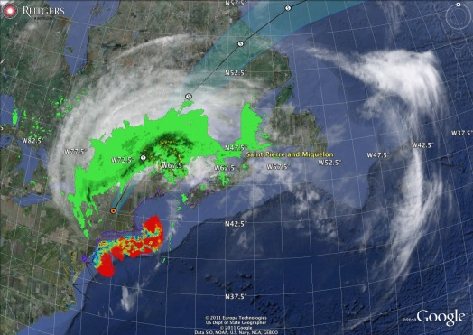
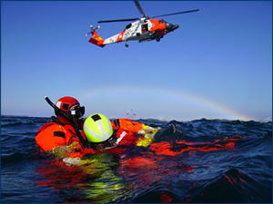
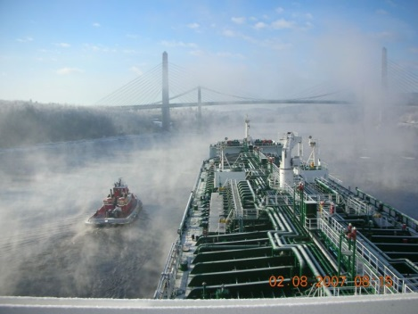
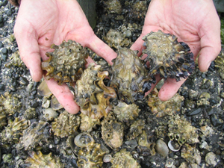
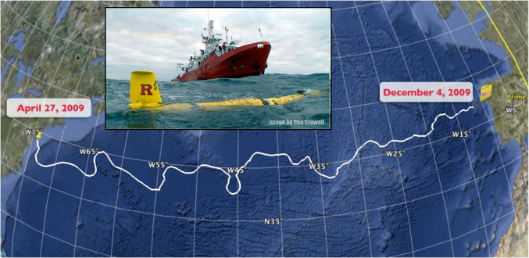
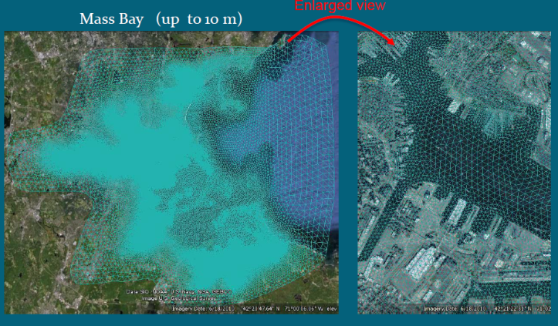
U.S. Integrated Ocean Observing System (IOOS®)
Zdenka Willis, Director, U.S. IOOS Program
March 17, 2014
Notes:
1

Slide 2
Update - Connections within the National Ocean Service
Redefining Priorities within NOAA's National Ocean Service
A new way of doing business
Taking advantage of Program strengths
Opportunities to leverage existing investments
2
Notes:
2

Slide 3
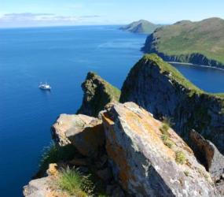
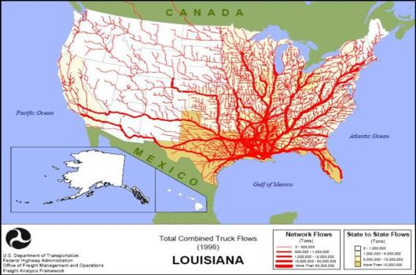
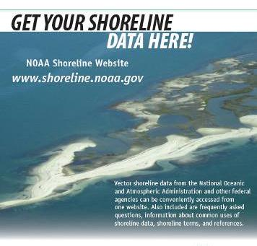
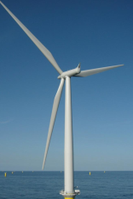
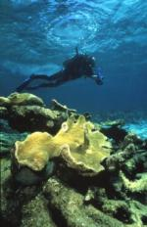
NOS Cross-cutting Priorities
Improve end-to-end coastal preparedness, response, recovery and resiliency
Coastal Intelligence
Enhance coastal and marine resource conservation through place-based management
3
Notes:
3

Slide 4
Coastal Intelligence
One of three National Ocean Service cross-cutting priorities
  Supports corporate messaging – “Coastal Intelligence” mirrors NOAA Administrator’s use of “Environmental Intelligence”
  Aligns NOS Offices, new budget structure, and priorities
  Requires more coordination and integration within and across NOS and NOAA
  Will inform an NOS Roadmap which will organize implementation activities (under development)
4
Notes:
4

Slide 5
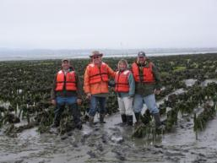
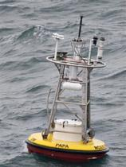
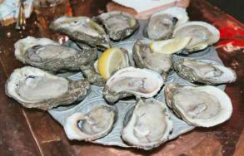


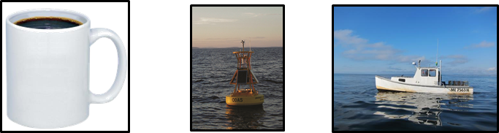
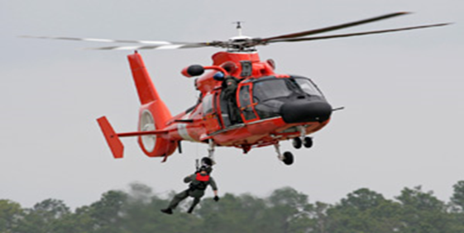
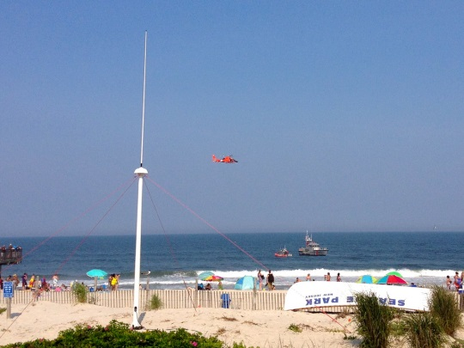
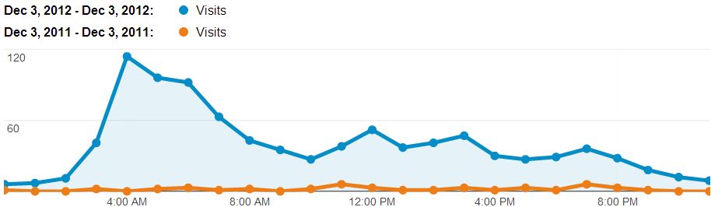
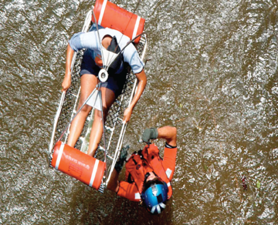
Coastal Intelligence – Types of Users
Maritime Operations
Shellfish Growers
+ +
2008 Whiskey Creek Hatchery lost 100% of oyster larvae
Ocean Acidification was the cause
Real-time Observing System established
By 2010, productivity was back to 70%
Fisherman
Search & Rescue
+ +
+ +
Search area decreased 66% in 96 hours
5
Notes:
5

Slide 6
IOOS Placement within new NOS Budget Structure
NATIONAL OCEAN SERVICE Operations, Research and Facilities ($ in Thousands) | FY 2014 President's Budget | FY14 Enacted
Navigation, Observations & Positioning
Navigation, Observations & Positioning | 145,852 | 136,000
Hydrographic Survey Priorities/Contracts | 26,946 | 25,000
IOOS Regional Observations | 34,520 | 28,500
4 Offices combined
  National Geodetic Survey
  Center for Operational Oceanographic Products and Services
  Office of Coast Survey
  IOOS
Important to build on strong relationships
Opportunity to extend & strengthen Regional IOOS
6
Notes:
6

Slide 7
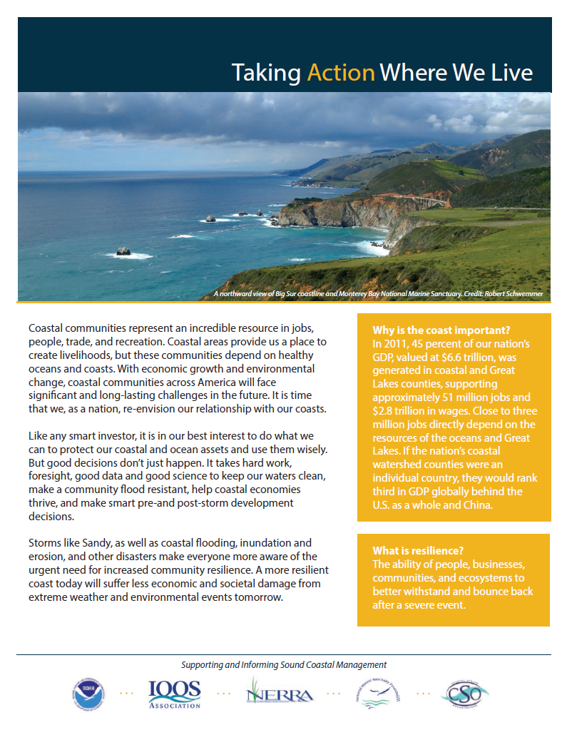




Coastal Roundtable
Dr. Bamford leading effort to better connect NOS Programs with partners
Monthly dialogue with:
IOOS Association
Coastal States Organization
National Estuarine Research Reserve Association
National Marine Sanctuaries Foundation
7
Notes:
7

Slide 8
It's Been a Busy Year!
National Glider Plan
National Modeling Strategy
Adoption of IOOS Sensor Observation Service
HF Radar data available to NCEP and NWS – AWIPS (Summer 2014)
Marine Sensor Innovation Program
QARTOD Manuals Published
Animal Telemetry Network
Certification
GEO Endorsed
8
Notes:
8

Slide 9
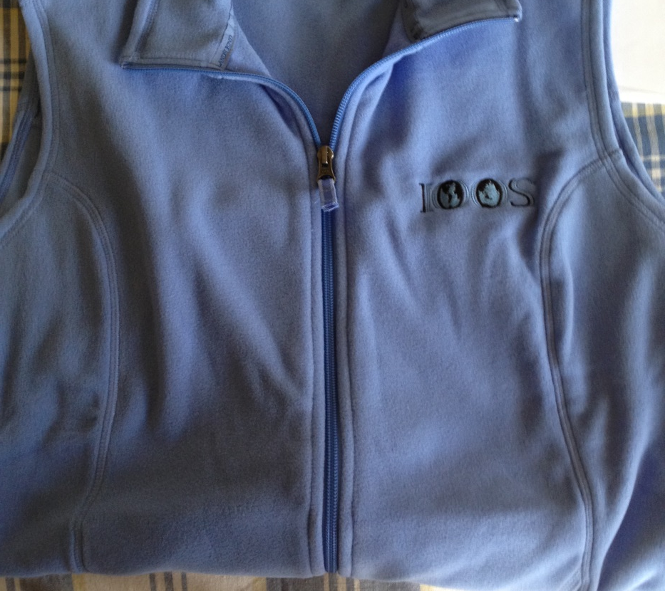
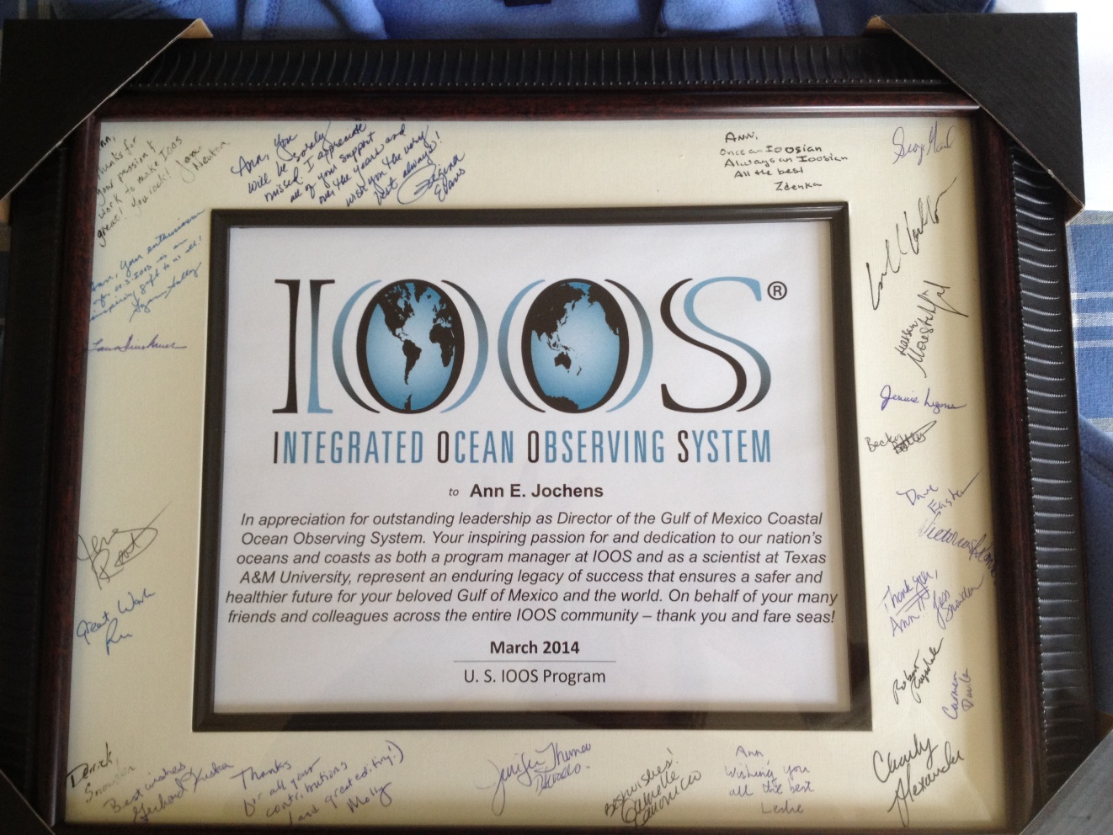
Thank You Ann
9
Notes:
9

