Slide 1
Marine Exchange of Alaska Collection & Dissemination of Real-Time Environmental Data
Brett Farrell
Assistant Director, Marine Exchange of Alaska
Providing information, communications and services to aid safe, secure, efficient and environmentally sound maritime operations

Slide 2
MXAK/AOOS Partnership
$508,000 in AOOS grant funding since 2011
$72.5k average funding per year
Primarily capital funding, some O&M in recent years
Focus on real-time weather collection and dissemination for mariners
Enhances MXAK’s existing vessel tracking network

Slide 3
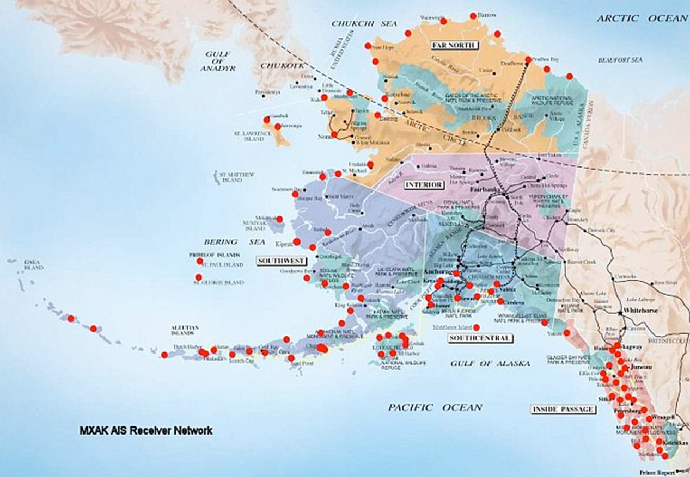
MXAK Marine Safety Sites

Slide 4
MXAK Weather Stations
47 Weather Receivers

Slide 5
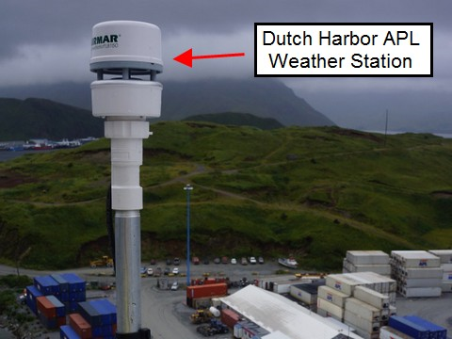
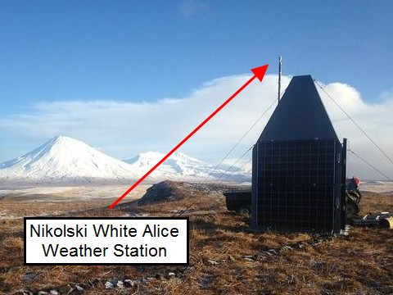
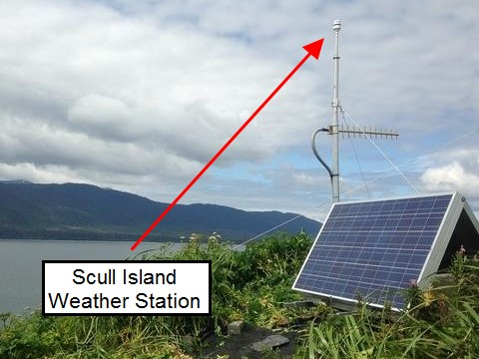
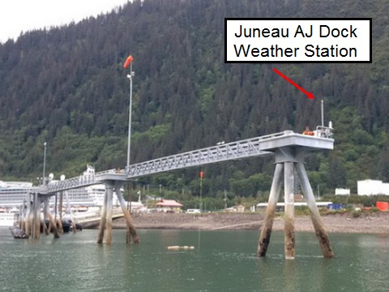
MXAK Weather Stations

Slide 6
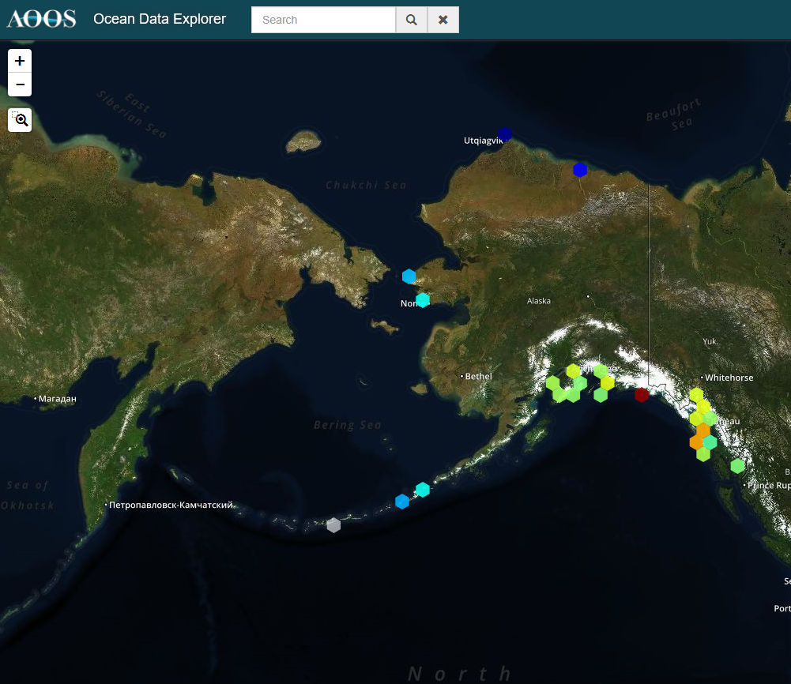
Dissemination: AOOS

Slide 7
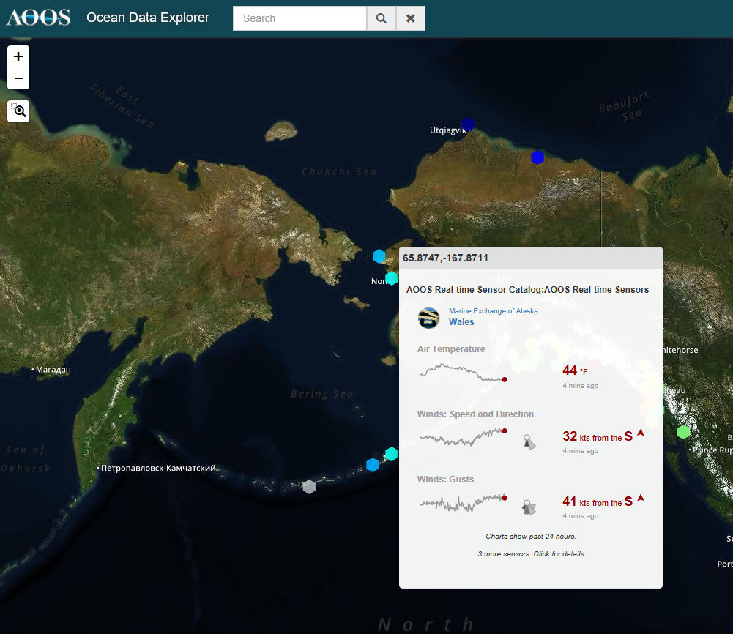
Dissemination: AOOS

Slide 8
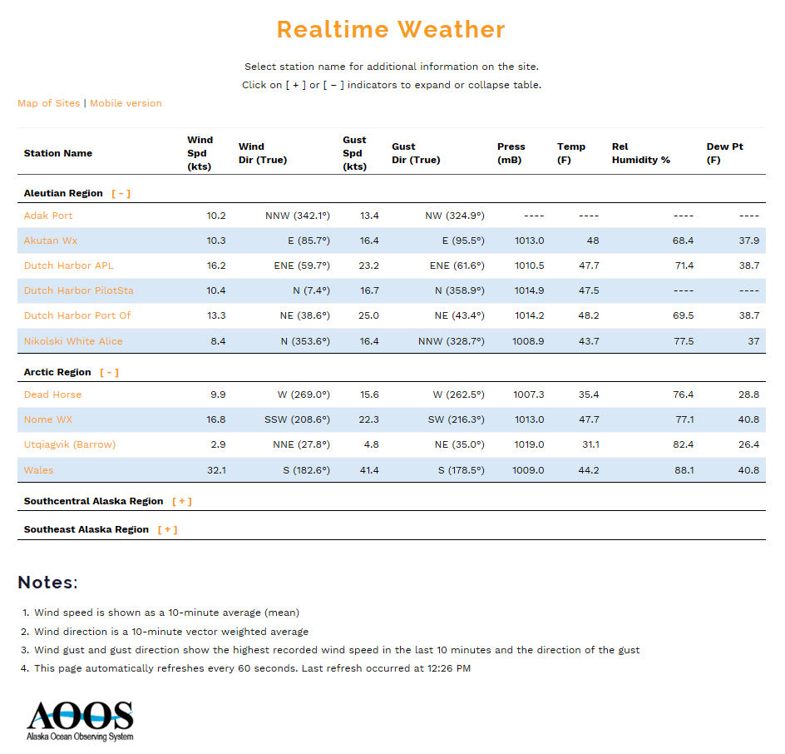
Dissemination: MXAK Website

Slide 9
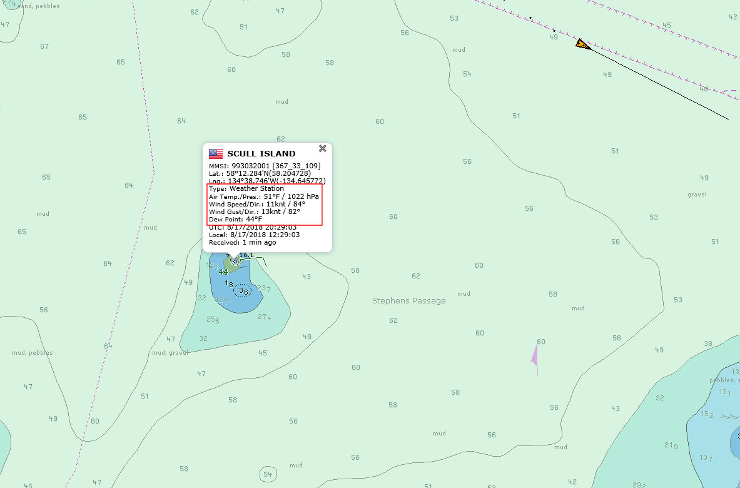
Dissemination: MXAK Tracking Display

Slide 10
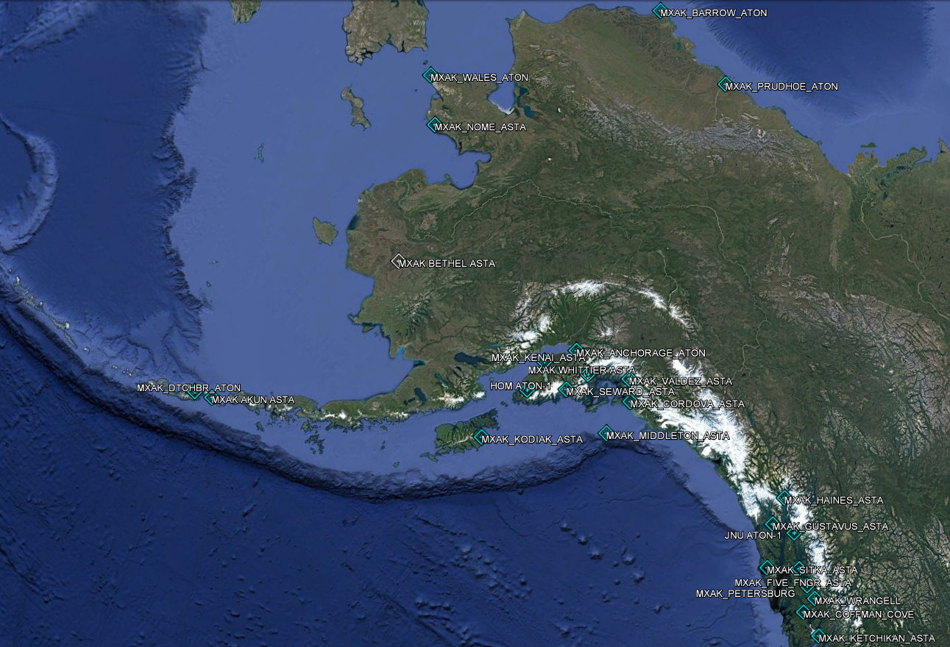
Dissemination: AIS

Slide 11
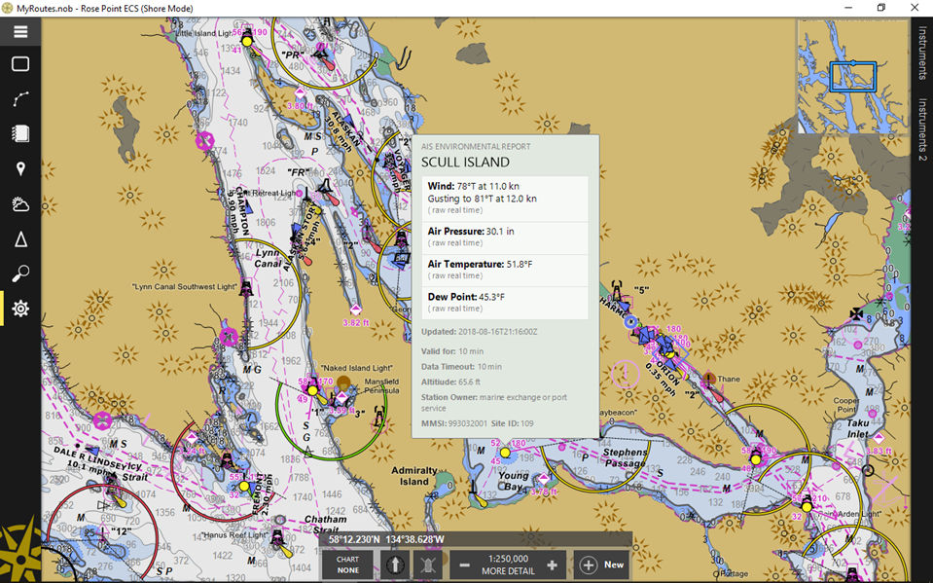
Dissemination: AIS

Slide 12
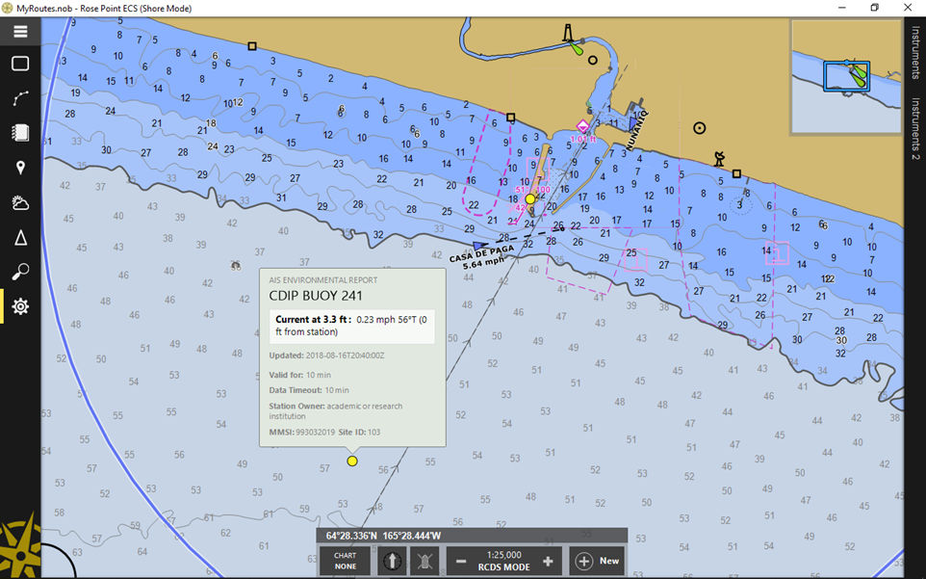
Dissemination: AIS

Slide 13
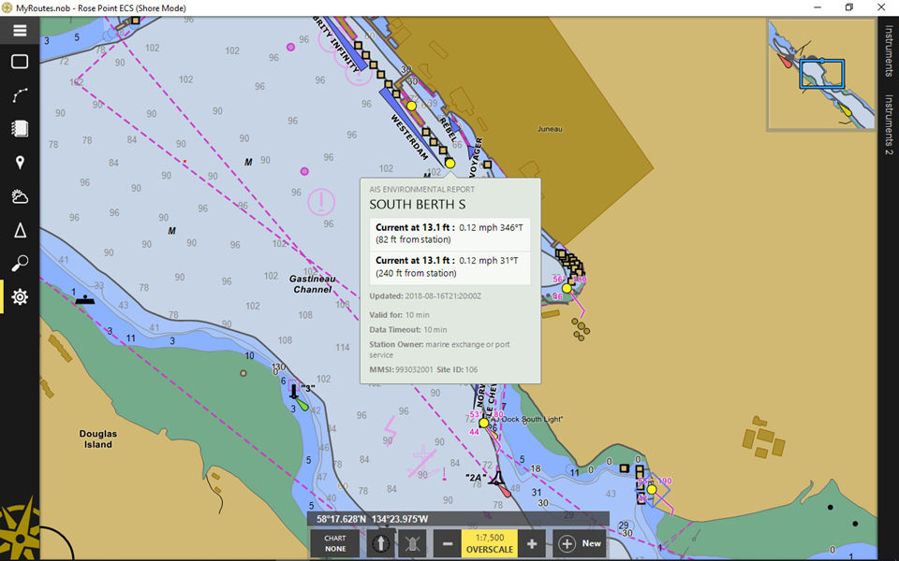
Dissemination: AIS

Slide 14
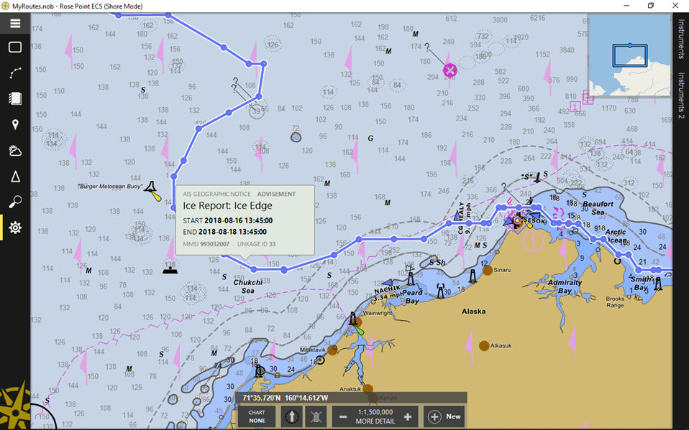
Dissemination: AIS

Slide 15
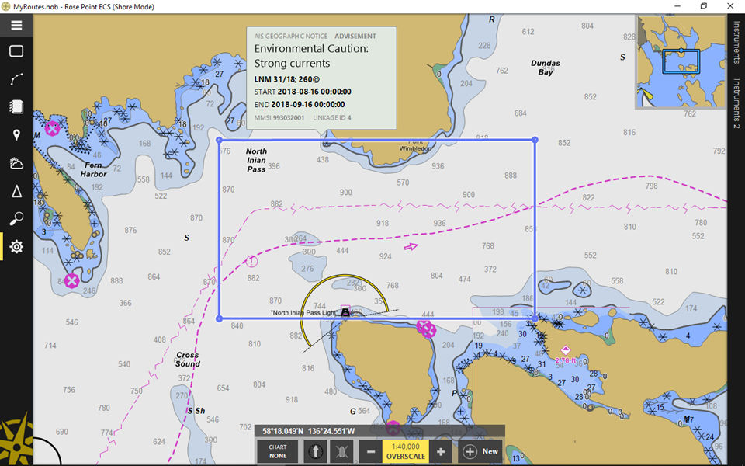
Dissemination: AIS

Slide 16
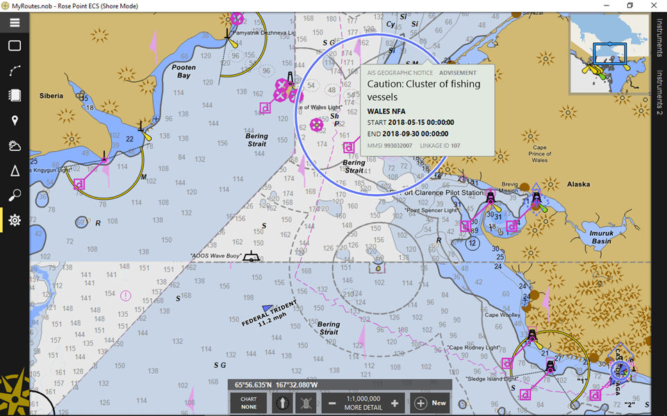
Dissemination: AIS

Slide 17
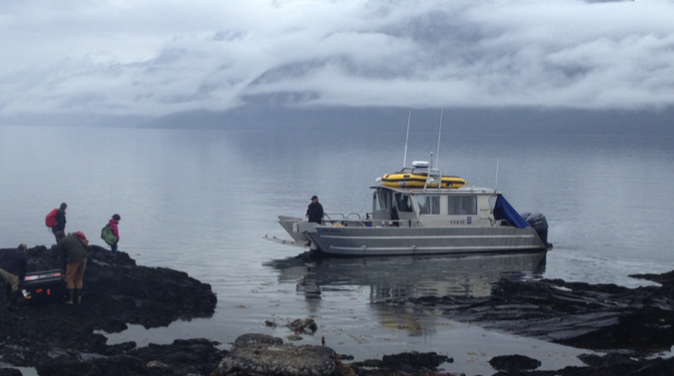
Marine Exchange of Alaska
Providing information, communications and services to aid safe, secure, efficient and environmentally sound maritime operations.

