Slide 1
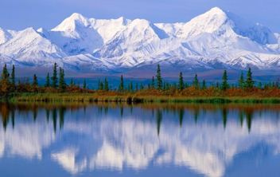

IOOS FAC Meeting
Josie Quintrell, Director
IOOS Association
August 2018

Slide 2
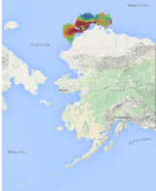
IOOS FAC Thank you!
Notes:
National network with regional capacity – 5 out of the 6

Slide 3
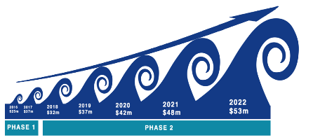
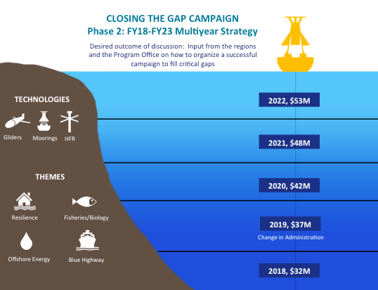
Closing the Gaps: 5 yr Campaign
Scalable campaign
Tangible outcomes
Align with Administration Priorities
Filling targeted gaps in:
  HR Radars
  Gliders
  And Moorings?
Notes:
New approach

Slide 4
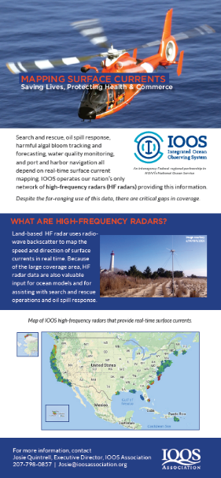
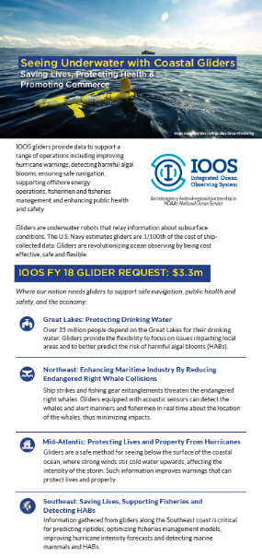
FY 18 Request: HFR and Gliders

Slide 5

Appropriations
“Within funds provided for IOOS grants, cooperative agreements, or contracts, the Committee directs each regional entity to assess current spending practices for resources that become damaged or unworkable as a result of hurricanes or other significant storms, including continually replacing damaged assets instead of repairing them or seeking to use hardened designs, and provide a cost-benefit analysis to the Committee on such practices within 120 days of this Act (e.g., July 20, 2018)”
Notes:
* Won’t know FY 18 until Feb 8
Planning now for FY 19

Slide 6
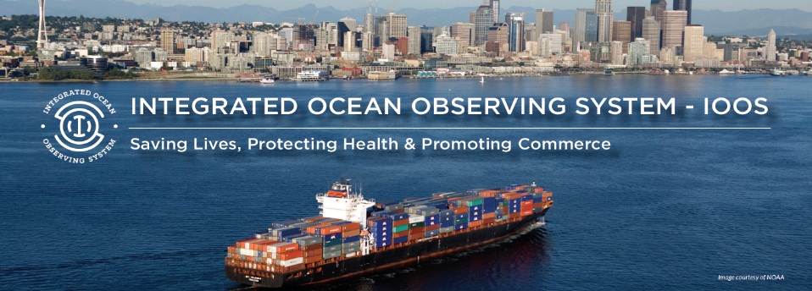
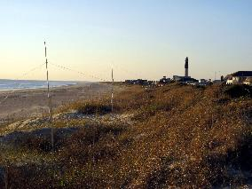
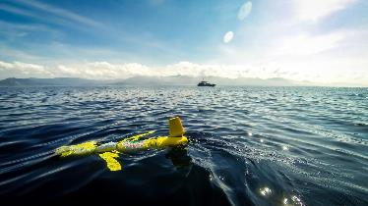
FY 20 Request - Continue Gaps Campaign
Mapping Surface Currents
Seeing Underwater with Coastal Gliders
Image courtesy of Ben Hollings, Blue Ocean Monitoring
Image courtesy of USC

Slide 7


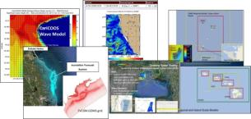

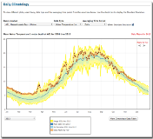
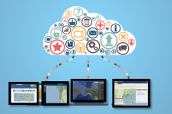
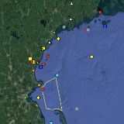
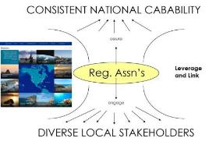
What’s Next? How to address other needs
Recapitalization of system
Models- Forecasts
Data Integration and Products
Notes:
The IOOS Regional Associations operate observing assets and leverage others from State, Local, Tribal governments, academia, non-profit organizations and industry.
They provide a considerable array of input to IOOS, and in some of the Regions provide a majority of the coastal buoys.
The IOOS Regions offer unique observations, like the 130 plus stations of the High Frequency Radar system, operated by 30 academic instituitions. The largest in the world, operating at better than 75% uptime. 95% of the US HF Radar and over 80% of the global HF Radar systems are provided by one of our sponsors CODAR.
The profiling gliders are predominantly operated by IOOS Regional partners and academic institutions funded by a variety of Federal and State dollars.
Some systems are hybrids, such as the wave buoy network which is operated by NOAA, US Army Crops and IOOS Regional Associations.
Emerging observing systems include the tagging of marine animals and fish.

Slide 8
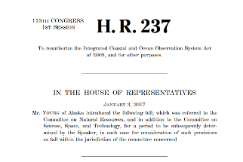
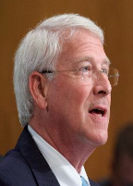
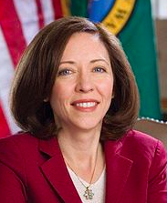
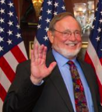
Reauthorization
SENATE
House
Sen Cantwell
D- WA
Weather Research and Forecasting Innovation Act of 2017
HABHRCA - HAB Reauth
Rep Young
Senators Wicker and Cantwell sponsored S 1425
CENOTE
Pending
PASSED
Aquaculture
Notes:
Webster – North of Tampa
Hice – inland
Rouzer- Wilmington

Slide 9
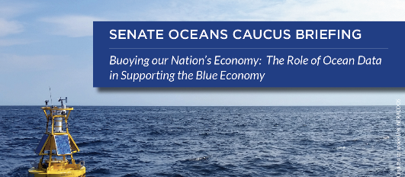
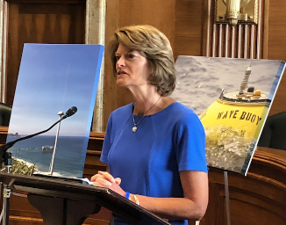
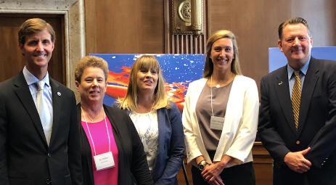
Senate Ocean Caucus Briefing: July 2018
Notes:
Joy Baker from Nome AK - wave buoy critical asset, Ruth from Shell, Leigh – Fishermen, Zack Kvyler “hasn’t been to court since NERACOOS buoys”

Slide 10
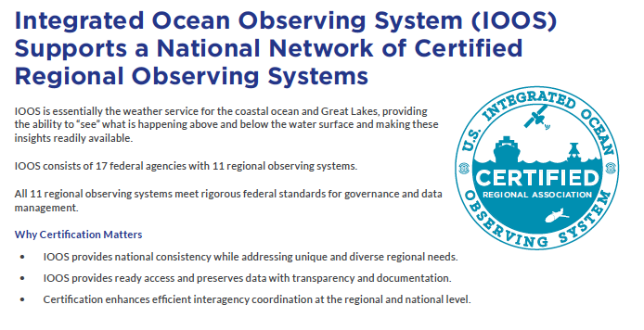
Major Milestone: Certified National Network
Notes:
Working with partners - what are the opportunities? Now that we have federal certified This was the result of a lot of work - governance and data management

Slide 11
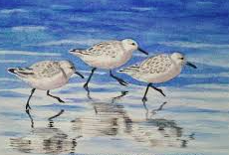
Upcoming Events
Biological Observations
  Defining the IOOS Niche
Who uses IOOS?
  RA Web Survey
The economic value of IOOS
  Pilot project
DMAC review (proposed)
  What’s working? What’s not? Opportunities for the future? Emerging needs and trends.
National Ocean Policy Ex Order

Slide 12
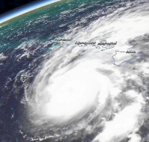
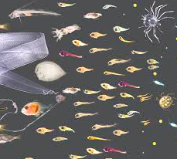
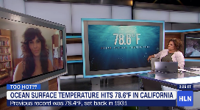
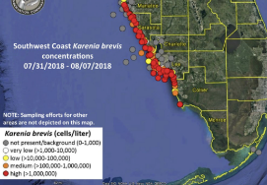
Observing Highlights
Hurricane Season
  Hurricane Lane - Hawaii
  Caribbean-Gulf and Atlantic Hurricane season
    Gliders – Navy NOAA and IOOS Project
Ocean Changes
Record Temperatures in CA
Regime changes
* Get IOOS on nightly news
Harmful Algal Blooms
  Alaska, West Coast, Great Lakes, Mid Atlantic, Northeast
  Observations, modeling, data integration
Notes:
Heard a sliver of what AOOS is doing,

Slide 13
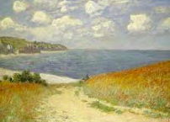
Questions for FAC
How can we best address the system’s need for recapitalization?
Addressing emerging needs :
  Acoustics
  Water levels
  Gaps
  Etc.
Communicating changing conditions
Communicate importance of IOOS enterprise (Fed Regional ) to NOAA leadership

Slide 14

Thank you for your support of IOOS

