Slide 1
Web Camera Applications Testbed (WebCAT) Project
Debra Hernandez, SECOORA Mark Willis, Surfline Joseph Long, USGS
Dwayne Porter, USC Greg Dusek, NOAA NOS
Kyle Wilcox, Axiom
Notes:
First thing: SAVE AS
LOCATION: I:\Communication & Outreach\Briefings\Project 101 Decks
NAMING CONVENTION: [project short name]_[date last updated]
***If you need a copy somewhere to remind yourself to keep it updated, create a shortcut and move the shortcut to wherever it needs to be for you. Leave the file itself in the shared folder.

Slide 2
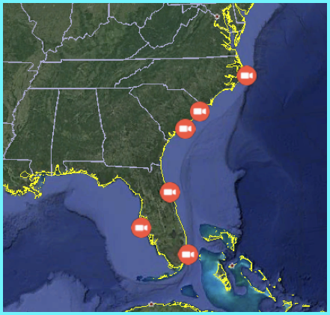
Web Cam Applications Testbed – “WebCAT”
Recently installed cams for “WebCAT” - NOS supported project to monitor and analyze coastal hazards/change via Surfline cams

Slide 3
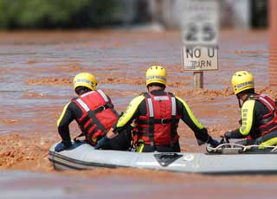
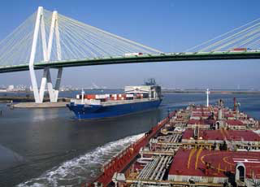
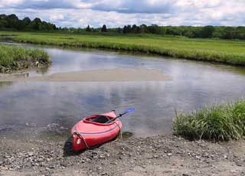
WebCAT Project
Funding by NOAA NOS and IOOS
One Year Project
Meet the needs of:
Preparedness and risk reduction
Safe and efficient transportation and commerce
Stewardship, recreation, and tourism
Images credited to NOAA NOS
Notes:
Safe and efficient transportation and commerce: capture right whale (Eubalaena glacialis) breaches, recreational and commercial vessel traffic, and environmental conditions to support port operations and minimize boat strikes and other impacts to wildlife.
Preparedness and risk reduction: validating rip current and wave runup and support water level predictions at NOS National Water Level Observing Network stations, enabling more accurate high tide flooding forecasts. The National Weather Service (NWS) uses web cameras for observing ocean conditions, for validating forecasts by observing wave heights and estimating wind speed from visual observations of sea condition (e.g., white-capping).
Stewardship, recreation, and tourism: Recreational human use data are notoriously difficult to capture. Cameras can be utilized to determine number and frequency of users, and document recreational activities and other uses of important places and habitats. Publically accessible web cameras also provide visual confirmation of beach and ocean conditions, which benefit tourism activities.

Slide 4
Project Team
Notes:
IOOS - Carl Gouldman, Dave Easter
SECOORA, Debra Hernandez
Axiom Data Science - Kyle Wilcox
Surfline - Mark Willis, Ross Garrett, Dennis Murphy
CO-Ops - Gregory Dusek
NERRS - Marie Bundy, Dwayne Porter
NWS Meteorological Development Lab - Michael Churma
Local NWS – Miami, etc.

Slide 5
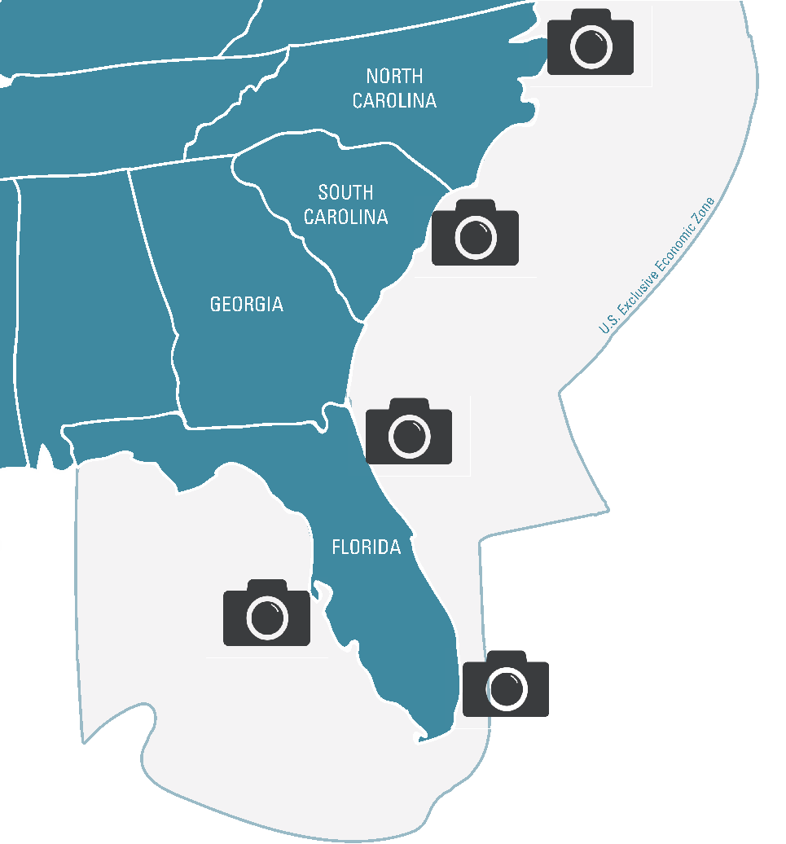
5
CAMERAS TO BE INSTALLED
1
YEAR OF DATA
ALL DATA TO BE AVAILABLE ON SECOORA WEBSITE
SECOORA.ORG/WEBCAT
Notes:
Cape Hatteras – installed
Miami - repurposed site at a current surfline location.
Mrytle Beach, SC – Cherry Grove Pier. IN conversation
GTM Reserve in St Augustine (gates gas station)
Tampa – no solid lead yet

Slide 6
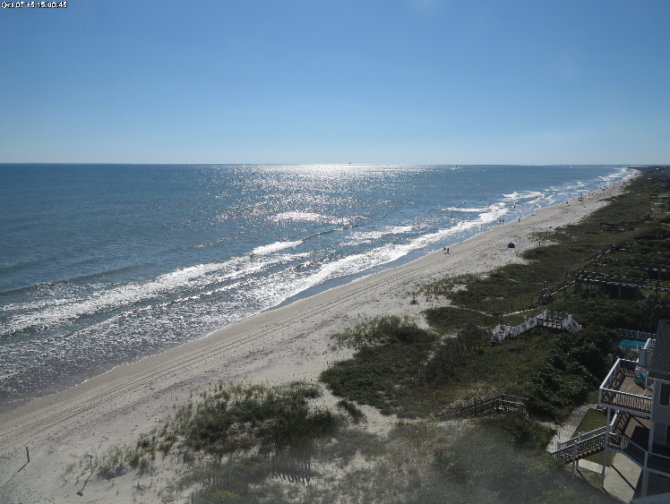
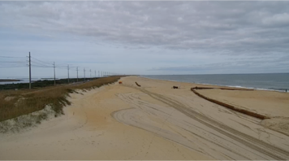
WebCAT – Wave Runup
The USGS is using Surfline cameras to observe changes in water levels and beach shape/size.
Each hour the position of the water level on the beach is tracked for comparison to models of coastal water levels and hazards such as beach and dune erosion.
NWS also using for Coastal Flood Operations.
Buxton, NC

Slide 7
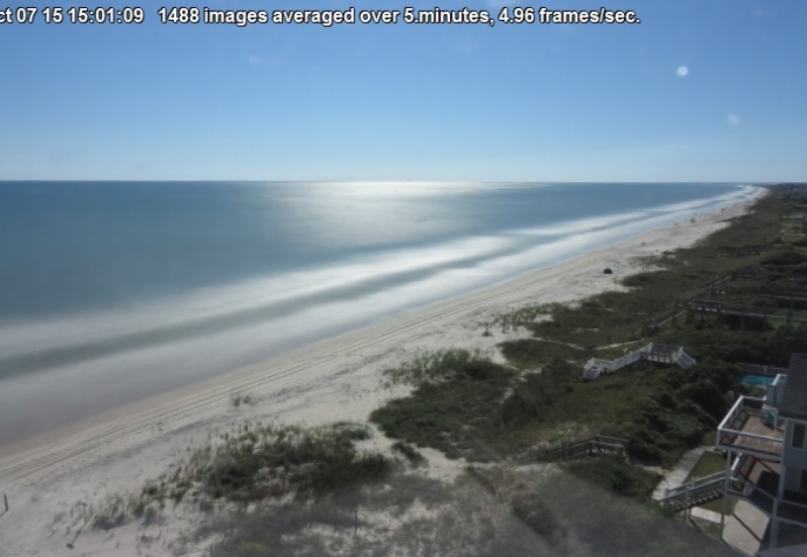
WebCAT – Rip Currents
NOS/NWS Rip Current Model has relied on lifeguard observations in the past. This approach is limited by lifeguard presence and subjective nature of visual observations. Cams can help!

Slide 8
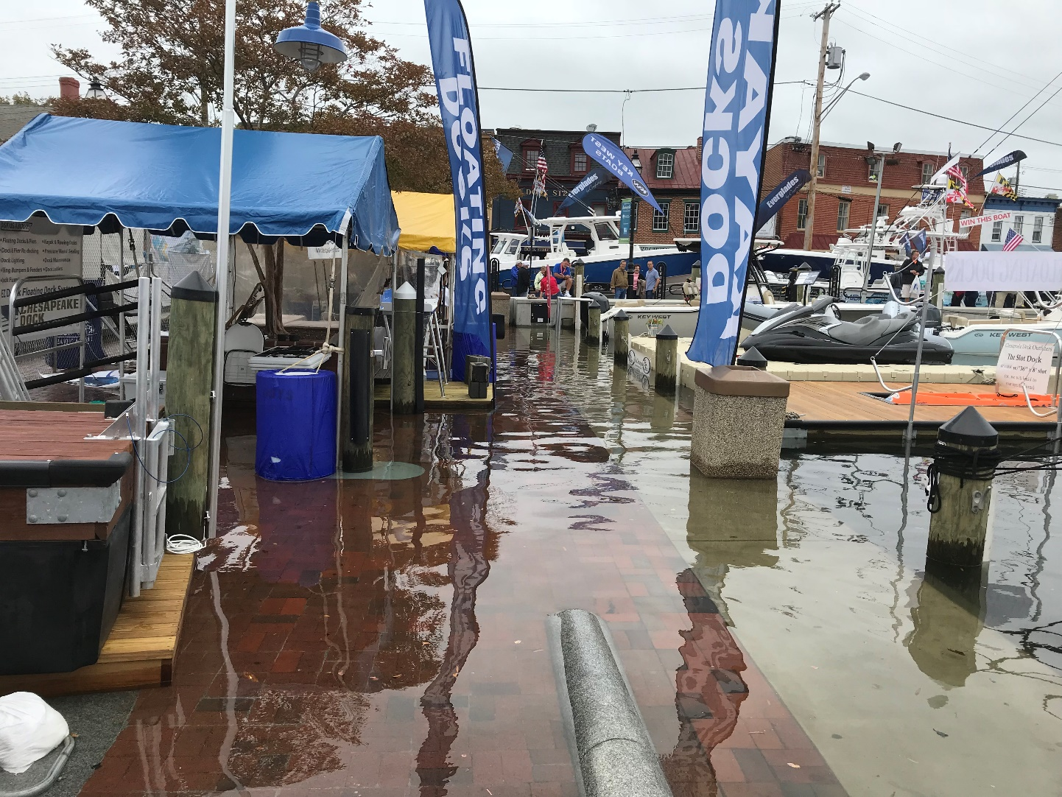
Web Cams for High Tide Flooding Observations
High tide flooding – coastal flooding influenced by the tide
Becoming more frequent
due to sea level rise
NOS provides annual
outlooks and seasonal High
Tide Bulletins
Challenge with relating
water level to impacts

Slide 9
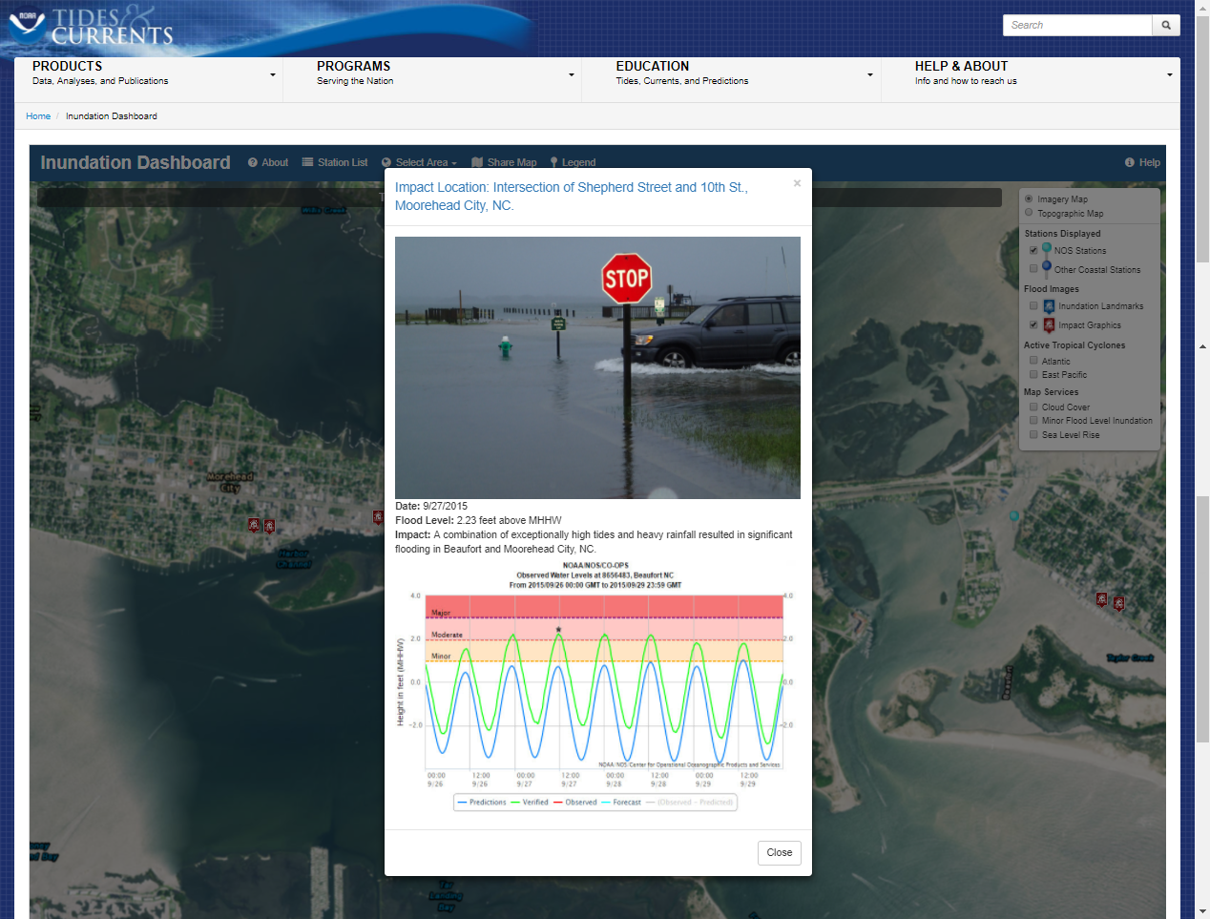
Web Cams for High Tide Flooding Observations

Slide 10
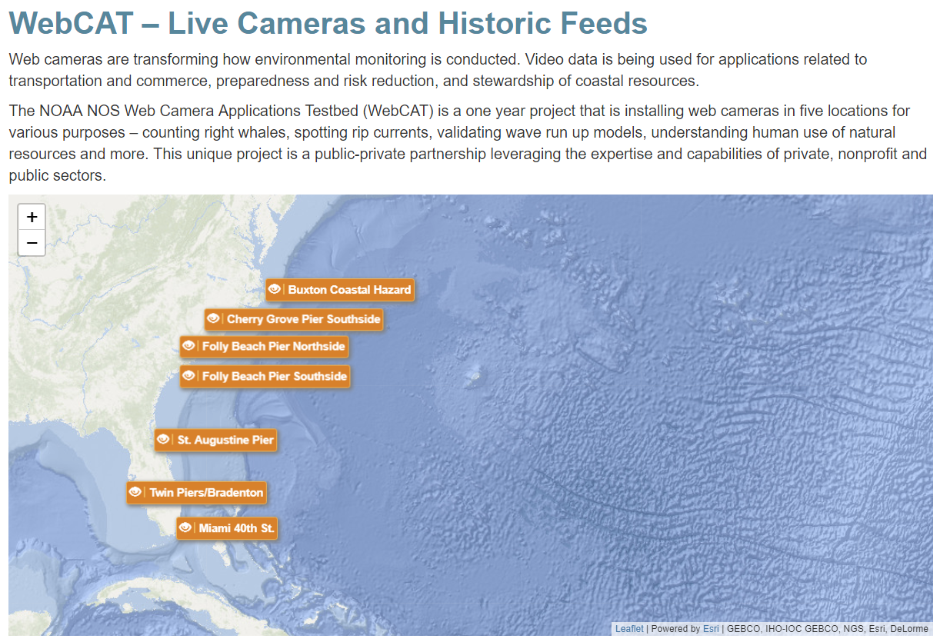
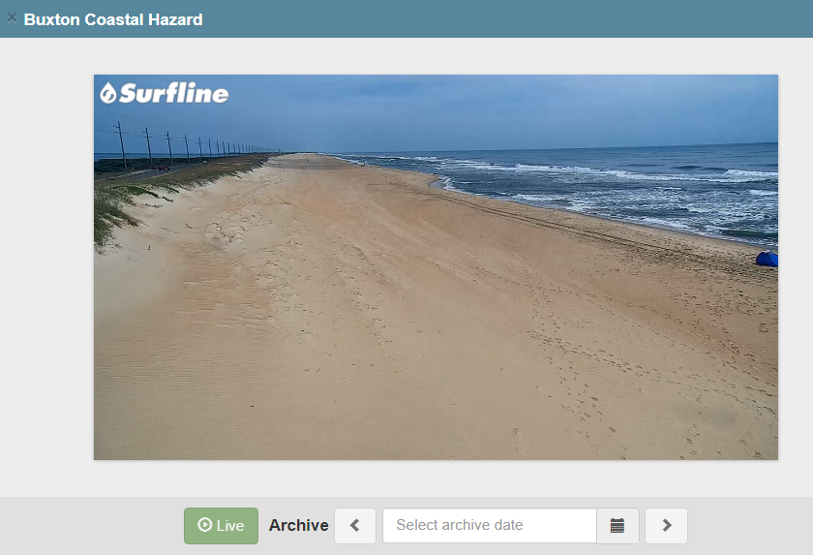
WebCAT webpage http://secoora.org/webcat

Slide 11
Data
Accessing the Camera Data
Demo
Simple streaming implementation
Post-processing trials/ideas
Question to Audience: What format do you find useful for analysis?

Slide 12
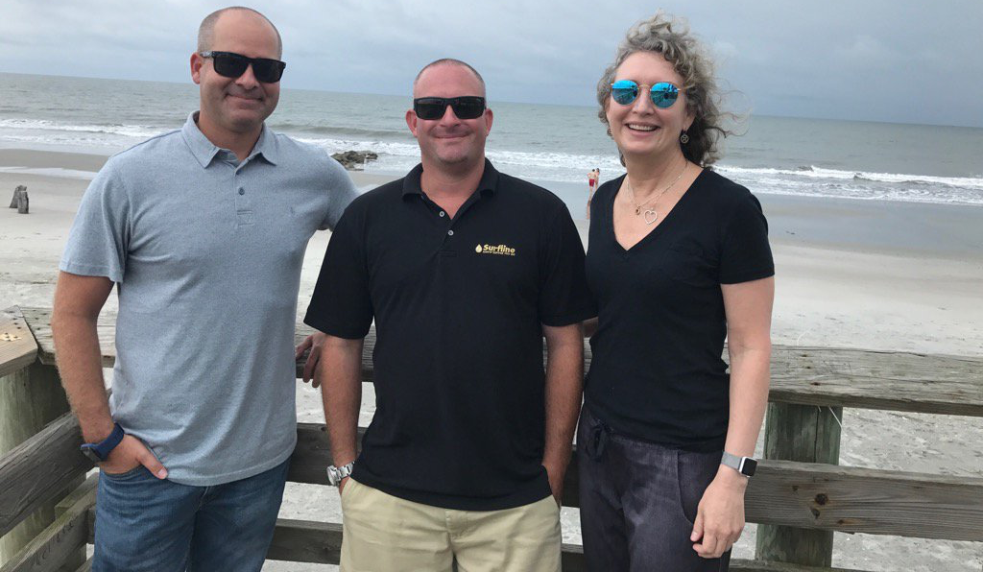
Data
Unique Partnership
Public-private partnership leveraging the expertise and capabilities of private, nonprofit and public sectors.

Slide 13
Data
WebCAT Workshop
Announcement coming mid 2018
Exploring applications, opportunities and challenges to using webcams for environmental monitoring
Focuses on use cases of camera data
Audience will be resource managers
Stay tuned for an announcement!
Notes:
https://docs.google.com/document/d/1S27hOJH9RN8Ao1wkK56luQ3vclPznk1UidF4lkpGWNI/edit

